Slide 1
Expansion Options

Slide 2
External Expansion - USB
USB (Universal Serial Bus) is a common standard used with all modern computers to connect peripherals such as printers, smartphones, cameras, and storage devices such as hard drives, flash drives.
USB has almost completely replaced previous industry standards for connection such as serial and parallel ports.

Slide 3

External Expansion - USB
All USB ports are not created equally however. Some are build to do things others aren’t.
For example, you might have noticed that your phone charges faster when you connect it to a certain USB port and slower when you connect it to a different one.

Slide 4

External Expansion - USB
To identify a USB port look for the following symbols next to one that you want to connect a device to.

Slide 5
USB 1.1 & 2.0
Both USB 1.1 and 2.0 Ports use the same symbol shown below known as the “USB Tree”
The difference between the two are the speed of the ports and the colour of the ports

Slide 6
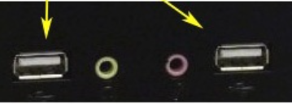
USB 1.1 Port
Known as “Full Speed Port
  White colour
  Max data speed
  12 Mbps
USB 1.1 Port

Slide 7
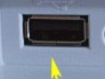
USB 2.0 Port
USB 2.0
  Known as “Hi-Speed”
  Black colour
  Max 480 Mbps
USB 2.0 Port

Slide 8

USB 3.0 Port
USB 3.0 Known as “SuperSpeed”
  Blue colour
  Max 5 Gbps

Slide 9
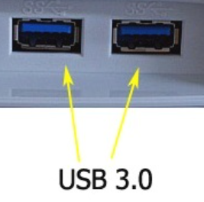
USB 3.0 Port
USB 3.0 Known as “SuperSpeed”
  Blue colour
  Max 5 Gbps

Slide 10
USB 3.1 Ports
Some USB connectors are red or yellow in colour. These ports are sleep-and-charge ports that allow the charging of devices while the computer is in sleep mode.
The USB 3.1 standard offers up to 10 Gbps transfer rates and is known as SuperSpeed+.

Slide 11
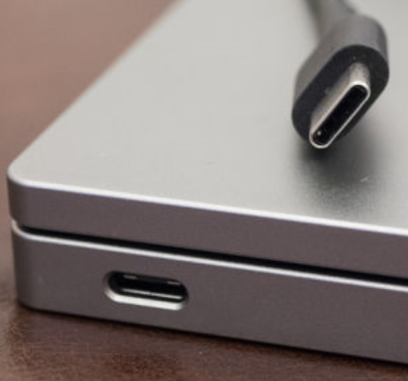
USB-C Port
The USB-C connectors connect to both hosts and devices, replacing various USB-B and USB-A connectors and cables.
Beware of non-compliant cables.

Slide 12
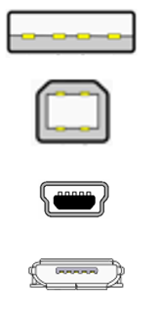
Common USB Connectors
USB A connector
USB B connector
USB Mini-B connector
USB Micro-B connector

Slide 13
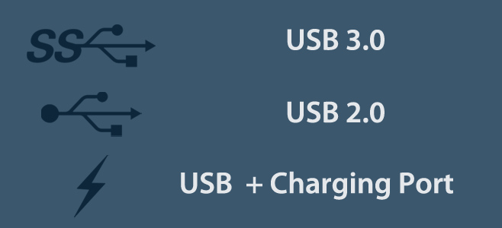
Common USB Symbols

Slide 14
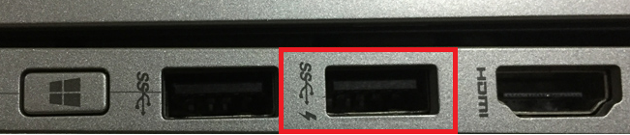
Common USB Symbols
Sometimes you will see the symbols combined.
This means that the port is meant for USB 3.0 and can charge a device.

Slide 15

IEEE 1394 (FireWire)
Developed by Apple to be the successor to USB
Used for: External storage devices, PVRs and digital cameras
Original version of FireWire called FireWire 400 (officially known as IEEE 1394a) supported up to 400 Mbps.
FireWire 800 (IEEE 1394b) doubled that to 800 Mbps.
Still in use by the military

Slide 16
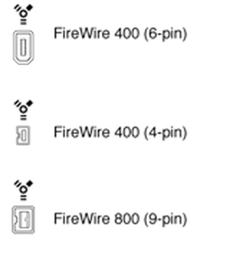
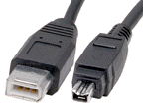
IEEE 1394 (FireWire) Connectors

Slide 17
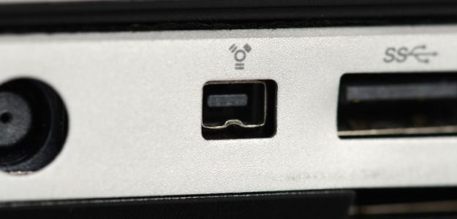
IEEE 1394 (FireWire) Connectors

Slide 18
Firewire vs USB
Both are hot-pluggable and fully plug-and-play compatible.
In both cases, devices can be externally powered or non-externally powered
USB supports up to 127 devices, Firewire supports up to 63
The use of Firewire requires that royalties be paid, USB is royalty-free

Slide 19
Firewire vs USB
FireWire devices are designed so that they can all daisy-chain to one another, but USB devices don’t and require a hub
FireWire is considered “peer to peer” because the devices don’t need a computer to communicate with each other. USB is “host based” because devices must be connected to the computer to communicate

Slide 20

Thunderbolt
Thunderbolt is a recent development in PC external expansion that was developed by Intel and first release on Apple computers (though now widely available on PC-based laptop and desktop computers.)
Thunderbolt is capable of 10 Gbps (in each direction) data transfers in its first generation, and doubles that to 20 Gbps (2nd generation) or 40 Gbps (short cable) in its third generation.
Thunderbolt supports hot plugging and can daisy-chain up to a maximum of 6 devices.

Slide 21
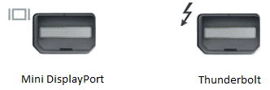
Thunderbolt Connector
Thunderbolt uses a Mini DisplayPort connector and supports Mini DisplayPort devices and Thunderbolt devices.
Note: While Mini DisplayPort devices work with Thunderbolt ports, but the reverse is not true.
Check for the symbol beside the port to know which you are using.

Slide 22
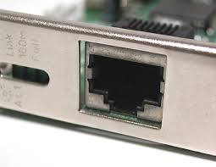
RJ45 Port
Most Laptops include one built-in RJ45 port for connecting the device to a wired network. (A notable exception, the MacBook Air, does not but allows connecting an Ethernet dongle to its USB port.) A computer’s RJ45 Port is connected to its internal Ethernet Network adaptor.

Slide 23
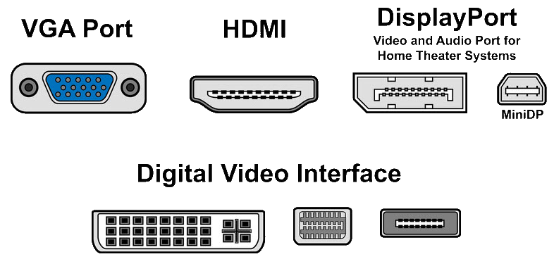
Video Ports
Mini-DVI
Micro-DVI

Slide 24
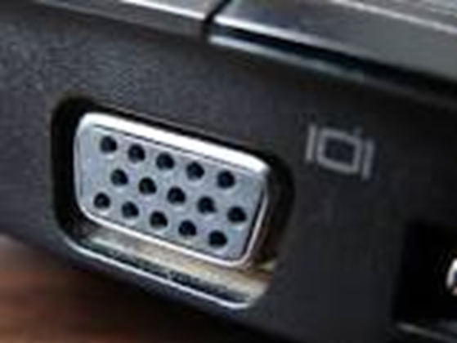
VGA
Video Graphics Adapter
15 pin D-Subminiature or D-Sub Connector
Analog Output VGA port on a laptop
Used to connect monitors/projectors

Slide 25
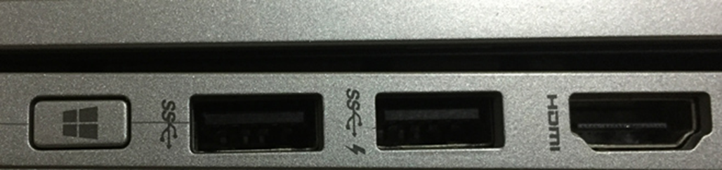
HDMI
High Definition Multimedia Interface
19 Pin Connector
Digital Video (and Audio) Output
10 Gbps transfer rate or better with newer versions

Slide 26
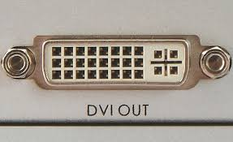
DVI
Digital Visual Interface
29 pin connector available in many configuration
Digital Output no Audio support (White Connector)
Analog variants available (Blue Connector)

Slide 27
Smart Card
Smartcard slots are used by companies that support two-factor authentication for logins.
You generally find smartcard readers on enterprise-grade laptops, since they don't have a use in the consumer space.
You'll usually find this in larger companies with mature IT infrastructure.
You need both the password AND physical smartcard to log in.

Slide 28
Smart Card
You plug in the smartcard to the laptop, and type in your username / password, in order to log in.
This way you are protected against single-factor authentication attacks; such as password-based attacks (key logger, weak passwords, leaked passwords)
You protect against stolen keys / smartcards.

Slide 29
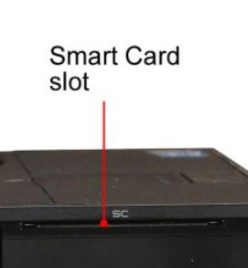
Smart Card Port

Slide 30
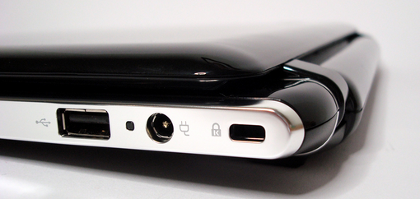
Kensington Lock Port

Slide 31
Kensington Lock Port
The Kensington slot may be marked with a small icon that looks like a padlock with a capital "K", or the slot may be unlabeled.
The hole is found in most laptops, although a lock for it is typically not included.

Slide 32

Parallel Port – obsolete but in use
Bandwidth is - 115 kbps to 3 MBps
Historically used by printers, scanners, etc…
3 - 32

Slide 33
Parallel Port
Can Be Used For
  Tape Back-up Devices
  Zip Drives
  Line Printers are still used Hospitals such as the Heart Institute located here in Ottawa

