Slide 1
Backup
CST8101 – Computer Essentials

Slide 2
Computer Essentials – Backup
Why Back Up?
What to Back Up?
Different types of Backups
How to Back Up?
Where to Back Up?
Now What? – Recovery
Other Options

Slide 3
Why Backup?
Hardware is replaceable and gets cheaper every year
You can easily buy a new computer or hard drive
Data is often irreplaceable and gets more valuable every year.
Data is the most important part of the computer

Slide 4
What to back up?
Data on a computer is kept in some form of storage.
What kind of storage? It depends on the computer.
  HDD, SSD, RAID array, USB, Optical etc.

Slide 5
Storage devices
Primary storage:
  Memory (Volatile)
Secondary storage
  Hard drives (magnetic)
  CD, DVD: Optical
Tertiary storage
  Big multimedia storage
    Robotic (Archival use)

Slide 6
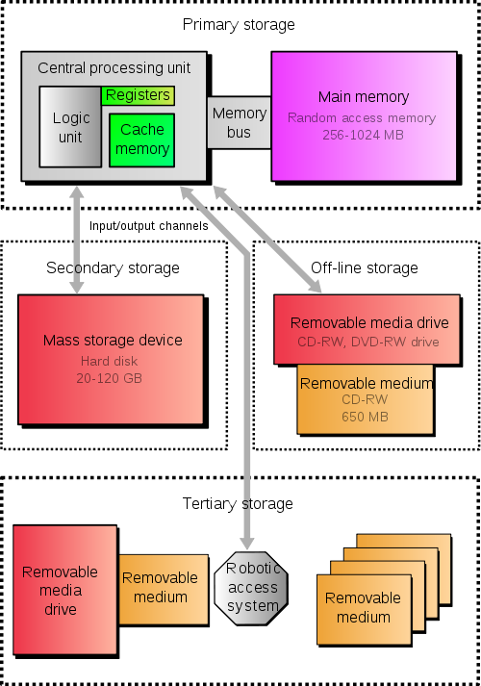
Type of storage
RAM
CPU
Level 1
Level 2
Internal HD
CD-DVD
External HD
Cloud Storage
Source: http://en.wikipedia.org/wiki/Computer_data_storage

Slide 7
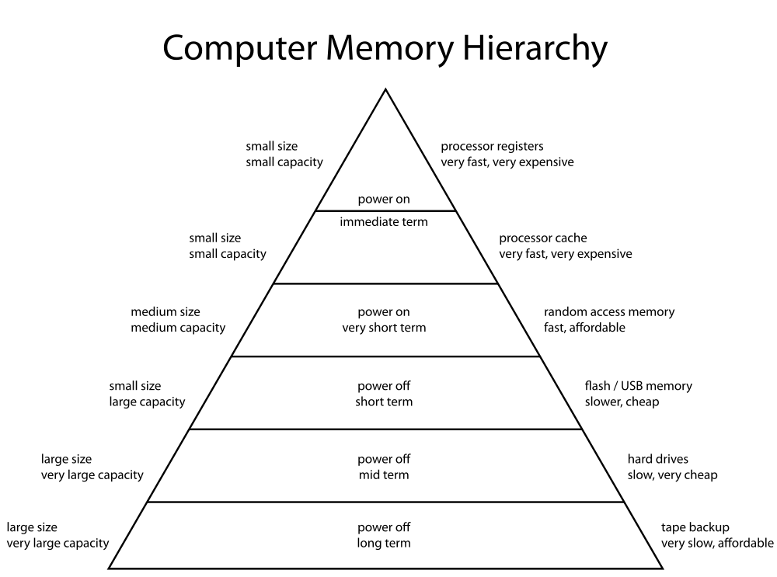
Computer Memory Hierarchy
size
Speed
1
2
3
4
5
6
Source: http://en.wikipedia.org/wiki/Computer_data_storage

Slide 8
Returning to Why Backup Data?
So, why backup data?
  The world is not perfect
  Hardware is not perfect
  Humans are not perfect
But also, things change
  Comparing present to past

Slide 9
Disaster type
Data loss can stem from many events
  Natural Disasters
  Unnatural Disasters
    What does this mean?

Slide 10
Natural Disasters
Natural Disasters
  Power failure
  Flood
  Fire
  Earthquake
  Tornado
  And all the structural things that break when a natural disaster happens.

Slide 11
Unnatural Disasters
Come in two basic categories:
  Accidental
  Intentional

Slide 12
Unnatural disasters - Accidental
  Power supply issues!
  My hard drive is dead!
  I dropped my computer!
  I overwrote my assignment!
  I deleted my picture / Pictures folder
  My significant other installed ____ and overwrote the entire hard drive!

Slide 13
Unnatural disasters - Intentional
Virus or other malware
My computer/account was hacked!
Someone stole/vandalized my laptop!
Someone wanted revenge!

Slide 14
So why back up?
Data is important!!!

Slide 15
What should I back up?
Mostly it’s the data you care about.
Anything that can be easily reinstalled is usually not worth backing up
Remember to include software settings and configurations when you make a backup plan.
The windows “Registry” is a good example.

Slide 16
What should I back up?
On a Windows computer, you normally want to backup the folder “Documents” and anything on “Desktop”
Other OS’es, have a similar place
Don’t forget about other directories or folders on your computer such as:
  Pictures, Music, etc
  Data on other hard drives (D:, etc)
  Data stored in non-standard places
    Some software will create other folders on your hard drive to store application specific stuff.

Slide 17
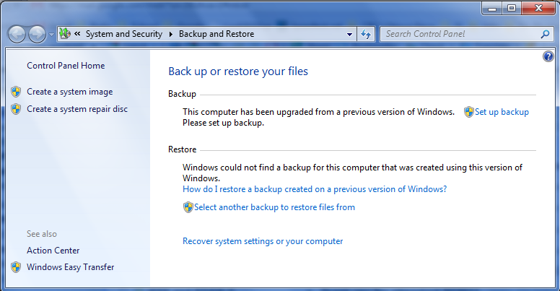
How do I back up my data?
Many OS’es have some built-in software.

Slide 18
How do I back up my data?
Automatically!
If you are using the built-in, bundled or some other backup software, just follow the instructions.
Set & forget

Slide 19
How do I back up my data?
Other methods generally involve copying the individual files yourself.
Sometimes you will create an “archive” or “zip” of a number of files first.

Slide 20
How do I back up my data?
“Proper” backups involve making multiple backups on a schedule.
“Proper” backups are automatic.
“Proper” backups are not all in one place. (ie. not same place as data)

Slide 21
Different types of Backups
Backups can be:
  Images
  Full
  Incremental or Differential
  Unstructured or “one-off”

Slide 22
Image backup
Image backup
  An image backup is a full backup of the entire structure of the hard drive. Norton Ghost, Paragon
  Often used to replicate software, settings and data.
  Usually depends on source media and target media being similar.

Slide 23
Full backup
Full
  A full backup is a complete byte copy of the target data
    To clarify, this is a document-oriented copy, not a bit-oriented backup. Every byte of every document is copied.
  A full backup:
    does not depend on any other backup
    does not depend on target restore media

Slide 24
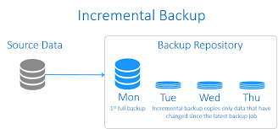
Incremental Backup
Mon Tues Wed Thurs Fri.
Full (50) N+C(20) N+C(18) N+C(16) N+C(27)
Daily BU 5+15 8+10 10+6 15+12
Advantage:
Faster daily back up(Tues, Wed, Thurs, Fri)
Disadvantage: longer to restore
C= Changed file N= New file

Slide 25
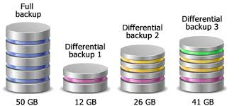
Differential Backup (cumulative)
Mon Tues Wed Thurs Fri.
Full (50) N+C(20) N+C(28) N+C(30) N+C(35) 5+15 5+8+15 5+8+2+15 5+8+ 2+5+15
        Advantage:
        Faster to restore (Monday + Friday)
        Disadvantage: Longer daily back up
C= Changed N= New Un=unchanged
cumulative

Slide 26
Incremental or Differential
  Incremental
    Only backs up new or changed files since the last backup
    Slow to restore data (full + all incremental backups)
  Differential
    Backs up all new or changed files since last full backup
    Quick to restore data (full + last differential only)

Slide 27
Incremental or Differential?
Incremental backups
  Take less time to do each backup.
  Take longer to restore.
  Require all the incremental backups (since the last full backup), and the last full backup,
  to fully restore your data

Slide 28
Incremental or Differential?
Differential backups
  Take more time to do each backup.
  Take less time to restore.
  Require only the last differential backup,
  and the full backup, to fully restore your data

Slide 29
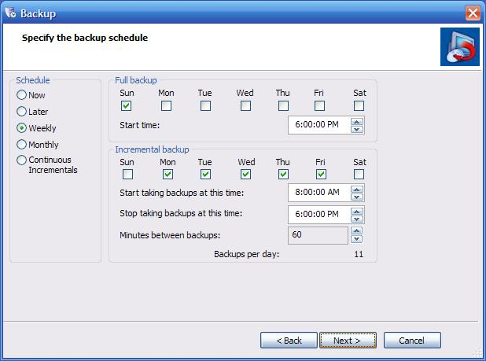
Different types of Backups
Incremental or Differential schedule
Image source: http://www.storagecraft.com/blog/tag/desktop-backup/

Slide 30
Unstructured or “one-off” backup
  Never automatic.
  The target storage will change depending on circumstance.
  Usually used for one file or one folder.

Slide 31
So, where do I back it up?
If you are using a backup application, the software will usually allow you to specify a backup location.
What are some places you would want to keep your backed up data?

Slide 32
So, where do I back it up?
Some places to keep a backup:
  External or removable hard drive
  USB flash drive
  CD/DVD
  Another computer (or server)
  Email (Yes, I often email myself data!)
  In the “cloud”
  Drop box, SkyDrive
  Tape files

Slide 33
So, where do I back it up?
It’s generally best to keep important data backups in more than one place.
It’s generally best to have multiple versions of data backups.

Slide 34
So I have a backup, how do I restore?
Usually with the program you used to back up your data.
If your backup format/file structure is not proprietary, you can generally restore data using a different tool than was used to create the backup.
You can also restore to a different computer or different OS (sometimes)

Slide 35
Backup & Recovery – Other Options
Microsoft Windows Vista and 7 have a “System Restore” feature.
You can use this to restore your computer software and settings to an earlier point in time. User data is not backed up or restored.

