Slide 1
Categorical Statements
In categorical reasoning the statements, or claims of interest are categorical statements.
Categorical statements make simple assertions about categories, or classes of things.
For example:
‘All cows are herbivores.’

Slide 2
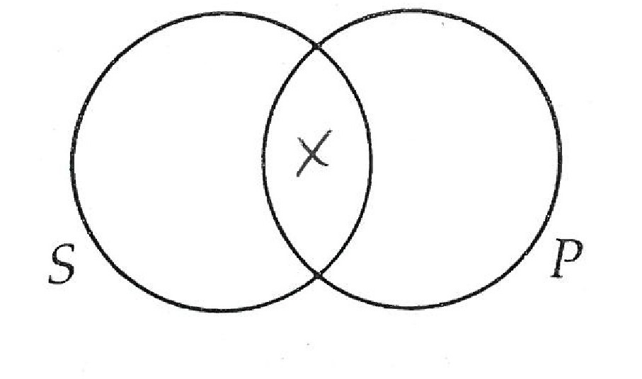
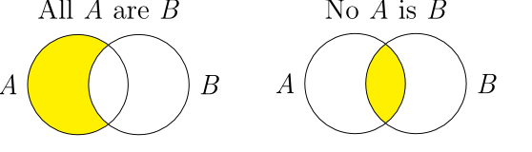
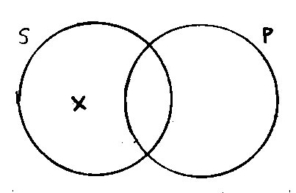
Four standard forms of categorical statements:
  All S are P.
  No S are P.
  Some S are P.
  Some S are not P.
  Two Types of Categorical Statements: Universal and Particular
Some S are P
Some S are not P

Slide 3
Examples of universal categorical statements:
‘All students are trouble-makers.’
‘No “A-students” are slackers.’
Examples of particular categorical statements:
‘Some people are liars.’
‘Some professors are not mean.’

Slide 4
1. All billionaires are rich.
Examples
B
R
4. Some organic fruits are not sweet and juicy fruits.
OF
SJ
5.Some vegetarians meditate.
2. No vicious animals make good pets.
v
B
VA
GP
3. Some rich people have mansions.
R
M

Slide 5
A valid categorical syllogism is such that if its premises were true, then its conclusion must be true.
  We can check the validity of categorical syllogisms using the Venn diagram method.
  If, after drawing or diagramming the two premises onto the Venn diagram, the conclusion is represented or present on the diagram, then the argument is deductively valid.’
On the other hand, if the conclusion is not represented or present after having drawn the two premises onto the Venn diagram, then the argument is invalid.
Anything on the line is invalid or indeterminate

Slide 6
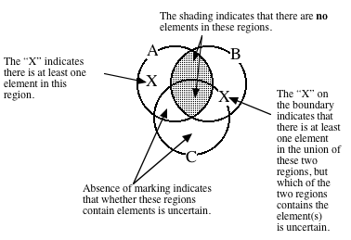

Slide 7
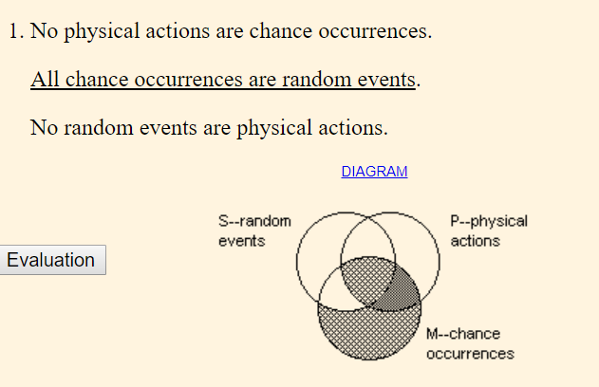
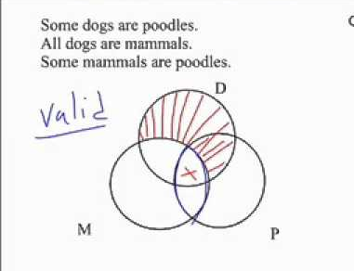
INVALID

Slide 8


