Slide 1
Chapter 2
Data Representation in Computer Systems

Slide 2
Objectives
Understand the fundamentals of numerical data representation and manipulation in digital computers.
Master the skill of converting between various radix systems.
( 10, 2, 16)
Understand the fundamental concepts of floating-point representation.
Binary addition and subtraction
one’s and two’s complement
Understand how errors can occur in computations because of overflow and truncation.
Gain familiarity with the most popular character codes.
Understand the concepts of error detecting and correcting codes.

Slide 3
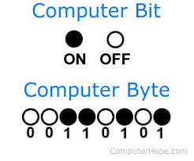
Bit and Bytes, address
What is bit?
A bit is the most basic unit of information in a computer.
  It is a state of “on” or “off” in a digital circuit or high or low vol.
A byte is a group of eight bits.
8 bits=1 byte or 1 character
  A byte is the smallest possible addressable unit of computer storage.
  The term, “addressable,” means that a particular byte can be retrieved according to its location in memory.

Slide 4
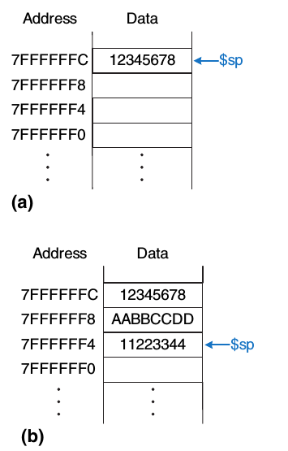
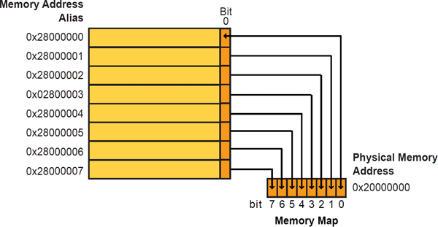
Bit, word memory address

Slide 5
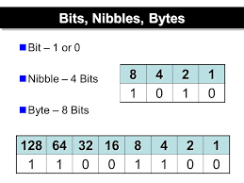
Word, Nibble
A word is a contiguous group of bytes.
  Words can be any number of bits or bytes.
  Word sizes of 16, 32, or 64 bits are most common.
  In a word-addressable system, a word is the smallest addressable unit of storage.
A group of four bits is called a
0000= a Nibble 0000-0000= 1 byte
High order Low order
  Bytes, therefore, consist of two nibbles: a “high-order nibble,” and a “low-order” nibble.
nibble (or nybble).

Slide 6
ten
Arabic عشرة Turkish on
Persian ده Romania zece (zeche)
Urdu دس Vietnamese Muoi
Spanish diez Hindi dus
French Dix Swedish Tio
German zehn Bulgaria дзесяць devet
Chinese 十 (Shi) Afrikaans tien
Japanese 十 (Tu) Hebrew עשר
Korean 십 (sib) Irish deich
Russian deshit

Slide 7
Radix point
a radix point (or radix character) is the symbol used in numerical representations to separate the integer part of a number (to the left of the radix point) from its fractional part (to the right of the radix point)
In base 10 (decimal): 13.625
In this example, 13 is the integer to the left of the radix point, and 625 (i.e. 625/1000) is the fractional part to the right. In base 2 (binary
1101.101
The binary number 1101.101 has the following digits:
1101.101₂ =1X2³+1X2²+0X2¹+1X2ᶿ+1X2¯¹+0X2¯²+1X2¯³
=1X8+1X4+0X2+1X1+1X0.5+0.25+1x0.125
13.625 =8+4+0+1+0.5+0+0.125 ½¹+½²+½³
http://en.wikipedia.org/wiki/Radix_point
Power of 2 | 3 | 2 | 1 | 0 |  | −1 | −2 | −3
Binary digit | 1 | 1 | 0 | 1 | • | 1 | 0 | 1

Slide 8
2.2 Positional Numbering Systems
The decimal number 947 in powers of 10 (Base) is:
  The decimal number 5836.47 in powers of 10 is:
  9 × 10 2 + 4 × 10 1 + 7 × 10 0
  5 × 10 3 + 8 × 10 2 + 3 × 10 1 + 6 × 10 0 . 4 × 10 -1 + 7 × 10 -2
  Base Base Base Base Base Base

Slide 9
Positional Numbering Systems
  When the radix of a number is something other than 10, the base is denoted by a subscript.
  Sometimes, the subscript 10 is added for emphasis:
  11001₂ = 25₁₀
Base 10-Decimal
Base 2-Binary
Subscript
456₈=302₁₀
Base 8- Octal

Slide 10
Positional Numbering Systems
  Our decimal system is the base-10 system. It uses powers of 10 for each position in a number.
  Any integer quantity can be represented exactly using any base (or radix).
Decimal Base 10
Example: 947
  Hundred Ten One
  2 1 0
  9 X10 + 4 X 10 + 7 X 10
  9X 100 + 4X10 + 7X 1
9 | 4 | 7
9X100 | 4X10 | 7X1
2
1
0

Slide 11
Decimal to Binary Conversions
Because binary numbers are the basis for all data representation in digital computer systems, it is important that you become proficient with this radix system.
Your knowledge of the binary numbering system will enable you to understand the operation of all computer components as well as the design of instruction set architectures.

Slide 12
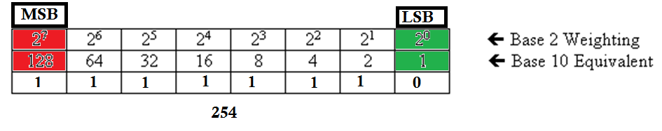
Binary representation
The binary numbering system has 2 digits: 0 and 1
The binary numbering system has a base of 2 with each position weighted by a factor of 2
The above table represents the base 2 (binary) weighting of an 8-bit (one byte) binary number.
Example

Slide 13
The most familiar number system to us is the decimal system or Base 10 number system
It is called Base 10 because it has ten symbols
{0, 1, 2, 3, 4, 5, 6, 7, 8, 9}
It is a place-value system because the position of a digit within a number is important

Slide 14
Binary System
Used by computers
Symbols used are: {0, 1}
The prefix bi means “two” and the binary number system is built from the two digits called binary bits or digits
So how do we represent the number 2 in binary
We simply add a bit to the left of the number
2₁₀ = 10₂
3₁₀ = 11₂
4₁₀ = 100₂

Slide 15
Before we get into how we convert numbers
You should at least memorize these powers of 2:
2⁰ = 1 | 2⁵ = 32
2¹ = 2 | 2⁶ = 64
2² = 4 | 2⁷ = 128
2³ = 8 | 2⁸ = 256
2⁴ = 16

Slide 16
Converting a Decimal number to a Binary Number
There are two methods for conversion:
the subtraction method
the division remainder method
The subtraction method is the easiest and more intuitive for 8-bit numbers but more cumbersome when dealing with 16-bit, 32-bit, and 64-bit numbers.
Divisional method is more cumbersome but is mechanical and easy to use with anything over 8 bits.

Slide 17
Examples of Converting Decimal to Binary
(Subtraction Method)

Slide 18
Example 3
Convert 239₁₀ to Binary
Step 1: Powers of 2
2⁷ | 2⁶ | 2⁵ | 2⁴ | 2³ | 2² | 2¹ | 2⁰
128 | 64 | 32 | 16 | 8 | 4 | 2 | 1

Slide 19
Example 3
Step 2: Convert into Binary
Can I subtract? Yes
239 – 128 = 111
We mark a 1 in the table below the 128
2⁷ | 2⁶ | 2⁵ | 2⁴ | 2³ | 2² | 2¹ | 2⁰
128 | 64 | 32 | 16 | 8 | 4 | 2 | 1
1

Slide 20
Example 3
Step 2: Convert into Binary
Can I subtract? Yes
111– 64 = 47
We mark 1 in the table below the 64
2⁷ | 2⁶ | 2⁵ | 2⁴ | 2³ | 2² | 2¹ | 2⁰
128 | 64 | 32 | 16 | 8 | 4 | 2 | 1
1 | 1

Slide 21
Example 3
Step 2: Convert into Binary
Can I subtract? Yes
47– 32 = 15
We mark a 1 in the table below the 32
2⁷ | 2⁶ | 2⁵ | 2⁴ | 2³ | 2² | 2¹ | 2⁰
128 | 64 | 32 | 16 | 8 | 4 | 2 | 1
1 | 1 | 1

Slide 22
Example 3
Step 2: Convert into Binary
Can I subtract? No because I would get a negative number
15 – 16 = -1
Since it does not fit we mark a 0 in the table below the 16
2⁷ | 2⁶ | 2⁵ | 2⁴ | 2³ | 2² | 2¹ | 2⁰
128 | 64 | 32 | 16 | 8 | 4 | 2 | 1
1 | 1 | 1 | 0

Slide 23
Example 3
Step 2: Convert into Binary
Can I subtract? Yes
15 – 8 = 7
Since it does fit we mark a 1 in the table below the 8
2⁷ | 2⁶ | 2⁵ | 2⁴ | 2³ | 2² | 2¹ | 2⁰
128 | 64 | 32 | 16 | 8 | 4 | 2 | 1
1 | 1 | 1 | 0 | 1

Slide 24
Example 3
Step 2: Convert into Binary
Can I subtract? Yes
7 – 4 = 3
Since it does fit we mark a 1 in the table below the 4
2⁷ | 2⁶ | 2⁵ | 2⁴ | 2³ | 2² | 2¹ | 2⁰
128 | 64 | 32 | 16 | 8 | 4 | 2 | 1
1 | 1 | 1 | 0 | 1 | 1

Slide 25
Example 3
Step 2: Convert into Binary
Can I subtract? Yes
3 – 2 = 1
Since it does fit we mark a 1 in the table below the 2
2⁷ | 2⁶ | 2⁵ | 2⁴ | 2³ | 2² | 2¹ | 2⁰
128 | 64 | 32 | 16 | 8 | 4 | 2 | 1
1 | 1 | 1 | 0 | 1 | 1 | 1

Slide 26
Example 3
Step 2: Convert into Binary
Can I subtract? Yes
1 – 1 = 0
Since it does fit we mark a 1 in the table below the 1
2⁷ | 2⁶ | 2⁵ | 2⁴ | 2³ | 2² | 2¹ | 2⁰
128 | 64 | 32 | 16 | 8 | 4 | 2 | 1
1 | 1 | 1 | 0 | 1 | 1 | 1 | 1

Slide 27
Example 3
Step 3: Since we have reached 0, we stop converting
Read the table, right to left
239₁₀ = 1110 1111₂
2⁷ | 2⁶ | 2⁵ | 2⁴ | 2³ | 2² | 2¹ | 2⁰
128 | 64 | 32 | 16 | 8 | 4 | 2 | 1
1 | 1 | 1 | 0 | 1 | 1 | 1 | 1

Slide 28
Example 4
Convert 185₁₀ to Binary
Step 1: Powers of 2
2⁷ | 2⁶ | 2⁵ | 2⁴ | 2³ | 2² | 2¹ | 2⁰
128 | 64 | 32 | 16 | 8 | 4 | 2 | 1

Slide 29
Example 4
Step 2: Convert into Binary
Can I subtract? Yes
239 – 128 = 57
Since it does fit we mark 1 in the table below the 128
2⁷ | 2⁶ | 2⁵ | 2⁴ | 2³ | 2² | 2¹ | 2⁰
128 | 64 | 32 | 16 | 8 | 4 | 2 | 1
1

Slide 30
Example 4
Step 2: Convert into Binary
Can I subtract? No
Does 57 - 64 = -7
Since it does not fit we mark 0 in the table below the 64
2⁷ | 2⁶ | 2⁵ | 2⁴ | 2³ | 2² | 2¹ | 2⁰
128 | 64 | 32 | 16 | 8 | 4 | 2 | 1
1 | 0

Slide 31
Example 4
Step 2: Convert into Binary
Can I subtract? Yes
57– 32 = 25
Since it does fit we mark a 1 in the table below the 32
2⁷ | 2⁶ | 2⁵ | 2⁴ | 2³ | 2² | 2¹ | 2⁰
128 | 64 | 32 | 16 | 8 | 4 | 2 | 1
1 | 0 | 1

Slide 32
Example 4
Step 2: Convert into Binary
Can I subtract? Yes
25 – 16 = 9
Since it does not fit we mark a 1 in the table below the 16
2⁷ | 2⁶ | 2⁵ | 2⁴ | 2³ | 2² | 2¹ | 2⁰
128 | 64 | 32 | 16 | 8 | 4 | 2 | 1
1 | 0 | 1 | 1

Slide 33
Example 4
Step 2: Convert into Binary
Can I subtract? Yes
9 – 8 = 1
Since it does fit we mark a 1 in the table below the 8
2⁷ | 2⁶ | 2⁵ | 2⁴ | 2³ | 2² | 2¹ | 2⁰
128 | 64 | 32 | 16 | 8 | 4 | 2 | 1
1 | 0 | 1 | 1 | 1

Slide 34
Example 4
Step 2: Convert into Binary
Can I subtract? No
1 – 4 = -3
Since it does not fit we mark a 0 in the table below the 4
2⁷ | 2⁶ | 2⁵ | 2⁴ | 2³ | 2² | 2¹ | 2⁰
128 | 64 | 32 | 16 | 8 | 4 | 2 | 1
1 | 0 | 1 | 1 | 1 | 0

Slide 35
Example 4
Step 2: Convert into Binary
Can I subtract? No
Does 1- 2 = -1
Since it does not fit we mark a 0 in the table below the 2
2⁷ | 2⁶ | 2⁵ | 2⁴ | 2³ | 2² | 2¹ | 2⁰
128 | 64 | 32 | 16 | 8 | 4 | 2 | 1
1 | 1 | 1 | 0 | 1 | 0 | 0

Slide 36
Example 4
Step 2: Convert into Binary
Can I subtract? Yes
1 – 1 = 0
Since it does fit we mark a 1 in the table below the 1
2⁷ | 2⁶ | 2⁵ | 2⁴ | 2³ | 2² | 2¹ | 2⁰
128 | 64 | 32 | 16 | 8 | 4 | 2 | 1
1 | 0 | 1 | 1 | 1 | 0 | 0 | 1

Slide 37
Example 4
Step 3: Since we have reached 0, we stop converting
Read the table, right to left
185₁₀ = 1011 1001₂
2⁷ | 2⁶ | 2⁵ | 2⁴ | 2³ | 2² | 2¹ | 2⁰
128 | 64 | 32 | 16 | 8 | 4 | 2 | 1
1 | 0 | 1 | 1 | 1 | 0 | 0 | 1

Slide 38
Examples of Converting Decimal to Binary
(Division Method)

Slide 39
Base, Quotient, Reminder
      Base
46 ÷ 3 = 15 Quotient
45
1 Reminder
46 3 Base
45 15 Quotient
1 Reminder

Slide 40
Example 5
Use repetitive division by 2
Example 122₁₀ can be converted to decimal as follows:
        2)122 = 61 with remainder 0 (LSB)
        2)61 = 30 with remainder 1
        2)30 = 15 with remainder 0
        2)15 = 7 with remainder 1
        2)7 = 3 with remainder 1
        2)3 = 1 with remainder 1
        2)1 = 0 with remainder 1 (MSB)
We get the binary number by reading from bottom up: 111 1010₂
Add a leading 0 to the front to make it an 8 bit number: (MSB) 0111 10102 (LSB)

Slide 41
Decimal to Binary -Division(Remainder)
33₁₀=100001₂ 47₁₀= 101111₂
Quotient Remainder Quotient Remainder
33/2= 16 1 47/2= 23 1
16/2= 8 0 23/2= 11 1
8/2= 4 0 11/2 =5 1
4/2=2 0 5/2=2 1
2/2=1 0 2/2=1 0
1 1
Read bottom up
Remainder
Remainder

Slide 42
Decimal to Binary Division (Remainder) example 1
71 2
Base 2
35
1
2
7110 =10001112
1
17
2
1
8
2
0
4
2
0
2
2
0
1
Remainder
Read bottom up

Slide 43
Example 1. Converting Binary to Decimal addition method
1011₂ is really
1011₂ = (1 * 2³) +(0 * 2²) +(1 * 2¹) +(1 * 2⁰)
1011₂ = (8) + (0) + (2) + (1) = 11₁₀
This is how to convert a binary number to decimal

Slide 44
binary to decimal addition method
^{example 3}
11001101₂=205₁₀
2⁷+ 2⁶+ 2⁵ + 2⁴+ 2³+ 2²+ 2¹ + 2⁰
128 64 32 16 8 4 2 1
(128*1)+(64*1)+(32*0)+(16*0)+(8*1)+(4*1)+(2*0)+(1*1)
128+64+0+0+8+4+0+1=205₁₀

Slide 45
Example 2. Converting Binary to Decimal
Convert 0110 0010₂ to Decimal
0110 0010₂ = (0*2⁷)+(1*2⁶)+(1*2⁵)+(0*2⁴)+(0*2³) +(0*2²) +(1*2¹)+(0*2⁰)
0110 0010₂ = 0 + 64 + 32 + 0 + 0 + 0 + 2
0110 0010₂ = 98₁₀
This is how to convert a binary number to decimal

Slide 46
Binary to decimal addition method
Ex: 0101₂= 5₁₀ Ex= 1111011₂=123₁₀
2³+ 2²+ 2¹+ 2⁰ 2⁶+ 2⁵ +2⁴+ 2³+ 2² +2¹ +2⁰
+ 4 + 2 + 1 64+ 32+16+ 8+ 4+ 2+ 1
(8X0)+(4X1)+(2X0)+(1X1) (64X1)+ (32X1)+(16X1)+ (8X1)+(4x0)+(2X1)+(1X1)
0+4+0+1= 5 64+32+16+8+0+2+1= 123
Ex: 111₂=7₁₀
2²+2¹+2⁰
4+2+1
(4X1)+(2X1)+(1X1)
4+2+1=7

Slide 47
Decimal to Octal (Division) Remainder
Ex: 189₁₀=275₈ 376₁₀=570
Quotient Remainder Quotient Remainder
189/8=23 5 376/8= 47 0
23/8=2 7 47/8=5 7
2 5
Remainder

Slide 48
Octal to Decimal
Ex: 71₈= 57₁₀ Ex:1234₈=668₁₀
8¹+8⁰ ( base 8) 8³+ 8²+ 8¹+8⁰ (base 8)
8+1 512+64+8+1
(7X8)+(1X1) (1X512)+(2X64)+(3X8)+(1x4)
56+1=57 512+128+24+4=668
Ex:307₈=
8²+8¹+8⁰ (base 8)
64+8+1
(3x64)+(0X8)+(7X1)
192+0+7=199

Slide 49
Octal to Decimal
Formula: Multiple each digit by 8 from right
6758 =445₁₀
6 7 5 Octal
64 8 1 Power 8
5X 1= 5 multiply by 8
7 X 8= 56
6 X 64=384
44510 Decimal

Slide 50
Octal to Binary 128 64 32 16 8 4 2 1 Value
Formula: separate each digit and find binary number for each digit in three bits
1238= 0010100112
1 2 3 Octal
3 bits representation 4 2 1 4 2 1 4 2 1
0 0 1 0 1 0 0 1 1 Binary
35678 =0111011101112
Value 4 2 1 4 2 1 4 2 1 4 2 1
011 101 110 111
3 5 6 7

Slide 51
Binary to Octal
Formula: separate the binary numbers into 3 digits group and calculate the value of each group in decimal
111 100₂=74₈ 111 100
7 4
111001010₂=712₈ 111 001 010
7 1 2
10 010 100 111 110₂=22476₈
10 010 100 111 110
2 2 4 7 6

Slide 52
Hexadecimal or Base 16
The hexadecimal numbering system uses the numerals 0 through 9 and the letters A through F.
  The decimal number 12 is C₁₆.
  The decimal number 26 is 1A₁₆.
  Hexadecimal: 0 1 2 3 4 5 6 7 8 9 A₁₀ B₁₁ C₁₂ D₁₃ E₁₄ F₁₅
It is easy to convert between base 16 and base 2, because 16 = 2⁴.
Thus, to convert from binary to hexadecimal, all we need to do is group the binary digits into groups of four.
A group of four binary digits is called a hextet

Slide 53
Decimal to Hexadecimal-division
1000
1000 ÷ 16 = 62÷16= 3
100010= 3E8
A₁₀ B₁₁ C₁₂ D₁₃ E₁₄ F₁₅
992
48
8 14

Slide 54
Decimal to Hex division (Remainder) formula: divide the number on 16
Ex:
Hexadecimal:
0 1 2 3 4 5 6 7 8 9 A₁₀ B₁₁ C₁₂ D₁₃ E₁₄ F₁₅
46₁₀= 2E₁₆
16
2
14
19₁₀ = 13₁₆
16
1
3
536₁₀=218₁₆
536 16
33 16
8 32 2
1
Read

Slide 55
Hexadecimal to Decimal addition method power of 16
1A9₁₆= 425₁₀
1 A 9
256 16 1 Power of 16
9X1=9
10X16=160
1X256= 256
9+160+256=425
A₁₀ B₁₁ C₁₂ D₁₃ E₁₄ F₁₅
1639₁₆= 5689₁₀
6 3 9
4096 256 16 1
9x1=9 Power of 16
3X16= 48
6X256= 1536
1X4096=4096
9+48+1536+4096=5689

Slide 56
Hexadecimal to Binary
7
6
76₁₆
Value
Binary 0 1 1 1 0 1 1 0
Example: 25C₁₆= 001001011100 ₂
0010 0101 1100
A₁₀ B₁₁ C₁₂ D₁₃ E₁₄ F₁₅
8
4
2
1
8
4
2
1
Use four digits for Hex
2
5
C

Slide 57
Hexadecimal to Binary and Decimal
7
6
76₁₆
Value
Binary 0 1 1 1 0 1 1 0
Add 64 32 16 4 2
64+ 32+16+ 4+ 2= 118ı0
http://thenetworkingdoctors.com
(converting Hexadecimal to decimal)
8 4 2 1
8 4 2 1

Slide 58
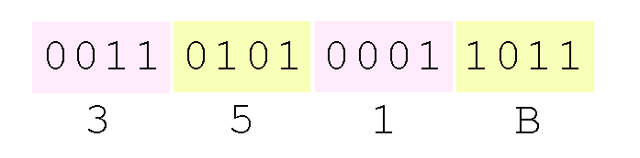
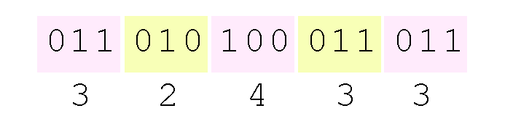
Binary to Hexadecimal
0 1 2 3 4 5 6 7 8 9 A₁₀ B₁₁ C₁₂ D₁₃ E₁₄ F₁₅
Using groups of hextets (four), the binary number
11-0101-0001-1011₂ (= 13595₁₀) in hexadecimal is:
Octal (base 8) values are derived from binary by using groups of three bits (8 = 2³):
Octal was very useful when computers used six-bit words.

Slide 59
Binary to hexadecimal
111 0 0 12= 3916
1 1 1 0 0 1 Binary
3 9 Decimal
Note: Hexadecimal choose 4 bits from right
8 4 2 1
8 4 2 1 Value

Slide 60
Fractional numbers
Fractional values can be approximated in all base system.
Unlike integer values, fractions do not necessarily have exact representations under all radices.
The quantity ½ is exactly representable in the binary and decimal systems, but is not in the ternary (base 3) numbering system.

Slide 61
Fractional
Fractional decimal values have nonzero digits to the right of the decimal point.
Fractional values of other radix systems have nonzero digits to the right of the radix point.
Numerals to the right of a radix point represent negative powers of the radix:
  0.47₁₀ = 4 × 10 -1 + 7 × 10 -2
  0.11₂ = 1 × 2 -1 + 1 × 2 -2
  = ½ + ¼
  = 0.5 + 0.25 = 0.75
.47
+
_

Slide 62
2.3 Decimal to Binary Conversions- Fractional
As with whole-number conversions, you can use either of two methods: a subtraction method and an easy multiplication method.
The subtraction method for fractions is identical to the subtraction method for whole numbers. Instead of subtracting positive powers of the target radix, we subtract negative powers of the radix.
We always start with the largest value first, n ⁻¹, where n is our radix, and work our way along using larger negative exponents.

Slide 63
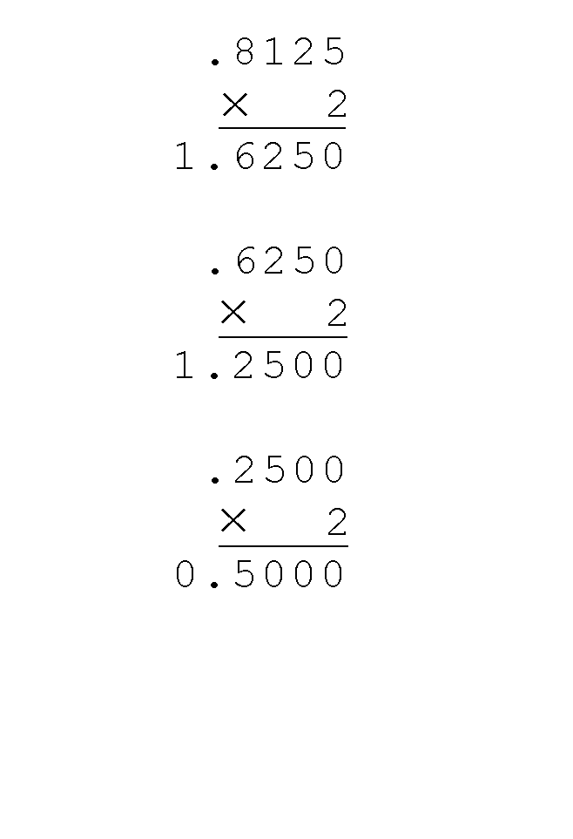
2.3 Decimal to Binary Multiplication
Converting 0.8125 to binary . . .
  Ignoring the value in the units place at each step, continue multiplying each fractional part by the radix.

Slide 64
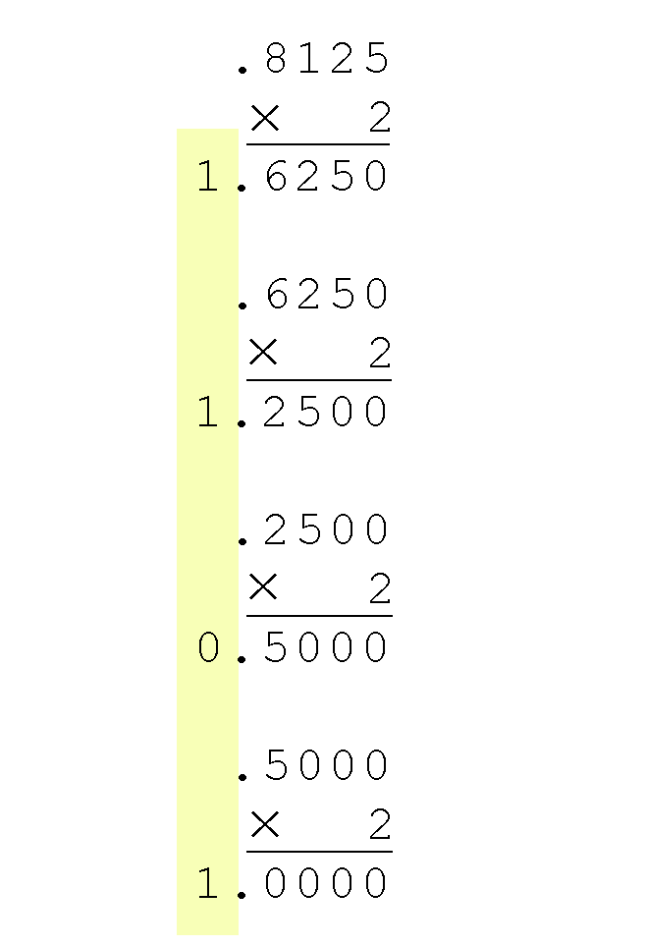
Decimal to Binary Conversions
Converting 0.8125 to binary . . .
  You are finished when the product is zero, or until you have reached the desired number of binary places.
  Our result, reading from top to bottom is:
  0.8125₁₀ = 0.1101₂
  This method also works with any base. Just use the target radix as the multiplier.

Slide 65
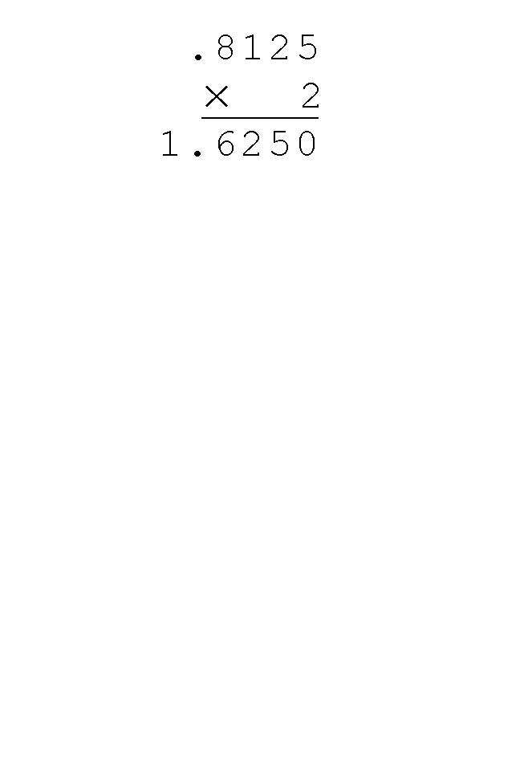
2.3 Decimal to Binary Conversions
Multiplication
Using the multiplication method to convert the decimal 0.8125 to binary, we multiply by the radix 2.
  The first product carries into the units place.

Slide 66
Fractional example
Decimal to Binary (Multiplication)
.62510
.110
.625 X 2 = 1. 250
.250 X 2 = 0.500
.500 X 2 = 1.000
Binary= .101
.1 X 2 = 0 .2
.2 X 2 = 0 .4
.4 X 2 = 0 .8
.8 X 2 = 1 .6
.6 X 2 = 1 .2
.2 X 2 = 0 .4
.4 X 2 = 0 .8
Binary= 0001100

Slide 67
Decimal to Binary (Fractional)-Multiplication
12.910= 1100.11100
1210 = 11002
• 910= .111002
. 9 X 2=1.8 (multiply by 2)
.8 X 2=1.6
.6 X 2=1.2
.2X 2=0.4
.4 X2=0.8

Slide 68
Fractional to binary – More example
40.2510
Integer 40 Fractional .25
64 32 16 8 4 2 1 .25 X 2= 0.5 Value
0 1 0 1 0 0 0 .5 X 2 = 1.0
40.2510= 0101 0 0 0.012

Slide 69
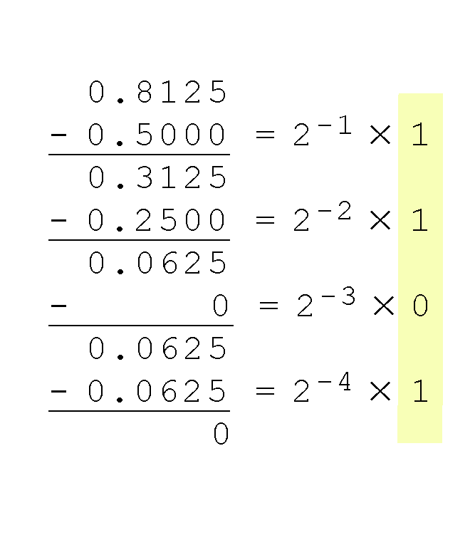
2.3 Subtraction
The calculation to the right is an example of using the subtraction method to convert the decimal 0.8125 to binary.
  Our result, reading from top to bottom is:
  0.8125₁₀ = 0.1101₂
  Of course, this method works with any base, not just binary.
No value
X= 2¯¹
X= = =.5
Flip, change the sign
2¯¹
1
1
+
2¹

Slide 70
Converting a decimal fraction into a binary number (subtraction)
0.8125
_ _ _ 0 . 1 1 0 1
2 2 2 2 2 2 2 2 2
16 8 4 2 1 1/2 1/2 1/2 1/2
0.8125 0.5 = 2¯¹ x 1
0.3125
0.25 = 2¯² x1
0.0625
0 = 2¯³ x 0 0.0625
0.0625 = 2¯⁴ x1
4
3
2
1
0
-1
-2
-3
-4
-
1
2
3
4
-
0.5 0.25 0.125 0.0625
Memorize these numbers

Slide 71
Fractional Binary to decimal
16 8 4 2 1 .5 .25 .125 .0625 .03125
1 0 1
1 1 0 0 0
5
.5 + .25
101.110002 = 5.7510

Slide 72
Signed Integer Representation
Positive and Negative bit
The conversions we have presented so far have involved only positive numbers.
To represent negative values, computer systems allocate the high-order bit to indicate the sign of a value.
  The high-order bit is the leftmost bit in a byte. It is also called the most significant bit. (MSF)
  Most Significant 128 64 32 16 8 4 2 1 lease significant bit
The remaining bits contain the value of the number.

Slide 73
Signed Integer Representation
There are three ways in which signed binary numbers may be expressed:
  Signed magnitude,
  One’s complement
  Two’s complement.
In an 8-bit word, signed magnitude representation places the absolute value of the number in the 7 bits to the right of the sign bit.

Slide 74
Signed Integer- Singed Magnitude
For example, in 8-bit signed magnitude,
positive 3: 00000011 the leftmost bit in a byte
Negative 3: 10000011
Computers perform arithmetic operations on signed magnitude numbers in much the same way as humans carry out pencil and paper arithmetic.
  Humans often ignore the signs of the operands while performing a calculation, applying the appropriate sign after the calculation is complete.

Slide 75
Signed Magnitude
Disadvantages of signed Magnitude:
Signed magnitude representation is easy for people to understand, but it requires complicated computer hardware.
Another disadvantage of signed magnitude is that it allows two different representations for zero: positive zero and negative zero.
For these reasons (among others) computers systems employ complement systems for numeric value representation.

Slide 76
Signed Magnitude problem with three bits representation
Binary Decimal
000 0 problem
001 1
010 2
011 3
100 -0 problem
101 -1
110 -2
111 -3
Causes hardware issue

Slide 77
Sign Magnitude- example 1
8 bit
+109=
-109=
01101101
11101101

Slide 78
Sign magnitude –example 2
8 bit
+43=
-43=
0 0101011
1 0101011

Slide 79
Complements
Complement system:
In complement systems, negative values are represented by some difference between a number and its base.
In the binary system, this gives us one’s complement. It amounts to little more than flipping the bits of a binary number.

Slide 80
One’s complement
One’s Complement:
The ones' complement of a binary number is defined as the value obtained by inverting all the bits in the binary representation of the number (swapping 0's for 1's and vice-versa).
Example: 0001111 ( positive) 15
One’s complement 1110000 (Negative) -15

Slide 81
Signed Integer Representation
One’s Complement: in 8-bit one’s complement,
Positive 3 is: 00000011
Negative 3 is: 11111100 (reverses 0 and 1)
In one’s complement, as with signed magnitude, negative values are indicated by a 1 in the high order bit.
Complement systems are useful because they eliminate the need for subtraction. The difference of two values is found by adding the minuend to the complement of the subtrahend.
8-3=5
Subtrahend

Slide 82
One’s complement
one’s complement is simpler to implement than signed magnitude.
But it still has the disadvantage of having two different representations for zero: positive zero and negative zero.
Two’s complement solves this problem.
Two’s complement is the radix complement of the binary numbering system.

Slide 83
One’s complement problem
Binary Decimal One’s
000 + 0 problem -111
001 1 -110
010 2 -101
011 3 -100
magnitude
100 -3
101 -2
110 -1
111 -0 problem
Causes hardware issue

Slide 84
One’s complement example
Note: If the number is positive, just convert it to binary and you’re done.
If the number is negative, just flip the bits
What is the one’s complement of 7 in 8 bits binary?
7= 00000111
What is the one’s complement of -7 in 8 bits binary?
-7= 11111000

Slide 85
One’s complement 3 bit system
Decimal Binary one’s (flip)
0 000 -111
1 001 -110
2 010 -101
3 011 -100
4 100 -011
5 101 -010
6 110 -001
7 111 -000 problem

Slide 86
Two’s complement
To express a value in two’s complement:
  If the number is positive, just convert it to binary and you’re done.
  If the number is negative, find the one’s complement of the number and then add 1.
Example:
  In 3-bit one’s complement, positive 3 is: 011 (original)
  Negative 3 in one’s complement is: 100
  Adding 1 gives us -3 in two’s complement form: 101.
  (Two’s complement to watch)
  http://www.youtube.com/watch?v=9W67I2zzAfo&feature=related
100
1
101 (two’s complement negative)

Slide 87
Two’s complement
Binary Decimal Flip
000 0 -111
001 1 -110
010 2 -101
011 3 -100
100 -3
101 -2
110 -1
111 -0
Original one’s flip Two’s
000 111 - 000 1
1000

Slide 88
Two’s complement example
What is the two’s complement of +23 in8 bit binary?
23= 00010111
What is the two’s complement of -45 in 8 bit binary?
-45= 11010011

Slide 89
Binary, one’s, tow’s 3 bits system
Decimal Binary One’s Two’s
0 000 111 111+1=1000 -
1 001 110 110+1=111 -
2 010 101 101+1=110 -
3 011 100 100+1=101 -
4 100 011 011+1=100 -
5 101 010 010+1=011 -
6 110 001 001+1=010 -
7 111 000 000+1=001 -
One’s com.+1=Two’s

Slide 90
Binary addition
Binary addition is as easy as it gets. You need to know only four rules:
0 + 0 = 0
0 + 1 = 1
1 + 0 = 1
1 + 1 = 10
  Note: In binary, any digit higher than 1 puts us a column to the left .
The simplicity of this system makes it possible for digital circuits to carry out arithmetic operations.
Let’s see how the addition rules work with signed magnitude numbers . . .

Slide 91
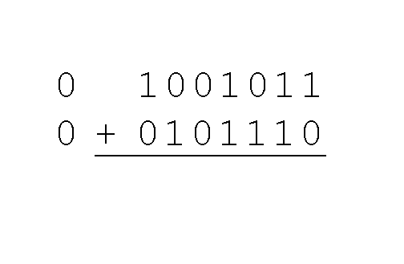
Binary addition
Example:
  Using signed magnitude binary arithmetic, find the sum of 75 and 46.
First, convert 75 and 46 to binary, and arrange as a sum, but separate the (positive) sign bits from the magnitude bits.
Sign bit
magnitude
75
46

Slide 92
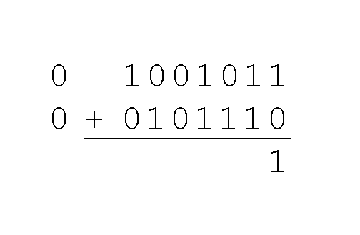
Binary addition
Example:
  Using signed magnitude binary arithmetic, find the sum of 75 and 46.
Just as in decimal arithmetic, we find the sum starting with the rightmost bit and work left.
0 + 0= 0
0 + 1= 1
1 + 0 =1
1 + 1= 10

Slide 93
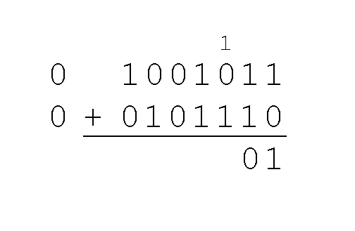
Signed Integer Representation
Example:
  Using signed magnitude binary arithmetic, find the sum of 75 and 46.
In the second bit, we have a carry, so we note it above the third bit.
0 + 0= 0
0 + 1= 1
1 + 0 =1
1 + 1= 10

Slide 94
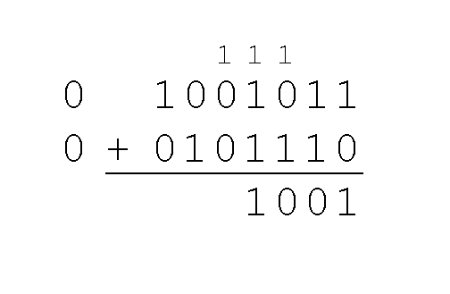
Binary addition
Example:
  Using signed magnitude binary arithmetic, find the sum of 75 and 46.
The third and fourth bits also give us carries.
0 + 0= 0
0 + 1= 1
1 + 0 =1
1 + 1= 10

Slide 95
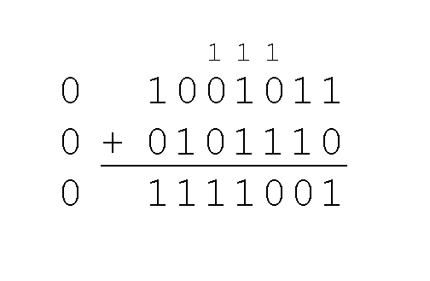
Binary addition
Example:
Using signed magnitude binary arithmetic, find the sum of 75 and 46= 121
Once we have worked our way through all eight bits, we are done.
7 bit
In this example, we were careful to pick two values whose sum would fit into seven bits. If that is not the case, we have a problem.

Slide 96
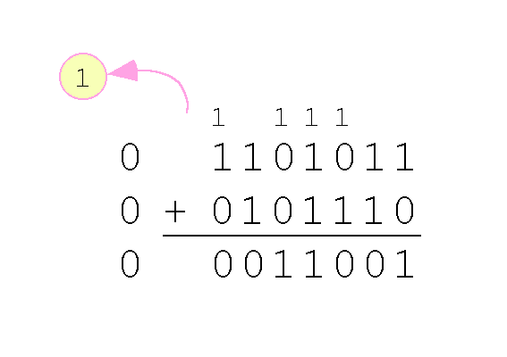
Binary addition
Example:
  Using signed magnitude binary arithmetic, find the sum of 107 and 46.
We see that the carry from the seventh bit overflows and is discarded, giving us the erroneous result:
107 + 46 = 25. Problem
107
46
25
0 + 0= 0
0 + 1= 1
1 + 0 =1
1 + 1= 10

Slide 97
Sign magnitude addition
Example
77+ 56=
0 1001101 + 0 0111000= 0 0000101

Slide 98
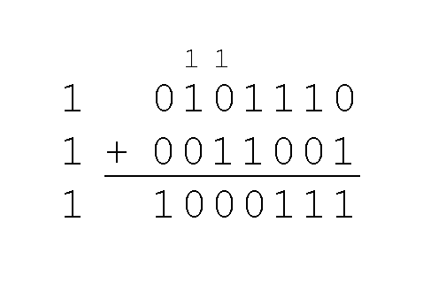
Binary addition
The signs in signed magnitude representation work just like the signs in pencil and paper arithmetic.
  Example: Using signed magnitude binary arithmetic,
  find the sum of - 46 and - 25.
  -Because the signs are the same, all we do is add the numbers and supply the negative sign when we are done.
Sign bit
46
25
-71

Slide 99
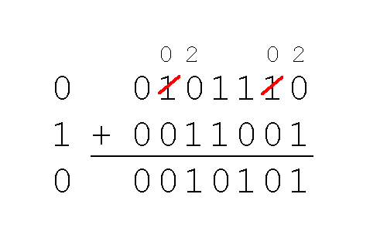
Mixed addition
0 minus1 needs to borrow 1 from left, becoming a “2” which equals 10; then the borrowed unit becomes “0”
Mixed sign addition (or subtraction) is done the same way
  Example: Using signed magnitude binary arithmetic, find the sum of 46 and - 25.
The sign of the result gets the sign of the number that is larger.
  Note the “borrows” from the second and sixth bits.
Sign bit
46
-25
21

Slide 100
Binary Addition – Example unsigned
0 + 0= 0
0 + 1= 1
1 + 0 =1
1 + 1= 10
001 + 111 1001
010 101 0111
011 1100 10 0 0 0
1
Carry bit
1
1
1
1
1
1
1
0
0
0

Slide 101
You do it
Simple addition
111 + 101=
10001+ 10101=

Slide 102
Binary Subtraction- Example-unsigned
15-9=6 13-11=2
1111 1101 1 1 0 0 0
-1001 -1011 - 1 0 0 1 24-9=15
0110 0 010 01 1 1 1
2
1
1
2
Borrow
2
2
0
2
0
0

Slide 103
You do it
1111-101=
11001- 01111

Slide 104
Overflow
When we use any finite number of bits to represent a number, we always run the risk of the result of our calculations becoming too large to be stored in the computer.
While we can’t always prevent overflow, we can always detect overflow.
In complement arithmetic, an overflow condition is easy to detect.

Slide 105
Overflow in Unsigned Binary (UB)
If you are representing numbers using 4 bits as unsigned binary, the minimum value is 0 (i.e., 0000₂, while the maximum value is 15 (1111₂). Any operation that results in a number larger than 15 or smaller than 0 has overflowed.
Example: summed 14 + 14 (in UB, that's 1110 + 1110), the resulting value is 28, but the value 28 has no representation using 4 bits (since the maximum represent able value is 15). Thus, there is overflow.
Two’s complement
Anytime an operation on two 4-bit numbers results in more than 4 bits, the highest bits are removed

Slide 106
Overflow
0=0000 minimum value
1=0001
2=0010
3=0011 10+2=12 15+3=18
4=0100 1010+ 1111+
5=0101 0010 0011
6=1100 1100 1 0010 (discarded)
7=0111
8=1000
9=1001
10=1010
11=1011
12=1100
13=1101
14=1110
15=1111 maximum value

Slide 107
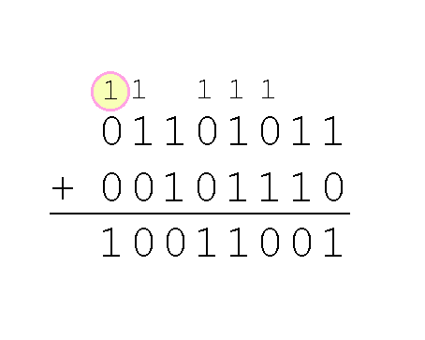
Overflow
Example:
  find the sum of 107 and 46.
We see that the nonzero carry from the seventh bit overflows into the sign bit, giving us the erroneous result: 107 + 46 = -25.
Rule for detecting signed two’s complement overflow: When the “carry in” and the “carry out” of the sign bit differ, overflow has occurred.

Slide 108
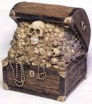
Signed Integer Representation
Overflow and carry are tricky ideas.
Overflow occurs when a calculation produces a result that
is greater in magnitude than that which a given register or storage location can store or represent.
If a carry out of the leftmost bit occurs with an unsigned number, overflow has occurred.
Carry and overflow occur independently of each other.

Slide 109
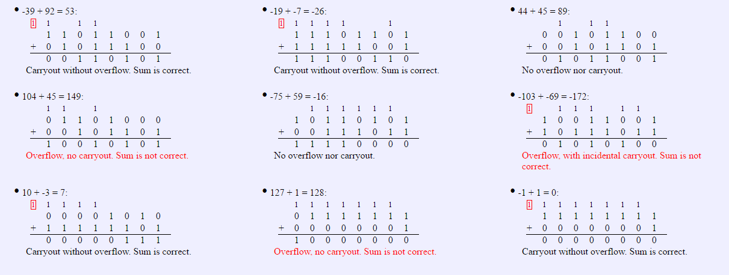
http://sandbox.mc.edu/~bennet/cs110/tc/add.html overflow examples

Slide 110
One’s complement addition/subtraction
1-Convert the negative number (-3) to one’s complement
2-Add the positive number to the one’s complement number.
3-If you have an extra bit (carry over bit) add it to the result.
Example: 7-3=4 7= 111 3=011
111 (7)
-011 (3)
100 one’s complement of 3 (invert bits)
111 +
Extra bit 1 0 11
Add 1
  10 0

Slide 111
One’s complement addition/subtraction 1
Using the one’s complement method, subtract these two binary numbers:
1100–11011=
  10000

Slide 112
One’s complement addition/subtraction 2
Using the one’s complement method subtracts these two binary numbers:
+ 11001
– 01100 =
10011 one’s
11001
CO 1 01100
1
0110 1

Slide 113
Two’s complement addition/Subtraction
1- convert both numbers to binary (positive/negative)
2- convert the negative number to one’s complement
3- add 1 to 1’s complement to get the 2’s complement
4-add both numbers positive and 2’s complement together.
Example: 6-5=1 6=110 -5=101
110 6
101 - 5
010 one’s complement of 5
Add 1
011 Two’s complement of 5
110 6
1 001
Discard

Slide 114
Two’s complement addition/subtraction example
Using the two’s complement method, subtract these two binary numbers 1000-010
Example: 8-2=6 8=1000 2=0010
Find the negative number of (-2) in two’s complement
+0010 (2)
1101 One’s complement of 2
add 1
1110 Two’s complement of -2
Add the two numbers together
1000 (8)
add 1110 + two’s complement -2
0110

Slide 115
Why we use floating point
What is Floating point?
A number that can contains a fractional part. Floating-point numbers have decimal points in them.
Example: 3.0 or -111.5
Real Fixed point Floating point
123456789.0 12345678 1.2345E8 (ie 1.2345*10^8)
0.0000000012345678 0.000000 1.234E-9 (ie 1.2345*10-9)

Slide 116
Floating Point video to watch
http://www.youtube.com/watch?v=MIrQtuoT5Ak&feature=related
(Part 1 and 2)
http://www.youtube.com/watch?v=cGmQASt1oNE
http://www.youtube.com/watch?v=iQFG7sAa7i4

Slide 117
Fractional Part – Multiplication Method
In the binary representation of a floating point number the column values will be as follows:
… 2⁵ 2⁴ 2³ 2² 2¹ 2⁰ . 2⁻¹ 2⁻² 2⁻³ 2⁻⁴ …
… 32 16 8 4 2 1 . 1/2 1/4 1/8 1/16…
… 32 16 8 4 2 1 . .5 .25 .125 .0625…

Slide 118
Example
Ex 1. Find the binary equivalent of 0.25
Step 1: Multiply the fraction by 2 until the fractional part becomes 0 25
x 2
0.5
x 2
1.0
Step 2: Collect the whole parts in forward order. Put them after the radix point
. .5 .25 .125 .0625
. 0 1

Slide 119
Fractional Part – Multiplication Method
Ex 2. Find the binary equivalent of 0.625
Step 1: Multiply the fraction by 2 until the fractional part becomes 0 .625
x 2
1.25
x 2
0.50
x 2
1.0
Step 2: Collect the whole parts in forward order. Put them after the radix point
. .5 .25 .125 .0625
. 1 0 1

Slide 120
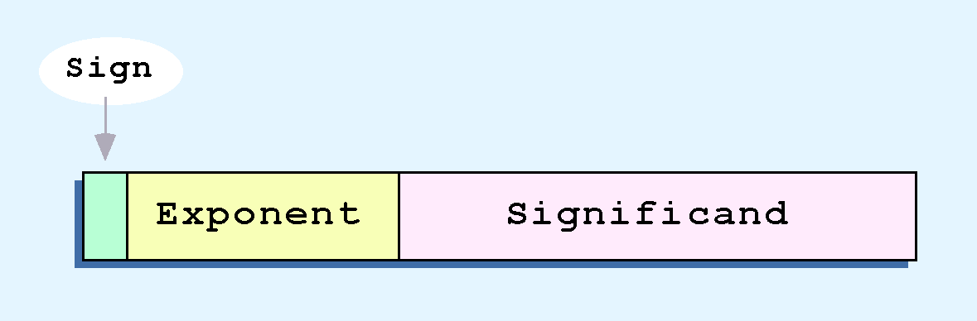
IEEE 754-Single precision FP
Mantissa
8 bit
23 bit
The IEEE-754 single precision floating point standard uses an 8-bit exponent and a 23-bit significand.
Single-precision floating-point format is a computer number format that occupies 4 bytes (32 bits) in computer memory and represents a wide dynamic range of values by using a floating point
IEEE : Institute Electrical and Electronic Engineering
.
For illustrative purposes, we will use a 14-bit model with a 5-bit exponent and an 8-bit significand.

Slide 121
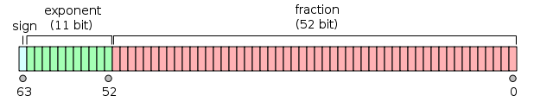
IEEE 754-Double precision standard FP
The IEEE-754 double precision standard uses an 11-bit exponent and a 52-bit significand.
DEF: In computing, double precision is a computer number format that occupies two adjacent storage locations in computer memory.
Modern computers with 32-bit storage locations use two memory locations to store a 64-bit double-precision number
IEEE : Institute Electrical and Electronic Engineering

Slide 122
IEEE Floating Point Representation
The first (leftmost) field of our floating point representation will STILL be the sign bit:
  0 for a positive number,
  1 for a negative number.

Slide 123
Storing the Binary Form
How do we store a radix point?
- All we have are zeros and ones…
Make sure that the radix point is ALWAYS in the same position within the number.
Use the IEEE 32-bit standard
→ the leftmost digit must be a 1
  Ex: 1.00101 X 2³

Slide 124
Solution is Normalization
Every binary number, except the one corresponding to the number zero, can be normalized by choosing the exponent so that the radix point falls to the right of the leftmost 1 bit.
Ex: 1 37.25₁₀ = 100101.01₂ = 1.0010101 x 2⁵
Ex:2 7.625₁₀ = 111.101₂ = 1.11101 x 2²
Ex:3 0.3125₁₀ = 0.0101₂ = 1.01 x 2⁻²
5 4 3 2 1 moved left
2 1 moved left
1 2 moved right

Slide 125
IEEE Floating Point Representation
The second field of the floating point number will be the exponent.
The exponent is stored as an unsigned 8-bit number, RELATIVE to a bias of 127 (magic number).
  Exponent 5 is stored as (127 + 5) or 132
    132 = 10000100
  Exponent -5 is stored as (127 + (-5)) or 122
    122 = 01111010

Slide 126
IEEE Floating Point Representation
The mantissa is the set of 0’s and 1’s to the left of the radix point of the normalized (when the digit to the left of the radix point is 1) binary number.
  Ex: 1.00101 X 2³
  (The mantissa is 00101)
The mantissa is stored in a 23 bit field, so we add zeros to the right side and store:
00101000000000000000000

Slide 127
Decimal Floating Point to
IEEE standard Conversion
Ex 1: Find the IEEE FP representation of 40.15625
Step 1.
Compute the binary equivalent of the whole part and the fractional part. (i.e. convert 40 and .15625 to their binary equivalents)
40= 101000 .15625=.00101
40.15625₁₀ = 101000.00101₂

Slide 128
Decimal Floating Point to IEEE standard Conversion
Step 2. Normalize the number by moving the decimal point to the right of the leftmost 1.
101000.00101 = 1.0100000101x 2⁵
5 4 3 2 1
Mantissa
Exponents changed to 5
Move
Radix point moved left 5 bit
Step 3. Convert the exponent to a biased exponent, means add
127 + 5 = 132
And convert biased exponent to 8-bit unsigned binary:
132₁₀ = 10000100₂
_{Sign exponent} Mantissa Add Zero
0 10000100 01000001010000000000000 (up to 32 bits)
132

Slide 129
Decimal Floating Point to
IEEE standard 32 bit Conversion
Step 4. Store the results:
Sign Exponent Mantissa
1 bit 8 bit 23 bit
0 10000100 01000001010000000000000

Slide 130
Decimal Floating Point to IEEE standard Conversion
Ex 2: Find the IEEE FP representation of –24.75
Step 1. Compute the binary equivalent of the whole part and the fractional part.
24₁₀=11000₂ .75₁₀=.11₂
Quotient Re .75X2=1.50
24/2=12 0 .50X2=1.00
12/2=6 0
6/2=3 0
3/2=1 1
1 1
So: -24.75₁₀ = -11000.11₂

Slide 131
Decimal Floating Point to
IEEE standard Conversion.
Step 2.
Normalize the number by moving the decimal point to the right of the leftmost 1.
-11000.11 = -1.100011 x 2⁴
Step 3. Convert the exponent to a biased exponent
127 + 4 = 131
==> 131₁₀ = 10000011₂
Step 4. Store the results from steps 1-3
Sign Exponent mantissa
1 10000011 1000110…0

Slide 132
1.0
binary 1₂ .0
Normalization 1.X2⁰ No mantissa
Magic number 127+0=127
Exponent 127= 01111111
0 011 1111 1 000 0000 0000 0000 0000 0000
S E M
3F8₁₆

Slide 133
1.
binary 1₂ .0
Normalization 1.X2⁰ No mantissa
Magic number 127+0=127
Exponent 127= 01111111
0 011 1111 1 000 0000 0000 0000 0000 0000
S E M
3F8₁₆

Slide 134
Scientific Notation
Floating-point numbers allow an arbitrary number of decimal places to the right of the decimal point.
  For example: 0.5 × 0.25 = 0.125
They are often expressed in scientific notation.
Scientific notation is a way of writing numbers that are too large or too small to be conveniently written in standard decimal notation.
Example: moved to the left
    0.125 = 1.25 × 10
    300= 3 X 10 ²
    6,720,000,000 = 6.72×10⁹
    0.125 = 1.25 × 10
=1.25 x
= 1.25 x 0.1= 0.125
-1
-1
1
10
+1

Slide 135
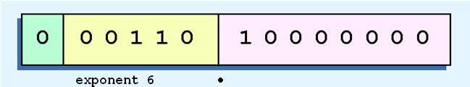

Scientific notation
Example: Express 32₁₀ in the simplified 14-bit floating-point model.
We know 32 = 2⁵ = 1 x 2⁵
So in scientific notation 3210 = 1.0 x 2⁵ = 0.1 x 2⁶
Using this information, we put 110 (= 6₁₀) in the exponent field and 1 in the significand as shown.
No value
FP moved one space to the left
Mantissa
Mantissa

Slide 136
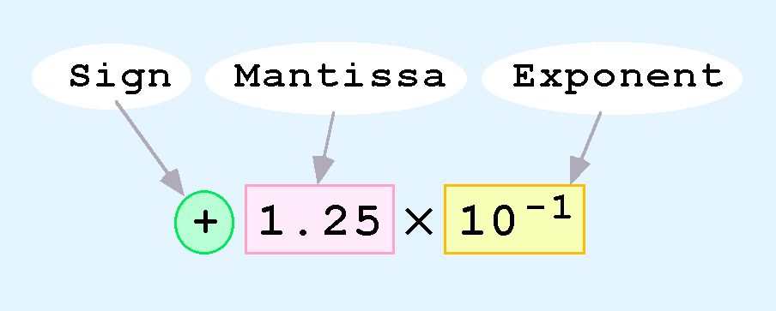
Floating-Point Representation
Computers use a form of scientific notation for floating-point representation
Numbers written in scientific notation have three components:

Slide 137
Floating-Point Representation
Computer representation of a floating-point number consists of three fixed-size fields:
This is the standard arrangement of these fields.
Mantissa

Slide 138
Floating-Point Representation
Mantissa
The one-bit sign field is the sign of the stored value.
The size of the exponent field, determines the range of values that can be represented.
The size of the significand (Mantissa) determines the precision of the representation.

Slide 139
Floating-Point Representation
Fractional value .25
The significand of a floating-point number is always preceded by an implied binary point.
Thus, the significand always contains a fractional binary value.
The exponent indicates the power of 2 to which the significand is raised.

Slide 140
Floating-Point Representation- negative exponent
Another problem with our system is that we have made no allowances for negative exponents.
For instance, we have no way to express 0.5=2 ⁻¹ = 1/2
Notice that there is no sign in the exponent field in the placeholder

Slide 141
Negative exponents
To provide for negative exponents, we will use a biased exponent.
A bias is a number that is approximately midway in the range of values expressible by the exponent. We subtract the bias from the value in the exponent to determine its true value.
  In our case, we have a 5-bit exponent. We will use 16 for our bias. This is called excess-16 representation
In our model, exponent values less than 16 are negative, representing fractional numbers.

Slide 142
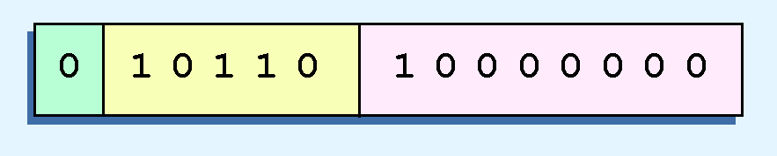
Floating-Point Representation
Example:
  Express 32₁₀ in the revised 14-bit floating-point model.
We know that 32 = 1.0 x 2⁵ = 0.1 x 2⁶.
To use our excess 16 biased exponent, we add 16 to 6, giving 22₁₀ (=10110₂).
Graphically:
6+16 bias and exponent

Slide 143
Floating-Point Representation
To resolve the problem of synonymous forms, we will establish a rule that the first digit of the significand must be 1. This results in a unique pattern for each floating-point number.
  In the IEEE-754 standard, this 1 is implied meaning that a 1 is assumed after the binary point.
  By using an implied 1, we increase the precision of the representation by a power of two.
In our simple instructional model, we will use no implied bits.

Slide 144
Floating-Point Representation example
Example:
Express 26.625₁₀ in the revised
14-bit floating-point model.
Solution:
We find 26.625₁₀ = 11010.101₂.
Fractional: multiply by 2
0.625 0.500 = 2 x 1
0.125
(0.25)0 = 2 x 0
0.125
0.125 = 2 x 1 0.000
-1
-2
-3

Slide 145
Floating-Point Representation
Floating-point addition and subtraction are done using methods analogous to how we perform calculations using pencil and paper.
The first thing that we do is express both operands in the same exponential power, then add the numbers, preserving the exponent in the sum.
If the exponent requires adjustment, we do so at the end of the calculation.

Slide 146
Floating-Point Representation
Floating-point overflow and underflow can cause programs to crash.
Overflow occurs when there is no room to store the high-order bits resulting from a calculation.
Underflow occurs when a value is too small to store, possibly resulting in division by zero.
Experienced programmers know that it’s better for a program to crash than to have it produce incorrect, but plausible, results.

Slide 147
Floating-Point Representation
When discussing floating-point numbers, it is important to understand the terms range, precision, and accuracy.
The range of a numeric integer format is the difference between the largest and smallest values that can be expressed.
Accuracy refers to how closely a numeric representation approximates a true value.
The precision of a number indicates how much information we have about a value

