Slide 1
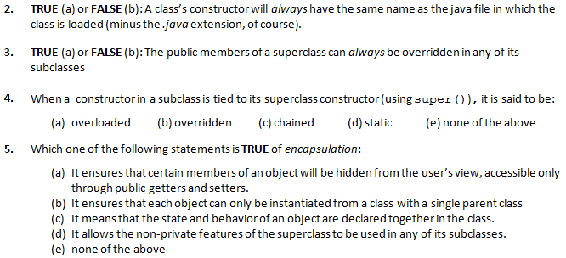
Quiz Solutions
Note: these answers are based on the ‘A version of the quiz. If you wrote the ‘B’ version, the same questions appear, but in a different order. In some cases, the wording between exams may be different, so check the wording carefully before reporting errors.
*Note: the static members of a superclass cannot be overriden, since they are part of the class, not the instance

Slide 2
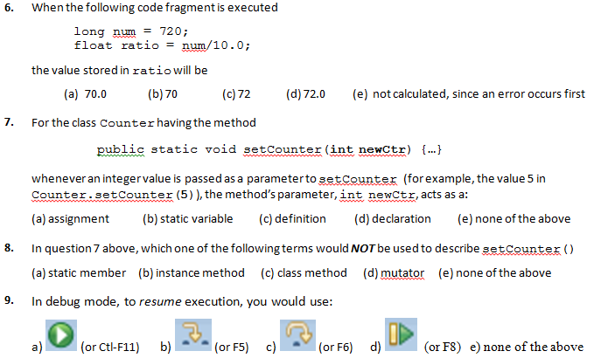

Slide 3
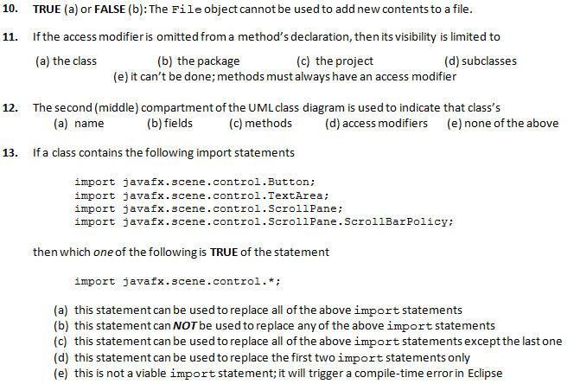

Slide 4
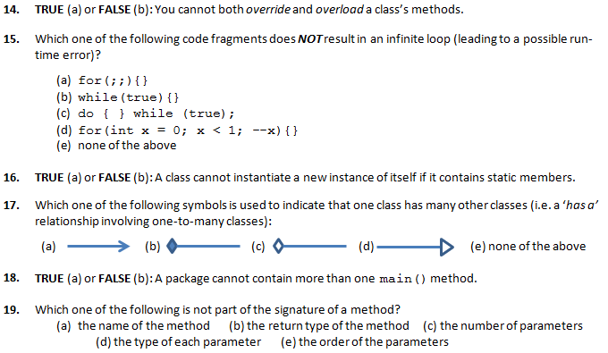

Slide 5
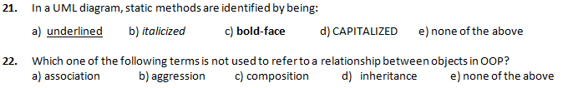

Slide 6
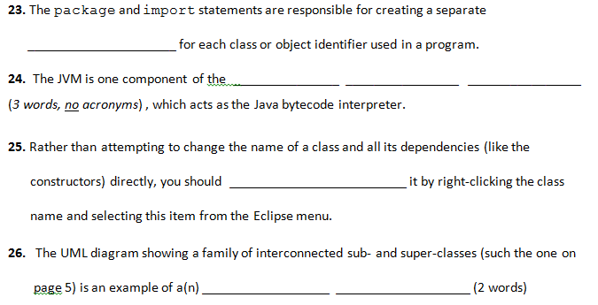
Part B: Terminology – worth 1 mark each
FILL IN THE SINGLE BEST ANSWER—ONE WORD IN THE EACH SPACE PROVIDED BELOW.
USE ONE WORD ONLY IN EACH SPACE; DO NOT USE ACRONYMS
namespace
Java
Runtime
Environment
refactor
class (or object) hierarchy

Slide 7
Part C: Written Answers – worth 9 marks total
public class CalorieCounterDemo {
public static void main(String[] args) {
Apples[] apples = new Apple[3]
apples[0] = new Apple(0.4f);
apples[1] = new Apple();
apples[2] = new Apple(0.3f);
float totCalories = 0;
for (int ctr=0; ctr < apples.length; ctr++)
totCalories += apples[ctr].getCalories();
System.out.println("Total calories in these "+
"apples.length apples is " +
totCalories + " Calories");
}
}
Should be Apple, not Apples, to be consistent with the data type used throughout the class
Missing semi-colon
apples.length should not be embedded in the string; it should be “…these” + apples.length + “ apples is ”…
1
2
3

Slide 8
public class Apple extends Fruit {
private float weight = 100.0;
public float getWeight() {return weight;}
public void setWeight(float weight) {
if (getWeight() <= 0)
System.out.println("Weight cannot be" +
" less than or equal to zero; resetting"+
" to default value");
this.weight = (weight<=0)?100:weight;
}
public Apple() {super();}
public Apple(float pS) {this(pS);}
public float getCalories() {
return (getWeight() *
3*(getSugarContent()+ getProteinContent());
}
}
Number will default to double, which cannot fit into float
getWeight() checks the currently-stored value of weight, when it needs to check the weight just entered.
Should use super() rather than this(), which leads to infinite loop, since constructor calls itself
Needs a closing parenthesis to finish statement
4
5
6
7

Slide 9
public class Fruit extends Food {
private boolean sweet = true;
private float proteinContent, sugarContent;
public boolean isSweet() {return sweet;}
public void setSweet(boolean s) {sweet = s;}
public float getProteinContent() {
return proteinContent;}
public void setProteinContent(float protein) {
proteinContent = protein;}
public float getSugarContent() {
return sugarContent;}
public void setSugarContent(float s) {
sugarContent = s;}
public Fruit () {this(0.1f);}
public Fruit (float pC) {this(pC, 0.3f);}
public Fruit(float pC, float pS) {
setProteinContent(pC);
setSugarContent(isSweet?pS:pS+0.3);
//incr sugar by 30% if sweet
float tempFibre = getFibreContent() –
(getProteinContent() - getSugarContent());
setFibre(tempFibre);
}
}
isSweet is a method, therefore needs ()
Logic is backwards; if apple is sweet, then add 30%
0.3 is a double by default, hence ps+0.3 becomes a double, while setSugarContent() expects a float
getFibreContent() does not exist; it should be getFibre(), as declared in Food class
Calculation will add sugar, rather than subtract it, due to a negative negative (+) built into the calculation
8
9
10
11
12

Slide 10
public class Food {
private float fibreContent = 1;
/// % fibre as decimal value; 1 = 100%
public float getFibre() {return fiberContent;}
public void setFibre(float fib) {
fib = fibreContent;
}
}
Should be fibreContent, according to the definition at the top of the class
Assignment is backwards; should be fibreContent=fib;
13
14

