Slide 1
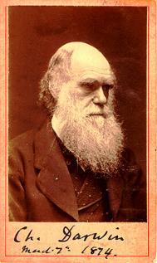
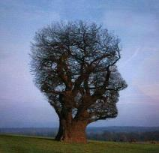
Chapter 3
Charles Darwin (1809- 1882) and Evolution
3.1 Charles Darwin: Education and Family
3.2 The Voyage on the Beagle
3.3 Evolution and Natural Selection
3.4 Proofs of Evolution: Homologies, Fossils, Vestigial Structures
Campbell Biology: p. 495-508

Slide 2
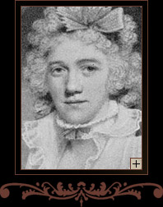
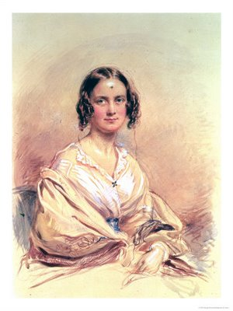

3.1 Charles Darwin: Education and Family
During his time at Cambridge he became interested in nature and after graduating decided he wanted to travel and study nature.
Born February 12th, 1809
Father was a doctor.
Mother was from the Wedgwood family (porcelain).
Mmarried (1838) to his cousin Emma Wedgwood (1808-1896)
Had 10 children
Stops his studies in medicine and takes a more serious interest in religion (CambridgeU).
  Prerequisite to become a pastor: Bachelor of Arts
Developed an interest in nature: taxidermy, insect collecting, botany, etc.

Slide 3
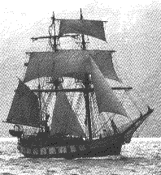
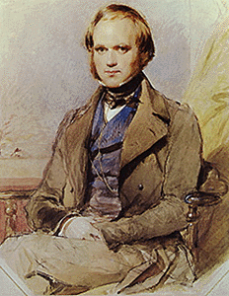
3.2 The Voyage on the Beagle
Darwin was actually hired as a companion for the captain.
The supposed naturalist/ biologist suddenly quit and asked Darwin to replace him, which he did.
During these trips they visit the cities and collect animals and plants. Conserve them and document them then leave them to be picked up by English ships.
Darwin wrote a book depicting the story of his travels. Afterwards he started compiling all the info he gathered and started to think seriously about his theories.
In 1831, he leaves on the Beagle, a ship commissioned by the British government to do the cartography of the coast of South America.
Darwin was invited on board as a companion of the captain Fitzroy but quickly became the _nauralist_ of the voyage.
He travels the world and spends most of his time on land to sample the fauna and flora and to study South-American geology.
The trip is planned for two years, lasted five years.

Slide 4

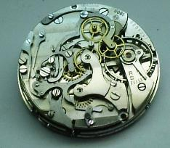
3.2 The Voyage on the Beagle
When he started his voyage he like the others believed the notion of catastrophism.
He would later use the books on religion to test his theories.
During the voyage, two books had an impact on Darwin
  William Paley (1743-1805): “Theology, or evidences of the existence and attributes of the deity”.
    Paley is the father of the Theology of Nature. This theology advocated that harmony and design in nature are indicators of the existence and the acts of God (today = __intelligent design_).
  Charles Lyell : “Principles of Geology”.
    Darwin began his expedition thinking like a good protestant: believing in the Great Flood and in Cuvier’s catastrophism.
    When he returned five years later, he was in total agreement with Lyell and Hutton’s _principle of uniformity_.

Slide 5
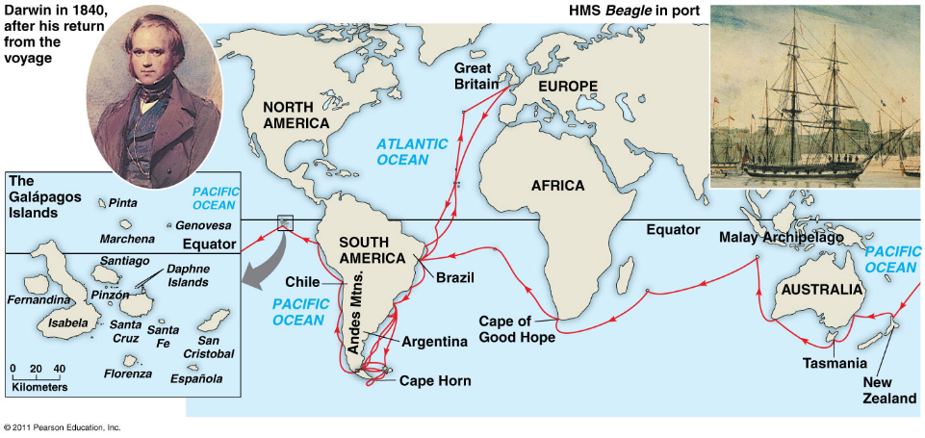
3.2 The Voyage on the Beagle
He travelled from London to south America to New Zealand to Africa to south America to England.
He touched all the continents and we able to observe them all.
When he was in chile there was an earthquake and realized afterwards that the coast had changed, and they had to remap.
This was an eye opener and he realized maybe the world is not constant.
He found later mollusk fossils 3000m above sea level.
These observations triggered some questionings.
Fig. 22.5 The voyage of the HMS Beagle (December 1831- October 1836)

Slide 6
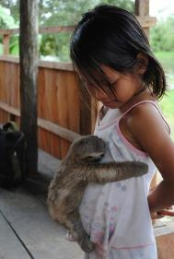
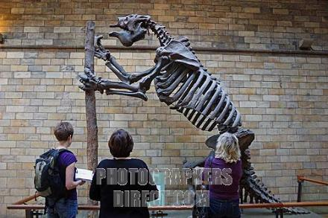
3.2 The Voyage on the Beagle
According to lemarck the fauna should have been similar in common habitats and different in different habitats, but they were not.
Three-Toed
Sloth
Giant
Sloth
The very distinct fauna of _South America_ had a profound effect on Darwin:
  Why do the fauna and flora of Africa, Europe, Australia and South America have relatively few species in common?
  Why are the animals and plants of the temperate zones of South America resemble the species living in the tropical zones of South America but not the species in temperate Europe?
  Why are the mammal fossils of South America absent from the current fauna (e.g. Giant Sloth)? Why do these fossils show resemblance with current species found only in South America (e.g. Three-toed Sloth)?

Slide 7
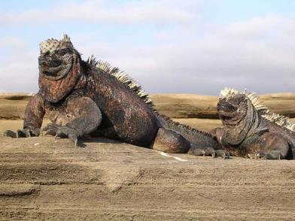
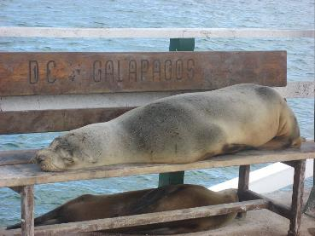
3.2 The Voyage on the Beagle
Why did God create distinct fauna In this particular place?
Fauna on the Galápagos Islands surprises Darwin.
  The fauna on the Islands is unique. Why?
  Why does it show resemblance with species on the American continent?
Galápagos _marine iguana_ (Amblyrhynchus cristatus) (only iguanas to live in a marine environment; unique to the Islands).
Galápagos Sea lions (closely related to the Californian sea lion)

Slide 8
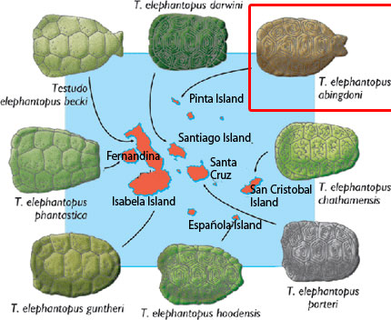
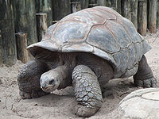
The Voyage on the Beagle
Every island turtle had variability In their shell.
Why so much shell _vary_______ in Tortoises in the Galápagos?
GalápagosTortoise
Giant Galápagos Tortoise (15 different subspecies on the Islands)
http://www.galapagosexpeditions.com/islets/lonesome-george-tortoise.php

Slide 9
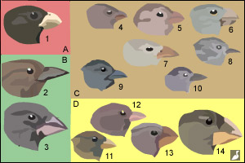
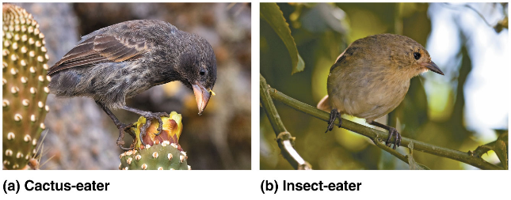
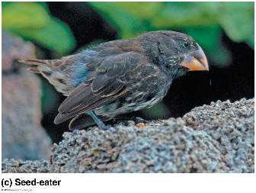
3.2 The Voyage on the Beagle
Finches of the Galápagos Islands
Why so much morphological variability in one group?
Why does each island, in most cases, have their own species?

Slide 10
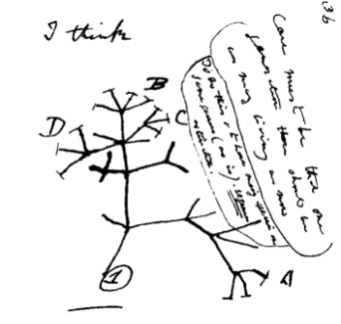
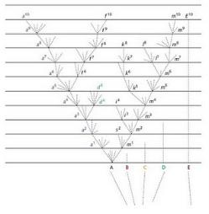
3.3 Evolution and Natural Selection
Darwin made the observation of common ancestry and drew in his notes a phylogenic tree indicating that species all came from one ancestor.
He rejected the idea of Lamarck (environmental determinism) that species in similar environments will look alike.
Evidence claims Darwin didn’t like controversy and that is why he waited so long to publish his work.
In 1837, we find in Darwin's notes the first mention that species show resemblance to each other because they share a _common ancestor (not a common environment).
  Rejects the fixity (no change) of species and accepts the concept of descent with modifications (evolution).
  Very materialistic view of life that is in contradiction to the religious dogma of the time.
  Rejects Lamarck’s evolutionary mechanism (environmental determinism)
Then, he begins the search for an evolutionary mechanism.
Darwin’s first phylogenetic tree (1837)
Darwin’s tree published in 1859

Slide 11
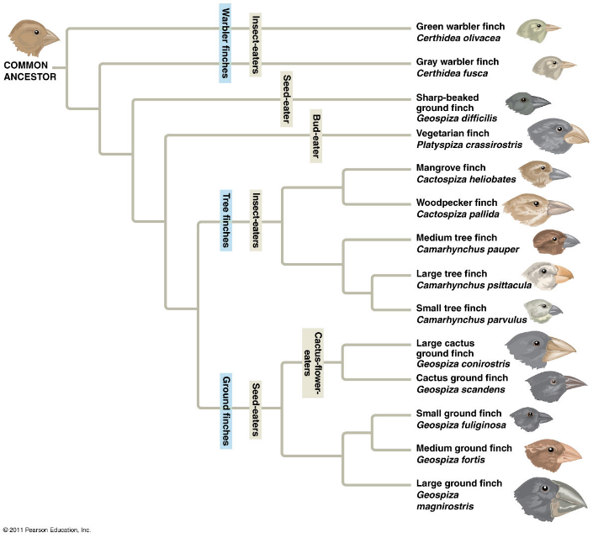
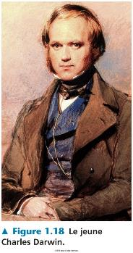
3.2 The Voyage on the Beagle
His finches brought about a theory that a species of the birds was pushed towards the Galapagos where they speciated and developed.
South-
American
Finches of the Galápagos Islands
The Finches show morphological similarities because they _share a common ancestor.
Fig 1.22

Slide 12
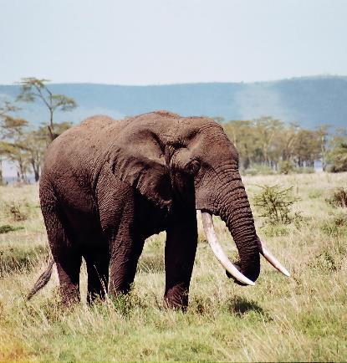
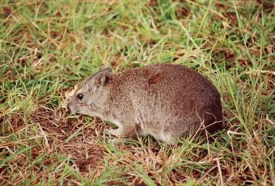
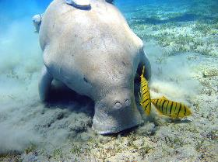
3.3 Evolution and Natural Selection
he wanted to fill the gaps between the species and thought fossils will help him do that.
Fossils gave a god idea of the evolutionary path from related organisms.
Rock hyrax
African elephant
Dugong

Slide 13
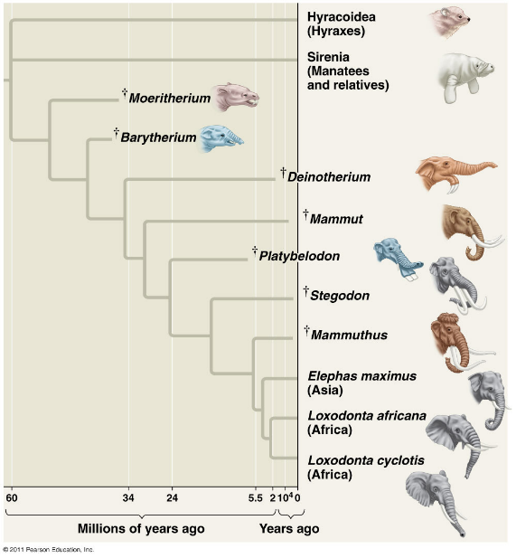
3.3 Evolution and Natural Selection
Fossils showed a lot about the development of morphological features that filled the gaps between organism.
_99_% of species that have lived on Earth are extinct.
Most of the evolutionary branches finish in a dead-end (extinction).

Slide 14
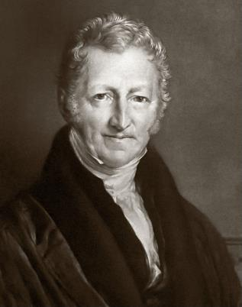
3.3 Evolution and Natural Selection
Was unsatisfied with Lamarck’s method of classification and came up with his own.
He was able to apply the concepts of Malthus to his studies and work.
In 1838, Darwin read “ An essay on the principle of population” written by the economist Thomas R. Malthus
This reading became one of the main sources that inspired him to formulate his famous theory on natural selection.
Thomas Malthus
1766-1834

Slide 15
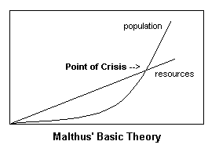
3.3 Evolution and Natural Selection
It was later proven that the capacity of humans to produce resources and thrive was not a linear relation.
A decline in resources showed turning point in which people would fight for survival and there would be winners and losers.
The population would grow but then come back and crash afterwards.
The concept of winners and losers struck Darwin as a concept he could use to explain his observations of nature.
In his book An essay on the principle of population (1798), Malthus wrote that:
Every human population has a tendency to increase _geometrically_, whereas the available resources to feed these populations increase _arithmetically_.
Population
Number of individuals
Crisis point
Nutritional resources or other
time
Malthus’s principle of population

Slide 16
3.3 Evolution and Natural Selection
The human population increases faster than its capacity to feed itself. This leads to _____ (famine, sickness, war, etc.) and eventually to a substantial reduction in population size.
Population
Number of individuals
Crisis point
Nutritional resources or other
time
Malthus’s principle of population

Slide 17
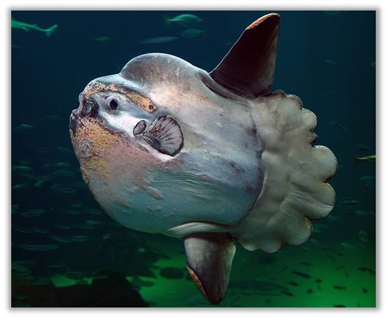
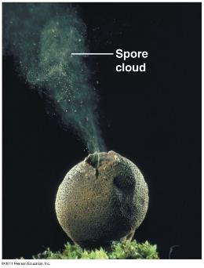
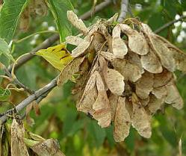
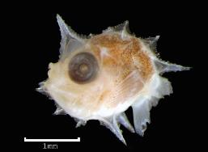
3.3 Evolution and Natural Selection
Ex: puff ball:
Spores are released when it ruptures and spread to create more puffballs although not all will grow.
Same concept with the seeds of a tree
Same concept with puffish that will produce hundreds of eggs each spawn however not all are fertilized and as a result not all will survive
The notion of winners and losers really struck Darwin. He thought maybe there were certain characteristic that would make a species winner for several generations.
Darwin’s first observation:
All species can produce more offspring than their environment can sustain and many of these _offspring_ fail to survive and reproduce
Fig. 22-11
Maple tree and its samaras
Puffball
Mola mola
(Ocean sunfish)

Slide 18
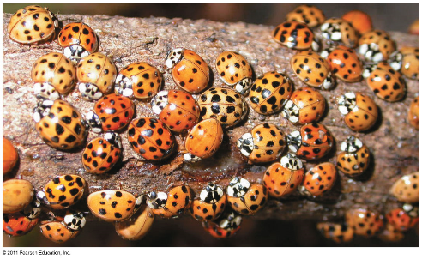
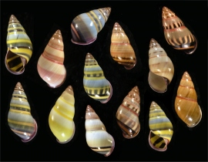
3.3 Evolution and Natural Selection
Population has variabilities in it and Darwin thought that the winner characteristics in species had to be hereditary.
Variation most likely gave certain members an advantage over the rest.
Variability is no longer an imperfection and more of an advantage.
He realized the variability and heredity through the cross breeding of pigeons.
He elaborated his theory of natural selection
1’9”
8’1”
Darwin’s second observation : Members of a population often vary in their _inherited traits__.
2’5”
8’3”
Fig. 22-10
Amphidromus adamsii
Asian ladybird beetles

Slide 19
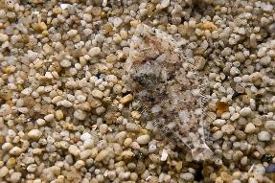
3.3 Evolution and Natural Selection
Individuals w/ inherited traits have a greater chance of survival and produce more offspring.
Evolution and natural selection always must involve the inherited traits.
Ex: color of fish:
Several colored fish in a pond have a visual predator (duck)
If the environment is red the duck will attack the fish that have the most contrast w/ the background.
Red fish are safer and thus winners so after a few generations and different colored fish being eaten the red fish will appear more frequently in a population.
Variability will give an advantage and after a few generations of predation it will be that feature that is more frequently occurring and favored in natural selection.
However, the environment is subject to change.
If the red background becomes blue. The red fish have lost their advantage and the blue ones now have the advantage.
Natural selection depends on the selective pressure of the environment.
Natural selection is simply a matter of winners and losers in a specific environment.
The only evolutionary process that actually produces adaptation.
Flatfish
Two inferences:
  Individuals whose inherited traits gives them a higher probability of surviving and reproducing in a given environment tend to leave more offspring than other individuals
  From generation to generation, this unequal capacity of survive and reproduce (differential reproductive success) results in an accumulation of favourable traits in a population.
    This is _natural selection . It enables the emergence of adaptations.

Slide 20
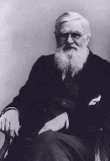
3.3 Evolution and Natural Selection
Darwin sat on the idea of natural selection for 20 years until he receives a letter from a scientist who has observed natural selection and asked for his help.
This event drove him to publish his theory of natural selection ‘on the origins of species’
It is a letter from Alfred Russel Wallace (1823-1913), received in 1853, that forced Darwin to publicly release his ideas.
Wallace had come to the same conclusions as Darwin concerning the theory of natural selection by observing the fauna of Indonesia.
Thus, it was 23 years after his voyage on the Beagle that Darwin publicly released his views on the evolution of species.
Wallace

Slide 21
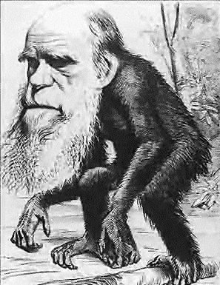
3.3 Evolution and Natural Selection
This book is considered to be one of the most important to be written in natural history.
The book explains about the passing of traits and selection despite no knowledge about genetics at the time.
He claimed that he did not need any supernatural forces to explain his theories.
On the same day, in 1858, Darwin and Wallace presented a resume of their ideas on natural selection to the Linnean Society of London.
In 1859, Darwin publishes the first edition of his book “On the Origin of Species”. The book became an instant bestseller and created great controversy.
The 6th and last edition of his book, published in 1872, contains a chapter dedicated to the most important arguments against his theory. Most of these arguments came from his creationist colleagues.

Slide 22
3.3 Evolution and Natural Selection
Important notions:
Individuals do not evole but populations do
Only traits that can be transmitted are subject to NS acquired traits do not count.
Variability is important for evolution. There has to be winners and losers or else the population would go extinct.
Natural selection: survival of the fittest. Fitist refers to those that can pass genes to the next generation.
Natural selection will allow for frequency in the beer adapted members of a population.
Adaptive feature vary depending on the pressure of the environment. (ex; white tail deers: vary in size from North America to Costa Rica. Changing of seasons counts as variation in environment). Species are under the influence of many selective pressure over their liftetimes.
Inherited traits can cause change in the morphology of the species (ex: the human jaw/ teeth: crocked teeth, wisdom teeth, teeth thatdo not correspond to jaw shape).
Important notions linked with natural selection:
  Individuals do not evolve, _populations_ evolve.
  Only hereditary traits are subject to natural selection.
  For evolution to occur, we need genetic variability.
  Natural selection corresponds to differential reproductive success within a population from generation to generation.
  With time, natural selection enables individuals to become better _adapted_ to their environment.
  Environmental factors vary in time and space. Thus, the selective forces are variable.
  Traits in populations will change and can modify the species.

Slide 23
3.3 Evolution and Natural Selection
Darwin applied the principle of uniformity b/c natural selection is a process that can occur over several generations. This can actually be tested.
Evolution and natural selection is not a random process. It has a consequences of favoring survivable characteristics.
There is no perfect form. Evolution does not seek perfection. It is not a directed process. There is no ultimate goal, it is a consequence of interacting with the environment.
For Darwin this mechanism is valid because:
  It respects the principle of uniformity of Lyell and Hutton.
  The results of natural selection are visible in nature
  The mechanism can be verified on current populations. (e.g. artificial selection)
  It is a materialistic concept (no need for divine intervention):
    The mechanism is _not random_. Natural selection enables individuals that are better adapted to their environment to become more abundant than those who are not (differential reproductive success).
    Not a quest for _perfection_ (evolution is not a directed process). It does not lead to the appearance of “perfect” traits. Organisms only adapt to their environment.

Slide 24
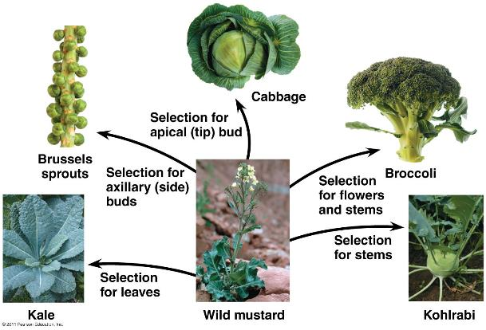
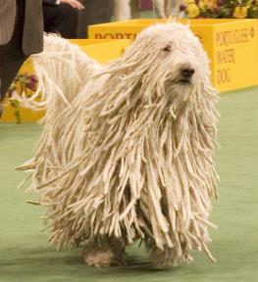
3.3 Evolution and
Natural Selection
Artificial selection with the intention/ objective of creating a species w/ a specific feature.
Natural selection is not finite.
Artificial selection has been around for several years and Darwin was aware of it and this helped him realize that traits can be passed down.
Fig.22-9
__artificial selection_ is finalized because the goal, fixed well in advance, precedes the causes. The end result can be obtained in a few generations.
__natural selection_ is not finalized. It can take a long time for changes to occur (geological time scale).

Slide 25
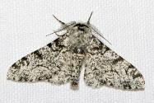
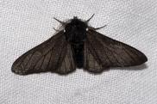
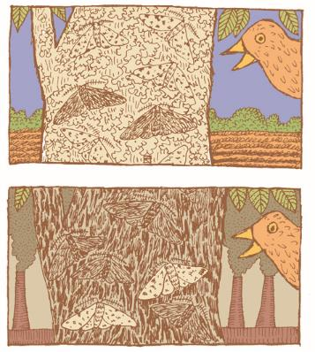
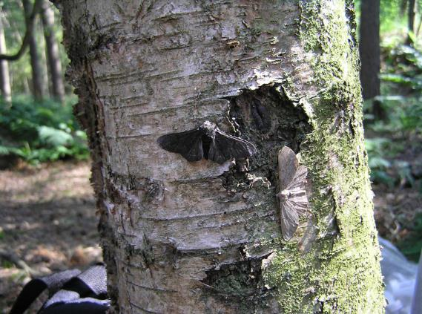
3 examples of natural selection:
Butterfly example:
Peppered moth:
Nocturnal butterflies.
There is grey an dark moths.
Predators included birds.
An experiment was made .
Coal was the main source of energy so everything has a dark layer. Lots of dark surfaces.
Countryside was not like that.
Frequency of moths was studied in the city and in the countryside.
Grey moth in the dirty environment were less frequent compared to the dark moths b/c the gray moths stood out/ contrasted the dark environment.
In the countryside the gray moths appeared more frequently b/c they are better camouflaged against the clean gray tree barks and were preyed upon less heavily.
In the cleaner cities the dark moths have become way less abundant b/c they no longer blend into their environment so the dark wing trait is not carried to the next generations.
3.3 Evolution and
Natural Selection
Peppered moth
(Biston betularia)

Slide 26
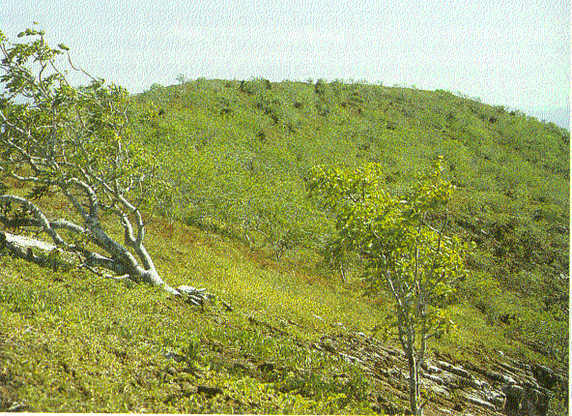
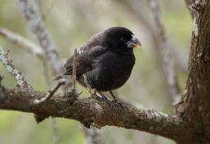
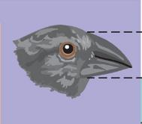
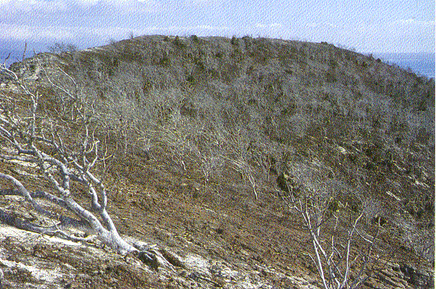
3.3 Evolution and Natural Selection:
Climate and the Medium Ground Finch
2) Darwin’s flinches example:
Every summer birds are caught in the Galapagos and band them with the color band system.
Population of the ground fish (seed eater) had its beak height measured.
Beak height affects what can be eaten.
Variability in beak height is transmitted.
Higher population birds had the larger beaks.
During dryness only large seed were available and only the birds capable of eating them survived and reproduced and as a result frequented.
Medium ground finch
(Geospiza fortis)
Height of the beak
- Drought in 1977 (also in 1980, 1982)
- Population _1200__ adults to _80_.
- Selection favouring individuals that have bigger and stronger beaks to break available seeds during the drought.
Daphne Major
(Galápagos)

Slide 27
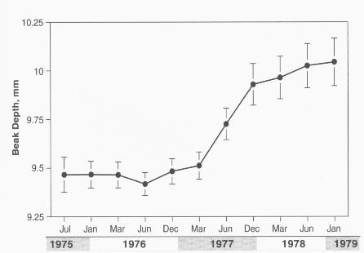
3.3 Evolution and Natural Selection:
Climate and the Medium Ground Finch
Height of beak mm
Changes in the height of the Medium groundfinch’s beak (Geospiza fortis) on Daphne Major Island during the 1977 drought.
Graphics adapted from Grant and Grant.2008. How and why species multiply; the radiation of Darwin's finches. Princeton Univ. Press.

Slide 28


3.3 Evolution and Natural Selection:
Humans and Altitude
3) Adaptations to altitude in humans:
In the Himalayas you travel from low altitudes to very high altitudes in hours. For someone not used to it this can cause sickness.
People born in the higher altitudes have a genetic basis that have allowed them to adapt to living in the higher mountainous areas.
Kongmaru Pass (Himalaya – India; 5150m)
Guide from Ladakh was born on the Qinghai–Tibet Plateau in the Himalayas and comes from a population which lives over 3500m above sea level for 22 000 years.
Mountain life: _adaptation to altitude.
François Chapleau: Comes from a population that has always lived under 500m above sea level.

Slide 29
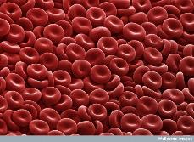
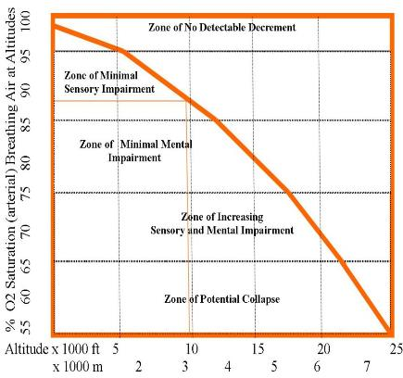
3.3 Evolution and Natural Selection:
Humans and Altitude
The body reacts and works harder to regulate with the new pressure and pumps more red blood cells. The danger of this is that the circulatory system is not well equipped to handle the increased density of red blood cells.
Over 2 000m, the partial pressure of O₂ is insufficient for normal saturation of hemoglobin for a traveller in high altitudes.
  Shortness of breath, altitude sickness
  Physiological response (_acclimatization_): After a few days at high altitude, the body compensates the low partial pressure of O₂ by increasing the concentration of red blood cells in our blood. Serious health risks: thrombosis, pulmonary edema, etc.).
2,000m
(respiratory stress)

Slide 30
3.3 Evolution and Natural Selection:
Humans and Altitude
Some few thousand years ago people from the low lands decide to move up.
Some individuals most likely had the genetic variability to adapt to higher altitudes w/o their knowledge. This is due to a random mutation that occurred in the lowland population.
Proportion of the potentially adapted travelled w/ a group to higher altitudes.
These were the people that survived and reproduced and became more abundant than the ones that were not adapted.
Generation 0
More than 22,000 years ago
Qinghai–Tibet Plateau
3,500 m
= Individuals who have the genetic traits allowing for survival and reproduction in high altitudes.
= Individuals who do not have the genetic traits allowing for survival and reproduction in high altitudes.
Lowlands of Asia

Slide 31

3.3 Evolution and Natural Selection:
Humans and Altitude
Generation 0
Human dispersion
(22,000 years)
Qinghai–Tibet Plateau
3,500 m
= Individuals who have the genetic traits allowing for survival and reproduction in high altitudes.
= Individuals who do not have the genetic traits allowing for survival and reproduction in high altitudes.
Lowlands of Asia

Slide 32
3.3 Evolution and Natural Selection:
Humans and Altitude
Generation 50
Qinghai–Tibet Plateau
3,500 m
= Individuals who have the genetic traits allowing for survival and reproduction in high altitudes.
= Individuals who do not have the genetic traits allowing for survival and reproduction in high altitudes.
Lowlands of Asia

Slide 33
3.3 Evolution and Natural Selection:
Humans and Altitude
Generation 500
Qinghai–Tibet Plateau
3,500 m
= Individuals who have the genetic traits allowing for survival and reproduction in high altitudes.
= Individuals who do not have the genetic traits allowing for survival and reproduction in high altitudes.
Lowlands of Asia
Notes:
.

Slide 34
3.3 Evolution and Natural Selection:
Humans and Altitude
Generation 1000
(now)
Qinghai–Tibet Plateau
3,500 m
= Individuals who have the genetic traits allowing for survival and reproduction in high altitudes.
= Individuals who do not have the genetic traits allowing for survival and reproduction in high altitudes.
Lowlands of Asia

Slide 35
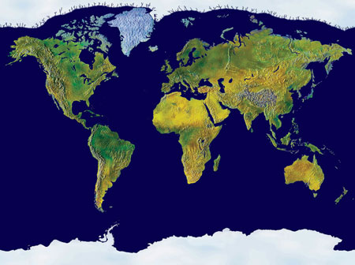
3.3 Evolution and Natural Selection:
Humans and Altitude
Many regions in high altitude were independently colonized by humans.
On the Qinghai–Tibet Plateau, human _adaptation_to high altitude differs from the Andes.
Andes
(11,000 Years)
550 generations
Qinghai–Tibet Plateau First traces 30,000 yrs
1,000+ generations

Slide 36
3.3 Evolution and Natural Selection:
Humans and Altitude
Capillaries are slightly larger which allows more blood to pass through.
Source populations that travel higher have different mutations that lead to different adaptations.
Adaptations
  Andes
    Increase in hemoglobin concentration (red blood cells).
  Qinghai–Tibet Plateau
    Deeper breath, larger pulmonary capacity and increased _blood flow .
Natural selection keeps the individuals with the genetic traits that allow adaptation to high altitude. This means that individuals that have the mutation are at an advantage for survival and reproduction (production of offsprings).

Slide 37
3.3 Evolution and Natural Selection
(modified slide)
In the three cases (moths, finches and humans), the _hereditary traits_ that give a _reproductive advantage (i.e. adaptation) to individuals in a population will be favoured. Thus, from generation to generation, there will be a higher percentage of individuals carrying the adaptation. This is _natural selection. It’s Darwin’s descent with modification. It’s evolution.
These adaptations can sometimes redefine a species and, in certain circumstances, define a new species.
Another example in the book : fig. 22.13

Slide 38

3.4 Proof of Evolution: Homology
Alternative too homology would be individual evolution but it has already been established that it is too complex of a theory and species hare a common ancestor.
Descent with modification theory (theory of evolution) explains the resemblance between certain traits even if the functions are different.
(homologous structures)

Slide 39

3.4 Proof of Evolution: Homology
Common features may lie hidden in the embryo.
In human embryo pharyngeal pouches disappear to form throat but In fish it later forms into girls.
In humans the tail is less obvious and regressed to form the coxas, but in animals it develops.
Similarities are not necessarily reflected in the adult form.

Slide 40

3.4 Proof of Evolution: Homology

Slide 41


3.4 Proof of Evolution: Fossils
Horses were around the side of large dogs and had complex feet with 4 visible fingers and short teeth to incorporate the leaf diet.
Over time the morphology gets simler and simpler and teeth get longer.
Horses seem to have left the forest habitat and then move to the plains.
Horses when eating grass may have also been eating sand which causes wear and tear to the teeth, so the teeth have adapted to accommodate for this.
The feet changed to adapt for speed. The quantity of bone and muscle is reduced to increase speed when running (mass reduction).
This is a simplistic view of evolution.
Evolution of the horse:
Hyracotherium
Classic
Interpretation
(linear evolution)

Slide 42

3.4 Proof of Evolution: Fossils
Many species of horses has previously existed.
So the simplistic outlook is not reality.
The evolution is more complex b/c of the variation of species.
We actually have a very overcomplicated tree.
Evolution of the horse:
More realistic interpretation
(phylogenetic tree)
See fig. 25.27

Slide 43
Proof of Evolution; humans:
Liear evolution from monkeys is a false representation of the evolution of humans. It is a linear evolution. Simplistic outlook.
The idea that we evolved from nkeys would imply that there was only one species of monkey/ human in time.
Human actually share a common ancestor with a chimpanzee but did not come from the chimpanzee.
It is likely the ancestor liked like a chimpanzee.
Another flaw is that it indicates the evolution of humans corresponds to change in height.
Human speces come in all sizes even some million years ago. The popular notion and the false notion indicates that humans grew in size.
In reality there were many species of human living at once, but they have since then disappeared.
A false perspective on evolution: human evolved from only one species.
Brain size was inherited only a couple million years ago.

Slide 44



3.4 Proof of Evolution: Fossils
Homology shows some interesting patterns.
Ex: whales can be considered mammals. Fossils show structures unique to both whales and mamlas.
Closest relatives of whales is the hippo. Clearly there is a big gap which is progressively being filled with the use of fossil.
Why did the whale come about?
It would seem that the pakicetus dinosaur would have adapted to living in water and slowly the land limbs would have regressed to form fins.
Fig. 22.19 (Astragalus)
Pakicetus
Fig. 22.20

Slide 45

Vestigial structure: structure with minimal or no function. Evidence of evolution.
Ex: pelvic girdle in whales shows the ancient existence of limbs.
3.4 Proof of Evolution: Vestigial Structures
Museum of Melbourne
Skeleton of a dwarf subspecies of a blue whale (Balaenoptera musculus)
(max length: 24 m).
Take note of the reduced vestigial posterior limb, the pelvis reduced to a floating pelvic bone under the spine.
_vestigial structure_: anatomic structure that has lost almost all of its initial function.

Slide 46





3.4 Proof of Evolution: Vestigial Structures in Humans (4)
Every dtrand of hair has a muscle attached to it. When stimulus is felt the muscle contracts and the hair stands up. This is what we call goose bumps. This serves no function in humans.
In animals with lots of fur and hair the goose bumps creates a layer of air between the tip of the raised hair and the skin and this keeps them warm. The cold air is tapped in the fur.
Humans lost this adaptation when they lost their fur. We still have all the mechanics and morphology associated with this but it is no longer useful to us and this vestigial.
It has minimum function.
Skin next to the eye is a remnant of the third eyelid.
It is a translucent membrane that offers protection to the eye when carrying out actions like swimming or flying. It is fully functional in many vertebrate species.
It may have had an important function in the human ancestor.
Appendix is found sticking out of the colon. It has a tendency to get inflamed and then must be removed.
In rabbits and horses the caecum and appendix is huge. It has many microorganisms and bacteria and an important site for digestion.
Human appendix is an indication that at one point human ancestors had a large caecum in order to facilitate digestion, but we have since lost the need for it.
There is a possibility the structure might eventually disappear.
stomach
Human
colon
Small
intestine
Nictitating membrane or third eyelid.
_appendix_______
_goose bumps and hair________
Chicken

Slide 47

3.4 Proof of Evolution: Vestigial Structures
Contraction of the diaphragm with the simultaneous closing off of the phrenic nerve.
When we have hiccups the phrenic nerve gets squished between 2 organs so the idea of getting it of hiccups is getting the nerve unpinched.
Why does the nerve have such a long path to the diaphragm why does it not start off from a closer organ?
The common ancestor was the fish and thei respiratory system is in the thought so the phrenic nerve is actually a short distance away from the disphragm.
In evolution the respiratory system moved downwards and the phrenic nerve has to extend to reach it.
Optimal design would be having the nerve come out at the same level of the diaphragm.
The epiglottis may have evolved from metamorphosing tadpoles. It would have allowed the tadpole to use its gold without ever having water enter the lungs.
Epiglottis
Phrenic Nerve
4thcervical vertebra
The _hiccups______ :
A heritage from fishes and amphibians
diaphragm

Slide 48

Discovery of a fossil in the wrong place on the geological archives would be sufficient to refute our concept of evolution
3.4 Proof of Evolution
Ray Troll art

