Slide 1
Chapter 15
International Trade
Principles of Microeconomics
Douglas Curtis & Ian Irvine

Slide 2
Learning Outcomes
By the end of this chapter you should understand…
Trade in our daily lives
Canada and the world economy
The gains from trade - comparative advantage
Intra-industry trade and dynamic gains from trade
Trade barriers: tariffs, subsidies and quotas
The politics of protectionism: good and bad arguments for protection
Trade agreements and trade institutions
15.1

Slide 3
Canada’s Imports and Exports
Table 15.1 Canada’s merchandise trade patterns 2014
 | Exports to | Imports from
United States | 73.5 | 63.1
United Kingdom | 3.5 | 2.3
Other EU economies | 8.6 | 10.4
China | 3.2 | 6.3
Mexico | 1.8 | 2.7
Others | 9.4 | 15.2
Total | 100.0 | 100.0
Source: Adapted from Statistics Canada CANSIM Database, http://cansim2.statcan.gc.ca, Tables 228-0001 and 228-0002.

Slide 4
Canada’s Exports
Table 15.2 Canadian goods exports 2012
Sector | Percentage of total
Agriculture and fishing | 9.0
Energy | 24.5
Forestry | 4.9
Industrial goods & materials | 25.5
Machinery and equipment | 17.6
Automotive products | 12.9
Other consumer goods | 3.6
Total | 100.0
Source: Adapted from Statistics Canada CANSIM Database, http://cansim2.statcan.gc.ca, Table 376-0007

Slide 5
Trade Issues for Canada and the World
Agricultural Protection
  Protects developed economy farmers, hurts farmers from LDCs
Globalization: Outsourcing of manufactures to LDCs
  Has the West lost good jobs due to outsourcing? Or is the loss of manufacturing jobs due to technological change? Or structural change in the economy?
Trade or Aid: Do trade barriers offset aid to LDCs?
15.2

Slide 6

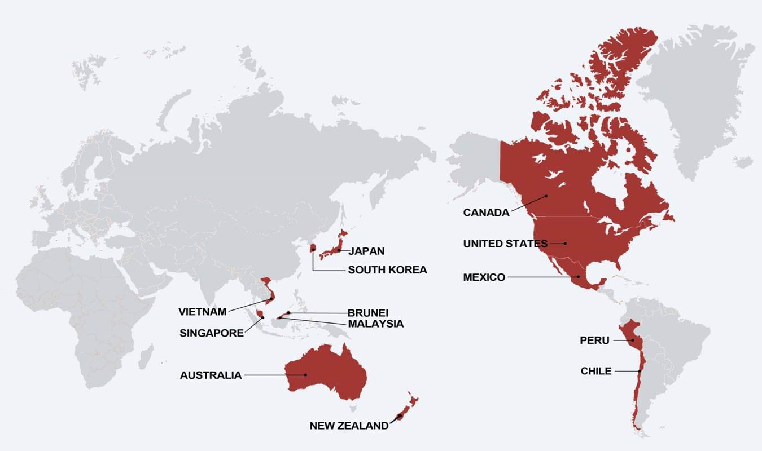
Recent Trade Agreements
CETA: Comprehensive Economic and Trade Agreement between Canada and the European Union. Signed in 2017. This will see trade barriers reduced.
The Trans Pacific Partnership: Canada was a party to this agreement with 11 other Pacific-Rim economies. But the US pulled out with the election of Donald Trump, and the agreement is now in limbo

Slide 7
Comparative Advantage
The Law of Absolute Advantage
  If one economy uses fewer inputs than another economy to produce a good or service, then that economy has an absolute advantage in its production
The Law of Comparative Advantage
  Countries specialize in the production and export of products they produce at lower relative cost than other countries
Illustration……
15.3

Slide 8
Trading: Individuals and Economies
In Chapter 1 we introduced the concepts of trade and the market as means of increasing the potential consumption of individuals
In those examples one each individual was more efficient in producing one of the goods – a case of absolute advantage
We will now apply this concept to economies as opposed to individuals and examine the principle of comparative advantage – where one economy is absolutely more efficient in producing both goods, but the degree of that efficiency differs
We will show that even in the latter case trade will usually lead to consumption gains on the part of the trading economies
Autarky denotes the no-trade world

Slide 9
Comparative Advantage – an Example
US has absolute advantage in both goods
Assume each economy has same resources – a given endowment of labour
 | Canada | United States
 | Production possibilities
Vegetable Production | 5 units | 8 units
Fishing | 35 units | 40 hours
Let us not be concerned with exchange rates or currencies for the moment – imagine we have a single currency, or that $1 Can = $1 US
Graphically…

Slide 10
Comparative advantage - production
Vegetable
8
US Specializes
US has absolute advantage in both goods over Canada
US PPF
US advantage is greater in V than F. Therefore it specializes in V
Canada specializes in F. Note Canada can transform 1 unit of V into 7 units of F – it is relatively more efficient than the US at Fish
Canada PPF
5
Canada specializes
35
40
Fish

Slide 11
Terms of Trade
Vegetable
Countries must now establish a rate of trade; also called the terms of trade
8
US Specializes
The result must benefit both economies if they are to trade
US PPF
Any trading/exchange rate between the rates of transformation will provide the potential for both to consume more
Canada PPF
5
Suppose they agree to trade at 1V = 6F
Canada specializes
35
40
Fish
We can now illustrate the consumption possibilities……

Slide 12
Comparative Advantage - Consumption
Vegetable
US consumption possibilities post trade
8
US Specializes
Canada consumption possibilities post trade
US PPF
5.83
Each consumption possibility frontier has the same slope : 1/6
5
Each economy can now consume outside its own PPF – as a result of comparative advantage Illustration……….
Canada PPF
35
40
Fish
Canada specializes
48

Slide 13
Comparative Advantage - Consumption
Vegetable
Suppose US trades 3V for 18F with Canada: US consumption is {5V, 18F}
8
US Specializes
Canada then consumes {17F, 3V}
US PPF
5.83
Each economy can consume outside its own PPF, because the efficiency of world production has increased – each economy has specializes where it has a comparative advantage
5
Canada PPF
35
40
Fish
Canada specializes
48

Slide 14
Currency Exchange Rates
  In this example we have not been concerned with different currencies – or we have assumed that $1 Can = $1 US
  In the modern marketplace products are traded because they are cheaper in the local currency
  Exchange rates between currencies are themselves determined in the market for foreign exchange
  In economies with many goods being traded internationally the exchange rate combined with comparative advantage will determine which goods are traded
15.3

Slide 15
Comparative Advantage
What is the source of Comparative Advantage?
Endowments: economies are naturally endowed with different advantages: Saskatchewan is better for producing wheat than Finland or Switzerland
Endowments as the result of investments – the knowledge economy: high-skill economies have an advantage over lower-skill economies in engineering products
But scale economies can also give rise to trade where no strong advantages exist – particularly in the form of intra-industry trade, where we see specialization in particular goods or services within a broad product group
15.4

Slide 16
Intra-Industry Trade
Manufacturing Intra-Industry Trade as % of Total Manufacturing Trade
Average for Years | 1988–1991 | 1992–1995 | 1996–2000
Canada | 73.5 | 74.7 | 76.2
United States | 63.5 | 65.3 | 68.5
France | 75.9 | 77.6 | 77.5
Germany | 67.1 | 72.0 | 72.0
United Kingdom | 70.1 | 73.1 | 73.7
Ireland | 58.6 | 57.2 | 54.6
Japan | 37.6 | 40.8 | 47.6
New Zealand | 37.2 | 38.4 | 40.6
Norway | 40.0 | 37.5 | 37.1
Australia | 28.6 | 29.8 | 29.8
Example: Canada US Auto Pact; graphical illustration…..
15.4

Slide 17
Intra Industry/Firm Trade
Sedans
Hunda currently produces in separate plants in US and Canada. Trade not permitted. With given resources, it can produce either 100,000 of each vehicle in either economy, or 40,000 of both in each economy. Hence production possibilities are given by the points {A, Z, B}. Pre trade it produces at Z in each economy due to trade barriers.
A =100,000
Post-trade consumption possibilities
40,000
Post trade it produces at A in one economy and B in the other, and ships the vehicles internationally. Total production increases from 160,000 to 200,000 using the same resources. The line AB represents post-trade consumption possibilities
Z
40,000
B = 100,000
SUVs
Increasing returns to specialization drive this result….Canada – US auto pact of 1965

Slide 18

Many modern firms obtain their components from suppliers worldwide. This is particularly true of electronic goods that are assembled in the home economy
Supply chains is the expression used to describe this process
The inputs are termed intermediate goods
In this world, a tariff may simply increase the costs of production or assembly for a domestic producer and be counter-productive. A domestic competing supply chain is higher cost if the manufacturer of the final good has decided to purchase components internationally

Slide 19
Does Everyone Gain from Trade?
Freer trade benefits the consumer, but some producing sectors lose out
  Example: Clothing manufacturers in the West have lost out as the consumer has gained through cheaper manufacture in Asia
  Example: Canada’s natural resource and food sectors gain as a result of free trade and comparative advantage
  In reality we have trade barriers because some segments of the economy gain from trade protection
  The theory of comparative advantage says that overall the economy gains from free trade – that is, the winners could compensate the losers. But of course that does not happen very frequently!
  Remember from Chapter 1: Trade is not a zero-sum game.
15.5

Slide 20
The Economics of Protectionism
Tariff – a type of tax
Quota – a physical limit on imports
Non-tariff barrier – standards designed to make sales difficult for overseas manufacturer
Subsidies and loans – used by aircraft manufacturers in many economies
15.6

Slide 21
The Effect of a Tariff
With free trade the quantity Q_{D} – Q_{S} is imported
Price
Domestic Demand
Tariff increases domestic production, lowers domestic consumption; imports decline
S
World supply price plus tariff
P= $12
Tariff = $2
P= $10
World supply price
Domestic Supply
D
Free trade equilibrium
Q_{S}
Q_{S}’
Q_{D}’
Q_{D}
Quantity
15.6

Slide 22
Costs and Benefits of a Tariff
Price
Consumer surplus loss caused by the tariff
Total Deadweight Loss
S
World supply price plus tariff
L
E
F
P= $12
J
C
G
P= $10
World supply price
I
H
Gov. tax revenue
Additional domestic profits
D
Quantity
Q_{S}
Q_{S}’
Q_{D}’
Q_{D}
DWL results from (i) reduction in total purchases, (ii) substitution of high-cost domestic production for lower cost imports
15.6

Slide 23
The Impact of Subsidy
The DWL reflects the additional higher cost of domestic producers relative to international producers who have been squeezed out of the market
A per-unit subsidy to domestic suppliers shifts their supply curve and increases their market share.
Price
S
S’ with a per-unit subsidy
World supply price
P
D
No DWL on demand side - Q_{D} and price remain unchanged
Q_{S}
Q_{S}’
Q_{D}
Quantity
Note also that raising the tax revenue for a subsidy itself carries a DWL
15.6

Slide 24
Impact of a Quota
Quota impact: Reduces total quantity from Q_{FT} to Q_{q}, and supplants low cost foreign production of (Q_{q} – Q’) with higher cost domestic production
Price
S to domestic market with import quota = quota
Dom S
Domestic price, post quota
World supply price
D
quota
Quantity
Q_{dom}
no quota
Q’
Q_{q}
Q_{FT} = free trade
15.6

Slide 25
Protectionism - Policy and Politics
Consumers and the economy at large gain from trade and lower trade barriers
But specific sectors of the economy lose jobs and profits
Globalization facilitates outsourcing to lower-cost economies
The decline of manufacturing in the West has been facilitated and caused by the opening up of Asia and Mexico to trade
Job losses in Canada are dealt with through Employment Insurance in the short term. But many long-tenured employees will not regain a comparable high-paying job
Retraining programs for labour?

Slide 26
Protectionism - Policy and Politics
Some sectors continue to enjoy protection from trade and imports
Examples……
Dairy sector is frequently governed by supply management policies. Cheese import quotas are small and marginal tariffs are at 250%
Domestic wines in Canada are usually protected by provincial alcohol agencies from free trade. The consumer pays more as a result. Where do we draw the line on protectionism?
Why are protectionist policies successful in many instances?
The answer seems to be that benefits are concentrated among a relatively small group and are large on a per-beneficiary basis
Whereas costs are small per person, and spread over many more individuals, but in the aggregate costs normally outweigh benefits

Slide 27
Good and Bad Arguments for Protection
  Infant Industries - a popular argument: give the infant time to grow, learn and expand, at which point protection will no longer be required. Unfortunately without incentives, infants rarely mature. Hence temporary protection more usually becomes permanent protection
  Dumping – a predatory practice aimed at driving out domestic producers, or resulting from surpluses in overseas markets. Example: EU butter mountain
  Way of Life arguments – frequently in the agricultural sector. However, in Canada agricultural protectionist policy benefits predominantly large farms not small family farms; farm consolidation in recent decades has been enormous
15.7

Slide 28
Institutions Governing Trade
The World Trade Organization (WTO - formerly GATT)
  Objective is to dismantle existing barriers and prevent further barriers from being erected
European Union
  EU has expanded to 29 members. Originally founded with the belief that economic integration would improve political relations after WW II: economic integration would lead to political integration, and peace.
  Now includes many former ‘Eastern Block’ economies
North American Free Trade Agreement
  Canada, Mexico, US (1994)
  Followed the FTA of 1989 between Canada and US
  Centerpiece is the dispute resolution mechanism
  Canada’s export share of GDP has grown dramatically since these agreements came into being
15.7

Slide 29
Trade Agreements and Content Requirements
Trade agreements usually come with content requirements.
Consider the NAFTA as it applies to auto trade: vehicles manufactured in North America can be shipped freely between economies provided that they satisfy a 62.5% content requirement.
This means in practice that a vehicle produced in say Oshawa Ontario cannot have more than 37.5% of its value in the form of inputs that do not originate in Canada
This is to prevent trans-shipment: A trader in Canada may not import a product that is almost wholly (say 90%) produced in a low-cost economy, add some value (10%) and ship it to Mexico or the US free of tariffs. Such a good does not satisfy the content requirements of the NAFTA

Slide 30
Chapter Summary
World trade has grown rapidly over the past 40 years
Countries have a comparative advantage in the goods they can produce relatively cheaply
Trade improves consumption possibilities even if one country has an absolute advantage in both goods
Other reasons for trade
  Economies of scale
  Intra-industry trade
The exchange rate will determine the actual flows of trade between economies

Slide 31
Chapter Summary
Tariffs, quotas, subsidies, and non-tariff barriers lead to inefficiencies and deadweight losses
Most popular arguments against trade liberalization are contrary to economic reasoning. There are some valid arguments for barriers, for example, dumping
Tariffs and other non-tariff barriers have fallen greatly since WW II under GATT and the WTO
The NAFTA and EU aim to reduce trade barriers, and the EU aims additionally to increase political integration in Europe

