Slide 1
Chapter 10
Monopoly
Principles of Microeconomics
Douglas Curtis & Ian Irvine

Slide 2
Learning Outcomes
By the end of this chapter you should understand…
Why monopolies exist
How monopolists maximize profits
The monopolist’s response to a demand shift: the short run and long run
Monopoly and market efficiency
Price discrimination and cartels
Invention, innovation and rent-seeking

Slide 3
Reasons for Monopoly
A natural monopoly is one where the AC of producing any output declines with the scale of operation.
- Increasing returns to scale, even at very high output levels….
National Policy: a deliberate government policy to protect a domestic monopoly
  e.g. a “national” carrier in the airline industry
Maintaining barriers to entry
  Patents, granted by government
  Predatory pricing, intended to drive out potential competition
  Lobbying government for subsidies as a means of preventing entry
  Excess production capacity
  Network goods that are utilized almost universally – e.g. Microsoft operating systems, Winzip

Slide 4
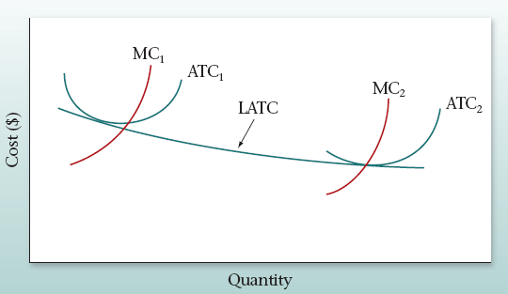
A “Natural” Monopoly
A “Natural” Monopoly experiences increasing returns to scale indefinitely
Since the LATC never increases, whoever attains scale economies can monopolize

Slide 5
Patents and Fixed Costs
With a fixed R & D cost F of producing the first unit and a constant MC thereafter, the LATC declines indefinitely
Cost ($)
F
A competitor who imitates this innovator does not incur F and could undercut the innovator
LATC
Constant MC
For example, to sell Q_{A} the imitator incurs the MC while the innovator incurs the ATC
1
Quantity
Q_{A}
Patents protect intellectual property rights; encourage research and development

Slide 6
The Profit-Maximizing Monopolist
Reminders…
Marginal revenue = MR = Change in total revenue obtained by selling on more unit
Total revenue = TR = P*Q
Average revenue = revenue per unit sold = P
Marginal cost = MC = change in total cost obtained by producing one more unit
Profit = total revenue – total cost = TR - TC

Slide 7
The Profit-Maximizing Monopolist
Example with demand and cost conditions for a monopolist
Quantity (Q) | 0 | 1 | 2 | 3 | 4 | 5 | 6 | 7 | 8
Price (P) | 16 | 14 | 12 | 10 | 8 | 6 | 4 | 2 | 0
Total Revenue (TR) | 0 | 14 | 24 | 30 | 32 | 30 | 24 | 14 | 0
Marginal Revenue (MR) | 14 | 10 | 6 | 2 | -2 | -6 | -10 | -14
Marginal Cost (MC) | 2 | 3 | 4 | 5 | 6 | 7 | 8 | 9
Total Cost (TC) = sum MC | 2 | 5 | 9 | 14 | 20 | 27 | 35 | 44
Profit = TC - TC | 12 | 19 | 21 | 18 | 10 | -3 | -21 | -44
Profit is maximized at 3 units of output;
revenue is maximized at mid-point of demand

Slide 8
Total Revenue
Revenue
TR is a Maximum; MR becomes negative at higher outputs
$32
$24
Quantity
2
4
8

Slide 9
The Optimal Output
Profit maximization rule:
  If MR > MC, increase output
  If MR < MC, reduce output
  If MR = MC, output is optimal
Example
  Demand: P = 16 – 2Q
  Marginal Cost: MC = 1 + 1Q
  Marginal revenue: MR = 16 – 4Q (slope is twice the D curve)
  MR = MC: 16 – 4Q = 1 + 1Q implies Q = 3
  P = 16 – 2 x 3 = 10
  Illustrated …..

Slide 10
Profit-Maximizing Output: discrete units
MR > MC
MR < MC
MR Function
14
MC Function
$
10
Profit maximizing output = 3 units
6
5
4
3
2
2
4
1
2
3
5
Quantity
0
-2

Slide 11
A second example using linear demand and cost
Customarily we use continuous smooth functions to describe the supply and demand sides of the market, rather than the step functions used above
Let us take another example to explore optimization in the framework

Slide 12
Example 2
The demand curve will yield the MR curve;
the total cost will yield AC and MC………

Slide 13
Example 2: Revenues, Costs and Profits
Plotting the data points from previous table and joining them yields the above graphic

Slide 14

Price | Quantity
12 | 0
11 | 2
10 | 4
9 | 6
8 | 8
7 | 10
6 | 12
5 | 14
4 | 16
3 | 18
2 | 20
1 | 22
0 | 24
T Revenue | M Revenue
0
22 | 11
40 | 9
54 | 7
64 | 5
70 | 3
72 | 1
70 | -1
64 | -3
54
40
22
0
Total Cost | Marginal Cost
0
1 | 0.5
4 | 1.5
9 | 2.5
16 | 3.5
25 | 4.5
36 | 5.5
49 | 6.5
64 | 7.5
81 | 8.5
100 | 9.5
121 | 10.5
144

Slide 15
Demand and Cost
The demand curve in example 2 is obtained by plotting the price-quantity combinations and joining them
The average cost is obtained as (total cost/Q). The resulting points linking AC and Q can then be plotted and joined. This process yields the AC curve
The marginal cost is the difference in total cost for each unit of output
The MR curve must intersect the Q axis mid way to the demand curve intercept – Why? Think: TR is maximized where elasticity = 1; at midpoint of demand
Profit max is where MR = MC

Slide 16
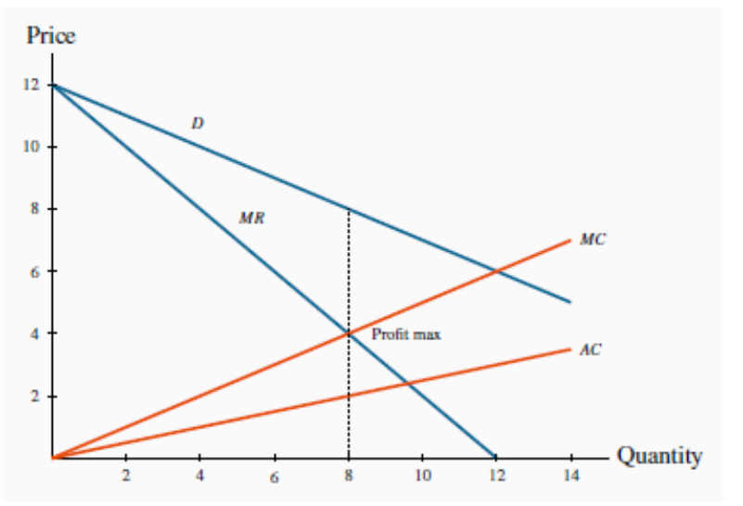
Advanced: Solving for the equilibrium
Looking at the MR curve its equation is clearly MR = 12 – 1*Q
The AC curve goes through the origin and is AC = (1/4)*Q
The MC has form MC = (1/2)*Q
Equate MR = MC and obtain Q = 8
At Q = 8 the price must be $8
Can we calculate profit? Yes: (P – AC) = $6; hence at Q = 8, profit = $48

Slide 17
Non Linear Costs
In the previous example the cost curves were straight lines – as were the demands.
There is no need for this to be the case
Illustrate…….

Slide 18
The Monopoly Equilibrium: Profit Calculation
$
Elastic Portion of Demand Curve
The profit max price is read from the demand curve
MC
P_{E}
ATC – We need to know cost conditions to compute profit
Profit
C_{E}
MR
D
Q_{E}
Quantity

Slide 19
The Monopolist’ s Choice of Plant Size
To illustrate we will assume CRS – a doubling of output involves an exact doubling of costs.
$
MC₁
MC₂
ATC₁
ATC₂
LAC = LMC as a result of constant returns to scale everywhere
Quantity

Slide 20
Plant Size in the Long Run
Profit max rule is always MR = MC, whether long run or short run
P₁
To establish Q* we need the MR curve
P₂
MC₁
MC₂
In the short run with plant size 1, optimum is Q₁ and P₁.
ATC₁
D
ATC₂
$
LAC = LMC due to constant returns to scale
MR
Q₁
Q₂
Long-Run Choice: Q₂ = Q*
using plant size 2, and P₂ = P*
Quantity

Slide 21
Monopoly Inefficiency
Objective: to compare the output produced by monopolist with the efficient output – produced in perfect competition
  Recall under perfect competition that profit maximization implies: P = MC
  Hence, if the demand curve reflects the true marginal value and if the MC represents true social cost, the profit maximization outcome represents a social optimum
  It reflects an efficient use of resources because out is produced up to the point where the true cost = the true benefit
  Illustrated…

Slide 22
Monopoly Output Inefficiency
The monopolist produces less and charges a higher price
$
DWL arises because value > MC for units Q_{PC} - Q_{M}
D
P_{M}
MC
Perfect competition market output
ATC
DWL
P_{PC}
MR
Assume this also equals the PC market supply curve
CRS for the monopolist implies LAC = LMC horizontal
Q_{M}
Q_{PC}
Quantity

Slide 23
Price Discrimination
Price discrimination involves charging different prices to different consumers in order to increase profit
Conditions for price discrimination
  The seller must be able to screen or segregate the market into those willing to pay more and those willing to pay less
  Resale must be impossible or impractical
Price discrimination may actually reduce the deadweight loss in the case of monopoly – because more may be sold in total

Slide 24
Profit Maximization through Price Discrimination
 | Uniform Price = $5 | Uniform price = $12 | Price discrimination (different prices)
No. of customers | 100 | 50
Total revenue | 500 | 600 | 850 (= 50*$12 + 50*$5)
Total costs | 140 | 140 | 140
Profit | 360 | 460 | 710
Example of two groups of movie goers: those willing to pay the full price of $12 and those willing to pay the reduced price of $5 (teens and seniors)
Discrimination increases profit
A single price of $5 yields a profit of $360
A single price of $12 yields a profit of $460
A twin price (discrimination) yields $710

Slide 25
Price Discrimination at the Movies
Efficient Output:
Since MC = 0 in this example (we have only fixed costs), efficiency requires an output where every customer’s demand is met
$
Demand
12
5
DWL
MC
50
100
Quantity
If only 50 customers buy there is a DWL = $5*(100-50) = $250

Slide 26
Perfect Price Discrimination
This is an imaginary case of where the producer could charge a different price to each buyer, implying D = MR!
$
It illustrates that if the supplier has more information about buyers, and can segregate them, his profit max choice comes closer to producing the efficient output Q*
P₀
TR for the perfect
price discriminator
MC
D=MR
Q*
Quantity
Q* is now the profit maximizing output – it is also the social optimum

Slide 27
Pricing in Segregated Markets
Two markets defined by D_{A} and D_{B} and associated MR curves
Cost conditions: for simplicity let MC be constant
P_{A}
D_{B}
To maximize profit produce where MC = MR_{A} = MR_{B}, and discriminate between the two markets by charging prices P_{A} and P_{B}.
P_{B}
D_{A}
MC
MR_{B}
MR_{A}
Q_{B}
Q_{A}
Quantity

Slide 28
Cartels - Acting like a Monopolist
A cartel is a group of producers who co-operatively reduce output with the aim of increasing profits
It behaves like a monopolist
Cartel instability
Cartels can break down as member firms usually have an incentive to expand output (against the agreement), resulting in a lower market price
Cartels within individual economies are almost universally illegal
But even legally sanctioned cartels may crumble ……

Slide 29
Cartels Sometimes Die
Most modern cities have a legal taxi cartel
Entrants must purchase a permit (medallion) to operate and permits are restricted by the city authority – under pressure from existing permit holders
In New York City taxi medallions were trading for $1m in 2012, today they trade at about one half of that price
In Toronto medallions were traded at $300,000 in 2012, but are on offer for about $100,000 in 2017
Information of prices in Canada can be found on www.kijiji.ca
The culprit? New technology in the form of ride sharing – Uber, Lyft and their international counterparts

Slide 30
Cartelizing a Competitive Industry
Monopoly output with multiple plants (cartel)
$
Perfectly competitive output and price, if S is the industry supply curve
MC = S
P_{M}
If MC is the joint supply curve of the cartel, market price is higher and less is produced than under perfect competition
P_{PC}
D
MR
Q_{M}
Q_{PC}
Quantity
Cartel Instability: there is an incentive for firms to break the collusive agreement and sell more – at Q_{M} the MC is less than the price and profit could be increased for an individual firm if other firms do not also increase output

Slide 31
Monopolies and Rent-Seeking Behaviour
Rent seeking is an activity that uses productive resources to redistribute rather than create output and value
  Lobbying the government to reduce competition
But rent seeking has a resource cost or time cost
  The work of lobbyists does not result in more output
Who pays for rent seeking?
  It gets incorporated into the cost structure of firms who have a degree of market power
  Consumers also pay in the form of higher prices

Slide 32
Rent Seeking and Costs
A monopolist seeking to maintain his monopoly position devotes resources to restricting competition. This will increase the firm’s cost
$
While it may reduce his profits in the short run, it helps maintain the monopoly status in the long run
MC
P_{M}
ATC’
ATC
MR
D
Q_{M}
Quantity

Slide 33
Monopoly, Technology and Innovation
Invention is the discovery of a new product or process through research
Innovation is the introduction of a new product or process
Do monopolies have a greater tendency to invent and innovate?
  Monopolists say yes, but empirical evidence does not support this claim
Patent laws: designed to foster innovation by granting monopoly production rights for a period of 10-15 years

Slide 34
Chapter Summary
A pure monopoly is a structure where a single supplier produces for the whole market
Monopolies can arise for several reasons
The monopolist faces a downward-sloping demand curve; therefore the marginal revenue from additional sales declines
A profit-maximizing monopolist should set MR = MC
A monopoly will result in an inefficient market output and deadweight loss
A discriminating monopolist is one who can charge different prices to different consumers

Slide 35
Chapter Summary
A discriminating seller must be able to segregate her customers and prevent resale
Perfect price discrimination involves charging a different price to every buyer or for every unit sold
Cartels involve groups of producers attempting to act as a monopolist. Cartels tend to be unstable
Monopolies give rise to rent-seeking behavior that wastes resources
Monopoly, despite its profits, does not produce more research and development than other market structures with a limited number of large firms

Slide 36
Demand, Marginal Revenue and Total Revenue
Profit maximization point must lie on the elastic segment of the demand curve.
Price
Demand curve: P = 16 – 2Q
16
Marginal revenue has twice the slope of D: MR = 16 – 4Q
10
Midpoint of D: price elasticity = -1, TR is a maximum, and MR = 0
Marginal Cost: MC = 1 + 1Q
3
4
8
Profit is maximized when MR = MC
Quantity

