Slide 1
Chapter 7
Firms, Investors, and Capital Markets
Principles of Microeconomics
Douglas Curtis & Ian Irvine

Slide 2
Learning Outcomes
By the end of this chapter you should understand:
The several forms of business organizations
Corporate goals – the role and determination of profit
Risk, uncertainty and the investor
Risk reduction through pooling and diversification

Slide 3
Business Organization Key Terms
Sole proprietor
  The single owner of a business
Partnership
  A business owned jointly by two or more individuals, sharing the profits and jointly responsible for any losses
Company or Corporation
  An organization legally allowed to trade and produce, and having limited liability
Shareholders
  Individuals who invest in companies and therefore are the owners

Slide 4
Business Organization Key Terms
Dividends
  Payments made from after-tax profits to shareholders
Capital gains
  Income resulting from selling shares at a price higher than the original purchase price
Limited liability
  The liability of the company is limited to the value of the company’s assets
Retained earnings
  Profits retained by a company for reinvestment and not distributed in dividends

Slide 5
Business Organizations
Use capital, labour and human expertise to produce a good, to supply a service or to act as an intermediary with the objective of earning a profit
Businesses are required to produce annual income statement that accurately describes the operation of the company

Slide 6
Business Income Statement
Net income from operations of $3,450m (represents after-tax profits).
Bank of Montreal financials 2016
Total operating revenue | $19.2b
Net income post-tax | $3.45b
Shares outstanding | 649m
Net income/share | $5.31
Dividends/share | $2.64
Share price | $63.60
Market capitalization | $41.3b
649 million shares outstanding at end 2016
If the $3,450m were allocated over all such shares, $5.31 would go to each share
Of the $5.31 earnings per share, $2.64 was distributed to shareholders and $2.67 was retained inside the company

Slide 7
Profit, Ownership, and Corporate Goals
Economists believe that profit maximization accurately describes a typical firm’s objective
Corporate goals sometime deviate from profit maximization
  Principal-agent relationship
    Management (agent) different from ownership (principal)
  Principal-agent problem
    If the principal cannot easily monitor the actions of the agent, the agent may not always act in the best interests of the principal

Slide 8
Accounting and Economic Profit
Critical difference between economic profit and accounting profit is the treatment of opportunity cost
The accountant focuses upon financial flows, the economist includes opportunity cost in addition
Opportunity cost must include a wage to a partner or proprietor that reflects her market opportunities
  Example: An owner who can earn $80,000 in the market place, but just pays herself $30,000 incurs an opportunity cost of $50,000
Opportunity cost must also include a market return on any private capital invested in the firm
  Example: If an owner invests $200,000 in her firm, the opportunity cost of that choice is the return that amount could safely earn in the market

Slide 9
Economic Profit - Example
 | Revenue | Accounting costs | Opportunity cost
 | 110,000
Wages |  | 35,000
Materials |  | 50,000
Capital at 4% |  |  | 10,000
Labour |  |  | 20,000
Total cost |  | 85,000 | 115,000
Profit |  | 25,000 | -5,000
Capital cost based upon having invested $250,000 in the firm (physical capital) that could earn 4% in the market, and an alternative wage of $55,000. These costs are also called implicit costs – as opposed to explicit costs.

Slide 10
What happens to profits in Canada?
Are profits all distributed as dividends to Canadians?
  No
  Some are retained by the firm
  Some go to foreign owners

Slide 11
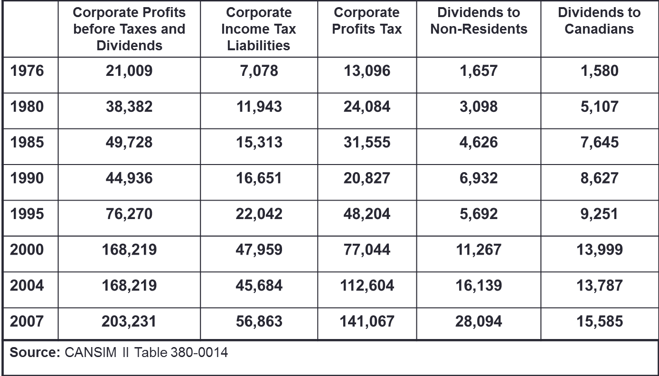
Corporate Profits in Canada in $ millions
Corporate profits fell in 1990, the worst year of the early 1990s recession
Significant amount of foreign ownership in the Canadian corporate sector as shown by high amounts of dividends to non-residents

Slide 12
Key Ideas in Risk and Investment
Individuals invest in ventures and enterprises that will generate a return for the investors – the investors hope
Some enterprises are successful, others fail; how can an individual invest savings to reduce the risk of loss?
The central idea is that individuals diversify risk by avoiding the temptation to put all of their eggs in the one basket

Slide 13
Risk and the Investor - Key Terms
Fair gamble
  On average yields a zero profit
Example 1:
  A coin toss game yielding $0 to a participant on ‘heads’ and $10 on ‘tails’ that has a fee for play of $5 is fair.
    (0.5 * $0 + 0.5 * $10 = $5)
Example 2:
  A fire insurance policy costing $1,000 to insure a $100,000 home is fair if the house may burn down one time in a hundred
    (0.01 * 100,000 + 0.99 * $0 = $1,000)
Example 3:
  If the Casino in Las Vegas pays out $0.95 for every $1.00 bet, the casino is not offering fair odds.

Slide 14
Risk and the Investor - Key Terms
Risk-averse person
  Prefers to avoid risk, but may choose to bet or gamble if the odds are sufficiently in their favour, despite their inherent dislike of risk.
  Will avoid a fair game or fair gamble
Risk-neutral person
  Only interested in whether the odds yield a profit on average, and ignores the dispersion in possible outcomes
  A risk averse person will pay more than the ‘fair gamble’ insurance premium in order to insure their house.
  If the fair premium is $500, then a home owner who is willing to pay $1,000 per year for insurance is more risk-averse than an individual willing to pay $800.

Slide 15
Are Venture Capitalists Risk Averse?
Investors in Silicon Valley pour vast sums of money into corporations that are little more than an idea and have no cash flow.
Are such investors risk lovers or could they be risk averse?
Surprisingly, they might be risk averse

Slide 16
Risk Pooling and Spreading
Risk pooling
  Aggregates independent risks to make the aggregate less uncertain and thereby increases average utility:
    Individuals pool their risk by investing their savings in several different corporations
Risk spreading
  Works by reducing the stake of each participant: insurers reduce their risk exposure by spreading the risk to other insurers:
    Lloyds of London will spread the risk of a supertanker sinking or an oil well blowing out among other insurers
  Illustrations…

Slide 17
Risk Spreading
If an insurer is asked to insure a nuclear reactor the insurer may not be able to assume all of the risk – the potential damage is too great
Thus the insurer, rather than refusing the opportunity for profit, may chose to reduce her risk exposure….
…. by spreading the risk to other firms in the insurance industry. The initial insurer offloads much of the risk to a group of insurers

Slide 18
Risk Pooling and Individual Incomes
 |  | IT Consultant
 |  | Good month 50% | Bad month 50%
Musician |  | $5,000 | 0
Good month 50% | $5,000
Bad month 50% | 0
By pooling their investments, each party reduces the variation in their monthly income
$5,000
$2,500
$2,500
$0
Alone: 50% of the time $5,000 and 50% of the time $0
Together: 25% of the time $5,000, 50% of the time $2,500, and 25% of the time $0

Slide 19
Independent Risks
In the previous example the risk incurred by each individual was independent of the risk incurred by the other
This means that the income profile of the IT consultant does not depend upon whether the musician has a good or bad month
In everyday life this may not be always true – macroeconomic conditions may impact the incomes of both individuals in a similar manner - this is sometimes called system risk
In stock markets, the movements of many of the stocks may be correlated – when one company in the mining sector has a good year, other companies in that sector may also; the returns are not completely independent

Slide 20
Uncertainty and Asset Returns
The real return
  is the nominal return minus the rate of inflation
Real return to investing in a company share/stock
  is the sum of the dividend and the capital gain or loss, adjusted for the rate of inflation

Slide 21
Financing the Risky Firm: Diversification
The capital market is the set of financial institutions that funnels financing from investors into bonds and stocks
A portfolio is a combination of assets that is designed to secure an income from investing and to reduce risk
Diversification reduces the total risk of a portfolio by pooling risks across several different assets
Total degree of risk can be measured by the variance

Slide 22
Diversification Example
Investor can invest in two stocks with profiles:
Investment Strategy | Possible Outcomes in Dollars
(i) $200 in oil | 220 (pr. = 50%) |  | 200 (pr. = 50%)
(ii) $200 in banks | 220 (pr. = 50%) |  | 200 (pr. = 50%)
(iii) $100 in each | 220 (pr. = 25%) | 210 (pr. = 50%) | 200 (pr. = 25%)
The returns on these stocks are independent of each other
Each stock has a 50% chance of yielding a 10% return and a 50% chance of yielding 0%
Conclude: diversification (by investing in both oil and banks) reduces the risk: the probability of ‘extreme’ outcomes diminishes.

Slide 23
Extreme Stock Price Variation
Imagine, in the preceding example that the investor could invest part of her savings in a third stock with the same or a similar profile
If she now invests in three stocks, rather than two or one, then the probability of three stocks all performing well or all performing badly is smaller than if just two stocks are chosen. Hence extreme high or low returns have lower probabilities – the risk of extreme values declines through added diversification
In the preceding example the variation was small. In real life the variation can be far beyond expectations
Examples………

Slide 24
Nortel Stock Price 1995-2005
This is an illustration of investment risk, as the payoff changed dramatically over time; it is desirable to attempt to diversify away from this risk

Slide 25
Most stocks exhibit considerable price variation; hence investors who are risk averse avoid putting all of their eggs in the one basket

Slide 26
Check out Stock Market Variation
An excellent site for stock information is Yahoo finance:
https://ca.finance.yahoo.com
Question: What do financial advisors do?
Many people think that they are good at ‘picking winners’ in the stock market.
In fact that is not their purpose. Some advisors will pick more winners than losers, others more losers than winners.
The principal value of an advisor is to prevent the investor (client) from putting all of her eggs in one basket! By doing that, the investor could make a very large return, or lose her life savings. Financial advisors should minimize risk by diversifying into different stocks

Slide 27
Advanced: The Portfolio Variance
The variance is a measure of how dispersed the outcomes are – how far the outcomes are from the average outcome
  It is a weighted sum of the squared deviations from the mean. Let us apply it to the earlier example:
  In each strategy the mean return is $210
  Strategy (i):
    Since each outcome has an equal probability the weights are 0.5
      Variance = 0.5 * (220 – 210)² + 0.5 * (200 – 210)² = 100
  Strategy (ii): Yields the same result as strategy (i)
  Strategy (iii):
    Outcomes have different weights here:
      Variance = 0.25*(220 – 210)² + 0.5*(210-210) + 0.25*(200 – 210)² = 50

Slide 28
Chapter Summary
There are three main types of firm:
  Self-employed sole traders
  Partnerships
  Companies/Corporations - owned by shareholders
Important variable for firms are:
  Revenue
  Costs
  Profits – directed to dividends or retained earnings
Capital gain is the difference between the purchase value of a stock and its current market value
Firms are assumed to maximize profits

Slide 29
Chapter Summary
The principal-agent relationship refers to the relation between a firm's owners and its managers
  Principal agent problems occur when management does not maximize profits
Firms are financed by investors who channel their funds through capital markets
Risk pervades economic life
Risk-aversion arises because individuals have diminishing marginal utility
  Most investors seek to reduce risk
  Fair gambles are typically refused by risk-averse individuals in favor of less risky investments

Slide 30
Chapter Summary
Insurers pool risks that are substantially independent and spread risk across many other insurers
Risk reduction is a driving force in investment strategies
Investment strategies depend on individual’s willingness to trade off higher risk with higher return
Portfolio diversification provides investors with the opportunity to invest some of their funds to highly risky ventures
Not all risk can be diversified away: remaining risk is called system risk, and depends upon macroeconomic conditions

