Slide 1
Chapter 6
Consumer Choice and Demand Decisions
Principles of Microeconomics
Douglas Curtis & Ian Irvine

Slide 2
Learning Outcomes
By the end of this chapter you should understand..
Rationality and Choice
Consumer choice with measurable utility
Consumer choice with ordinal utility
Indifference analysis: the budget constraint and tastes
Consumer optimization
Applications: subsidy and income transfer policies

Slide 3
Rational Choice
Individuals have goals or objectives that they wish to attain
They maximize their personal well-being – or the well being of their family, as one goal
Self-interest does not preclude philanthropy; individuals may get satisfaction from giving to others
We do not assume that individuals have every single piece of information in the universe in their head; nor that brains are super computers
We do assume that individuals act in a way that is consistent with achieving their objectives
Behavioral psychology has influenced economists’ thinking greatly in recent decades: ‘nudges’ are found to be influential in decision making
Consumer theory is well capable of dealing with addictions and habits

Slide 4
Consumer Choice with Measurable Utility
Cardinal utility is a measurable concept of satisfaction – not so far fetched
Total utility, TU, is a measure of the total satisfaction from consumption derived from consuming all of the units over a time period
Marginal utility, MU, is the addition, or increment, to total utility created when a small increase of a good or service is consumed
  MU = ΔTU/Δconsumption
We assume that marginal utility is diminishing
  Each additional unit consumed yields less additional utility than the one consumed right before it

Slide 5
Utilities from Snowboarding and Jazz
Table 6.1 Utils from snowboarding and jazz
1 | 2 | 3 | 4 | 5 | 6 | 7
Visit number | Total snowboard utils | Total jazz utils | Marginal snowboard utils | Marginal jazz utils | Marginal snowboard utils per$ | Marginal jazz utils per $
1 | 72 | 52 | 72 | 52
2 | 132 | 94 | 60 | 42
3 | 182 | 128 | 50 | 34
4 | 224 | 156 | 42 | 28
5 | 260 | 180 | 36 | 24
6 | 292 | 201 | 32 | 21
7 | 321 | 220 | 29 | 19
Price of snowboard visit = $30, Price of jazz club visit = $20
Graphically….

Slide 6
Total Utility
Total utility increases with the amount consumed

Slide 7
Marginal Utility
Marginal utility declines with the amount consumed, but is always positive

Slide 8
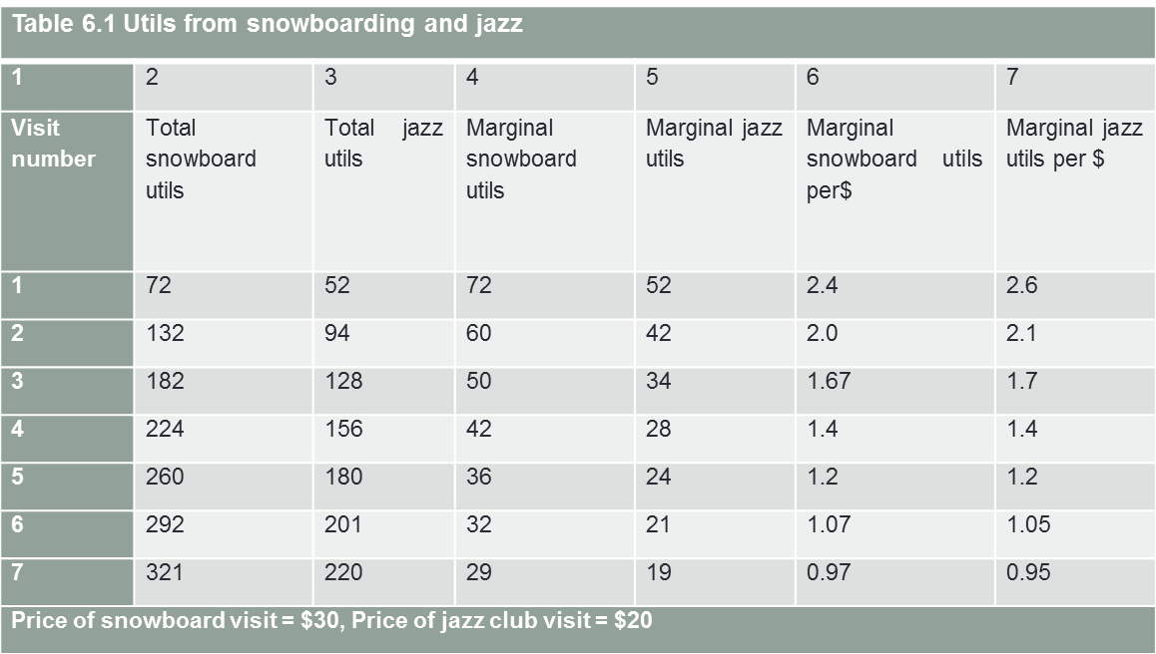
Consumer Choice
The consumer should allocate income where it yields the greatest utility per dollar
  Hence, consumers should initially buy a unit of jazz
  Then a unit of snowboarding; then another unit of jazz, etc…
  … until entertainment budget is exhausted
First purchase
When the budget is exhausted, 4 units of each are consumed and MU/$ is equal
Utility is maximized here because there is no reallocation of expenditure that can increase utility

Slide 9
Consumer Choice and Demand Decisions
A consumer equilibrium occurs when marginal utility per dollar spent on the last unit of each good is equal
If this equality does not hold, then the consumer can increase TU by making switches

Slide 10
Consumer Choice and Demand
Note that the consumer chooses the quantities based on marginal utility rather than on total utility
  Think of this as the budget allocation rule
Assume that all income is spent - we are not concerned with the savings decision here

Slide 11
Utility to Demand
One purpose of analyzing consumer choice is to derive the demand curve for an individual
Consider the equilibrium condition MU_{s}/P_{s}=MU_{j}/P_{j}
  If the price of snowboarding rises, the ratio on the left side decreases
  Equilibrium can be restored if the MU of snowboarding rises as well
  Given the law of diminishing marginal utility, this can occur only if its quantity falls
  Hence an increase in price reduces the quantity demanded. This result is called the Law of Demand

Slide 12
Utility to Demand (cont..)
We started with an increase in the price of snowboarding, and ended with a decrease in the quantity demanded of snowboarding
This is the law of demand at work:
  Holding all other factors constant, as price increases quantity demanded decreases
Illustration: Assume the price of snowboarding increases to $40 from $30. Recompute columns 6 & 7 of table 6.1. New equilibrium is S = 3, J = 4
Let us plot these two outcomes..

Slide 13
Utility to Demand
Price increases, quantity falls
Price falls, quantity increases
The Law of Demand…
Other things equal, the more of a good demanded, the lower its price
The resulting demand curve

Slide 14
Indifference Analysis – Ordinal Utility
This approach to consumer choice involves a different assumption about utility
  We assume consumers can order bundles of goods in accordance with the satisfaction or utility the bundles generate
  This is the concept of ordinal utility, as opposed to cardinal utility
There are two elements to this analysis
  The budget constraint, which defines what is affordable or feasible
  Indifference curves, which reflect preferences or tastes

Slide 15
Indifference Analysis: The Budget Constraint
The first primary element is the budget constraint, which is the locus of all of the combinations of the two goods that the consumer can buy with her income
Stretching one’s dollars: Points beyond the budget constraint are not affordable, while points on it are just affordable

Slide 16
The Budget Line
Snowboarding
D = I / P_{S}
A and B are affordable combinations
P_{S} S + P_{J} J = I
$30 S + $20 J = $200
A
Non-Feasible Region
4
2 {
Slope = - (I / P_{S}) / (I / P_{J})
= - P_{J} / P_{S}
= - 2 / 3
B
2
K
}
Feasible Region
3
Jazz
0
4
7
C = I / P_{J}

Slide 17
Indifference Analysis: Tastes
Indifference analysis is the counterpart for the consumption schedules that were employed for the cardinal utility approach:
  The TU and MU variables
Assume that consumers prefer more to less
The tastes can be represented graphically by an indifference map
In the graph to follow, the axes are the same as they are for the graph of the budget line: snowboarding on the vertical axis and jazz is on the horizontal axis
The figure examines the consumer’s ranking of bundles of the two goods

Slide 18
Indifference Analysis – Tastes
Snowboarding
Region preferred to R
W
L
Points like L are preferred to R, since more of each good is consumed at L
But points such as W and T are difficult to compare without a knowledge of tastes
R
V
T
K
Jazz

Slide 19
Indifference Curves
An indifference curve defines combinations of goods and services that yield the same level of satisfaction to the consumer
  She is indifferent between all bundles on a given curve
An indifference map is a set of indifference curves, where curves further from the original denote a higher level of satisfaction
  This map describes the consumer’s tastes for the two goods over all consumption levels

Slide 20
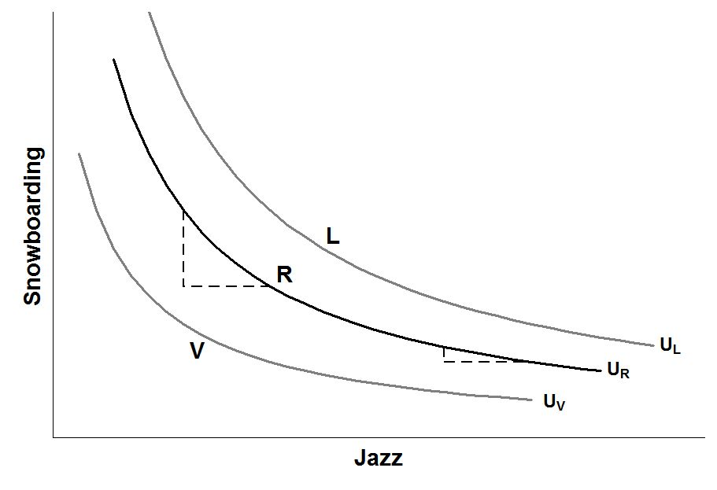
Indifference Curves
From M, if the individual receives CR of jazz, how much snowboarding will he sacrifice to stay on U_{R}? Answer: MC.
Ask same question, starting at N. Answer is NF
Declining MRS:
Although CR = FH, CM > FN
M
C
N
H
F
Interpretation…

Slide 21
Indifference Curves - Properties
Curves further from the origin reflect higher levels of satisfaction and vice versa:
  Because more is preferred to less
Negatively sloped, slope = marginal rate of substitution (MRS)
  Less of one good requires more of the other to maintain a given level of satisfaction
Indifference curves cannot intersect

Slide 22
Indifference Curves - Properties
Convex shape away from the origin, reflecting a diminishing marginal rate of substitution:
  They become flatter as one moves from left to right
  Due to the law of diminishing marginal utility: each additional unit of jazz consumed yields a lower MU than the unit consumed right before it
  Conversely, MU is high when consumption levels are low

Slide 23
Optimization
The consumer’s choice is determined by the highest indifference curve attainable, subject to the budget line
  This gives the highest possible indifference curve, and hence highest level of satisfaction, given the consumer’s income and prices
  This occurs at the point where the budget line just attains that indifference curve – where they are tangent
  Consequently, slope of the indifference curve = slope of the budget line
  Mathematically, MRS = P_{J} / P_{S}
  Illustration…..

Slide 24
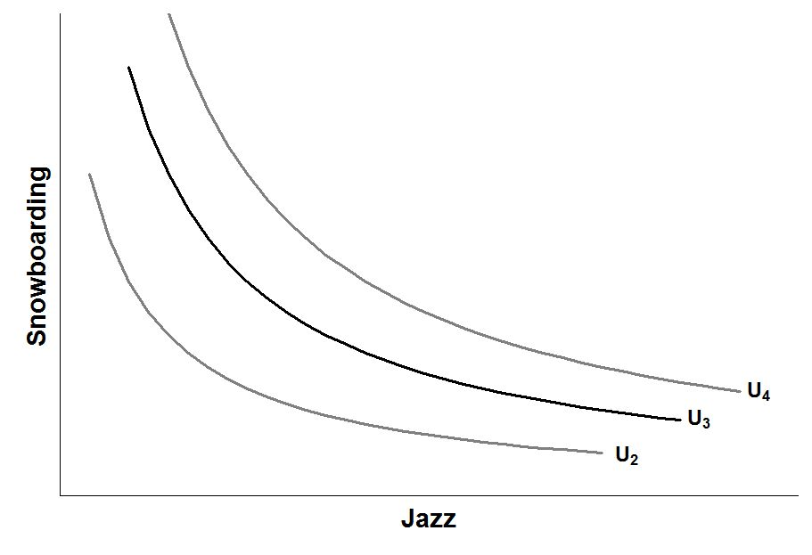
Consumer Optimum
The budget constraint constrains the individual to points on or below HK
The highest level of satisfaction attainable is U₃, where the budget constraint just touches (at E)
H
F
At this optimum, the slope of the budget constraint (P_{J} / P_{S}) equals the MRS
E
G
K

Slide 25
Income Adjustments
If income rises and the prices remain the same, the budget line shifts outward in parallel fashion
  The consumer can afford more of both goods
  He will reach a higher indifference curve, and hence a higher level of satisfaction
  Graphically….

Slide 26
Income Adjustments
The budget constraint shifts from I₀ to I₁ as income rises
A higher level of utility, U₄, is now attainable—more jazz and snowboarding are consumed here, implying both are ‘normal’ goods.
S₁
S₀
J₀
J₁
I₀
I₁

Slide 27
Price Adjustments
If the price of jazz rises, the budget line rotates inward, but the Y-intercept does not change
  The budget line becomes steeper
  The consumer can afford less
  He will reach a lower indifference curve, and hence a lower level of satisfaction
  The quantity of jazz consumed will fall – the law of demand
  The quantity of snowboarding may rise or fall
  Illustration…..

Slide 28
Price Adjustments
The budget constraint rotates from I₀ to I₂ as the price of Jazz tickets rises.
A lower level of utility, U₂, is now attainable. Less Jazz and more snowboarding will be consumed.
S₂
S₀
I₂
I₀
J₂
J₀
These goods are substitutes – Why?

Slide 29
Applications of Indifference Analysis
We have seen that indifference analysis can illustrate normal and inferior goods
Also we have seen substitutes and complements illustrated
Can we illustrate what product marketers attempt to achieve?
Let us also develop the concepts of income and substitution effects

Slide 30
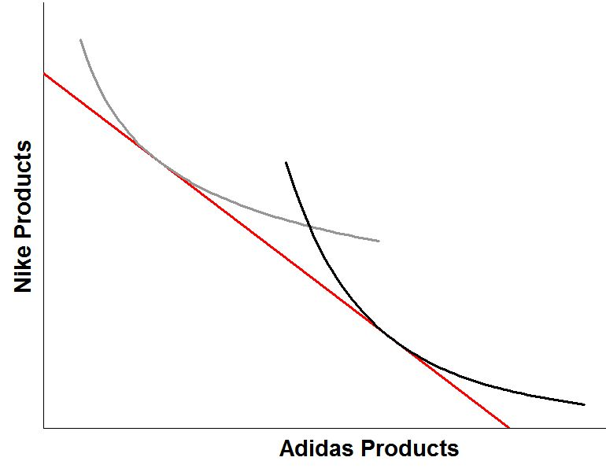
Marketing and Tastes
Nike tries to influence consumers to have stronger preferences for Nike products
Nike tries to move the consumer’s indifference curve so that an equilibrium such as B is optimum
B
A
A consumer in equilibrium at point A purchases more Adidas products than Nike products

Slide 31
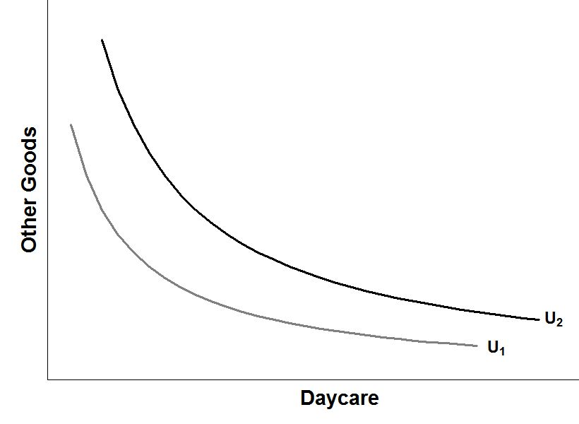
Policy Application: Income Transfer
The increase in income from the government transfer shifts the budget constraint outwards from I₁ to I₂ increasing the consumption of daycare and other goods
E₂
E₁
But perhaps the government would like to see less additional expenditure on other goods and more on the targeted good……….
I₁
I₂

Slide 32
Policy Application: Price Subsidy
Subsidizing the targeted good, by lowering its price, changes the budget constraint from I₁ to I₂
This induces the consumer to direct expenditure relatively more towards daycare and relatively less towards other goods
E₁
E₂
I₁
I₂
Question: are these goods substitutes or complements as they are illustrated?

Slide 33
Application: Price subsidy versus income transfer
Subsidizing the targeted good, by lowering its price, changes the budget constraint from I₁ to I₂
I₃
An income transfer to I₃ that enables the consumer to buy the bundle E₂ yields a higher level of utility than the subsidy.
E₁
E₂
I₁
I₂

Slide 34
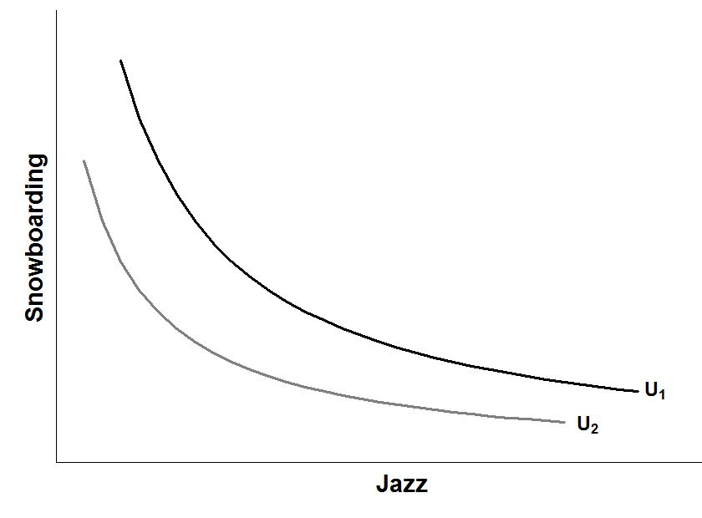
Advanced: Income and Substitution Effects
Substitution Effect = E₁ to E’ Income Effect = E’ to E₂
An initial equilibrium E₁ is disturbed by an increase in P_{J} that rotates the budget constraint from I₁ to I₂
E’
The new equilibrium, E₂, has higher consumption of snowboarding and lower consumption of jazz
E₂
E₁
Shift new budget constraint parallel until it is tangent to U₁.
I₂
I₁
J₁

Slide 35
Chapter Summary
Total utility is the amount of satisfaction obtained from consuming all of the units
Marginal utility is the increment to total utility obtained from consuming one more unit
Law of diminishing marginal utility states that marginal utility diminishes as more is consumed
With the cardinal utility approach, consumers can actually measure how much satisfaction they obtain from consumption
An optimizing individual chooses a consumption bundle so that the marginal utility per dollar is equal for the last unit of each good consumed
A change in income or prices requires an optimizing consumer to reallocate the available budget so that that equilibrium condition holds

Slide 36
Chapter Summary
The law of demand posits that there is an inverse relationship between price and quantity demanded, and it is derived from the law of diminishing marginal utility
The budget constraint states that the sum of expenditures on all goods must not be greater than the total income
Consumer tastes can be represented by a map of non-intersecting, negatively-sloped indifference curves
They exhibit a diminishing MRS, which gives them their convex shape

Slide 37
Chapter Summary
Utility-maximizing consumers choose the highest possible indifference curve permitted by their budget constraint; here, the MRS equals the price ratio
If prices remain fixed, an increase in income shifts the budget constraint outward. Consumption of normal goods will rise
A change in prices causes a rotation of the budget constraint. Consumption of goods whose price has risen will fall, and vice versa
This framework has applications for government income support programs and price subsidy programs

