Slide 1
Chapter 3
Supply and Demand
Principles of Microeconomics
Douglas Curtis & Ian Irvine

Slide 2
Learning Outcomes
By the end of the chapter you should understand…
The market and trading
Demand and supply curves: concepts and equilibrium solutions
Non-price determinants of demand
Non-price determinants of supply
Simultaneous shifts in supply and demand
Free and managed markets
From individuals to markets
Useful techniques – demand and supply equations

Slide 3
Some Key Terms
Market: a set of arrangements by which buyers and sellers interact in order to exchange goods or services
Demand: the quantity of a good buyers wish to purchase at each conceivable price
Supply: the quantity of a good sellers wish to sell at each conceivable price
Illustrated…
Notes:
See Sections 3-1 and 3-2 in the main text.

Slide 4
Some Key Terms
Quantity demanded is the exact quantity purchased at a given price
  Think in terms of one value
Quantity supplied is the exact quantity supplied at a given price
  Think in terms of one value
At the equilibrium price:
quantity demanded = quantity supplied
We say that this price clears the market

Slide 5
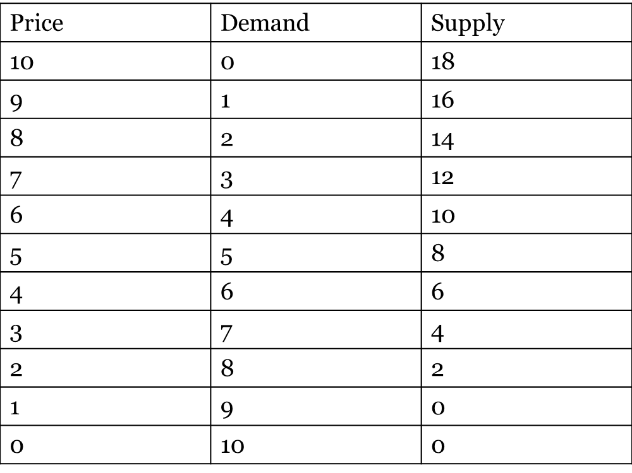
Demand and Supply of Natural Gas
Quantity demanded
Demand
Similarly; supply and quantity supplied
Note: “Other Things Being Equal” Assumption

Slide 6
The Equilibrium Price
6
Price | Demand | Supply | Excess Demand/Supply
10 | 0 | 18
9 | 1 | 16
8 | 2 | 14
7 | 3 | 12
6 | 4 | 10
5 | 5 | 8
4 | 6 | 6
3 | 7 | 4
2 | 8 | 8
1 | 9 | 0
0 | 10 | 0
Supply > Demand
Excess Supply
Equilibrium
Demand > Supply
Excess Demand
Ch 3.2

Slide 7
Demand and Supply Curves
The demand curve is a two-dimensional graph of the demand function
The supply curve is a two dimensional graph of the supply function
When drawing them, all factors except price are held fixed

Slide 8
The Demand Curve
Each point defines a pair of values from the table.
The line through the points is a straight line with vertical intercept value = $10 and slope = -1

Slide 9
The Supply Curve
Each point defines a pair of values from the table.
The slope of this curve is 0.5: For each unit change in the Y variable there is a two-unit change in the X variable.
The line through the points is a straight line with vertical intercept value = $1 and slope = + 0.5

Slide 10
Demand and Supply – The Market
Price
10
Excess Supply at Price Above 4
Supply
E
4
Demand
1
Quantity
6
10
Excess Demand at Price Below 4

Slide 11
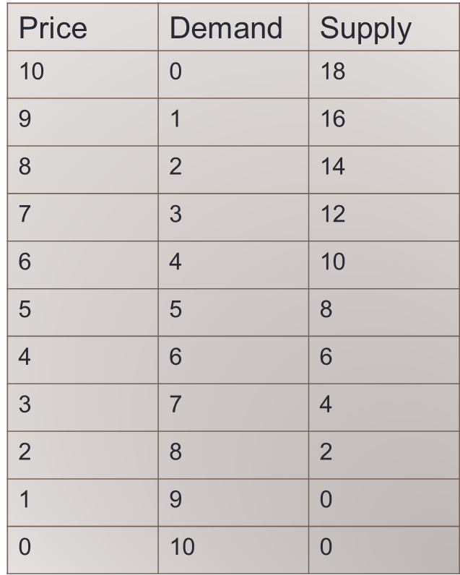


Advanced: Deriving the Demand & Supply Equations
Demand
  Intercept: at Q = 0, P=10
  Slope from the graph = -1
  Slope from the data = (ΔP/ΔQ) = (-1)/(1) = -1
  Hence: P = 10 - 1×Q
Supply
  Intercept: at Q=0, P=1
  Slope (ΔP/ΔQ)
  (1)/(2) = +0.5
  Hence: P = 1 + 0.5×Q

Slide 12
Advanced: Computing the Market Equilibrium
Demand: P = 10 – 1Q
Supply: P = 1 +0.5Q
Market equilibrium
  Demand price = Supply price
  Quantity demanded = Quantity supplied
  10 -1Q = 1 + 0.5Q or 9 = 1.5Q
  Q = 9/1.5 = 6
  Demand (Supply) price at Q = 6
  P = 10 – 1 × 6 = $4

Slide 13
Excess Demand and Supply
At prices below the equilibrium level, quantity demanded exceeds quantity supplied
  ==> Upward pressure on prices
At prices above the equilibrium level, quantity supplied exceeds quantity demanded
  ==> Downward pressure on prices emerges
At the equilibrium, the market is in balance, and there is no incentive to change
Example: too many items sitting on eBay for a long time period leads suppliers to accept a lower price or to post a lower reserve price

Slide 14
Behind the Demand Curve
  What might cause a change in the demand relationship? What might shift the demand curve?
The Prices of Related Goods
Consumer Incomes
Tastes and Networks
Expectations

Slide 15
Behind the Demand Curve
Prices of related goods
  Complementary goods are consumed together
    If the price of one good increases, the demand for the other decreases
    Example: electronic readers and electronic books
  Substitute goods are consumed in lieu of each other
    If the price of one good increases, the demand for the other increases
    Examples: electronic books and paper books; Apple and Samsung smart phones; Netflix and Amazon Prime;

Slide 16
Behind the Demand Curve
Effects of Consumer Incomes
  As incomes rise, the demand for normal goods rises
    Most goods are normal:
    Examples: Restaurants; concerts; clothing
  As incomes rise, the demand for inferior goods falls
    Inferior goods are not necessarily of low quality: Examples: Laundromats; public transit

Slide 17
Behind the Demand Curve
Effects of tastes and fashions
  When goods or services become more popular, the demand expands:
  Example: Clothing of a particular style
Effects of price expectations
  If prices are expected to rise in the future, the demand expands today:
  Example: if we think gold will increase in price tomorrow we buy it today

Slide 18
Shifts in Demand Curve - Summary
A change in the prices of related goods, consumer incomes, consumer preferences or price expectations will each shift the demand curve
A change in price results in a move along the demand curve

Slide 19
Shifts in Demand Curve
A rise in consumer incomes implies that more is demanded at each price: D shifts to D₁
Price
S
P₁
E₁
Supply = Demand (E₀)
P₀
E₀
D₁
If price stayed at P₀ there
would be excess demand,
So, the market moves to a
new equilibrium at E₁.
D
Q₀
Q₁
Quantity
Notes:
See Sections 3-4 and 3-5 in the main text.

Slide 20
Advanced: Shifts in Demand Curve
New Demand Curve. Suppose its new form is:
D₁: P = 13 – 1Q
Supply remains as: P = 1 + 0.5Q
Equating the two yields:
13 – 1Q = 1 + 0.5Q
13 – 1 = 1Q + 0.5Q
12 = 1.5Q
Q = 8
Therefore P = 13 – 1×8 = $5
As a result of demand increase, both the equilibrium quantity traded and the equilibrium price in the market increase

Slide 21
Behind the Supply Curve
Effect of technology
  An improvement expands the supply
Effect of input costs
  A rise in input costs contracts the supply
  A fall in input costs expands the supply
Effect of the number of suppliers
  The greater then number of firms, the greater the supply

Slide 22
Shifts in Supply Curve
New technology
Price
S
More will be supplied at
each price. S shifts to S₁
S₁
P₀
E₀
Supply = Demand (E₀)
P₁
E₁
If price stayed at P₀ there
would be excess supply
D
So, the market moves to a
new equilibrium at E₁.
Q₀
Q₁
Quantity
Notes:
See Sections 3-4 and 3-5 in the main text.

Slide 23
Simultaneous Shifts in Supply and Demand
Example 1…
Price of natural gas
Growth in the demand for energy over time
Technological developments in shale gas discovery and supply
Illustrated…

Slide 24
Simultaneous Shifts in Supply and Demand
Initial equilibrium at E₀
Demand for gas grows
Supply increases due to new discoveries and technology
New equilibrium at E₁
P decreases, Q increases in this example
If the demand shift had been stronger and the supply shift weaker, price might have increased
Price
S
D
E₀
P⁰
S¹
E₁
P¹
D¹
Quantity
Q⁰
Q¹

Slide 25
Simultaneous Shifts in Supply and Demand
Example 2…
A Model of the Housing Market
Was it primarily demand-side or supply-side forces that generated the observed price pattern?
Illustrated…

Slide 26
A Model of the Housing Market
Initial equilibrium in 1997
Vertical supply curve – means what?
Supply in 2002 is less than 1997
Demand was stronger due to higher incomes and lower mortgage rate
New equilibrium
Higher price in 2002, due to pressures on both sides of the market
S₂₀₀₂
S₁₉₉₇
300
E₂₀₀₂
D₂₀₀₂
E₁₉₉₇
D₁₉₉₇
200
50
75

Slide 27
Free Markets and Managed Markets
Price controls are government rules or laws that inhibit the adjustment of price to clear markets:
  Price ceilings
  Price floors
Quotas are physical restrictions on output

Slide 28
Price Ceilings as Rent Controls
Price
Price ceiling is less than the equilibrium price
S
E₀
A price ceiling succeeds in holding down the price but leads to excess demand
P₀
P^{c}
Excess Demand
D
Q^{c}
Q₀
Quantity

Slide 29
Price Floors as Minimum Wage
Price = wage
Price floor exceeds equilibrium price
S
Excess Supply
P^{f}
A minimum wage raises the hourly wage, but reduces the hours of work demanded and leads to excess supply
P₀
E₀
D
Quantity
Q^{f}
Q₀
Unemployment? Think of the impact of a less elastic supply curve

Slide 30
Discussion: Should the Minimum Wage be $15?
Critical issue is the shape of the demand and supply curves for labour
If they are relatively ‘vertical’ around the equilibrium then the excess supply will be ‘small’
But if these curves are more ‘horizontal’ around the equilibrium then there could be substantial excess supply = large unemployment!
The shapes of the curves express the ‘responsiveness’ of each side of the labour market – develop…..
In the chapter on elasticities we will develop all of this more fully

Slide 31
The Effect of a Quota
Equilibrium price is deemed too low to support agricultural producers, so government decides to restrict supply
Price
Supply under quota
S
P^{q}
E₀
P₀
A production quota reduces the supply
D
Q^{q}
Q₀
Quantity

Slide 32
Markets
The forces of supply and demand frequently work to offset or moderate the intended goal of the regulated price or quantity in ways that are predictable
  “the law of unintended consequences” states that policy measures frequently produce impacts that are unintended, and that these impacts may undermine the primary goal of the regulation
  Examples….

Slide 33
Law of Unintended Consequences
Example 1 - Impact of a quota
Quotas are a way of reducing supply and increasing the price.
They are valuable to the individuals who have the right to them.
If the quotas are valuable, a market in quotas may develop – either legally or illegally.
In agriculture, the right to bring milk to market may be worth $30,000 per cow in Canada

Slide 34
Summing Individual Decisions
At P₁ market demand Q₁ = Q_{A1} + Q_{B1}
D_{A}
At P₂ market demand Q₂ = Q_{A2} + Q_{B2}
D_{B}
Market demand is the horizontal summation of the individual demand curves
P₁
D_{market}
P₂
Q_{B1}
Q_{A1}
Q₁
Q₂
Q_{B2}
Q_{A2}

Slide 35
What, How, and For Whom
The market determines
  How much of a good or service will be supplied
  For whom the goods and services are produced
  What goods and services are produced

Slide 36
Chapter Summary
Demand defines a relationship between price and quantity on the part of buyers.
Quantity demand is the particular amount demanded at a given price
Supply defines a relationship between price and quantity on the part of suppliers.
Quantity supplied is the particular amount supplied at a given price
When price equates the quantity supplied and the quantity demanded, the market clears (in equilibrium)

Slide 37
Chapter Summary
Incomes, tastes, networks, and expectations shift the demand curve
A technological innovation or a reduction in input costs will shift/lower the supply curve
Supply and demand curves can shift simultaneously, resulting in a new market equilibrium
Managed markets can involve price ceilings, floors, and quotas
The Law of Unintended Consequences states that market controls may have consequences not envisaged or desired
Market demand is the horizontal sum of individual demands

