Slide 1


Slide 2

Notes:
Survey (chapter outline, headings, structure)
Question (predictions, interests, goals)
Read (chapter sections)
Rehearse (test yourself, paraphrase what you read)
Review (look over what you’ve read and your notes)

Slide 3

Getting the most out of lectures
Listen actively
  Try to establish the main idea and the sub-ideas of each lecture
  Ask questions during/after class
Review your notes before the next class to ensure you understand everything before adding new information
Be prepared! Pre-read your textbook and look over the notes before class

Slide 4


Keep up to date on your readings
  You have about 350 pages to read in 13 weeks
  That works out to about 8 pages per day
  Don’t plan to cram – there’s simply too much material

Slide 5
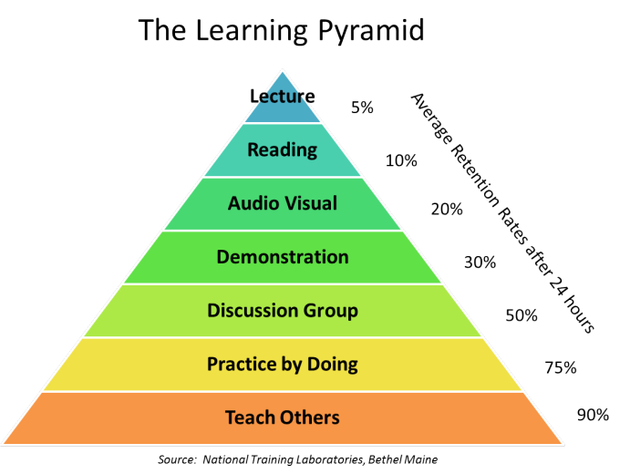
Learning and study strategies
Notes:
Study actively, not passively
Make sure you review the lecture notes regularly. When I say 'review a lecture', I mean you
should do it actively. Just re-reading a lecture doesn't actually help you learn it very well.
Instead, try some of these approaches:
Look over the lecture notes for one lecture, then cover the notes and try to write down everything from them. You may need to break a lecture down into a few components to do this (at least early on in your studying). You can do the same thing with textbook sections.
Try to come up with multiple choice questions on the material, or think of changes that could be made to the practice questions I've posted to make a different answer correct.
Make use of the textbook website.
Explain a concept from class to a friend, classmate, or family member. If you don't have anyone to do that with, explain it to your pet! You'll get a feeling of what concepts you understand well and which ones you need to spend more time on. Teaching is one of the best ways to learn.
Don't spend time copying or highlighting your notes. Rewriting them from memory is a good exercise, but reading and copying the words really doesn't help you learn very well. It exercises your hand, but not your brain!

Slide 6

STUDY IN A GROUP
  Teach others what you know well
  Find the holes in your understanding
  Improve your understanding through active discussion

Slide 7

Two keys to successful studying
Your studying should be active, not passive.
You should spread your studying out. Cramming doesn't work.
Notes:
1 - You want your studying to be similar to the situation you'll be facing in the exam. That means you want to have to draw the information out of your memory during studying, not off the page. In the exam, you won't have the information on the page!
2 - Figure out (DECIDE) what time you can devote to this course (remember, this is in addition to reading the textbook and attending lectures). Maybe try to find 15 minutes 5 days a week to spend actively studying for this course. That's really not much time! You don't have to be at your desk to study - do it on the bus, while you're cooking dinner, or while you're eating breakfast. Get creative with your time - if you're watching TV, try reading a section of a lecture during the first ad segment, then see if you can write down what you read at the next ad segment. (But don't do all your studying in front of the TV!) Once the exam gets closer, you'll spend more time in a day studying for this course, but if you've already been studying a bit every day, you'll find that final push a lot easier.

Slide 8

What strategies have worked for you?
?
?
?
?

