Slide 1
Lecture 2
Review & intro to OMICS
RNA & proteins
Tools for studying DNA

Slide 2
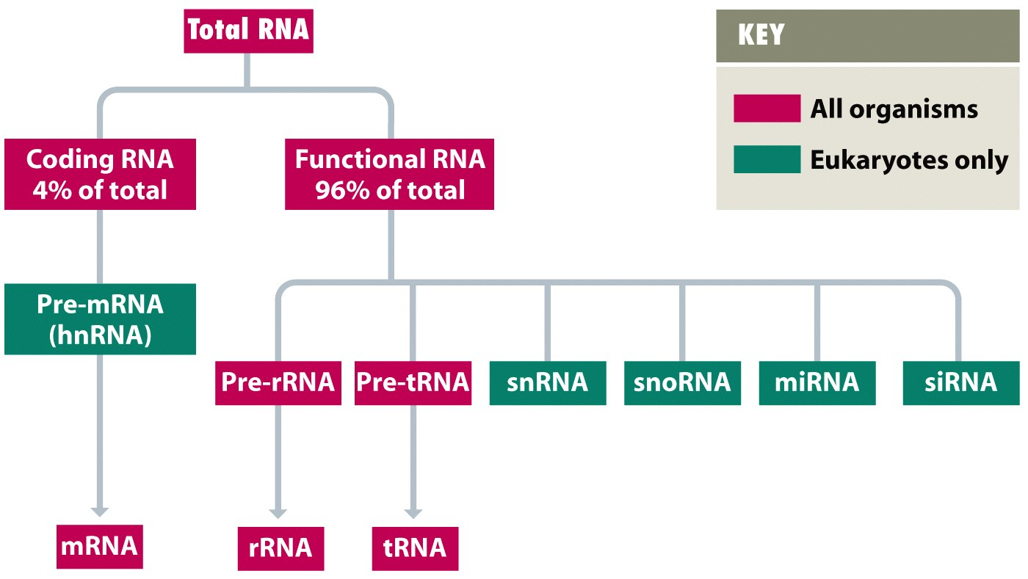
RNA content of a cell
small regulatory RNAs
snRNAs (small nuclear)
- role in splicing
NB: small non-coding (nc) regulatory RNAs are also present in bacteria
sRNAs
Fig.1.12
snoRNA (small nucleolar)
- role in methylation of rRNAs
miRNA (microRNAs) & siRNA (short interfering RNAs)
- role in regulation of expression of individual genes
lncRNA long non-coding RNAs (~200 nt or longer)
- role in regulation such as chromatin remodeling
Notes:
Foms more complex secondary structures
Heterogeneous nuclear RNA interchangeable with pre-mRNA
Functional RNA - non coding
Most form the rRNA and tRNA
the nucleotides in those are highly modified not the typical T and A, etc
not surprising they are so abunden
snRNA helps find the introns to splice it out
miRNA and siRNA emerging of having bigger impact on biology
miRNA are single stranted RNA they are about 22 nucleotides – play a role in regulating stability in mRNA transripts; they typically bind to 3’ end of transcript; targeting microRNA you can shorter life line of transcription RNA
siRNA is double stranded RNA and can do similar things as miRNA
these two have new role in gene expression – looking at their role in defense viral infections

Slide 3
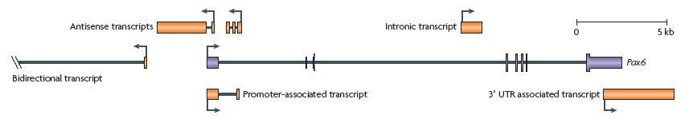
Example of human pax6 gene
(with “extra” non-coding transcripts in orange)
What does the bent arrow signify?
Where would the initiation and stop codons be?
Tall bars: coding exons
Short bars: non-coding exons
Functions of some ncRNAs have been determined:
Chromatin remodeling
Transcription activation/repression
Changes in RNA splicing pathways
Modulate protein activity (or localization)
Mercer Nat Rev Genet 10: 155, 2009
Difficult to distinguish transcriptional “noise” vs. functional molecules?
Notes:
SLIDE IN WRONG PLACE

Slide 4
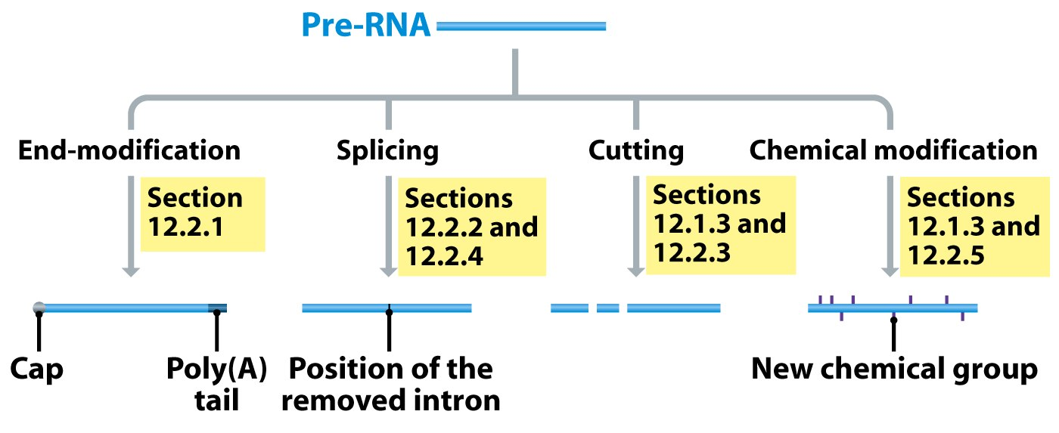
RNA processing in eukaryotes
Methylation of rRNAs
Modification of tRNAs
- may be alternative splicing pathways so more than one protein generated from one gene (Discussed later, Chapter 6)
- presence of long introns (& short exons) can make finding genes in eukaryotic DNA sequences difficult
Fig.1.13
Notes:
Heavily processed in eukaryotes
End modification im0ortant
5’ cap added
Poly (A) tail
Splicing
Cutting
Make one pre mrna and form multiple rna
Chemical modification
Extensive chemical modification to creae extensive structures

Slide 5
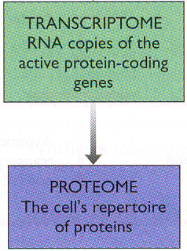
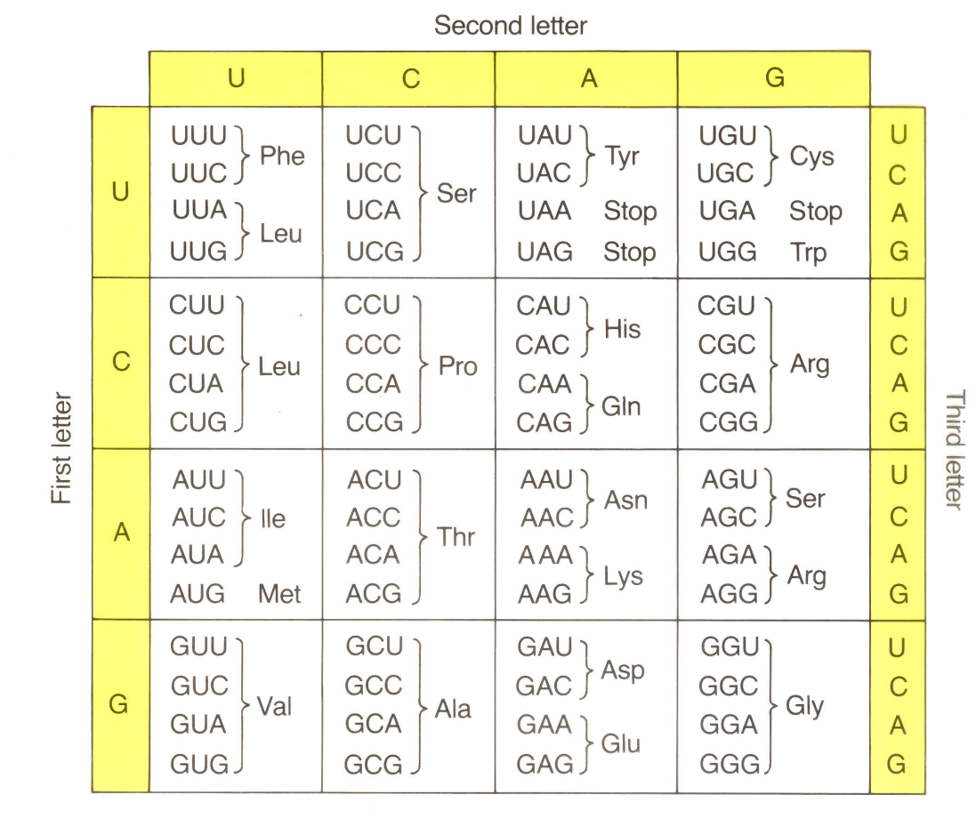
Link between transcriptome & proteome
Mediated by tRNAs
(codon-anticodon)
Genetic code
“standard code”
- can deduce amino acid sequence of protein from nt coding sequence
… using genetic code table
Fig.1.2
Fig.1.20

Slide 6
PROTEIN-CODING GENES
divided into codons
5’ …. ATG GGA TTG CCC GCC …. 3’
“coding strand”
DNA
3’ .… TAC CCT AAC GGG CGG …. 5’
“template strand”
mRNA
5’ …. AUG GGA UUG CCC GCC …. 3’
  in research papers DNA usually shown as single-stranded
with coding strand in 5’ to 3’ orientation (left to right)
… so genetic code table can be used directly
Remember that although AUG is the standard initiation codon, there can also be AUG triplets within an ORF (open reading frame),
… specifying internal Met residues in the protein
And when analyzing DNA data obtained in the lab, initiation codon might be located outside the sequenced region
Notes:
mRNA matches coding strand (5’ to 3’) excepts U instead of T
usuful you can read right of the DNA sequence and quickly
When shown as a single stranded its always 5’ to 3’
In procaryotes sometime there is aternative start codons. In some organimss GTG or CTG can be used; more common in prokaryotes ex E. coli
even if the alternative is another amino acid it is still methlyline that will connect first
DNA is almost prctically conserved

Slide 7
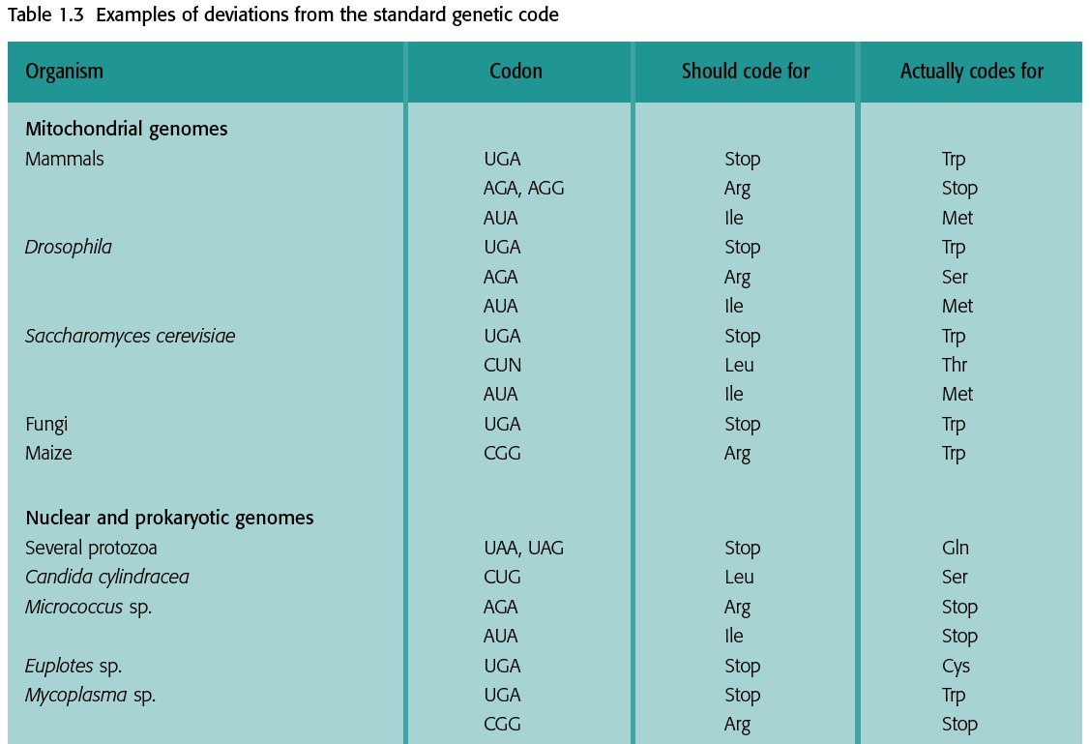
Examples of deviation from the standard genetic code in mitochondria and microbes
Actually RNA editing changes CGG to UGG in mRNA, so genetic code is NOT deviant in plant mitochondria
Table 1.3
Notes:
Mitochondria genome is not as conservative – very diverse
Does happen sometimes in nuclear genome but less frequent,rare,
On the most common residues to be converted into something else is Arg is because theres a lot of functional redundency

Slide 8
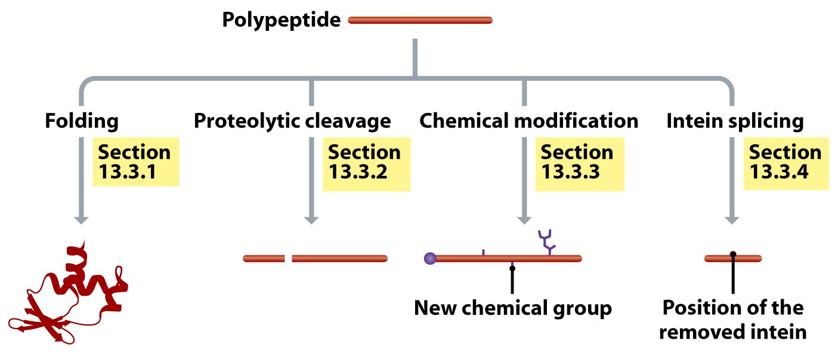
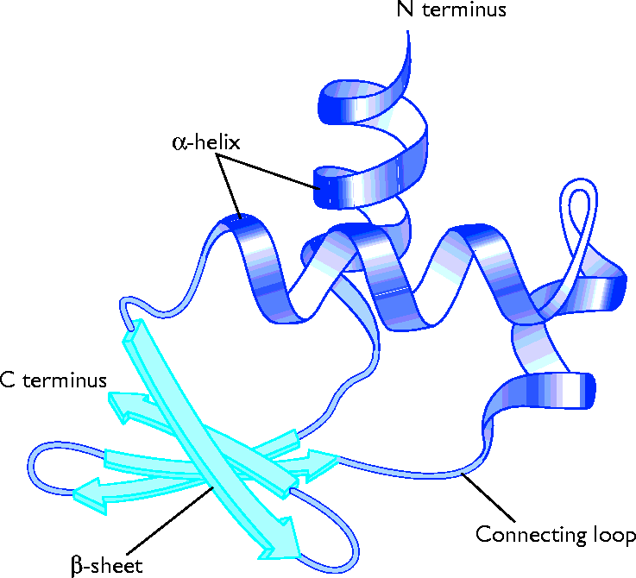
PROTEIN SEQUENCE
& STRUCTURE
Fig.13.24
Fig.1.17
Different proteins can be generated from single precursor polypeptide
through post-translational events
…so can have larger proteome (set of proteins) than predicted from
number of genes in genome
& alternative splicing can also contribute to larger proteome
Notes:
Processig of the polypeptides to have alternative protei nformed
Polypeptides can undergo same type of modification
foliding –hydrophobic colapse, enthropy driven – want the hydrophobic stuff in the middle to avoid contact with water. Forms tertiary structures
proteolytic cleavage – number of proteases inactive until the end sequence is cut off to become active. Found in many viral genomes. After translation it will be clipped up to see various proteins now activ
chemical modification – vast majority undergo some kind of chemical modification (PTMs –post translational modification) example – phosphorylation, or adding sugars (happens in eukaryote ), can be prenlated (add carbon to them). One sinlge ploy can be converted into many different proteins.
itein splicing- section of the polypeptide gets spliced out.non functional → to functional

Slide 9
TECHNIQUES & TOOLS FOR STUDYING DNA
Genomes are very large…
- so need methods to obtain small (relatively speaking) sections of DNA in abundant & pure form for molecular analysis
1. Restriction enzyme cleavage & agarose gel electrophoresis
2. Southern hybridization & northern hybridization
3. PCR (polymerase chain reaction) & RT-PCR
4. Molecular cloning

Slide 10
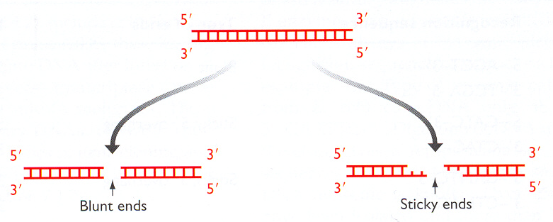
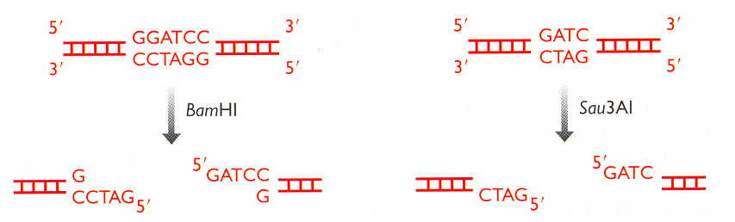
1. Restriction endonucleases
- cleave DNA into specific, small fragments
DNA endonucleases cut double-stranded DNA at specific recognition sites
“blunt” ends
“sticky” ends
Cohesive ends
Fig.2.10
BamHI: staggered cut with 5’ overhang
Notes:
Restiction endonucleases cut DNA at specific site and exonucleaases cut at the end
They are naturally occuring enzymes – almost exclusively from bacteria; they use them to protect themselves from viruses
it need to be sequence selection soyou odnt chew up bacterial genoe
Blunt ends cut the phophos ester at the same spot on both strans
Cohesive ends cuts at two different spots of the phophodiester backbone – they are left unpaired.
Exmaple BamH1 leaves cohesive it cuts the specific sequence view pic
Cuts palodromic sequecnes – they read the same and they cut at the same size

Slide 11
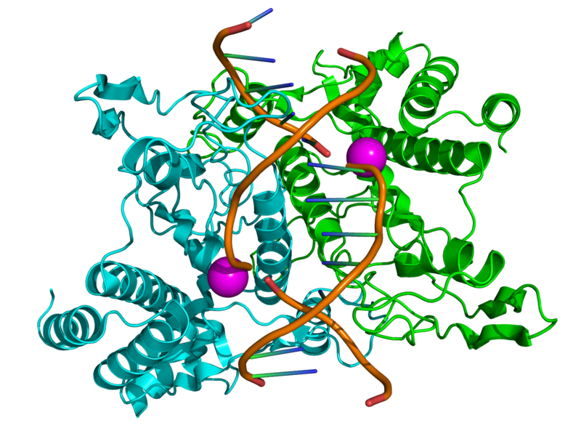
4 types (I-IV) restriction endonucleases occur naturally
Most commonly used are Type II
5’-GAATTC-3’
3’-CTTAAG-5’
Type II
recognize a palindromic DNA sequence
  of 4-8 bp
cut within the recognition site
homodimeric
require Mg2+ as cofactor
Nomenclature
Example EcoRI
E genus of producing strain
co species of producing strain
R additional strain descriptor
I order of identification from strain
EcoRI bound to major groove of DNA
Recognition sequences often 4 or 6 bp, but also “rare cutters” (eg. NotI 5’ GCGGCCGC 3’ ) can be useful for generating very large fragments in genomic mapping
Notes:
Palindromic – same on 5’ and 3’ strands
RI binds major groove, some bind minor groove
Most commonly use as type 2 - palindromic
usually have recognition sites of 6 if we wanna be selective; 4 if we just wanna cut everything up
Magnesium is the pink balls in the pic
Nomenclature
1 is the first strain they identified in the Ecoli R strain

Slide 12
Two different restriction enzymes may generate same “sticky ends”
“compatible ends” useful for cloning
(eg. partial Sau3A genomic digest ligated into BamHI site in vector)
Isoschizomers – restriction enzymes with identical recognition sequences
… but may have different response to methylation state
MspI cleaves 5’ CCGG 3’ regardless of methylation state
HpaII does not cleave 5’ CCGG 3’ if 2d C is methylated
Useful for epigenetic studies (evaluating DNA methylation status near gene of interest)
Notes:
This way some can come together again
Compatible ends good for constructing a library
Some are mentylation sensitive some are not – useful in epigenetics to understand how methylation changes the ability of DNA to be transcribed

Slide 13
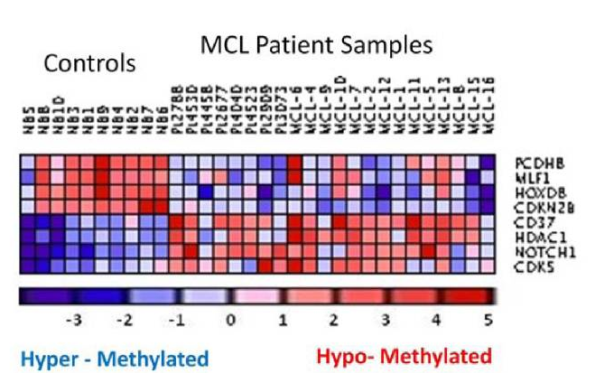
Example using isoschizomers to assess DNA methylation state of genes in cancer patients
- used assay called “HpaII tiny fragment Enrichment by Ligation–mediated PCR”
- found “significant aberrancy in promoter methylation patterns compared with normal NBCs”
NBC: naïve B cells (ie. from healthy people)
log(HpaII/MspI) ratios
Colour-coded figure: “heat map”
“Genome-wide DNA methylation analysis reveals novel targets for drug development in mantle cell lymphoma”
Leshchenko et al. Blood 116:1025, 2010
Notes:
HELP
Alternative approach - shotgun bisulphite sequencing
Ligation PCR – we will talk about what this is
Technique takes advantage of different reactivity of the isoschizomers
Heat map – common way to present data as a color – gives us 3 variables in this 2D image – patient, gene, degree of methylation
Use 2 different enzymes one methylation sensitive and other insensitive to see how much methylation is gained or lost in patients – see what changes occur between healthy patients and effected patients
Example: good in MCL patient samples – mManlte cell lymphoma

Slide 14
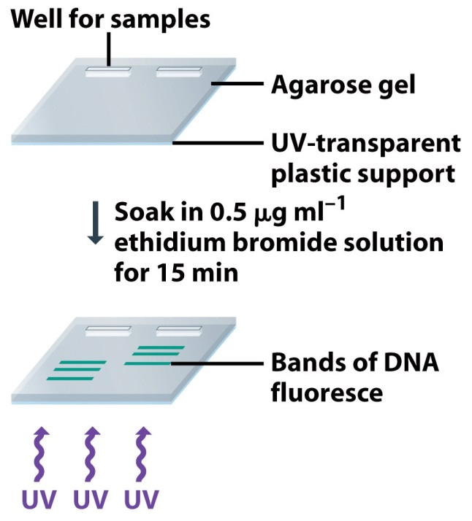
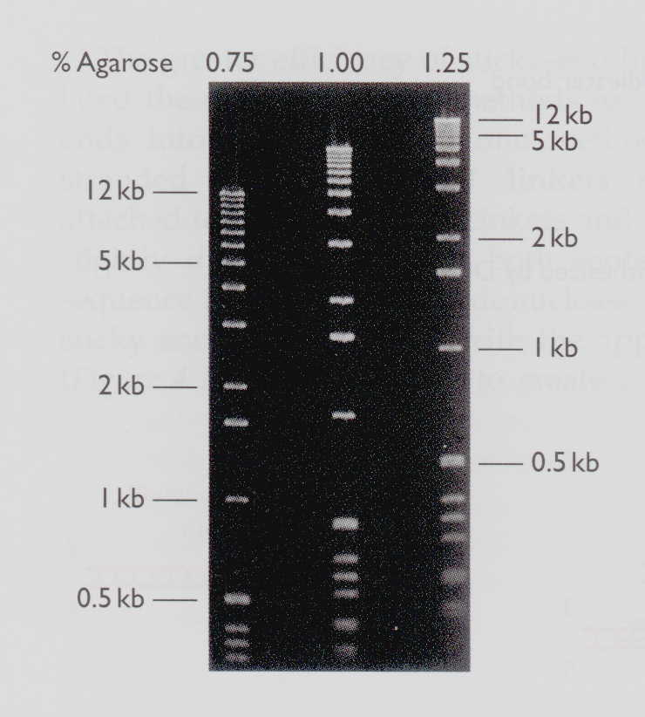
Agarose gel electrophoresis
- to separate DNA fragments by size
Fig.T2.1
Small fragments migrate more rapidly than large ones
Fig.T2.2
Lanes with size markers,
on gels of different % agarose
“Pulsed field” electrophoresis for separation of large DNA molecules (Fig.3.30)
For example : restriction fragments generated by “rare cutters”
      megaplasmids
      whole chromosomes (eg. yeast)
Notes:
Works great for DNA due to the charge on DNA phosphate backbone – negative charge
Typical gel electrophoresis works for 100 bp-20kb
For large DNA fragments, 10-250 kb – need pulsed field electrophoresis
At >30kb all DNA runs about the same in regular electrophoresis
Pulsed field changes the direction of the field quickly
Large DNA is slower to realign – this provides the separation of particles
Have to be able to seprate DNA by size
Works well because DNA is generally charged from the phosphate backbone
>30doesnt migrate at al just stays on top of the gel
Lareg piece of DNA form rare cutters – specific cutting sites

Slide 15

Because genomic DNA (bacterial or eukaryotic) is very complex, number of restriction fragments generated is too large to see discrete bands after electrophoresis...
so “continuum” of signals in lane
1 2 3
Why are different profiles expected for genomic DNA cleaved with BamHI (6 bp cutter) vs. Sau3A (4 bp cutter)?
Lane 1 = uncut DNA
Lane 2 = 6 bp cutter
Lane 3 = 4 bp cutter
Notes:
Distance between 6 bp site is greater than 4 bp sites
With 50% GC recognition site in DNA with 50% GC content
6bp cutter cuts every 4e6 (4096), 4bp cutter cuts every 4e4 (256)
4bp cutter will appear more frequently and cut into more pieces – shorter pieces will cause the DNA to travel further down
Assume 50% GC content in DNA – need 4^6 bases to find 16 bp cut site that’s approzimately 4096 bp – need 4^4 bases to find 14 bp cut site that’s approximately 256 bp

Slide 16
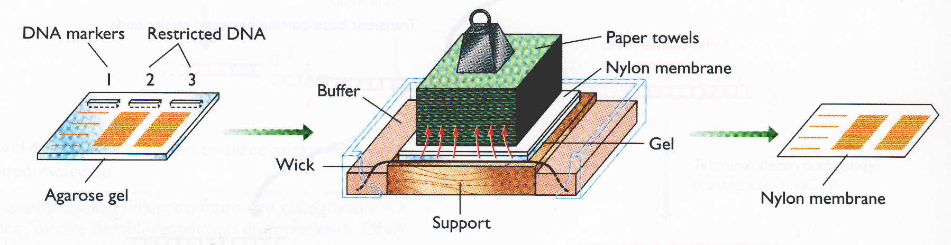
2. Southern hybridization
- to detect specific DNA fragment containing sequence (eg.gene) of interest (vs. all other fragments)
Fig.2.11A
After electrophoresis, denature DNA and transfer it from gel to membrane (eg. by capillary action or electroblotting…)
…so that DNA fragments remain in same relative positions
Notes:
Names after Edwin Southern – british biologist who developed it in 1975
DNA fragments often from restriction digest
Alkaline method for transfer denatures the dsDNA
Named after Edwin Southern – british biologist
Developed approach in 1975
Transfer from gel to membrane stay in the same fragments – basically like a photocopy
Also important that you denature – so single stranded DNA on the membrane that is seperated by size

Slide 17
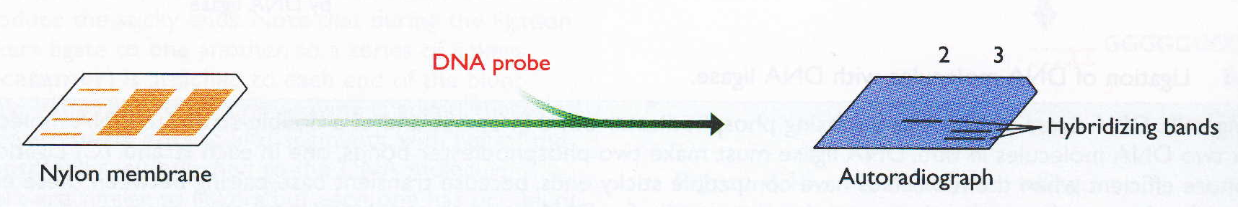
- probe will anneal with single-stranded DNA
on blot, if sequences are complementary
Fig.2.11B
2. Hybridize blot with “probe” (DNA, oligomer, cDNA, or RNA…
which is tagged either radioactively or non-radiolabelled)
and detect specific hybrid by autoradiography
Stability of hybrid depends on:
- length of hybrid, (eg for oligomer probes), GC content …
- hybridization conditions (such as temperature, ionic strength…)
15-20’ mer probes can form stable hybrids under appropriate conditions
..and hybrids of ~ 50 bp or longer are stable under all standard conditions
Notes:
If you have a proble with complementary sequence It will bind because we have single stranded DNA
Selective due to complementary base pairing – if you make you sequence long enough it should bind to you selective sequence
In the past used radioactivty now more common is non radiolabelled
examples are Ir dyes or UV dyes or florescent dyes – most common is probably the dlorescent markers because they are more sensitive
Lower the GC content the less stable the intercations because At have 2 HB rather then 3HB like CG

Slide 18
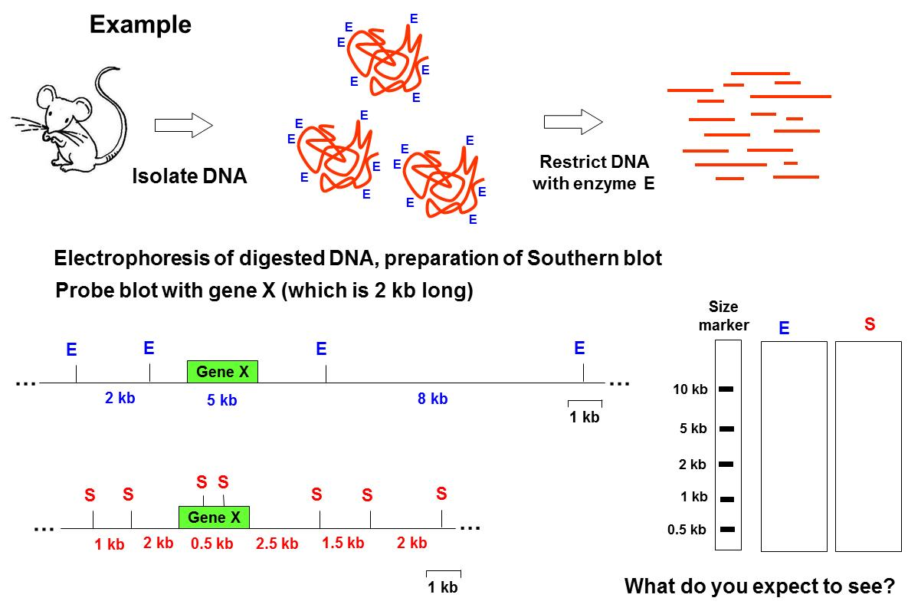
Notes:
Consider it like a DNA library
What do you expect to see
Enzyme E with gene X we should see only one band that corresponds with that DNA (the green square)
Enzyme S with gene X we should see 3 bands- theres two S int there
so there should be a cut at 2.5kb 0.5 kb and 2 kb

Slide 19
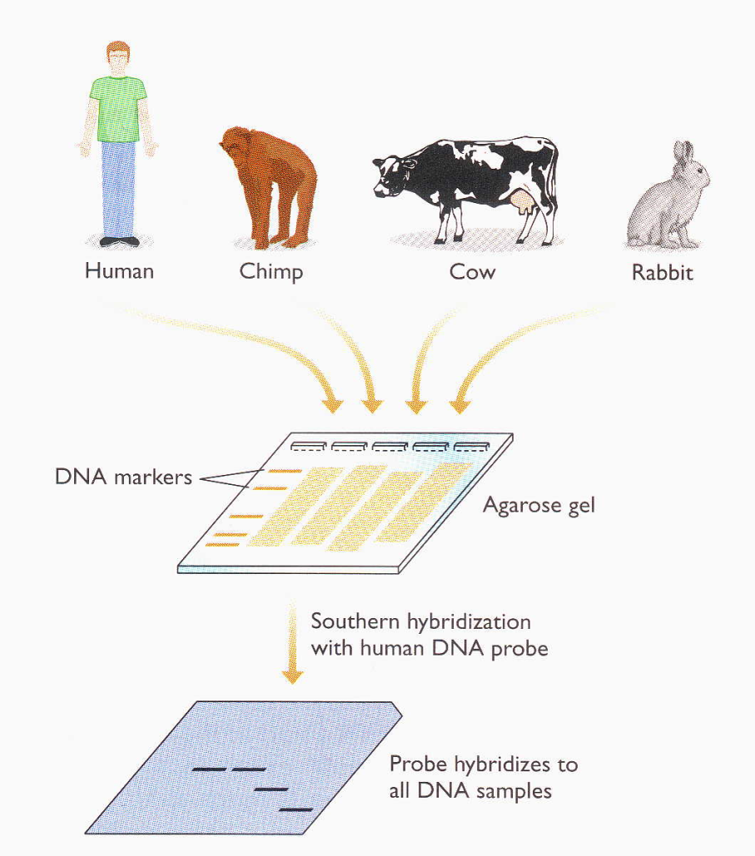
Some applications of Southern blot analysis
- to identify restriction fragment carrying sequence (eg gene) of interest
- to identify gene copy number (eg. multi-gene families)
- to identify homologous genes in other organisms (zoo blot)
Heterologous hybridization
- use conditions of “reduced stringency” (eg lower temp) so that duplex hybrids with some mismatches are stable
Interpretation of data shown in figure?
suppose probe is human gene X...
8 kb-
5 kb-
2 kb-
See also : Southern of pulsed-field gel , Boritsch Nature Microbiol. 1:15019, 2016
Fig. 5.12
Notes:
Homologous
Orthologous gene is present in all 4 species
Restriction pattern in cow and rabbit are different from human and chimp
Orthologous gene present in all 4 organisms except the gene must slightly vary among species because size or place of cutting is different

Slide 20
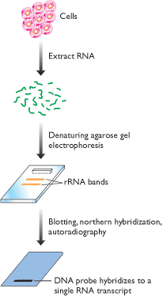
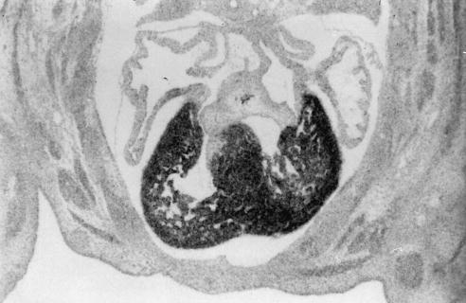
Northern hybridization (RNA blot) analysis
  - to identify expressed regions of genomes
– RNA is electrophoresed, blotted to membrane and hybridized with probe (eg gene of interest)
  - are transcripts are present or not?
  - length of mRNA?
  - abundance of mRNA?
Brain
Kidney
Heart
Lung
Liver
In situ hybridization
- to determine cellular
Location of mRNA
gene X probe
Probe: tagged DNA (eg. PCR product, restriction fragment, cDNA clone…) in denatured form or oligomer or antisense (synthetic) RNA …
³⁵S-labeled β-myosin antisense probe hybridizing to heart ventricle in 13-day embryonic mouse
Strachan & Read Fig. 5.17
Fig. 5.11
(NB: many identical copies of a particular mRNA are present on blot)
See also: Northerns of new ncRNAs (van der Meulen RNA Biol. 13: 353, 2016)
Notes:
Developed in 1977 at Stanford, like Southern but with RNA thus northern.

Slide 21
Some protein encoding genes are constitutively expressed …
“housekeeping gene” products needed at all times
… whereas others are differentially expressed
in specific tissue type
during development
in response to environmental cues
Only a subset of genes are expressed at a given time
and mRNA levels can vary greatly among genes
~10,000 – 15,000 different mRNAs present in “typical” mammalian
cell type under given condition
(~ 20,000 different proteins present)
Aside: RNA-sequencing studies suggest ~ 8000 genes ubiquitously expressed in human tissues (Ramskold PLoS 2009)
Notes:
Transcriptional regulation of gene expression – primary way biology is regulated

Slide 22
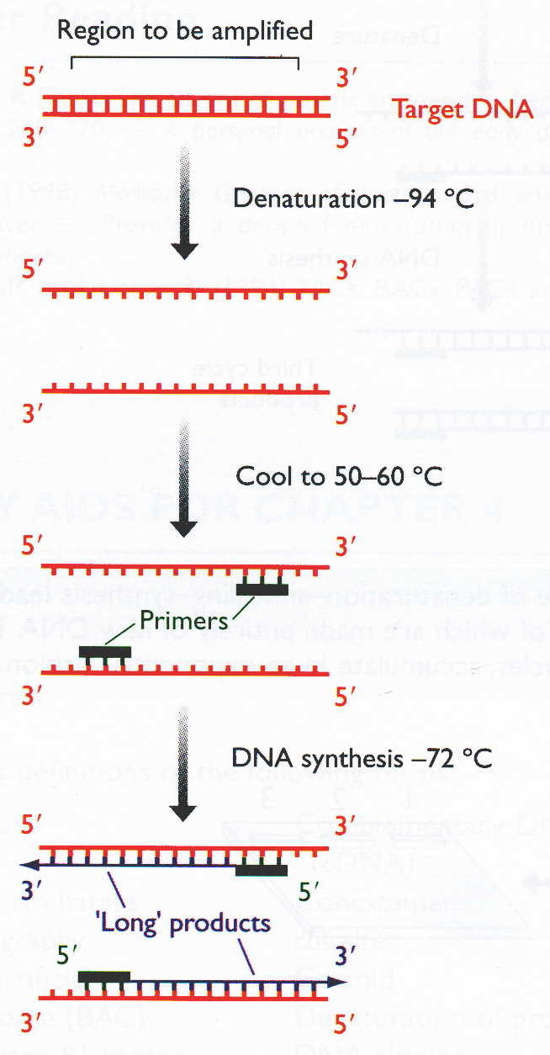
3. PCR - polymerase chain reaction
- to obtain one specific DNA region in large copy number
- rapid amplification of DNA region
of interest by enzymatic reaction in test tube
1. Denaturation of duplex DNA
2. Annealing of 2 different primers
(synthetic oligomers, usually 15-25 nt )
flank region of interest,
in opposite orientation
… so anneal to opposite strands of DNA
3. Extension of complementary strands
- cycle repeated 25-30 times
First cycle
Fig.2.28

Slide 23
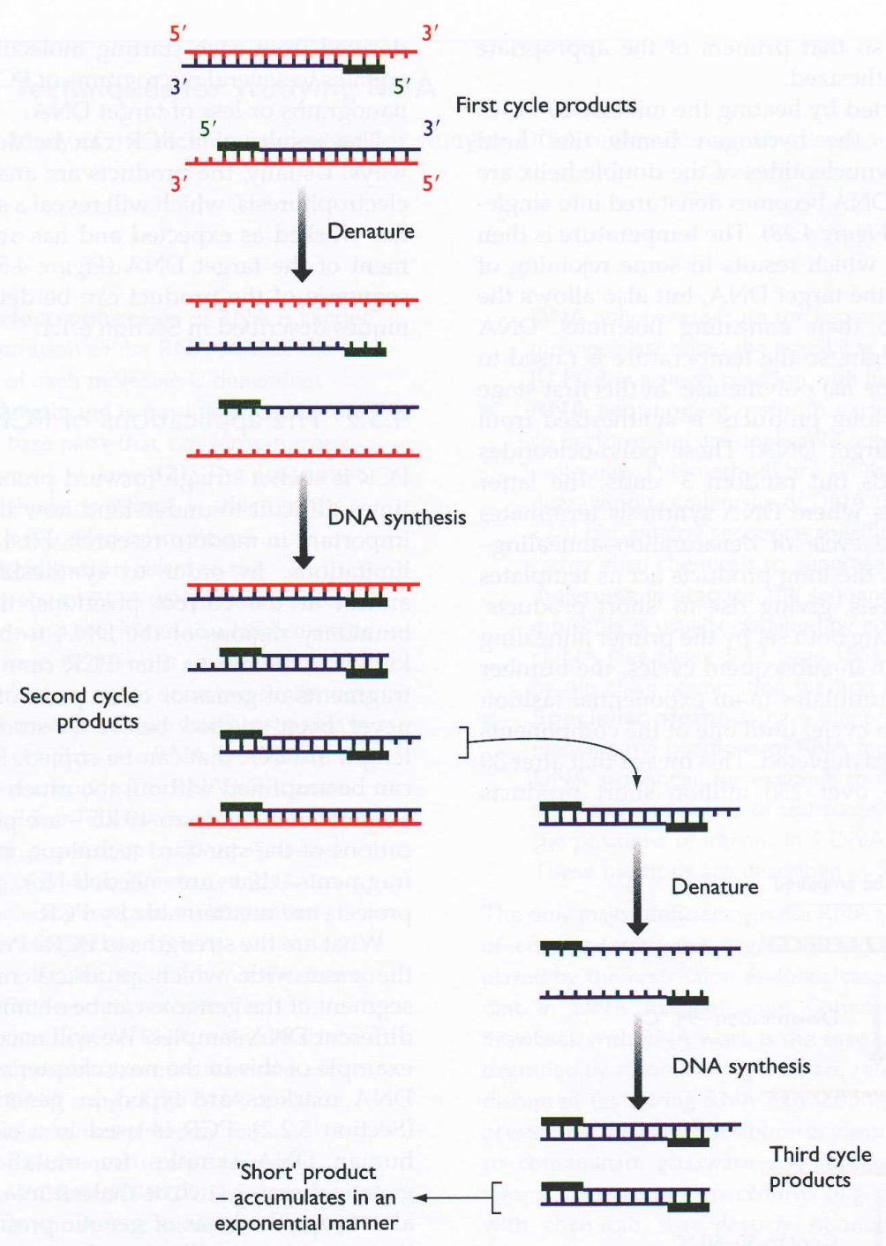
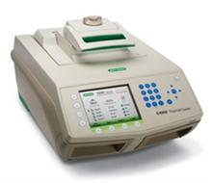
Subsequent PCR cycles
- discrete PCR product generated
- its length corresponds to distance
between primers (including the primers)
- sequences at ends of amplicon
correspond to the 2 primers used
Bio-Rad C1000 Thermal Cycler
NB: even though text shows both primers as black bars, they have different nt sequences
Fig.2.29

Slide 24
Powers & pitfalls of PCR
- rapid method to generate large amounts of specific segment
of DNA (product usually < 10 kb in length)
“Long-range PCR”
~ 20-30 kb products
- need very small amount of template DNA
…but can lead to contamination problems
- need prior sequence info to design primers
Typically use 20-25 nt oligomers,
but for simplicity (as on a test) 6’mers are shown here
Why choose ~ 20’mers?
Tip: see Question 2.5 in text (p.61)
Notes:
Getting easier to access long PCR products: high fidelity thermostable proof-reading polymerases – Herculase, Fusion etc
20 mers – specificity
A random 20 mer has less than 1% chance of occurring in the human genome (assuming 50% GC) (1/4e20)*3.2*10e9

Slide 25
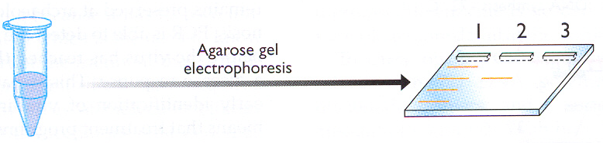

How to double-check that PCR product (amplicon) is correct one?
1. Is it the right size?
- agarose gel electrophoresis (with size markers)
Well
Fig. 2.30
2. Does it contain the right sequence (eg gene X)?
- Southern hybridization
- using gene X (eg. clone) as probe
- restriction analysis
- are expected restriction sites present?
- nested PCR
New primer
- design “internal” primers
to use in 2d PCR experiment with
1st PCR product as template DNA
New primer
Notes:
Sequence prc product

Slide 26
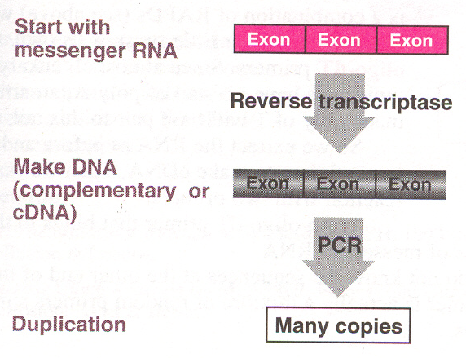
RT-PCR
Reverse Transcriptase
3’
5’
3’
5’
5’
3’
5’
3’
3’
5’
total population of poly A+ RNAs (for euk) or total RNA (for bacteria)
Gene-specific oligomer
or oligo dT
3’
5’
5’
3’
3’
5’
- then sequence RT- PCR product
directly (or after cloning)
- (need sequence data to
design primers for RT-PCR)
5’
3’
3’
5’
(see p.142, Chapter 5)
Notes:
Reverse transcriptase – generates DNA from RNA
Not the typical flow of information as seen in the central dogma
RNA to DNA – done by RNA viruses
Commercial RT come from retroviruses (positive sense RNA genomes) like AMV and MuLv

Slide 27
Choice of primer for cDNA synthesis
1. oligo dT - anneals to polyA tail of mRNA (if eukaryotic)
5’
AAAAAAAAn
3’
Generates copies of all mRNAs present
TTTTTTTTTT
3’
5’
2. Random short primers (eg. 6’mers)
5’
AAAAAAAAn
3’
Generates partial copies of mRNAs
NNNNN
5’
NNNNN
5’
3’
NNNNN
5’
3. Sequence-specific primer
5’
AAAAAAAAn
3’
Generates cDNA just for specific gene of interest
3’
5’

Slide 28
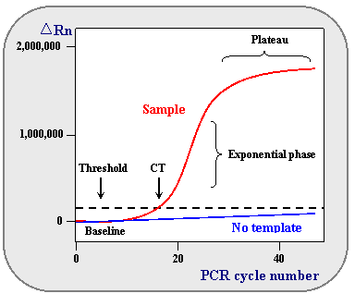
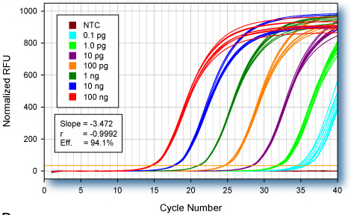
Real-time quantitative qPCR
- to measure relative or absolute amount of mRNA present in different tissue types/developmental stages/environmental conditions…
- detection and measurement of products generated during each cycle of PCR by using a reporter fluorescent probe
eg. SYBR green, TaqMan
ΔRn : increment of fluorescent signal at each time point
CT : PCR cycle number where reporter fluorescence is greater than threshold
RFU = relative fluorescence units
NTC = no template control
http://www.ncbi.nlm.nih.gov/projects/genome/probe/doc/TechQPCR.shtml
NCBI Technologies website

