Slide 1
Chapter 2 Phase Rule and First Law

Slide 2

Phase Rule
For a closed system at equilibrium, the degree of freedom of the system is given by the following equation:
F = 2 - π + N (2.7)
  F is the degree of freedom, which represents the number of independent variables that must be fixed to determine the intensive state of a system;
  π is the number of phases in the system;
  N is the number of chemical species in the system
CO₂ (O₂, N₂ …)
Water & CO₂ (sugar, minerals, O₂, N₂ … )

Slide 3
Intensive and complete state
When the intensive state of a system is determined; all intensive properties are fixed;
For multiple phase systems, the overall compositions are not phase rule variables; only the composition of individual phases are.
The state of a system is completely determined if the intensive state and the amount of substance (extent) of the system are determined.

Slide 4

Equilibrium
Thermodynamics is an engineering discipline dealing with equilibrium states.
A system is at equilibrium when it has no tendency towards change at macroscopic scale (changes may occur at microscopic scale but the net results are zero)
At equilibrium, all driving forces of change such as mechanic forces, temperature gradient, chemical potentials, etc. are at balance.
If System A is at equilibrium with System B, and System B is at equilibrium with system C, then, system A is at equilibrium with System C.

Slide 5
Example 1
An ethanol/water binary system in a closed container has two phases at equilibrium and the liquid phase contains 50% (mol) ethanol. Then an amount of pure anhydrous ethanol is added into the system and the system returns to the same temperature and pressure with two phases when a new equilibrium is reached, please answer:
  What is the concentration of ethanol in the liquid phase?
  Is the overall ethanol/water ratio still the same in the system (i.e., including both the vapour and liquid phases)?
  Will the ratio of the vapour phase and the liquid phase remain the same?
  Only composition of individual phases are phase rule variables (Overall or total compositions are not phase rule variables when multiple phases are involved).

Slide 6

Energy of a closed system
Kinetic energy
Potential energy
PV energy
Internal energy
  Thermal movement of particles internal to the system
  Chemical bounding
  Nuclear bounding
H = U + PV
Kinetic energy and potential energy dependant on the references of choice and can be set to zero in most scenarios

Slide 7
Types of systems
Open system: a system that may have energy and mass exchange with its surroundings
Closed system: a system that may have energy exchange with its surroundings but with no mass exchange. The mass of a closed system is necessarily constant. (Is it possible to have a system that exchange mass with its surrounding only?)
Isolated system: a system without any exchange with the surroundings, neither mass nor energy. The total mass and energy of an isolated system is necessarily constant.

Slide 8
First Law of Thermodynamics
First law (energy conservation):
Although energy assumes many different forms, the total quantity of energy is constant. When energy disappears in one form, it appears simultaneously in other forms.
Δ(Energy of system)+Δ(Energy of surroundings)= 0

Slide 9
Energy Balance for Closed Systems
No internal energy exchange between a closed system and its surroundings. All energy exchange occurs in the form of heat (Q) and work (W).
Sign convention of this textbook, heat and work always refer to the system, i.e., both Q and W are positive if transferred INTO the system.
Energy balance equation for a closed system
ΔU^{t} = Q + W

Slide 10
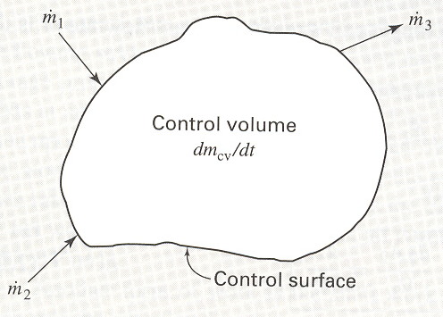

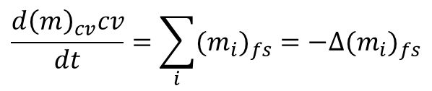
Mass balance of open systems
Control volume: the space identified for the analysis of an open system;
Control surface: the interface that separates the control volume from its surroundings;
Mass balance equation:
Symbol Δ: equivalent to Σ but with opposite sign convection: everything entering the control volume is negative and everything leaving the system is positive.
$$\frac{d{\left(m\right)}_{cv}cv}{dt}=\sum_{i}{{{(m}_{i})}_{fs}}=−∆{{(m}_{i})}_{fs}$$
$$\dot{m_{i}}$$

Slide 11
Mass and energy balance equations of open systems
Important: ∆ is equivalent to ∑, the sum sign, except that all the properties of streams leaving the control volume are counted as positive and vice versus when ∆ is used. In other words, the sign convention is reversed when ∆ is used in place of ∑.

Slide 12
Special Cases of energy balance
General equation
When potential and kinetic energy changes are neglected:
Steady-state flow processes (d(mU)/dt = 0):
For single stream flow at steady state:
For British engineering unit system, g_{c} = 32.1740 (lb_{m})(ft)(lb_{f})⁻¹(S)⁻²

Slide 13
Some tips for solving energy balance questions
Define system: closed (system) or open (control volume)
Start from the general energy balance equation
  Closed system: ΔU = q + w (ΔU^{t} = Q + W)
  Open system:
Identify special cases to reduce the equation to the simplest form
Solve the question;
Draw a schematic diagram of the process(s) involved is often very helpful!

Slide 14
Example 2
(Q2.25) Water at 28 ºC flows in a straight horizontal pipe in which there is no exchange of heat with the surroundings. Its velocity is 14 m S⁻¹ in a pipe with an internal diameter of 2.5 cm until it flows into a section where the pipe diameter abruptly increases. What is the temperature change of the water if the downstream diameter is 3.8 cm? What is the maximum temperature change for an enlargement in the pipe?
This question tests the following:
Process diagram;
General energy balance equation (2.28);
Sensible heat (enthalpy change due to temperature change) at constant pressure;
Continuity;
conversion of unit: m²/S² = 10⁻³ kJ/kg

