Slide 1
Defining the target behaviour
Operational Definitions
Category Mistakes

Slide 2
Defining the Target Behaviour
Operational Definition:
  A definition that specifies the operation (procedure) by which a term will be measured.
Notes:
Range of behaviour – everyone has a different range of sitting behaviour
No two incidents of behaviour are same
Specific behaviour is defined by how it will be measured

Slide 3
Example Operational Definition
E.g. Measuring the “mouth wateringness” of food.
  Label: Salivation
  Operational Definition: number of milligrams of saliva absorbed by cotton balls (of size X) placed in a particular area in the mouth for specified period of time.
Notes:
Label is not behaviour definition
Label does not define person’s behaviour

Slide 4
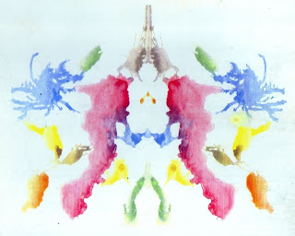
Operational Definitions
Precise
Interobserver reliability
  People using the same definitions should reach the same conclusions.
Quantitative
Objective/unambiguous
Not reference internal states or motivations
Practical
Notes:
Interobserver reliability – two people using same definition should reach same conclusioin
Quantitative – frequency, duration, intensity ( time, percentage, counts)
Lastly, should be significant to research question – the target change should be significant, have a purpose

Slide 5
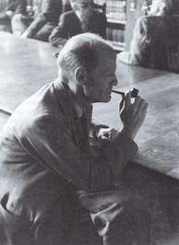
Category Mistakes
Category Mistake:
  Treating a category label as an instance of a category.
Category Mistake Example:
  Name three fruits:
    ☑ Apple, banana, peach.
    ☒ Apple, banana, fruit.
Gilbert Ryle
(1900 – 1976)
Notes:
Category label and instance of category are not the same

Slide 6
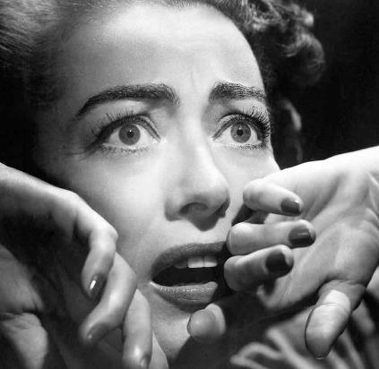
Category Mistakes
Fear:
  Increased heart rate, skin conductance, verbal exhortation, certain facial expression, etc.
  Category Mistake:
    These behaviours indicate the presence of “fear.”
  Behaviour Science Perspective:
    These behaviours are fear.
Notes:
It is mistake to treat fear as behaviour itself
Fear is category label

Slide 7
Measuring the Target behaviour
Behavioural Assessment
Measuring Behaviour Change
Notes:
-

Slide 8
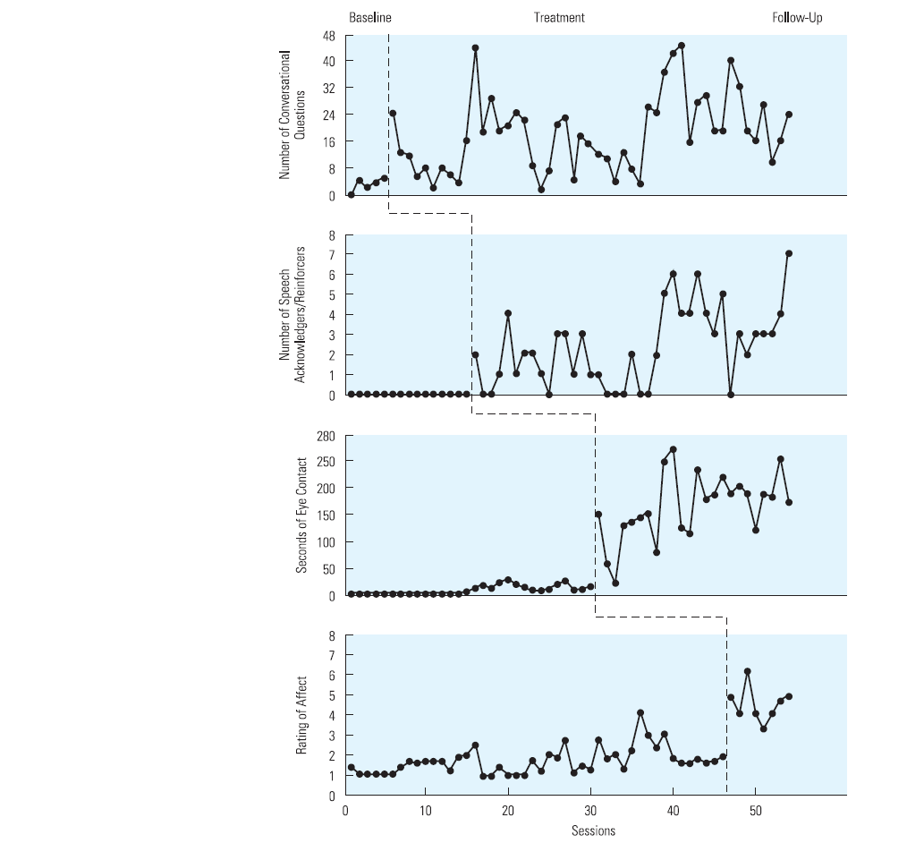
Behavioural Assessment
Behavioural Assessment: Baseline measurement of the target behaviour.
  1) Determine if treatment is necessary.
  2) Determine whether or not your treatment was successful.
A-B Design:
Baseline
Treatment
Sessions
Notes:
Baseline – behaviour measurement before any implementation of treatment
Why is assessment important?
It will help you determine if treatment is necessary
It will help you determine if treatment was effective or not

Slide 9
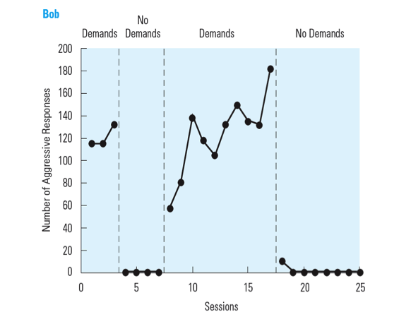
A-B-A-B Reversal Design
Bob’s
Behaviour
Notes:
Bob gets angry when teacher demands him

Slide 10
A-B-A-B Reversal Considerations
Demonstrates a functional (i.e., causal) relationship between the manipulated (independent ie measurable) variable and the dependent (target behaviour) variable.
  E.g., “Bob’s aggressive behaviour varies as a function of the teacher’s demands”
    i.e., “Demands cause aggressive behaviour in Bob.”
Variations:
  E.g., A-B-A-C-A
Is it ethical to remove treatment?
Can the treatment be removed?
How long do you gather baseline and treatment data?
Notes:
Reactivity – when baseline measurement causes the behaviour change not the treatment

Slide 11
Direct vs. Indirect Assessment
Direct Assessment (ideal)
  Target behaviour is measured as it occurs.
  The observer need not be a person, but can also be a camera or some other recording device.
  Self-Monitoring: Client is trained to observe their own target behaviour.
      Useful when . .
        Independent observers are not available
        Target behaviour is infrequent
        Target behaviour does not occur in the presence of other people
Notes:
What we have discussed so far is direct assessment

Slide 12
Direct vs. Indirect Assessment
Indirect Assessment
  (Tries to) measure target behaviour with interviews, questionnaires, and/or rating scales.
  May rely on testimony from other people (parents, teachers, etc.)
  Requires recall of a individual’s behaviour (i.e., behaviour is not measured directly).
  Concerns:
    Testimonials may be biased, inaccurate, unreliable, and/or incomplete.
Notes:
Less preferred method

Slide 13
Is this Direct or Indirect Assessment?
At the end of the day, the parent records how many times her child peed in the toilet that day.
  Answer: Indirect
Each time the child pees in the toilet, the parent marks it down on a data sheet.
  Answer: Direct
Notes:
-

Slide 14


Research Designs:
Populations vs. Individuals
Common statistical approaches emphasize averages across individuals.
  Sample mean estimates the true population mean (μ).
  Sample variance estimates the true population variance (σ²).
ANOVA
Individual Scores
Population Scores
Notes:
-

Slide 15
Research Designs:
Populations vs. Individuals
Generalize from individuals to populations
Generalize from populations to individuals
Notes:
Individual to population can be generalized
The vice versa is not true

Slide 16
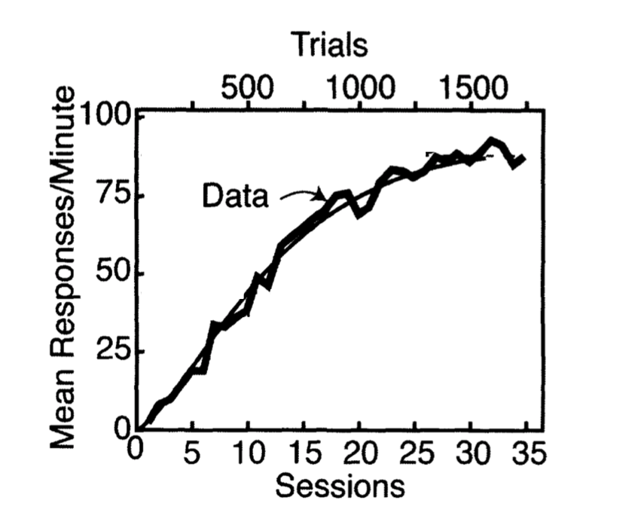
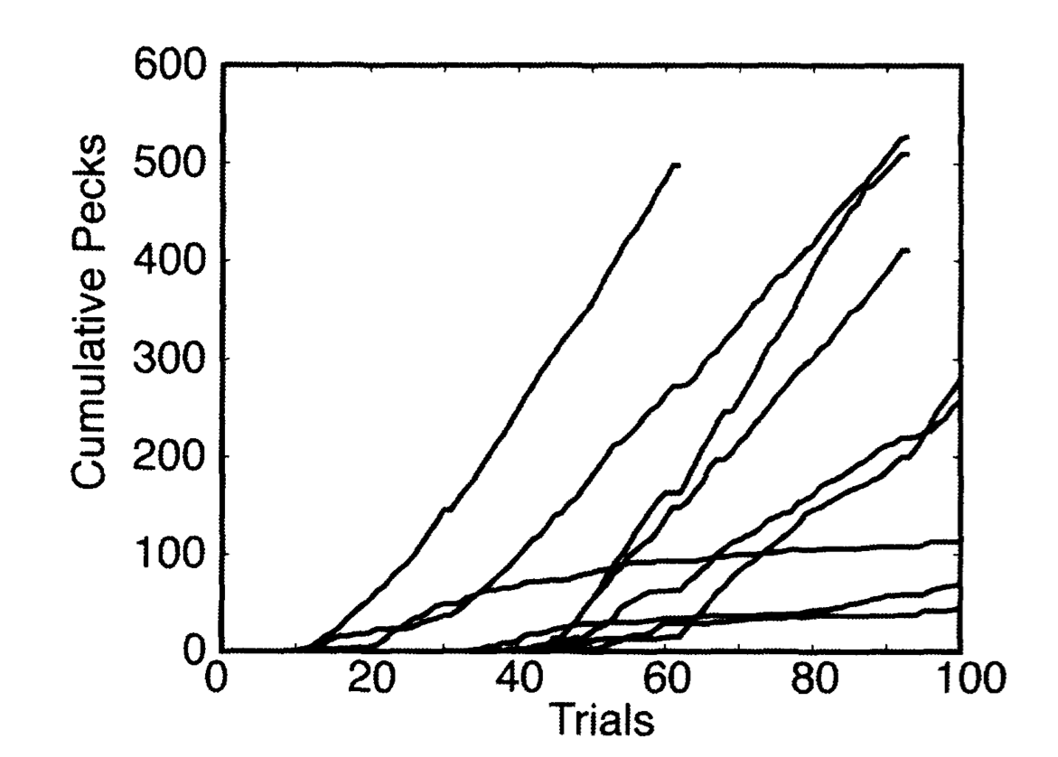
Research Designs:
Populations vs. Individuals
Averaged Learning Curve
Individual Learning Curves
Gallistel, C. R., Fairhurst, S., & Balsam, P. (2004). The learning curve: Implications of a quantitative analysis. Proceedings of the National Academy of Sciences of the United States, 101(36), 13124-13131.
Notes:
-

Slide 17
Research Designs:
Populations vs. Individuals
The behaviour often appears abruptly and not gradually.
Asymptotic levels of performance differ massively between the individuals.
Latency (onset of responding) differs massively between individuals.
Notes:
The average learning curve is not characterizing the individual
Each individual has different performance levels nad different latency ( frequency, duration is different)

Slide 18
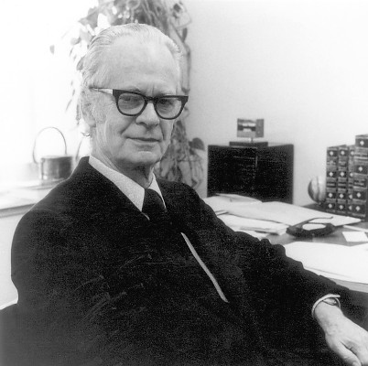
Research Designs:
Populations vs. Individuals
Follow B.F. Skinner’s Advice
  Accurately describe the results at the level of each individual subject and then generalize (i.e., average) only when a repeatedly demonstrable truth emerges.
Notes:
- Only generalize or average when repetition is demonstrated in individuals

Slide 19
Research Designs
Single-Case Designs:
  Within-subject research method concerned with discovering the principles and conditions that govern an individual organism. The individual acts as its own control group.
  Also called Single-Subject Designs
  Not the same thing as a Case Study

Slide 20
Measuring Learning
Learning: A change in behaviour due to experience.

Slide 21
Common Methods
Change in accuracy (error reduction / percent correct)
Change in topography
Change in intensity
Change in speed
Change in latency
Change in duration
Distribution of behaviour (i.e., Choice)
Rate / Frequency
Notes:
Accuracy – error reduction or mistake reduction
(least common) Topography – form behaviour takes ( ie mirror tracing task) ( ie analyzing technique while throwing basketball)
Intensity –the strength of the behaviour (ie how loud the child screams)
Speed – the speed of the behaviour ( how fast im typing)
Latency – the amount of time it passes to produce/ learn a target behaviour
Duration – the time of onset and offset of the behaviour (how long im typing for)
Distribution – how the behaviour is distributed overtime ( ie whether bird is pecking or doing a different behaviour)
Frequency/ rate – the count of time the behaviour is performed

Slide 22
Test yourself
Notes:
Test yourself
Recording the amount of weight bob bench presses – intensity
Recoding how many times bob lifts the weights – frequency
Recoding how long it took bob to get the weight bench once he entered the gym – latency
Recoding how long it took bob to compete a set – duration
Recording at the end of each min whether Bob is lifting weighs or talking to friend – time sample (choice)
Measuring the size of bobs biceps over the course of the semester – product ( rate of bicep increase)

Slide 23
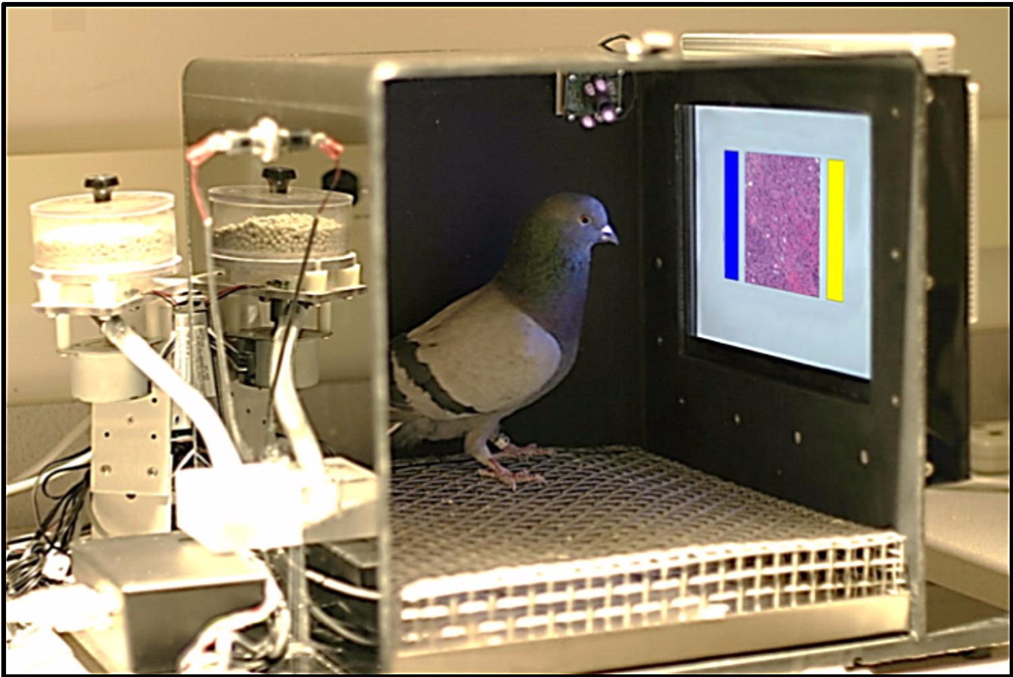
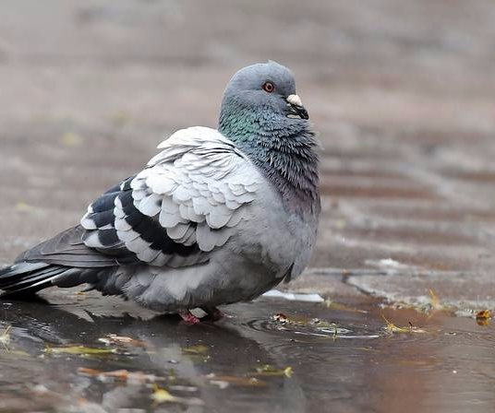
Where to Record/Measure
Natural Environment
Analogue Environment
Notes:
Analogue is unrealistic , results may be biased

Slide 24
Recording Instruments
Data Sheet
Counters
Stopwatches
Mobile Device (cool apps)
Key Consideration:
  Should be immediate and practical.
Notes:
Recording should be done as soon as the behaviour is observed

Slide 25
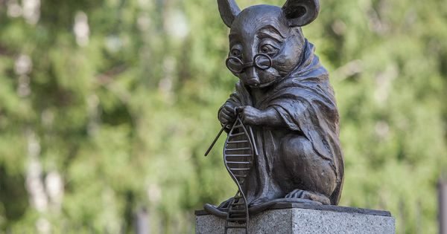
Animal Research
Novosibirsk, Russia

Slide 26

Animal Research, cont’d
Animal research has lead to behavioural treatments for…
  Phobia
  Depression
  Self-injurious behaviour
  Dyslexia
  Hyperactivity
  Mental retardation
  Autism
  Brain damage
  Tourette syndrome
  And much more.

Slide 27
Why Do We Use Animals?
Control the influence of heredity
  i.e., know their genetic history
Control the influence of learning
Practicality
Need to apply procedures that would be considered unethical with humans.
  #3. Nuremberg Code
    The experiment should be so designed and based on the results of animal experimentation and a knowledge of the natural history of the disease or other problem under study, that the anticipated results will justify the performance of the experiment.
Notes:
Cost effective
Easy to control
Can study long-term

Slide 28
Notes:
Apopo video – animal reaseach
Mine sniffing rats – rats trained to detect land mines

