Slide 1

Structure & Function
Biochem 320
Protein Tertiary and Quaternary Structure
Protein Quaternary Structure
University of Alberta
Department of Biochemistry

Slide 2
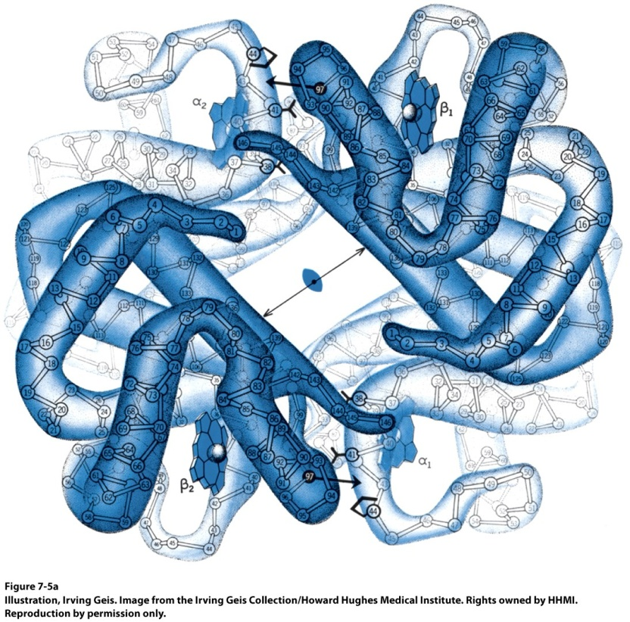
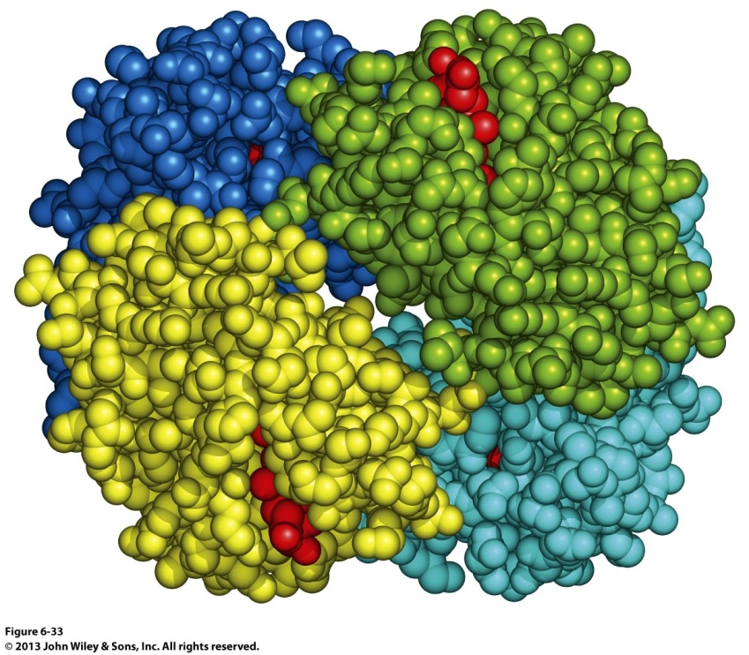
The Subunits of Hemoglobin are Arranged in Symmetric Pairs
Hemoglobin is described as a tetramer or as a dimer of αβ protomers.
It was the first oligomeric protein structure studied in detail.

Slide 3
Quaternary Structure
Multiple subunits (>1 polypeptide) combine to form the protein.
Subunits → Multimers
  Subunits (individual polypeptides) assemble to form the quaternary structure.
Protomers → Oligomers
  Oligomers have repeating structures. The repeating unit in an oligomer is a protomer.
  Protomers may be composed of >1 polypeptide.
  Will be associated with a symmetry form (rotation and translation)

Slide 4

Quaternary Structure
Less DNA required, less synthesis.
Errors in translation are less critical.
May be able to recruit different functions in different contexts.
  PDH complex and α-ketoglutarate dehydrogenase

Slide 5
Symmetries
Cyclic (C)
  C_{N} is N protomers arranged around 1 rotation axis.

Slide 6
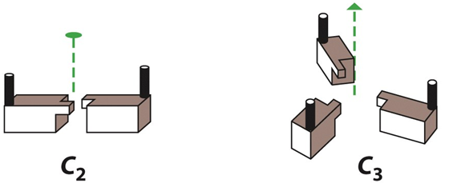
Rotational Symmetry-Cyclic
Twofold symmetry
Threefold symmetry
In cyclic symmetry, subunits are related by rotation about a single n-fold axis, where n is the number of subunits (Cn).

Slide 7
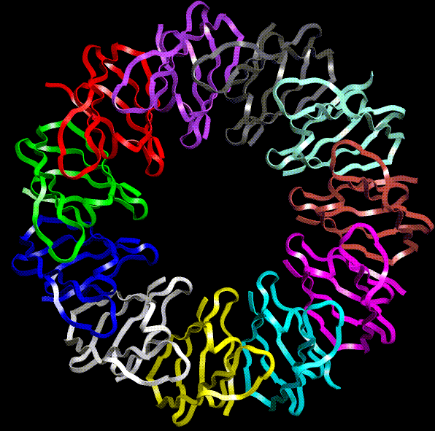
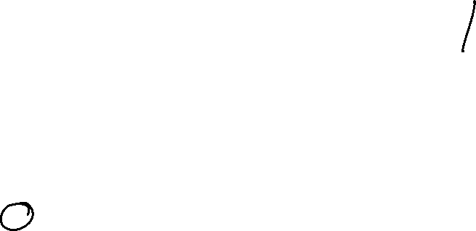
The following structure has cyclic symmetry. What is the notation for its symmetry?
C₆
C₉
C₁₀
C₁₁
C₁₂
TRAP Trp attenuation protein of Bacillus subtilis

Slide 8
Symmetries
Cyclic (C)
  C_{N} is N protomers arranged around 1 rotation axis.
Dihedral (D)
  D_{N} is 2N protomers arranged around 2 axes (2x C_{N}).
  1 axis is N-fold, the second is a twofold axis.

Slide 9
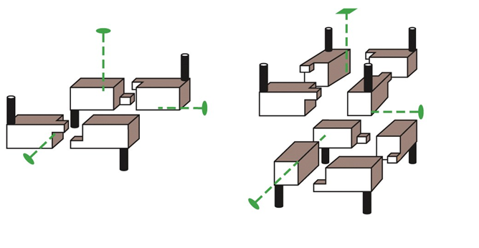
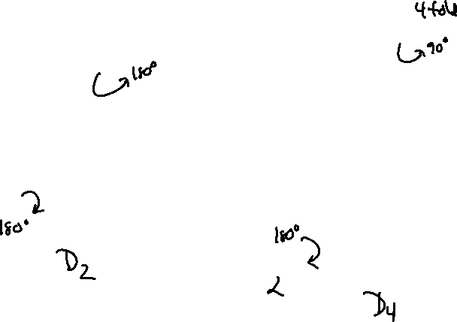
Rotational Symmetry-Dihedral
Dihedral symmetry is a somewhat more complicated rotational symmetry. Subunits are related by rotation about a two-fold axis which intersects with an n-fold axis at right angles.

Slide 10
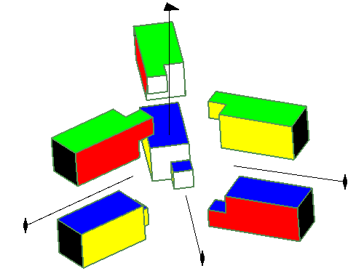
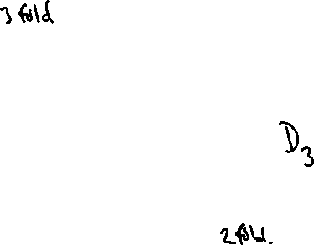
Dihedral symmetry

Slide 11
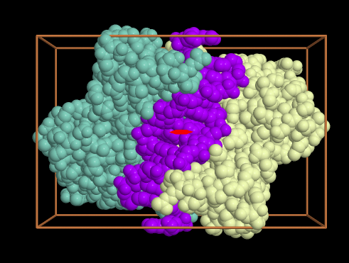

DNA often contains symmetrical “palindrome” sequences (the sequence is the same in either direction). What symmetry would you expect for a protein that binds to a palindrome?
C₂
C₄
D₂
D₄

Slide 12
Symmetries
Cyclic (C)
  C_{N} is N protomers arranged around 1 rotation axis.
Dihedral (D)
  D_{N} is 2N protomers arranged around 2 axes (2x C_{N}).
  1 axis is N-fold, the second is a twofold axis.
Tetrahedral, Octahedral, Icosahedral
  12, 24, and 60 protomers (respectively) arranged around multiple axes.

Slide 13
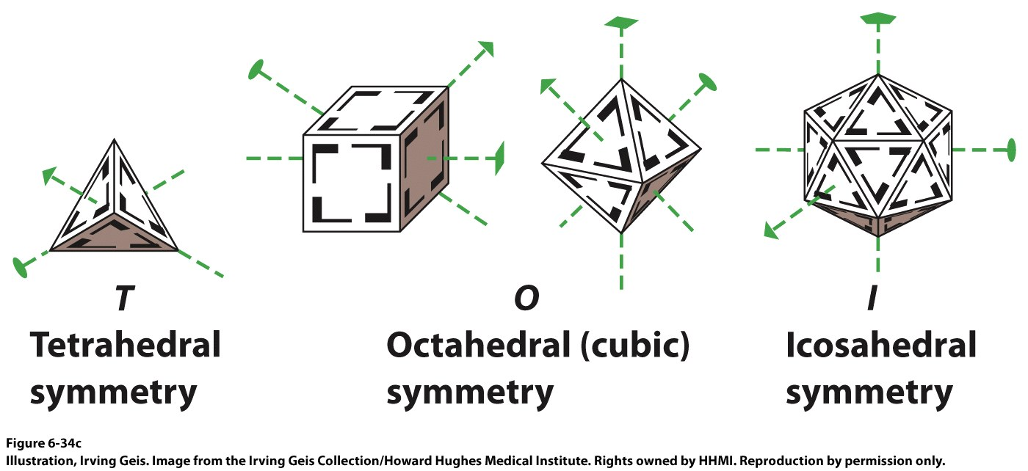
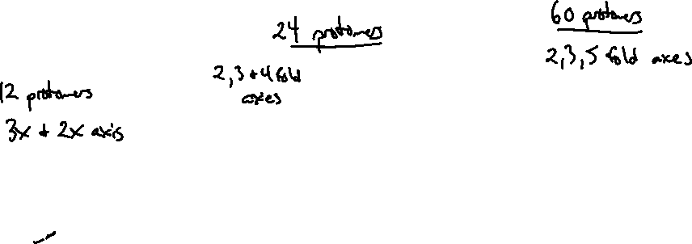
Rotational Symmetry

Slide 14
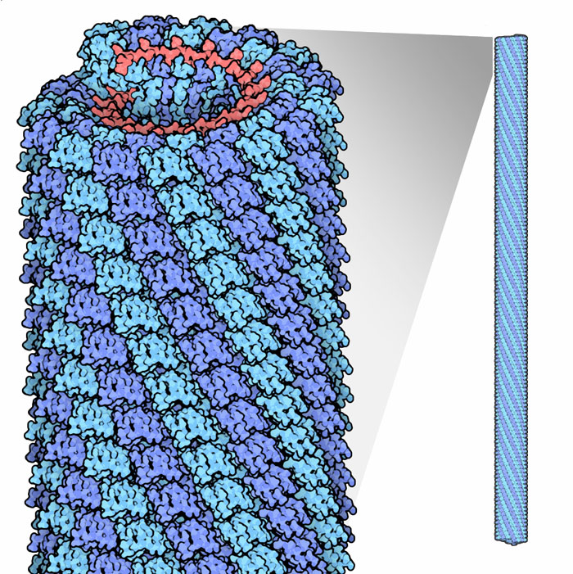
Other Symmetry Forms
Helical symmetry
  Protomers are related to each other by both a rotation and a translation.
  Tobacco Mosaic Virus has helical symmetry.

Slide 15
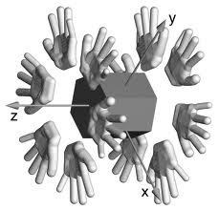

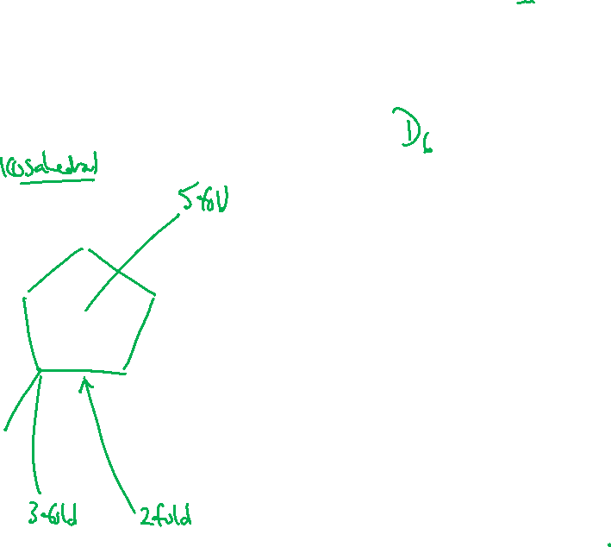
What kind of symmetry can we describe for:

Slide 16

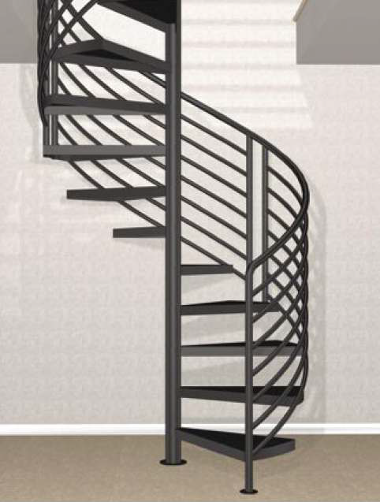
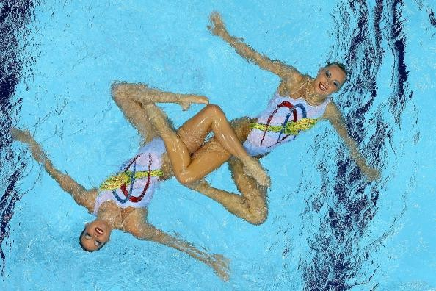


Slide 17
Symmetry
The following webpage has links and description to many of the common symmetry forms (and not so common forms). This includes examples of proteins where specific symmetries are adopted.
http://www.cryst.bbk.ac.uk/PPS2/course/section11/symmetry.html

Slide 18
Structure & Function
Biochem 320
The three-dimensional structure of proteins
Protein denaturation and folding
University of Alberta
Department of Biochemistry

Slide 19
Protein Denaturation
Forces in protein folding are largely weak, non-covalent forces
Native state can be destroyed (denatured)
  Heat
  pH
  Detergents
  Organic solvents (eg. Acetone, Guanidine-HCl)

Slide 20
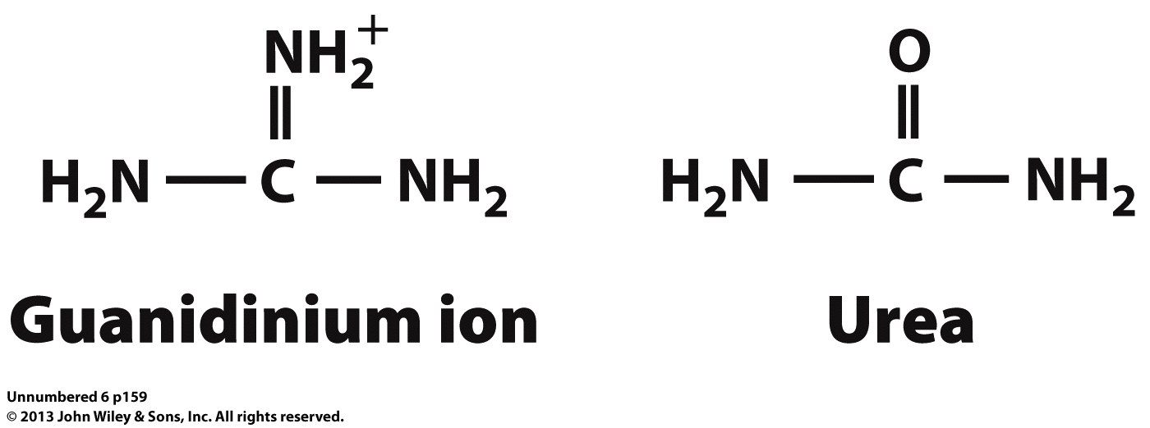

Some denaturants
“Chaotropic” agents
Water soluble
Disrupt hydrophobic interactions

Slide 21
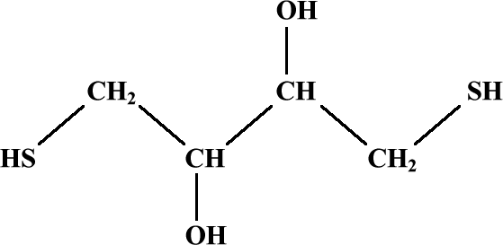
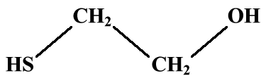
Reducing agents
β-mercaptoethanol
dithiothreitol
Reduce disulfide bonds
Become oxidized as part of the reaction

Slide 22
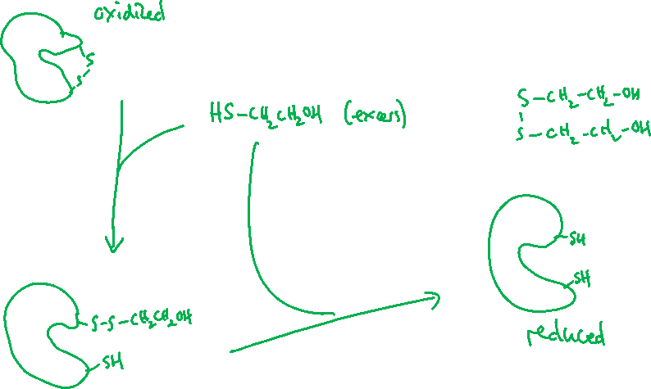
Disulfide Exchange

Slide 23
Denaturation
Cooperative process
  Transition from folded to unfolded occurs over a small range.
  Midpoint of transition (T_{m}) is characteristic of both the denaturant and the protein.
  Unfolding part of the protein decreases the energy required to unfold the rest of the structure.

Slide 24
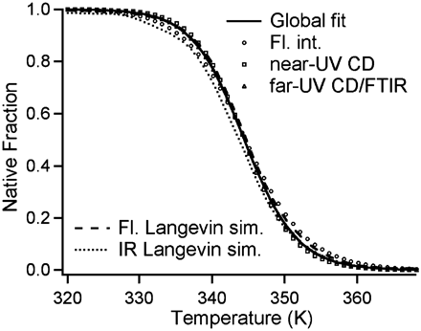
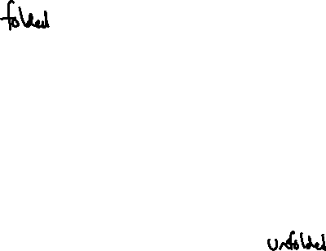
Thermal Denaturation of Proteins
Temperature as a denaturant can break weak non-covalent forces.
The transition between folded (low temperature) and unfolded (high temperature) can be tracked using spectroscopic markers.
T_{m} marks the midpoint between fully folded and fully unfolded.
T_{m} = 345K
Source: Hairong Ma* and Martin Gruebele “Kinetics are probe-dependent during downhill folding of an engineered 6–85 protein” PNAS 102:2283-2287 (2005)

Slide 25
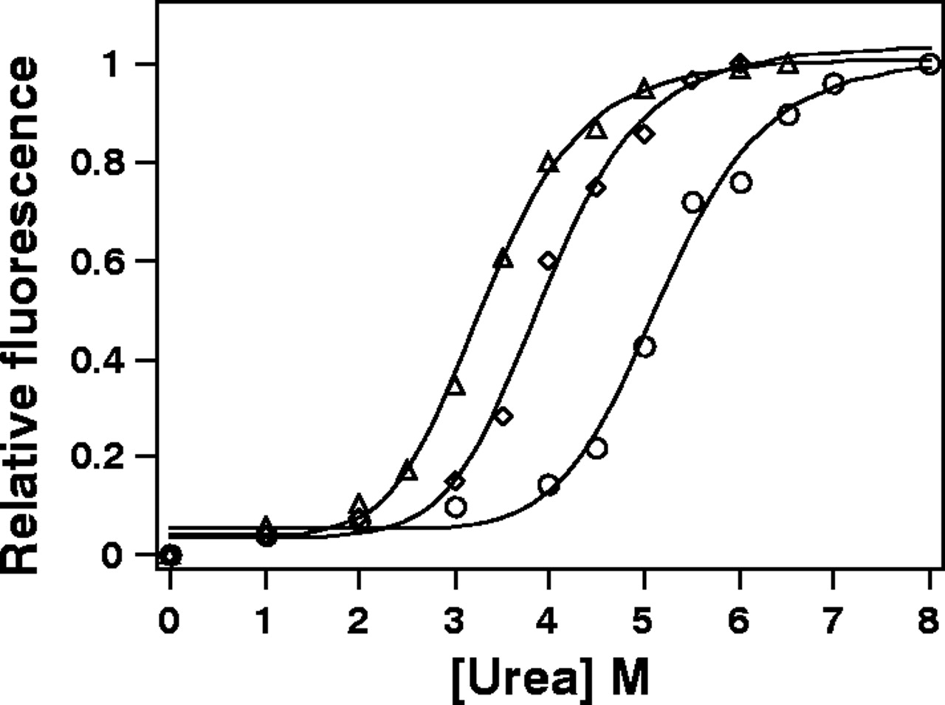

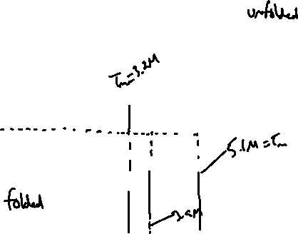
Denaturation of a protein by urea.
Urea and Guanidine-HCl both act to disrupt hydrophobic interactions.
Increasing concentrations lead to denaturation.
T_{m} in these experiments will have a value of [Urea] in M.
Kovar D R et al. J Cell Sci 2001;114:4293-4305
©2001 by The Company of Biologists Ltd
Notes:
CrPRF is an extremely stable profilin. The stability of CrPRF (circles), HPRO1 (triangles) and ZmPRO5 (diamonds) proteins was determined by incubating them with increasing concentrations of urea and measuring their intrinsic tryptophan fluorescences. The relative fluorescence was plotted against the urea concentration and fitted to a sigmoid curve. For this representative experiment, the denaturation midpoint for HPRO1 was 3.3 M, for ZmPRO5 4.0 M and for CrPRF 5.2 M.

Slide 26
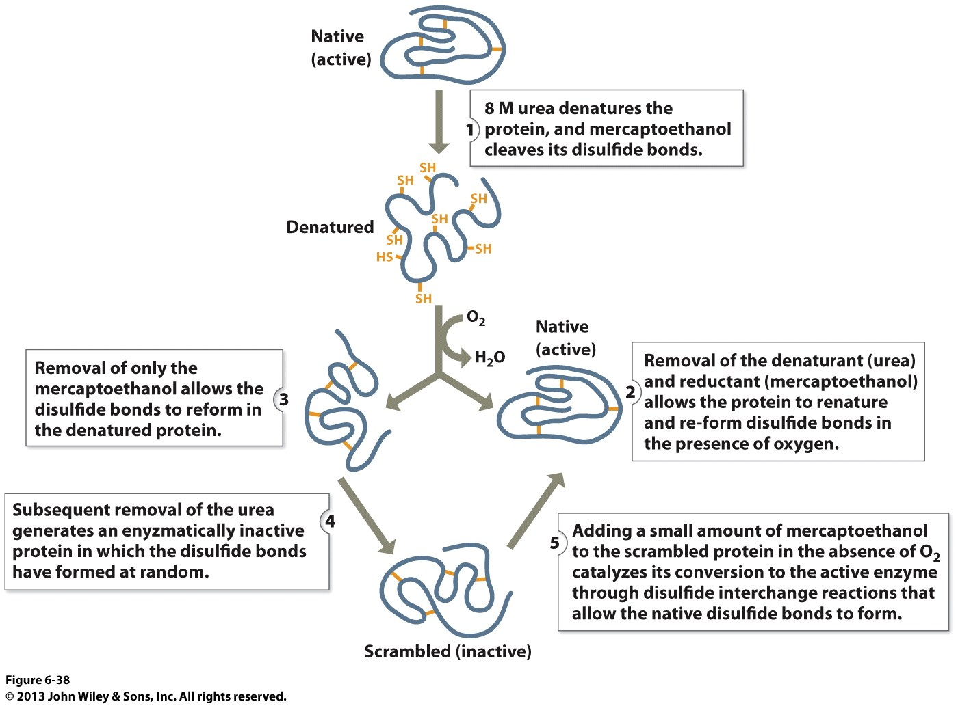
Renaturation of Denatured Ribonuclease (Christian Anfinsen)
Removal of denaturants may allow a protein to refold
A protein will refold into the native structure providing no covalent bonds have been affected
If the disulfide bonds reform before the denaturant is removed the protein may be “locked” into the wrong conformation

Slide 27
“The native conformation is determined by the totality of interatomic interactions and hence by the amino acid sequence, in a given environment.”
—Christian Anfinsen, Nobel Prize speech

Slide 28
Protein folding
Cooperative process (like unfolding)
Not fully understood
Overall process may reflect a directed pathway and energetic collapse to folded state.

Slide 29
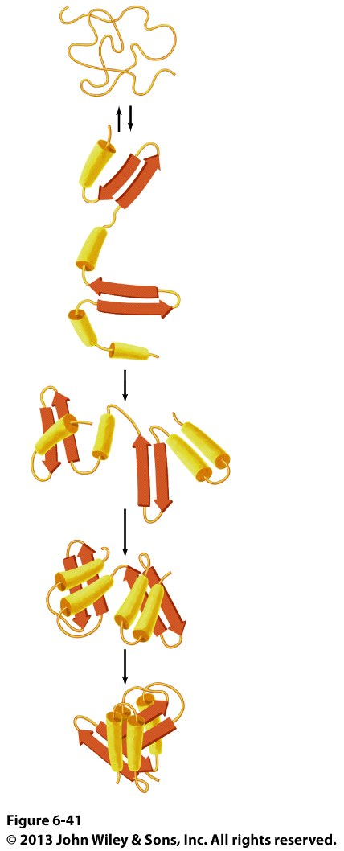
Folding pathways
Stepwise process from unfolded to folded state:
  Formation of secondary structures
  Formation of motifs
  Formation of domains
  Final tertiary structure
After formation of secondary but prior to completion of tertiary structure, protein adopts “molten globule” state.
  Hydrophobic core.
  Secondary structures present.
  Collection of dynamic structures.

Slide 30
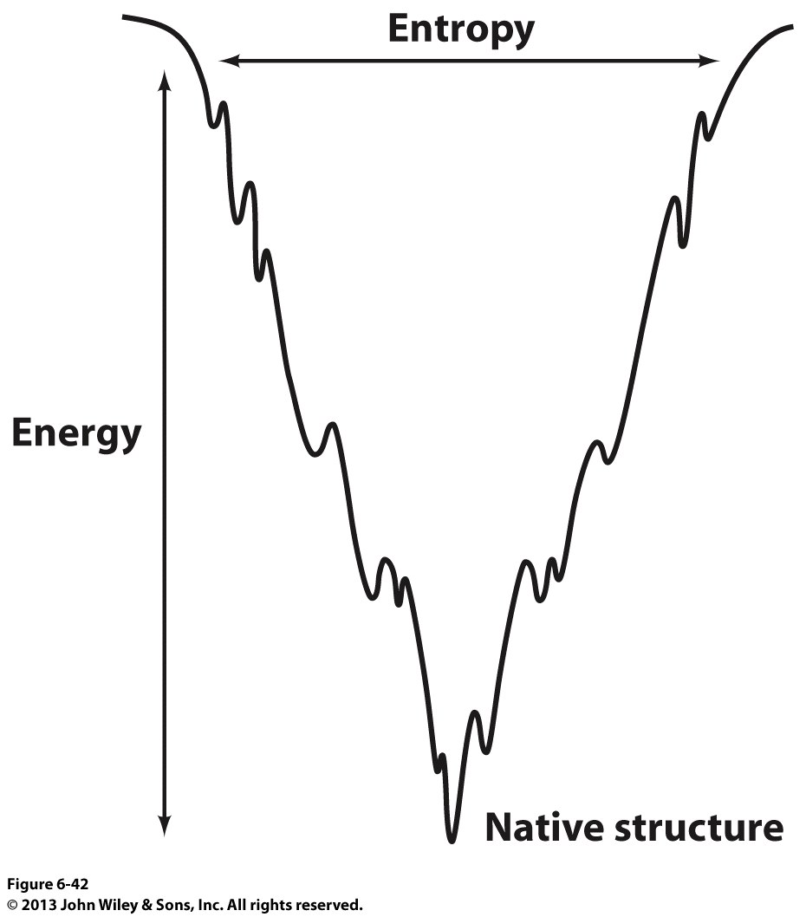
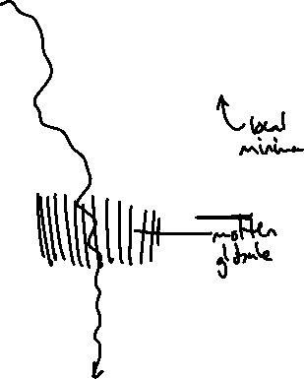
Free energy of folding
The folding process can be visualized as a free-energy funnel.
Unfolded states (top) have large conformational entropy and relatively high free-energy.
As folding progresses, the number of states present decreases and the conformational entropy decreases.
Some structures may be relatively stable but do not represent the native structure
The native, folded state (bottom) has the lowest conformational entropy.

Slide 31
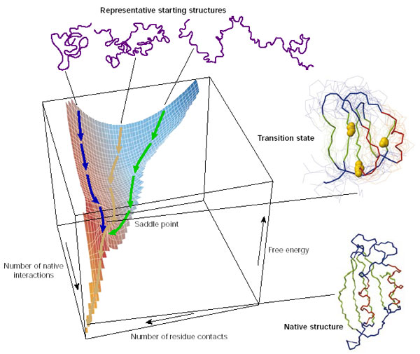
The energetic funnel
Proteins fold into their correct minimal-energy configuration because of the physicochemical properties of their amino acid sequence.
Trends Biochem Sci, 25, 2000

Slide 32
Protein folding animation
https://www.youtube.com/watch?v=gFcp2Xpd29I

Slide 33

Which statement is true for the native state of a protein?
It is a single rigid structure.
The low entropy of the native state makes it energetically favourable.
It will maximize the number of hydrogen bonds that can be formed.
It may contain knots in the polypeptide chain.
Both B and C.

Slide 34
“Scientists Unscramble Eggs”
Like many researchers, he has struggled to efficiently produce or recycle valuable molecular proteins that have a wide range of applications but which frequently “misfold” into structurally incorrect shapes when they are formed, rendering them useless.
“It’s not so much that we’re interested in processing the eggs; that’s just demonstrating how powerful this process is,” Weiss said. “The real problem is there are lots of cases of gummy proteins that you spend way too much time scraping off your test tubes, and you want some means of recovering that material.”
http://news.uci.edu/press-releases/uci-fellow-chemists-find-a-way-to-unboil-eggs/

Slide 35
Structure & Function
Biochem 320
Protein Denaturation and Folding
Chaperones and Assisted Folding

Slide 36
Misfolding
Stable structures which are not native structures may form.
May be disease states:
  Amyloidosis (e.g. Huntington’s, Alzheimer’s)
  Prion diseases (e.g. BSE, scrapie)
  Collagen defects (e.g. Osteogenesis imperfecta)

Slide 37
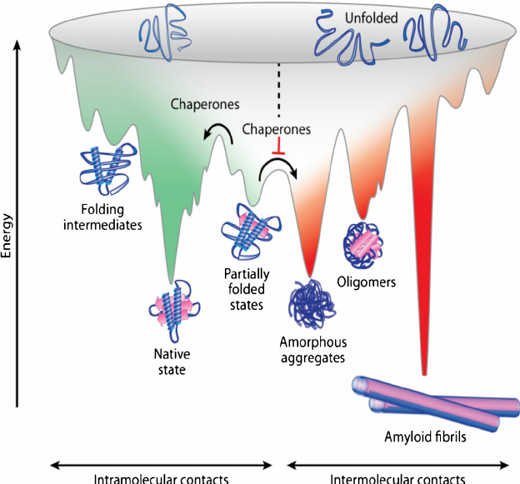
Misfolding
Source: Muntau et al., J. Inherit Metab Dis (2014) 37:505-23

Slide 38
Assisted folding
Protein folding processes may be assisted by other proteins:
Molecular chaperones
  Heat shock proteins (e.g. Hsp70/Hsp40; Hsp90)
  Chaperonins
Isomerases
  Protein Disulfide Isomerase (PDI)
  Peptide Prolyl Isomerase (PPI)

Slide 39
Chaperones/Chaperonins
Similarities:
  Misfolded proteins have exposed hydrophobic regions which may aggregate.
  Energy is required (ATP hydrolysis).
  Molecular chaperones isolate misfolded proteins so that they are unable to interact.
  Process is repeatable for multiple cycles.
  The effect is a kinetic one, not a thermodynamic one (does not impose a fold on the protein, but assists in formation).

Slide 40
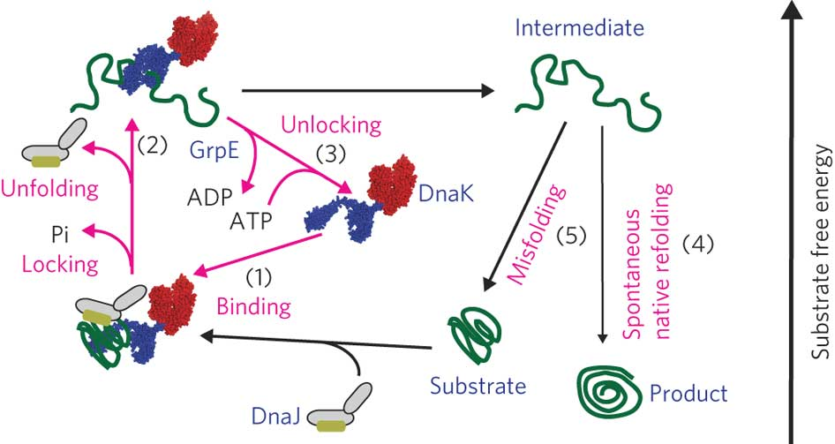
DnaK/DnaJ (bacterial chaperones)
Source: Sharma et al. Nature Chem. Biol. 6, 914–920 (2010)

Slide 41
ATP hydrolysis is linked to unfolding.
  ATP binds to DnaK (Hsp70), which then associates with DnaJ (Hsp40) and misfolded substrate.
  ATP hydrolysis changes the binding site for the protein substrate.
  After release, GrpE is involved in nucleotide exchange (releases ADP)

Slide 42
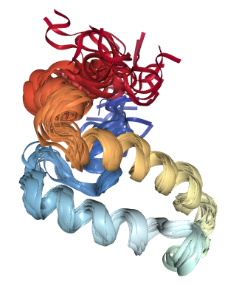
The structure of one domain of DnaJ (Hsp40) is shown below. This domain contains 77 amino acids. What can you reasonably conclude from this image?
This structure was solved by X-ray crystallography.
This domain is largely α-helical.
Hsp40 contains a single domain.
This domain represents approximately half the full protein.
None of these conclusions are reasonable.

Slide 43
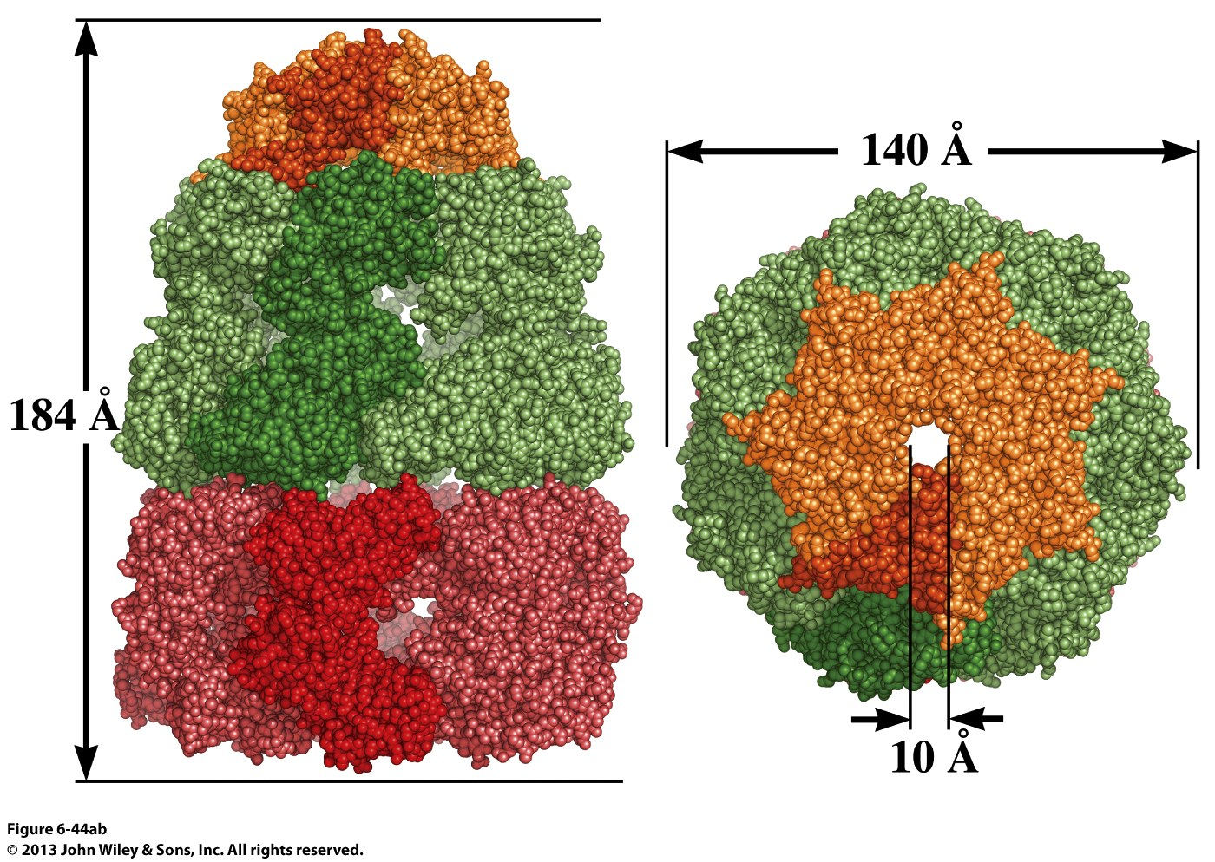
Surface and Cut-Away Images of the GroEL/GroES Complex (Chaperonin)
Note the large interior space within the complex.

Slide 44
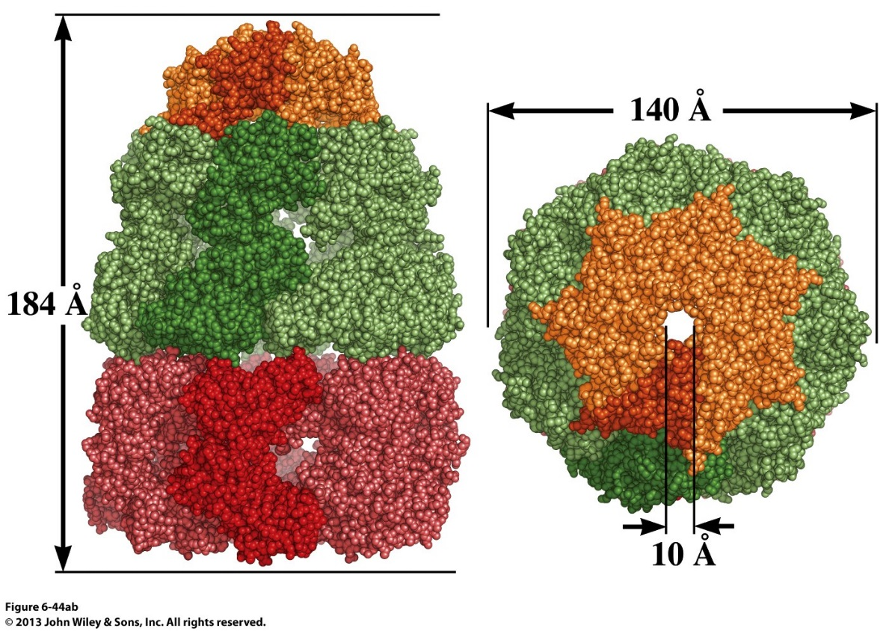

E. coli GroEL/GroES consists of 14 GroEL subunits and 7 GroES subunits. What symmetry does it likely have?
C₇
C₁₄
D₇
D₁₄
Either B or C.

Slide 45
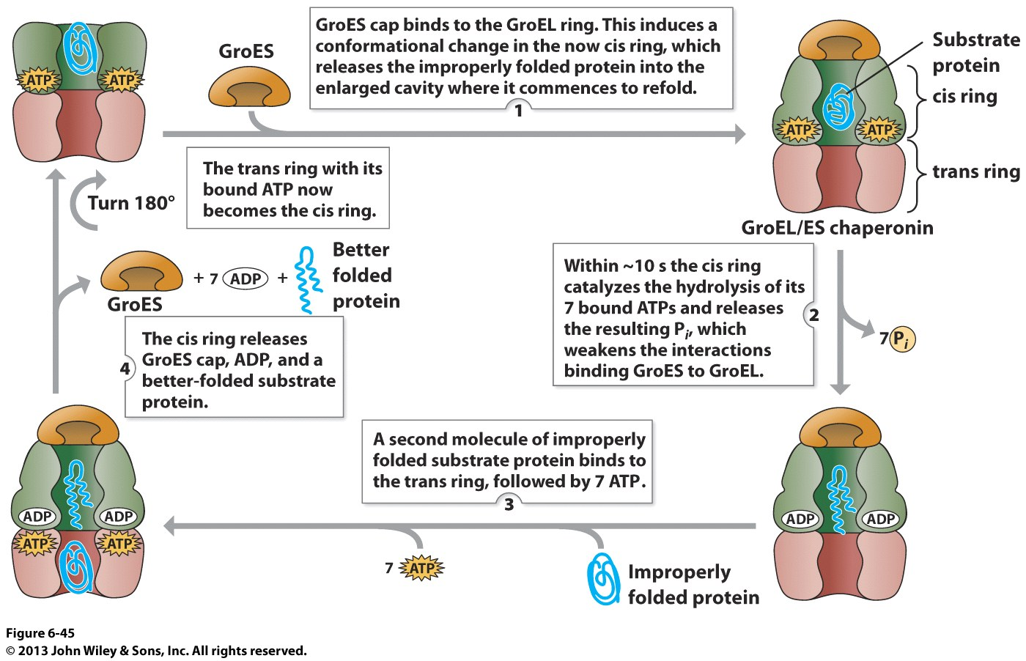
The GroEL/GroES Complex is a Chaperonin System in E. coli
Proteins up to 60kDa can fit in the internal cavity. ATP hydrolysis leads to changes in the cavity (hydrophobic areas become buried) that assist in protein folding.
Notes:
Chaperonins are elaborate protein complexes required for the folding of some cellular proteins that do not fold spontaneously. In E. coli 10-15% of proteins require the resident chaperonin system.

Slide 46
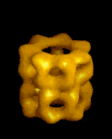
GroEL/GroES conformation changes
Significant conformational changes are associated with the mechanism of chaperonins
Source: people.cryst.bbk.ac.uk/~ubcg16z/chaperone.html

Slide 47

Protein Disulfide Isomerase will break disulfide bonds in protein substrates. What amino acids are likely found in the active site?
A
W
C
R
D

Slide 48
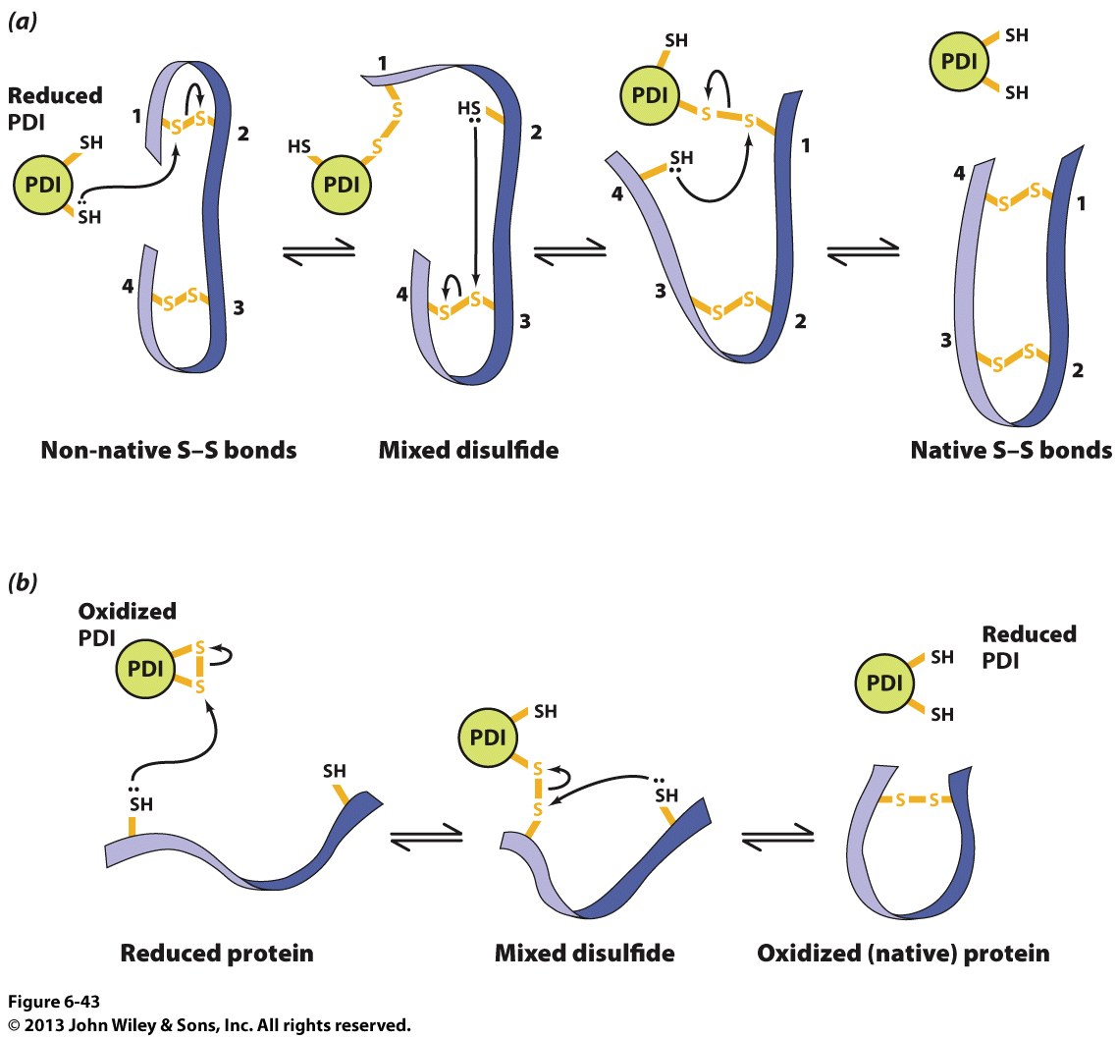
Protein Disulfide Isomerase (PDI)
Protein disulfide isomerase (PDI) catalyzes the shuffling of disulfide bonds to form the correct bonds of the native conformation.

Slide 49
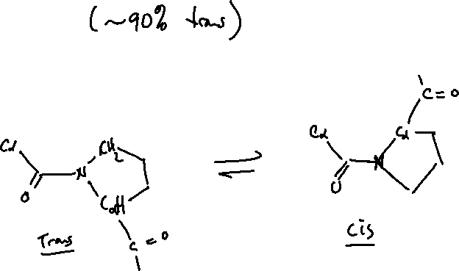
Peptide prolyl cis-trans isomerase (PPI)
Proline residues may adopt a cis or trans peptide bond.
  ~10% of proline residues have cis peptide bonds
Adopting a cis bond is not spontaneous.
  PPI will assist in the reaction.

Slide 50
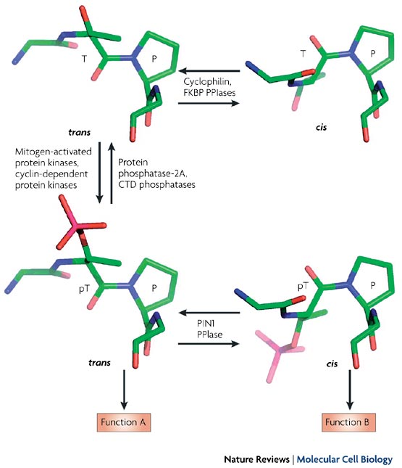
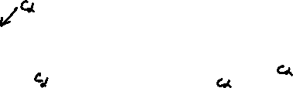
Source: http://www.nature.com/nrm/journal/v8/n11/full/nrm2261.html

Slide 51

Which statement(s) are true regarding chaperones?
They consume ATP as part of their action.
They change the native state of the protein substrates.
They act on only very specific proteins.
They prevent aggregation of unfolded proteins.
Both A and D.

