Slide 1
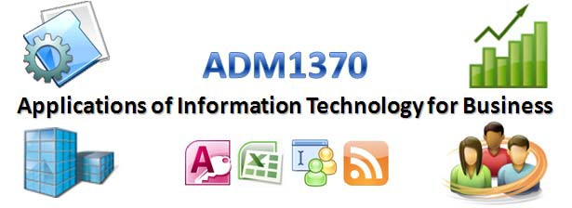
Dr. Umar Ruhi
umar.ruhi@telfer.uottawa.ca

Slide 2


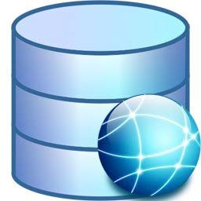


Agenda
Database Normalization (contd.):
❑ Overview & Example
Database Queries (contd.):
❑ Types of Queries
❑ SQL
Data Warehouses & Data Marts:
❑ Definitions
❑ System Components
❑ Examples

Slide 3




Database Normalization
Database normalization is the process of removing redundant data from your tables in to improve storage efficiency, data integrity, and scalability.
a method for analyzing and reducing a relational database to its most streamlined form to ensure minimum redundancy, maximum data integrity, and optimal processing performance.
In the relational model, methods exist for quantifying how efficient a database is. These classifications are called normal forms (or NF), and there are algorithms for converting a given database between them.
Normalization generally involves splitting existing tables into multiple ones, which must be re-joined or linked each time a query is issued.

Slide 4
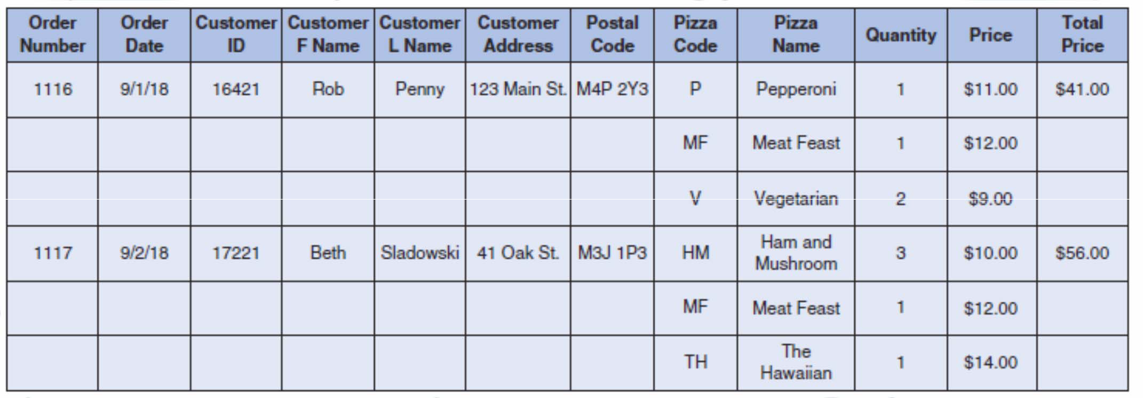
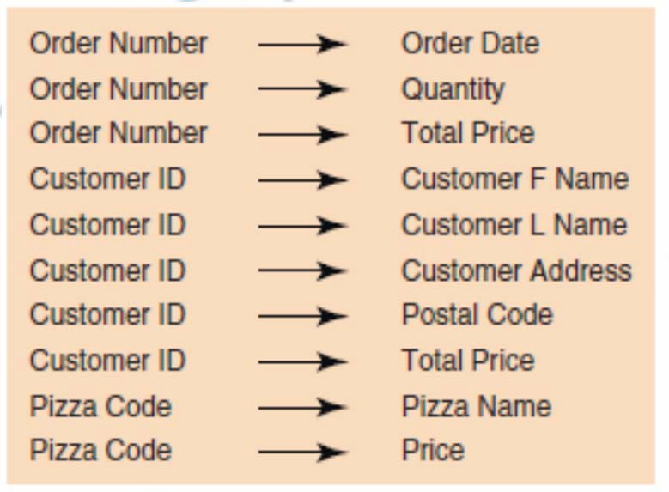

Database Normalization
Initial Non-normalized version of a Pizza Shop Orders Database:
❑ Null values
❑ Many repeating groups
❑ Need look at functional dependencies among attributes to figure out different entities/tables

Slide 5
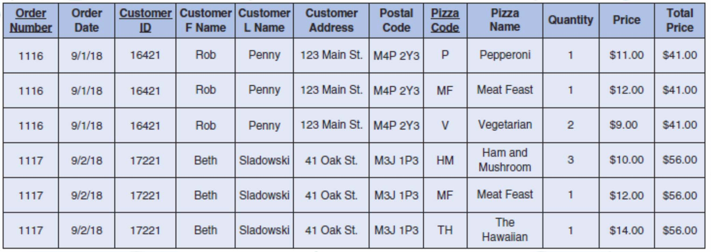
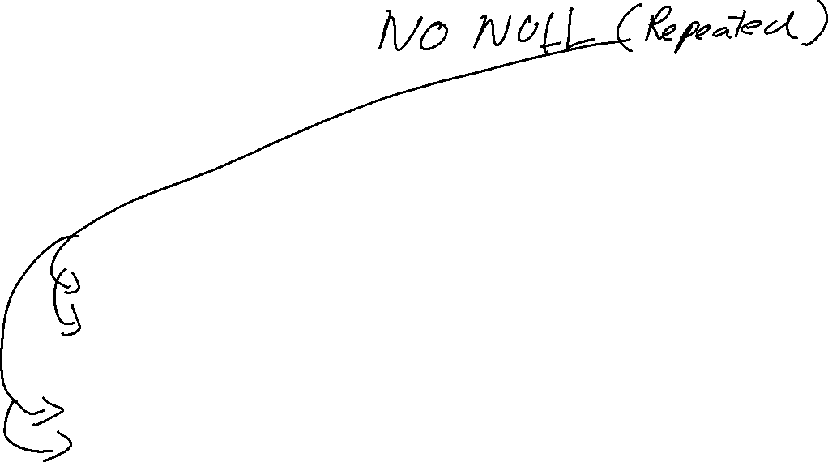



Database Normalization
1st Normal Form (1NF):
❑ Identify/assign Primary Keys
However,
❑ multiple entities still represented in the same table
❑ table contains repeating groups

Slide 6
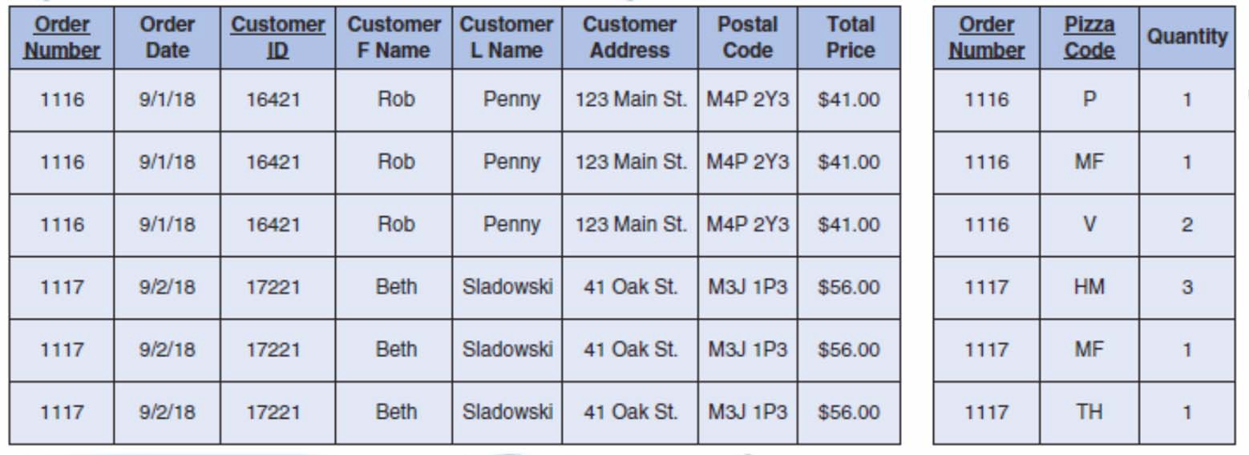
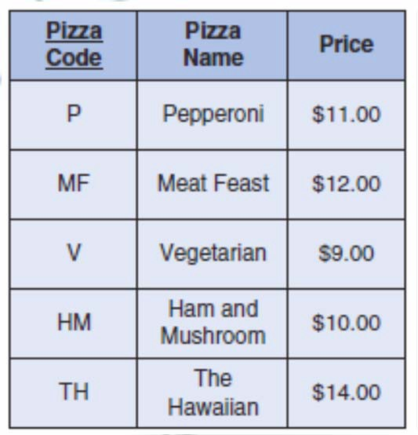














Database Normalization
2nd Normal Form (2NF):
❑ Separate tables for some entities.
❑ Functional dependency between primary key and all attributes within the same table.
However,
❑ Some tables still contain repeating groups
❑ Still need to separate some entities further

Slide 7
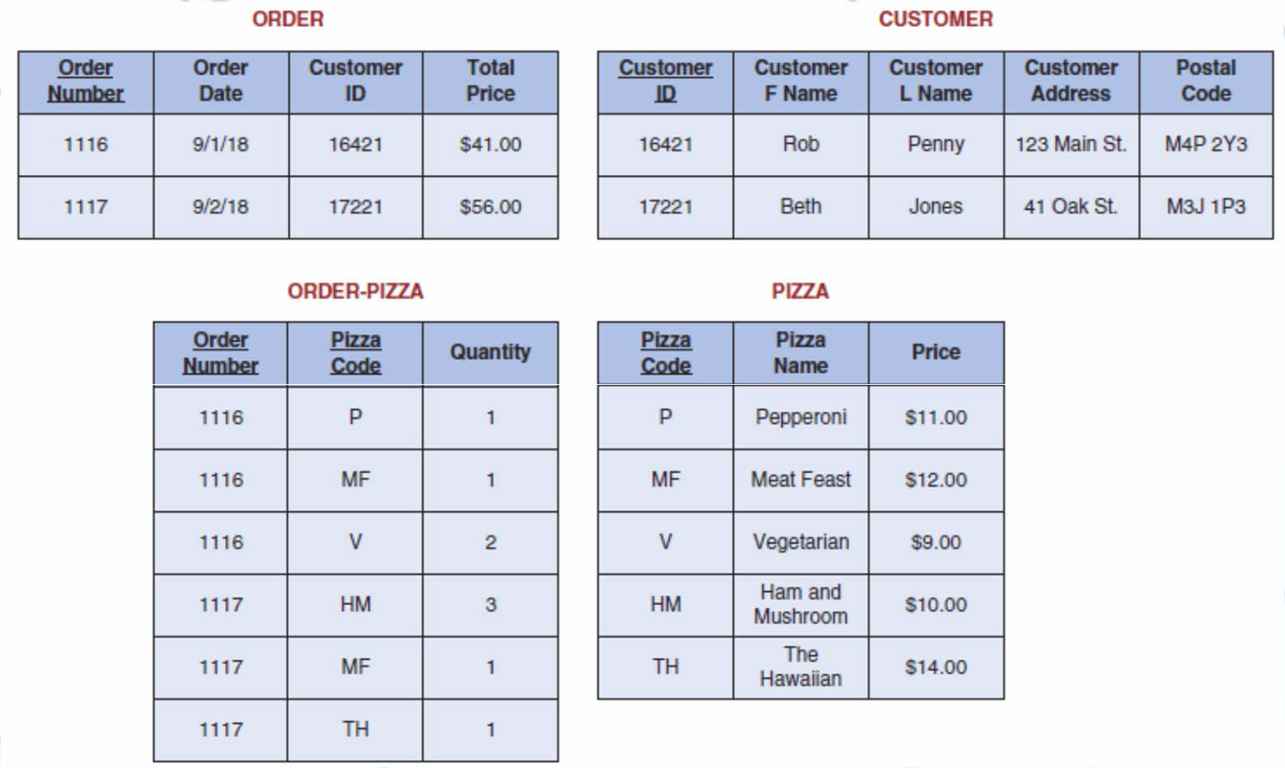





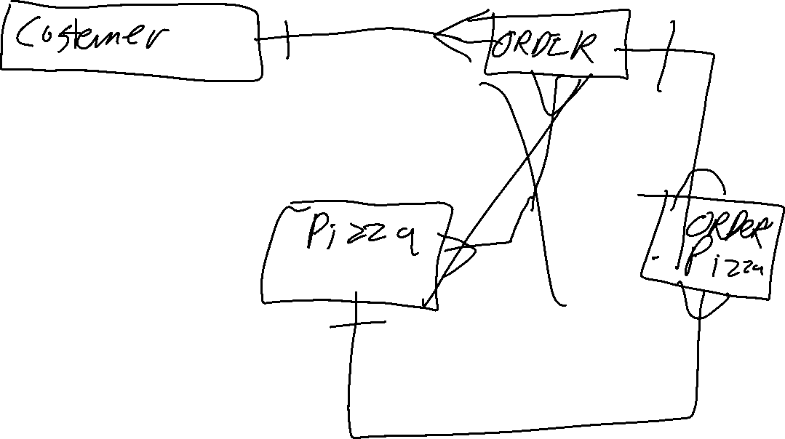









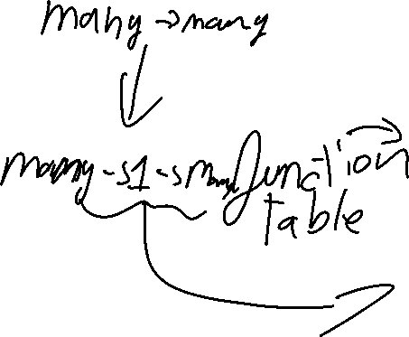















Database Normalization
3rd Normal Form (3NF):
❑ Separate tables for all entities.
❑ Foreign keys are used to link related tables.
❑ No data redundancy.

Slide 8
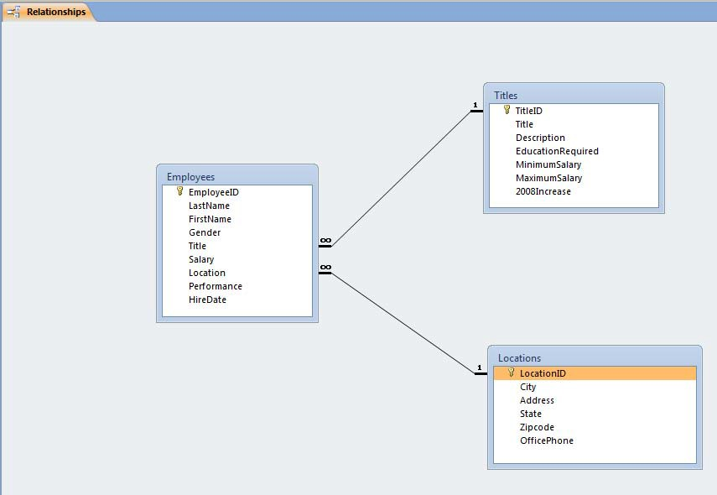




Normalization & ERD Example: Relational Database of Employees
The Relationships Tool in MS Access allows explicit creation of relationships between tables.
❑ Referential Integrity & Cascading Updates ensures data integrity between parent and child tables.

Slide 9










Working with Database Objects: Queries
Query:
❑ a set of instructions used for working with data
❑ creating a query is like asking the database a question.
❑ running a query performs these instructions and provides the answers.
the results that a query returns can be sorted, grouped, or filtered.
❑ A query can get its data from one or more tables, from existing queries, or from a combination of the two.
❑ The tables or queries from which a query gets its data are referred to as its record source
❑ The results from a query are referred to as its recordset

Slide 10

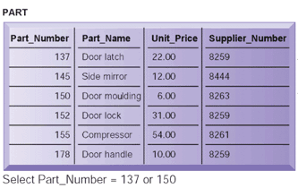






Relational DBMS Concepts: Basic Database Query Operations: Select
3 Basic Query Operations to develop useful sets of data:
1. Select
❑ Creates a subset of records that meet certain criteria
❑ e.g., Select records (rows) with part number = 137 or 150

Slide 11
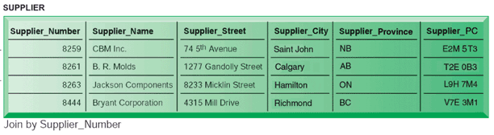







Relational DBMS Concepts: Basic Database Query Operations: Join
3 Basic Query Operations to develop useful sets of data:
2. Join
❑ combines tables into one with more info
❑ e.g., join the resulting table from (1) (previous slide) and SUPPLIER

Slide 12
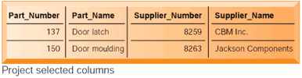














Relational DBMS Concepts: Basic Database Query Operations: Project
3 Basic Query Operations to develop useful sets of data:
3. Project
❑ Creates a subset of columns
❑ e.g., from the resulting table project Part_Number, Part_Name, Supplier_Number, Supplier_Name

Slide 13






Relational DBMS Concepts:
Creating Queries
Methods to Create Queries:
Structured Query language (SQL):
❑ the most popular query language used for interacting with a database:
❑ allows people to perform complicated searches by using relatively simple statements or key words.
Typical key words are SELECT (to choose a desired attribute), FROM (to specify the table or tables to be used), and WHERE (to specify conditions to apply in the query).
Query by Example (QBE):
❑ The user fills out a grid or template—also known as a form—to construct a sample or a description of the data desired. Users can construct a query quickly and easily by using drag-and-drop features in a DBMS such as Microsoft Access.
❑ Conducting queries in this manner is simpler than keying in SQL commands.

Slide 14
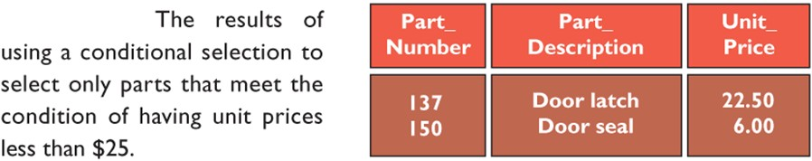

Relational DBMS Concepts: Querying Databases using SQL
SQL (Structured Query Language):
❑ Example:
SELECT part_Number, Part_Description, Unit_Price FROM PART
WHERE Unit_Price < 25.00

Slide 15


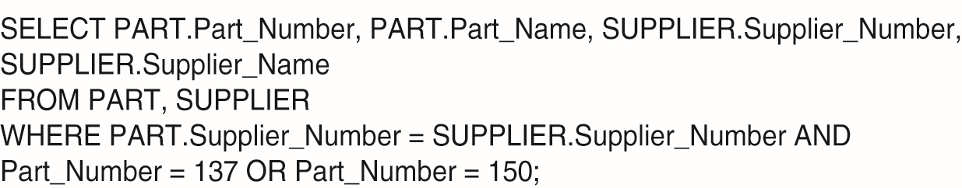

















Relational DBMS Concepts: Querying Databases using SQL
A DBMS has a data manipulation language used to add, change, delete, and retrieve data in the database
One such language is SQL (Structured Query Language)
❑ MS Access uses SQL behind a user-friendly interface (so that you don’t need to learn SQL in order to manipulate your data)
❑ Here is the SQL query for the previous example:

Slide 16








Types and Vendors of DBMS: Enterprise & Desktop
DBMS products fall into two broad categories:
❑ Enterprise DBMS and Personal / Desktop DBMS.
Enterprise DBMS
❑ These products process large operational and analytical databases.
❑ These products can support thousands of users at a time, along with multiple database applications.
❑ IBM’s DB2, Microsoft’s SQL Server, and Oracle are examples of enterprise DBMS products.
Personal / Desktop DBMS:
❑ These products are designed for smaller, simpler database applications.
❑ Such products are used for personal or small workgroup applications that involve fewer than 100 users, and normally fewer than 15.
❑ The great bulk of databases in this category have only a single user.
❑ e.g. MS Access, FileMaker
ADM4377 – Electronic Commerce ⬅➔ Winter 2016 ⬅➔ Umar Ruhi

Slide 17
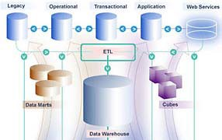
Next Topic
Data Warehouse, Data Marts & Data Mining:
❑ Definitions:
Product
Process
❑ System Components
❑ Examples

Slide 18
















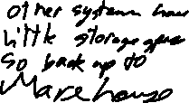





















Data Warehouses & Data Marts: Introduction
For business decision-making purposes, data from many sources and over many time periods must be gathered together and organized in a consistent and useful way.
Data Warehouses and Data Marts support business intelligence (BI) applications.
A Data Warehouse is a copy of transaction data specifically structured for querying, analysis, reporting, and more rigorous data mining
❑ A data warehouse is a repository of historical data that are organized by subject to support decision makers in the organization.
❑ The data warehouse contains a copy of the transactions which are not updated or changed later directly by the transaction system.
A data mart is a low-cost, scaled-down version of a data warehouse that is designed for the end-user needs in a strategic business unit (SBU) or an individual department.

Slide 19
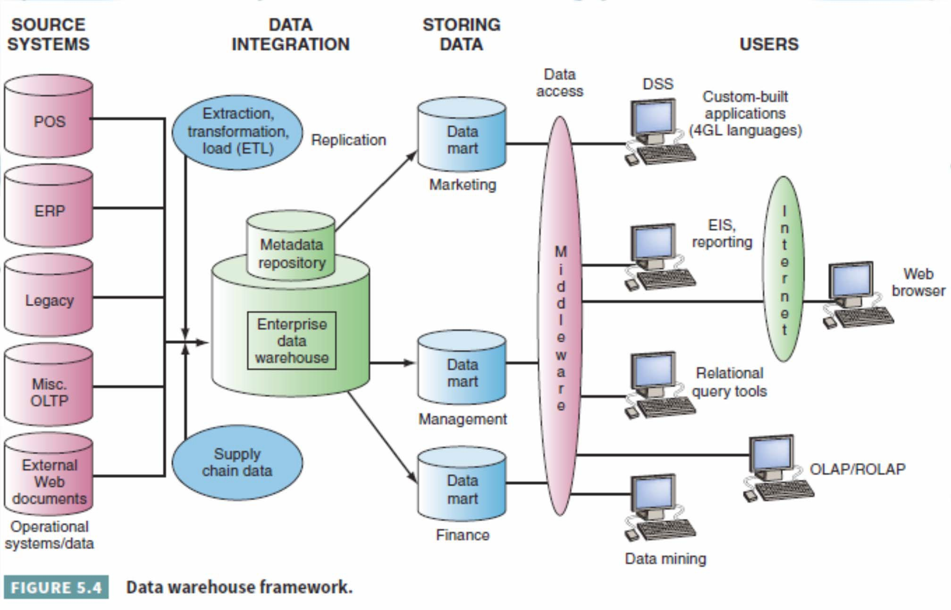
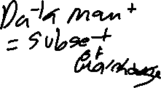

















Data Warehouse Environment

Slide 20
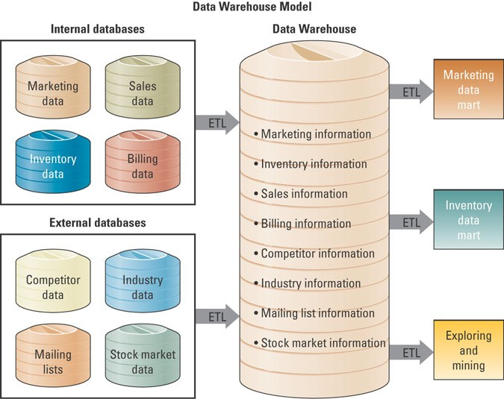








Data Warehouse Environment

Slide 21



Data Warehouse Environment
Extraction, transformation, and loading (ETL):
❑ a process that extracts information from internal and external databases, transforms the information using a common set of enterprise definitions, and loads the information into a data warehouse
Data mart:
❑ contains a subset of data warehouse information
❑ contains summarized or highly focused portion of data for a specified business unit or group of users
❑ contains a snapshot of operational data for specific business contexts.
❑ creation of a data mart is predicated on a specific, predefined need for a certain grouping and configuration of select data

Slide 22
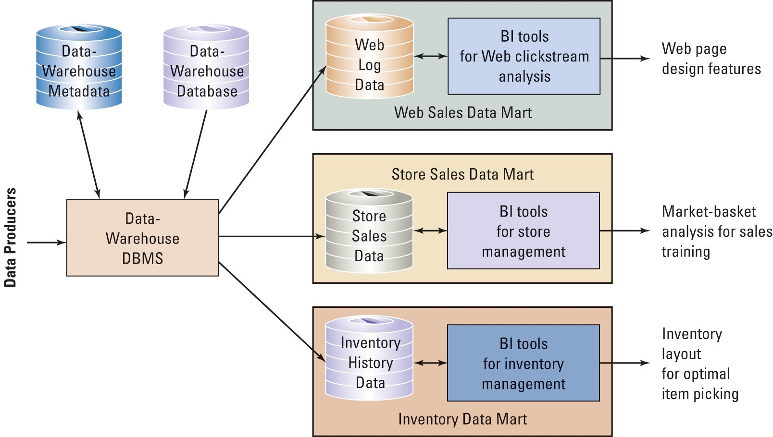





Data Mart Examples

Slide 23


















Characteristics of a Data Warehouse
Organized by business dimension or subject:
Data are organized by subject, e.g. by customer, vendor, product, price level, and region. This arrangement differs from operational databases, where data are organized by business process, such as order entry, inventory control, and accounts receivable.
Use online analytical processing (OLAP):
Involves the analysis of accumulated data by end-users, as opposed to operational databases that use online transaction processing (OLTP).
Integrated:
Data are collected from multiple systems and then integrated around subjects. For example, customer data may be extracted from internal (and external) systems and then integrated around a customer identifier, thereby creating a comprehensive view of the customer.
Time variant:
Data warehouses and data marts maintain historical data (i.e., data that include time as a variable).
Unlike transactional systems, which maintain only recent data
Non-volatile:
end-users or transactional processes cannot change or update the data directly. Warehouses and marts are updated through IT-controlled load processes rather than by users.
Multidimensional:
❑ Typically, the data warehouse or mart uses a multidimensional data structure. A common representation for this multidimensional structure is the data cube.

Slide 24
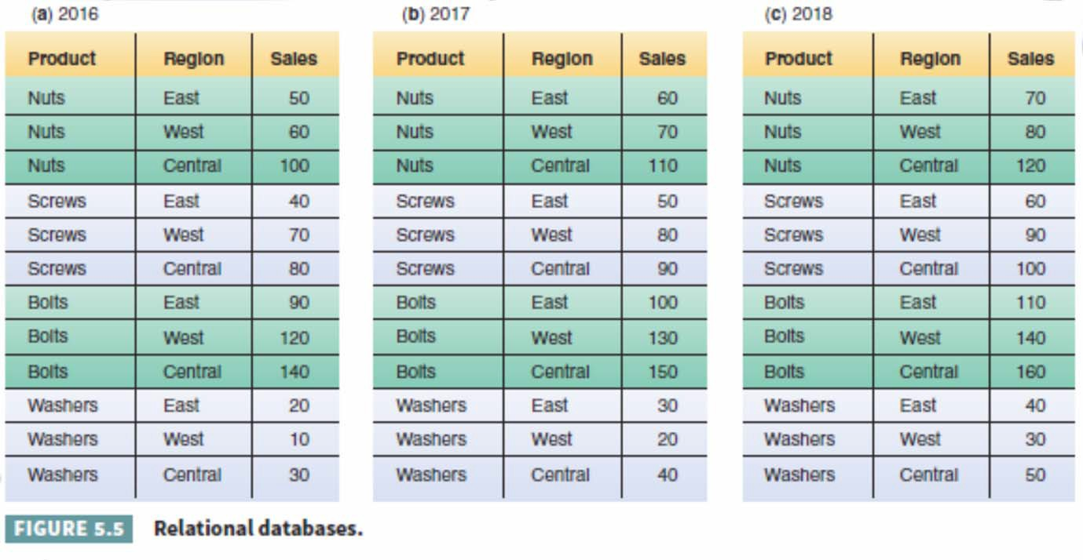
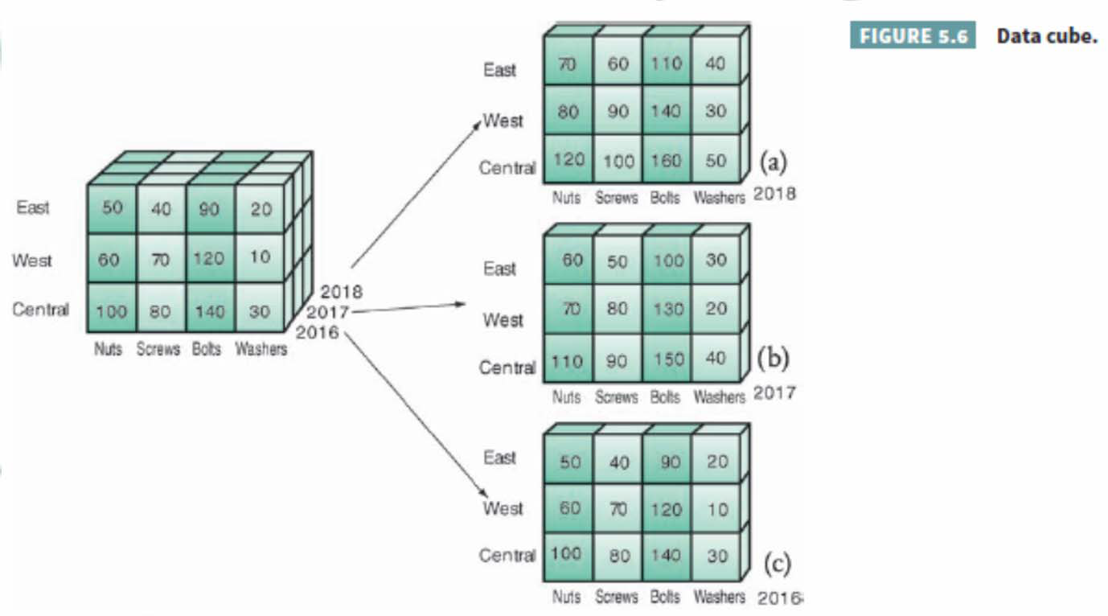



Characteristics of a Data Warehouse

Slide 25
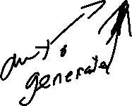




Data Warehouses and Reporting Systems
❑ Types of Reports:
Static
Dynamic
Query Based
OLAP
Reporting System Functionalities:
❑ Reports Media:
Files
Dashboards
Alerts
Web Services
❑ Report Authoring
❑ Report Managing
❑ Modes of Reporting:
Push vs. Pull
❑ Report Delivery

Slide 26
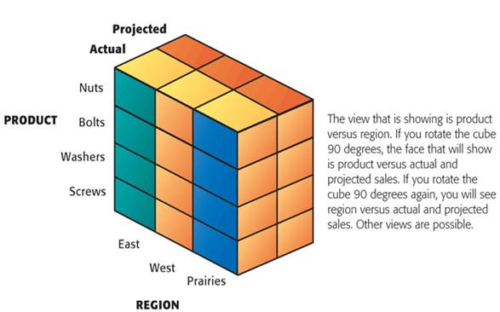

Data Warehouses and Reporting Systems
Multi-Dimensional Data Analysis using OLAP (Online Analytical Processing)
❑ Allows users to analyze large volumes of data and present the same data in different ways
❑ Each aspect of information represents a dimension (e.g., pricing, region, time period)

