Slide 1
PHP Continues
PHP – OOP and Arrays
CST8285

Slide 2
PHP & OOP (Object Oriented Programming)
PHP scripts can be both procedural and OOP since PHP 5 OO.
  Once again this is a vast subject and we will simply be scratching the surface in this program.
  This subject could be a course all on its own.
What is object oriented programming?
  Think of it as having smaller programs inside of a larger program

Slide 3
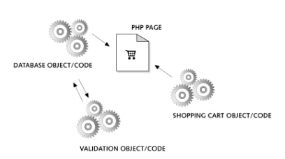
Simple PHP OOP Diagram
Taken from www.killerphp.com

Slide 4
OOP Uses / Advantages
What are the advantages or OOP?
  Allows you to better organize your code
  Allows you to reuse code
  Makes updating the application and maintenance much easier and efficient
  Why would we use this type of programming PHP?
    Especially with larger applications
  Having a vast collection of code libriaries can increase your ROI
  Take advantage of existing PHP frameworks

Slide 5
Classes
To use an object you need to create a class
  A class is like a blueprint for the object
The class itself contains all the code (data and functions)
  Inside a class data/variables are called properties
  Functions inside a class are called methods
Encapsulation – this is a method whereby only the methods inside the class can manipulate its properties
  This makes it easier to maintain the class/code

Slide 6
Declaring a Class
Define a class using the class keyword
<?php
$object = new User;
class User
{
public $name, $password
// the variable $name and $password are the properties of the class User
// The save_user function inside the class User is called a method
function save_user()
{
echo “Save User code goes here”;
}
}
?>

Slide 7
Inheritance – Superclass / Subclass
Inheritance
  One class inherits all properties of another class
At times you may require two classes that are similar but accomplish a different tasks
  Instead of rewriting code you can simply inherit and therefore use the properties of the other class
  To extend the use of one class to another you use the extends operator.
The original class is called the superclass and new class is called the subclass.

Slide 8
Creating an Object
Think of an object as a jukebox
To create a class you use the keyword new
Example:
$object = new User;
Referencing the class to use.
Assigned an object named $object to the User class

Slide 9
Accessing Objects
$object = new User; // assigned the object
$object->name = “Michael”;
//sets the value of the name property in the class User
$object ->password = “pass123”;
//sets the value of the password property in the class User
$object->save_user();
// calls the method save_user in the class User
Notice the use of the “->” pointer. The pointer allows access to the classes properties and methods.

Slide 10
Constructors
Similar to a function call, you can pass a list of arguments to a class being called.
Arguments are passed to a special method within the class called the constructor.
The constructor method initializes various properties within the class.
Class User
{
function __constructor($param1,$param2)
{
//constructor codes goes here
}
}

Slide 11
Methods
Functions inside classes are called methods
Methods are created and called the same way as functions are.
  Do not start your method names with underscores
  These are reserved for special methods as constructors and destructors
In methods you have access to a special variable called $this
The $this variable is used to access the current objects properties

Slide 12
Methods Con’t
<?php
$mypass = new User;
echo $mypass->get_password();
class User
{
public $name = “Michael”;
public $password = “mypass”;
function get_password()
{
return $this->password;
}
}
?>
Observe the get_password method above.
Using the special $this variable give access to the current object ($mypass) and then returns the value of the password property.
Notice the $ is missing from the property $password when using the “->” pointer

Slide 13
Declaring Properties
It is not necessary to declare properties within classes. They can be defined when first used.
  However, not declaring properties is not a good practice. This makes your code within the class very clear.
You can define Constant Properties using const keyword.
const tax = 0.13;
Constant variables can be referenced using the self keyword and the double colon operator.
echo self::tax;

Slide 14
Property and Method Scope
There are 3 keywords for controlling the scope of both properties and methods.
public
  Is the same as var and is the default when declaring properties and methods.
protected
  Properties and Methods declared protected can be referenced only by the objects class and subclasses
private
  Properties and Methods declared private can only be referenced by that particular class.

Slide 15
The final word on OOP
There is so much material to cover we cannot cover it all in one class!
You will do your own research on the following;
  The extends operator
  The parent operator
  Investigate the Subclass constructors
  The final keyword
These will be on the final exam and you will be expected to know what they mean and how they are used.
I implore you all to take the time to play around as much as possible with OOP and all the keywords and operators discussed in these slides.

Slide 16
PHP Arrays
PHP arrays are like ordered maps that associates values to keys.
There are three types of arrays
  Numerically indexed arrays
  Associative arrays
  Multidimensional arrays

Slide 17
Indexed Array
Numerically Indexed Array
  <?php
  $paper[] = “Copier”;
  $paper[] = “Inkjet”;
  $paper[] = “Laser”;
  $paper[] = “Photo”;
  $print_r($paper);
  ?>
  Try this example to see what print_r does!

Slide 18
Associative Arrays
Associative arrays allow you to reference the items in an array by name rather than by number (as per the indexed array)
  Here is an example of an associative array
<?php
$paper[‘copier’] = “Copier & Multipurpose”;
$paper[‘inkjet’] = “Inkjet Printer”;
$paper[‘laser’] = “Laser Printer”;
$paper[‘photo’] = “Photo Printer”;
?>
Each item has a unique name that can be used to reference its value.
The names are called indexes
Research how to create an array using keywords!

Slide 19
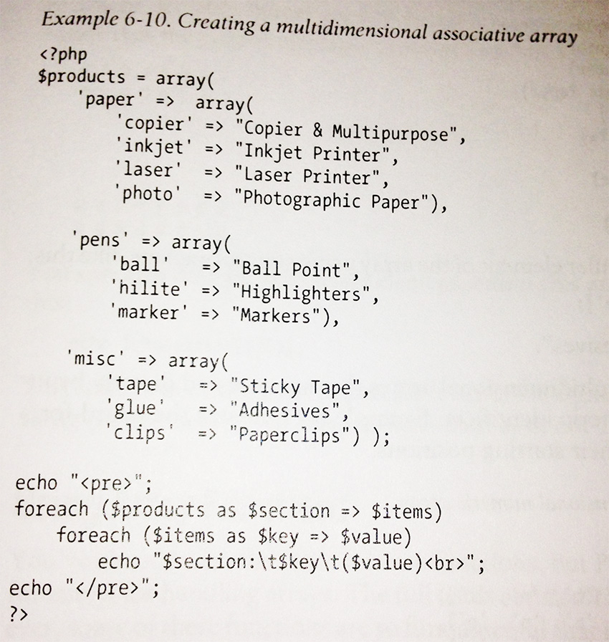
Multidimensional Arrays

Slide 20
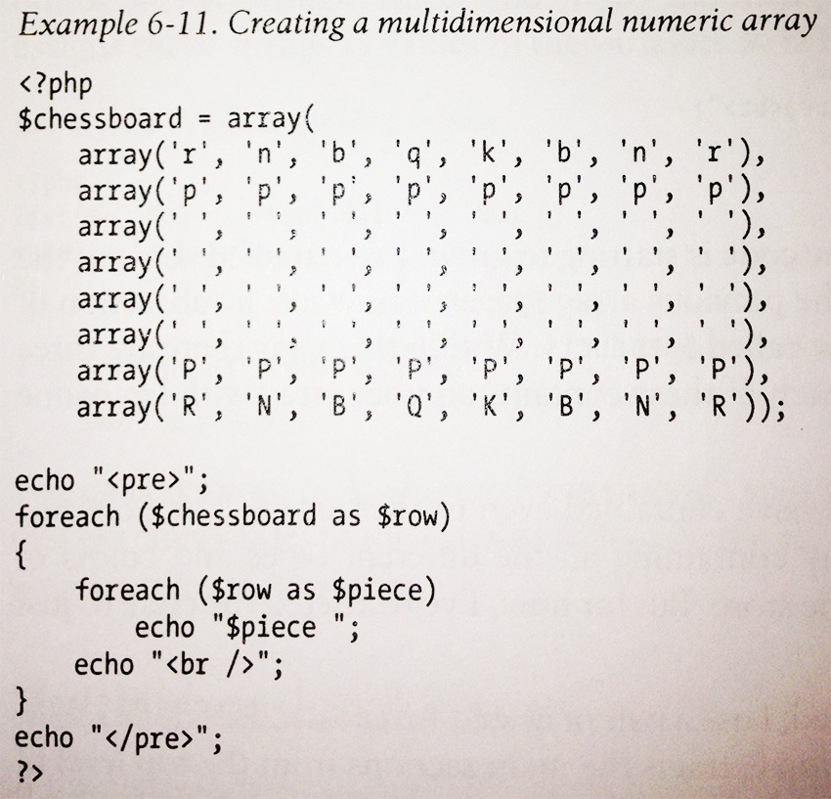
Multidimensional Arrays

Slide 21
Accessing Arrays
There are multiple ways of accessing arrays.
  for loops (easy for numeric arrays)
  foreach … as loop
  The list() and each() functions

Slide 22
Array Functions
There are a number of array functions that help us manage and manipulate the values inside arrays
Become familiar with these functions
  is_array()
    Determines if a variable is an array
  count()
    Determine how many elements are in an array
  sort()
    Sorts the values of an array (numeric and string)
  shuffle()
    Arranges the values of an array in random order

Slide 23
Array Functions Con’t
  explode()
    Takes a string and places it into an array
  extract()
    Useful for creating associative arrays from GET and POST arrays
  compact()
    Creates arrays from variables
  reset()
    Places the pointer to the first element in an array
  end()
    Places the pointer to the last element in an array

