Slide 1
BIO1140 - Introduction to Cell Biology
LAB1: Introduction to the microscopes, prokaryotic and eukaryotic cells

Slide 2
Presentation of BIO1140 Labs
Teaching team:
Lab coordinator: Dr. Fabien AVARON
Office BSC106
email: fabien.avaron@uottawa.ca
Office hours: Friday 10:30-12:00
Lab website: www.biolab1.uottawa.ca
For questions regarding absence to a lab contact the biolab team at:
biolab1@uottawa.ca
Your TAs for the semester:
Ta1: TYPE Your name + email address here + announce office hours now
Ta2: TYPE your name here
Write this info in your lab manual

Slide 3
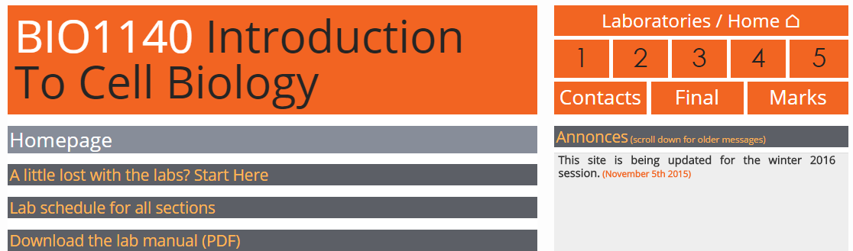
Lab website: www.biolab1.uottawa.ca
Lab marks (end of semester only)
Lab final exam page
Date of all labs - for all sections
Email addresses and office hours info of TAs
Lab specific docs (instruction for reports, data submission and download etc…)

Slide 4
Presentation of BIO1140 Labs
5 Labs + Final exam
Final exam (written): Saturday April 7, 2018 at 1PM (duration: about 75min.)
Contact coordinator in case of conflict
See lab manual for details

Slide 5
Presentation of BIO1140 Labs
Evaluation – Lab component of BIO1140 counts for 25% of final mark
    Lab 1 – Microscopy: skills and specimen - Quiz (9%)
    Lab 2 - Permeability of the red blood cell – Table (9%)
    Lab 3 - Cellular process Amoeba – graph (9%)
    Lab 4 - Mitosis - graphs (9%)
    Lab 5 - Meiosis-biological illustration (9%)
    Prelab quizzes for labs 3, 4 and 5 (5% total)
    Final lab exam (50%)
    Technical skills: Up to 15% of each lab grade (included in lab mark)
  Read lab manual introduction for attendance requirements etc…

Slide 6
Presentation of BIO1140 Labs
Chain of correction: Talk to your TA during office hours about correction problems
Late reports (penalties -10% /day). 2 days max. then zero.
Report handed in in wrong box: -10%
Absence: provide note within 7 days
Visit BIO1140 Lab website for more info

Slide 7
Presentation of BIO1140 Labs
Laboratory rules:
Lab coats and Safety Glasses
No food or drink
No bags or outwear
Promptness: Quiz at beginning of all labs starting lab 2. Don’t arrive late or you’ll get a zero.

Slide 8
SAFETY FEATURES
Eye wash stations
Safety showers
Fire extinguishers
First aid drawers
Evacuation when alarm sounds:
Proceed to emergency exit: locate primary and secondary emergency staircase corresponding to your lab (see list in lab manual).
Exit building and wait outside with your TA (leave your bag in locker)

Slide 9
BIO 1140 Introduction
Choose a lab partner and put your name on the seating plan - stay at the same seat for the rest of the semester
Be prepared for pre-lab quizzes at the beginning of each labs, starting next lab

Slide 10
Today’s Objectives
Learn how to work in the lab
Learn how to use the dissecting and compound microscopes and how to take digital pictures using Infinity Capture
distinguish the differences between eukaryotic and prokaryotic cells
Follow step-by-step instructions from lab manual and answer questions.

Slide 11
Installing the microscopes
Read the instruction in the Guide Biolabo to know how to carry the microscopes.
Take both microscopes out of the cupboard.
Use the handles to carry the compound microscope. Be careful it is very heavy!
Gently place the microscopes at the end of your bench (NOT in between the sink and the computer)
Connect the power cord

Slide 12
Installing the microscopes
Then connect the camera to both microscopes following the instructions given by TAs (One cable per camera).
Don’t push hard if you feel it doesn’t fit – ask for help or you would break the connector

Slide 13
Part 1 – Compound Microscope
Before using the microscope make sure:
You carefully read the lab manual
Then follow all the steps in the section “Setup and bright field alignment” of the guide Biolabo
Go through all the steps once before you start using the microscope.

Slide 14
Part 1 – Compound Microscope
  Follow the instructions on the manual “using the microscope” and answer all questions.
Three series of observations:
Orientation and working distance
Depth of field
Specimen size and magnification of the image using Infinity Capture
Time budget
60 min.

Slide 15
Part 1 – Compound Microscope
Use any prepared slide
Use to take digital picture: go to lab website and click the “taking digital pictures using Infinity Capture” link
Save all pictures as JPG files in: (K drive)
My documents/BIO1140/BIO1140[your section]
Create the folder if needed. Use this folder for the rest of the semester
Don’t forget to delete all files when you’re done.
Tech marks !

Slide 16
Specimen size & Magnification
Use the instructions and formulas in the lab manual.
Use the known width of the field of view (= whole width of a picture) to calculate the actual size of a specimen
Compound microscope – Camera fields of view
Objective Field of view
4x 1.80 mm
10x 0.72 mm
40x 0.180 mm (see also lab manual
100x 0.072 mm ← do not use this objective

Slide 17
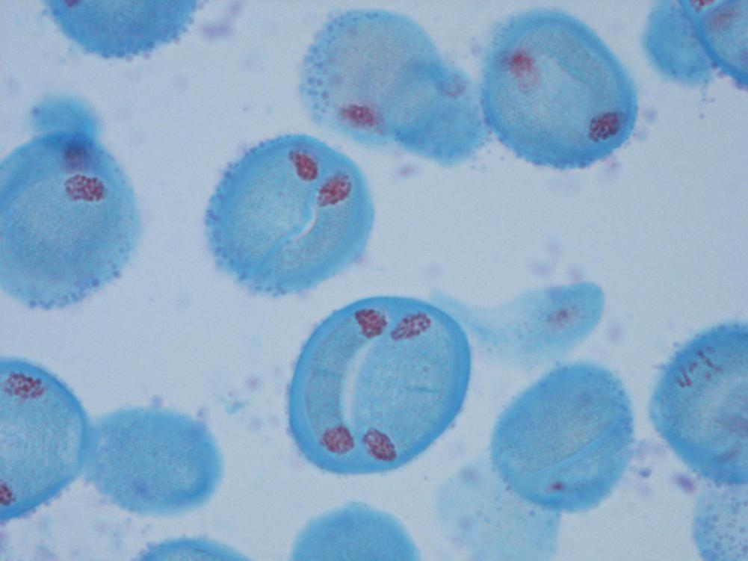
Using the field of view
Picture taken at 40x (pollen cells)
The size ratio between 2 objects do not vary on screen and in real world:
A₁ = B₁
A₂ B₂
40 cm = 9 cm
0.180mm x
x = 0.180*9/40 = 0.0405 mm
40.5 µm
9 cm : on screen width of the specimen
0.180mm (known width of snapshot: see lab manual for width of field of view at each objective)
40cm: size of the screen

Slide 18
Part 2 - Stereoscopic Microscope
Go to biolabo (stereomicroscope) read setup part then follow directions in manual
Observe a coin → What’s the best source of light: reflected or transmitted
Brine shrimp (Artemia)→ reflected or transmitted light?
Time budget
20 min.
Notes:
RESUME HERE

Slide 19
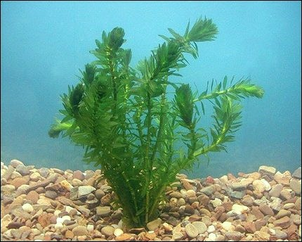
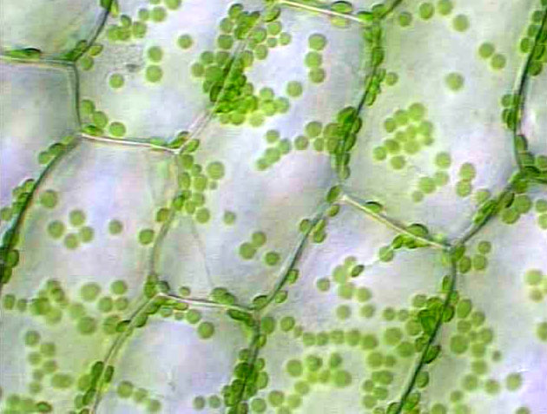
Prokaryotic & Eukaryotic cells
Time budget
40 min.
I- Eukaryotic cells:
make wet mount of Elodea
Induce plasmolysis with 5% NaCl
Take digital pictures (before and after adding the NaCl solution)
Dispose of glassware in (blue) broken glass boxes (NOT THE PREPARED SLIDES)
See the video demonstration in Biolabo to learn how to prepare a wet mount

Slide 20
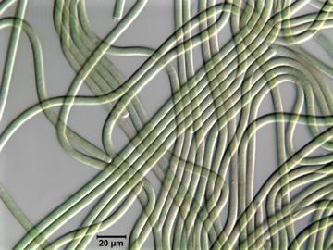
Part 3 - Prokaryotic & Eukaryotic cells
II- Prokaryotic cells:
Cyanobacteria – Prepare wet mount of Oscillatoria
Time budget
20 min.
Notes:
We’ll used Oscillatoria instead of Lyngbya this year

Slide 21
When you have finished your observations
TECH MARKS
Clean up microscope stage and your bench
Set the compound scope on the 4x objective
Put back all samples in the trays where you found them
Gently unplug the USB cable and the power cord (make a loose coil with the cord around the eyepieces).
Put back microscope in cupboard.
Leave an unclean bench or don’t follow the above instructions = technical penalty (up to 15% for each lab)
Delete all files you may have saved during the lab (send them to your email account or copy them to a USB memory key if you want to keep them).
CALL YOUR TA BEFORE YOUR LEAVE or lose tech marks

Slide 22
Evaluation of Lab1
Quiz at the beginning of Lab #2.
Duration: 10 minutes. Be on time, nobody will be let in the lab once quiz has started. Late students will receive a zero.
Technical marks: up to 15% of the mark of each lab dedicated to technical skills
What’s covered in Lab1 quiz: microscopes parts and function, use of microscope and Infinity capture, measurements, metric system and specimens…
How much does it weigh? 9% of the final mark.

Slide 23
Any questions at any time……ask!!!
Don’t try to fix any problem with
the microscope, just ask for help and
TAs will help you.

Slide 24
Lab2: Red blood cell permeability
in two weeks.
Read the manual carefully.
BE ON TIME for the quiz…

