Slide 1
POLI 204
Introduction to Canadian Politics
Political Parties and Electoral Behaviour

Slide 2
Outline
The history of party systems in Canada
How parties work
Voting Behaviour in Canada
Essay Question

Slide 3
Party Systems in Canada
Before we begin studying party systems, we need to define what they are.
Based on your readings, how would you define a party system?

Slide 4
Party Systems in Canada

Slide 5
Party Systems in Canada
According to the textbook, there are 4 different stages in the evolution of party systems in Canada
Bipartisan party system (1867-1921)
Appearance of third parties (1921-1957)
The nationalization of political parties (1963-1988)
The regionalization of political parties (1993-2015)

Slide 6
Party Systems in Canada
The first party system spans the period going from the foundation of Canada to the first election following World War 1.
There were not many differences in the political positions defended by these parties.
Politics under the first party system were thus an affair of patronage.

Slide 7
Party Systems in Canada
What is patronage?

Slide 8
Party Systems in Canada
While patronage politics is often seen negatively today, it had the advantage of integrating diverse populations within one country.
Canada’s population was divided, especially along the French-English axis.

Slide 9
Party Systems in Canada
Questions?

Slide 10
Party Systems in Canada
A key reason for the emergence of the second party system was linked to World War 1.
Wartime conscription proved a particularly divisive issues.

Slide 11
Party Systems in Canada
This division had an impact on the two parties of the time.
The Conservatives, who were in government, supported conscription.
The Liberals opposed the government.
The Conservatives won in 1917 on a pro-conscription platform, but lost to the Liberals in 1921.

Slide 12
Party Systems in Canada
The 1921 election was remarkable for other reasons.
It marked the entry of a new party in the political arena: the Progressive Party.
This marked the increasing importance of regional and class based divisions in Canadian politics.

Slide 13
Party Systems in Canada
This marks the beginning of the second party system.
The economic depression of the 1930s led to the apparition of two new political parties defending western populism.
The Co-operative Commonwealth Federation represented a left-wing alternative.
The Social Credit represented a right-wing alternative.

Slide 14
Party Systems in Canada
This period also marked the beginning of brokerage politics in Canada.
Brokerage politics refers to the idea of brokering an agreement between multiple sides on a given issue.

Slide 15
Party Systems in Canada
French vs. English
Rural vs. Urban
West vs. East
Class Conflict
Politics in the second party system were not ideological, but they were not based in patronage either.

Slide 16
Party Systems in Canada
The Liberals maintained their advantage in Quebec during this time period.
In doing so, they managed to win most elections and become the « natural governing party » over this time period.

Slide 17
Party Systems in Canada
Questions?

Slide 18
Party Systems in Canada
The Liberal hold on government lasted from 1935 to 1957.
It was broken by John Diefenbaker.
He was then defeated in 1963.
This marks the beginning of the third party system.

Slide 19
Party Systems in Canada
The Liberals returned to their dominant position in the third party system.
Lester B Pearson and Pierre-Elliot Trudeau are the two defining Prime ministers of the time period.
The CCF rebranded itself as the New Democratic Party (NDP).

Slide 20
Party Systems in Canada
Furthermore, many changes happened at the time to electoral competition.
Politics became more ideological, with the structure of left-right politics we are familiar with today.

Slide 21
Party Systems in Canada
Trudeau developed a national strategy, based on symbols of Canadian identity.
During this time period, the parties started appealing to the whole country at once, rather than select groups.
This is the period of nationalized campaigning in Canada.

Slide 22
Party Systems in Canada
One reason for this nationalization of electoral campaigns rests upon the emergence of new technology.
What technological tool appeared in this time period that would help national campaigns?

Slide 23
Party Systems in Canada
It is not because the parties tried to do so that they succeeded.
The Liberals did poorly in the West.
Conservatives did well in English Canada.

Slide 24
Party Systems in Canada
Questions?

Slide 25
Party Systems in Canada
After Trudeau’s departure from politics in 1984, Mulroney led the Conservatives to victory.
Key topics for Mulroney were constitutional negotiations and negotiating a Free Trade Agreement with the United States.

Slide 26
Party Systems in Canada
The first mandate went rather well.
The government prepared the Meech Lake Accord, which received wide support from provincial premiers (including Quebec’s).
They also succesfully negotiated the free trade agreement with the U.S.

Slide 27
Party Systems in Canada
However, this success would not last.
The free trade agreement led to sharp criticisms.
Most importantly, the constitutional negotiations were never concluded succesfully.

Slide 28
Party Systems in Canada
As seen before, parties in Canada were trying to run campaigns while promoting unity and brokerage politics.
Not so much for the two parties that appeared in the 1993 election.
Can you name them?

Slide 29
Party Systems in Canada
The creation of these two parties left the Conservative party without a base.
In the 1993 election, it went from 156 seats to only 2.
The NDP was reduced to 8 seats.
The Bloc Québécois won 54 and the Reform won 53.
The Liberals won 177, in large part thanks to support in Ontario.
This means that in 1993, the Bloc Québécois, a party devoted to separation from Canada, served as Her Majesty’s Loyal Opposition.

Slide 30
Party Systems in Canada
The Liberals ruled without interruption after 1993.
The right-wing parties (Conservative and Reform/Alliance) realized that the division of right-wing votes between two parties was a problem.
The Conservative Party won in 2006.

Slide 31
Party Systems in Canada
The Bloc Québécois remained relatively strong during this time period.
It lost steam after 1993, but regained a lot of support after the sponsorship scandal (2004 election).
However, it did not manage to maintain this level of support during the time Harper spent in government.

Slide 32
Party Systems in Canada

Slide 33
Party Systems in Canada
It is unclear what will happen to the Bloc Québécois.
Will it regain support, or be limited to a small number of seats, or even disappear?
Will Canadian politics stabilize at 3 main parties, which would be a return to the third party system?
Will new parties appear, and if so, what would cause this to happen?

Slide 34
Party Systems in Canada
Questions?

Slide 35
How parties work
Political parties are institutions that have many roles in Canada.
They play a role in parliamentary representation.
They are responsible for ensuring the link between the electorate and the governance of Canada.

Slide 36
How parties work
Originally, representatives were not elected under a party banner.
Instead, individuals would be elected on the basis of their personal competence and charisma.
Collectivities would choose who to send to represent the commune on this basis.

Slide 37
How parties work
Representatives would soon notice, however, that they would vote similarly to others in Parliament.
They approached these other representatives to form coalitions of mutual interest.
Eventually, these coalitions became the parties we know today.

Slide 38
How parties work
Party membership in Canada is fairly low.
Certain groups are overrepresented.
Parties do try to change this fact, by creating commissions and clubs targeting underrepresented groups.

Slide 39
How parties work
There are many rules limiting how parties are financed in Canada.
They were introduced in the 1974 Elections Expenses Act.
This encouraged donations and encouraged parties to maintain contact with individuals in-between elections.
It also ensured greater transparency.

Slide 40
How parties work
In 2003, PM Jean Chrétien adopted a law making it illegal for corporations and unions to donate to political parties.
Similar restrictions were adopted as early as 1977 by the Lévesque government in Québec.
The Québec cap was further reduced to 100$/year in 2012, after the Charbonneau commission.

Slide 41
How parties work
Party activities tend to be very busy around election time.
Things are less busy between elections.
Many members would like to have greater influence in the party, especially regarding the creation of party policy.

Slide 42
How parties work
The choice of local candidates is largely left to the choice of the members.
Party leaders have the ability to veto a candidate, but they rarely use it.
They may impose their candidate if they have a star candidate that they think would make a good minister, for instance.

Slide 43
How parties work
The selection of party leaders has become more open with time.
Initially, leaders were selected by a small group that included parliamentarians and party insiders. There was very little influence from the base.
The 1960s saw the beginning of large delegate conventions.

Slide 44
How parties work
With time, even delegate conventions seemed too restrictive.
The first parties to change the model federally were the Reform Party and the Bloc Québécois.
The other parties had to follow because of pressure from their own members.

Slide 45
How parties work
The NDP follows a direct model of one-member, one-vote.
The Conservative Party has adopted a system where individual votes are weighed so that each constituency has the same weight.
Finally, the Liberals have adopted a system where even non-members can vote.

Slide 46
How parties work
Questions?

Slide 47
Voting Behaviour in Canada
In order to function, political parties need electoral support.
We are thus going to conclude with an overview of voters in Canadian politics.
How many Canadians vote?
Who votes for whom?

Slide 48
Voting Behaviour in Canada
Abstention in Canada is fairly high.
Abstention has varied from 25% to 40% since the end of the second World War.
A Royal Commission on the topic identifies three institutional reasons for this low turnout.

Slide 49
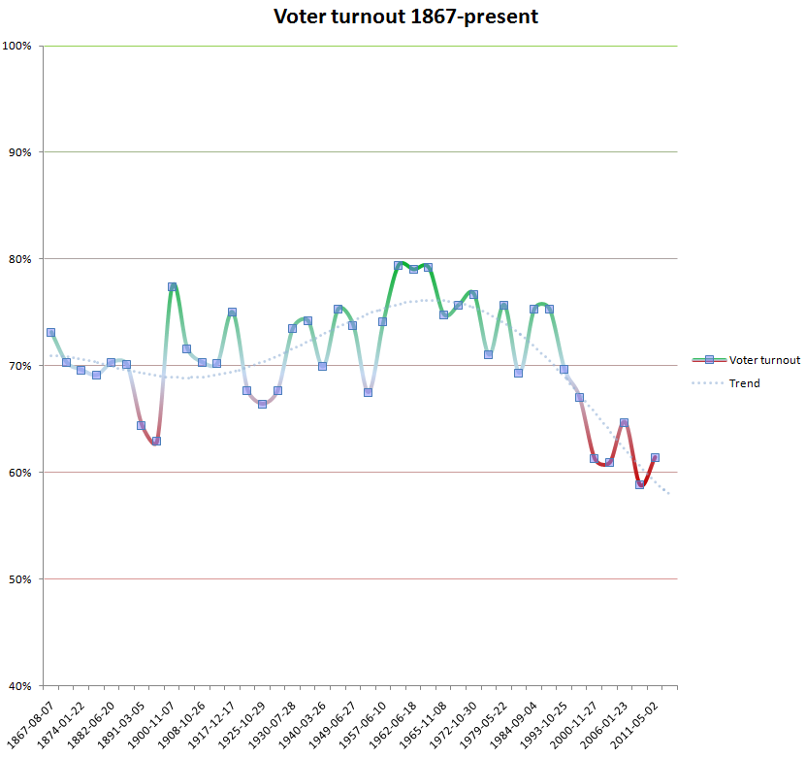
Voting Behaviour in Canada

Slide 50
Voting Behaviour in Canada
No mandatory voting law.
Bicameralism
3. Majoritarian electoral system

Slide 51
Voting Behaviour in Canada
The cause of the drop in turnout over time is due to generational change.
This should not be confused with a life cycle effect.
Youth are also less interested in politics, less informed, and less likely to see voting as a duty.

Slide 52
Voting Behaviour in Canada
Many explanations have been offered to explain vote choice in Canada.
Some argue that the vote is based on sociodemographic characteristics.
These characteristics include region, religion, language, unionization and gender.

Slide 53
Voting Behaviour in Canada
Traditionally, the Liberals obtained many votes in Quebec, and the Conservatives obtained votes in the West.
So did the NDP, to a lesser degree.
This was interrupted by the 1993 election.

Slide 54
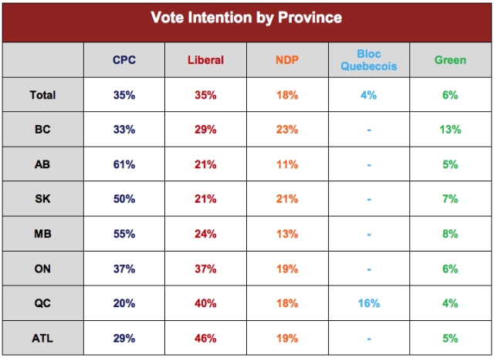
Voting Behaviour in Canada
Angus Reid: October 10-12, 2017

Slide 55
Voting Behaviour in Canada

Slide 56
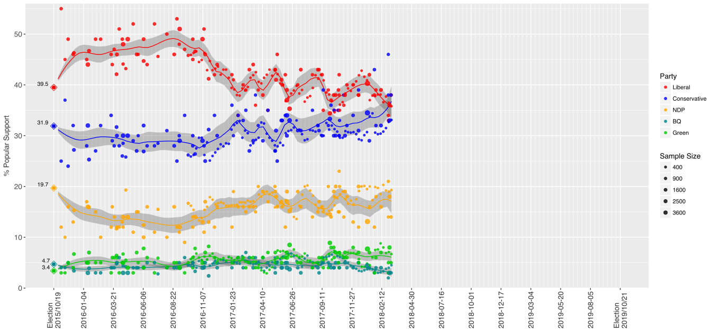
Voting Behaviour in Canada

Slide 57
Voting Behaviour in Canada
Religion is strongly associated with vote choice.
Catholics are more likely to vote Liberal.
Protestants are more likely to vote Conservative.
Non-believers are more likely to vote for the NDP.

Slide 58
Voting Behaviour in Canada
Language and origins also matter for the vote.
French Quebecers are much more likely to vote for the Bloc Québécois than other Quebecers.
English-speaking citizens are more likely to support the Conservatives.
Linguistic minorities are much more likely to vote for the Liberal Party.
Citizens who are not of European descent are more likely to vote for the Liberal Party.

Slide 59
Voting Behaviour in Canada
There is also a gender split in voting in Canada.
Women are more likely to support the NDP.
Men are more likely to support the Conservatives.

Slide 60
Voting Behaviour in Canada
Another variable that explains voting behaviour is party identification.
Party identification is a psychological attachment to a given political party.
The voter thinks of themself as being a Liberal, Conservative, etc.

Slide 61
Voting Behaviour in Canada
In Canada, about half the public identifies with a political party.
Half of this group identifies with the Liberal party.
This gives the Liberal party a strong advantage, as it has a bigger base than the other parties.

Slide 62
Voting Behaviour in Canada
Other factors that matter are issues and leader evaluations.
Canadians will vote for the party that most closely defends their position on issues.
This can also be understood on the basis of ideology (Left vs. Right) rather than specific issues.

Slide 63
Voting Behaviour in Canada
Finally, leader evaluations will matter as well.
What traits do voters wants their leaders to have?

Slide 64
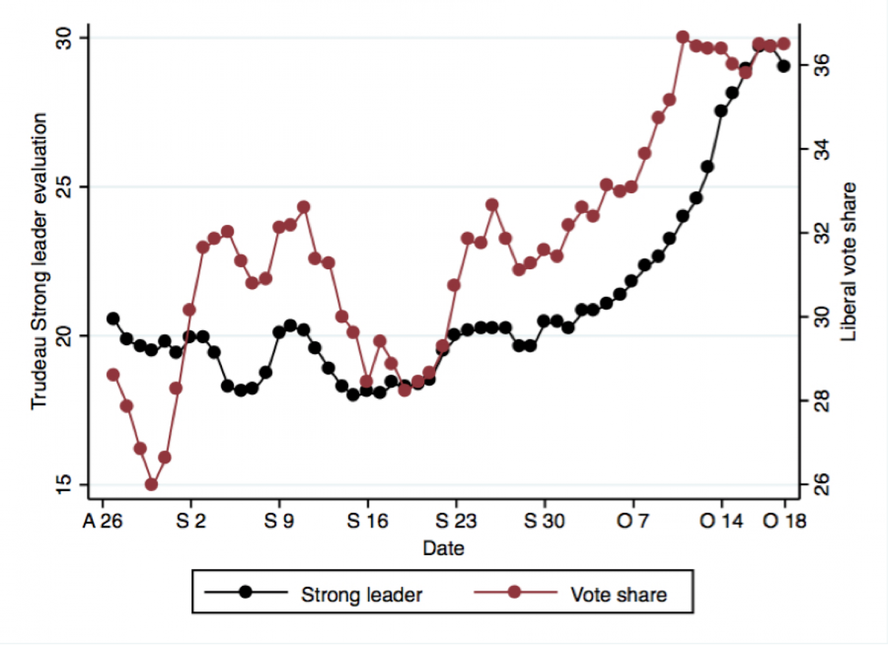
Voting Behaviour in Canada

Slide 65
Voting Behaviour in Canada
Voting behaviour can thus be said to be a function of:
Sociodemographics
Party identification
Issue positions
Leader evaluations

Slide 66
Voting Behaviour in Canada
Questions?

Slide 67
Conclusion
The history of party systems in Canada
  4 party systems
How parties work
Voting Behaviour in Canada
  Turnout
  Vote Choice

