Slide 1
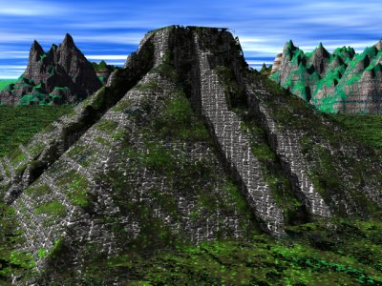
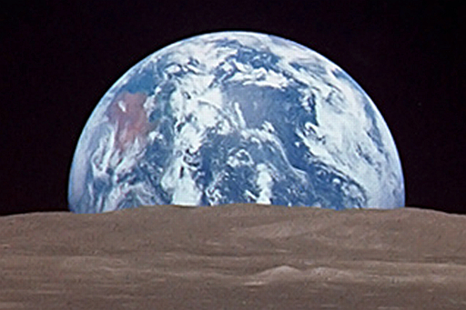
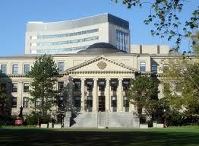
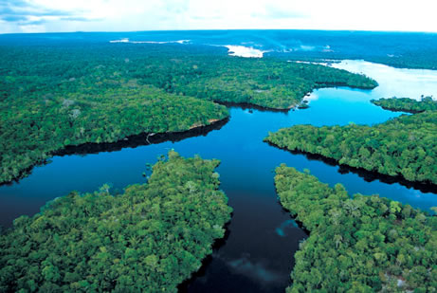
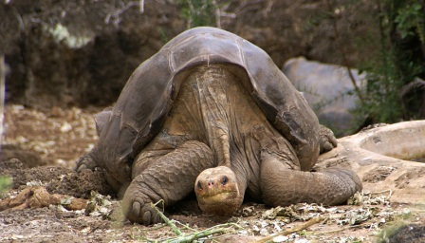
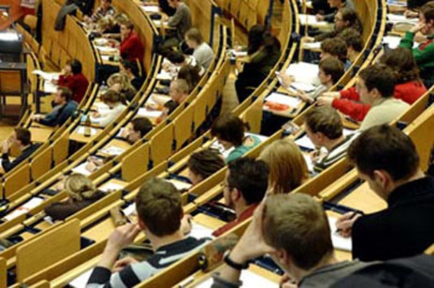
Welcome
To Global Environmental Issues
ENV 1101A
Autumn 2012

Slide 2
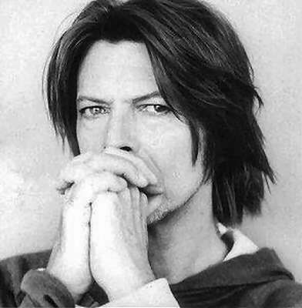
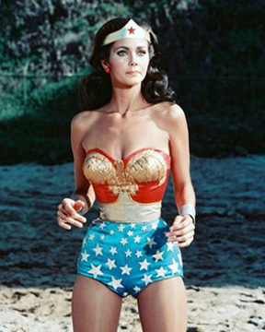
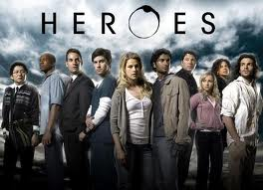
Are you a hero?
Bowie thinks we can be heroes. But what does that mean? Contemporary culture lusts for the larger than life hero who defies suburban mass culture conformity, is able to transcend the monotony of life, and can fix the complex problems of an increasingly incomprehensible world. What are the characteristics of a hero? What makes an act heroic?

Slide 3
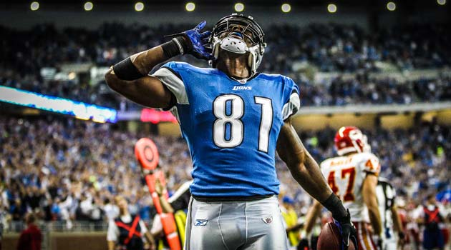
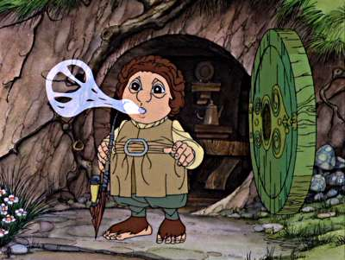
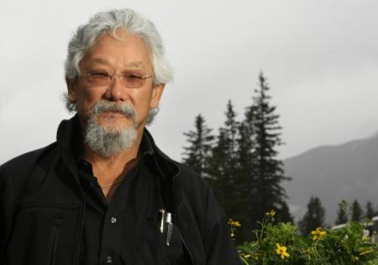

What is an environmental hero?
When we think of heroes we think of politicians, athletes, and celebrities. “Environmental hero” doesn’t really have that ring, does it? But why is that?

Slide 4
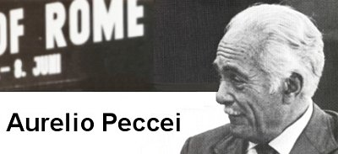
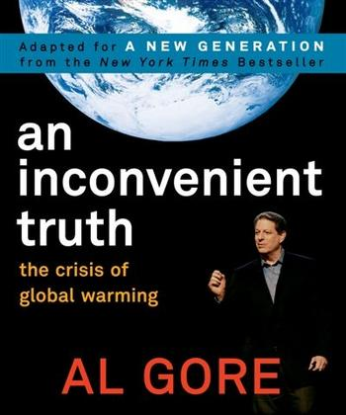
Warning to Humanity
1971 Club of Rome Report
  Limits to Growth
  Disjunction between growth and finite planet
1988 Stephen Lewis Toronto Conference:
  Climate change threatens human survival
  Danger greater than anything besides ‘nuclear war’
1992 UCS: Warning to Humanity
  1700 Top Scientists warn of necessity of major remedial action to address a range of climate challenges.
2006 Al Gore, Inconvenient Truth
  Threat of Climate Change

Slide 5
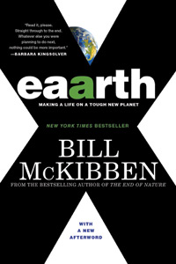
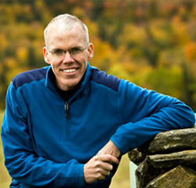
Eaarth
Among scientists in diverse fields there is growing concern about the state of world ecosystems. From climate scientists, to ecologists, wildlife biologists, agronomists, development experts, to security analysts the general consensus is that environmental challenges are not a concern for our grand children’s generation, but are already shaping our world and writing our future prospects. In short, if their judgement is correct, you will need to be a climate hero.

Slide 6
This Course:
There are many different environmental challenges facing modern society, most of them are complex, and they are not easily solved. Students that matriculate through this course will:
Acquire a background in the principal environmental challenges that threaten human civilization.
Sustainability will not be taught as a purely scientific or technical problem, but instead you will be challenged to think about how environmental challenges will impact your life and what ecological citizens can do to put sustainability into practice.
If this course does not produce the heroic Messiah that will lead us to the promised land, at least you will develop some tools and perspectives for dealing with the Age of Scarcity and Environmental Limits.

Slide 7
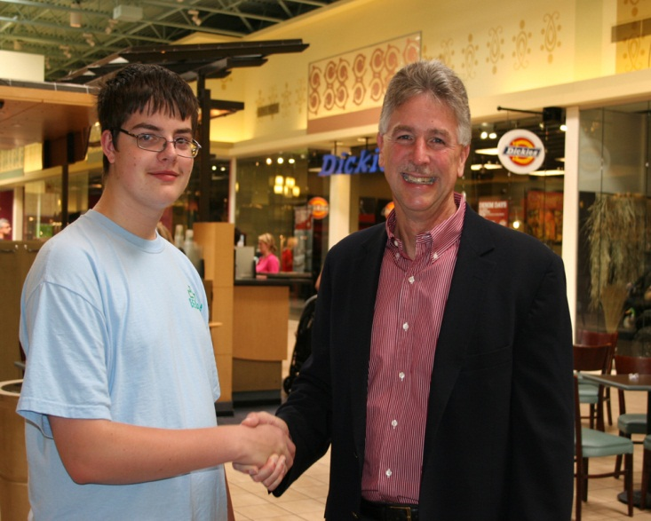

Let’s Get Acquainted
Name:
Hometown:
Major:
Why did you take this class?:
Do you have an idol or hero?
Least Favorite Celebrity:
How many ‘earths’ is your footprint?
Little Known Personal Fact:

Slide 8
Biography
MA History Minnesota
PhD People & Environment Geography Madison
Taught environmental history, third world development, global, and twentieth century history
Environmental Science and Social Science
Pedagogical approach to sustainability focused on bridging realm of nature with the world of humanity
Talloires Declaration “ecological literacy” and “eco-citizenship”

Slide 9
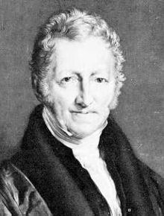
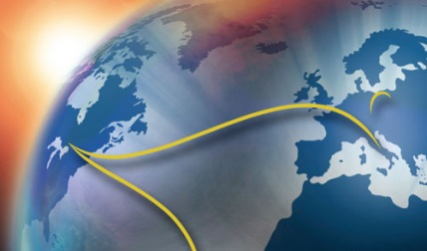
The Global Prospect
It is impossible to ‘predict’ the future and those that have imagined that they had such perspicacity have invariably proven themselves wrong like Malthus.
‘Forecasting,’ however, is an established scientific process where one collects diverse data sets and projects current trends into the near future.
Malthus correctly predicted famine and misery, but failed to anticipate the arrival of the Agricultural Revolution that would bump the carrying capacity.

Slide 10
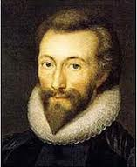
Living in a Global World
We live in a global world. What this means is that Middle Class Canadians are not immune to problems sourced thousands of miles away, or environmental changes that are imperceptible to us.
Most Canadians live in a bubble in so far that we dwell in a particular place, we define our lives relative to our friends, and chart our life course relative to inherited social values.
To understand our future prospects we need to understand the complex tissue of the environment, the natural systems upon which human civilization is built.
As John Donne famously noted, “No Man is an island,” yet most Canadians are blithe to the global forces that shape their lives in often intangible ways.

Slide 11
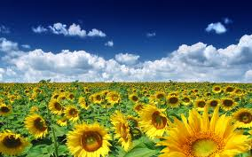

The Summer that was. . .
The beginning of the academic school year marks the end of summer. Every debut represents an exciting time of transition for students, and also one of mourning for the warm days and simple pleasures that were.
To a careful observer there was a wealth of meaningful environmental news streaming across the press wires was a bit alarming.
Predictably, the media provided no context for a summer filled with ominous climatic events.

Slide 12
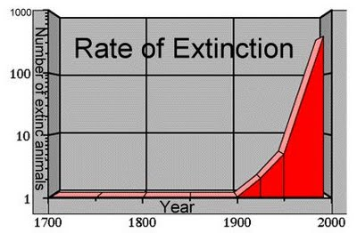
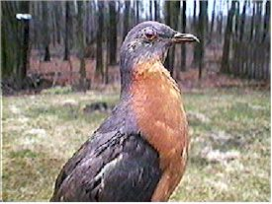
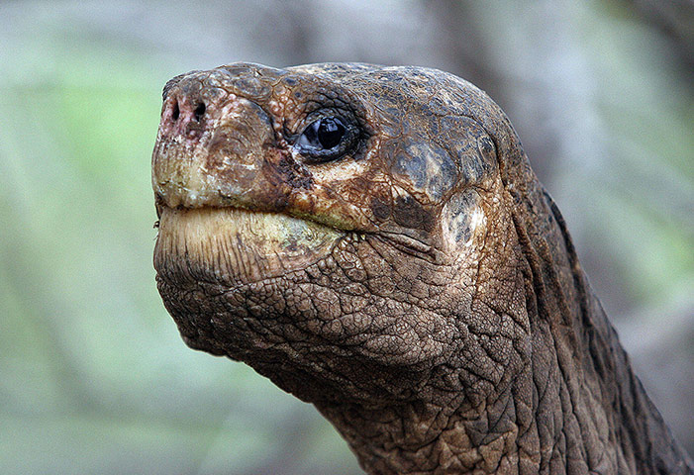
Death of Lonesome George: The Last of His Kind
RIP; 24, June 2012
Chelonoidis nigra abingdonii
Pinta Island
  Goat Introduction
  1971 Galapagos Discovery
Lonesome George is just the latest victim of the triumph of the human species over its natural environment. From the perspective of George and the other disappeared, what is human civilization?

Slide 13
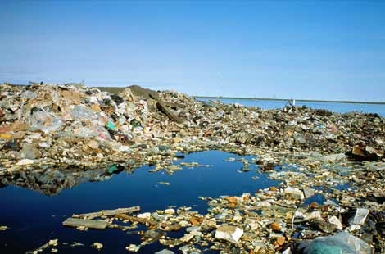
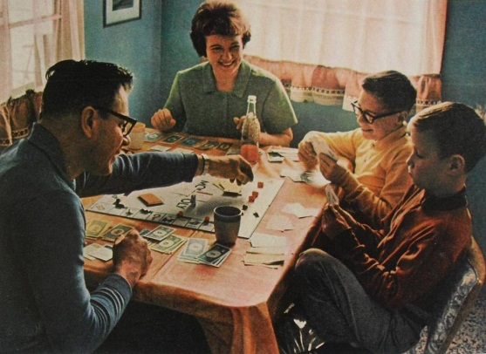
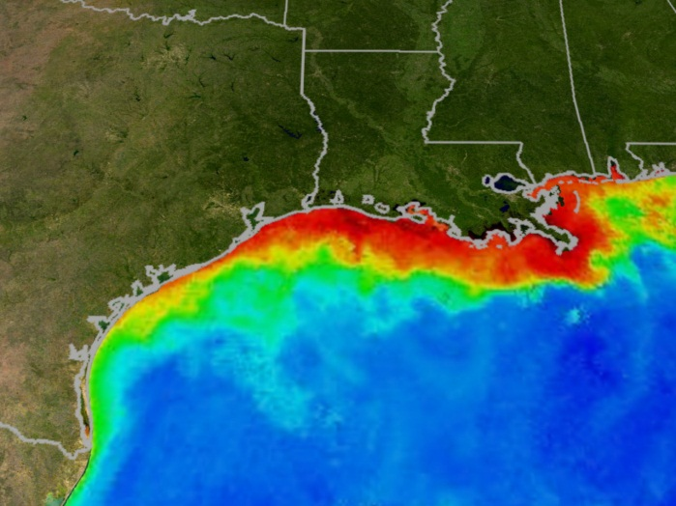
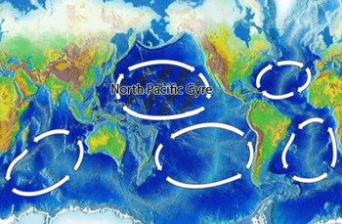
An Oasis of Death
Across the globe dead zones have emerged in the oceans that once seeded planetary life. The largest resides deep in the Pacific, in the form of a floating island of garbage a hundred miles wide. This is the amazing product of a global consumer ‘throw away’ economy. This raises the question: how are global environmental challenges related to Canada and the Canadian way of life?

Slide 14
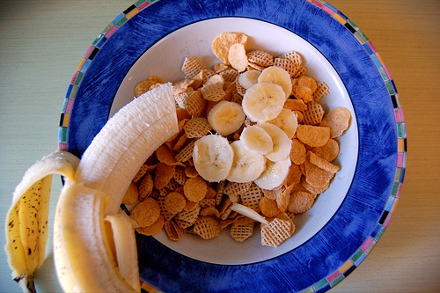
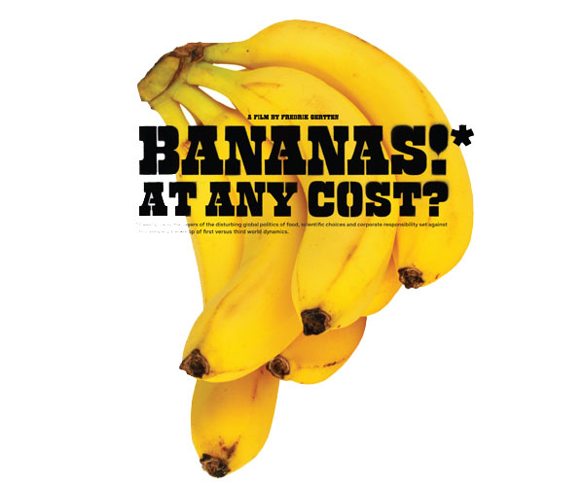
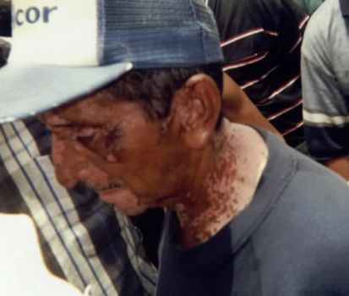
My Breakfast Banana
Breakfast of Champions
Introduction of Bananas into Canadian diet
Plantation system
Plantation workers
It is a truth of the global economy that modern consumers have become alienated from what they eat. A child in the Bronx instructed to draw a fish, might sketch a ‘patty.’ How is the distance from the natural world related to current environmental problems?

Slide 15
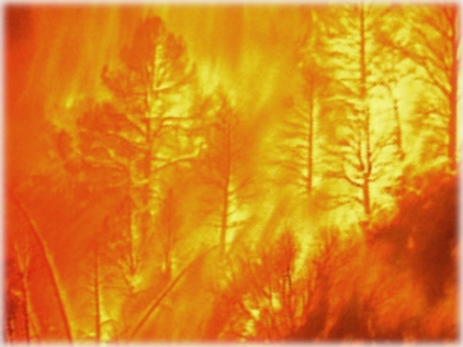
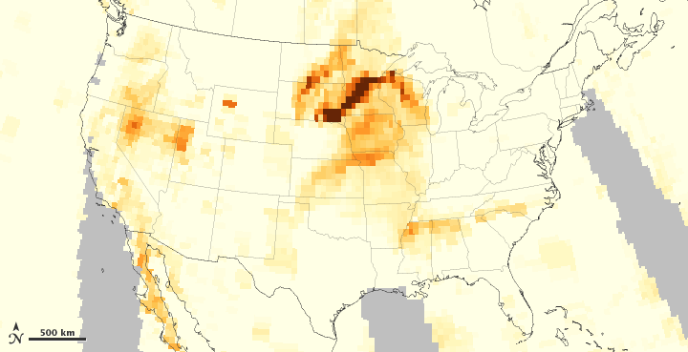
The West is Burning
It was another dry summer in the American West with wildfires raging out of control and million dollar homes consumed.
Climate change is felt differently throughout the globe and Canada as a northern region has been relatively insulated from its effects, but drought in arid areas is leading to rapid desertification
In addition to the North American West, rainforests in Amazon and Indonesia are burning, foreshadowing the new climate reality that will restructure human life and prospects.

Slide 16
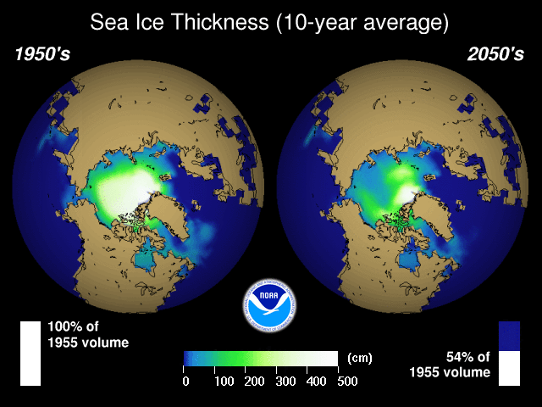
Disappearing Artic Ice
Last Summer, scientists were shocked by satellite photos that revealed the speed of Arctic ice melting 50% more than forecast, forcing them to dramatically revamp their models for global warming impacts on the Arctic region. How does ice melt in an Artic few of us have ever seen, impact us?

Slide 17
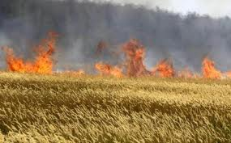
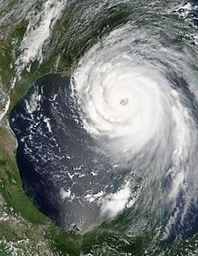
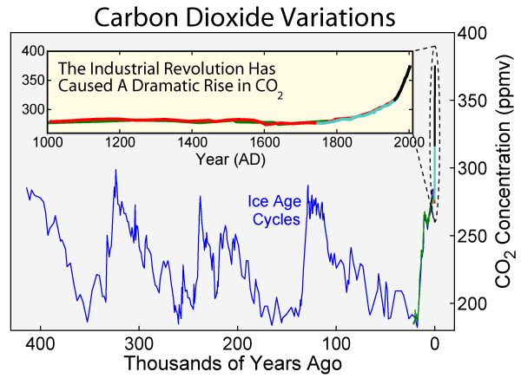
Extreme Weather Patterns
Recent research has confirmed the long suspected belief that climate change will result in more extreme weather events: floods, hurricanes, wildfires, and their like. How does extreme weather impact our society and economy?
Even though the economic cost of crop failures, property damage resulting from flooding, and the cost of coping with refugees is higher than conservation the modern market system through which we interact is structured in such a way to promote profits rather than environmental security.
Hurricane Irena hits NOLA again. Is Bourbon Street viable?

Slide 18
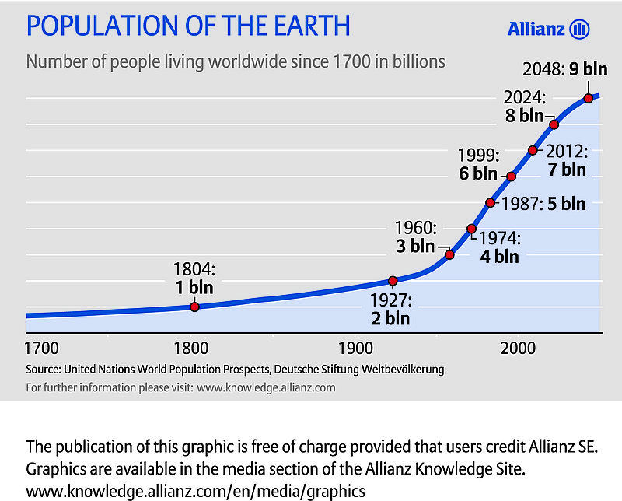

One Hungry Earth, an unsettled political climate
Although human population growth rates are diminishing, the total world population is projected to approach 10 billion in 2050. It has already significantly exceeded any objective measure of the earth’s carrying capacity.
The human population is fed by 10 main cereal crops and 15 animal species in an intensively farmed monoculture system that is highly vulnerable to shocks.
Persistent crop failures over last decade has contributed to food inflation and political turbulence in poor countries that has already toppled corrupt regimes in the Middle East.
Egyptians have lived under authoritarian regimes during the twentieth century, but poverty, food inflation, and chronic unemployment triggered a popular revolt that ousted Mubarak from power.

Slide 19
Warning to Humanity
1971 Club of Rome Report
  Limits to Growth
  Disjunction between growth and finite planet
1988 Stephen Lewis Toronto Conference:
  Climate change threatens human survival
  Danger greater than anything besides ‘nuclear war’
1992 UCS: Warning to Humanity
  1700 Top Scientists warn of necessity of major remedial action to address a range of climate challenges.
2006 Al Gore, Inconvenient Truth
  Threat of Climate Change

Slide 20
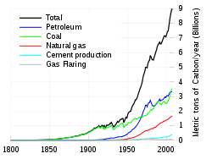
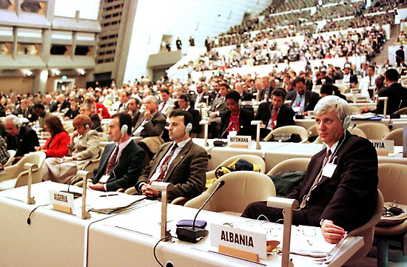
Global Inaction
Climate change has been labeled the test of our civilization.
1997 Kyoto Protocol
2007 Bali Conference
2009 Copenhagen Summit
2012 Rio Conference
You might think that if environmental degradation presented a serious problem to human civilization our leaders would do something about it, but would you like their solutions? Why have human civilizations risen and fallen over the sands of time?
As famed Ernst Becker noted, denial is a fundamental property of the human mind; perhaps it is no surprise that we will not react to a looming danger that threatens human existence.

Slide 21
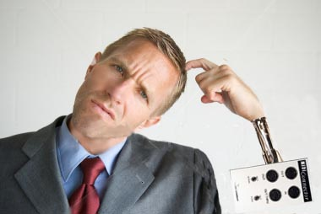
The Big Questions:
How do you explain the disjunction between the credibility of seemingly severe environmental threats and the muted responses to them?
Why have we as a global society been so slow to act upon climate change, devoted so few resources to environmental issues compared to other priorities?
What are the real bottom line consequences of global inaction?
How will climate change and a range of other pressing climate challenges impact the world economy, agriculture, Canada’s future, the composition middle class, and your job prospects?

Slide 22
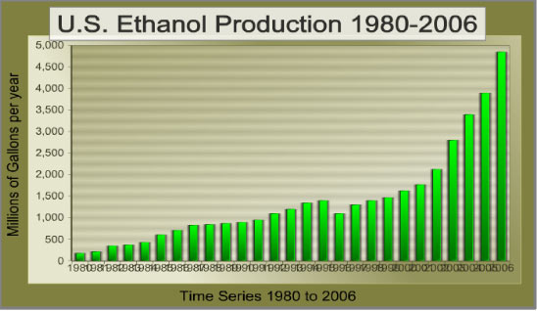
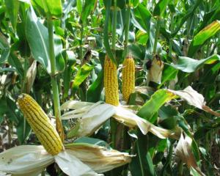
Failed Policies; International, National, Local Levels?
Our civilization seem normal to us, but there are many things fundamentally irrational about global environmental policies. The biosphere supports life, yet we are degrading natural systems at increasingly higher rates. Irrational policies proliferate the globe: petroleum subsidies and free trade policies promote an economic system where food is grown with industrial nitrogen fertilizer half a planet away. The politics of US Farm Belt senators results in subsidies for inefficient ethanol production that endangers prairie farmers and spawns food inflation across the globe. Can we simple replace our politicians with better leaders?

Slide 23
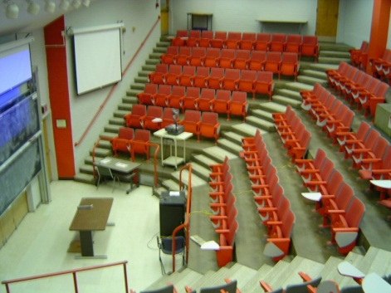
Failure in Education?
Many Canadian secondary schools teach environmental subjects, but this remains just a small part of the curriculum that has to share time with other pressing issues; social justice, gender equality, global awareness, basic math and reading. Universities like ours have pledged to teach ‘sustainability’ but this subject is seen differently in various faculties and departments and throughout North America there are few coherent green curricula that will give the next generation of students the tools necessary for implementing sustainable solutions. Is education the solution?

Slide 24
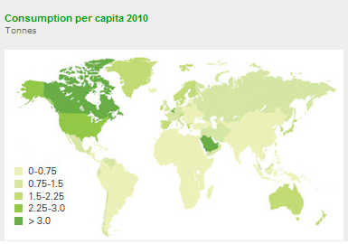

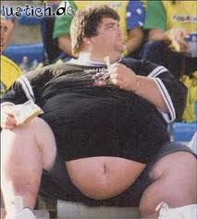
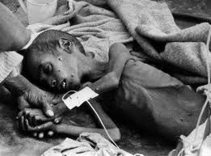
Shallow Environmentalists?
Energy hogs, obese, consumption vampires, Canadians consume more than their fair global share.
Public polls reveal that Canadians care deeply about the environment and want to do the right thing; their pocket books reveal a debt inspired binge for consumer goods like i-phones, SUVs, and McMansions that offer only the allure of happiness, while an array of drug prophylactics offer a fix for anxiety, depression, and overeating. Are Canadians consumers or environmentalists?
Canada has won many medals in hockey, but it has been consistently the world’s number one consuming nation.

Slide 25
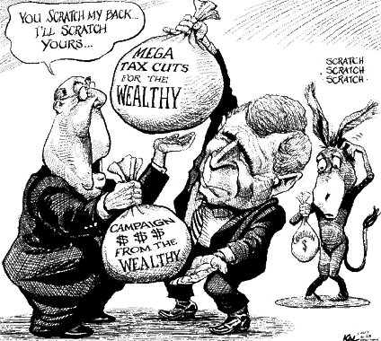
Market Failure?
One problem with implementing good climate policy at the global level is that there is no meaningful international governing body. In fact the principal international organization is the WTO, and its core mission is to promote trade. If capitalism is the principal mode through which individuals and states related to each other, and profit is the singular motive of this system, how can we implement policies that reflect an ecological bottom line?
Crony capitalism refers to a market system that serves an elite few, and which typically results in large debts for the many.

Slide 26
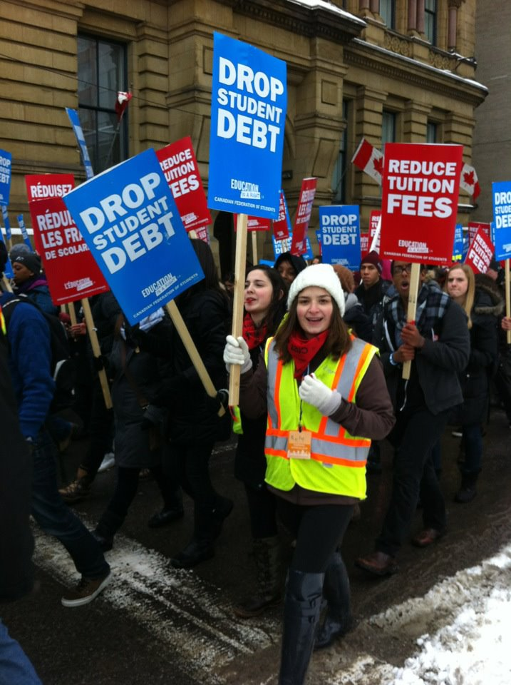
Student Tuition
Throughout Canada students have protested the inflating price of a higher education, especially in light of dim job prospects. Student debt levels are clearly not sustainable, but why is tuition rising above the rate of inflation? How are your life prospects tied to the world economy and staked to the health of the biosphere?
UOttawa students are, like other social groups throughout the world, are reacting to adverse conditions afflicting them, but will special interest pressure on narrow and local issues resolve the fundamental source of threats that span the globe?

Slide 27
Course Description:
The threat of human induced environmental degradation and the societal responses to these environmental challenges. Case studies from contemporary examples such as climate change, air pollution, and water depletion, and its impact on human health and social viability from a social science perspective.

Slide 28
The Pedagogical Challenge
Global Environmental Challenges
  Complexity of environmental systems; science, policy, and implications of climate change, air pollution, population, human health etc.
  Vastness of the globe; thousands of states, biomes, cultures.
  Intricacy of human civilization, its production systems, institutions, and values
Bioregional Test: Where you at?
  Ladies and gentlemen; tune your iPhone!
Talloires Declaration
  Universities matriculate ecological illiterates
  Pledge towards university leadership towards sustainability
  Ecological Literacy
  Ecologically Informed Citizenry

Slide 29
Course Design
Global Perspective
  The course aspires to encompass the whole planetary surface
  Canada revealed as part of a broader world system
  Reveal obscure chains that bind us to the global system
  Case study approach to illustrate a global picture
Environment
  Cover all dimensions of relationship between natural systems that support human life and modern industrial civilization: soils, forests, water conservation, air pollution, climate change
Challenges=Sustainability
  How can humans and the natural world co-exist?
  Technological, policy, conservation, and moral dimensions of this problematic.
  Practical and self-reflective exercises
Social Science Perspective
  Science denotes an empirical approach that is fact based and free of bias’ transcending the propaganda and false narratives that afflict the media and much public discourse (from both right and left)
  Reference environmental issues to all dimensions of our lives: dreams, ways of eating, cultural expectations, beliefs about happiness, hopes for the future

Slide 30
Syllabus
In Course Documents Folder
Virtual Syllabus: contains hyperlinks
Supplements: AV and Readings
Instructor: Dr. Thomas A. Boogaart ENV1101A
Office: Desmarais 9111 University of Ottawa
Lecture Period: T: 1900-2200 Geography
Lecture Hall: MNT 203 Fall 2012
Office Hours:MON 10-1120email: tboogaar@uottawa.ca

Slide 31
Survey of Website
Course Documents: This folder contains the syllabus and other documents relative to the logistics of the course.
Grade Folder: This folder will contain the grade record of every student so that you can track your progress over the course of the semester.
Assignments Folder: This folder contains the assignment sheets for the written work for the course and any supplementary material.
Review Folder: This folder contains various supplementary material to help students in writing the essays or study for exams.
Discussion Forum: This is used as a virtual office hours to enable students to contact the professor outside the regular lecture period.
Announcement Bulletins: They are used by the professor to communicate time critical information to all students.

Slide 32
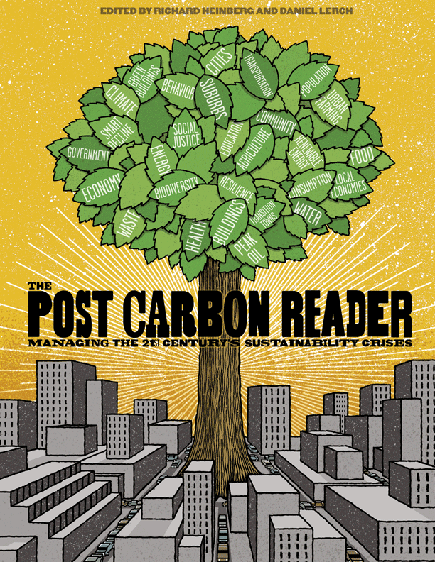
Texts
Main Text: Post-Carbon Reader: (Agora)
Course Reader of articles and documents: (Rytec)
Hyperlinks on virtual syllabus

Slide 33
Assignments
VI. Mark Computation
Midterm 15% 30 pts.
Sustainability Project 15% 30 pts.
Reflection Essay 12.5% 25 pts.
Final Essay 15% 30 pts.
Final Exam 40% 80 pts.
Participation 2.5% 5 pts.
TOTAL 200 POINTS

Slide 34
Sustainable Lifestyle Project
The Vegan Life: For carnivores a week’s long experiment in sampling vegetarian cuisine.
The Simple Life: For consumers a week break from the i-phone.
The Low Carbon Life: For high octane lives, a week to measure your ecological footprint.
CSL Project: Various community service projects relating to sustainability.

Slide 35
Challenge Levels of Difficulty
Level | Low Carbon Life | Small Life | Vegan Life
Platinum | 1 Earth + Comprehensive Carbon Footprint | 60 Things and no electronic devices+Water Footprint | Vegan Week+Carbon Footprint
Gold | 1.3 Earths+ Garbage audit | 85 Things + Water Audit | Vegetarian week + Food Audit
Silver | 1.5 Earths+basic footprint calculator | 120 Things+basic footprint calculator | 50% less meat+basic footprint calculator

Slide 36
Important Deadlines
Oct. 9: Hero Short Reaction Paper
Oct. 16 Mini-Midterm
Oct. 30 Challenge Journal Due
Nov. 20 Final Short Essay Due
Nov. 27 CSL Projects Due
Final Exam T.B.D.

Slide 37

CSL: Community Service Learning
At your discretion you may elect to pursue a special CSL project in lieu of the sustainable living project.

