Slide 1

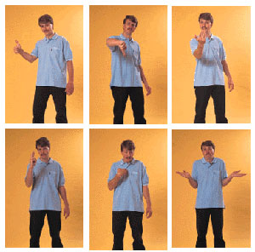
Detecting Emotion in Non-Verbal Cues
This includes facial expressions as well as body gestures/postures and tone of voice
  E.g., eye contact can signal interest, submission, aggression
10-second clip of end of a speed date
  Can often detect if one person is attracted to the other
10-second clip of teachers talking to school children (or just the audio clip)
  Can often determine whether teacher likes the child
2-second film clips of faces or bodies
  Can often detect whether the emotion is anger or sadness
Introverts tend to be a little better than extroverts
  Extroverts are easier to read than introverts
Females better than males
  Better emotional literacy
  Express greater empathy
Information that is missing in electronic communication
Notes:
Verbal Communication ➔ words they’re using
Non Verbal ➔ tone of voice, eye contact, hand shaking
Handshake: submissive, aggressive etc.
Eye Contact: extended could mean either aggression/attraction
Intuitive/Unconscious Processing can very quickly read someone’s intention or emotion (~100 milliseconds)
Mr. Kuehn’s Seven Levels: Love, Integrity, Empathy, People Pleasing, Following Rules, Reward, Avoid Punishment

Slide 2




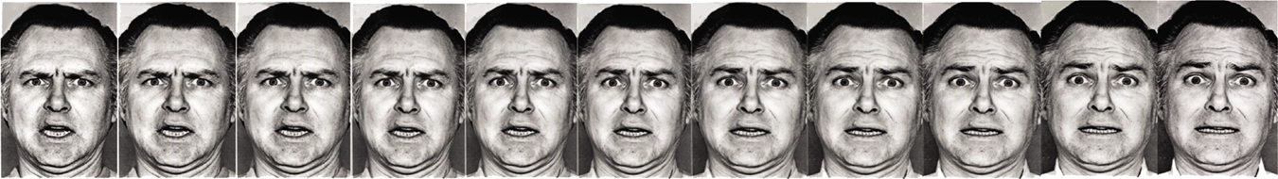
Detecting Emotion in Non-Verbal Cues (cont’d)
Particularly sensitive to anger
  E.g., subliminally flashed words
  E.g., faces in crowds
  Sensitivity can be heightened with experience
    Abused children more sensitive to anger
Relatively insensitive to lying
  Only 54% accurate
Notes:
Primal Emotions: Anger (threat if detected, humans can quickly accurately detect to avoid aggression) and Fear
Subliminal ➔ below the threshold of sensation or consciousness; perceived by or affecting someone's mind without their being aware of it
Humans are the best at deception of all species

Slide 3
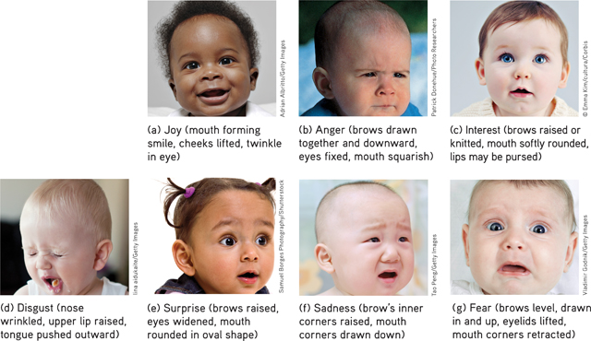
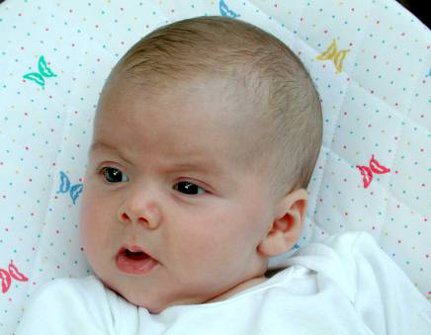
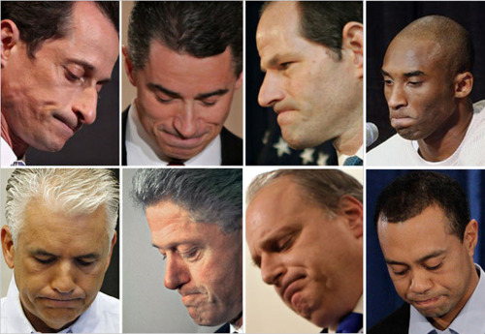
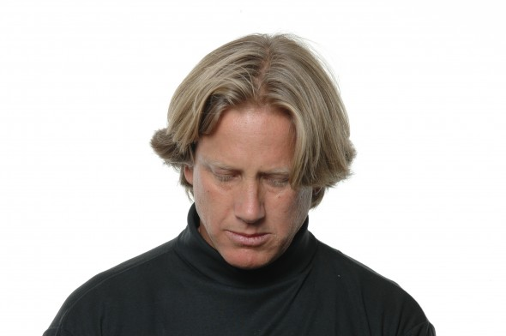


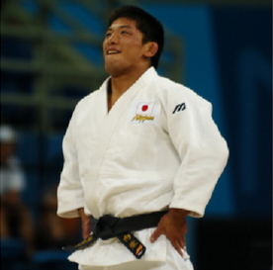
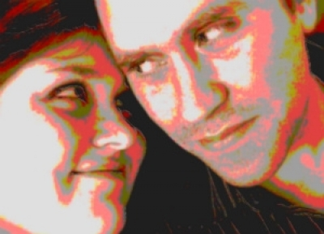
The Experience of Emotion: Basic Emotions
There are different accounts of primary emotions
E.g., Carrol Izard
  10 basic emotions
  Joy, sadness, fear, anger, disgust, surprise, interest-excitement, contempt (evaluate something as worthless), shame (feel bad about who you are),
  guilt (feel bad about behaviour)
  Other emotions are a combination of the basic emotions
    E.g., love is a combination of joy and interest-excitement
Others include more primary emotions
  E.g., pride, love
Notes:
In private: universal expressions
In public: culturally different management of emotions

Slide 4
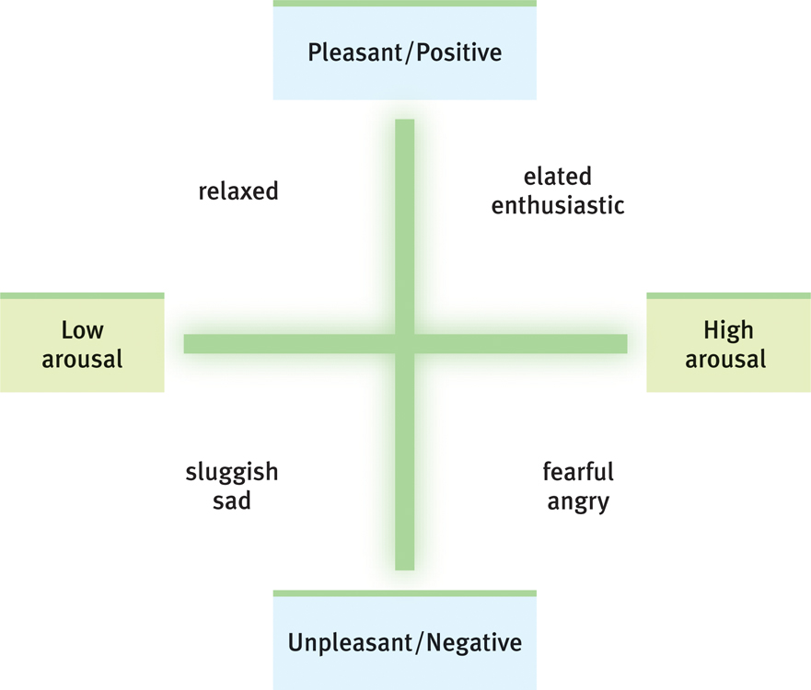
The Experience of Emotion:
Valence and Arousal
Emotional experienced placed along two dimensions
1) Valence
  Positive or negative
  Pleasant or unpleasant
  Emotional ranges
    E.g., apprehension, fear, terror
    E.g., content, happy, elated
2) Arousal
  High or low
  Emotional ranges
    E.g., annoyance, anger, rage
    E.g., interest, absorption, excitement
Notes:
VALENCE: Whether an emotion is positive (pleasant) or negative (unpleasant)

Slide 5
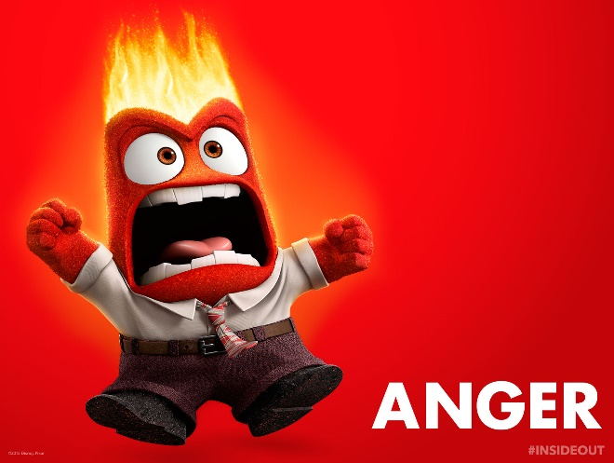
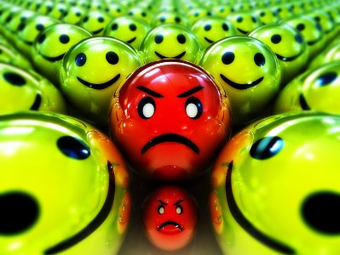
Anger
Response to some perceived misdeed
  To oneself or someone one cares about
  Particularly if perceived as willful, unjustified or avoidable
Adaptive function
Catharsis
  Emotional release
Catharsis Hypothesis
  Releasing aggressive energy (through action or fantasy) relieves aggressive urges
  E.g., screaming, hitting pillows, kicking garbage cans
Notes:
Interpretation that someone has wronged you (violation of rights, misdeed, blocking acquistion of a need uniustified)
Adaptive function: being angry is a communication to others (you’ve done something I find unacceptable, if you continue to do it there may be consequences)
if you have anger that’s directed at the target, most cultures have situations where you shouldn’t express it (e.g. no anger towards authority/upward)
Catharsis: directed at somebody, but can’t be expressed twowards them. In this case, you can release this anger in another way (Release)
Steam wouldn’t be released on its own, will build up and come out so it doesn’t come out inappropritaely (in public for exmaple)

Slide 6
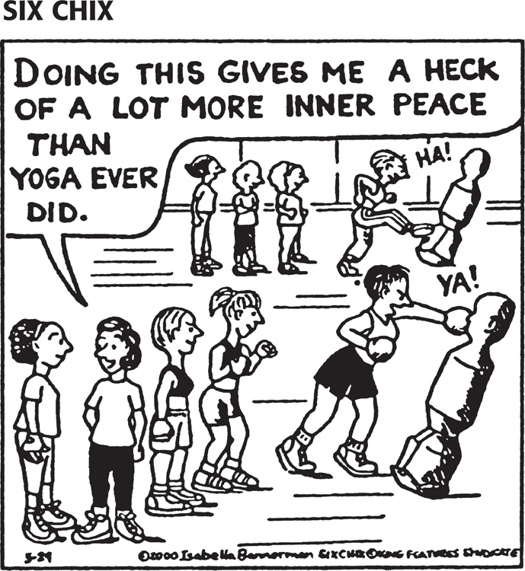


Catharsis Research
E.g., Bushman (2002)
  Make people angry by insulting their essay
  Some hit punching bag, others not
    If hit bag, show more aggression
  Rumination vs. distraction
    Story about student treated unfairly by professor
    Those who ruminate show more anger
Sometimes acting aggressively temporarily leads to calming
  A) when the provoker is the target
  B) the retaliation seems justifiable
  C) the target is not intimidating

Slide 7
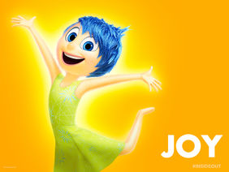

Happiness
Happiness
  A state of well-being and contentment
  A response to some perceived fortune
Positive Psychology
  The scientific study of human flourishing, with the goals of discovering and promoting strengths and virtues that help individuals and communities thrive
  Studying the factors related to happiness
  E.g., brain correlates of happiness, genes, personality characteristics, effects on health, how to teach happiness, behaviours
Notes:
Tach people to engage in particular behaviours, have particular outlooks on life that increase happiness

Slide 8
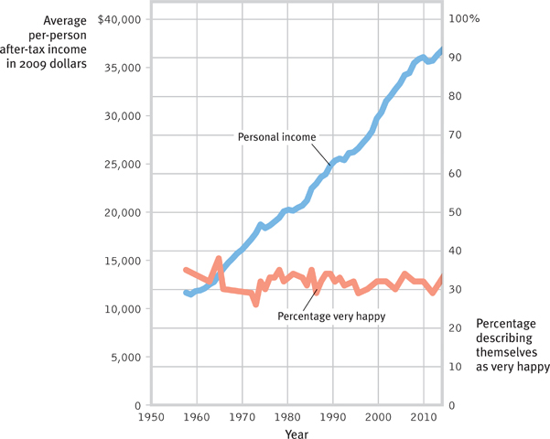
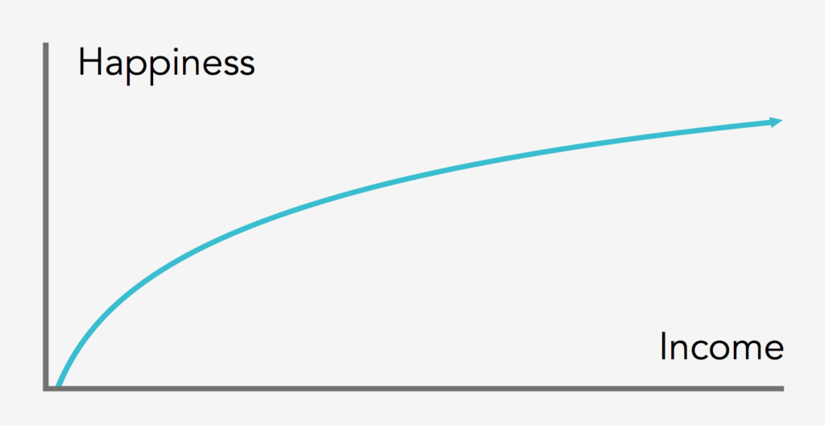
Determinants of Happiness
Genes
  Twin studies (identical more closely related than fraternal)
Wealth?
  82% of American college students think “Being very well off financially” is very important
  People with lots of money are happier than those who struggle to afford life’s basic needs
  People in rich countries experience greater well-being than those in poor countries
  However, while incomes continue to increase, happiness has not
  Once people have their basic needs met, happiness ratings tend to level out
Notes:
Any personality characteristic

Slide 9
Evidence Based Suggestions for a Happier Life
Realize that enduring happiness may not come from financial success
Take control of your time
Act happy
Seek work and leisure that engage your skills
Buy shared experiences rather than things
Join the “movement” movement
Give your body the sleep it wants
Give priority to close relationships
Focus beyond the self
Count your blessings and record your gratitude
Nurture your spiritual self

