Slide 1
FINANCIAL ACCOUNTING
Chapters 1 & 2: Financial Statements
Shujun Ding, Ph.D.
Full Professor, Accounting
Telfer Excellence Fellow
Winter 2017

Slide 2
Learning Objectives
Understand:
  The statement of income
  The statement of retained earnings
  The statement of financial position (Balance Sheet)
  The statement of cash flows
  The relationships between the above financial statements
  The importance of the above statements in financial decision
  Accounting principles in Canada and around the world
Perform:
  Classifying the financial statement accounts
  Constructing the above statements

Slide 3

Why is Financial Accounting Information Important?
For-profit Organizations
  Public Companies:
    Need money from investors, creditors…
  Private Companies:
    Need money from investors, creditors…
Not-for-profit Organizations
  Need donations from donors

Slide 4
Who Use Financial Accounting Information?
External users
  Shareholders / owners
  Potential investors
  Creditors (bankers or suppliers)
  Others:
    Tax authorities
    Competitors
    Credit rating agencies
    Labour union
Internal users
  Board of directors
  Management

Slide 5
What is Financial Accounting?
Company
Identifies
Records
Communicates
External decision makers
A system
Financial statements
Understandable
Relevant
Reliable
Comparable
Statement of income
Statement of changes in equity
Balance Sheet
Statement of cash flows
Notes to financial statements

Slide 6
The Basic Accounting Equation
Economic Resources = Claims to Economic Resources
Assets = Liabilities + Owners’ Equity

Slide 7
The Accounting Equation
Assets are the economic resources
of a business that are expected to
produce a benefit in the future.
Liabilities are “outsider claims”
or economic obligations
payable to outsiders.
Owners’ equity represents the
“insider claims” of a business.

Slide 8
The Accounting Equation
Assets
Liabilities
Owners’
Equity
Assets = Liabilities + Owners’ Equity

Slide 9
The Accounting Equation
For a corporation, shareholders’ equity
is divided into two main categories.
Contributed capital
Retained earnings
Assets = Liabilities + Shareholders’ equity
Assets = Liabilities + Contributed capital + Retained earnings

Slide 10
The Accounting Equation
Contributed capital is the amount invested
in the corporation by its owners.
The basic component of contributed
capital is common shares.
Retained earnings is the amount earned
by income-producing activities and
kept for use in the business.

Slide 11
The Accounting Equation:
Net income
Revenues are increases in retained
earnings from delivering goods
or services to customers.
Expenses are decreases in retained
earnings that result from operations.

Slide 12
Financial Statements
Income statement:
  Reports revenues and expenses for a specific period of time
Statement of changes in equity:
  Reports the changes in each component of equity during a period of time
Statement of financial position:
  Shows the assets, liabilities and shareholders’ equity at a specific point in time

Slide 13
Financial Statements (continued)
Statement of cash flows :
  Shows, for a specific period of time, how company obtained cash and how that cash was used

Slide 14
Income Statement
Income statement shows the operation performance of a company over a period of time (monthly, quarterly, or yearly, typically the fiscal year of the company).
Life of the Business
a fiscal year
a fiscal year
a fiscal year
a fiscal year
a fiscal year
2007
2008
2009
2010
2011
2012
2013

Slide 15
Income Statement
How to measure performance:
Revenues - Expenses
Revenues result from the sales of products or services for a period of time.
  Examples: sales revenue, rent revenue.
  Do not necessarily correspond to cash received...
Expenses are costs incurred to generate revenues for a period of time.
  Examples: cost of goods sold (COGS), rent expense, salary expense, tax expense…
  Do not necessarily correspond to cash paid...

Slide 16
Structure of Income Statement
Company Name
Income statement
 | For the year ended December 31st 20x9
 | Sales | 100,000
– | Cost of goods sold | 60,000
= | Gross profit | 40,000
– | Operating expenses
 | Salary expense | 11,000
 | Depreciation | 4,000
 | Insurance expense | 2,000
 | Rent expense | 8,000
= | Operating income | 15,000
+/– | Other revenues & expenses
 | Interest expense | 5,000
 | Interest income | 8,000
 | Rent revenue | 1,000
= | Net Income before taxes | 19,000
– | Income tax expense (40%) | 7,600
= | Net income | 11,400
Name of company
Name of statement
Fiscal year
-
Revenues
Expenses

Slide 17

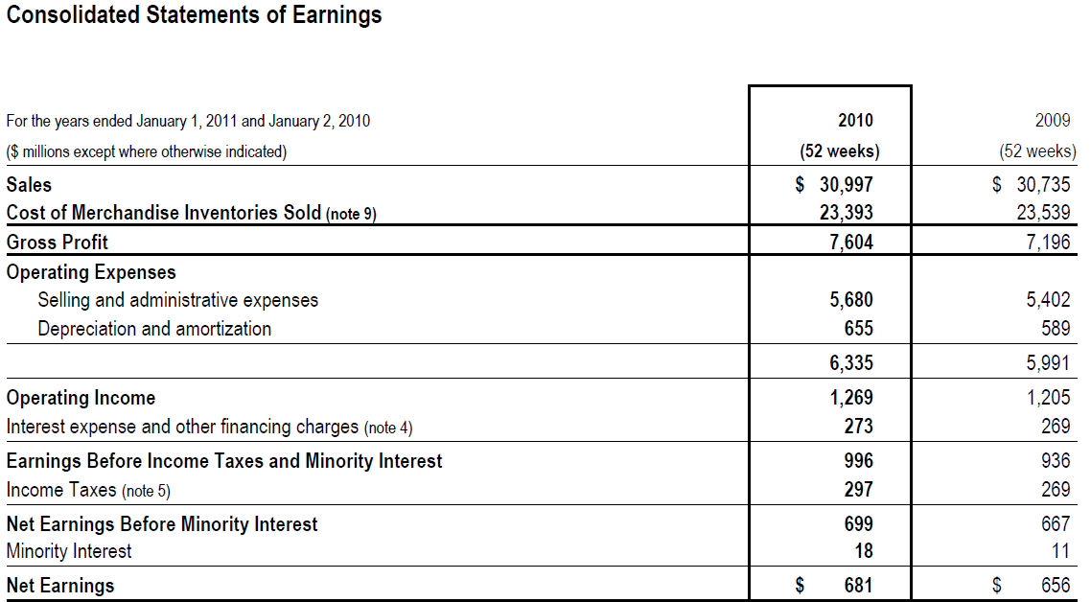
Loblaw’s Statement of Income

Slide 18

Example – Income Statement
The following are revenue and expense account balances for the Coffee Shop, a private company, on December 31, 2010:
Prepare an income statement for the year ended December 31, 2010.
Cost of goods sold | $126,000
Rent expense | 11,800
Sales revenue | 248,000
Supplies expense | 1,800
Wage expense | 51,200
Interest expense | 3,000
Income tax expense | 15.5%

Slide 19
Example – Income Statement
Coffee Shop
Income statement
 | For the year ended December 31st 2010
 | Sales | $248,000
 | Cost of goods sold | 126,000
 | Gross profit | 122,000
 | Operating expenses:
 | Wage expense | 51,200
 | Supplies expense | 1,800
 | Rent expense | 11,800
 | Operating income | 57,200
 | Interest expense | 3,000
 | Net Income before taxes | 54,200
 | Income tax expense (15.5%) | 8,401
 | Net income | $45,799
= 54,200×15.5%

Slide 20
Example – Income Statement
Coffee Shop
Income statement
 | For the year ended December 31st 2010
 | Sales | $248,000
 | Cost of goods sold | 126,000
 | Gross profit | 122,000
 | Operating expenses:
 | Wage expense | 51,200
 | Supplies expense | 1,800
 | Rent expense | 11,800
 | Operating income | 57,200
 | Interest expense | 3,000
 | Net Income before taxes | 54,200
 | Income tax expense (15.5%) | 8,401
 | Net income | $45,799
= 54,200×15.5%

Slide 21
Example – Income Statement
Coffee Shop
Income statement
 | For the year ended December 31st 2010
 | Sales | $248,000
 | Cost of goods sold | 126,000
 | Gross profit | 122,000
 | Operating expenses:
 | Wage expense | 51,200
 | Supplies expense | 1,800
 | Rent expense | 11,800
 | Operating income | 57,200
 | Interest expense | 3,000
 | Net Income before taxes | 54,200
 | Income tax expense (15.5%) | 8,401
 | Net income | $45,799
= 54,200×15.5%

Slide 22
Example – Income Statement
Coffee Shop
Income statement
 | For the year ended December 31st 2010
 | Sales | $248,000
 | Cost of goods sold | 126,000
 | Gross profit | 122,000
 | Operating expenses:
 | Wage expense | 51,200
 | Supplies expense | 1,800
 | Rent expense | 11,800
 | Operating income | 57,200
 | Interest expense | 3,000
 | Net Income before taxes | 54,200
 | Income tax expense (15.5%) | 8,401
 | Net income | $45,799
= 54,200×15.5%

Slide 23
Example – Income Statement
Coffee Shop
Income statement
 | For the year ended December 31st 2010
 | Sales | $248,000
 | Cost of goods sold | 126,000
 | Gross profit | 122,000
 | Operating expenses:
 | Wage expense | 51,200
 | Supplies expense | 1,800
 | Rent expense | 11,800
 | Operating income | 57,200
 | Interest expense | 3,000
 | Net Income before taxes | 54,200
 | Income tax expense (15.5%) | 8,401
 | Net income | $45,799
= 54,200×15.5%

Slide 24
Summary: Income Statement
Company Name
Income statement
 | For the year ended December 31st 20x9
 | Sales | 100,000
– | Cost of goods sold | 60,000
= | Gross profit | 40,000
– | Operating expenses
 | Salary expense | 11,000
 | Depreciation | 4,000
 | Insurance expense | 2,000
 | Rent expense | 8,000
= | Operating income | 15,000
+/– | Other revenues & expenses
 | Interest expense | 5,000
 | Interest income | 8,000
 | Rent revenue | 1,000
= | Net Income before taxes | 19,000
– | Income tax expense (40%) | 7,600
= | Net income | 11,400
-
Revenues
Expenses
=
Net Income/Net Loss
Net income/loss in one fiscal year !!!
How to deal with (or distribute) net income???
What is the impact on shareholders’ equity???

Slide 25
Statement of Changes in Equity
Shows the changes in each component of shareholders’ equity for the period
Share capital:
  Amounts contributed by shareholders
  May have common and preferred classes
Retained earnings / deficit:
  Cumulative profit retained in the company
  Less dividends paid to shareholders

Slide 26
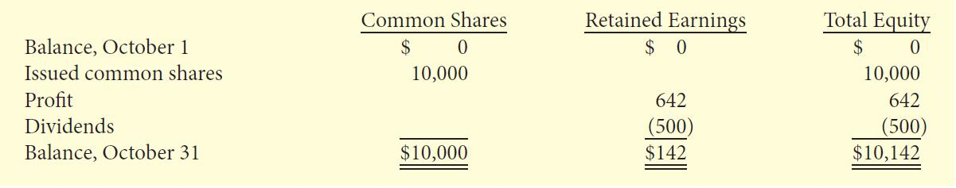
Statement of Changes in Equity - Example
SIERRA CORPORATION
Statement of Changes in Equity, Month Ended October 31, 2012

Slide 27
Statement of Retained Earnings
Revenues for
the period
–
Expenses for
the period
Start of
the period
=
End of
the period
Beginning
balance of
retained
earnings
+
or
–
Net income
(or Net loss)
for the
period
–
Dividends
for the
period
=
Ending
balance of
retained
earnings

Slide 28
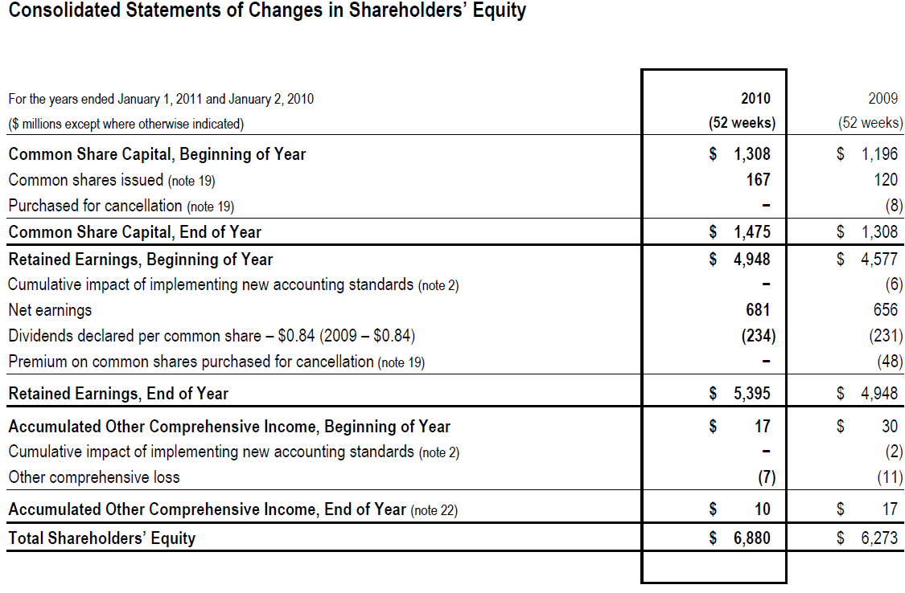
Statement of Retained Earnings: An Example

Slide 29
Balance Sheet / Statement of Financial Position
Provides a snapshot of a company’s financial position at a particular point in time (e.g., at the end of the fiscal year).
  Economic resources controlled by the company (assets)
  Economic resources borrowed from creditors (liabilities)
  Economic resources invested by shareholders (shareholders’ equity)

Slide 30
Structure of Statement of Financial Position
Accounting Equation:
Structure:
Assets | = | Liabilities | + | Equity
Economic Resources Owned or Controlled | = | Economic Resources Borrowed | + | Economic Resources Contributed by Shareholders
Company’s name
Statement of Financial Position
As at MM/DD/YY
Assets: |  | Liabilities:
Current Assets |  | Current Liabilities
 |  | Noncurrent Liabilities
 |  | Shareholders' Equity:
Noncurrent Assets |  | Contributed Capital
 |  | Retained Earnings

Slide 31
Current Assets
Assets expected to be converted to cash or used in the business within one year or one operating cycle:
  Operating cycle is the average time it takes to go from cash to cash in producing revenue
Usually listed in order of liquidity:
  Reverse order of liquidity also possible

Slide 32
Current Assets (continued)
Examples include
  Cash
  Short-term (trading) investments
  Accounts receivable
  Merchandise inventory
  Prepaid expenses

Slide 33
Non-Current Assets
Assets not expected to be converted to cash or used in the business within one year or one operating cycle
All assets not considered current
Examples:
  Long-term investments
  Property, plant, and equipment
  Intangible assets and goodwill
  Other assets

Slide 34
Long-Term Investments
Investments in:
  Debt securities: loans, notes, bonds, mortgages
  Equity securities: shares of other companies
These assets are normally not intended to be sold within the next year

Slide 35
Property, Plant, and Equipment
Tangible assets with relatively long useful lives
Used in operating the business
Examples:
  Land
  Buildings
  Equipment
Usually listed in order of permanency

Slide 36
Depreciation
Allocation of the purchase price of property, plant, and equipment over their estimated useful lives:
  Companies systematically assign a portion of the cost of an asset to expense each year
  Under IFRS, this allocation is referred to as depreciation for property, plant, and equipment, and amortization for intangible assets
  Under ASPE, amortization is often used instead of depreciation

Slide 37
Depreciation (continued)
The cost of long-lived assets with indefinite lives is not depreciated (e.g. land)
Accumulated depreciation account shows the total amount of depreciation taken to date
The difference between the cost of the asset and its accumulated depreciation is referred to as the carrying amount of the asset

Slide 38
Intangible Assets
Non-current assets that do not have physical substance and represent a privilege or a right held by the company
Examples:
  Patents, copyrights, trademarks, licenses
  Goodwill: excess price paid on acquisition of another company
Generate a future value to the company
Apple's patent claim against Samsung: $1 billion

Slide 39
Current Liabilities
Obligations that are to be paid within the coming year or one operating cycle
Examples:
  Bank indebtedness
  Accounts payable
  Accrued liabilities
  Bank loan/notes payable
  Current maturities of long-term debt

Slide 40
Non-Current Liabilities
Debts expected to be paid or settled after one year
Examples:
  Bank loan/notes payable
  Lease obligations
  Pension and benefit obligations
  Deferred income tax liabilities
Usually accompanied by extensive notes to the financial statements

Slide 41
Shareholder’s Equity
Share capital:
  Investment of cash (or other assets) in the company by shareholders in exchange for preferred or common shares
Retained earnings:
  Cumulative profits kept for use in the company

Slide 42
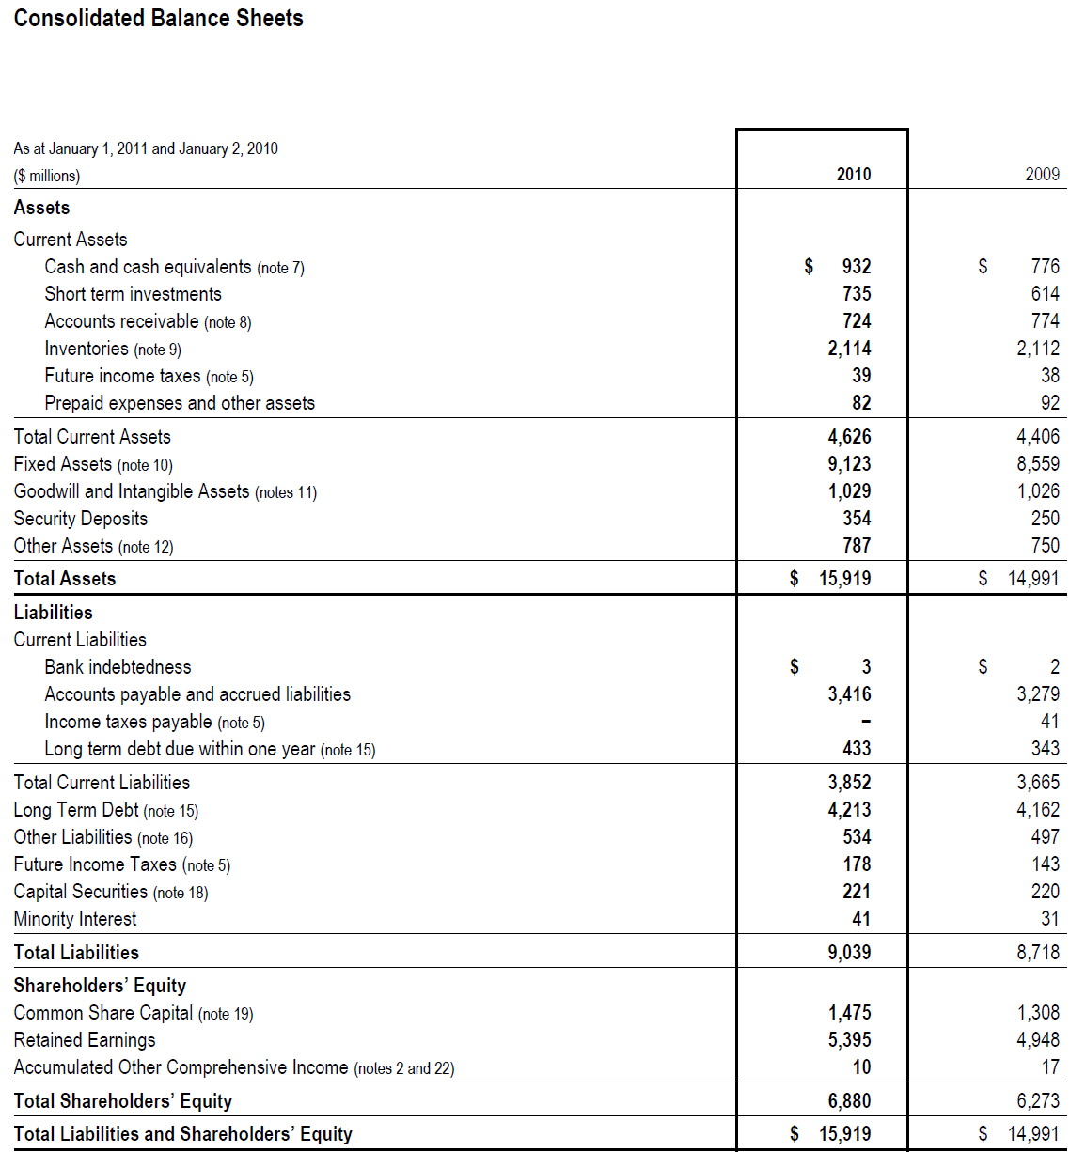
Loblaw’s Balance Sheet

Slide 43
Example –Statement of Financial Position
The Coffee Shop provided you with the following information and asked you to prepare its balance sheet as at Dec 31, 2010:
Accounts payable | $12,000 |  | Loan payable (due Feb, 2012) | $35,000
Salaries payable | 4,500 |  | Prepaid expenses | 7,000
Accounts receivable | 16,000 |  | Land | 35,000
Cash | 24,000 |  | Retained earnings | 132,500
Share capital | 75,000 |  | Accumulated depreciation | 30,000
Building | 100,000 |  | Patents | 35,000
Inventory | 52,000 |  | Short-term investments | 40,000
Bank loan payable (due Oct 31, 2011) | 20,000

Slide 44
Example – Balance Sheet
Step 1: Identify where each account appears in the Balance Sheet.
Accounts payable | $12,000 | CL | Loan payable (due Feb, 2012) | $35,000 | NCL
Salaries payable | 4,500 | CL | Prepaid expenses | 7,000 | CA
Accounts receivable | 16,000 | CA | Land | 35,000 | NCA
Cash | 24,000 | CA | Retained earnings | 132,500 | S/E
Share capital | 75,000 | S/E | Accumulated depreciation | 30,000 | NCA
Building | 100,000 | NCA | Patents | 35,000 | NCA
Inventory | 52,000 | CA | Short-term investments | 40,000 | CA
Bank loan payable (due Oct 31, 2011) | 20,000 | CL

Slide 45
Example – Balance Sheet
Step 2: Construct Balance Sheet
The Coffee Shop
Balance Sheet
as at December 31, 2010
ASSETS
Current Assets
Cash |  | $24,000
Short-term investments |  | 40,000
Accounts receivable |  | 16,000
Inventory |  | 52,000
Prepaid expenses |  | 7,000
 |  | $139,000
Noncurrent Assets
Building | 100,000
Less Accumulated depreciation | 30,000 | 70,000
Land |  | 35,000
Patents |  | 35,000
 |  | $140,000
 |  | $279,000
LIABILITIES & SHAREHOLDERS'EQUITY
Current Liabilities
Accounts payable |  | $12,000
Salaries payable |  | 4,500
Bank loan |  | 20,000
 |  | $36,500
Long-term debt |  | $35,000
 |  | $71,500
Shareholder's Equity
Share capital |  | $75,000
Retained earnings |  | 132,500
 |  | $207,500
 |  | $279,000
At a specific point in time!

Slide 46
Example – Balance Sheet
Step 2: Construct Balance Sheet
The Coffee Shop
Balance Sheet
as at December 31, 2010
ASSETS
Current Assets
Cash |  | $24,000
Short-term investments |  | 40,000
Accounts receivable |  | 16,000
Inventory |  | 52,000
Prepaid expenses |  | 7,000
 |  | $139,000
Noncurrent Assets
Building | 100,000
Less Accumulated depreciation | 30,000 | 70,000
Land |  | 35,000
Patents |  | 35,000
 |  | $140,000
 |  | $279,000
LIABILITIES & SHAREHOLDERS'EQUITY
Current Liabilities
Accounts payable |  | $12,000
Salaries payable |  | 4,500
Bank loan |  | 20,000
 |  | $36,500
Long-term debt |  | $35,000
 |  | $71,500
Shareholder's Equity
Share capital |  | $75,000
Retained earnings |  | 132,500
 |  | $207,500
 |  | $279,000
ORDER

Slide 47
Example – Balance Sheet
Step 2: Construct Balance Sheet
The Coffee Shop
Balance Sheet
as at December 31, 2010
ASSETS
Current Assets
Cash |  | $24,000
Short-term investments |  | 40,000
Accounts receivable |  | 16,000
Inventory |  | 52,000
Prepaid expenses |  | 7,000
 |  | $139,000
Noncurrent Assets
Building | 100,000
Less Accumulated depreciation | 30,000 | 70,000
Land |  | 35,000
Patents |  | 35,000
 |  | $140,000
 |  | $279,000
LIABILITIES & SHAREHOLDERS'EQUITY
Current Liabilities
Accounts payable |  | $12,000
Salaries payable |  | 4,500
Bank loan |  | 20,000
 |  | $36,500
Long-term debt |  | $35,000
 |  | $71,500
Shareholder's Equity
Share capital |  | $75,000
Retained earnings |  | 132,500
 |  | $207,500
 |  | $279,000

Slide 48
Summary- Balance Sheet / Statement of Financial Position
Name of Company
Name of Statement
Date (As at ….)
Accounts are listed under the right category (current / non current)
Total assets = total liabilities + total S/E

Slide 49
The Cash Flow Statement
The cash flow statement reports
the company’s cash inflows and
outflows from operating, investing,
and financing activities.
Details to be covered later

Slide 50
Statement of Cash Flows
Reports the effect on cash of the company’s:
  Operating activities
  Investing activities
  Financing activities
Shows net increase or decrease in cash for the period

Slide 51
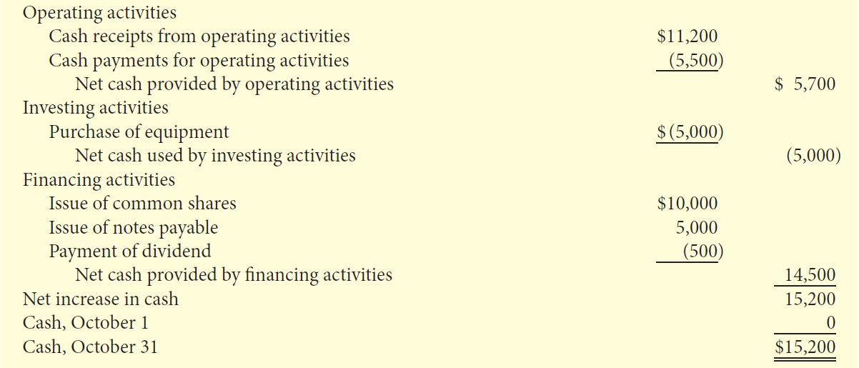
Statement of Cash Flows - Example
SIERRA CORPORATION
Statement of Cash Flows, Month Ended October 31, 2012

Slide 52
Relationships Between Statements
Statements are interrelated:
  Results from some statements are used as data in other statements
Examples:
  Profit from income statement is reported in statement of changes in equity
  Ending balances of shareholders’ equity are reported in both statements of financial position and changes in equity
  Statement of cash flows is related to statement of financial position

Slide 53
Relationships Among the Statements
Income Statement
Revenues | $100,000
Expenses | 90,000
Profit | $10,000
Statement of Retained Earnings
Beginning retained earnings | $58,000
Profit | 10,000
Dividends | 6,000
Ending retained earnings | $62,000
Balance Sheet
Assets | $162,000
Liabilities | $30,000
Shareholders' Equity
Share capital | 70,000
Retained earnings | 62,000
Total Liabilities and Equity | $162,000

Slide 54
Using the Financial Statements
Specific tools can be used to analyze the financial statements
Ratio analysis expresses the relationships between selected financial statement data
Use comparisons to aid in analyses:
  Intracompany comparisons cover two or more years for the same company
  Intercompany comparisons between the company and a competitor
  Industry average comparison based on averages for the particular industry

Slide 55
Liquidity Ratios
Measure a company’s short-term ability of to pay its obligations that will come due within the next year
Working capital | = | Current assets – Current liabilities
Current ratio | = | Current assets
 |  | Current liabilities
Higher is GENERALLY better

Slide 56
Solvency Ratios
Measure a company’s ability to survive over a long period of time:
  The higher the percentage of debt to total assets, the greater the risk that debts cannot be repaid when they are due
Debt to total assets | = | Total liabilities
 |  | Total assets
Lower is GENERALLY better

Slide 57
Profitability Ratios
Measure a company’s operating success of for a given period of time
Earnings per share | = | Profit available to common shareholders
 |  | Weighted average number of common shares
Price-earnings ratio | = | Market price per share
 |  | Earnings per share
Higher is generally better

Slide 58
Conceptual Framework of Accounting
Guides decisions about:
  what to present in financial statements
  alternative ways of reporting economic events
  appropriate ways of communicating this information

Slide 59
Conceptual Framework for Financial Reporting
Five main sections:
  Objective of financial reporting
  Qualitative characteristics of useful financial information
  Underlying assumptions
  Elements of financial statements
  Measurement of the elements of financial statements

Slide 60
Objective of Financial Reporting
To provide financial information that is useful to existing and potential investors, lenders and other creditors
Who are making decisions about providing resources to a company:
  Buying, selling, holding equity and debt
  Providing or settling loans or other credit
Financial information is provided by general purpose financial statements using accrual accounting

Slide 61
Qualitative Characteristics of Accounting Information
Relevance:
  Information has relevance if it makes a difference in users’ decisions
  May have predictive value and/or confirmatory value
  Materiality is important: will information influence the decisions of users?
Faithful representation:
  Information should reflect economic reality
  It must be complete, verifiable and free from material error

Slide 62
Enhancing Qualities of Useful Information
Comparability:
  Users can identify and understand similarities and differences in items
Verifiability:
  Independent consensus that information is faithfully represented
Timeliness:
  Available before it loses its usefulness in decision-making
Understandability:
  Classified, characterized and presented clearly and concisely

Slide 63
Cost Constraint
Ensures that the value of the information provided by financial reporting is greater than the cost of providing it
The benefits of financial reporting should justify the costs of providing and using it

Slide 64
Going Concern Assumption
The business will continue operating in the foreseeable future
The key assumption – provides a foundation for accounting
Provides justification for using cost as the value of certain assets

Slide 65
Elements of Financial Statements
Assets
Liabilities
Equity
Revenues
Expenses

Slide 66
Measurement of the Elements
Accountants have developed principles that describe when and how the elements of financial statements should be:
  Recognized
  Measured, and
  Reported
Known as generally accepted accounting principles

Slide 67
Generally Accepted Accounting Principles
Historical cost:
  Assets and liabilities should be recorded at their cost when acquired
  Not only at time of purchase, but throughout the life of each asset and liability
Fair value:
  Certain assets and liabilities should be recorded and reported at fair value
In choosing between these two, apply the concepts of relevance and representational faithfulness

Slide 68
  Where to find the Financial Statements
Canadian Public Companies:
http://www.sedar.com/
US Public Companies:
http://www.sec.gov/edgar.shtml
Company’s website—investor relation
Google Finance / Yahoo Finance

Slide 69

In-Class Exercise

