Slide 1
Midterm revision
Quiz 1-2
Kalima vico
Comm 220

Slide 2

Terms
Utility =
Endowment Point: ( e ) =
Consumption Optimum: ( C*) =.
Price Ratio=
Marginal Rate of Substitution =
measure of how satisfied you are with x and y combination
people make choices that maximize their utility subject to their budgets
What you already own. Your starting combination of x and y before trade.
Maximum Utility reached through trading achieved with your present wealth
the rate at which the market is willing to trade x and y goods
rate at which a consumer can give up some amount of one good in
exchange for another good while maintaining the same level of utility.

Slide 3
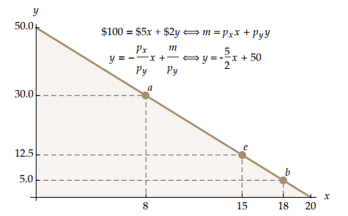
Budget line
Income: $100
px = $5
py = $2
Don’t own anything
Units of x → 20
Units of y → 50
Endowment?
Price ratio?
Wealth?
Bundles

Slide 4
Examples
Endowment
x= 15
y=12.5
e = (15,12.5)
Price ratio
Wealth
15 x $5 → $75 of x
$100 12.5 x $2 → $25 of y
Endowment point
px = $5
py = $2
5 = 2.5
2
x is two and half times more expensive than y

Slide 5
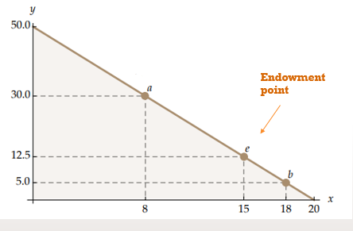
Marginal rate of Substitution and
Price ratio
C*
C*

Slide 6
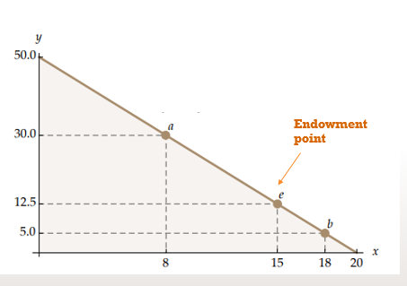
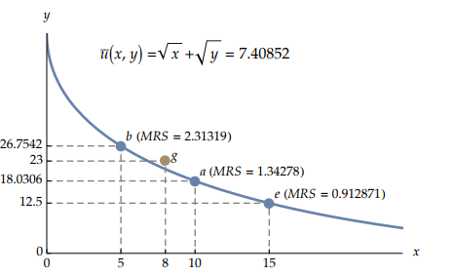
Indifference curve
Set of bundles that are modelled into a curve economically
At e
Utility?
MRS?

Slide 7
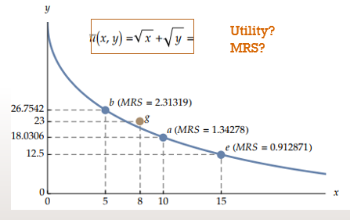

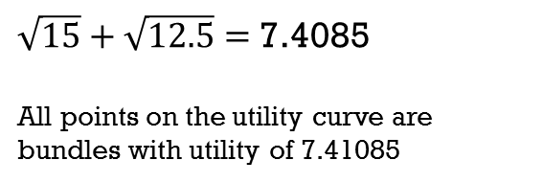
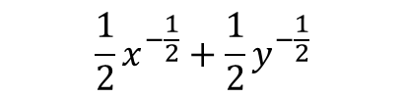
Utility
MRS
= slope of the curve
derivate the utility formula
WONT BE ASKED TO DO THIS
$\sqrt{15}+\sqrt{12.5}=$7.4085
All points on the utility curve are bundles with utility of 7.41085
Different utility curve.
g has higher utility
Change in y
Change in x
$$\frac{1}{2}x^{−\frac{1}{2}}+\frac{1}{2}y^{−\frac{1}{2}}$$

Slide 8
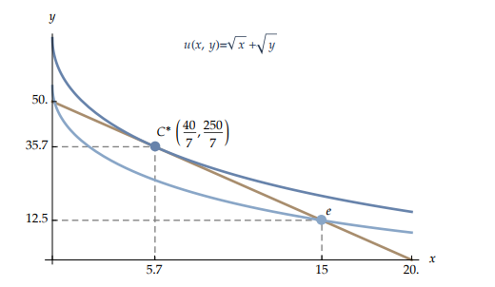
Consumption optimum
C*
Price ratio?
MRS?
Higher utility curve
Budget line

Slide 9

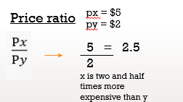
The marginal rate of substitution is the rate at which you are willing to trade x for y
Price ratio is the rate at which the market is willing to trade them
MRS
= 2.5

Slide 10
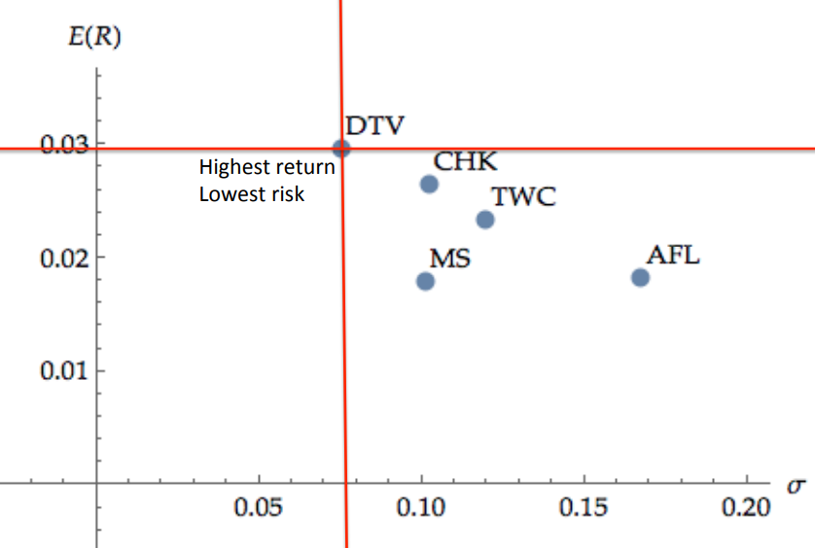
Which stock?
0.03
0.02
0.01
is the most risky?
is the least risky?
Less Risky
gives the biggest return ?
Highest Return
gives the least return ?
Lowest Return
Risky
WHICH ONE DO YOU INVEST IN?

Slide 11



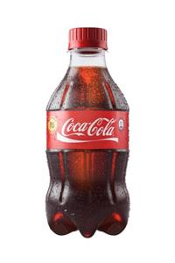
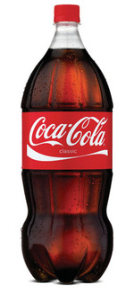

Arbitrage
Earning a riskless profit without putting up any of your own money.
Only works because the market is inefficient.
Buy $200 worth of little coke
= 100 little cokes
→ 50 “big cokes”
Borrow
$200
You made $250!
Give poor grandma her $200 back
Profit of $50
Sell all your
little cokes in the big coke market
=50 x $5 = $250
Markets
Costs $2
500 ml
1 litre = $4
Costs $5
1 litre

Slide 12
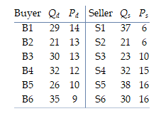
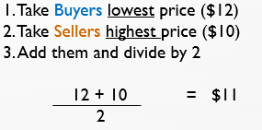
Equilibrium call market
B1 37-29 = 8 left
Takes 29 S1
B2 takes 8 left
Equilibrium
Quantity?
Price?
B2 21-8 = 13 left
B2 21-13= 8 left
Takes left S2
B3 takes 8 left
B3 30-8 = 22 left
B3 23-22 = 1 left
29+21+30+1 = 81
Takes left S3
Take 1 left
Takes 1 left S3

Slide 13
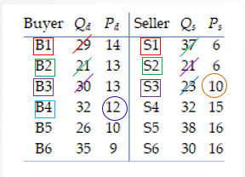
Consumer surplus
Producer Surplus
Difference between the total amount that consumers are willing and able to pay for a good or service and the total amount that they actually do pay
Difference between the amount a producer of a good receives and the minimum amount the producer is willing to accept for the good.
29 x (14-11) = 87
21 x (13-11) = 42
30 x (13-11) = 60
1 x (12-11)= 1
Total: 190
37 x (11-6) =185
21 x (11-6) = 105
23 x (11-10) =23
Total: 313
Total gains from trade = CS + PS
190+313 = 503

Slide 14
Financial math

Slide 15
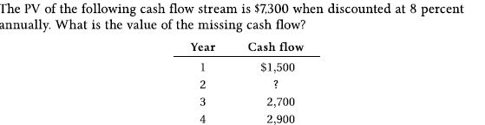
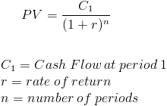
PV uneven stream of payments
$7,300=\frac{1,500}{\left(1+0.08\right)}$ + $\frac{x}{\left(1+0.08\right)²}$ + $\frac{2,700}{\left(1+0.08\right)ᵌ}$ + $\frac{2,900}{\left(1+0.08\right)⁴}$
7,300 = 1,388.89 + $\frac{x}{\left(1+0.08\right)²}$ + 2,143.35 + 2,131.59
7,300 – 1388.89 – 2,143.35-2,131.59 = Missing cash flow
($1,636.18)

Slide 16
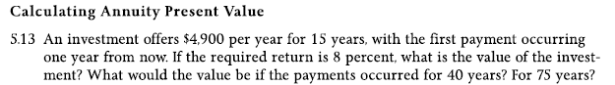
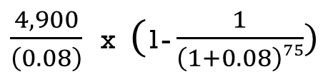
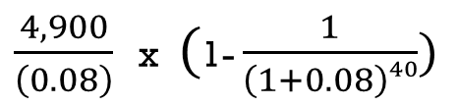
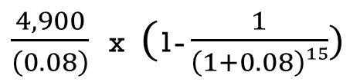
PV annuity
r= rate of return
c= cash flow
t=time
Financial
Calculator
4,900
$\frac{4,900}{\left(0.08\right)}$ x $($1- $\frac{1}{\left(1+0.08\right)¹⁵})$
= $41,941.45
PMT
I/Y
8
$\frac{4,900}{\left(0.08\right)}$ x $($1- $\frac{1}{\left(1+0.08\right)⁴⁰})$
= $58,430.61
N
15
CPT
PV
$\frac{4,900}{\left(0.08\right)}$ x $($1- $\frac{1}{\left(1+0.08\right)⁷⁵})$
= $61,059.31

Slide 17
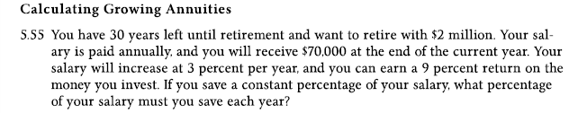
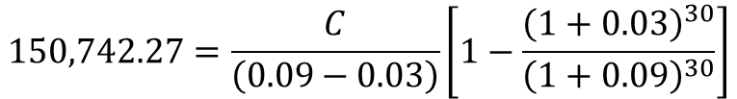

PV growing annuity
g= growth rate
n= rate of return
c= cash flow
t= time
PV$=\frac{2,000,000}{(1+0.09)ᵌ⁰}$
= $150,742.27
$$150,742.27=\frac{C}{\left(0.09−0.03\right)}\left[1−\frac{{\left(1+0.03\right)}^{30}}{{\left(1+0.09\right)}^{30}}\right]$$
C = 11,069.6857

