Slide 1
Why have a coaching philosophy?
KIN 365

Slide 2
Why have a coaching philosophy?
Philosophy
A particular system of thought
A study of a particular branch of knowledge/experience
Greek = ‘the love of wisdom’

Slide 3
Why have a coaching philosophy?
Developing a Philosophy
Foundational
Done through reflection
“learning to think”
Method of analyzing
Notes:
Foundational- Principles of knowledge and conduct
Done Through Reflection – What worked? What didn’t work? How can I make it work? Reflect on what you did personally. Serious thoughts or considerations, take an honest view of yourself. Term of reference based on personal experience
Method of analyzing- interoperation, seeing things from others point of view.

Slide 4
Why have a coaching philosophy?
Sport Coach Philosophy includes:
__Purpose_____________
  Motivation and effort for each practice and game
_____Leadership___________
  discipline, sportsmanship and competence
___Values/Beliefs/Governing Principles __________________________________________
  Accountability, responsibility, team unity, mental toughness, and self-confidence
Notes:
Purpose- As a coach you need to be there at each and very game, you have to want to be there, you have to make sure you are giving 110%.
Leadership- As a coach you must be competent at all time. If you don’t know something go and find out
Values/Beliefs/Govering Principles – What do you believe in? How far are you willing to go for it? Are you confident in your own abilities.

Slide 5
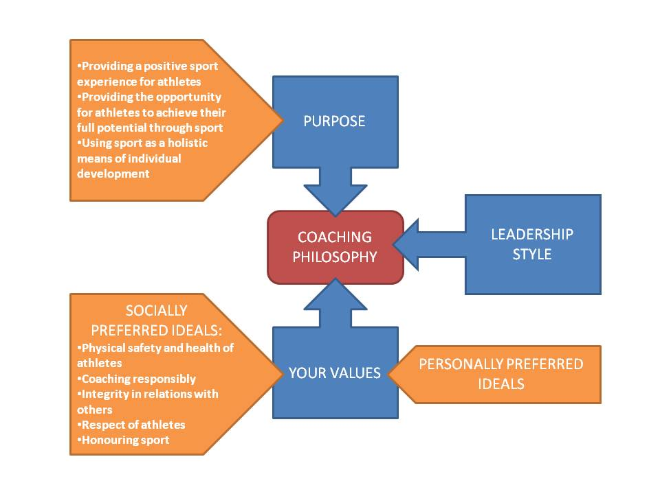
Why have a coaching philosophy?
Notes:
Everything in a fawkin nut shell.

Slide 6
Why have a coaching philosophy?
Why do you do what you do? – context of your role as a coach
Life experiences
Athlete experiences
Coach experiences
Notes:
Life expierences: As a child ? As a student? As a partner? As a athlete? All these are going to have an effect on who you are and who you became as an person. Positive or negative they are all influential.
Athlete expeirences: Diversity of sport options? As a child? Successes? Challenges? Have you had many options, or have you just played one sport all your life? What were you good and how did this boost your confidence? What were you bad at? And how did that make you feel/change you.
Coach Experiences: Coaching kids? Coaching Adults?

Slide 7
Why have a coaching philosophy?
Consider the following:
What are your goals as a coach?
What are your non-negotiable as a coach?
Notes:
Goals as a coach? ( where do you want to coach/ what age group/ what level)
What are your non-negotiable as a coach? (what line won’t you cross)

