Slide 1
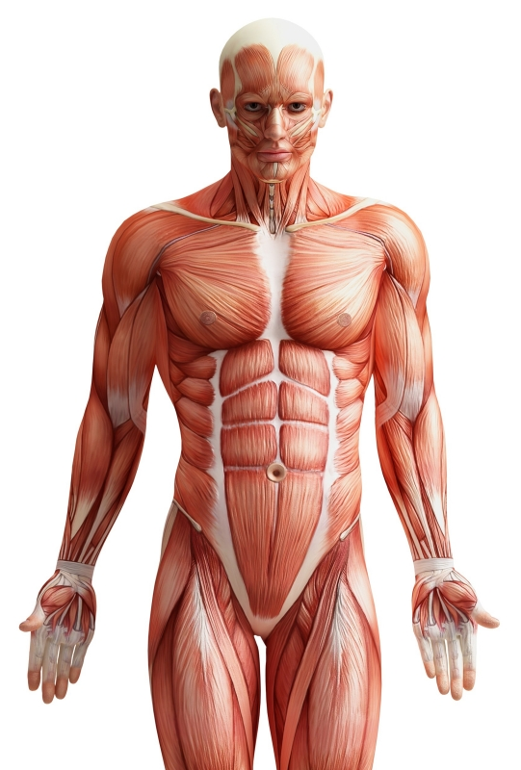
ANP 1106 B
M. Zeroual
Anatomical Terms
Anatomy of the Skeletal System
Anatomy and Physiology of the Joints
Anatomy of the Muscular System
Anatomy of the Nervous System
Integumentary System
F. Feiner F.
Physiology of the Nervous System

Slide 2
Specific Objectives:
Anatomical terms (pp.11-20)
1.1 Define the anatomical position, the regional and the directional terms, as well as planes and sections
1.2 Describe the body cavities

Slide 3
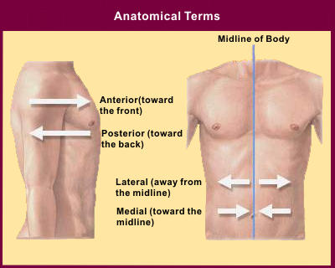
TOPIC #1: ANATOMICAL TERMS
1.1 Become familiar with anatomical nomenclature (pp. 11-20)
http://www.becomehealthynow.com/article/anatom/704/

Slide 4
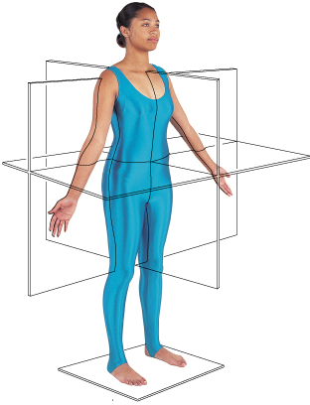

1.1. Describe the anatomical position, the regional and the directional terms as well as planes and sections
The Anatomical Position of the Human Body (see Table 1.1)
to describe body parts/positions precisely & with as few words as possible:
a) an initial reference point = body in standard anatomical position
b) an indication of direction - remember that “right” and “left” refer to the patient or the cadaver, not the observer
The anatomical position is very simple: body erect, feet slightly apart, and palms face forward with thumbs pointing away from body.
J. Carnegie, UofO
Fig. 1.8

Slide 5
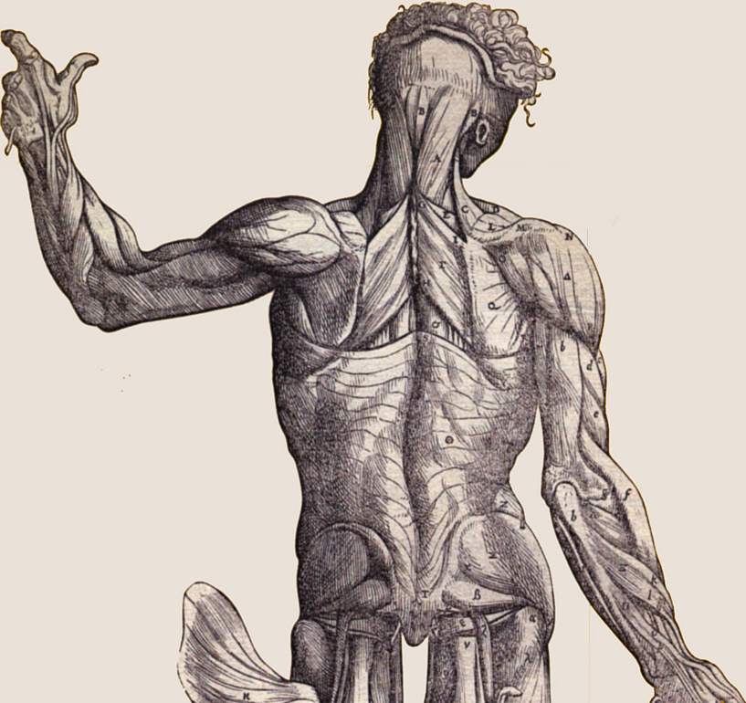
Regional Terms:
2 fundamental divisions of body:
1. axial part: = head, neck & trunk
2. appendicular part: = appendages or limbs attached to axis
then regional terms (see fig. 1.7) used to designate specific areas within the axial or appendicular part of the body
http://graphics.stanford.edu/courses/cs48n-03/

Slide 6
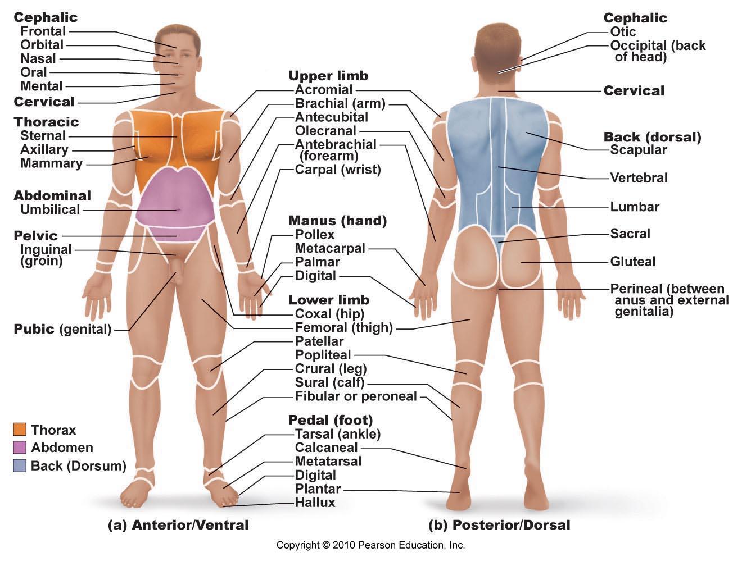
Fig. 1.7

Slide 7

Body Planes & Sections
3 common body planes - 2 are vertical & 1 is horizontal
1) sagittal plane: vertical plane that divides body into right & left parts
Why not right and left halves? What is a midsagittal or median plane? What is a parasagittal plane?
2) frontal plane: vertical plane that divides the body into anterior and posterior parts; also called a coronal plane
3) transverse or horizontal plane: from right to left dividing the body into superior and inferior parts
transverse section = cross-section
What is an oblique section??
J. Carnegie, UofO
Fig. 1.8

Slide 8
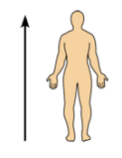
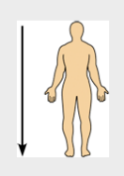


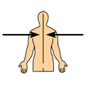
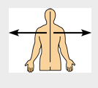
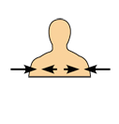
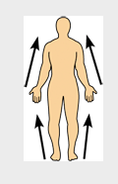
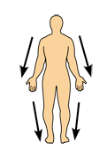


Slide 9
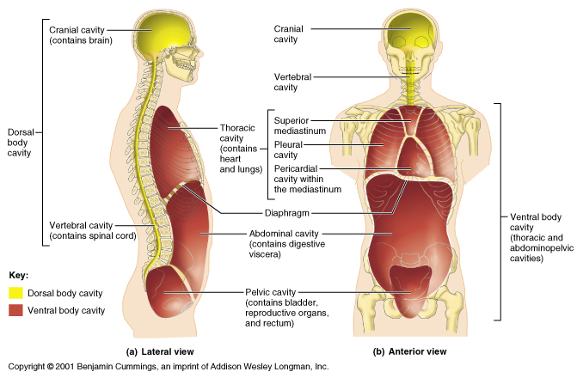
1.2 Describe the body cavities
1. Dorsal body cavity:
cranial cavity: enclosed by the skull and houses the brain .
vertebral (spinal) cavity: enclosed by vertebral column and houses the spinal cord
Both cavities are continuous and well-protected
Fig. 1.9
J. Carnegie, UofO

Slide 10
2. Ventral body cavity:
larger; houses the viscera
thoracic cavity: 2 lateral pleural cavities + central pericardial cavity
abdominopelvic cavity: superior abdominal cavity (stomach, intestines, spleen, liver) & inferior pelvic cavity (bladder, some reprod organs, rectum)
J. Carnegie, UofO
Fig. 1.9

Slide 11
What structure separates the thoracic and abdominopelvic cavities?? The abdominal and pelvic cavities??
In which body cavity do the organs receive the least protection from physical trauma??

Slide 12
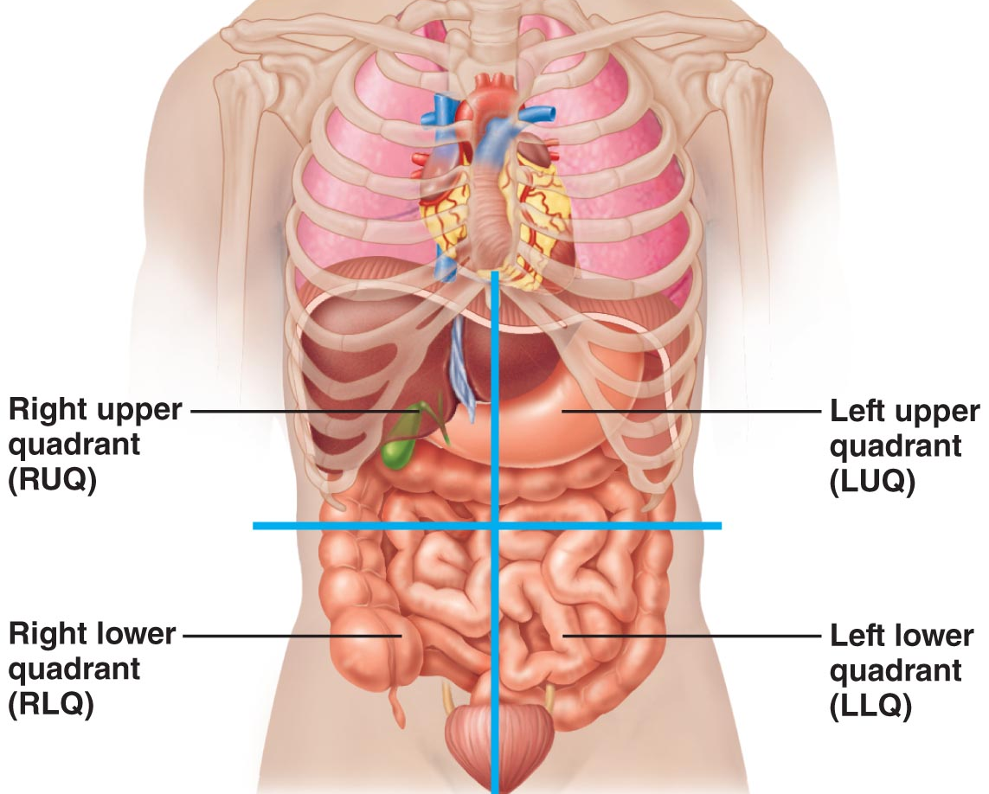
Abdominopelvic Quadrants
Fig. 1.11: Transverse and median planes intersect at the umbilicus

Slide 13
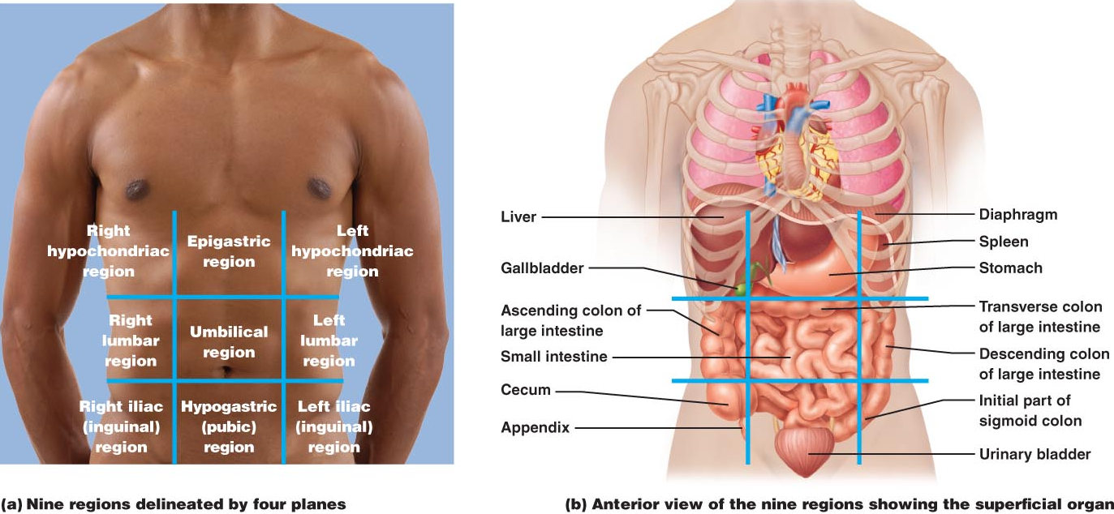
Nine abdominopelvic regions
Fig. 1.12: This division method is used primarily by anatomists

Slide 14
Review
What is anatomical position?
Name the structures located in the dorsal body cavity
Which plane divides the body into superior and inferior parts?
Which plane divides the body into anterior and posterior parts?
Which cavity is divided into three others cavities?
Why it’s important to divide the abdominopelvic cavity into nine regions?

