Slide 1
Philosophical Origins of Motivation
Let’s talk about Passions
And
Is Free Will Real?

Slide 2
René Descartes (1596 – 1650)
Mind-body dualism: The mind is a nonphysical entity that is uniquely different from the body.
Actions and objects do not necessarily have a higher-order purpose: Descartes disagreed with Aristotle and argued that when it came to physical phenomena, they could be completely explained by mechanics.
Rational soul: Only human behavior was driven by a sense of purpose.
Descartes argued that the mind and body influence each other, and at times, the rational mind was not always in control.
  Foundation for instinct

Slide 3
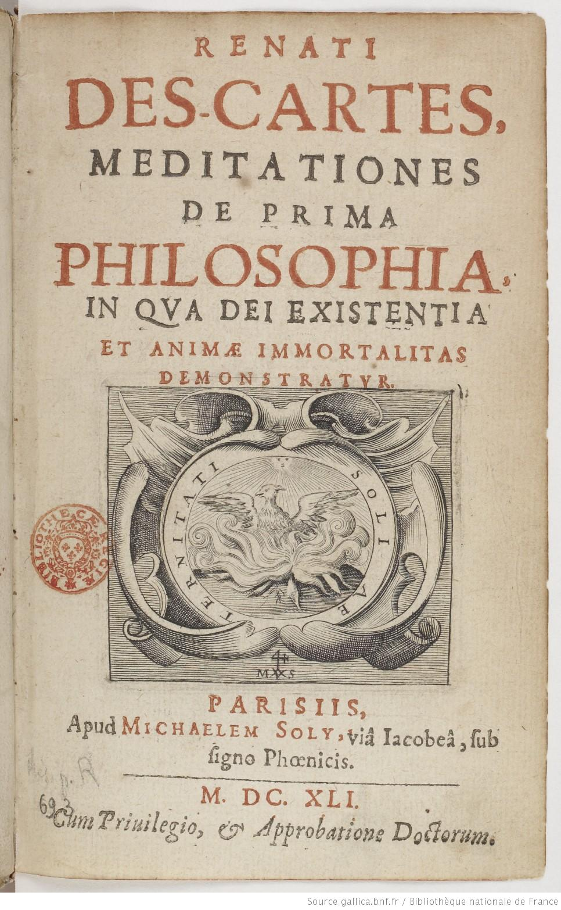
Meditations on First Philosophy (In which the existence of God and the immortality of the soul are demonstrated)
The book is made up of six meditations, in which he discards all belief in things that are not absolutely certain, and then tries to establish what can be known.
Doubt everything
I think therefore I am
If the idea of God exists, God must exist too
I can be wrong and imperfect without God being wrong or imperfect
God exists because math says so
The body and mind are distinct, and the material world exists because God wouldn’t deceive us about that

Slide 4
Descartes’ passions
Descartes argued that there exist six primary passions or emotions, each characterized by a motivational force that moves humans toward or away from a particular object.
They did not oppose each other, they were like primary colours and could be mixed.
The soul was influenced by the body through the brain, so it was important for rational man to understand the physiological effects of their emotions in order to avoid being controlled by them.
Descartes’ theory of passions is one of the earliest recognitions of the important role that emotions play in motivation.
Notes:
Didn’t believe that patterns weren’t inherently oppositional -- you can hate someone but love them at the same time or want something but fear it as well

Slide 5
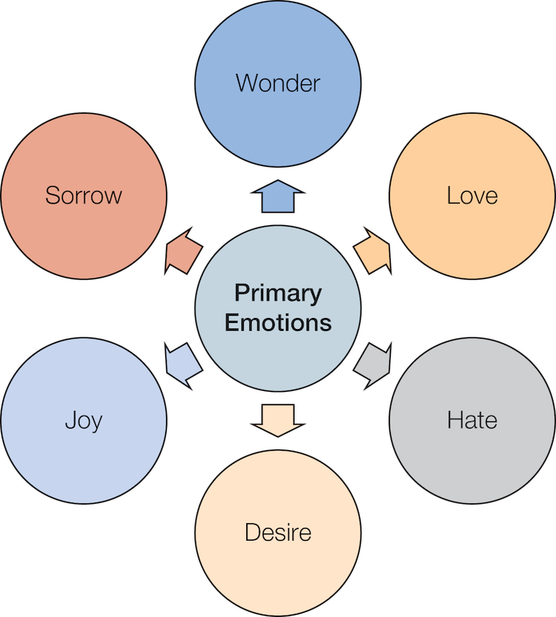
The Six Primary Passions or Emotions

Slide 6
Thomas Hobbes (1588 – 1679)
Hobbes’ central ideas
  Abandoned Descartes’ “mind” portion of dualism
  Materialism: Materialism suggests that all human behavior consists of blind, automatic reactions to environmental stimuli. Rationalism and free will are illusions we use to feel good about ourselves.
  Hedonistic: Life tries to seek out pleasure and avoid pain. Man is not “good” or “evil” or “noble” or “drawn to sin” we’re just survival machines. Hedonism is the principle of motivation.
    This was a radical proposition at the time but 100 years later the behaviourists were going to run with it.

Slide 7
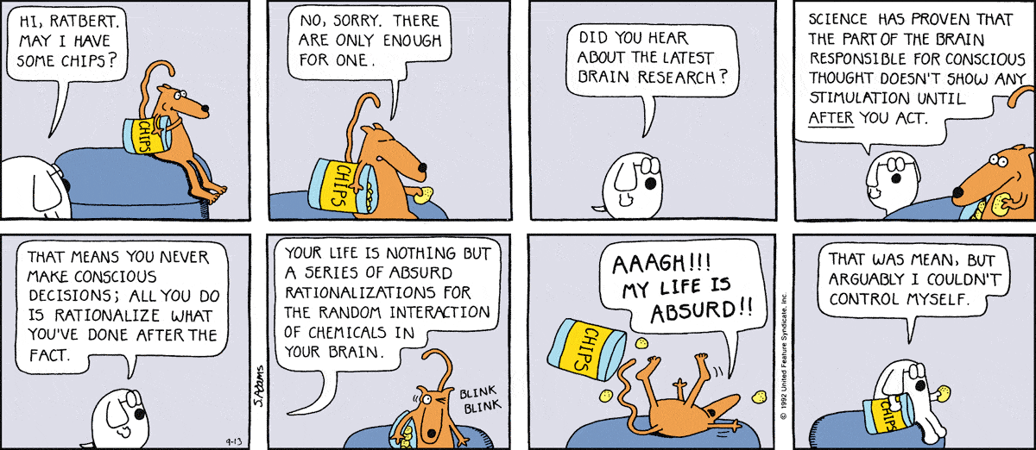
Thomas Hobbes

Slide 8
Thomas Hobbes
Hobbes’ theory of the relationship between thoughts and emotions
    Desire for an outcome comes from emotions
    Expectation of the outcome comes from thoughts
  Expectation for an outcome is not enough for action; one must also have the desire. Emotions are primary motivators: thoughts just let us find the way to get what we want.
  Hobbes’ ideas would later be revisited in both behaviorism and in expectancy-value theory.
Notes:
We’re motivated inherently by our survival instincts, our emotions, our animal tendencies but our developed mind helps us think and lets us do them
You have to have desire and you have to have an expectation for that motivation to become real

Slide 9
John Locke (1632-1704)
Locke’s ideas
  Blank slate: Locke argued that the human mind was a tabula rasa and that behavior was solely motivated by nurture (environment).
  Hedonism: Behavior stems from uneasiness
  Delay of gratification: While Locke’s ideas rely on hedonistic principles, he argues that people can choose not to give into their temptations. People who do succumb are failing to anticipate the future.
    “Few people would drink if the hangover came first.”

Slide 10
John Locke (1632-1704)
Locke’s additional contributions
  Empiricism: Experience is the only way to gain knowledge; his ideas formed the basis for the scientific method.
  American Declaration of Independence: American founders built off of the tabula rasa concept, and argued that all men (and women) are created equal, therefore the divine right to rule was bunk.
  Many of Locke’s ideas helped shape American society.
    Separation of church and state
    Separation of government branches
Notes:
Blank slate;
We can only know things that we experience
Not born w instincts or inherent desire to be good/bad so we only know what our senses tell us

Slide 11
David Hume (1711-1776)
  Motivation includes belief component and also desire, without which there is no motivation.
    The rational mind is “the slave of the passions.”
    Beliefs play an important role in the formation and experience of emotions.
  Hume’s passions
    Direct: Direct passions arise immediately from feelings of pleasure and pain. (desire, grief, joy, aversion, hope, fear, despair, security)
    Indirect: Indirect passions are experienced through pleasure and pain, but with the addition of beliefs associated with the object producing the pleasure or pain. (pride, humility, passion, love, ambition, vanity, hatred, envy, pity, malice, generosity)
Notes:
You need to have the emotional drive but also cognitive component to get stuff done
Your thinking can affect your emotional experience to something
2 passions;
Direct = arise immediately from pleasure and pain; cognition affects them less
Indirect = experienced thru pleasure and pain but w addition of beliefs associated w object
If given chocolates on V-day, you’ll be happy w the chocolates but your brain will say “aw bf got me a heart-shaped box of chocolates” as a result of your belief that he’s into you

Slide 12
Age of Enlightenment
Philosophers in the Age of Enlightenment (17th and 18th centuries) focused on the topics of freedom, reason, knowledge, and science.
  Shift away from emotion, good/evil, sin, as motivators. More interest in:
    Willpower
    Free will
    Morality
    Redefining hedonism
Notes:
Morality = always a god involved

Slide 13
Jeremy Bentham (1748 – 1832)
Bentham’s utilitarianism
Utilitarianism asserts that the utility of a particular course of action is determined by how much it maximizes happiness and reduces suffering.
  Created a mathematical algorithm to compute the utility of a particular course of action: Felicific calculus
  Encouraged the comparison of the pros and cons of any moral dilemma. “Hedons vs. dolors” (pleasures vs pains)
  Also created a list of 14 sources of motivations, what he called the “springs of human action.” List of pains and pleasures. This was the first book we’re aware of that was written exclusively about motivation.

Slide 14

Felicific calculus
Intensity: How strong is the sensation?
Duration: How long does it last?
Certainty: What are the odds of it happening?
Propinquity: How soon will it occur?
Fecundity: Will it occur again?
Purity: Will it also produce the opposite outcome?
Extent: Will it affect other people?
Intense, long, certain, speedy, fruitful, pure;
Such marks in pleasures and in pains endure;
Such pleasures seek if private be thy end:
If it be public, wide let them extend.
-J. Bentham
Notes:
You had to break down the idea
When considering whether or not to do a thing, consider;
Intensity = if you love skydiving, it’s worth saving up to experience the intensity of skydiving
Certainty = take into acct the odds of it happening
Extent = if you’re experiencing pleasure, why not share it with other ppl too? Extend it to others
This is how you decide if something is moral in utilitarianism

Slide 15
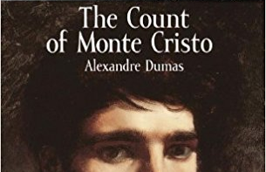
Immanuel Kant (1724 – 1804)
Kant’s philosophy of motivation
Reason is golden
Kant’s beliefs were reminiscent of the Stoics.
Minimize impact of emotions
Affect vs. passion: He distinguished between affect and passion; affect is quick to build, and passion is slow.
  Anger vs Hatred: Anger will pass and allow reason to resume. Hatred will use reason and logic to justify itself and also to carry out evil plans against the object of the hatred.
  Both are an “illness of the mind” but affect is easier to treat. Passions are dangerous.
Notes:
Affect is an emotion you feel in the moment and it’ll pass and you’ll be ok
Watching a movie and crying cause someone dies
Turn off the movie and then you get over it
Passion is a long lasting thing that you don’t shrug off and get over
Someone in your family dies and you don’t just get over it
Passion will use your logic to continue hating that person

Slide 16
Arthur Schopenhauer (1788-1860)
First to use the word “motivation” as the term for what drives us.
“Will” as intangible active force of nature, universe, and mankind: Schopenhauer viewed will as a blind, mindless, aimless, irrational urge that propels human action toward largely selfish endeavors. More like what we call “instinct”.
Driving behavior: Schopenhauer believed all human action occurs because we are acting in accordance with our “inborn and immutable behavior,” which is inherently selfish.
  Kind of dismal picture of humans as being always selfish and never satisfied, free will is an illusion, life is pointless suffering.
  But he said we can sometimes escape this state! Enjoy some art. Be kind. And get ascetic.
Notes:
Nowadays will = willpower but for him, it means instinct or urges of the body (little voice inside us that wants to eat all the candy)
No freewill, only will and our mindless instincts driving us constantly
No soul, rational mind, etc. we’re just human animals
No tabula rasa → we’re immutable, motivated to make ourselves comfortable and safe, we’re selfish, only about self-preservation
Painted a dismal picture of humans
We can temporarily ascend from this selfish state of will and become one w the greater something in the world
3 ways to do this;
Enjoy art → temporarily transcended your body and selfish nature and elevated you to something greater
Be kind → altruism was a way to ascend from gremlin state to temporarily become more than just a person seeking to satisfy their means all the time
Get ascetic → give away your worldy goods, starve yourself for a bit, be a monk, etc. → if you’re causing pain deliberately to yourself, you’re elevating yourself above this instinctive gratification, selfish, safety-seeking creature level bc we’re not instinctively driven to cause pain to ourselves

Slide 17
Summary: Philosophical Origins of Motivation
  The earliest theories used to explain motivation stemmed from ancient Greek and tended to focus on hedonism. However, the Stoics also tried to separate emotion from reason.
  During the medieval times, Saint Augustine argued that emotions were not inherently good or bad, but were defined by whether they are directed toward a good or bad object. Saint Thomas Aquinas examined two passions: concupiscible and irascible. Descartes promoted mind-body dualism and argued that human behavior is a function of urges of the body and a rational mind. Hobbes endorsed materialism, while Locke believed the mind was a tabula rasa. Hume argued that cognition can alter emotion.
  During the Age of Enlightenment, the understanding of motivation changed greatly. Bentham endorsed utilitarianism, while Kant focused on affect and passion. Schopenhauer was the first person to use the term “motivation,” and argued that will is the subjective illusion that we control our own movements when, in fact, we do not control them.

Slide 18

Reminder
Do your homework.

