Slide 1
Week 1: Gender Difference and Male Dominance
Chapter 1
Human Beings: An Engendered Species

Slide 2
Outline
Introduction
Are Men and Women Different?
Why Different?
Making Gender Visible
Gender and Power
Gender Differences
Mean Differences
Difference and Domination
Major Challenge and Solution

Slide 3
Introduction
Welcome to the class!
Introduction of:
the professor and the T. A.
Discussion of course outline
Questions

Slide 4
Are Men and Women Different?
The two tasks of any study of gender is to explain difference and dominance (inequality).
  Why do societies differentiate people on the basis of gender? (Perceived differences between men and women, kind of differences, division of labour and the use of gender as the basis of difference).
  Why are nearly all societies based on male dominance? (Unequal gender division of labour, unequal distribution of resources, men get more resources than women, men’s and women’s tasks are valued differently)

Slide 5
Why Different?
Two schools of thought:
  Biological determinism (Nature)
  Differential socialization (Nurture)
Most arguments about gender difference begin with biology
  Sex differences: Anatomical, hormonal, chemical, and physical differences between men and women (but there are ranges of maleness and femaleness)

Slide 6
Sex and Gender
Most social and behavioural scientists differentiate between ‘sex’ and ‘gender’
  Sex (male and female): Biological apparatus; chromosomal, chemical, anatomical organization etc.
  Gender (masculinity and femininity): Meanings attached to those differences within a culture (and within historical contexts). There are cross-cultural variations.

Slide 7
Making Gender Visible (Men and Women)
Until the 1970s, studies of social life focused only on class and race (or the family)
Last 50 years has seen an increasing study of women, gender, and now, men and masculinity (due to feminist advocacy). Gender is used either to construct or constrain individuals
Masculinity was visible but it is perceived as invisible because of privileges associated with it (invisibility of masculinity because men occupy powerful positions)

Slide 8
Making Gender Visible (Men and Women)
Invisibility of masculinity
  Invisibility of privilege : ‘power is often invisible to those who have it’ . Men are defensive when pointed out to them (p.5)
  It is a position of luxury
  North America: the objective is male and white
  Gender standards are male standards but are seen as objective standards (gender neutral) that are used to judge women.
  Teen violence among boys ignored
  What are some examples of invisibility of privilege of invisibility?

Slide 9
Gender and Power
Hegemonic masculinity
  Only one version of masculinity operating in a culture is ‘culturally honoured’ or hegemonic; other masculinities are organized under it (hierarchically)
  Emphasizes competition among men for power and dominance
    Developed in 1980s by R.W. Connell to explain male gender ideology
Gender intersects with race, class, age, ethnicity, region and sexuality to determine people’s experiences

Slide 10
Gender and Power
According to Connell, there is no ‘hegemonic’ version of femininity
Women’s gender expectations
  Exaggerated femininity (the ideal): ‘emphasized femininity’ stresses empathy and nurturance, not technical competence
  Its goal is for women to serve men’s interests and desires (p.9)

Slide 11
Gender Differences
Many of the differences we observe between men and women are deceptive distinctions, not gender differences
Language and communication patterns
  Men and women use language differently in different situations (men are silent at home but talk at work. They use competitive language (Tannen, p.10), chat with their supervisors because of powerlessness; occupation determines the use of language, not gender (O’Barr, p.10)
Money matters and heterosexual relationships
  Understanding of money matters is associated with masculinity so women fear that if they are also knowledgeable they will not find a partner (Dowling, p.11); the Y chromosome does not manage money when the women lack experience in the working world (Quinn, p.11)

Slide 12
Mean Differences
The reality is that differences are not as great as was once thought of.
Few differences between men and women are ‘hard-wired’
Men and women are not like day and night, earth and sky, life and death or opposites (Rubin, p.13) .
Gender differences are mean differences:
  Differences in the average scores of men and women on standardized tests

Slide 13
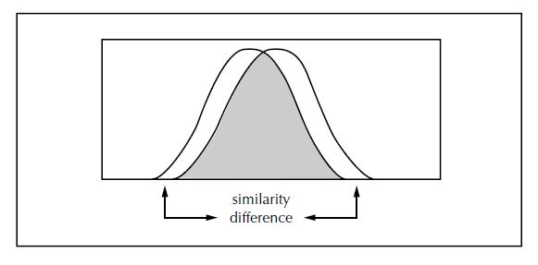
Mean Differences
Figure 1.1: Schematic rendering of the overlapping distributions of traits, attitudes, and behaviours by gender

Slide 14
Difference and Domination
Social institutions are gendered institutions
We become gendered selves in a gendered society:
  Social institutions reproduce and reinforce dominant definitions of gender and ‘discipline’ those who deviate from these definitions
A question about political and personal dilemmas
  Must women become ‘like men’ and sacrifice their femininity to succeed in the arenas that are established to reproduce masculinity?

Slide 15
Major Challenge and Solution
Negative influence of ‘interplanetary’ theory on proponents of biological determinism and differential socialization
There are differences between men and women (and they are greater than among men and among women)
Differences between men and women:
cannot be avoided
is the source of domination and inequality

Slide 16
Major Challenge and Solution
Social Constructionist Approach
Difference, domination and inequality can change
Our bodies (i.e., biology) are not the sources of difference
Differential socialization alone does not explain gender differences and domination
Elimination of gender difference will reduce levels of other forms of inequality (E. g., race, class, ethnicity, age, sexuality etc.)

Slide 17
Major Challenge and Solution
Social Constructionist Approach (Important)
Elimination of gender differences will reduce other forms of inequality (E. g., race, class, ethnicity, age, sexuality etc.)

