Slide 1
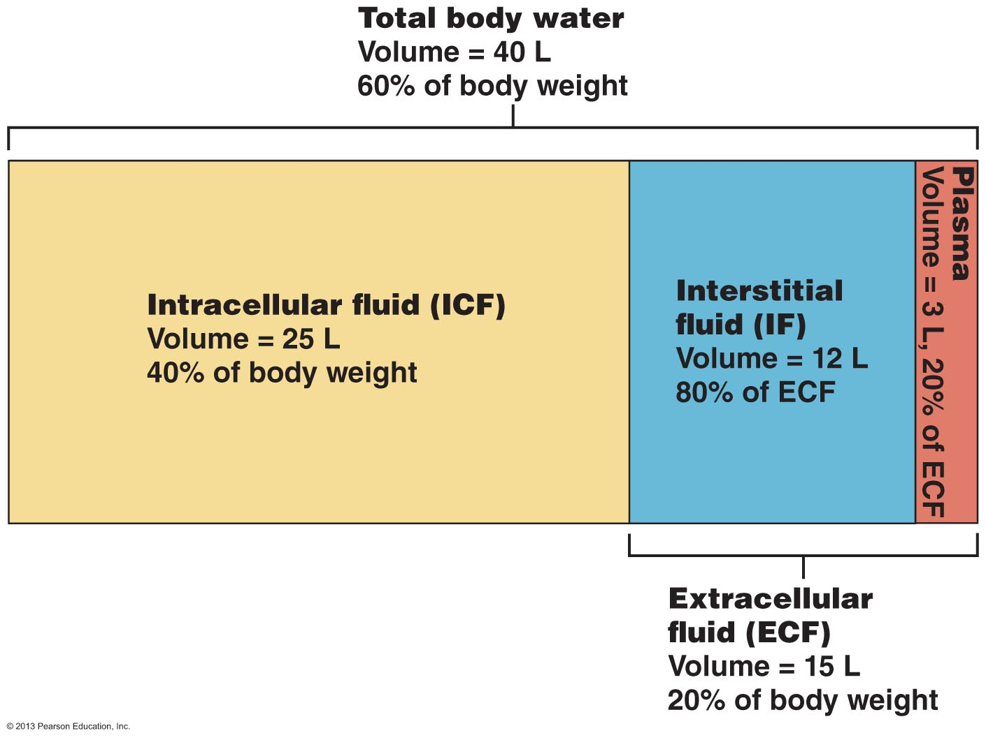

4.4 Demonstrate understanding of the role of the kidneys in fluid & electrolyte balance (Ch. 26)
4.4.1 define the fluid compartments
Intracellular fluid compartment (ICF) – within cells 60% total body fluid
Extracellular fluid compartment (ECF) – 40% body fluid; 2 areas
(a) plasma: ~20% ECF
(b) interstitial space: ~80% ECF – includes???
Fig. 26.1
J. Carnegie, UofO
Notes:
In between the cells and also fluids in the synovial joint and GI track and eye balls like fluids that is actually touchable

Slide 2
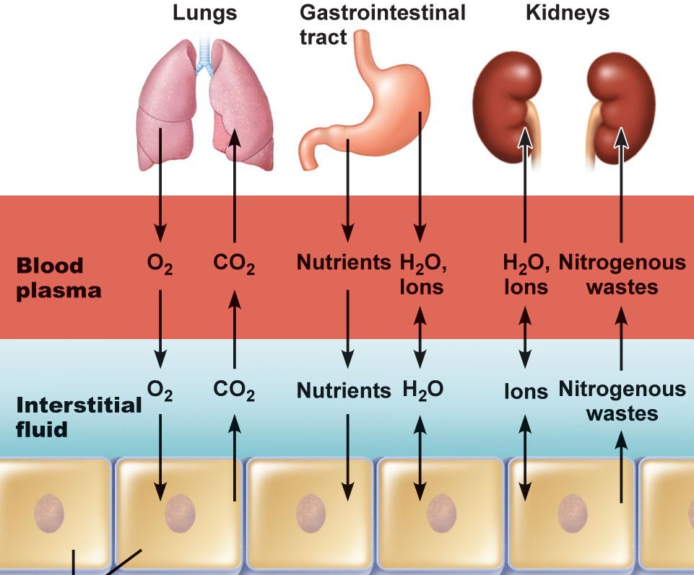
4.4.2 remind yourselves of the differences between electrolytes & non-electrolytes and of the key electrolytes in ICF & ECF
• electrolytes have greater osmotic power than non-electrolytes – Why?
• in ECF: chief cation is and chief anion is
• in ICF: chief cation is and chief anion is
• Na⁺ and K⁺ are opposite, when comparing ECF & ICF ⇒ ATP-dependent Na/K pumps keep intracellular [Na⁺] low and maintain high intracellular [K⁺]
renal mechanisms can reinforce these ion distributions by secreting K⁺ as Na⁺ is reabsorbed from filtrate
Fig. 26.3
Notes:
ECF: sodium plus Cl minues
ICF: K plus and phosphate minus

Slide 3
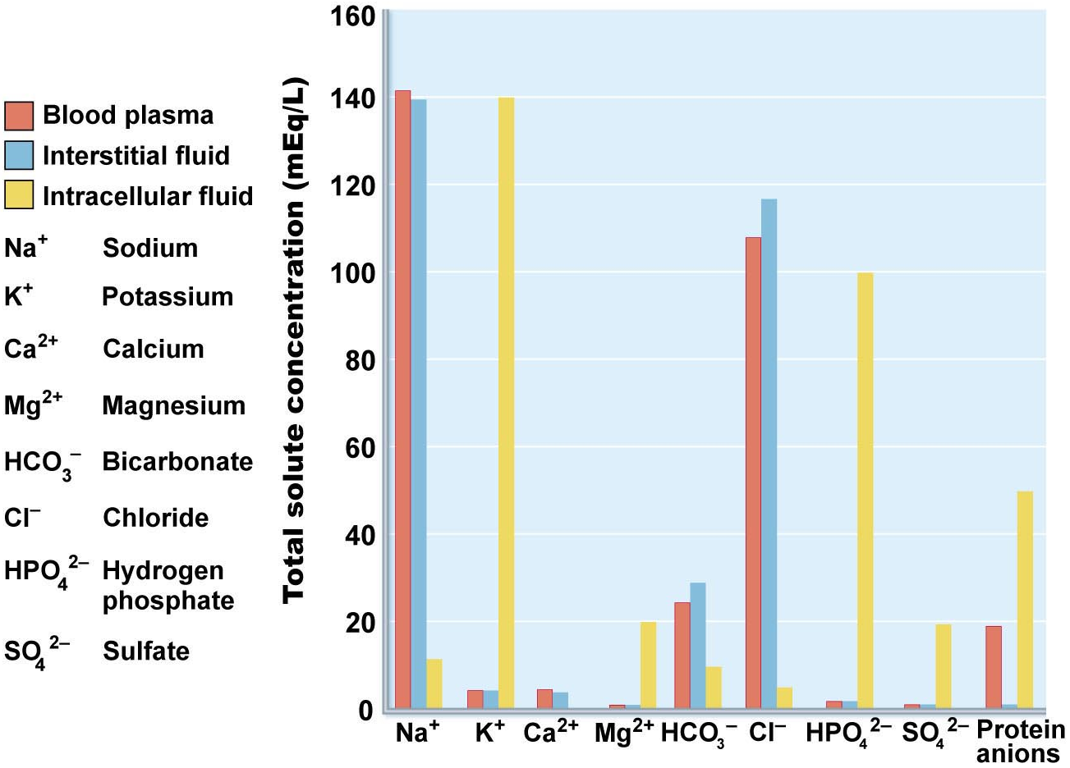
mEq/L = [mg/L]/atomic weight x number electrical charges/atom
Na⁺: 3300/23 x 1 = 143 mEQ/L; Ca⁺⁺: 100/40 x 2 = 5 mEq/L
Fig. 26.2
Notes:
wont ask us able mili equivelence (just get an idea of what is greater inside and outside the cell)
Wont ask us anything on it

Slide 4
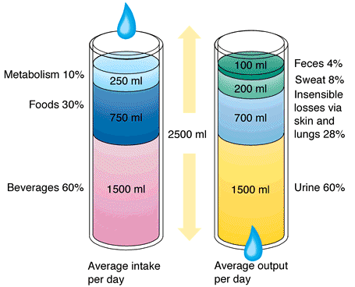
4.4.3 define water balance
• water intake must = water output
Intake: liquids, foods, cellular metabolism
Output: ~60% via kidneys; also lungs, skin, sweat, feces
Increased plasma osmolality (usu 285-300 mOsm):
thirsty → increase water intake
ADH stimulates renal water reabsorption
Decreased plasma osmolality:
thirst not stimulated
ADH secretion not stimulated
J. Carnegie, UofO
Fig. 26.4
Notes:
If it gets highter than 300 then we will get thirsty and we will drink more water
If it drops below 285 then we wont feel thirsty and we stay hydrated

Slide 5
4.4.3 (cont) describe the thirst mechanism
↓ in plasma volume of > 10% or ↑ in plasma osmolarity of 1-2% ⇒ dry mouth
osmoreceptors of hypothalamic thirst centre lose water to hypertonic ECF → become irritable & depolarize
dampening of thirst begins once mucosa of mouth & throat moistened → prevents overdrinking while water moves to ECF
Obligatory water losses:
(i) insensible water loss via lungs/skin
(ii) via feces
(iii) min sensible urinary loss = 500 ml/day
Notes:
500 ml per day if someone is dehydrated which is the minimum amount of level of body hydration
ECF extra cellular fluid

Slide 6
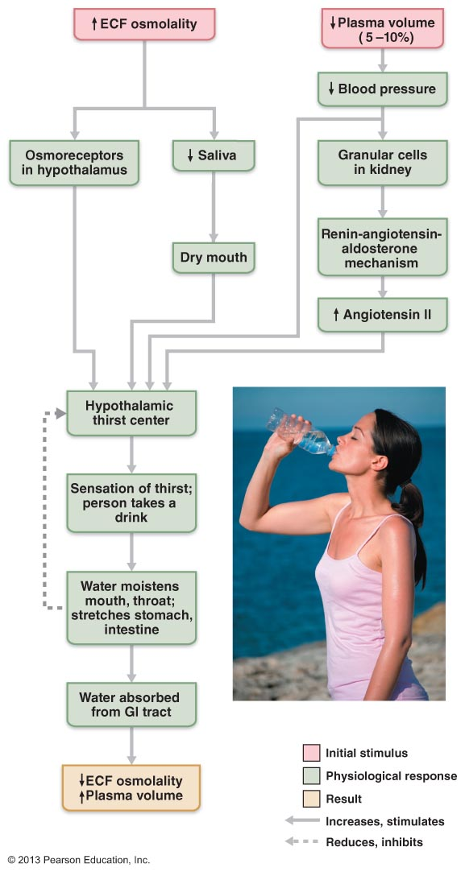
Fig. 26.5 The thirst mechanism for regulating water intake

Slide 7
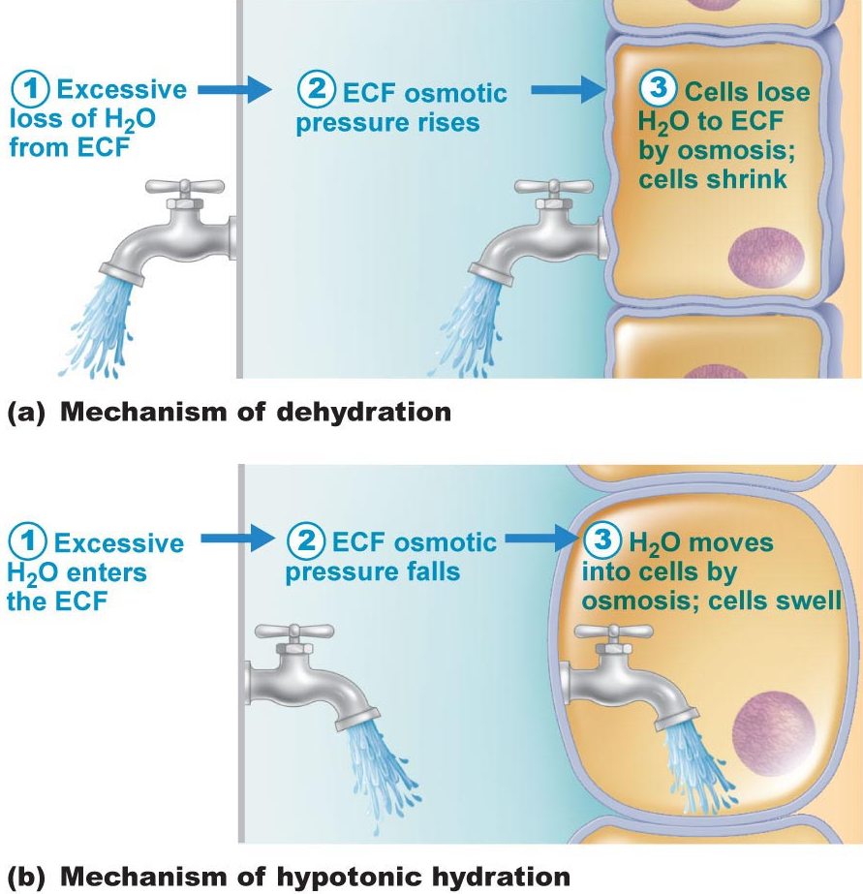
Disorders of water balance:
(i) Dehydration:
(ii) Hypotonic hydration:
(iii) Edema:
Fig. 26.7
Notes:
Dehydration: Do not have enough water if you sweat too much or not drinking enough, you have to hydrate someone who is dehrate them slowly so we don’t ruprture the cells
Hypotonic hydration: what can happen when you rehydrate someone realy quickly and the cell with swell quickly and rupture
-edema; swollen feet in pregnant people, fluid that should be in the blood stream and it accumelates

Slide 8
4.4.4 justify the role of sodium as the only solute exerting significant osmotic pressure and describe the influences on sodium balance of: aldosterone, cardiovascular baroreceptors, ADH and ANF
• salt content of body can vary due to: diet, loss via sweating, vomiting, etc
Sodium
• 90-95% of ECF solute (sodium + anions); NaCl & NaHCO₃ contribute 280 of the 300 mOsm solute concentration
• regulating Na⁺ balance one of most important functions of kidneys
• sodium content of body may change, but its concentration in ECF remains stable due to immediate adjustments in water volume (what happens to blood pressure after a salty meal?)
water follows salt if water channels open!!!
Factors influencing [Na⁺]
Aldosterone
• most influential agent wrt kidney; acts slowly
• even without aldosterone, 65% Na⁺ in filtrate reabsorbed in PCT & 25% in loop of Henle; aldosterone secretion essential to life
• high aldosterone: virtually all remaining Na⁺ (chloride co-transported) actively reabsorbed by DCT & collecting ducts
J. Carnegie, UofO
Notes:
After a salty meal?? BP will go up
You will feel thirsty because your osmolarity went up over 300 and blood pressure goes up because of the salt and then fluid from the GI so both salt and fluid is high but then BP will go to normal levels

Slide 9
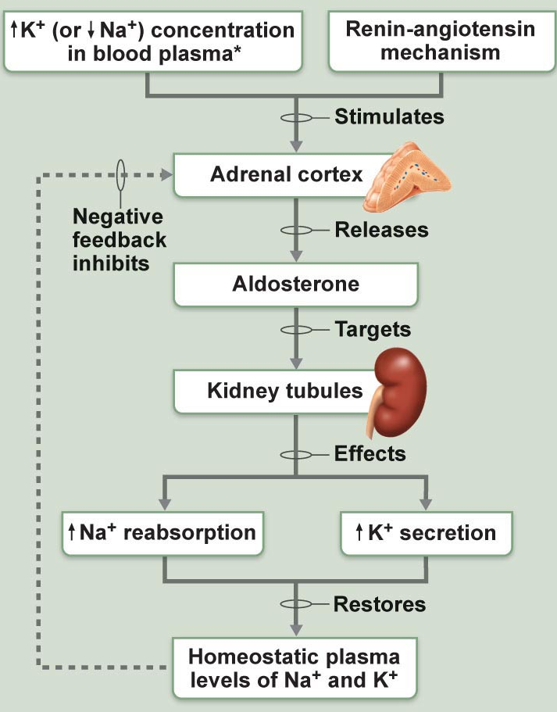

2 pathways to aldosterone secretion:
(i) renin-angiotensin system
(ii) direct effect of high K+ or low Na+
renin secretion in response to:
(i) symp ns
(ii) decreased filtrate osmolarity
(iii) decreased stretch (bp)
angiotensinogen (from liver)
(renin)
angiotensin I
(ACE)
angiotensin II
Addison’s disease
hyposecretion of aldosterone excess loss of Na⁺ & water in urine
Fig. 26.8
J. Carnegie, UofO
Notes:
They lose to much salt and then lose too much water and go on hormone treatment to regulate it because it is essential to life

Slide 10
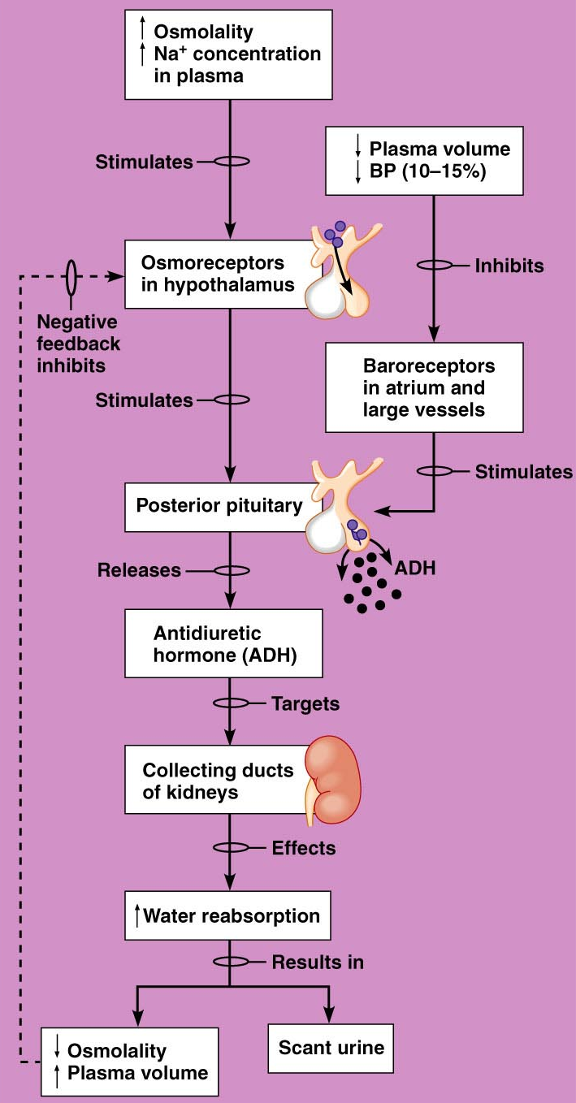
(b) ADH
water reabsorption in collecting ducts relies on ADH secretion
osmoreceptors in hypothalamus:
(i) low [Na⁺] = excess fluid → reduced ADH secretion & dilute urine
(ii) high [Na⁺] = decreased blood volume → ADH & reduced urine volume
Fig. 26.6

Slide 11
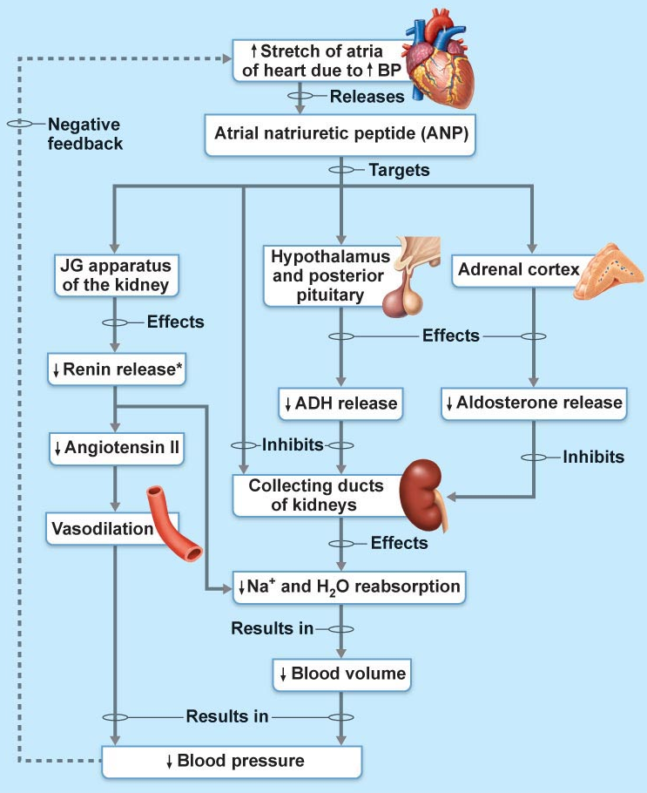
(c) Atrial Natriuretic Factor
• released by certain cardiac cells when bp ⇑
• potent diuretic & natriuretic hormone:
(i) inhibits Na⁺ reabsorption by DCT & collecting duct
(ii) ↓ release of ADH, renin & aldosterone
(iii) induces vasodilation
overall effect is to reduce bp
(d) Other Hormones
  Estradiol
  Progesterone
  Cortisol
Fig. 26.9
J. Carnegie, UofO
Notes:
ANF is produced in the heart when bp increased due to eating a salty meal and drinking a lot of water
-ANF interefers with reabsorbing of water and salt (ADH and aldosterone)
-other hormones they have very little influnces on water and salt

Slide 12
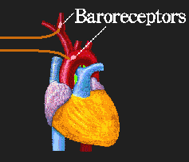
(e) Cardiovascular Baroreceptors
• pressure diuresis:
when blood volume and/or pressure ↑, symp input to kidney ↓ ⇒⇒ result is dilation of afferent arterioles & ↑ GFR --- overall result is???
• not that effective – why????
• this reflex provides information on blood volume and potential needs to adjust sodium and water output/reabsorption
http://user.gru.net/clawrence/vccl/chpt6/local.htm
J. Carnegie, UofO
Notes:
Over result? Unload more water and salt at the levels of the kidneys
Why??

Slide 13

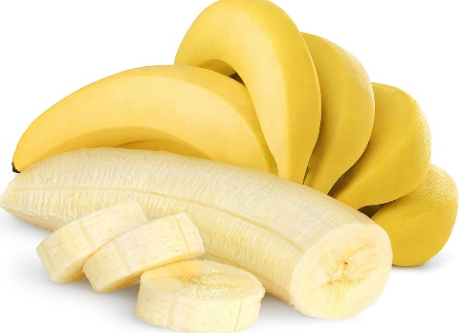
4.4.5 outline the main features of potassium balance
• high [K⁺] in ECF is toxic
√ reduces membrane excitability
√ involved in acid-base balance by moving in opposite direction to H+
• usually 10% K⁺ in filtrate lost (90% )
• if [K⁺] in ECF high, tubular secretion by the principal cells of the cortical collecting ducts kicks in
• dietary K⁺ important – why??
J. Carnegie, UofO
Notes:
and reabsorb 90%
Why? to maintain the intracellular level of K inside the cell

Slide 14
2 factors determine rate & extent of K⁺ excretion:
(i) plasma [K⁺]
(ii) [aldosterone]
Fig. 26.8

Slide 15
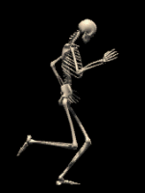
4.4.6 outline the main features of calcium and phosphate balance
• 99% of body’s calcium found in bone
• Ca⁺⁺ important for: , , -- hence must be closely regulated
• 2 hormones:
(i) PTH: primary, from parathyroid glands; increases blood Ca⁺⁺
(ii) calcitonin: parafollicular cells of thyroid gland; decreases blood calcium
• usu ~98% filtered Ca⁺⁺ is reabsorbed
http://www.edb.utexas.edu/faculty/dingwell/
Notes:
Muscle contractions, maintaing bone density, important for neuron to neuron communications
-if we have too much calcium its okay the calcium will go to the bones
PTH: parathyroid hormone, it makes sure that calcium levels don’t drop to low

Slide 16
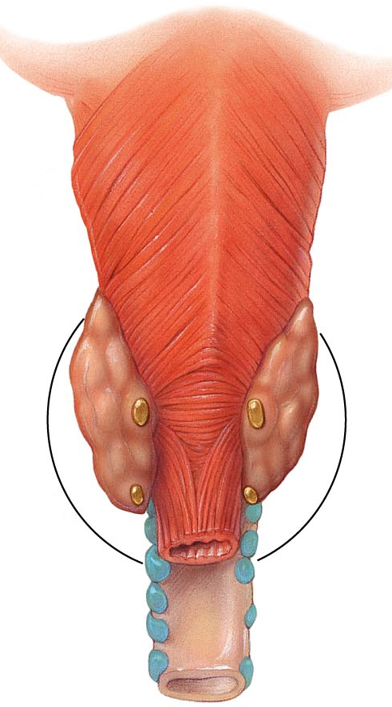
PTH:
• stimulus for secretion is drop in blood Ca⁺⁺
  bone (osteoclasts)
  small intestine
  kidneys – opposite effects on Ca⁺⁺ vs phosphate
• most (~75%) of filtered phosphate reabsorbed in proximal tubules by AT
  no PTH: phosphate reabsorbed to T_{m}
  high PTH: reduced AT of phosphate
calcitonin:
• stimulus for secretion is rising blood Ca⁺⁺
J. Carnegie, UofO
Fig. 16.12 – Posterior view of Thyroid Gland
Notes:
The 4 tiny structures are parathyroid glands that release parathyroid hormones
When there is a drop in calcium then it triggers the parathyroid gland to realse parathyroid hormones and the bones and the Sm from the meal you just ate and the kidneys because there are good places for calcium

Slide 17
4.4.7 describe the 3 mechanisms of acid-base balance used in the body; describe in detail the 3rd mechanism – the role of the kidneys
• very important: activity of functional ptns depends on pH (7.4 arterial, 7.35 venous, 7.0 intracellular)
What is alkalosis? What is acidosis?
Sources of acid:
  Breakdown of phosphorus-containing ptns → phosphoric acid
  Anaerobic metabolism of glucose →
  Fat metabolism → fatty acids & ketone bodies
  Loading & transport of CO₂ as bicarbonate → H⁺ ions
  HCl released during digestion stays in GI tract but must be buffered
Notes:
If its drop below 7.35 then its acidosis
If its above 7.45 then it alkalosis (check)
Ketone boddies can lower blood PH

Slide 18
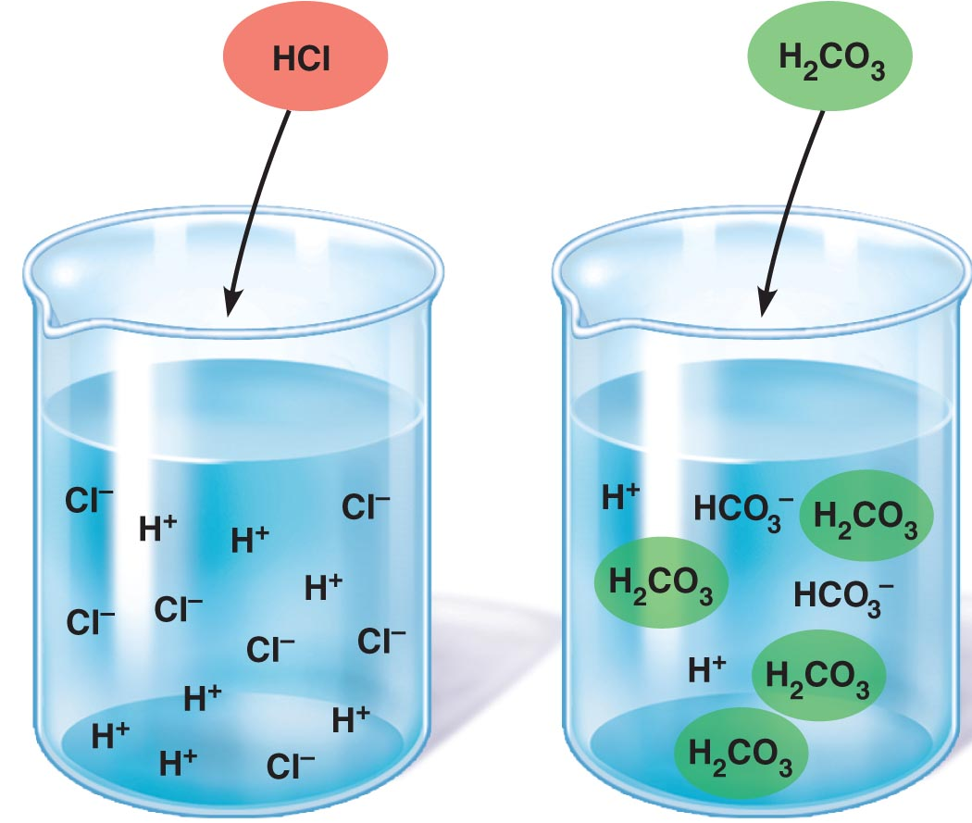
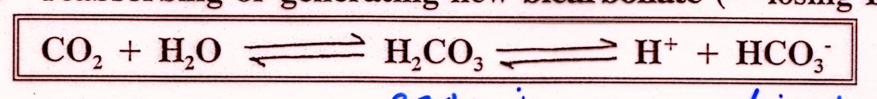
Blood [H⁺] is regulated by:
Chemical buffer systems: (H₂CO₃ ⇔ HCO₃⁻, Na₂HPO₄ ⇔ NaH₂PO₄, protein buffers)
pro:
con:
Respiratory centre in brain stem:
pro:
con:
Renal mechanisms:
pro:
con:
• renal mechanism involves:
(1) excreting bicarbonate (= gaining H⁺)
(2) reabsorbing or generating new bicarbonate (= getting rid of H⁺)
Fig. 26.11
J. Carnegie, U of O
Notes:
Most of the time we are dealing with acidosis
1. Pro; it is the fastest way to use buffers in the blood plasma from preventing blood PH to drop (temporary fix)
Con; it’s a limited capacity
3. Pro; you get rid of things and mcuh larger to help get rid of hydrogen ions
Con; takes time for the kidneys to deal with they hydrogen ions
2. Pro: blow off co2 quicker and get rid of hyrogen ions (breathe more rapidyly and get rid of co2) its faster then 2 but slower then 3 and not as limited as 1 but less limited than 3

Slide 19
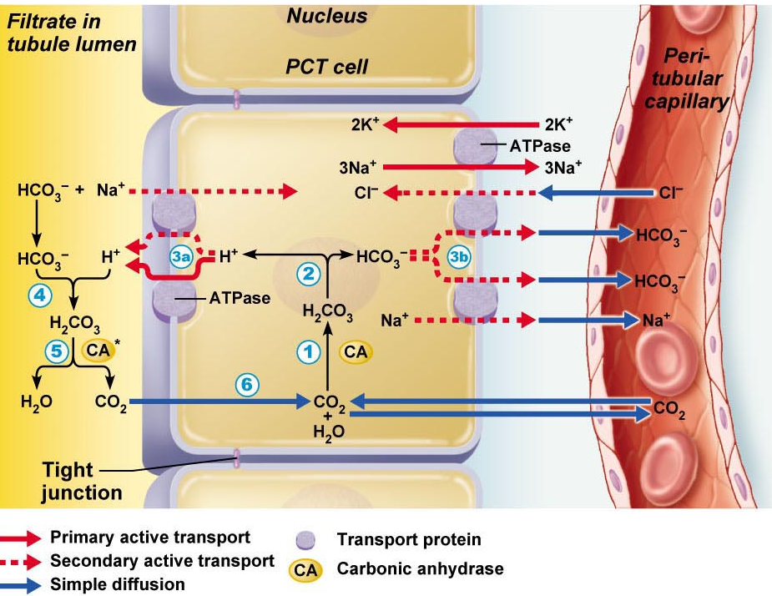
H⁺ Secretion:
tubule & collecting duct respond to pH of ECF & alter rate of H⁺ secretion
Secreted H⁺ comes from carbonic acid
For each H⁺ actively secreted into tubule lumen, one Na⁺ is reabsorbed, maintaining electrochemical balance
H⁺ can combine with HCO₃⁻ producing CO₂ & H₂O; CO₂ returns to tubule cell & promotes more H⁺ secretion
Fig. 26.12
J. Carnegie, UofO

Slide 20
Bicarbonate reabsorption:
Problem: tubule cells almost completely impermeable to bicarbonate in filtrate
• need to constantly replenish body’s stores of bicarbonate
(why?? how is it lost??)
• bicarbonate ions are reabsorbed indirectly from bicarbonate made in tubule cells
• Na⁺ accompanies HCO₃⁻ into peritubular capillaries
Generating new bicarbonate ions:
• bicarb reabsorption just recycles bicarb already present in body
• new H⁺ enters via diet ➢ must generate new bicarb to maintain pH
(i) phosphate buffer system
(ii) NH₄⁺ excretion
Notes:
Why how is it lost? check

Slide 21
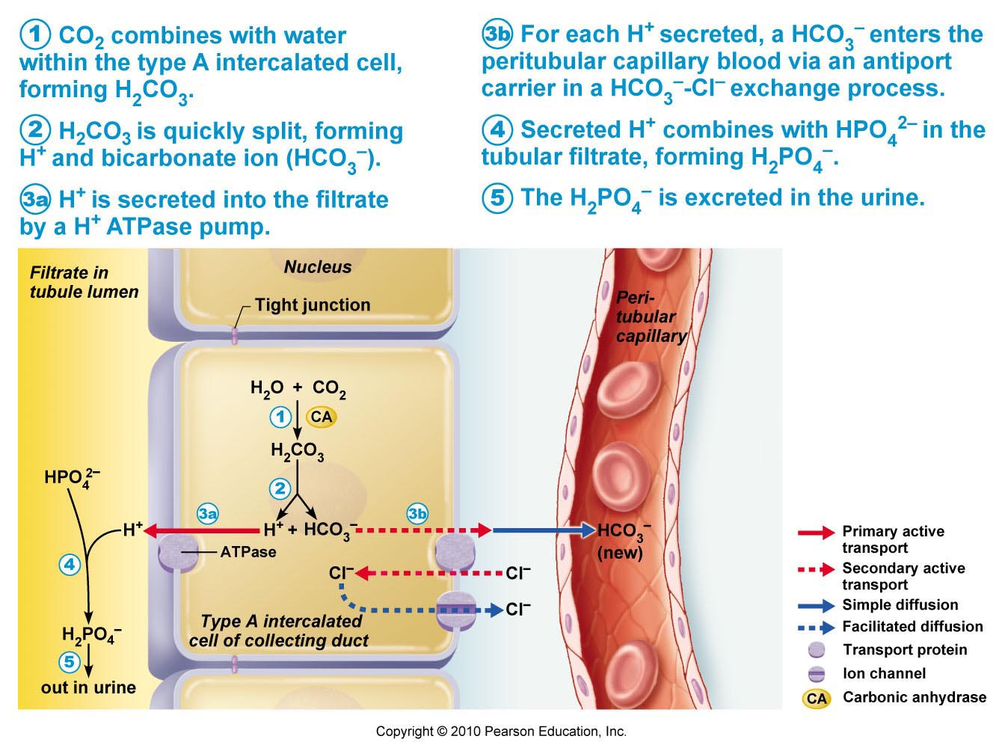
Phosphate buffer system:
weak base is HPO₄²⁻
components freely filter into tubules; usually ~75% reabsorbed, except during acidosis
type A intercalated cells actively secrete H+ (new HCO₃⁻ generated as byproduct; HCO₃⁻/Cl⁻ antiport)
Fig. 26.13: Phosphate buffer system
J. Carnegie, UofO

Slide 22
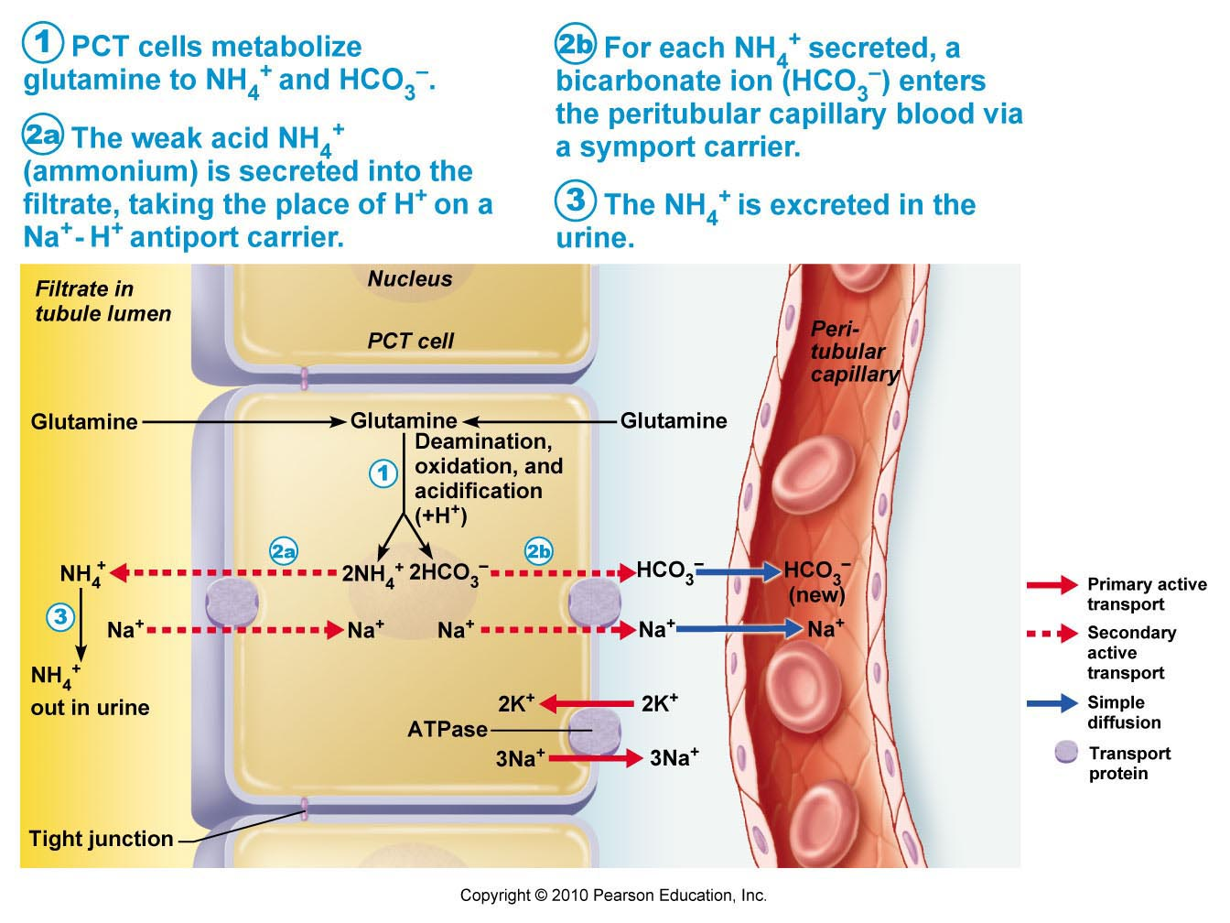
Fig. 26.14: NH₄⁺ excretion
NH₄⁺ Excretion:
• generated in PCT cells by metabolism of glutamine
• HCO₃⁻ moves into blood; NH₄⁺ is a very weak acid – lost via urine
Bicarbonate ion excretion:
• more rare occurrence; type B intercalated cells; reverse of reabsorption
Notes:
Here you generate new bicorbonate in the system

Slide 23
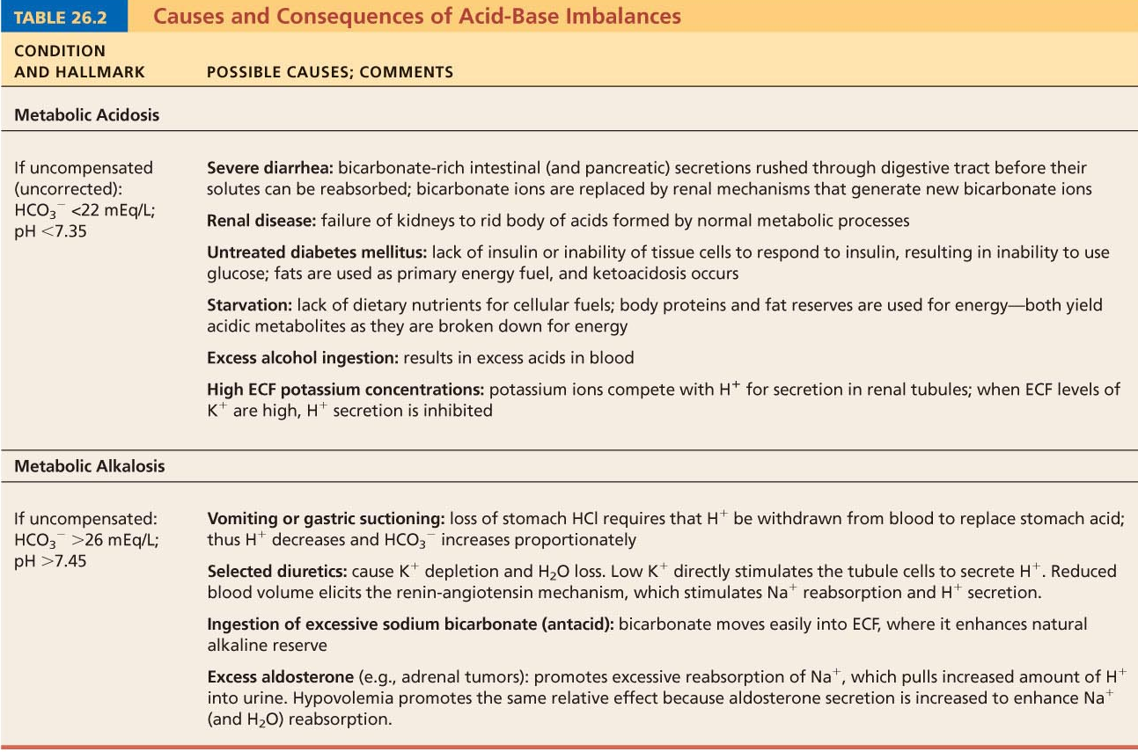
Notes:
Blowing co2 is alkaosis and taking in co2 is acidosis (check)
If youre in metabloic acidosis or alkalosis then you will use respirotary acidosis or alkalosis to fix it

Slide 24
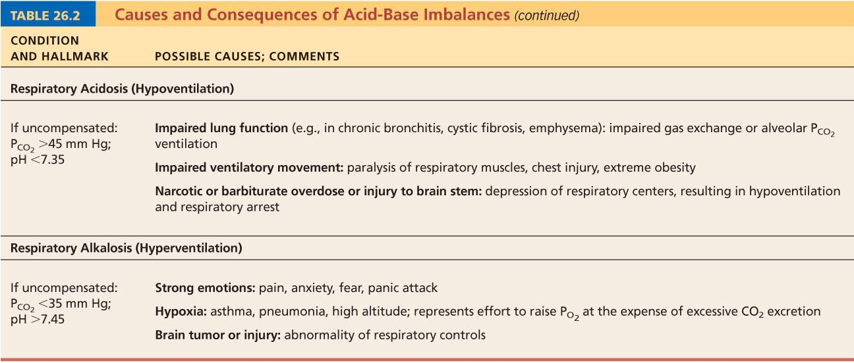
Notes:
Hypoventilate; you breathe shallow an Ph is below 7.35
Alcalosis is hyperventilating; you breathe more rapidly because you generate more oxygen therefore you must get ride of co2 quickly and ph will be above 7.45 (when you have a panic attack) and someone with asthma

Slide 25
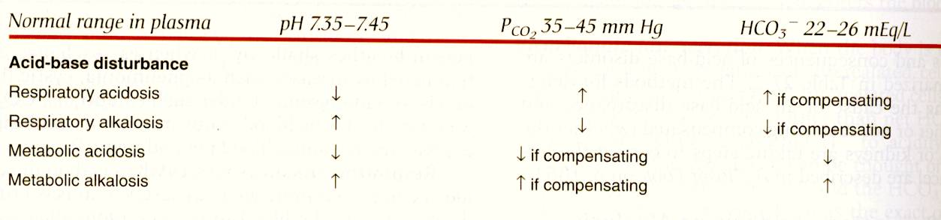
Problem #1
Blood values: pH 7.6, P(CO₂) 24 mm Hg, HCO₃⁻ = 23 mEq/L
Problem #2
Blood values: pH 7.48, P(CO₂) 46 mm Hg, HCO₃⁻ = 33 mEq/L
J. Carnegie, UofO
Notes:
Problem one is alkalosis; it is respiratory alkalosis (because there is low co2), there is no body compensation
Problem 3; is alkalosis , it is metabolic alkalosis and there is a body compensation because there are trying to push ther levels of co2 up

Slide 26

Effects of aldosterone include:
a) increase in sodium ion excretion
b) increase in water retention
c) increase in [K⁺] in the urine
d) higher blood pressure
e) c) and d)
To calculate renal clearance, one must know:
a) the concentration of the substance in the plasma
b) the concentration of the substance in the urine
c) the glomerular filtration rate
d) a) and b)
e) a), b) and c)
TR was standing at a urinal in a crowded public rest room and a long line was forming behind him. He became anxious and found he could not micturate. Use logic to deduce TR’s problem.
a) his internal urethral sphincter would not relax
b) his external urethral sphincter would not relax
c) his detrusor muscle was contracting too forcefully
d) he almost certainly had a burst bladder
Inhibition of ADH secretion:
a) is caused by alcohol consumption
b) results in edema
c) disturbs acid-base balance
d) is triggered by hyponatremia
e) a) and d)
J. Carnegie, UofO
Notes:
1. C
2. D
3. Internal is voluntary (A) (check which one is voluntary and which one is involuntary)
4. E both a and d

