Slide 1
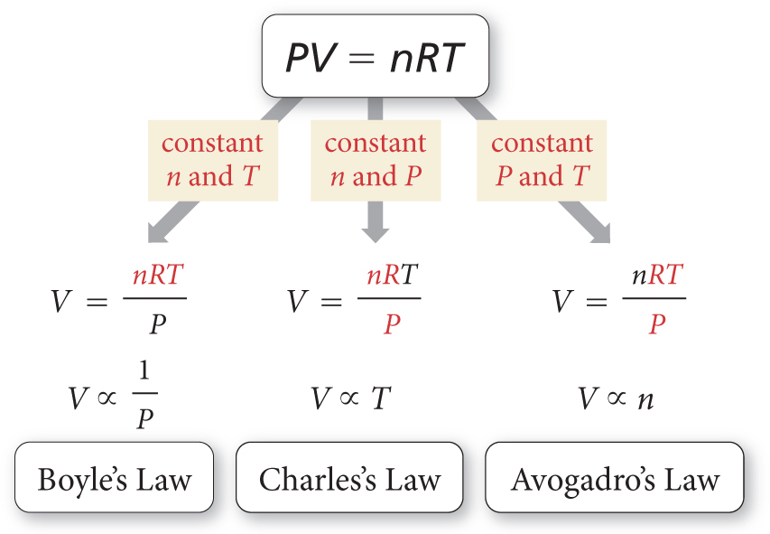
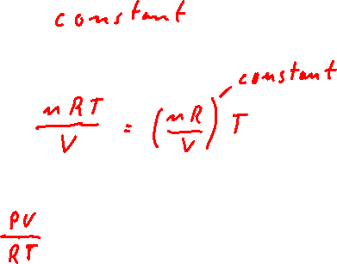
The Ideal Gas Law
R = 0.08314 L bar mol⁻¹ K⁻¹
PV_{n,T} =
P_{n,V} =
n =

Slide 2
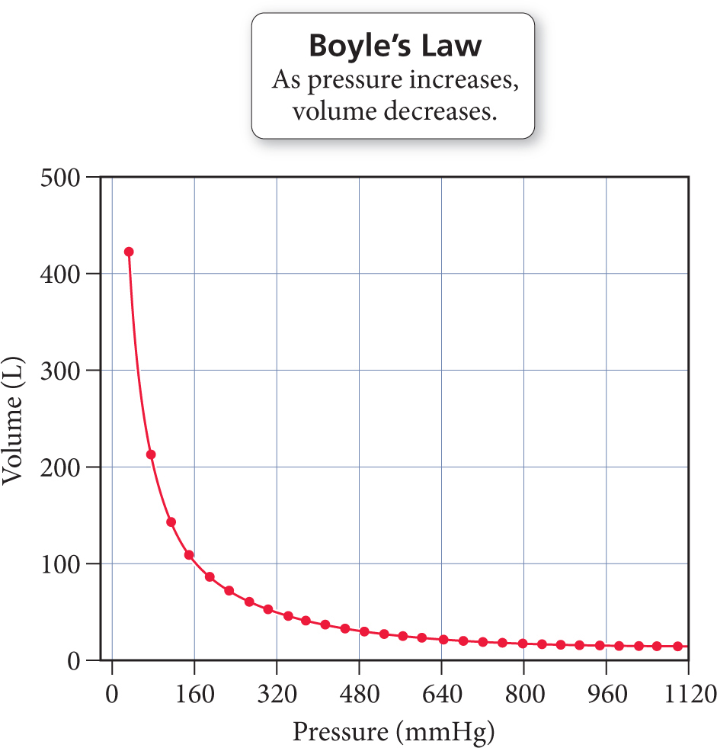
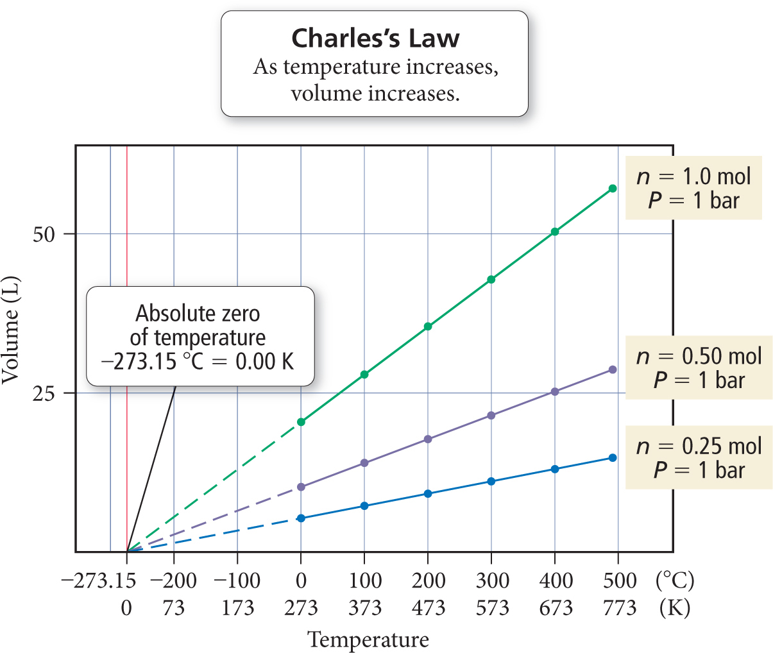
The Ideal Gas Law

Slide 3
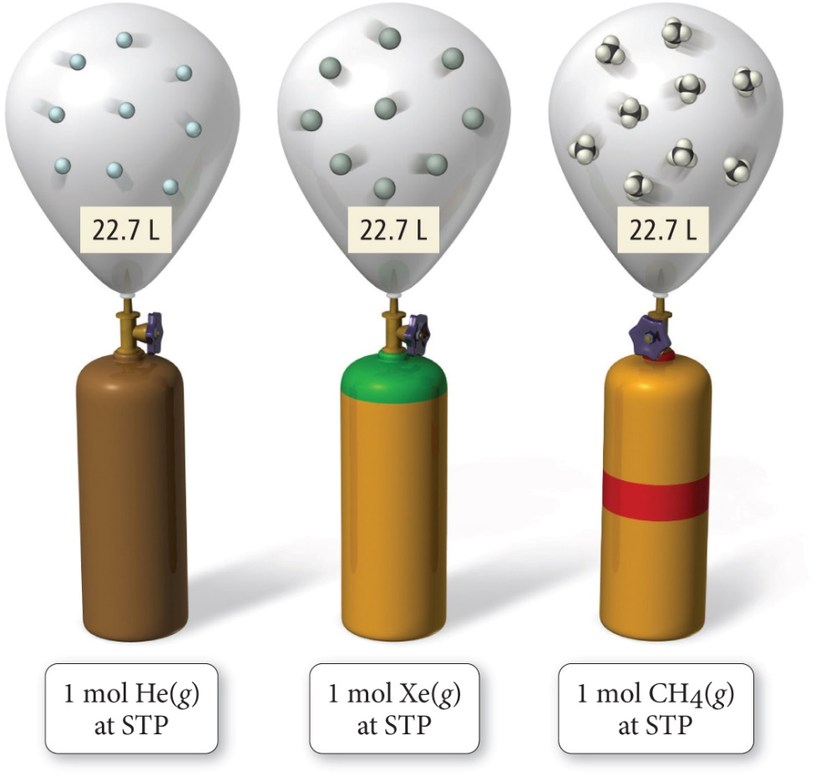
The Ideal Gas Law
How does atomic mass affect the ideal gas law?
e.g. how does the volume of 1 mol of H₂ (MW = 2 g/mol) and 1 mol of propane (44 g/mol) differ?
At standard temperature (273.15 K) and pressure (1.00 bar).
Standard temperature (273.15 K), pressure (1.00 bar) and volume (1L).

Slide 4
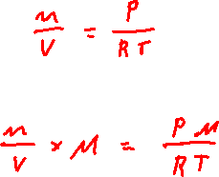
The Density of Ideal Gases
Molar Density =
Density (d) =
At standard temperature (273.15 K) and pressure (1.00 bar).
What is the difference in density 1 L of H₂ (MW = 2 g/mol) and 1 L of propane (44 g/mol) gas?
Standard temperature (273.15 K), pressure (1.00 bar) and volume (1L).

Slide 5
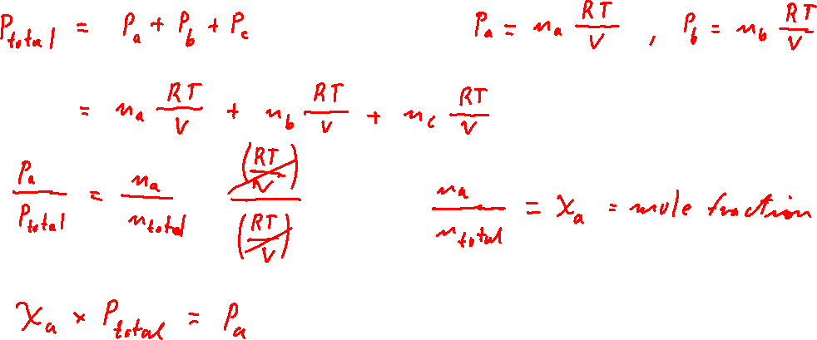
Partial Pressures of Ideal Gases
Dry Air = 78% N₂, 21% O₂, 0.9% Ar, 0.04% CO₂

Slide 6
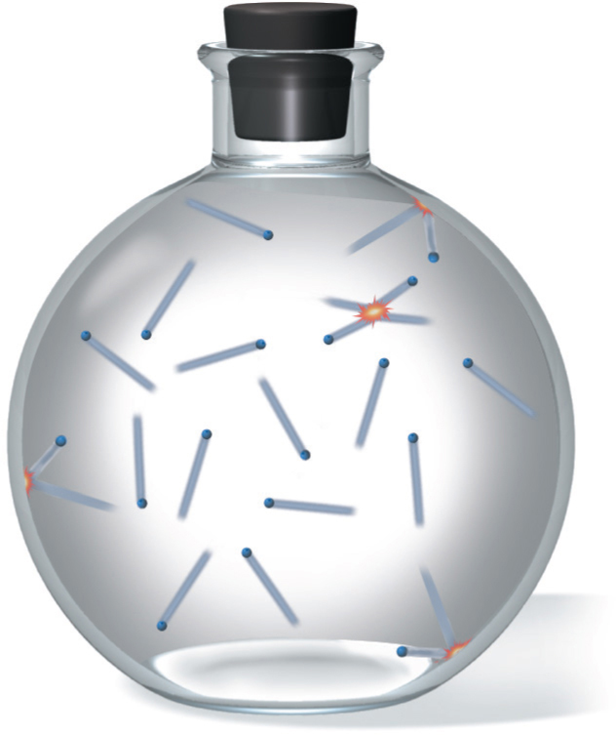
Kinetic Molecular Theory
Observations → Laws → Hypotheses/Theories
The size of each gas particle is negligibly small.
The average kinetic energy (1/2 m v²) of a particle is proportional to the temperature in kelvins.
The collision of one particle with another (or with the walls of the container) is completely elastic.

Slide 7
Kinetic Molecular Theory
How does KMT relate?
Boyle’s Law
1
at constant T:
P ∝
V
collisions
P
V
Charles’s Law
at constant P:
V ∝
T
T
collisions
P_{const V}
V_{const P}
Avogadro’s Law
at constant T an P:
V ∝
n
n
collisions
P_{const V}
V_{const P}
Dalton’s Law
at constant V and T:
P_{tot} = P_{a} + P_{b} + P_{c} + …
n
collisions
P_{const V}

Slide 8
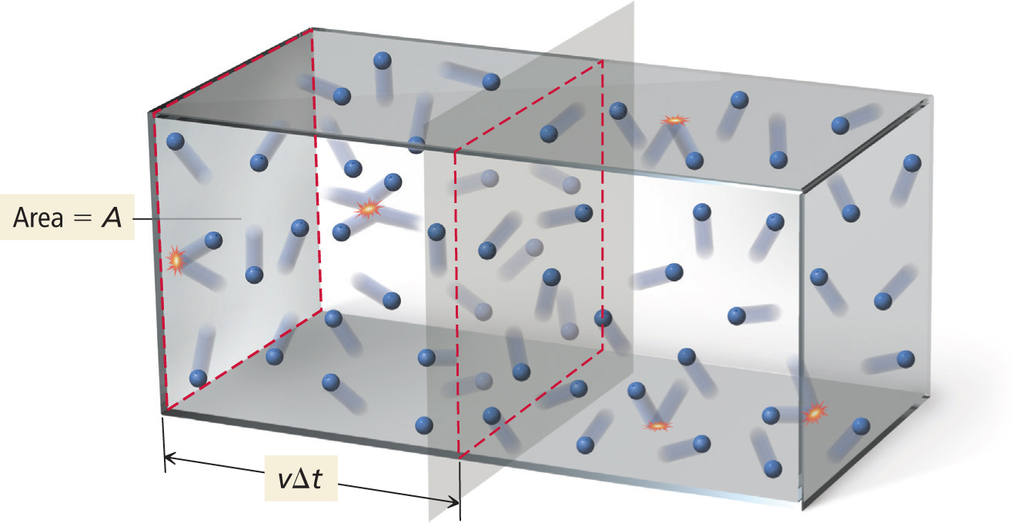
Kinetic Molecular Theory and the Ideal Gas Law
5.16
Pressure on the Wall of a Container

Slide 9
Description of macroscopic pressure with collisions of gas molecules with the surfaces of their container.
F_{total}
P
=
A
F_{total} = force of each collision ×frequency of collisions with surface
Newton’s Second Law: Force = mass × acceleration
Δv
2v
Force of each collision
F_{collision}
=
m
=
m
for a straight line elastic collision
Δt
Δt
If particles move at v, then vΔt is the maximum distance they can be away from a surface to hit it within Δt. Consequently, the number of collisions ∝ number of particles within vΔt of a wall.
n
∝ vΔt × A ×
V
Volume
Density of particles

Slide 10
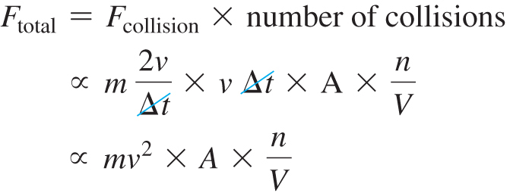

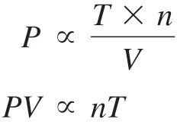
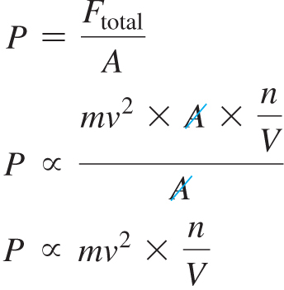
(kinetic energy of particles)
PV = nRT

Slide 11


Temperature and Molecular Velocity and Mass
Particles of different masses have the same average kinetic energy at a given temperature
1
3
KE_{average per particle}
=
mv²
=
kT
k = Boltzmann constant
2
2
In a gas at a given temperature, lighter particles travel faster (on average) than heavier ones
u_{rms}
=
u²
v = u = velocity

Slide 12
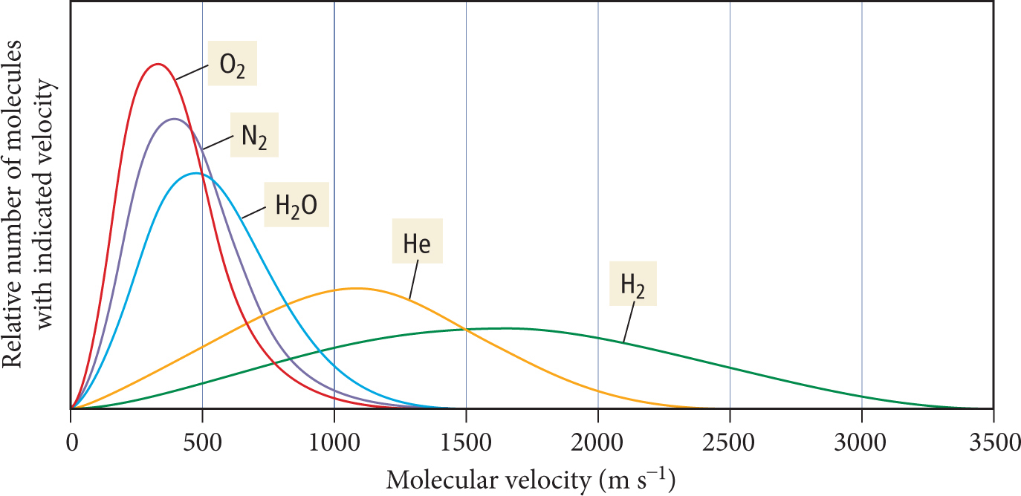
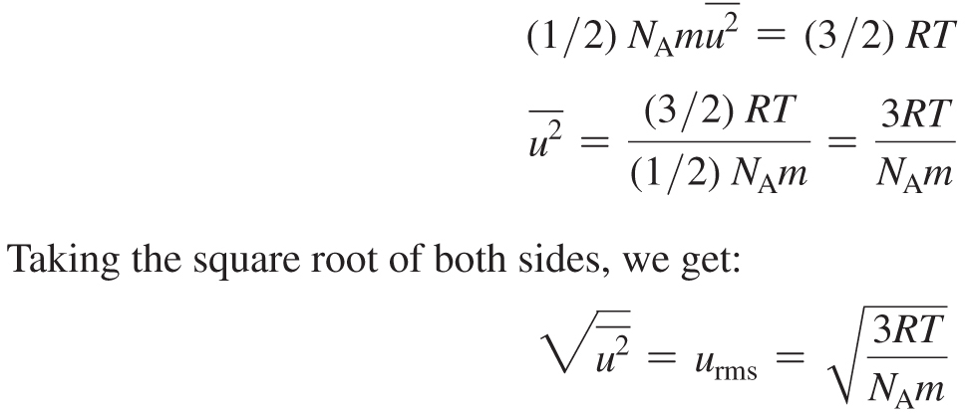
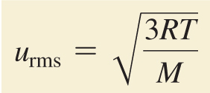
Velocity Distribution for Several Gases at 25ºC

Slide 13
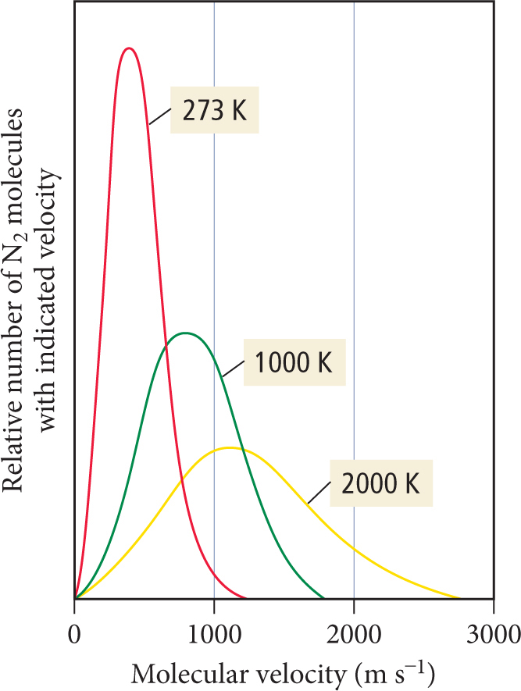
Velocity Distribution for Nitrogen at Several Temperatures

Slide 14
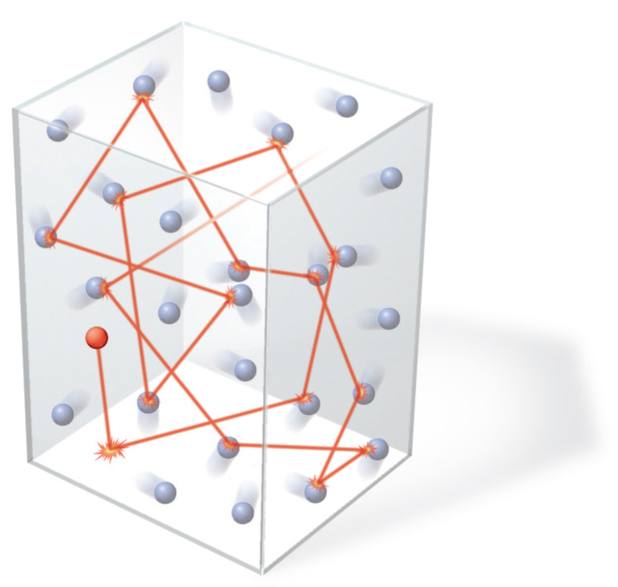
Mean Free Path, Diffusion, and Effusion of Gases
Mean Free Path

Slide 15
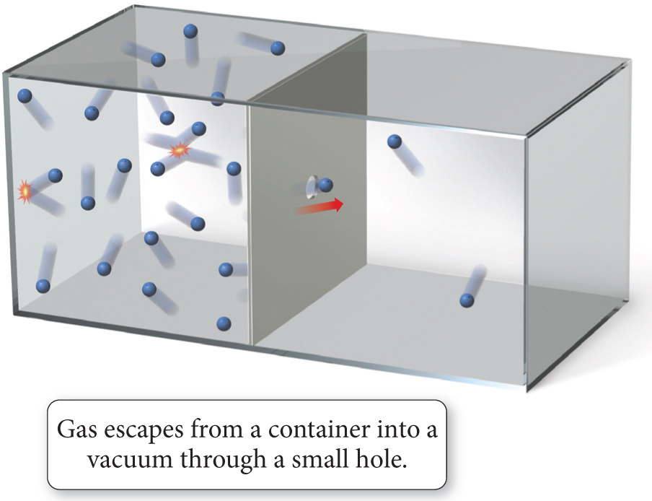
Effusion of Gases

Slide 16
Example Problems
5.33 Given: V₁ = 48.3 mL, T₁ = 22 °C, and T₂ = 87 °C Find: V2

Slide 17
Example Problems
5.41 Given: V = 28.5 L, P = 1.8 bar, and T = 298 K; Find: n

Slide 18
Example Problems
5.49 Given: sample a = 5 gas particles, sample b = 10 gas particles, and sample c = 8 gas particles, with all temperatures and volumes the same; Find: sample with largest P

Slide 19
Example Problems
5.60 Given: m = 0.555 g, V = 117 mL, T = 85 °C, and P = 753 mmHg, Find molar mass M;

Slide 20
Example Problems
5.65 Given: m (N₂) = 1.25 g, m (O₂) = 0.85 g, V = 1.55 L, and T = 18 °C Find: χ_{Ν2}, χ_{Ο2}, P_{N2}, P_{O2};

Slide 21
Example Problems
5.81 Given: F₂, Cl₂, Br₂, and T = 298 K Find: u_{rms} KE_{avg} for each gas and relative rates of effusion.

