Slide 1
9 Movement principles and Newton’s laws

Slide 2
Objective of this Chapter
• Describe the 9 fundamentals of biomechanics and who they are linked to Newton’s laws of motion.
• Define several kinetic variables and be able to calculate them, such as force, mass, weight, moment of force, inertia, moment of inertia.
• Understand and be able to compose vectors or break them down vectors in components.
• Explain the three types of levers and be able to calculate their mechanical and kinematic advantage.
• Be able to calculate the (missing) force to keep an object in balance using moments.
• Define center of mass (CoM) for the whole body and for body segments. Be able to calculate the location of the CoM

Slide 3
Nine Fundamentals of biomechanics
• Inertia
• Force-Motion principle
• Force-Time
• Range of Motion
• Balance
• Continuum
• Segmental Interaction
• Optimal Projection
• Spin

Slide 4
Inertia
Newton’s 1st Law
“An object either remains at rest or continues to move at a constant velocity, unless acted upon by an external force”
Inertia is the property of all objects to resist changes in their state of motion.

Slide 5
Inertia
• Linear inertia Depending on the mass
• Angular inertia Depending on
- Mass
Shape
Distribution of mass
Axis of rotation

Slide 6
Moment of inertia
Factors that influence the moment of Inertia
1. Mass
2. Distribution of mass (in relation to the axis)
3. The position of the axis of rotation

Slide 7
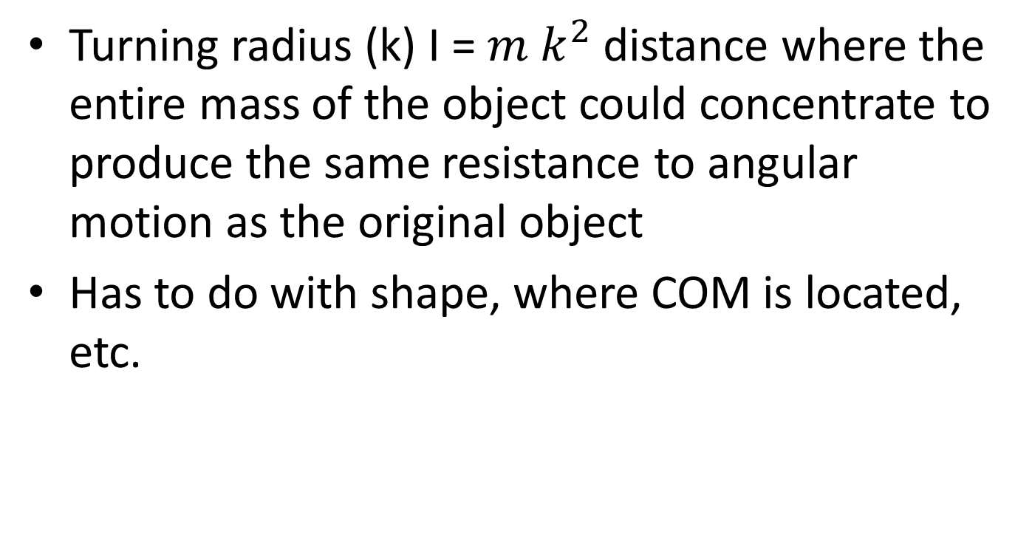
Moment of inertia
Turning radius (k) I = $m k^{2}$distance where the entire mass of the object could concentrate to produce the same resistance to angular motion as the original object
Has to do with shape, where COM is located, etc.

Slide 8
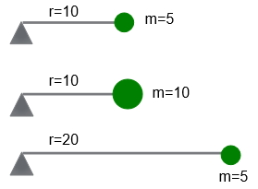
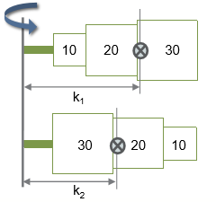
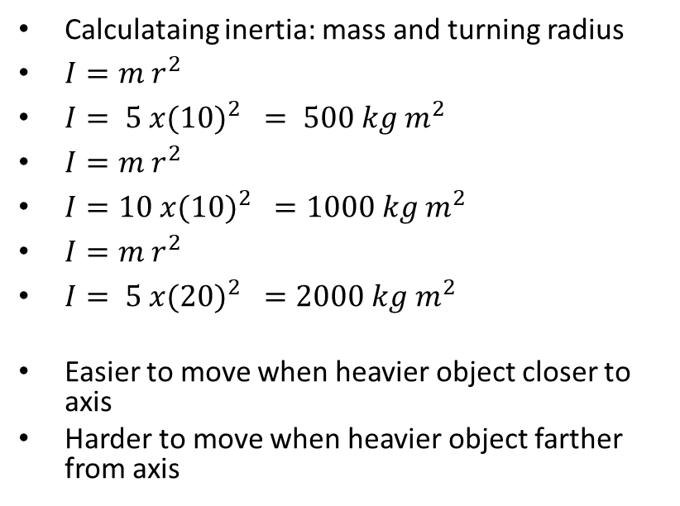
Calculating Inertia
Calculataing inertia: mass and turning radius
$I=m r^{2}$
$I= 5 x(10)^{2} = 500 kg m^{2}$
$I=m r^{2}$
$I=10 x(10)^{2} =1000 kg m^{2}$
$I=m r^{2}$
$I= 5 x(20)^{2} =2000 kg m^{2}$
Easier to move when heavier object closer to axis
Harder to move when heavier object farther from axis

Slide 9
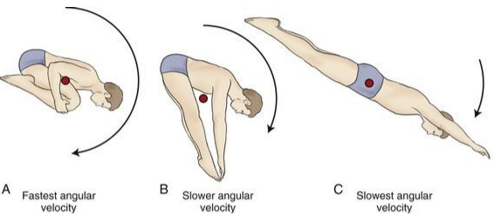
Moment of inertia of the body
The human body is not a rigid body
Movements of segments induces a different distribution of mass about an axis of rotation
Therefore, the movement of inertia varies around said axis of rotation

Slide 10
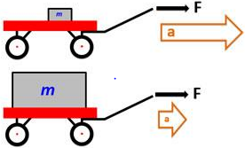
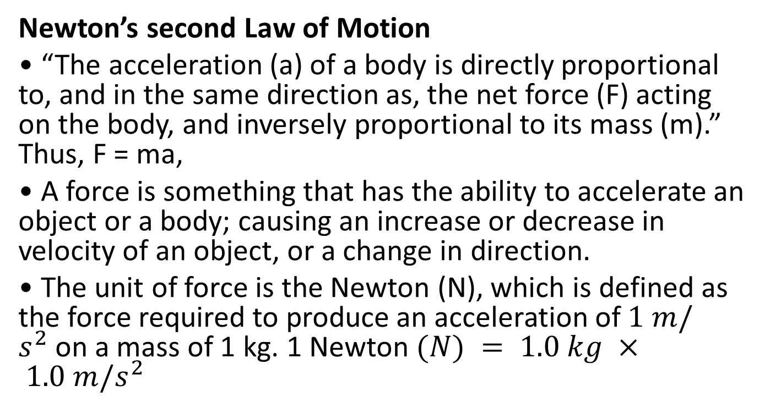
Acceleration
Newton’s second Law of Motion
• “The acceleration (a) of a body is directly proportional to, and in the same direction as, the net force (F) acting on the body, and inversely proportional to its mass (m).” Thus, F = ma,
• A force is something that has the ability to accelerate an object or a body; causing an increase or decrease in velocity of an object, or a change in direction.
• The unit of force is the Newton (N), which is defined as the force required to produce an acceleration of $1 m/s^{2}$on a mass of 1 kg. 1 Newton $(N) = 1.0 kg × 1.0 m/s^{2}$

Slide 11
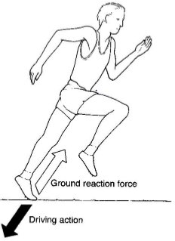
Action= -reaction
Newton’s third Law of Motion
“When one body exerts a force on a second body, the second body simultaneously exerts a force equal in magnitude and opposite in direction to that of the first body.”

Slide 12
Force-motion principle
• For motion to occur, first there must be forces to act on the object (person)
Force = mass x acceleration
Based on Newton’s Laws
1st: Every object in a state of uniform motion tends to remain in that state of motion unless an external force is applied to it
2nd: The relationship between an object’s mass (m), its acceleration (a), and the applied force (F) is F = ma.
3rd: For every action there is an equal and opposite reaction.

Slide 13
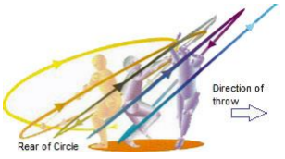
Force-time principle
• Not only the amount of force but also the amount of time the force is applied to an object will affect the change in motion.
• Impulse = Force x time (in Ns)
- Increasing time when throwing will increase the impulse (bigger ROM)

Slide 14
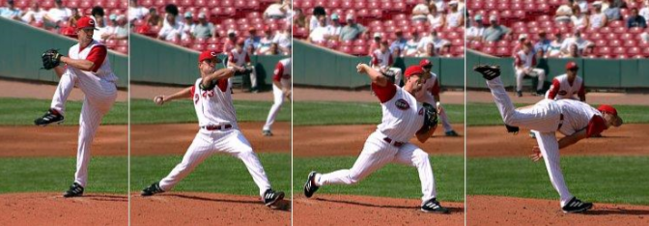
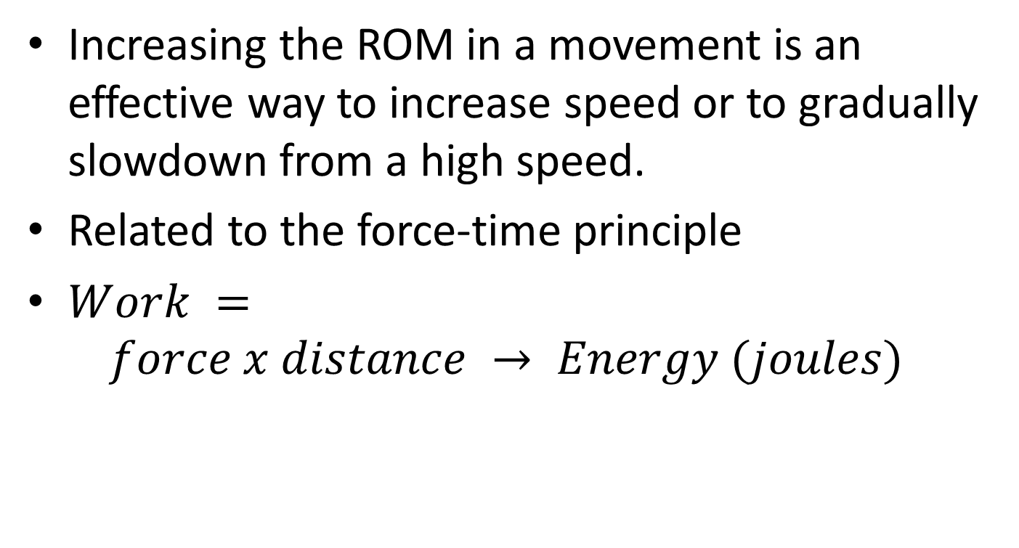
Range of Motion
Increasing the ROM in a movement is an effective way to increase speed or to gradually slowdown from a high speed.
Related to the force-time principle
$Work =$
$$force x distance → Energy (joules)$$

Slide 15
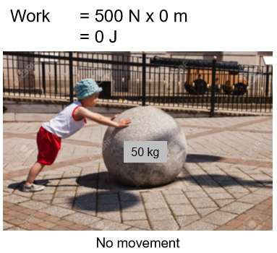
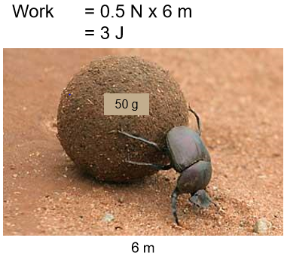
Range of motion
• Work = Force x distance
Work (kid)= 500N x 0m= 0J
Work (beetle) = 0.5 N x 6m= 3J

Slide 16
Balance
Ability to control the body position relative to some base of support
- Base of support: distance from hands to wall

Slide 17
Balance, dynamic balance, mobility
Mobility is the ability to perform functional movement patterns with no restrictions in the ROM
Flexibility + control of movement= mobility

Slide 18
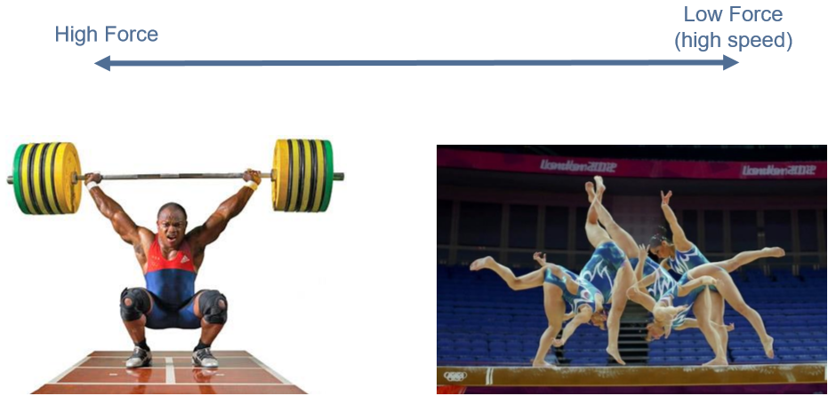
Coordination continuum
• Optimal timing of muscle actions or segmental motions depends on the goal of the movement.
Weightlifters: much more simultaneous movements
Gymnastics: much more sequential movements

Slide 19
Segmental Interaction
• The body is made of rigid segments that are interconnected. This allows the force generated by the muscles to be transferred by the joints.
• Terms used: transfer, summation, sequential

Slide 20
Optimal Projection
• For most human movements involving projectiles there is an optimal range of projection angles for a specific goal.

Slide 21
Spin
Rotations imparted to projectiles
• Stabilizes flight
• Creates a fluid force called lift
- lift force is used to create a curve or to counter gravity affecting the trajectory and bounce of the ball.
- Spinning the ball creates “chaos” in the molecules, making it go a greater distance

Slide 22
Concept of Force
Characteristics of a force: e.g., Weight Concept of Force
F=mass x gravitational force
4 characteristics : Vector quantity:
-A magnitude (ex : 686N)
- Line of action/orientation (vertical)
-A direction (downwards)
-A point of application (CoM)

Slide 23
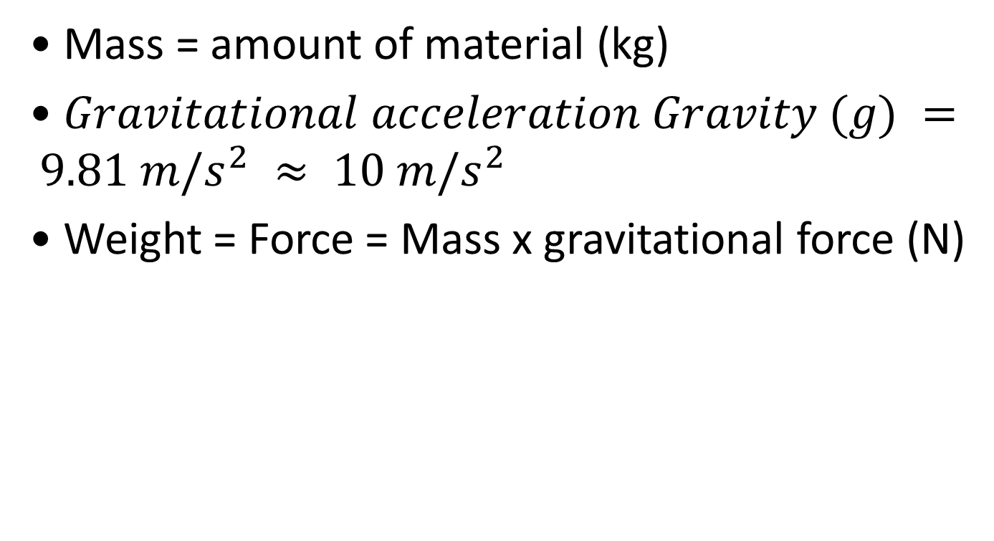
Mass vs Weight
• Mass = amount of material (kg)
• $Gravitational acceleration Gravity (g) = 9.81 m/s^{2} ≈ 10 m/s^{2}$
• Weight = Force = Mass x gravitational force (N)

Slide 24
Moment of Force
• The cause of motion is an internal or external force
• Newton’s first Law of Motion:
- If an object is not accelerating or decelerating it experiences a state of constant velocity
- No motion is the state of a constant ‘zero’ velocity!
• Forces that act through the body’s centre of mass will cause linear motion
• Forces that do not go through the centre of mass or pivot point of an object cause a rotation or angular motion (about an axis of rotation)
• When a force causes angular motion the effect is known as a moment of force or torque

Slide 25
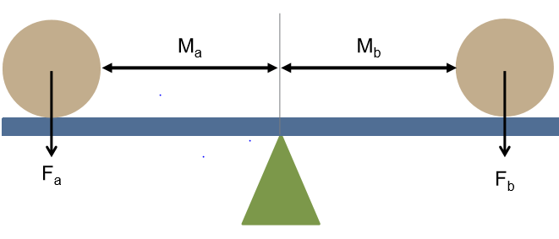
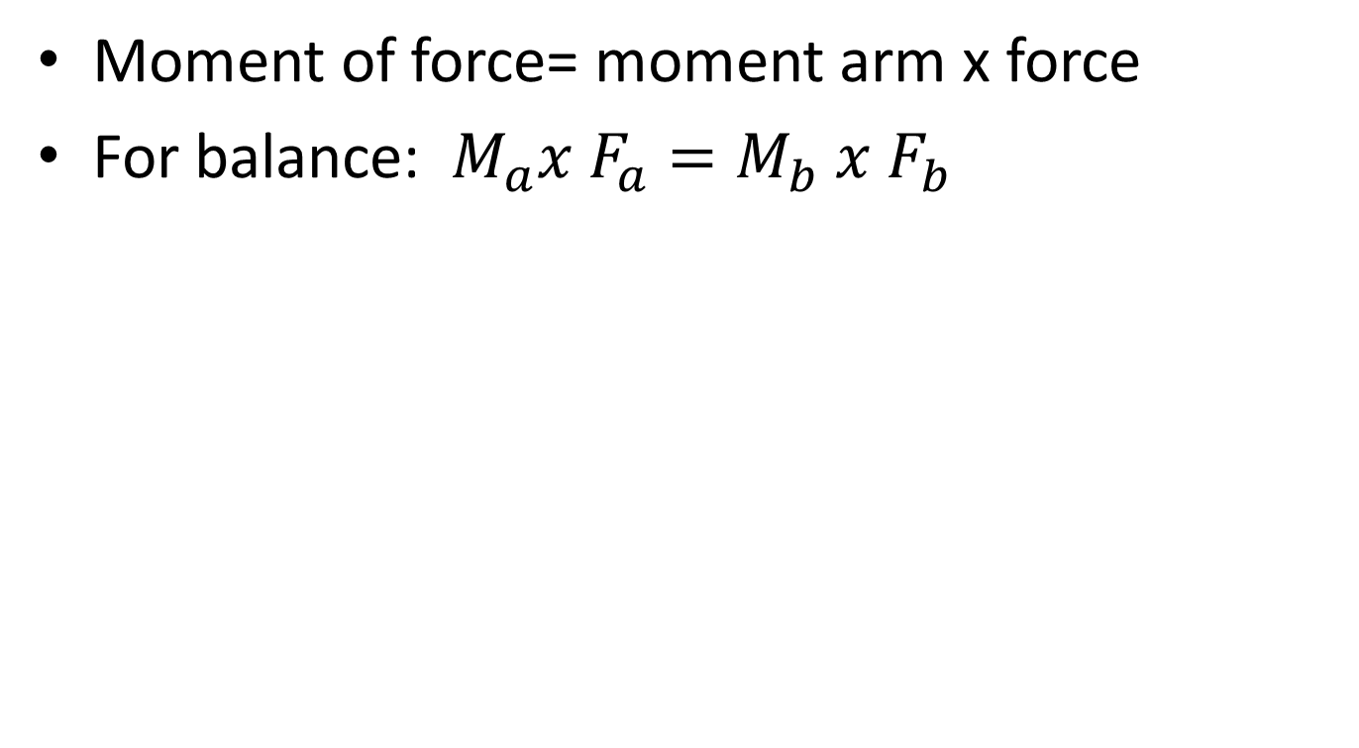
Moment of Force
Moment of force= moment arm x force
For balance: $M_{a}x F_{a}=M_{b} x F_{b}$

Slide 26
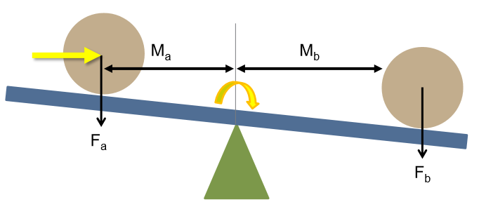
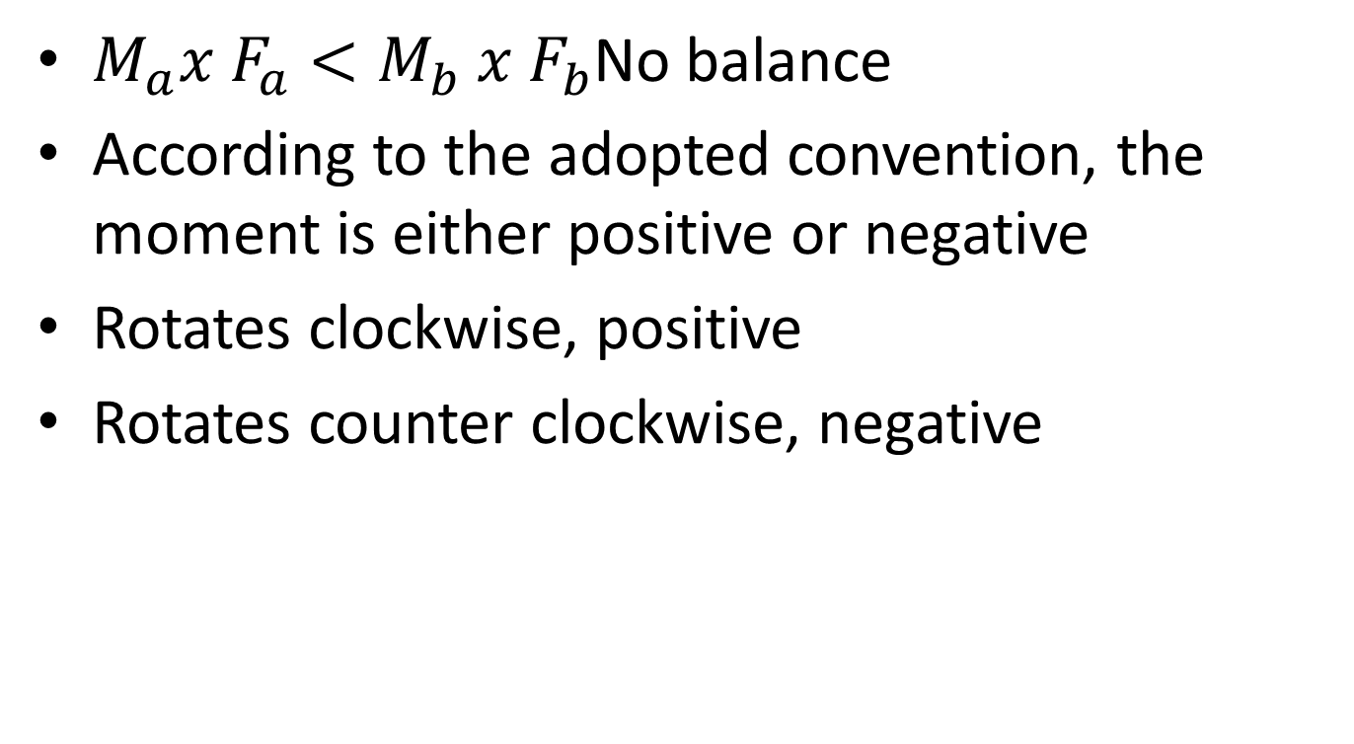
Moment of Force
$M_{a}x F_{a}<M_{b} x F_{b}$No balance
According to the adopted convention, the moment is either positive or negative
Rotates clockwise, positive
Rotates counter clockwise, negative

Slide 27
Moment of Force
Definition: force applied at a perpendicular distance from the axis of rotation.
The rotational movement is modulated by the magnitude of the applied force and the length of the lever arm

Slide 28
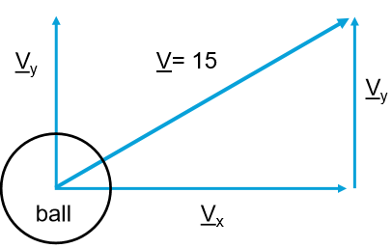
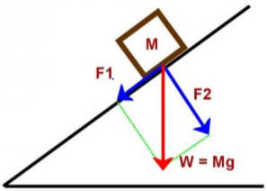
Vector Resolution
As the velocity of the ball has a vector quality it can be resolved into horizontal and vertical components
Resolve the force vector in a plane /axis that makes sense!
F1 causes the movement!
(There is no movement in the line of F2; ΣF=0)

Slide 29
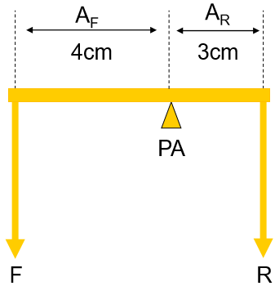
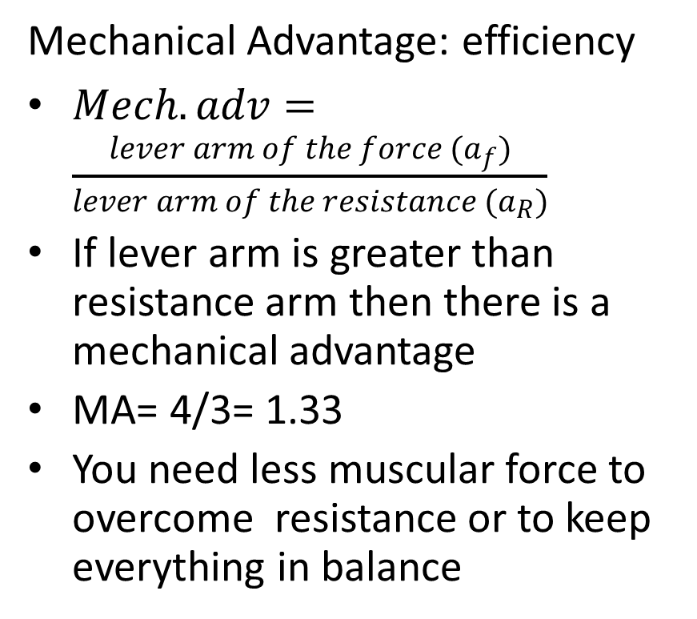
Types of Levers
Mechanical Advantage: efficiency
$Mech. adv=\frac{lever arm of the force (a_{f})}{lever arm of the resistance (a_{R})}$
If lever arm is greater than resistance arm then there is a mechanical advantage
MA= 4/3= 1.33
You need less muscular force to overcome resistance or to keep everything in balance

Slide 30
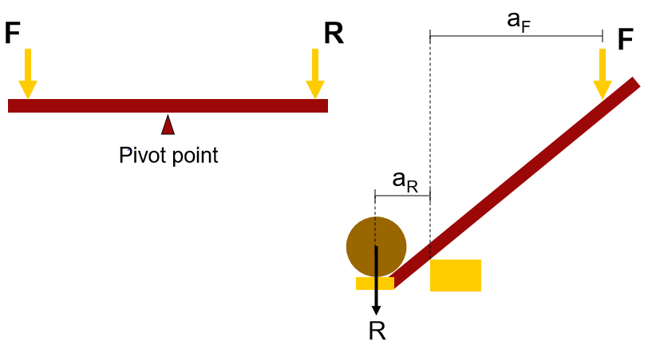
Class 1 lever
Promote balance
Rare in human body

Slide 31
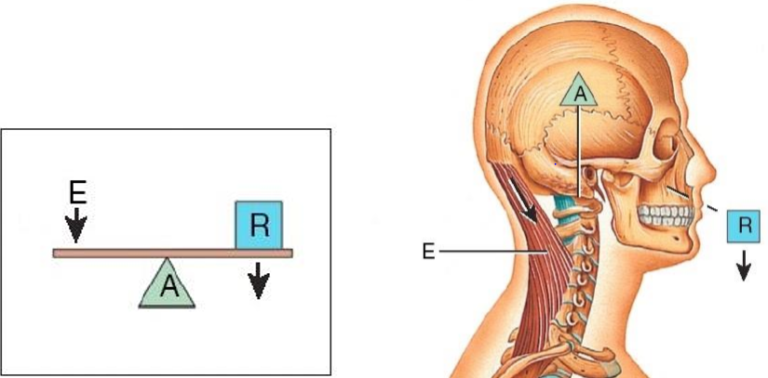
Example of class 1 lever
Axis of rotation is atlas

Slide 32
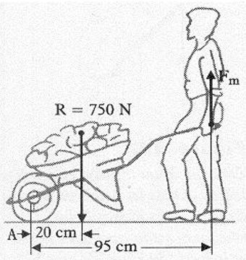
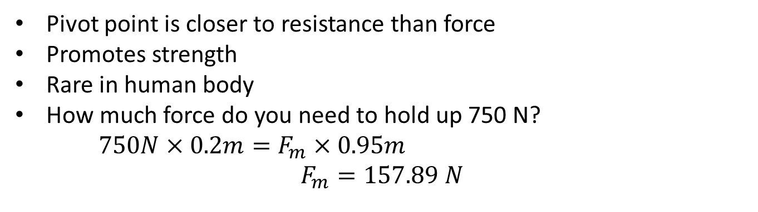
Class 2 lever
Pivot point is closer to resistance than force
Promotes strength
Rare in human body
How much force do you need to hold up 750 N?
$750N×0.2m=F_{m}×0.95m$
$$F_{m}=157.89 N$$

Slide 33
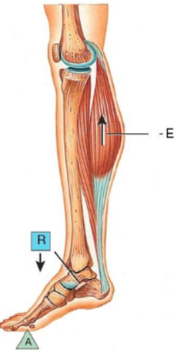
Example of Class 2 Lever
Axis of rotation is ankle joint

Slide 34
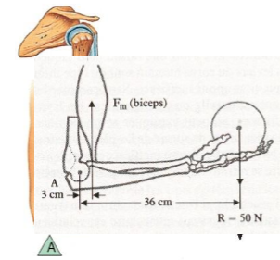
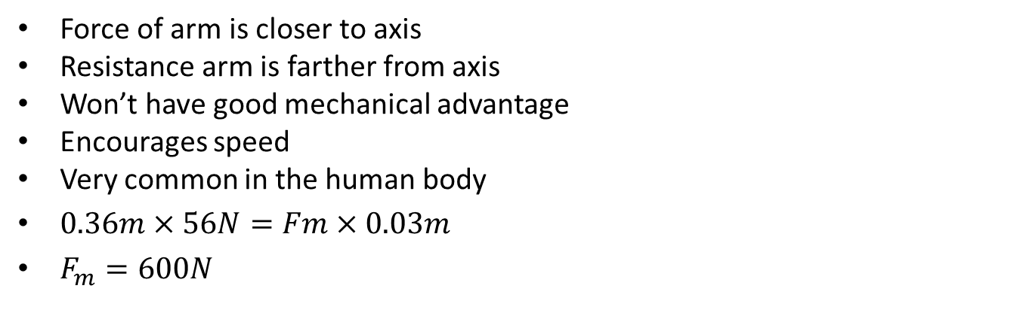
Class 3 Lever
Force of arm is closer to axis
Resistance arm is farther from axis
Won’t have good mechanical advantage
Encourages speed
Very common in the human body
$0.36m×56N=Fm×0.03m$
$F_{m}=600N$

Slide 35
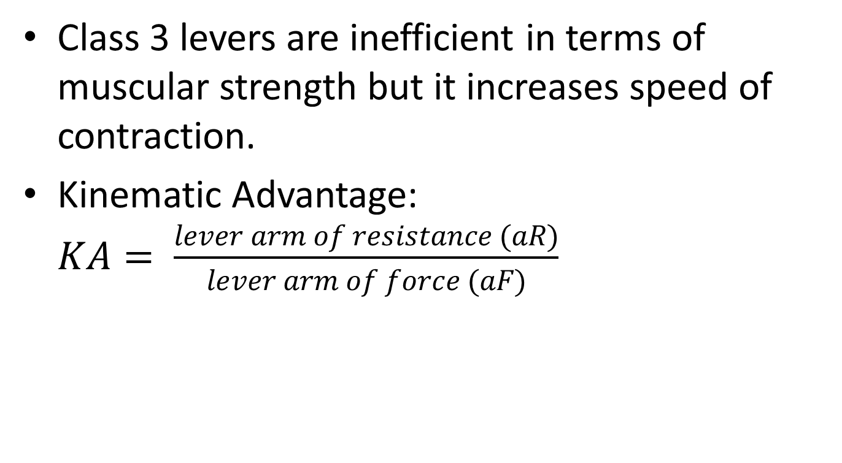
What is the advantage of having only class three levers?
Class 3 levers are inefficient in terms of muscular strength but it increases speed of contraction.
Kinematic Advantage: $KA= \frac{lever arm of resistance (aR)}{lever arm of force (aF)}$

Slide 36
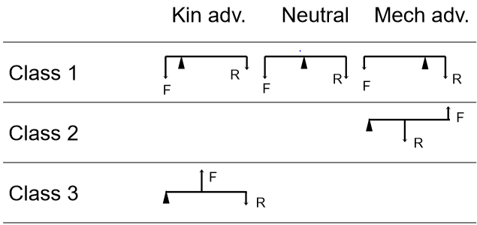
Types of Levers

Slide 37
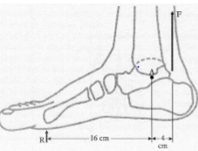
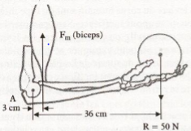
Types of Levers
Ankle: More of a kinematic advantage
Elbow: More of a kinematic advantage

Slide 38
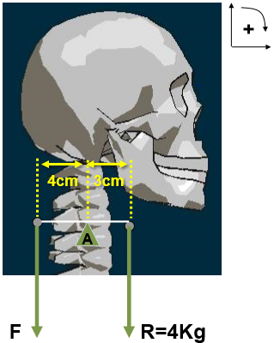
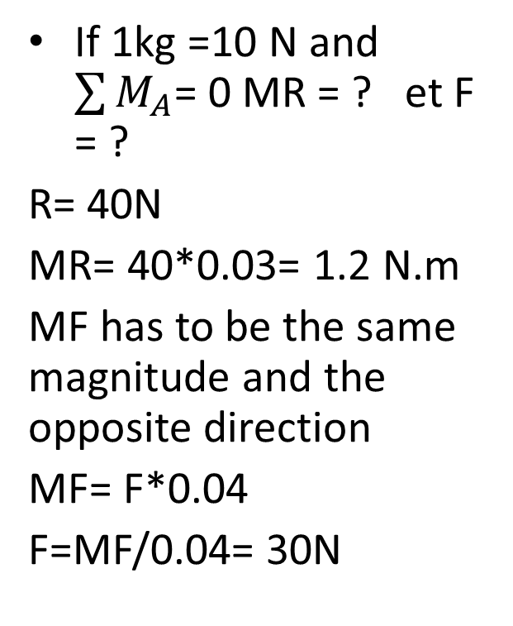
CALCULATIONS OF FORCES AND RESISTANCES CONCEPT OF TORQUES
If 1kg =10 N and $\sum{M_{A}}$= 0 MR = ? et F = ?
R= 40N
MR= 40*0.03= 1.2 N.m
MF has to be the same magnitude and the opposite direction
MF= F*0.04
F=MF/0.04= 30N

Slide 39
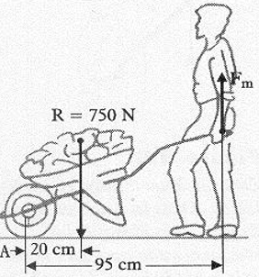
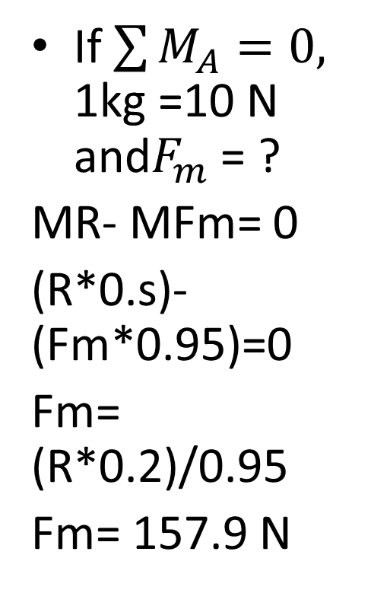
CALCULATIONS OF FORCES AND RESISTANCES CONCEPT OF TORQUES
If $\sum{M_{A}=0, }$ 1kg =10 N and$F_{m}$= ?
MR- MFm= 0
(R*0.s)-(Fm*0.95)=0
Fm= (R*0.2)/0.95
Fm= 157.9 N

Slide 40
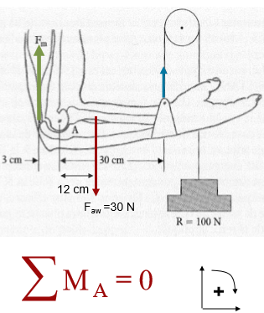
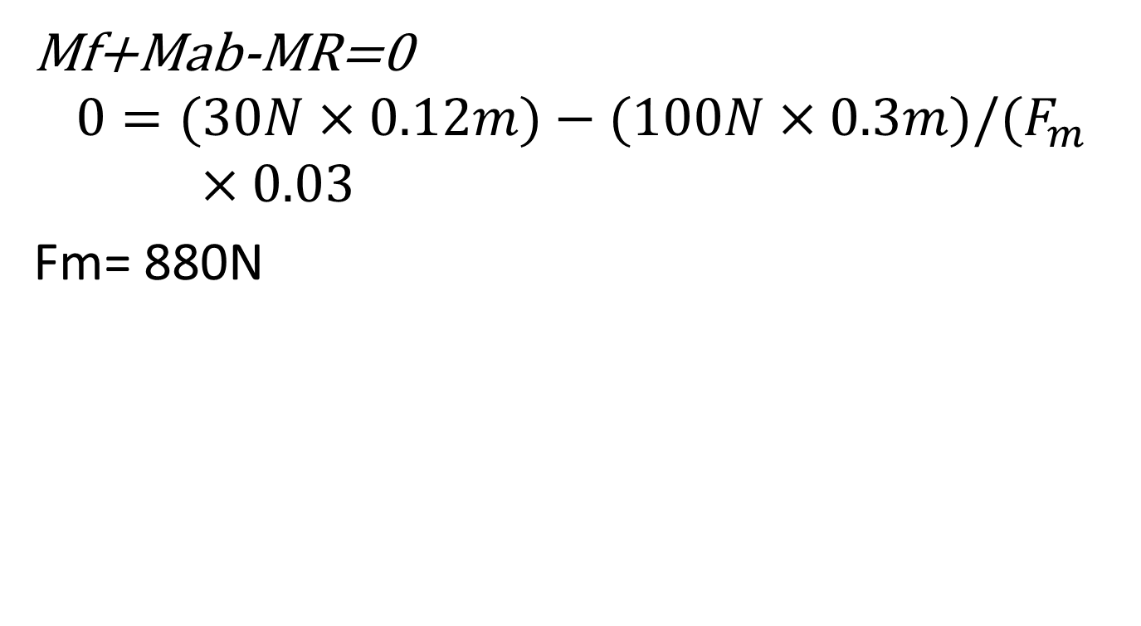
System With More than Two Forces
Mf+Mab-MR=0
$$0=(30N×0.12m)−(100N×0.3m)/(F_{m}×0.03$$
Fm= 880N

