Slide 1

Marketing Management I :
Introduction to Marketing
1
Week 3
Chapter 5

Slide 2
Agenda
Chapters 5&4
Bonus question of P&G
Project overview
Quiz (1)

Slide 3
Chapter (4)
Analyzing the marketing environment

Slide 4

Environmental Forces
The Marketing Environment
  Factors outside marketing that affect marketing management’s ability to build and maintain successful relationships with target customers.

Slide 5
Environmental Forces
Microenvironment:
    Forces with direct impact to the company
    Internal & external
Macroenvironment:
    External forces with direct impact across industries

Slide 6
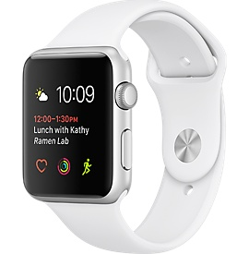


Discussion Question- Teams
Thinking of ……
what can be the micro and macro environmental factors having an impact on its performance?

Slide 7
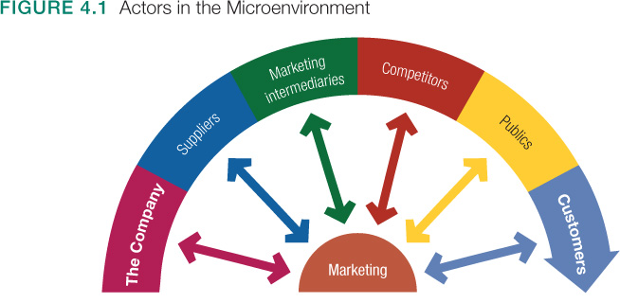
The Microenvironment
Notes:
Publics:

Slide 8

The Microenvironment
Publics
  Financial publics
  Media publics
  Government publics
  Citizen-action publics
  Local publics
  General public
  Internal public

Slide 9
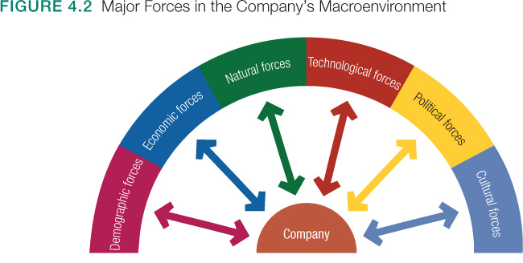
The Macroenvironment

Slide 10

Chapter (5)
Managing Marketing Information
to Gain Customer Insights

Slide 11
Chapter 5: Learning Objectives
5.1 Marketing information and customer insights
5.2 Assessing marketing information needs
5.3 Developing marketing information
5.4 Marketing research
Notes:
Outlines learning objectives from this chapter.
11

Slide 12
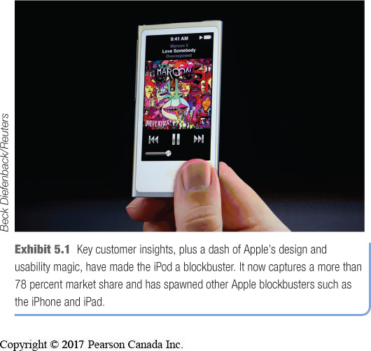
Marketing Information and Customer Insights
Customer Insights:
  Understanding of customers and the marketplace
  Basis for creating customer value and relationships
Develop competitive advantage
Insights stem from many sources

Slide 13
Marketing Information System
Marketing Information System (MIS): consists of people and procedures which:
    Assess information needs
    Develop needed information
    Analyze and use information

Slide 14
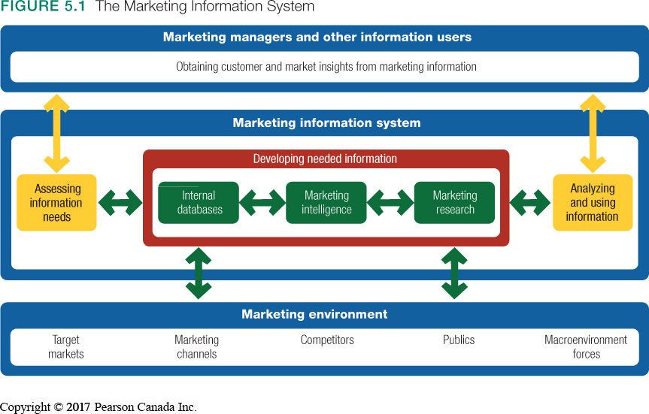
Marketing Information System

Slide 15
Assessing Marketing Information Needs
A good MIS balances information wants, needs, and feasibility
  An MIS has limitations – determine possibility
  An MIS is costly – must consider ROI

Slide 16
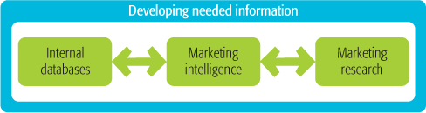
Developing Marketing Information
Information from sources within the company
Accessed more efficiently
Prone to gaps in knowledge
Environmental analysis
Publically available information
Ethical issues raised
Used when new problem exists
Systematic collection, analysis, and reporting of data

Slide 17
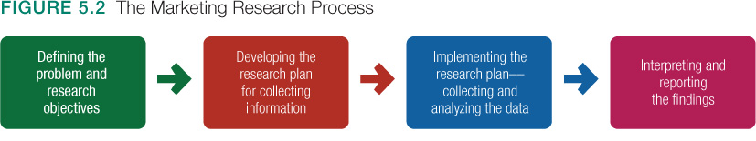
Marketing Research Process

Slide 18
Marketing Research Process
Various Objectives:
  Exploratory: Gathers information to help define the problem (What?)
  Descriptive: Describes marketing situations or markets (How?)
  Causal: Test hypotheses of cause-and-effect relationships (X to Y)

Slide 19
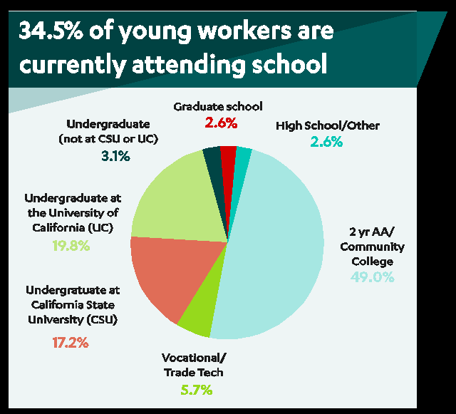
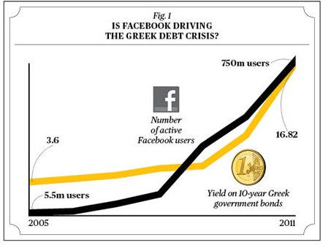
Matching exercise-
For participation grades
Question A: Can you tell me more about your opinion of Starbucks ?
Question B: Is obesity related to consuming heavy sugar products ?
Question C: How excited are students in this class about marketing?
Figure 2
Figure (1)
What is your definition of veganism?
“Veganism is not hurting animals”
“Veganism is refusing the use any animal related products “
Figure 3

Slide 20
Developing the Research Plan
Research plan outlines:
  Sources of existing data (Primary, Secondary)
  Specific research approaches (Observation, Survey, Experiment)
  Contact methods (mail, telephone, person, online) and sampling plans (Probability, Non Probability)
  Instruments for data collection (Questionnaire, Mechanical Instrument)

Slide 21
Collecting Data
Primary Data:
Information collected for a specific problem
Must be relevant, accurate, current, and unbiased
Secondary (Existing) Data:
Advantages:
  Quicker and cheaper
Disadvantages:
  Relevance, currency, accuracy
  Rarely provides all necessary information

Slide 22
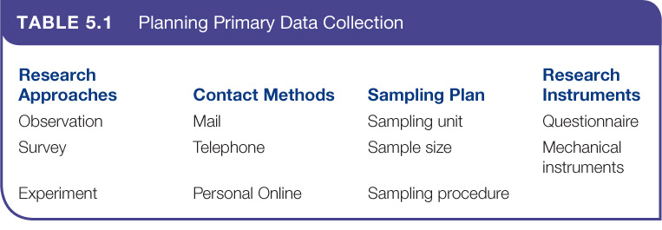
Primary Data Collection

Slide 23
Research Approaches
Observational
Gathers data by observing relevant people, actions, situations
Impossible to observe feelings
Ethnographic yields deeper observation
Survey
Gathers data by asking people questions
Most used method for primary data
Suited for gathering descriptive information
Experimental
Matches groups of people / looks for differences in responses
Best suited for explaining cause-and-effect relationships

Slide 24
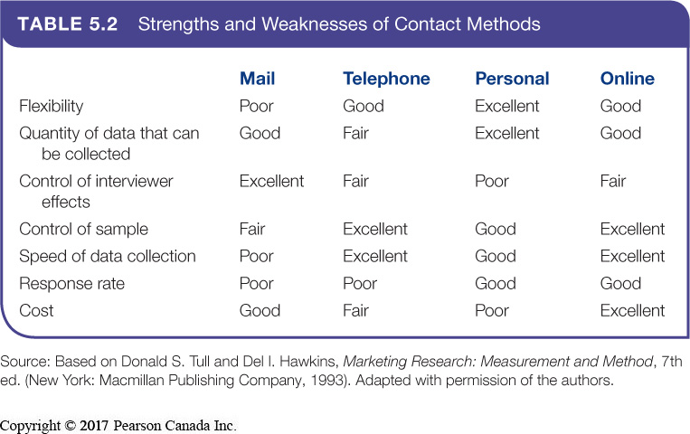
Contact Methods

Slide 25
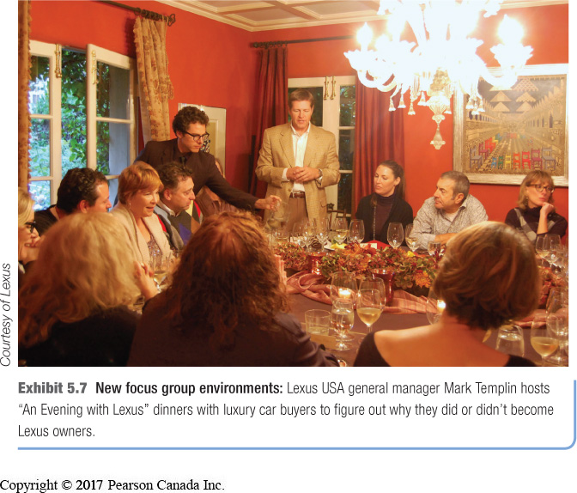
Contact Methods
Mail, Telephone, and Personal Interviewing
  Personal interviewing vs. group interviewing
  Focus group interviewing

Slide 26
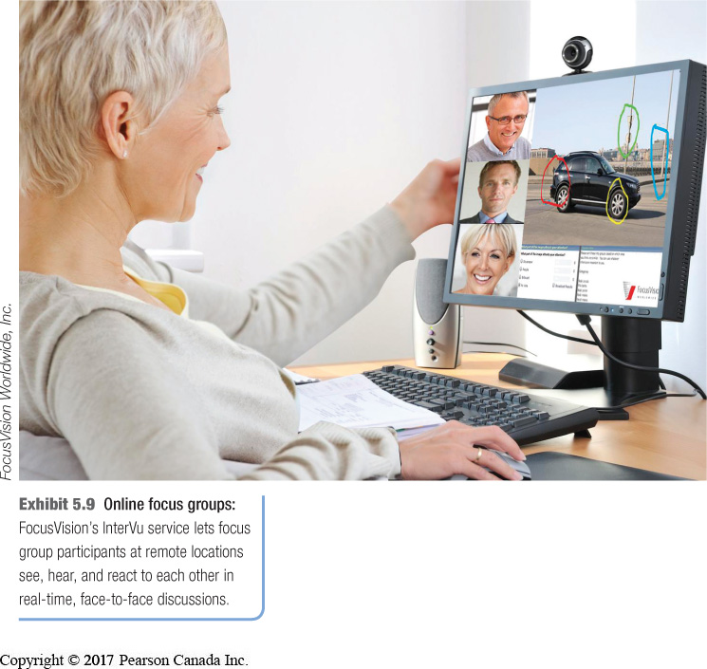
Contact Methods
Online Marketing Research
  Well suited to quantitative research
  Qualitative internet approach: online focus groups
Online behavioural and social tracking and targeting

Slide 27
Sampling Plan
Sample:
  Segment of the population representing the whole
Requirements:
  Who to survey
  How many to survey
  How to choose
Whole Population
Sample

Slide 28
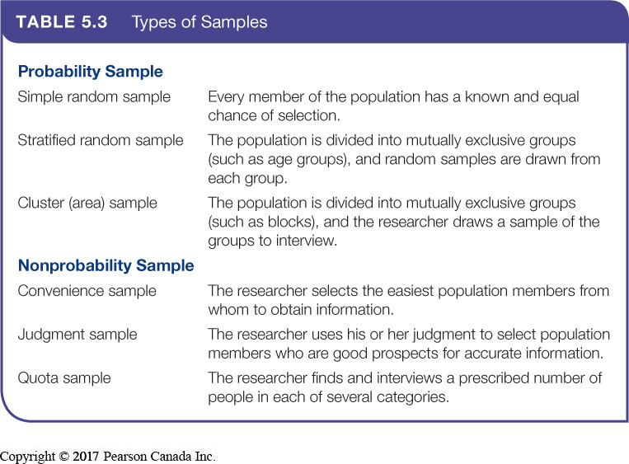
Types of Samples

Slide 29
Research Instruments
Questionnaire:
  Questions to ask
  Style of questions; open-ended and/or closed-ended
  Wording and ordering of questions
Mechanical Instruments:
  Monitor consumer behaviour
  Includes people metres, checkout scanners, etc.

Slide 30
Implementing the Research Plan
Implementation
Collect
Process
Analyze

Slide 31
Interpreting and Reporting the Findings
Interpret the findings
Draw conclusions
Report to management:
  Present findings and conclusions that will be most helpful to decision making

Slide 32
Analyzing and Using Marketing Information
Customer Relationship Management (CRM):
  Manages detailed information about individual customers to maximize customer loyalty
  Captures and analyzes information from all customer sources
  Findings may lead to new marketing opportunities

Slide 33
What to do for next class
Study chapters 4&5
Be prepared with an ad of a favorite brand (print, radio, or on TV) bring a version of it with you to class

Slide 34
What to do for next class
Assignment (1):
-Read Oracle case p.191-193 and answer questions 1-5.
-On a word file font 12, 1.5 spaced. Write you name and ID in the header and the page number in the footer
-Bring a hardcopy of your answers and hand it once you enter the classroom, if you aren’t coming to class send it to email before Failure to submit on time would result in a 1.0 daily deduction from your grade.
5.45 next Thursday
*

Slide 35
Thank you

