Slide 1

Marketing Management I :
Introduction to Marketing
1
Week 2
End of Chapter (1, assigned parts of chapter 2)

Slide 2
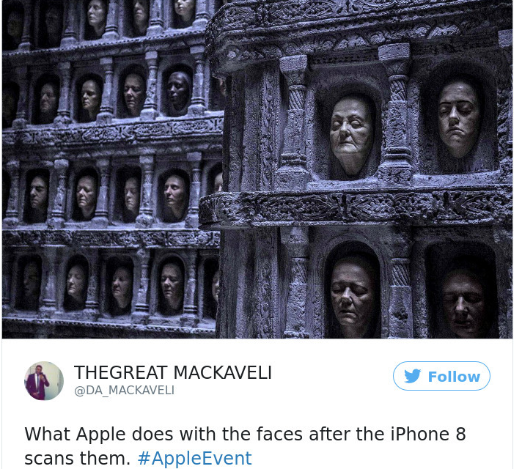

Slide 3
What did we cover last week ☺

Slide 4
Rest of chapter (1)

Slide 5
Customer Driven Marketing Strategy:
Marketing Management Orientations
Strategies based upon one or more orientations:
  Production Concept
  Product Concept
  Selling Concept
  Marketing Concept
  Societal Marketing Concept

Slide 6

Customer Relationship Management
Profitable Customer Relationships:
  Building and maintaining profitable customer relationships by delivering superior customer value and satisfaction
  Deals with all aspects of acquiring, keeping, and increasing customers

Slide 7
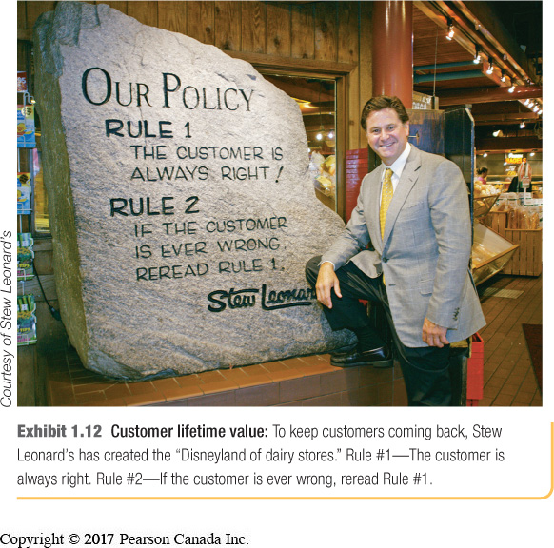
Customer Relationship Management
Customer-Perceived Value:
  Customer’s evaluation of the difference between all benefits and costs of a marketing offer relative to those of the competitors

Slide 8

Customer Relationship Management
Customer Satisfaction:
  Extent to which the product’s perceived performance matches a buyer’s expectations
Meets Expectations = Loyalty
Exceeds Expectations = Advocacy

Slide 9
Customer Relationship Management
Firms build relationships at different levels
Basic relations
Full partnership
Frequency
Club marketing programs
Loyalty

Slide 10
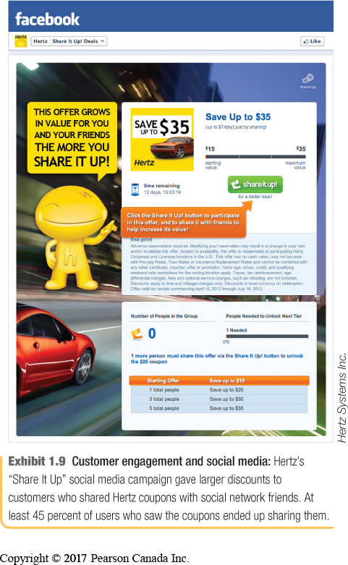
Engaging Customers
Customer-Engagement Marketing
Involving the consumers in brand conversations, experiences and brand community
Customer engagement and social media: Hertz’s “Share It Up” social media campaign gave larger discounts to customers who shared Hertz coupons with social network friends. At least 45 percent of users who saw the coupons ended up sharing them.

Slide 11
Customer Relationship Management
Trends:
  Targeting fewer, more profitable customers
  Building two-way relationships through digital
  Attracting, rather than intruding upon, the market
Notes:
11

Slide 12

Customer Relationship Management
Trends:
  Consumer-generated marketing
    Uninvited (C2, blogs, video sharing, social media and digital forums)
    Invited (companies are pulling consumer)
  Partner-relationship marketing
    Internally
    Externally
Notes:
12

Slide 13

Customer Relationship Management
Value from customers in purchases
Value to customers in benefit offered
  Satisfied loyal customers buy more
  Creates customer loyalty and retention, share of market, share of customer, and customer equity

Slide 14

Customer Relationship Management
Customer Lifetime Value | The value of the entire stream of purchases that the customer would make over a lifetime of patronage
Share of Customer | The portion of the customer’s purchasing that a company gets in their product categories
Customer Equity | The total combined customer lifetime values of all the company’s current and potential Customers

Slide 15
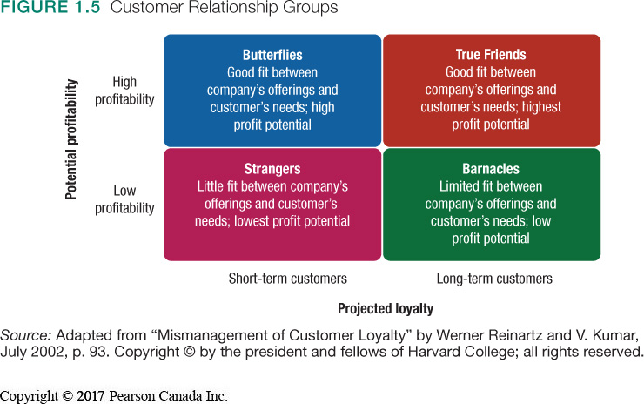
Customer Relationship Groups

Slide 16
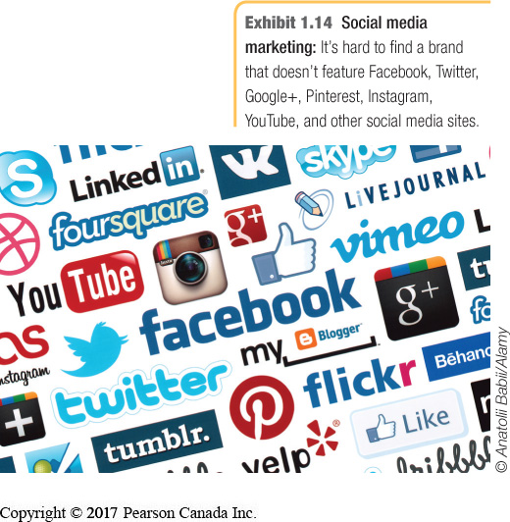
Trends in Marketing Landscape
Advancing digitized communication –online, mobile, social media
Uncertain economic environment
Not-for-profit marketing
Rapid globalization
Sustainable Marketing –
  Corporate social responsibility

Slide 17
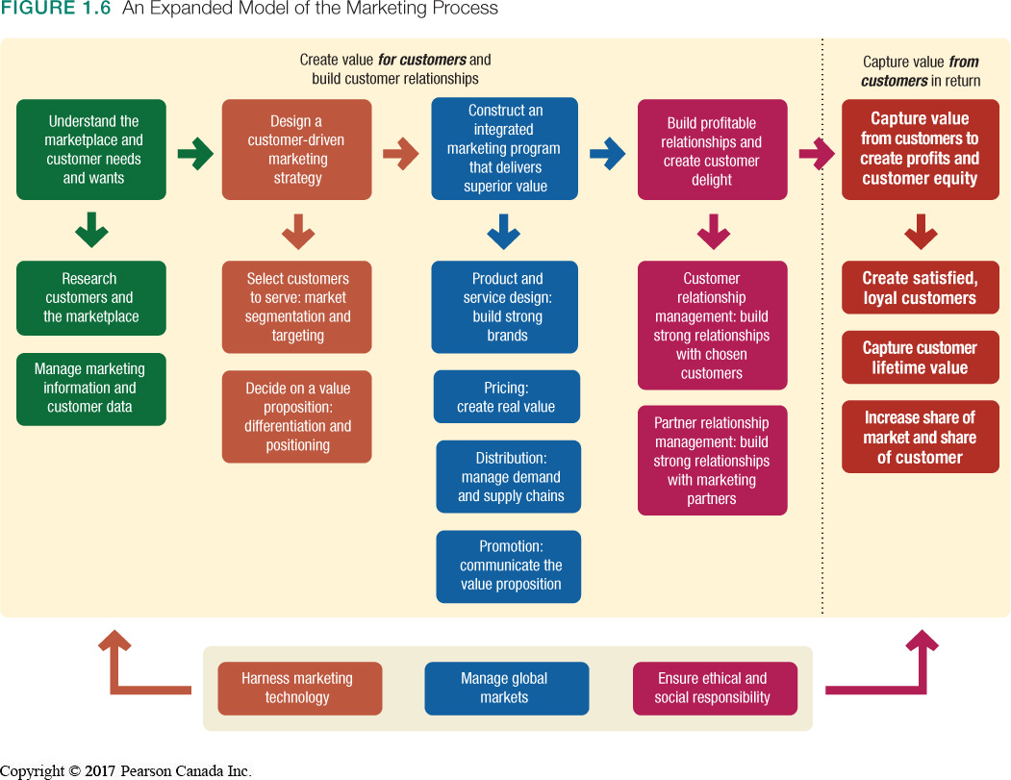

Slide 18


Slide 19
Discussion questions – End of chapter
Chapter (1)
Define marketing and outline the steps in the marketing process
What is marketing myopia and how can it be avoided?
What is customer-engagement marketing and how is it related to the surge in digital and social media technologies?
What is consumer-generated marketing? Describe examples of both invited and uninvited consumer exchanges
Discuss trends impacting marketing and the implications of these trends on how marketers deliver value to customers.

Slide 20
Chapter (2)
Marketing: Creating and capturing customer value

Slide 21
Chapter 2: Learning Objectives
Marketing strategy and the marketing Mix
Managing marketing effort

Slide 22
Marketing Strategy and the Marketing Mix
Objective: build profitable customer relationships through value creation
Strategies include:
  Market segmentation and targeting
  Differentiation and positioning
Marketing strategy guides marketing mix decisions

Slide 23
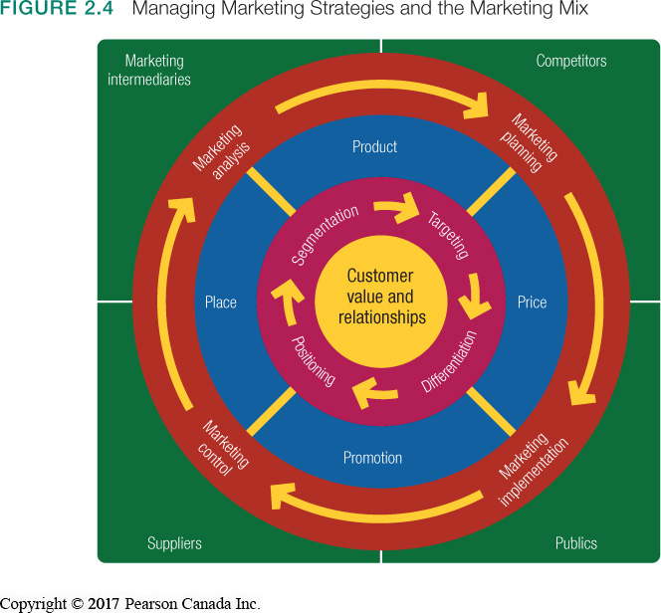
Marketing Strategy and the Marketing Mix

Slide 24
Marketing Strategy and the Marketing Mix
Segmentation:
  Dividing a market into segments of buyers according to needs
Targeting:
  Evaluating each segment and selecting which to pursue
✗
✗
✔
✗

Slide 25
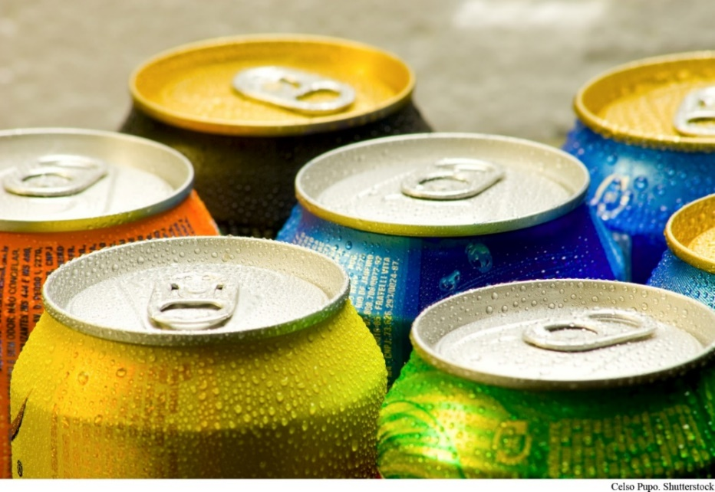
Marketing Strategy and the Marketing Mix
Positioning:
  Attempting to occupy a desirable place in the minds of target consumers
Differentiation:
  Creating unique and superior customer value

Slide 26

Discussion question
Who are the target market and what is the value they get from the following:
1- Apple iphone 7
2- Walmart
3-Royal Bank of Canada

Slide 27



CARS
BMW
MINI
Rolls-Royce

Slide 28
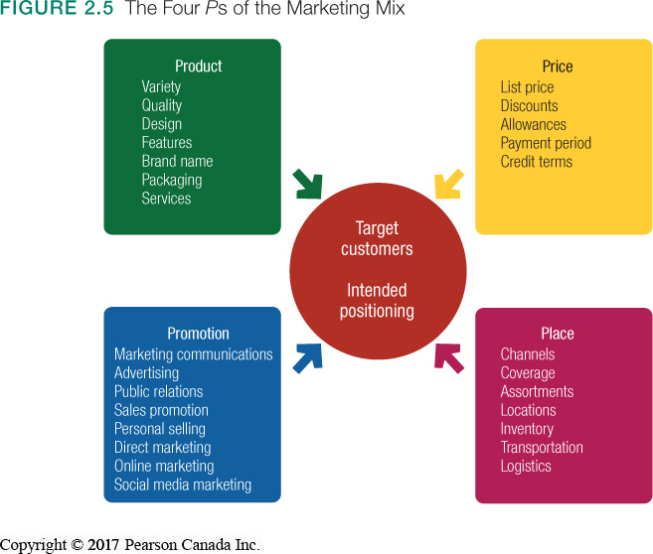
Marketing Strategy and the Marketing Mix
Marketing Mix:
    Product
    Price
    Place
    Promotion

Slide 29
Marketing Strategy and the Marketing Mix
Seller View – Four Ps | Buyer View – Four Cs
Product | Customer Solution
Price | Customer Cost
Place | Convenience
Promotion | Communication

Slide 30
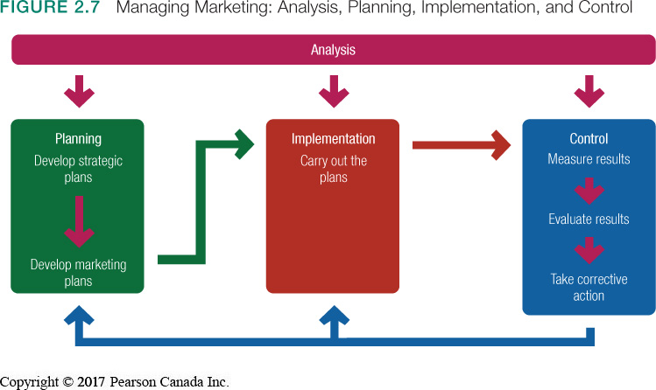
Managing Marketing

Slide 31
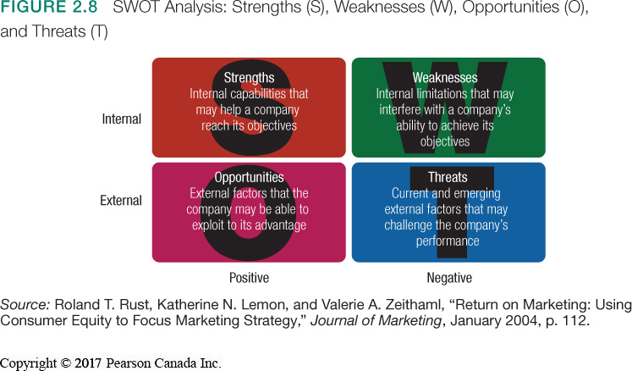
Marketing Management: Function 1
SWOT Analysis:

Slide 32

Marketing Management: Function 2
Marketing Plan
Executive Summary
Current Marketing Situation
  SWOT
Objectives and Issues
Marketing Strategy
Action Programs
Budgets
Controls
Table 2.2 p.65

Slide 33

Marketing Management: Function 3
Implementation:
Plans converted to actions by assigning:
    Who
    Where
    When
    How

Slide 34
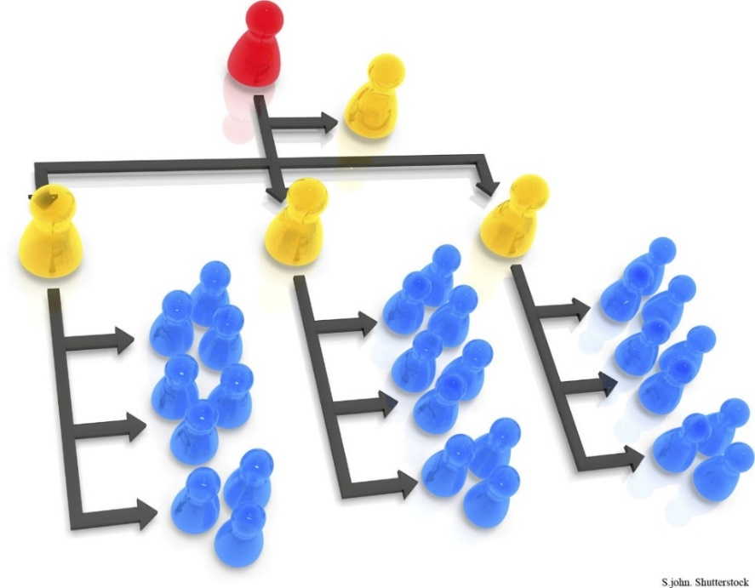
Marketing Department Organization
Chief Marketing Officer/
VP Marketing
• Functional organization
• Geographic organization
• Product management
• Market or customer
• Combination

Slide 35
Marketing Management: Function 4
Marketing control involves four steps:
  Set specific marketing goals
  Measure performance in the marketplace
  Evaluate performance
  Take corrective action to close the gaps between goals and performance

Slide 36
Check Your Understanding
SWOT Breakdown
The elements of SWOT are easy to remember but difficult to apply. “S” and “O” are good. “W” and “T” are bad. The differences between the two positive forces and the two negative forces lies in where they originate. Strengths and weaknesses come from within and are totally controlled by the firm. Opportunities and threats come from outside and are uncontrollable by the firm. Assign an S, W, O, or T to the statements on the right.
1. A slow economy will decrease consumer demand. ____
The firm has a high customer satisfaction rating. _____
The firm will postpone expansion due to shortage of capital. _____
There is a growing demand for the firm’s type of goods. _____

Slide 37

You are the CMO of..

Slide 38
Chapter (4)
Analyzing the marketing environment

Slide 39
Chapter 4: Learning Objectives
1
Describe the environmental forces that affect the company’s ability to serve its customers.
Explain how changes in the demographic and economic environments affect marketing decisions.
Identify the major trends in the firm’s natural and technological environments.
Explain the key changes in the political and cultural environments.
Discuss how companies can react to the marketing environment.
2
3
4
5
Notes:
39

Slide 40
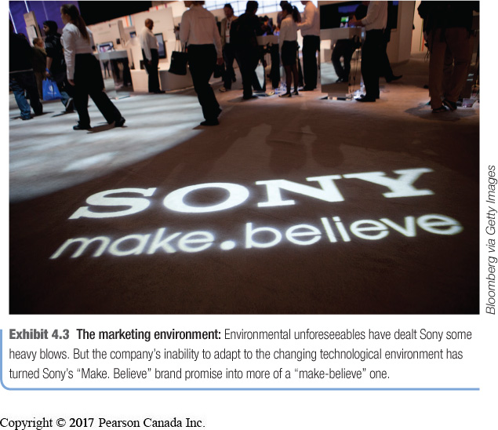
Environmental Forces
The Marketing Environment
  Factors outside marketing that affect marketing management’s ability to build and maintain successful relationships with target customers.

Slide 41
Environmental Forces
Microenvironment:
    Forces with direct impact to the company
    Internal & external
Macroenvironment:
    External forces with direct impact across industries

Slide 42
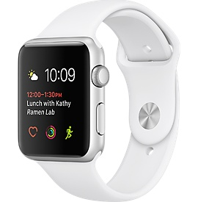
Discussion Question
Thinking of the apple smart watch, what can be the micro and macro environmental factors having an impact on its performance?

Slide 43
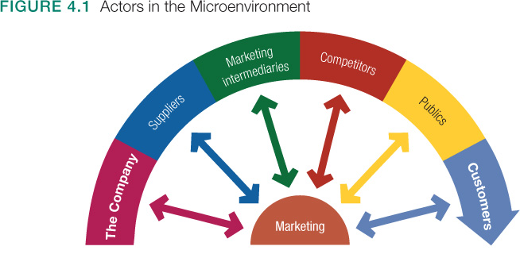
The Microenvironment

Slide 44

The Microenvironment
Marketing Intermediaries
  Resellers
  Physical distribution firms
  Marketing service agencies

Slide 45
The Microenvironment
Competitors
pure competition
monopolistic competition,
Oligopolies
monopolies

Slide 46

The Microenvironment
Publics
  Financial publics
  Media publics
  Government publics
  Citizen-action publics
  Legal publics
  General public
  Internal public

Slide 47
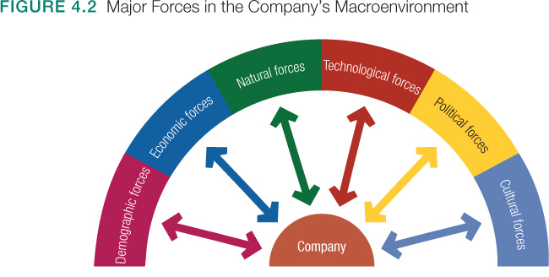
The Macroenvironment

Slide 48
The Demographic Environment
Demography:
  Study of human populations
  Strategic decisions often based upon shifts in demographics
Changing age demographics of the Canadian population is both an opportunity and a threat

Slide 49
The Demographic Environment
Three Largest Generational Groups
Baby Boomers
1947–1966
9.8 million
Wealthy but hard hit by recession
Strong target for financial services
Generation X
1967–1976
7 million
Highly educated
Experientially driven
Less materialistic
Millennials
(Gen Y)
1977–2000
10.4 million
Tech savvy
Personally centered
Personalization and customization are key

Slide 50
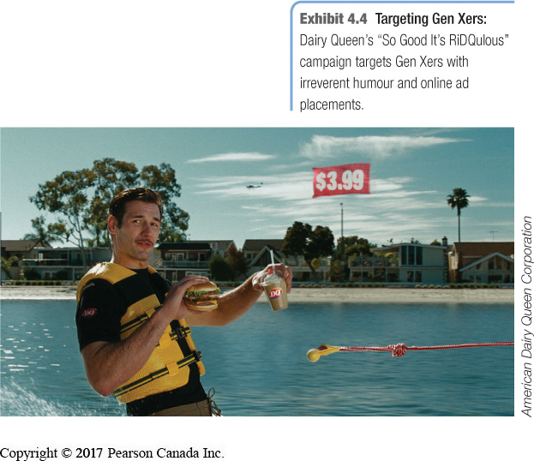
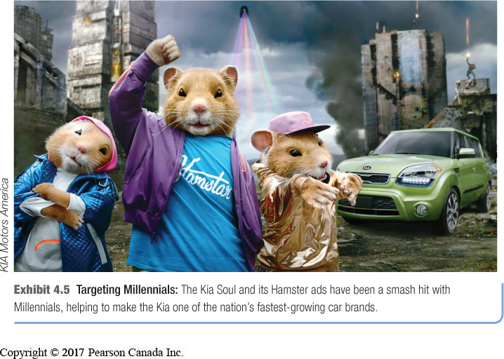
Targeting Gen Xers and Millennials
Targeting Gen Xers:
Dairy Queen Ad
Targeting Millennials:
The Kia Soul

Slide 51
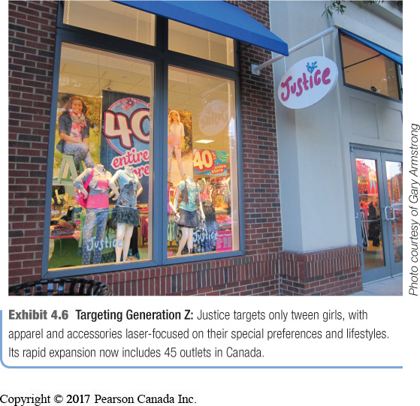
The Demographic Environment
Generation z
Born after 2000
Make up important kid, tween, and teen markets
5.6 million
Fluent with digital technology

Slide 52
The Demographic Environment changes
Canadian family/households are changing
Better Educated, White-Collar Population
Increasing Diversity:

Slide 53

The Demographic Environment
Canadian family/households are changing:
  Growing market of “non-traditional” households
  Growing “crowded nest” syndrome
  Fewer families have children
  More dual-income families

Slide 54
The Demographic Environment
Geographic Shifts in Population
  Growth rates across Canada are not uniform
  Rural to urban migration continues
  Buying habits differ by region
  Growth in telecommuting market

Slide 55

The Demographic Environment
Better Educated, White-Collar Population:
  Increased demand for higher quality
  Increased understanding of value
  Creates demand in different products

Slide 56

The Demographic Environment
Increasing Diversity:
  Large and growing visible minority market
  Growth in recognized disabilities
  Acceptance of LGBT and gay marriages

Slide 57

The Economic Environment
  Nations vary greatly in their levels and distribution of income
    Industrial economies
    Subsistence economies
    Developing economies

Slide 58
The Economic Environment
Factors that affect spending
  Changes in income
    Consumption frenzy, record personal debt
    Economic crisis leading to consumer frugality
    Value marketing is key to success
  Changes in spending patterns

Slide 59

Natural Environment
Natural resources used to produce goods
  Shortage of raw materials
  Increased pollution
  Increased government intervention
Strategic decisions around creating environmentally-sustainable products

Slide 60
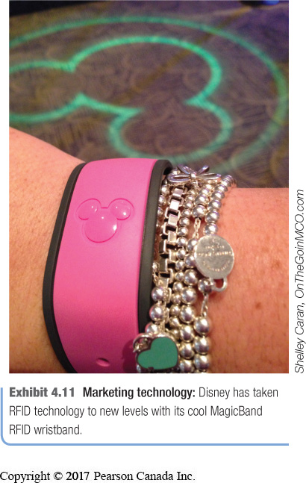
Technological Environment
Technology Advances
  Creating new markets and opportunities
  Increasing obsolescence
  Accelerating customer needs
  Resulting in constantly evolving regulations

Slide 61
Political Environment
Regulatory Trends - Evolving laws influence organizations
Business legislation:
  Protects companies from each other
  Protects consumers from unfair business practices
  Protects the interests of society
Increased emphasis on ethics and socially responsible behaviour.

Slide 62

Cause-Related Marketing
Companies linking themselves with worthwhile causes

Slide 63
The Cultural Environment
Standard acceptable belief system that affects a society’s basic values
  Core beliefs slow to change
  Secondary beliefs are more open to change
Secondary
CORE

Slide 64

The Cultural Environment
Society’s major cultural views are expressed in people’s views of:
    Themselves
    Others
    Organizations
    Society
    Nature
    The Universe

Slide 65
Responding to the Marketing Environment
Reactive | Proactive
Wait for change; then react | Anticipate change; act now
Missed opportunities | Seized opportunities
Damage from threats | Mitigate impact of threats

Slide 66


Slide 67
What to do for next class
Be ready for quiz (1)
Prepare Answers for
  Discussion question 5 p.73
  Exercise “Think like a marketing manager” p.149
Finalize your team and send me a PPT with your names and pictures 24 hours before class

Slide 68


