Slide 1

Marketing Management I :
Introduction to Marketing
1
Week 1

Slide 2
Chapter (1)
Marketing: Creating and capturing customer value

Slide 3
Chapter 1: Learning Objectives
1
Define marketing and outline the steps in the marketing process.
Explain the importance of understanding customers and the marketplace, and identify the five core marketplace concepts.
Identify the key elements of a customer-driven marketing strategy and discuss the marketing management orientations that guide marketing strategy.
Discuss customer relationship management and identify strategies for creating value for customers
and capturing value from customers in return.
Describe the major trends and forces that are changing the marketing landscape in this age of relationships.
2
3
4
5
Notes:
3

Slide 4
Thinking of any brand… (Facebook)!
What is Marketing?
How does Marketing work?
How far/close are you from Marketing?

Slide 5
What is Marketing
Marketing is managing profitable customer relationships
How?
1- Attract new customers by promising superior value
2- Maintain current customers by delivering satisfaction
Definition:
The process by which companies create value for customers and build strong customer relations in order to capture value from customers in return

Slide 6
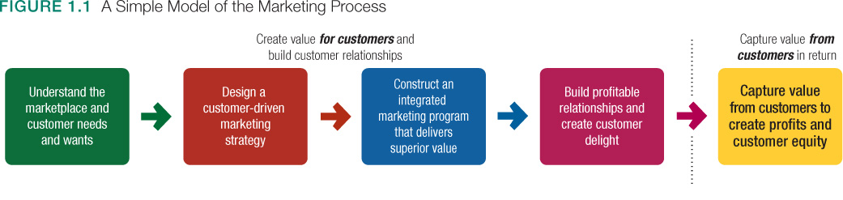
Marketing and Marketing Process

Slide 7
Understanding the Marketplace and Customer Needs: 5 Core Concepts
  Needs, wants, and demands
  Market offerings (market myopia)
  Value and satisfaction
  Exchanges and relationships
  Markets

Slide 8
Core Concept 1:
Customer Needs, Wants, and Demands
Demand - Sum of wants and buying power
Wants - Needs influenced by culture and personality
Needs- Deprived of physical, social, individual basics

Slide 9

Discussion Question
Describe commuting to and from school in terms of wants, needs, and demands?

Slide 10
Core Concept 2: Market Offerings
Demand
Products, Services, Experiences
Marketing Myopia
Wants
Market
offerings
Needs

Slide 11
Core Concept 3:
Customer Value and Satisfaction
Demand
Wants
Customer
Value &
Satisfaction
Needs

Slide 12

Core Concept 4: Exchange Relationships
Relationship
Exchange

Slide 13
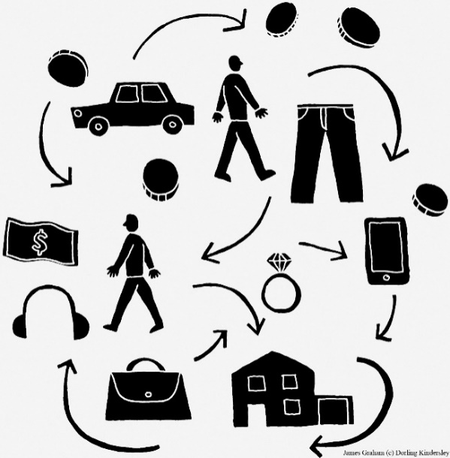
Core Concept 5: Markets
Market:
  Buyers of a product
  Common wants and needs satisfied through exchange

Slide 14
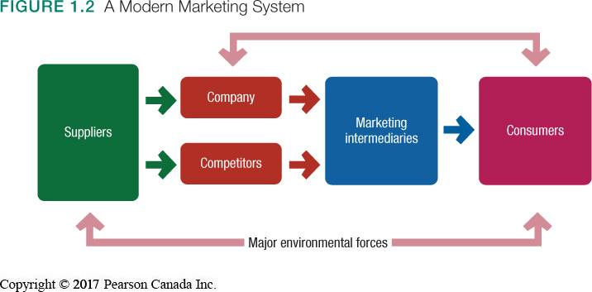
Core Concept 5: Markets

Slide 15
Discussion Question
Think of a recent purchase you have made and identify the value delivered to you and returned to the company from whom the purchase was made. Think beyond the mere exchange of money for product.
Think About Mutual Value

Slide 16
Designing a Customer-Driven
Marketing Strategy
Marketing Management:
  Choosing target markets and building profitable relationships with them
  Finding, attracting, keeping, and increasing number of customers by providing value

Slide 17
Designing a Customer-Driven
Marketing Strategy
Winning marketing strategies formed by answering:
  What customers will we serve?
      Target market
  How can we best serve these customers?
      Value proposition

Slide 18

Designing a Customer-Driven
Marketing Strategy
Market Segmentation:
  Dividing the market into groups of customers
Target Marketing:
  Selecting one or more segments to serve

Slide 19
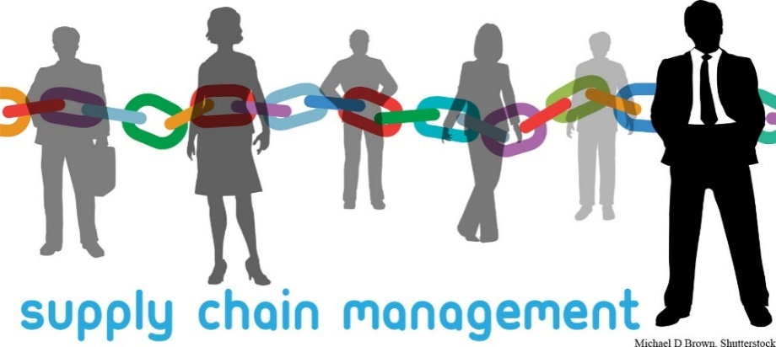
Designing a Customer-Driven
Marketing Strategy
Value Proposition:
  The benefits promised to deliver to consumers
  Differentiates brands within the marketplace

Slide 20
Discussion question
Who are the target market and what is the value they get from the following:
1- Apple iphone 7
2- Walmart
3-Royal Bank of Canada

Slide 21
Customer Driven Marketing Strategy:
Marketing Management Orientations
Strategies based upon one or more orientations:
  Production Concept
  Product Concept
  Selling Concept
  Marketing Concept
  Societal Marketing Concept

Slide 22
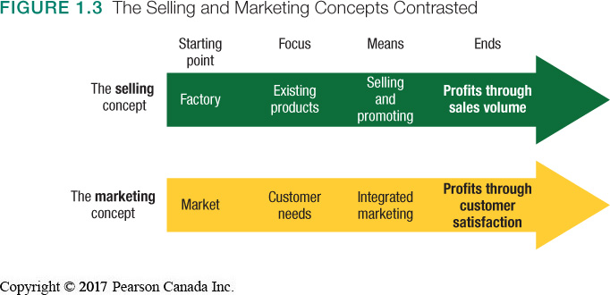
Marketing Management Orientations
Selling and Marketing Concepts:

Slide 23
Marketing Management Orientations
Societal Marketing Concept:
  Considers society’s long-run interests
  Results in sustainable marketing, socially and environmentally responsible marketing that meets present needs while considering future interests
…all while achieving profitability

Slide 24
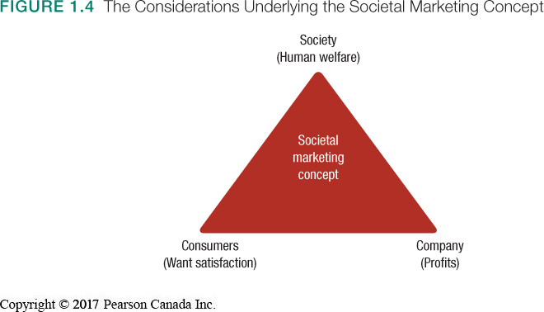
Societal Marketing Concept

Slide 25
Preparing an Integrated
Marketing Plan and Program
Integrated Marketing Plan:
  Analyzes firm’s current situation and transforms the marketing strategy into action
  Describes the four P (marketing mix) strategies:
        Product
        Price
        Place (Distribution)
        Promotion

Slide 26
Reviewing the Concepts
Define marketing and the marketing process.
Understand customers and identify the five core marketplace concepts.
Identify elements of a customer-driven marketing strategy and discuss the marketing management orientations that guide strategy.

Slide 27
For next class
Start thinking of your team and project idea
GO over the materials discussed so far
Read Boston Pizza comprehensive case p.34 and be ready to answer its questions

Slide 28


