Slide 1
Chapter 2
Theories, Models and Data
Principles of Microeconomics
Douglas Curtis & Ian Irvine

Slide 2
Learning outcomes
In this chapter we will examine…
How economists operate, analyze and develop policy
Data and data types
Variables and index numbers
Economic theory, economic models and testing
Diagrams and economic analysis
Ethics and beliefs - normative and positive economics
The role of government

Slide 3
Observations, Theories and Models
Economists:
observe and study economic behaviour, experience and events.
  Example: what is the impact of price on alcohol purchases?
think in terms of economic costs, benefits
and incentives
  Examples: what is the impact of tax deductibility of retirement savings on the decision to save? Or What is the net benefit of Uber taxis?
try to determine and understand causes and consequences - theorize
  Example: impact of incarceration on crime reduction

Slide 4
Variables, Data and Index Numbers
Economic theories and models work with economic variables and are tested with economic data
Economic variables:
Measures that can take on different values
Economic data:
Actual recorded values of variables
Forms of data:
Time series data of different frequencies
Cross-section data
Longitudinal data
Illustrations….

Slide 5
Time Series Data in a Table:
TABLE 2.1 House Prices by Time Period
Date | Price of detached bungalows, N. Vancouver
2006Q1 | 580,000
2007Q1 | 630,000
2008Q1 | 710,000
2009Q1 | 605,000
2010Q1 | 740,000
2011Q1 | 800,000
2012Q1 | 870,000
Source: Prices for North Vancouver houses come from Royal Le Page

Slide 6
Cross – Section Data Table
Table 2.2 Unemployment rates, Canada and Provinces, monthly 2012 (% seasonally adjusted)
 | Jan | Feb | Mar | Apr | May | Jun
CANADA | 7.6 | 7.4 | 7.2 | 7.3 | 7.3 | 7.2
NFLD | 13.5 | 12.9 | 13.0 | 12.3 | 12.0 | 13.0
PEI | 12.2 | 10.5 | 11.3 | 11.0 | 11.3 | 11.3
NS | 8.4 | 8.2 | 8.3 | 9.0 | 9.2 | 9.6
NB | 9.5 | 10.1 | 12.2 | 9.8 | 9.4 | 9.5
QUE | 8.4 | 8.4 | 7.9 | 8.0 | 7.8 | 7.7
ONT | 8.1 | 7.6 | 7.4 | 7.8 | 7.8 | 7.8
MAN | 5.4 | 5.6 | 5.3 | 5.3 | 5.1 | 5.2
SASK | 5.0 | 5.0 | 4.8 | 4.9 | 4.5 | 4.9
ALTA | 4.9 | 5.0 | 5.3 | 4.9 | 4.5 | 4.6
BC | 6.9 | 6.9 | 7.0 | 6.2 | 7.4 | 6.6
Source: Statistics Canada CANSIM Table 282-0087
Canada’s provinces at a moment in time form a cross-section
These data form repeated cross-sections – they are cross sections repeated for 6 months

Slide 7
Longitudinal data
Example: A survey of the same participants every year yielding data that define the group – for example a health survey that follows individuals through time

Slide 8
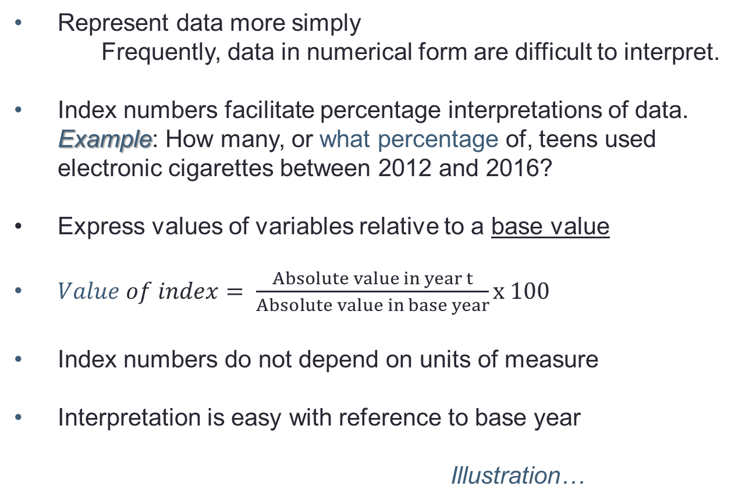
Index Numbers
Represent data more simply
Frequently, data in numerical form are difficult to interpret.
Index numbers facilitate percentage interpretations of data.
  Example: How many, or what percentage of, teens used
  electronic cigarettes between 2012 and 2016?
Express values of variables relative to a base value
$Value of index= \frac{Absolute value in year t}{Absolute value in base year}x 100$
Index numbers do not depend on units of measure
Interpretation is easy with reference to base year
Illustration…

Slide 9
Price indexes in Table 2.1
We can use the data in columns 1 & 2 to construct a price index
Year, Q1 | Price in $ | House Price Index
1999 | 330,000 | 100
2000 | 345,000 | 104.6
… | … | …
2006 | 580,000 | 175.8
2007 | 630,000 | 190.9
2008 | 710,000 | 215.2
2009 | 605,000 | 183.3
2010 | 740,000 | 224.2
2011 | 800,000 | 242.4
2012 | 870,000 | 263.3
Relative to 1999Q1, house prices in 2012 increased 163.3%
How did we get the final column?
…….
Relative to 1999Q1 house prices in 2009Q1 increased 83.3%

Slide 10
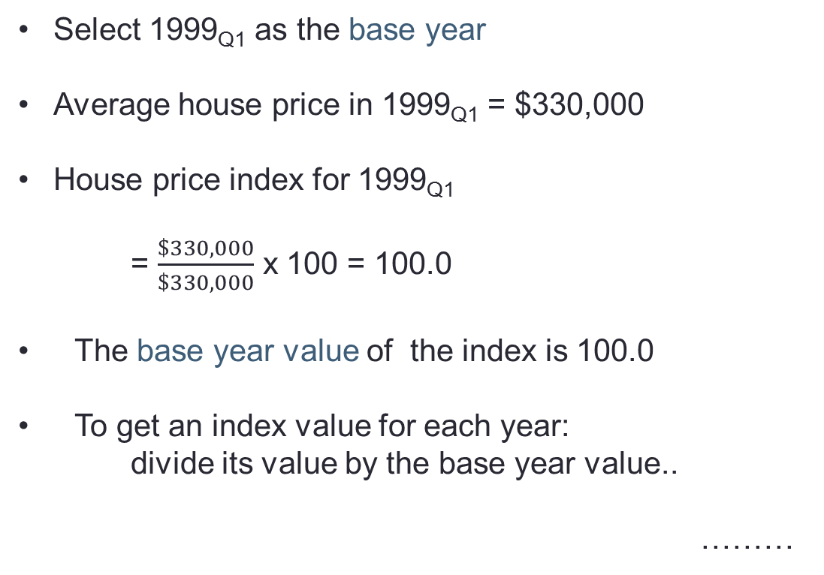
Constructing a House Price Index
Select 1999_{Q1} as the base year
Average house price in 1999_{Q1} = $330,000
House price index for 1999_{Q1}
= $\frac{\$330,000}{\$330,000}$ x 100 = 100.0
The base year value of the index is 100.0
To get an index value for each year:
divide its value by the base year value..
………

Slide 11
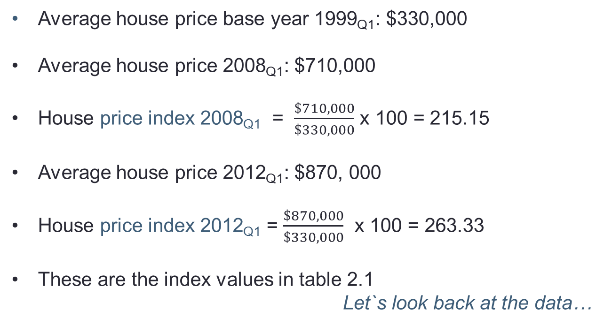
Constructing a House Price Index (cont’d)
Average house price base year 1999_{Q1}: $330,000
Average house price 2008_{Q1}: $710,000
House price index 2008_{Q1} = $\frac{\$710,000}{\$330,000}$ x 100 = 215.15
Average house price 2012_{Q1}: $870, 000
House price index 2012_{Q1} = $\frac{\$870,000}{\$330,000}$ x 100 = 263.33
These are the index values in table 2.1
Let`s look back at the data…

Slide 12
Composite Index Numbers
Suppose we want to define a price index for a group of products
Examples: By what percent have electronics prices changed every year between 1990 and today? In this instance it would be necessary to average the prices of all of components in this category: TVs, ipods, smart phones, etc.
More generally we might wish to know by how much the prices of all goods consumed in the economy have changed since 1990
Clearly we would need to average the price changes of each product entering the group.
Some items are more important than others, and so such items get a bigger weighting in the calculation.
The consumer price index (CPI) for Canada reflects the prices of all consumer goods and services
CPI is obtained from Statistics Canada, CANSIM II, Series V41692930

Slide 13
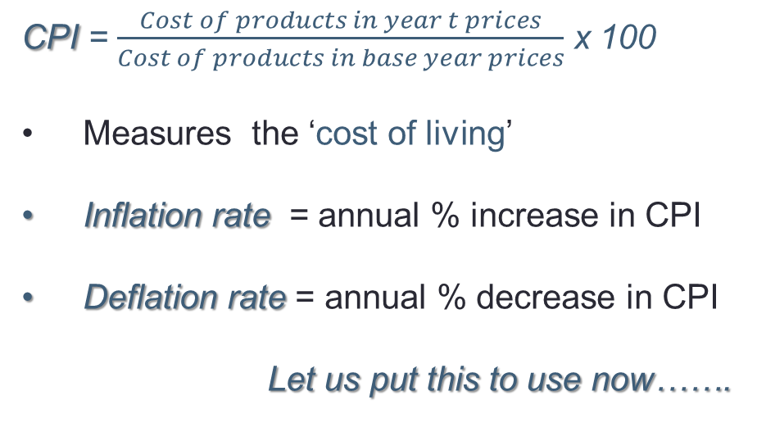
The Consumer Price Index (CPI)
CPI = $\frac{Cost of products in year t prices}{Cost of products in base year prices}$ x 100
Measures the ‘cost of living’
Inflation rate = annual % increase in CPI
Deflation rate = annual % decrease in CPI
Let us put this to use now…….

Slide 14

Real price changes in Table 2.1
Year, Q1 | Price in $ | House price index | Percentage price change | Inflation rate = change in CPI | Real price change
1999 | 330,000 | 100
2000 | 345,000 | 104.5
… | … | …
2006 | 580,000 | 175.7
2007 | 630,000 | 190.9
2008 | 710,000 | 215.2
2009 | 605,000 | 183.3
2010 | 740,000 | 224.2
2011 | 800,000 | 242.4
2012 | 870,000 | 263.6
=(24.3/190.9)=12.7%
2.3%
≈ 10.4%
Between 2007-2008 if the CPI increased by 2.3% then the real increase in house prices was approximately 10.4%

Slide 15
Plots of data
Frequently we present data in graphical form
With time series data we might have time on the horizontal axis and the values of the series on the vertical axis
Let us plot the house price series from table 2.1…

Slide 16
Time Series Data Plotted:
This is a plot of the house price series – going back to 1999. The line joins every pair of date-price points
For example, 2009, Q1 prices fall to $605,000

Slide 17
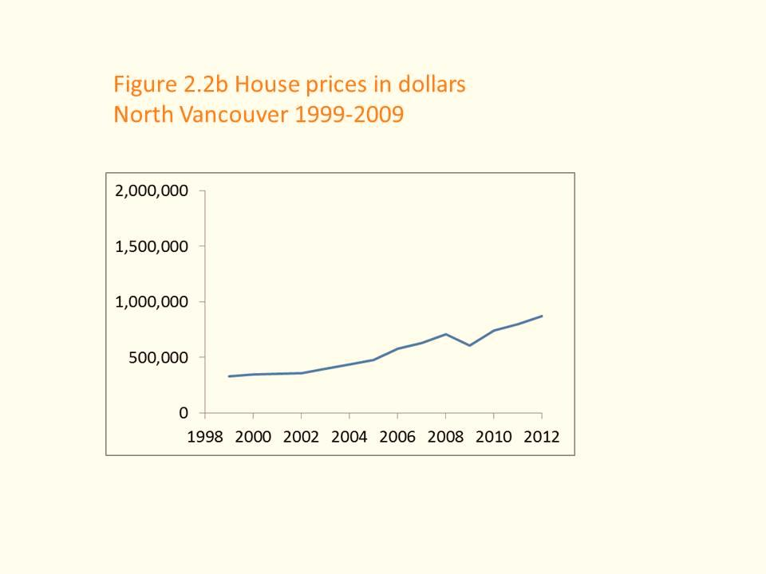
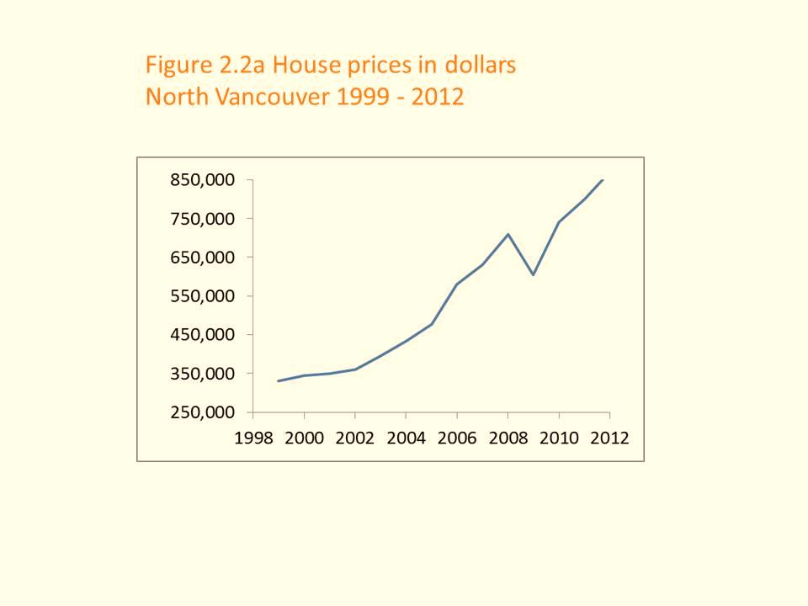
Interpretation of Plots
The scale of the axes is critical in interpretation
These plots present the same information
The vertical axis has been compressed in the second figure

Slide 18
Data, Theories and Models
Economists
use economic theories and models to explain behavior and predict policy outcomes
  Example: A model of the housing market helps to predict the impact of mortgage rates on home prices
  Modelling tools…

Slide 19
Illustration: A Simple Economic Model
Theory: Mortgage rates determine the finance cost of buying a house, therefore we:
Hypothesize that changes in mortgage rates cause changes in house prices
Construct a model to test the hypothesis and gather data
Observe in the data: Increasing house prices and falling mortgage interest rates simultaneously
Infer: House prices are inversely related to mortgage rates
Prediction: Does the model help with prediction?

Slide 20
Data for House Price Model
Year | House price | Mortgage rate
2001 | 350,000 | 7.75
2002 | 360,000 | 6.85
2003 | 395,000 | 6.6
2004 | 434,000 | 5.8
2005 | 477,000 | 6.1
2006 | 580,000 | 6.3
2007 | 630,000 | 6.65
2008 | 710,000 | 7.3
2009 | 605,000 | 5.8
2010 | 740,000 | 5.4
2011 | 800,000 | 5.2
Prices are as from earlier example. Mortgage rate is the 5-year rate obtainable for CANSIM or the Bank of Canada

Slide 21
From Data to Scatter Plot
Consider the data in the preceding table
The first data combination is {$350,000, 7.75%}
This can be plotted as a single point in a two-dimensional diagram with appropriate axes
All of the combinations in the table can be plotted in the same way
The question:
Does the resulting data plot suggest there is a relationship between the variables in question?
Illustration….

Slide 22
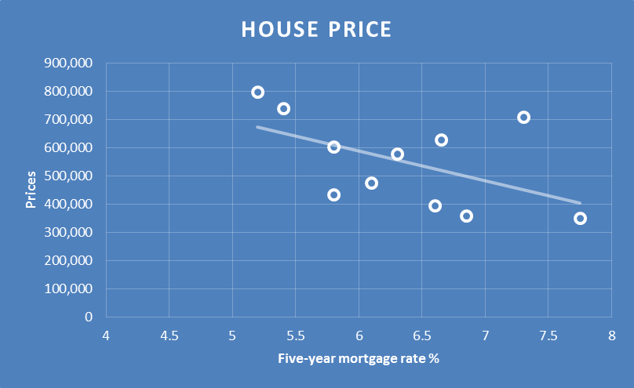
Plot of House Prices versus Mortgage Rate
We now have evidence supporting the theory
A regression line through the scatter suggests a negative relationship – higher mortgage rates are associated with lower prices

Slide 23
Regression Lines
Econometrics is the science of quantifying relationships between economic variables
Regression line shows average relationship between variables – here the mortgage rates and house prices
The equation of the regression line quantifies the relationship between mortgage rates and house prices.

Slide 24
A Richer Model
Simple model:
Changes in mortgage rates cause changes in house prices, ceteris paribus, and the relationship is inverse
Broader model:
House prices = f(mortgage rates, incomes, supply of housing, population growth, rents….)
Statistical test of simple model:
Examine house price and mortgage rate data in conjunction with other variables.
Illustration using data and scatter plot…

Slide 25
The Model in ‘Algebra’
The previous representation of our economic model was graphical
The relationship we have supposed between mortgage rates and house prices is a straight line. Straight line functions are convenient and simple to work with
We will see presently that such a line can be described completely by its slope and the value of one of the intersection points with the axes
For now we infer that if the straight line we have inserted accurately reflects the relationship between the two variables
This relationship could be used for ‘prediction’. For example, if the mortgage rate fell to 4%, this model would predict a rise in house prices – just project the regression line leftwards

Slide 26
Diagrams and Economic Analysis
Diagrams are important tools for economic illustrations and analysis
Straight line diagrams provide useful simplifications of economic relationships
In some cases curved lines are better illustrations of economic relationships and fit the data better
Changes in economic conditions and relationships change parameters of the model and shift the lines in diagrams – we explore this in chapter 3

Slide 27
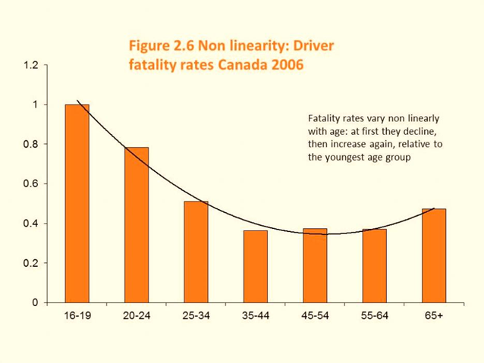
Statistics and Policy Design
Figure 2.6 presents data on fatalities per driver by age group in Canada relative to the youngest age group..
Note the strong non-linear pattern to the data – fatalities decline quickly, then level off and again increase for the oldest age group.
In keeping with these data, drivers are now required to pass a driving test in most provinces once they attain a certain age – usually 80, because the data indicate that fatalities increase when drivers age.
See: CANADIAN MOTOR VEHICLE TRAFFIC COLLISION STATISTICS 2009, Transport Canada

Slide 28
Ethics, Efficiency and Beliefs
Positive economics: objective and scientific explanations of how the economy functions.
Example on inference
Normative economics: recommendations that incorporate value judgements
Example using political perspectives
Economic equity: the distribution of well – being among members of society
  Pursuit of happiness: curvilinear relationship between average happiness and national income

Slide 29
Revisiting the Definition of Economics
A set of ideas and methods for the betterment
  of society
Markets are critical: Permit trade, specialization and efficiency
Incentives matter
Legal institutions, property rights & enforceable contracts are essential to market functions

Slide 30
Chapter Summary
Economics is concerned with the interplay of theories, models and data
A model is a simplified representation of reality, often formulated to test a hypothesis
Hypothesis can be refuted or supported by analyzing data
Data come in time-series, cross-section and longitudinal form
Index numbers provide a simplified way of analyzing data relative to a base year. Index numbers may also be averages of components
Nominal financial data values are translated into real values by dividing the nominal series by the CPI

Slide 31
Government
Provides the legal framework essential for a mixed economy – market and public sectors. Government is integral to the economy, not an appendage.
Intervenes to support efficient market functions through:
  Competition policy and regulatory frameworks
  Social policy – an educated workforce
  International trade policy – reduce protectionism
  Monetary policy and fiscal policy – to foster growth
Intervenes to redistribute to individuals and other levels of government

Slide 32
Chapter Summary
Data can be represented by means of a scatter plot and a regression line through the plot
Economic relationships may be linear or non-linear
A straight line is defined totally by its two intercepts or one intercept and the slope
Economics is concerned with equity as well as markets
Government is essential to the functioning of a modern economy

Slide 33
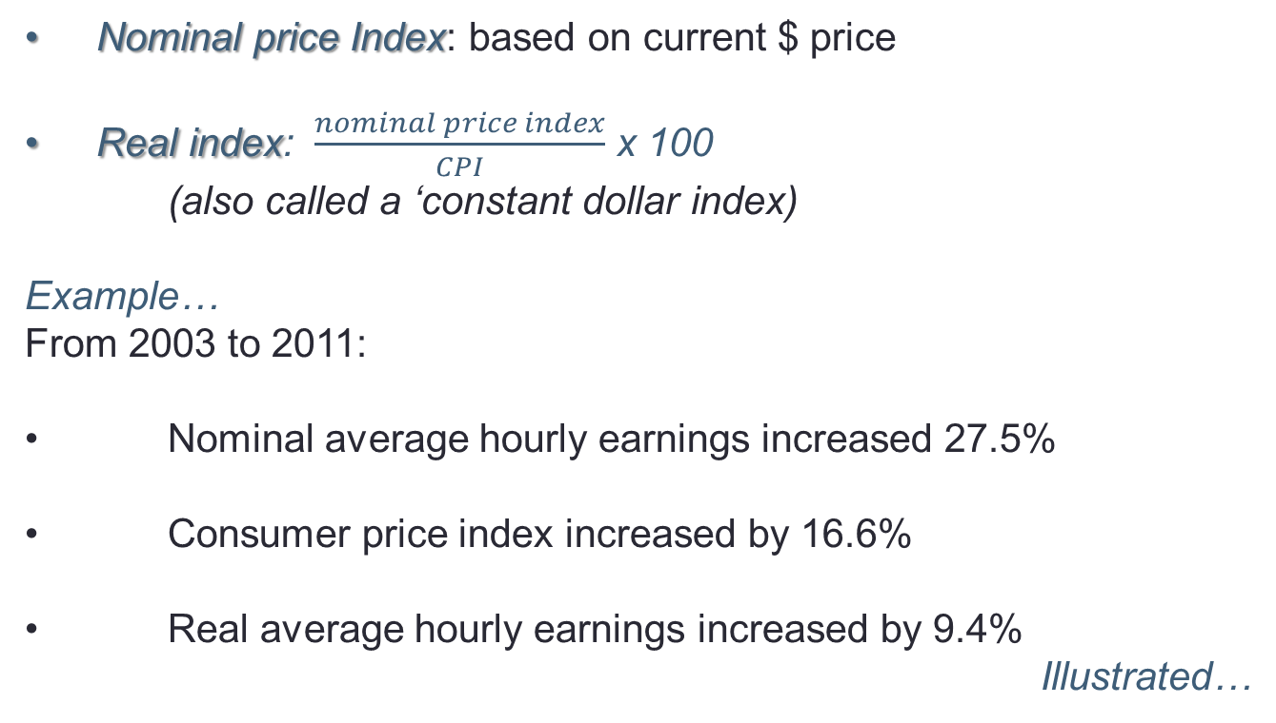
Advanced: Nominal and Real Values Using CPI
Nominal price Index: based on current $ price
Real index: $\frac{nominal price index}{CPI}$ x 100
(also called a ‘constant dollar index)
Example…
From 2003 to 2011:
Nominal average hourly earnings increased 27.5%
Consumer price index increased by 16.6%
Real average hourly earnings increased by 9.4%
Illustrated…

Slide 34
Advanced Nominal and Real Values
Relative real hourly earnings 2003 → 2011 = $\frac{127.5}{116.6 }$x 100 = 109.4

Slide 35
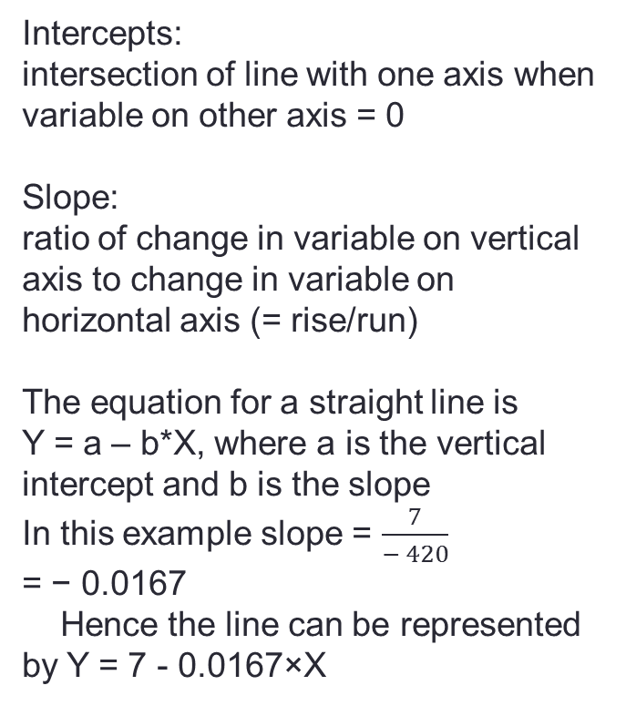
Advanced: Properties of the Regression Line
Variable Y
Intercepts:
intersection of line with one axis when variable on other axis = 0
Slope:
ratio of change in variable on vertical axis to change in variable on horizontal axis (= rise/run)
The equation for a straight line is
Y = a – b*X, where a is the vertical intercept and b is the slope
In this example slope = $\frac{7}{− 420}$
= − 0.0167
Hence the line can be represented by Y = 7 - 0.0167×X
7
Rise
Run
0
Variable X
420

