Slide 1


Brick & Mortar Expansion
Mackenzie Duncan, VP of Operations
September 10th, 2017
Notes:
Take a moment to picture your favourite athlete. They are in high school and although it’s clear that they have great potential, there is a long and difficult road ahead, and in their mind they need every bit of help they can get to reach their goals. When that athlete goes to get their running shoes we want Nike on their mind.

Slide 2
Analysis of Current Stores
Why Nike’s Market is Different
Introducing Nike Training Grounds
What our current brick and mortar locations contribute
Why our customers value physical locations
How we will keep our stores but change their purpose
1
2
3

Slide 3

Current DTC Operations
1,143 Location World Wide
Stores
9%
Revenue
Streams
Sales
7%
Whole Sale
DTC
In-Store
Digital
30%
2017
Digital Sales Growth
51%
2016
59%
2015
Notes:
We have 1143 Nike locations world wide and that number is growing up 9% from last year. Our Same store sales are up as well 7% form last year. So clearly brick an mortar is alive an well.
Not only is our brick an mortar growing at a healthy pace but it also makes up a significant percentage of total revenues
As you can see it makes up roughly 21% of our total revenue while online sales make up only 7%
So where has all this talk of going digital come from? A lot of it is the media and a lot of It is our digital sales growth numbers
While these numbers are good lets keep in mind that our online sales still only make up 7% of total revenue
Why don’t we take a look at where that 7% is coming from.

Slide 4
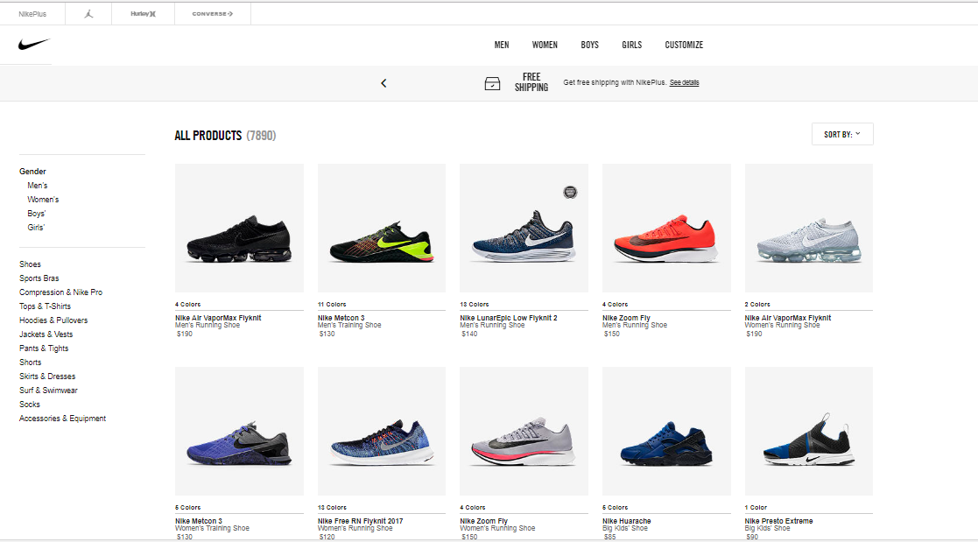
Something Doesn’t Feel Right…
Notes:
As im sure you all know this is our very sleek online store, and it’s beautiful ill admit but I cant help thinking that something doesn’t feel right
Something about buying that shoe before I have had it on my foot feels off
And this has to do with our core value proposition it has to do with what sets Nike apart from the competition

Slide 5
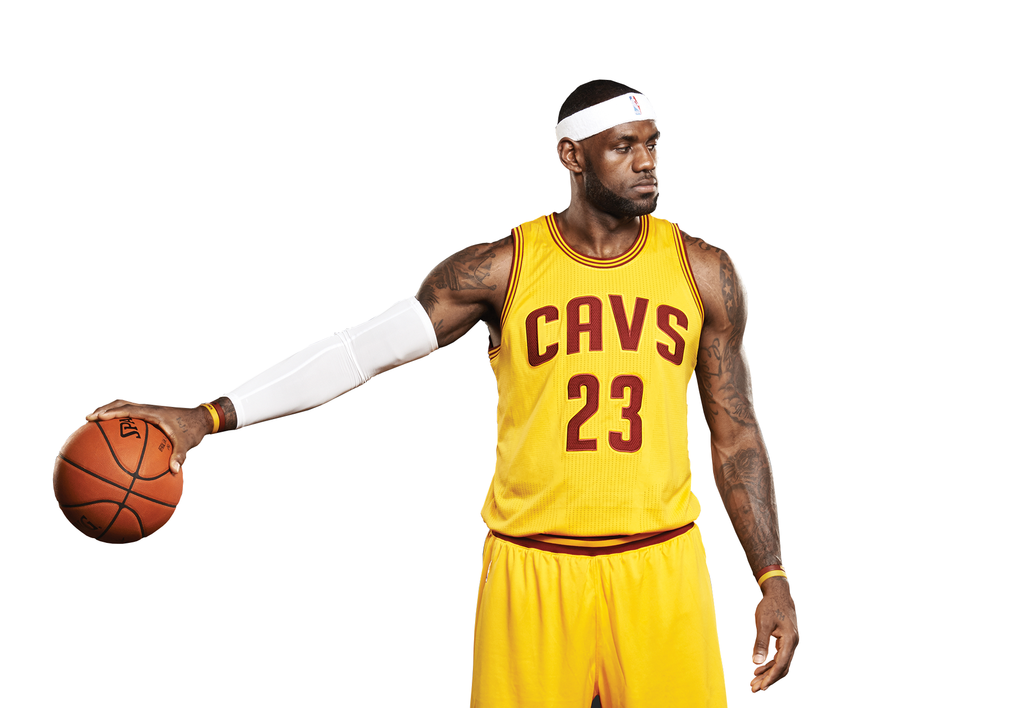
Nike Is Different
High Performance Sports Wear
for
High Performance Athletes
Performance should be amplified by the product you pick
People need to try it before they buy it
Notes:
-what do we do? We provide high performance sports wear to high performance athletes
When you pick up a Nike product it should amplify you performance and our products do that and that’s why the sports hero you have in your head is likely training with a Nike product
Now spencer you bought a Ferrari last year
Yes I did
Its bright red and its beautiful, would you have bought that Ferrari without sitting in it and feeling the road beneath it and feeling the power of its engine?
No probably not
No you would not, so if we are trying to sell the Ferrari of basketball shoes our customers are going to want the same thing
They are going to want to feel the court beneath their Jordans before they buy them
And we have a solution to that

Slide 6
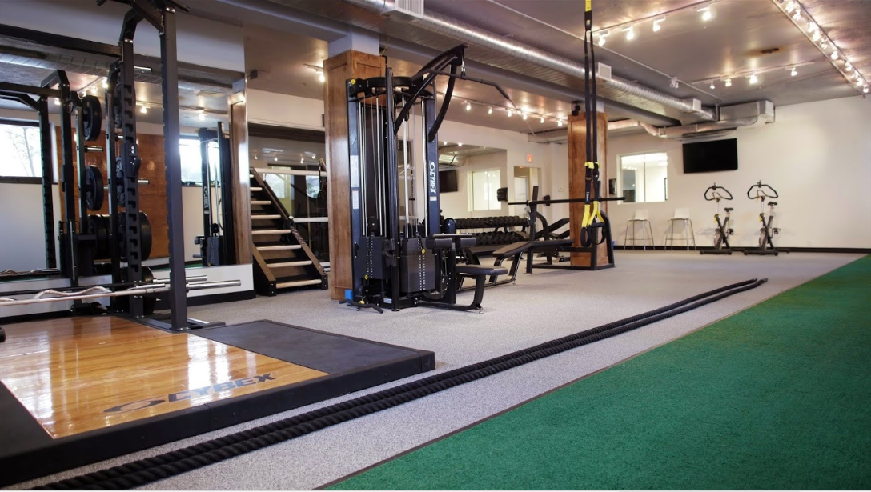
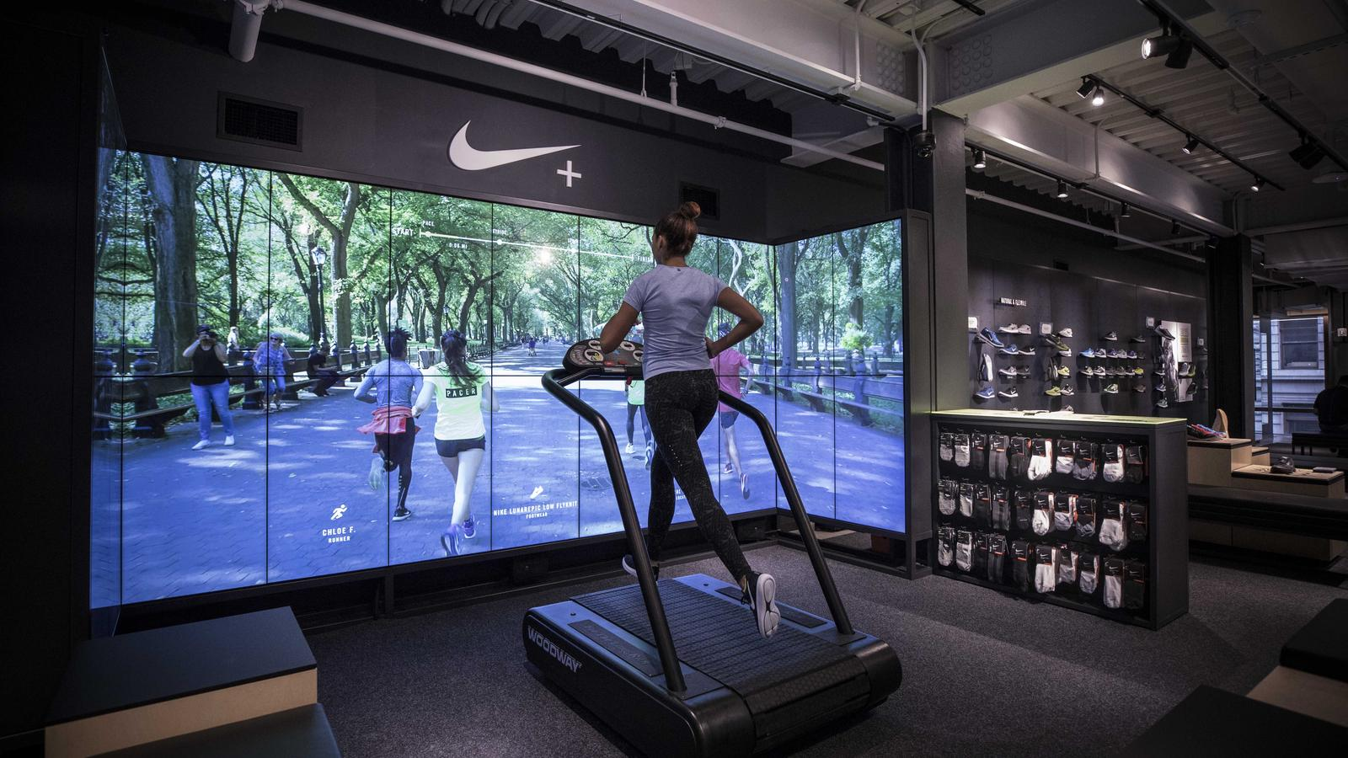
Nike Training Grounds
150ft turf lane
200ft² of basket ball court
Interactive golfing room
Virtual reality treadmill
1 security guards and Nike customer service
Notes:
- 150ft of turf so you run that 40 yard dash before you get on the field
200 square ft of basketball court so you can take that jump shot before you buy those Jordans
An interactive golfing room so you can drive that ball down the center of the fairway before you buy those perfectly weighted clubs
And the best part? Virtually no inventory, no cashier, 1 security guard and some customer service agents to make sure you get the best Nike product for you
all purchases happen through kiosks that connect customers to our online store where all the customization you could want is available , welcome to the future of our brick and mortar
Let take a look at what have been over

Slide 7
Analysis of Current Stores
Why Nike’s Market is Different
Introducing Nike Training Grounds
Brick and mortar is our bread an butter
High performance goods that customers evaluate in-store
A place to feel the performance you are buying
1
2
3
Notes:
We discussed that despite the growth of online sales brick and mortar is still our bread and butter
We know that people want to feel the performance of our products before they invest in them because players need every advantage they can get
and we introduced the future of our brick and mortar operation, Nike Training Grounds a place where athletes can feel the performance they are buying
So when that teenage or Gretzky or Rousy is looking for the gear that will give them a leg up, they know they can test drive Nike and be confident that their goals are a little more attainable with the Ferrari of sports gear behind them

Slide 8
Mackenzie Duncan
Email: Mackenzie.duncan@nike.com
Phone: 647-970-9321
Notes:
Thank you all for your time, I am happy to take any questions

Slide 9
Work Cited
http://s1.q4cdn.com/806093406/files/doc_financials/2017/ar/docs/nike-2017-form-10K.pdf
http://s1.q4cdn.com/806093406/files/doc_financials/2016/ar/docs/nike-2016-form-10K.pdf
http://s1.q4cdn.com/806093406/files/doc_financials/2015/ar/docs/nike-2015-form-10K.pdf

