Slide 1
Midterm I - Format
30 Multiple Choice Questions
You get to choose 2 out of 4 short answer questions
50 minutes to complete the midterm
Make sure to bring: pencil, pen, student card
NO phones, computers or calculators allowed
Additional sample questions will be posted on CourseLink by Monday, to be discussed during the review session on Wednesday (27 September)

Slide 2

Attention
Part 2 of the assignment – due on September 25th midnight

Slide 3
Lactose Intolerance
Find your tolerance level
  Cheese has little lactose [processing]
  Yogurt may be easier to digest!
  Kefir may be easier to digest!
  Small amounts may cause no problem
  EXPERIMENT!
Other options: Lactase-treated milk, lactase tablets, soy milk or other calcium-fortified milk alternatives (rice and almond milks)
Fermented + processing

Slide 4
Today
What are carbohydrates?
  What are they?
  What foods contain carbohydrates?
  Chemical composition of sugar, starch, & fibre
How are they digested?
What do they do in the body?

Slide 5
Question
Is lactose (sugar found in milk)?

Slide 6
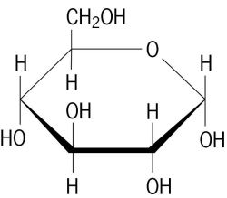
All Carbohydrates are made of...
1 Sugar molecule
____________________________________

Slide 7
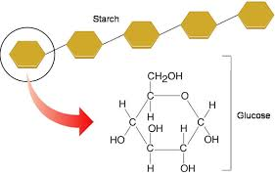
Types of Carbohydrates (CHO)
___________ carbohydrates (aka sugars)
  One (monosaccharide) or two (disaccharide) sugar molecules
___________ carbohydrates (aka polysaccharides)
  Many sugar molecules strung together
    Starch, fibre

Slide 8
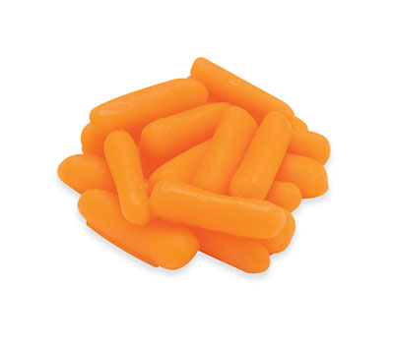
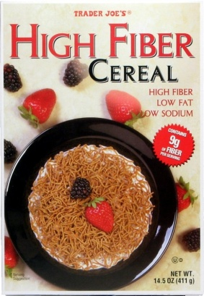
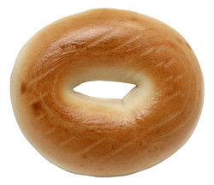
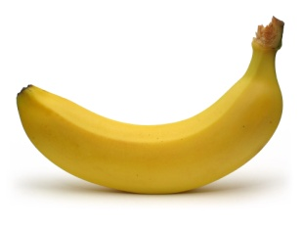
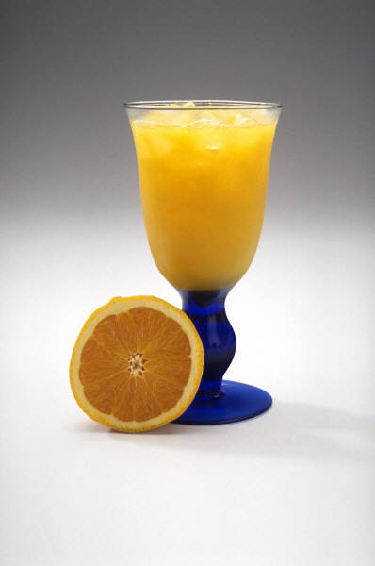
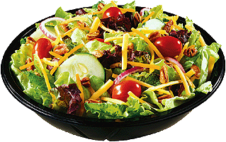
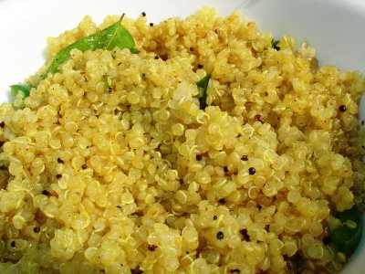
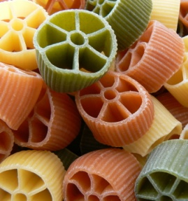
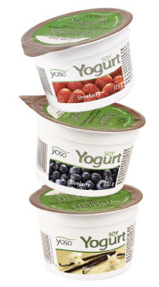
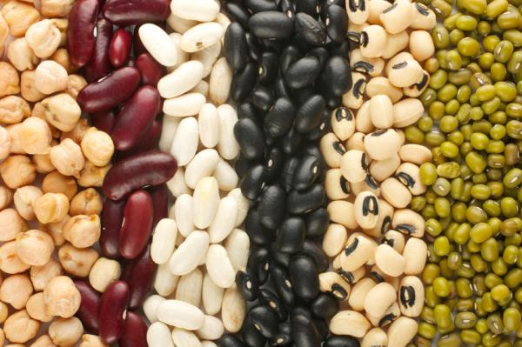
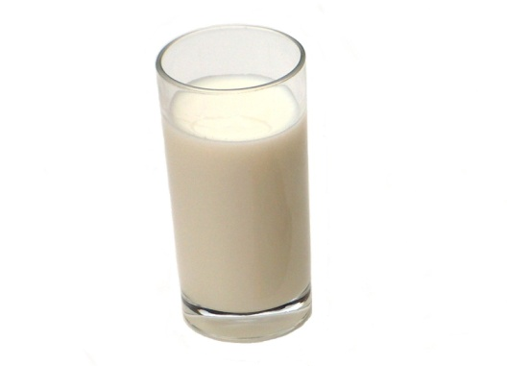
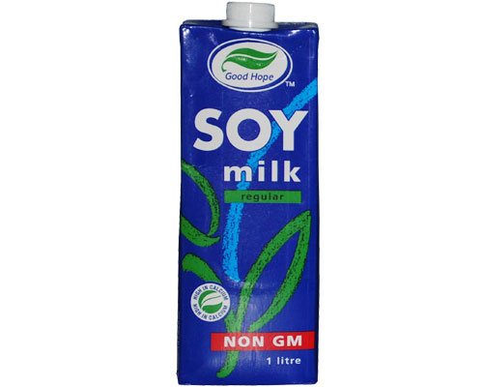
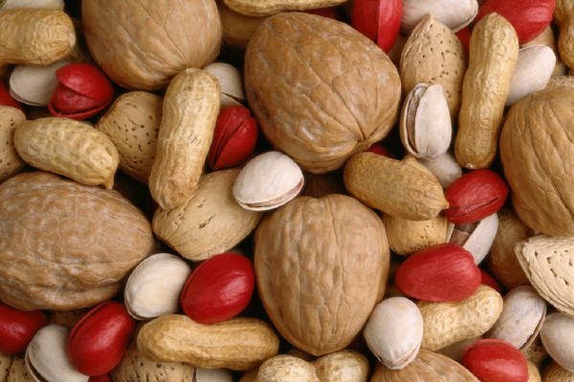
Found in all plant foods and milk

Slide 9
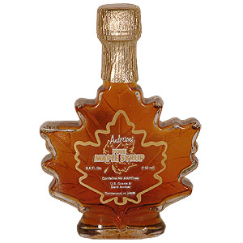
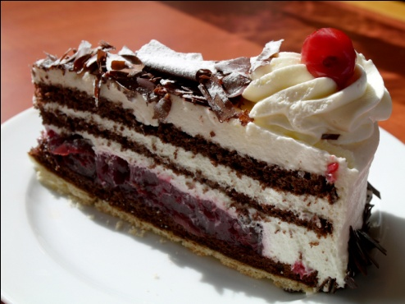
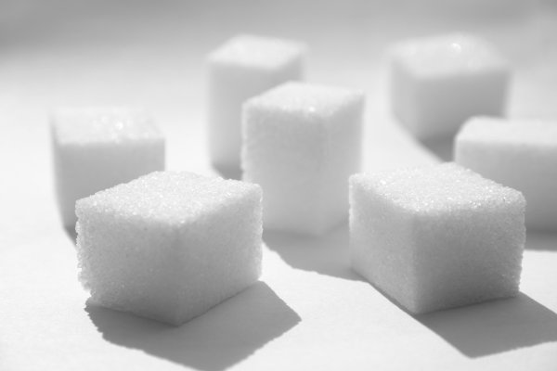

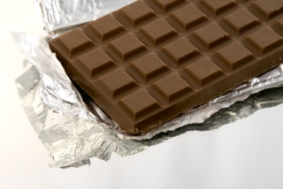
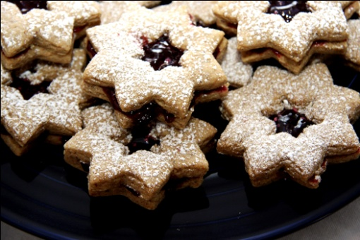

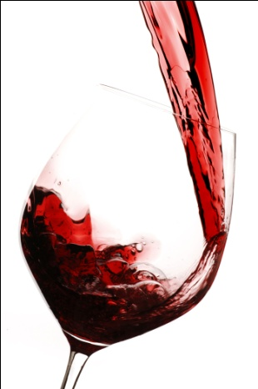
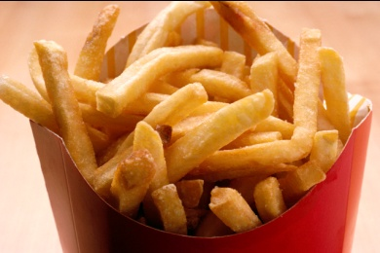
CHO in many foods NOT in a Food Group

Slide 10
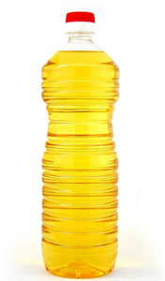
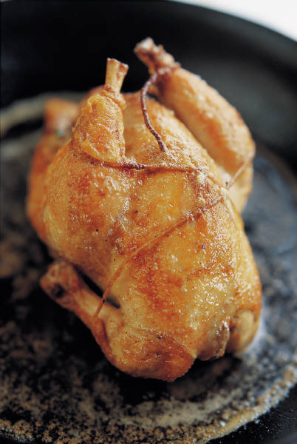
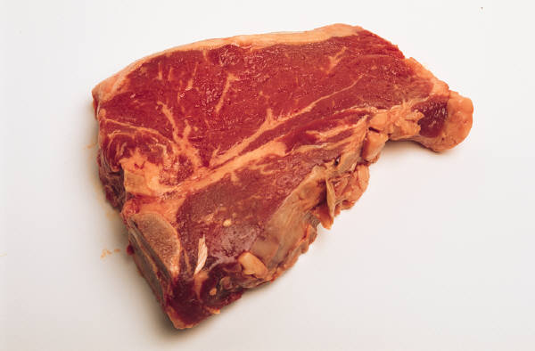
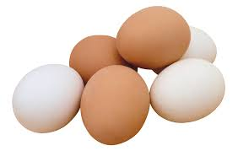
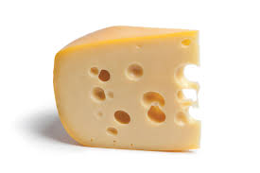
Meat, fish, poultry and fats have ___ CHO
Eggs and Cheese have ____________ CHO

Slide 11
Carbohydrate Terminology
Suffix –ose means carbohydrates
  E.g. Gluc-OSE, fruct-OSE, dextr-OSE
Saccharide = sugar molecule
  Mono-saccharide = ____ sugar molecule
  Di-saccharide = ______ sugar molecules
  Poly-saccharide = _______ of sugar molecules

Slide 12
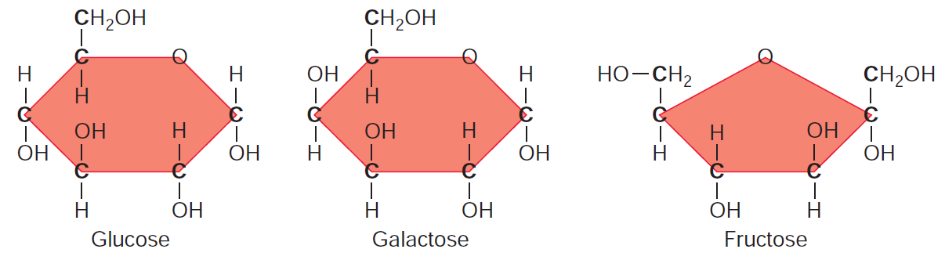
The Monosaccharides
Each contains 6 carbons, 12 hydrogens, and 6 oxygen atoms
Notes:
- Compased of glucose, galactose, fructorse,
- each molecule of them 6 Carbon 12 Hydrogen 6 Oxygen atoms *

Slide 13
Glucose
Glucose circulates in the blood and is the most important carbohydrate fuel for the body
It is produced in plants by the process of _photosynthesis__, which uses energy from the sun to convert carbon dioxide and water into glucose and oxygen
Glucose occurs as a monosaccharide in honey, but is most often part of a disaccharide or starch
Notes:
- major form of nurtient that flows in our blood
- photosynthesis *bank*
- Can find monosacharide in honey, but mostly glucose is found in food as disaccharide, starch or even fibre

Slide 14
Fructose
Is a monosaccharide that tastes sweeter than glucose
It is found in _fruits & veggies_______, and makes up more than half the sugar in honey
It does not cause a great rise in blood _glucose level__
Most of the fructose in our diets comes from high-fructose corn syrup – this is sweeter and less expensive than table sugar

Slide 15
Galactose
Rarely present as a monosaccharide in the food supply, but occurs most often as part of _lactose____, the disaccharide in milk

Slide 16
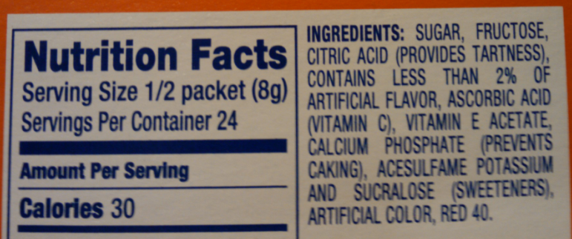
Monosaccharides
Free glucose and fructose found naturally
Basic unit of carbohydrates
Found in honey, fruit, vegetables, and milk
  Ex. glucose, fructose, galactose
Often added as __sweetener___________ sto processed foods
  Ex. glucose, fructose
Notes:
- companies use fructose as a sweetners in products

Slide 17
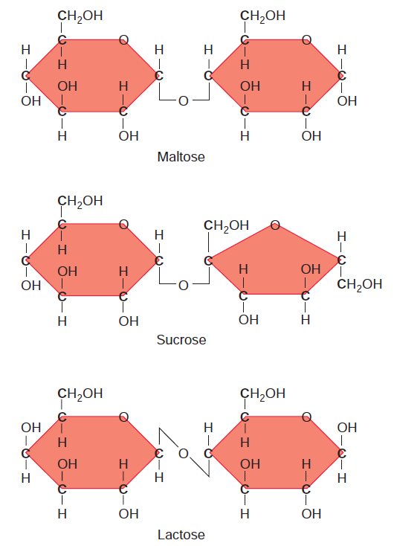
The Disaccharides
= 2 glucose molecules
= 1 glucose, 1 fructose
= 1 glucose, 1 galactose
Notes:
- made of maltose , sucrose, lactose *** must know composition
Maltose = 2 glucse molecules
Sucrose = 1 glucose, 1 fructose
Lactose = 1 glucose, 1 galactose

Slide 18
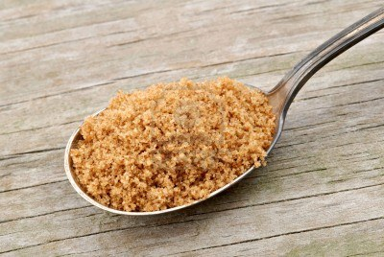
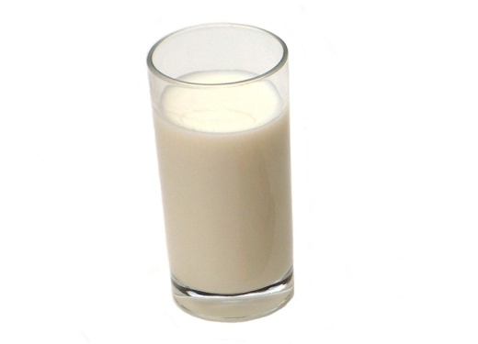
The Disaccharides
Two monosaccharides linked together
Sucrose = __table sugar_____________
Ingredient “Sugar” = sucrose
Maltose is naturally found in __beer______
Maltose is used as a food additive
Lactose is __milk sugar_________ sugar
Lactose is less sweet than sucrose

Slide 19
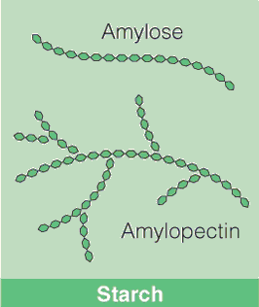
Starch is Plant Energy Storage
A class of polysaccharides
LONG strings of __monosaccharides_________________
  Straight – amylose
  Branched – amylopectin
Storage form of carbohydrates for plants
Lots of starch in grains, potatoes, & legumes
Notes:
- Two types of starch structures, amylose (linear), amylopectin (branched) **must know**

Slide 20
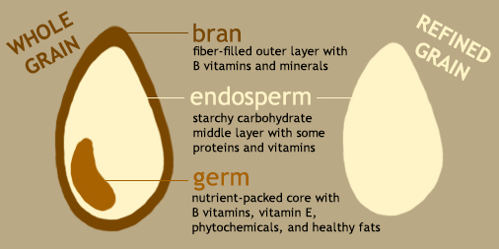
Whole Grains versus Refined Grains
FYI ONLY
Notes:
- Bran layers, germ, endosperm ***must know**

Slide 21
Whole grains versus Refined Grains
Whole grains:
Bran layers: good source of fiber and vitamins
Germ: good source of vegetable oils and vitamin E
Endosperm: contains starch and some protein
Refined grains (e.g. corn flakes):
Made largely from the endosperm and are mostly starch
May be enriched with thiamin, riboflavin, niacin (__all are vitamin B____________________), and iron
May be fortified with ____folate________

Slide 22
Questions

Slide 23
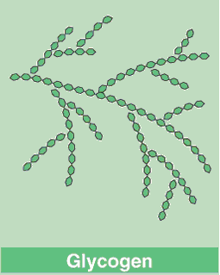
Glycogen
_______________
Animals store glucose as glycogen
Found in liver and muscle
Liver - Keeps blood glucose levels stable
Muscle- Fast energy for exercise
_NOT________ a dietary source of carbohydrate
Notes:
- Way we store glucose in body, both animals and humans
- NOT a dietary source *blank*
- You can NOT eat glycogen

Slide 24
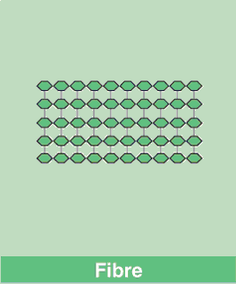
Fibre
A class of _polysaccahrides____________
Often made of glucose but can be other monosaccharides
Provides structure_to the leaves, stems and seeds of plants
Lots in whole grains, vegetables, fruit and seaweed
Cannot be digested by enzymes our bodies produce

Slide 25
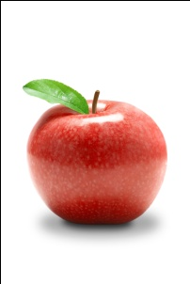
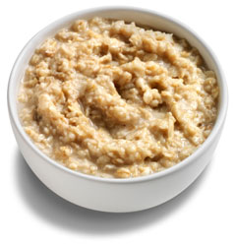
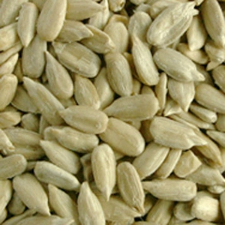
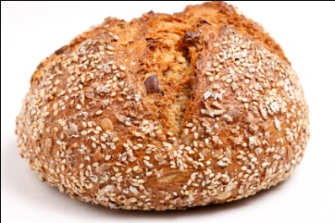
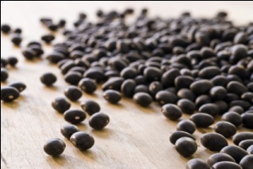
Types of fibre
_soluble____ fibre
_insoluble____________ fibre
Absorbs water
Often used as gelling agents or thickeners
Pectins, gums, mucilages
High in oatmeal, beans, oat bran, barley, apples, legumes
Digested by bacteria in our large intestine
Does not absorb water
Give stiff structure to plants
Cellulose, hemicellulose, lignin
Found in whole grains, wheat and rye bran, fruit skins and seeds
Unable to be digested by bacteria; excreted out of the body
Notes:
Water soluble fibre can be fermented
Insoluble fibre cannot be fermented will be excreted

Slide 26
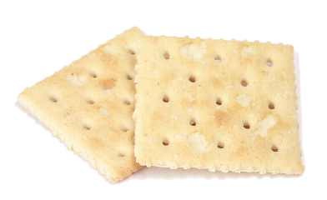
Carbohydrate Digestion
Starts in the __MOUTH_____ – salivary amylase
  Salivary amylase breaks starch into glucose and smaller polysaccharides

Slide 27
__NO_____ carbohydrate digestion happens in the stomach

Slide 28
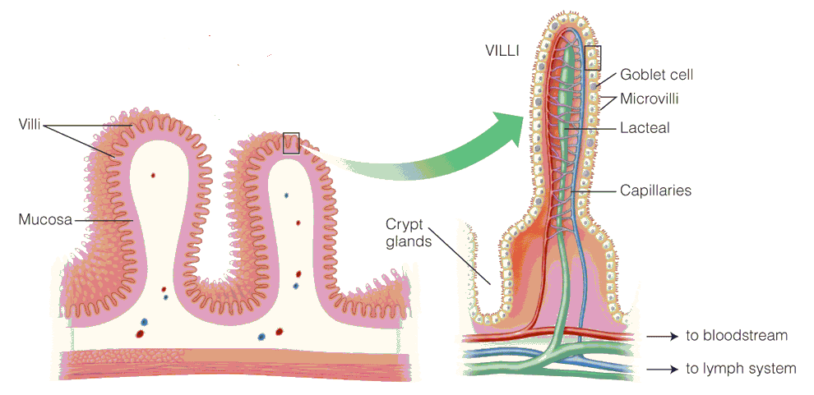
Carbohydrate Digestion
Small intestine:
  Pancreatic ____amylase________
    starch glucose and maltose
  _sucrase – sucrose
  _maltase – maltose
  _lactase – lactose
glucose and fructose
2 glucose molecules
glucose and galactose
Notes:
- Panceratic AMylASTE (will break down starch into glucose and maltose(

Slide 29
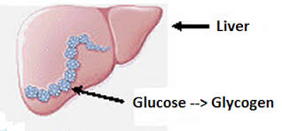
Carbohydrate absorption
Monosaccharides intestinal cells blood
The blood delivers them to the liver
  All monosaccharides hepatic portal system
  Glucose can be burned for energy or stored as glycogen in the liver

Slide 30
Glucose utilization
Glucose is metabolized via cellular respiration to produce ATP
  ATP – the energy currency of cells
Cellular respiration occurs within each cell, via the ___mitochondria____

Slide 31
Questions

Slide 32
Question
Which of the following sequences represents a __________________________________________________________________________?
a)
b)
c)
d)

