Slide 1
What is a service?
Notes:
What are these Four key characteristics?

Slide 2
I-ntangibility
H-eterogeneity
I-nseparability
P-erishability
Notes:
What are these Four key characteristics?

Slide 3
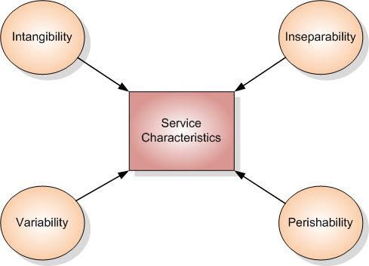
Current Paradigm-IHIP
Four key characteristics make service uniquely different from goods
Are they grounded in empirical research or they merely theoretical constructs open to ambiguous interpretation?

Slide 4
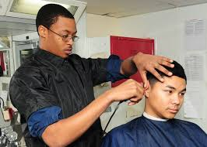
Intangibility
Physical Intangibility: cannot be touched
Mental Intangibility: the degree to which a product can be visualized and provide a clear and concrete image before purchase
“The crucial point about services is that they are doubly intangible”
Intangibility: Services cannot be seen, tasted, felt, heard, smelled or evaluated before purchase
Does that mean that goods are easier to evaluate than services?

Slide 5

Tangible nature of service experience
The appearance of physical facilities, equipment, personnel and communication materials are key dimensions of service quality
The “servicescape”

Slide 6
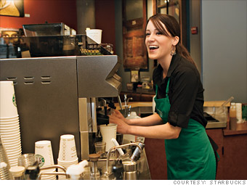
Variability
A characteristic of labor-intensive services
At present, there is a trend towards replacing labor by automation to improve productivity and achieve standardization in service delivery
So, is variability as much of a problem as we have come to think?

Slide 7
Inseparability
Production and consumption of services is simultaneous.
  Presence of customer during service delivery and the customer’s role as co-producer
Separable services and Inseparable services
  Simultaneity of production and consumption is a characteristic of inseparable services
Notes:
Partial employees, perform self service

Slide 8
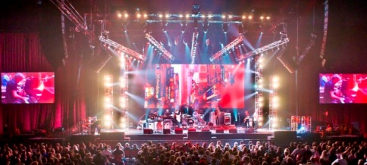
Perishability
Service firms cannot produce for inventory and sell their products later
What about musical performances, entertainment, religious services and news that can be recorded for subsequent use?
What about Just-in-time inventory?

Slide 9
So…what’s the verdict?...
So when is IHIP applicable and when not?
The claim that services are uniquely different from goods on the IHIP characteristics is only true for certain types of services

Slide 10

Non-ownership

Slide 11
A New characteristic: Non-ownership
Marketing transactions that do not involve a transfer of ownership are distinctively different from those that do
If customers do not receive ownership when they purchase a service, then what are they buying?
Services involve a form of rental or access
Value is created when service customers benefit from obtaining desired experiences and solutions

Slide 12
Broad categories within the ownership framework
Rented goods
Defined space and place rentals
Labor expertise rentals
Access to shared physical environments
System and network access

Slide 13
Services Defined

Slide 14
Services defined
Services are economic activities offered by one party to another, most commonly employing time based performances to bring about desired results in recipients.
In exchange for their money, time, and effort, service customers expect to obtain value from access to goods, labor, professional skills, facilities, networks, and systems, but they normally do not take ownership of any physical element involved
Where does value come from?
  Value comes from access to a variety of value creating elements rather than from transfer of ownership

Slide 15
Task
Work with the person sitting next to you
Plot these following products on the spectrum
  Airline
  Teaching
  Consulting
  Full service restaurant
  Fast food outlet
  Cars
  XBOX
  Cosmetics
  Ketchup
  Boxed Matches
  Cricket Bat

Slide 16
The Tangibility Spectrum
Tangibility spectrum
  Products defined as goods are arrayed on the tangible-dominant half of the spectrum and products defined as services on the intangible dominant half
  Pure goods and pure services lie at the extremities

Slide 17
Transformation from product to service orientation

Slide 18
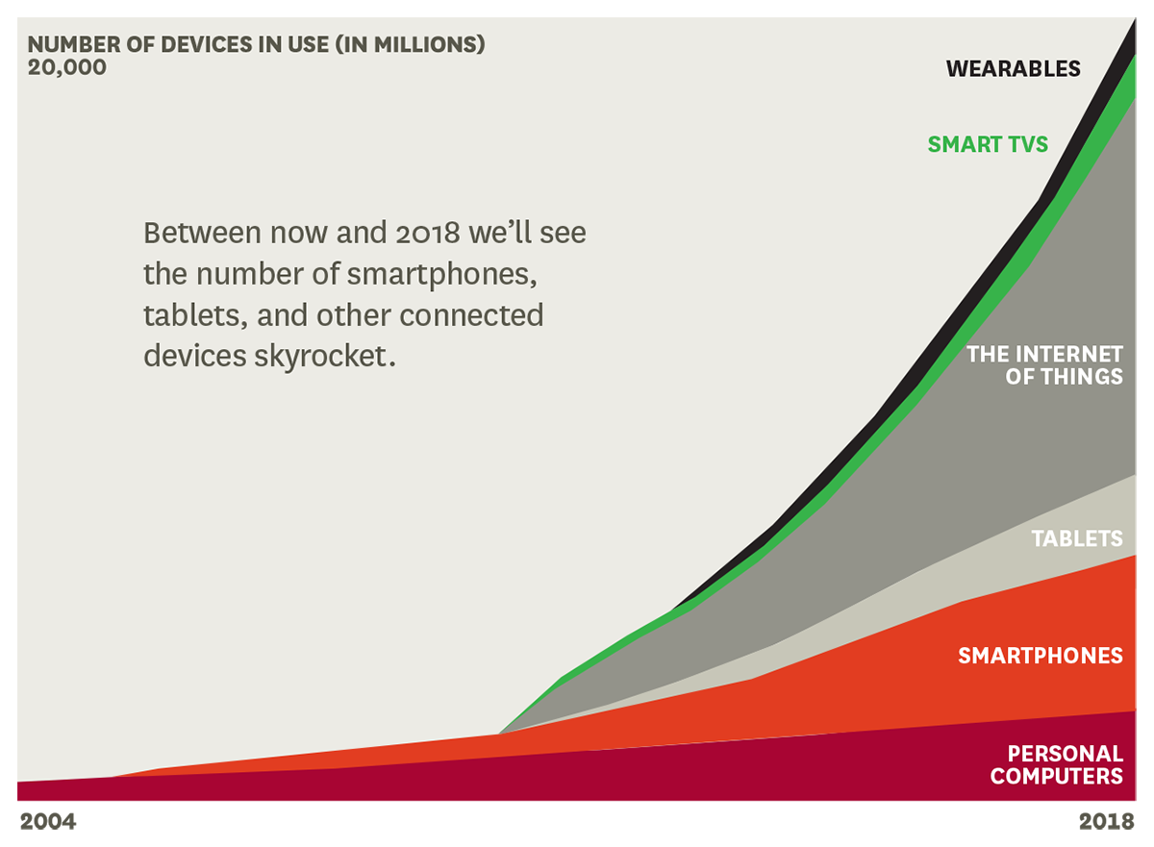
An Explosion in Connected Devices

Slide 19
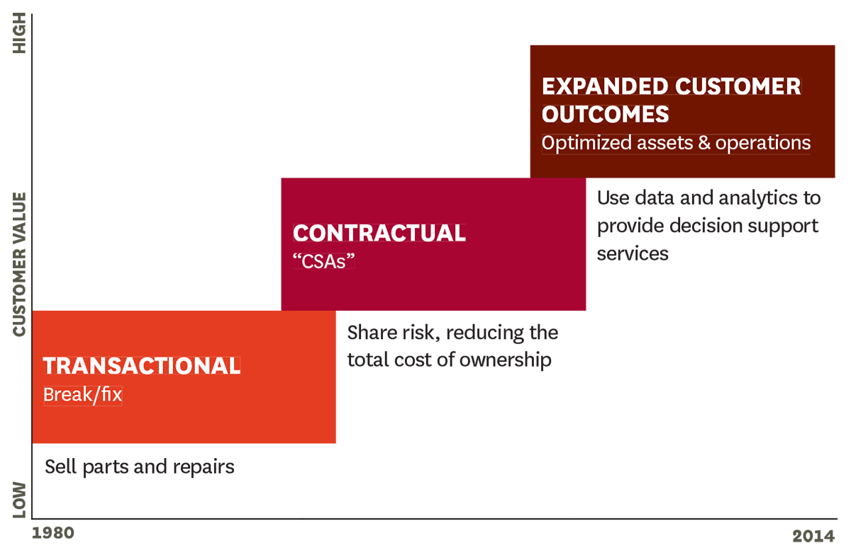
The Evolution of GE Service Models

Slide 20

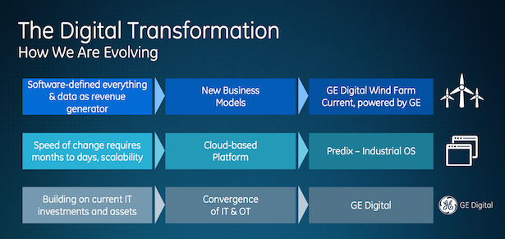
General Electric
Notes:
Earlier this year GE launched its first new business unit in 75 years , GE Digital, and it is quite exciting. We’ve all heard terms like “the Internet of things” and “digital transformation,” but few really know what these little catchy phrases actually mean. In its global strategic alliance with EY, General Electric seems to have a very solid answer. In short, the answer is the strategic utilization of Web-based technology to optimize ‘old-world’ equipment.
https://www.ge.com/digital/blog/hbr-ge-revolutionary-evolution
https://www.cnbc.com/2016/06/07/heres-how-ge-is-using-software-to-change-its-business-model.html
https://www.forbes.com/sites/advisor/2016/06/20/how-general-electric-is-transforming-itself/
http://deloitte.wsj.com/cio/2017/02/28/ges-digital-transformation-journey/

