Slide 1
ENGR 245 Mechanical Analysis Lesson 1
Introduction
Vectors

Slide 2
Learning objectives
Know the definition of scalars and vectors.
To be able to manipulate vectors.
To be able to express a vector and its properties in terms of its scalar components in two or three dimensions.
To be able to determine a vector’s magnitude and direction.
To be able to use the various vector products.

Slide 3
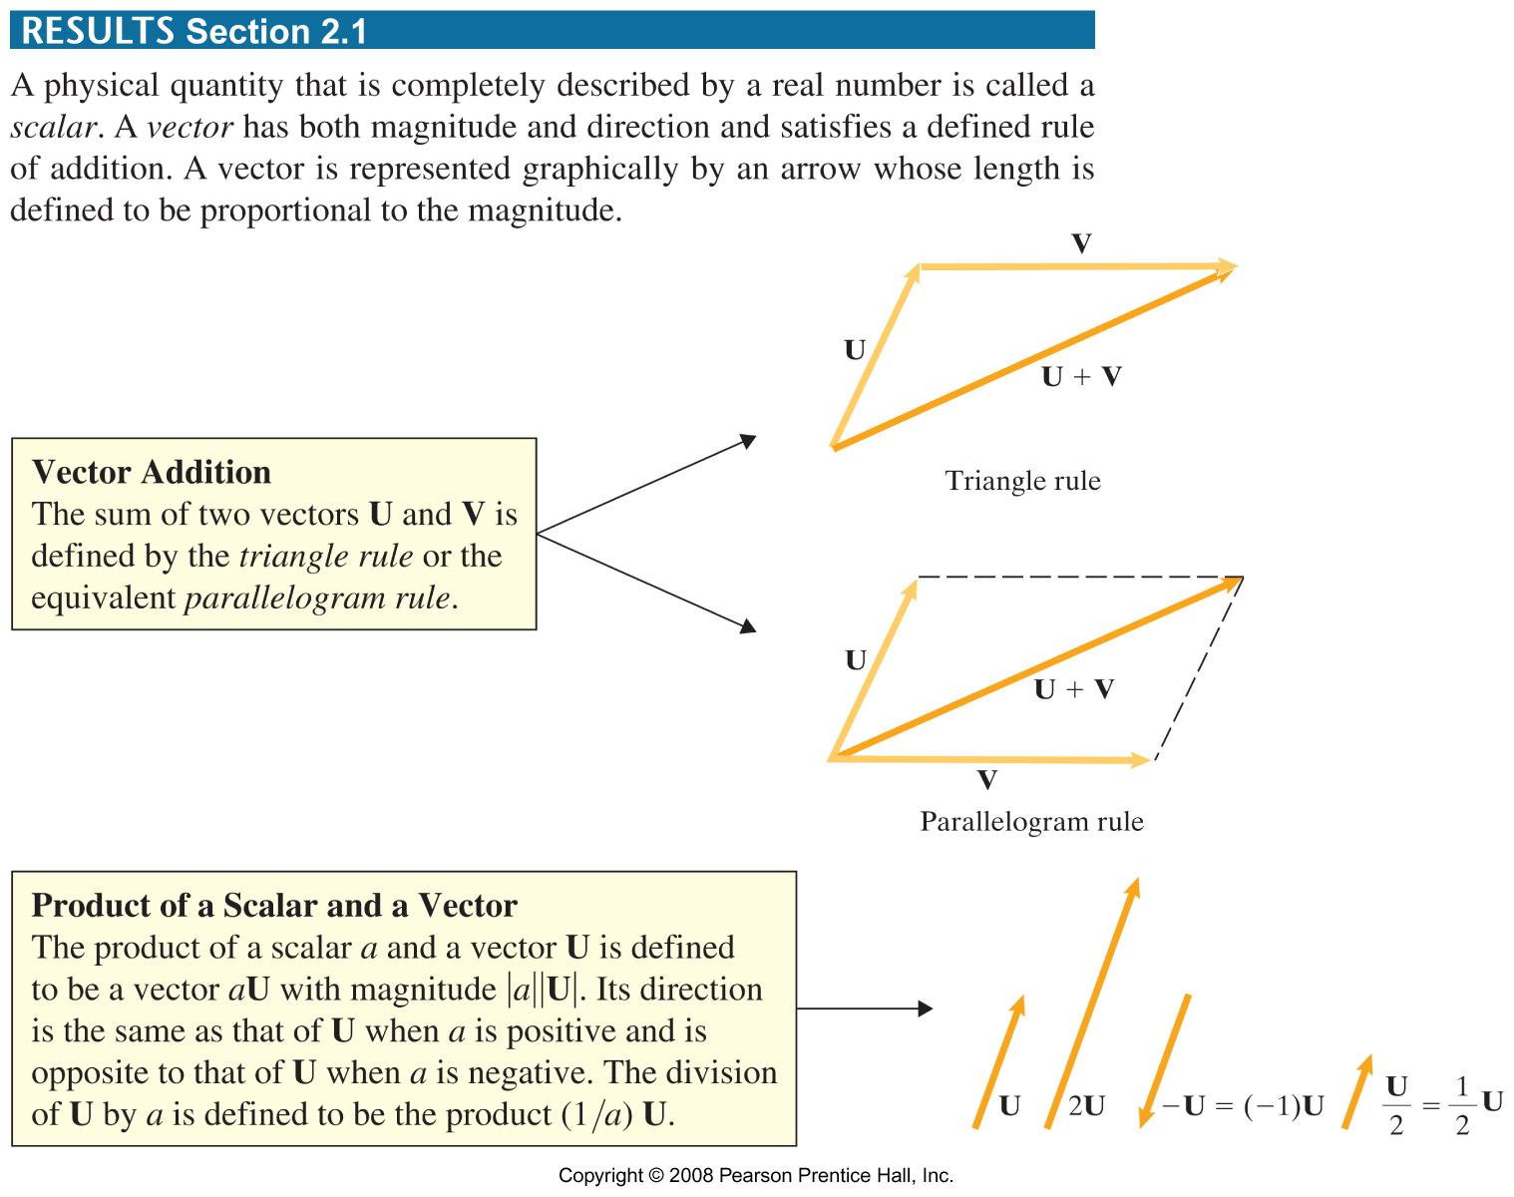
Results 2.1A

Slide 4
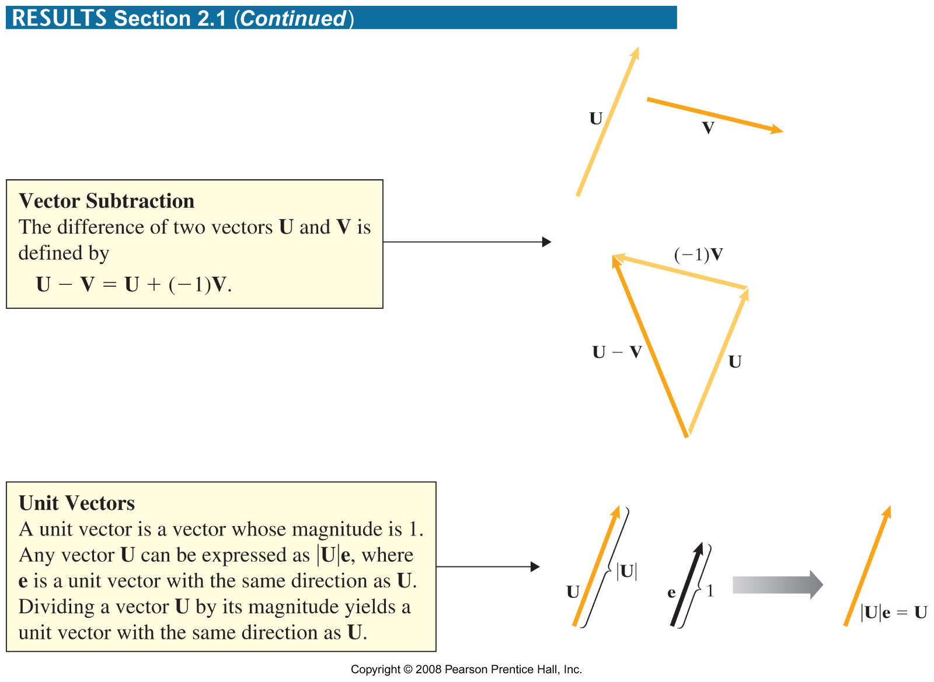
Results 2.1B

Slide 5
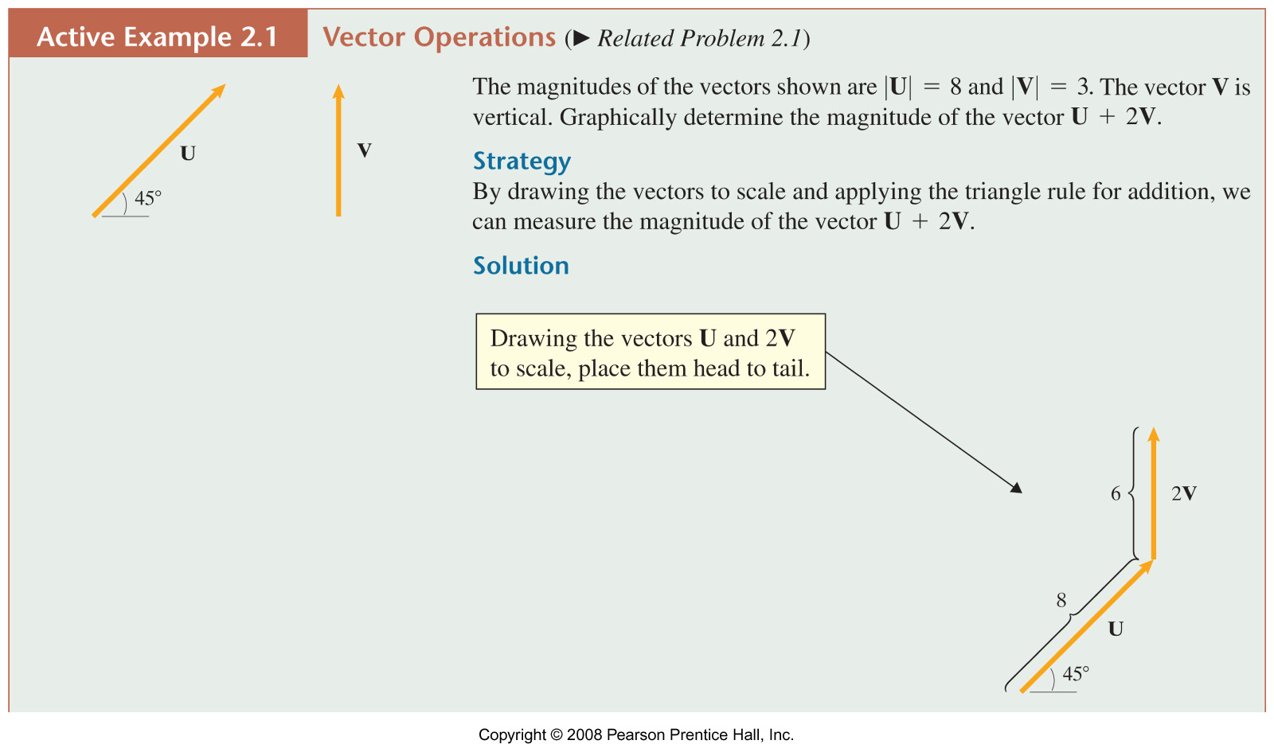
Example 2.1A

Slide 6
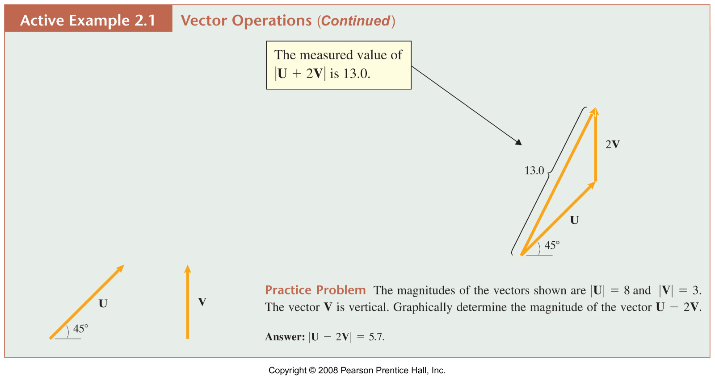

Slide 7
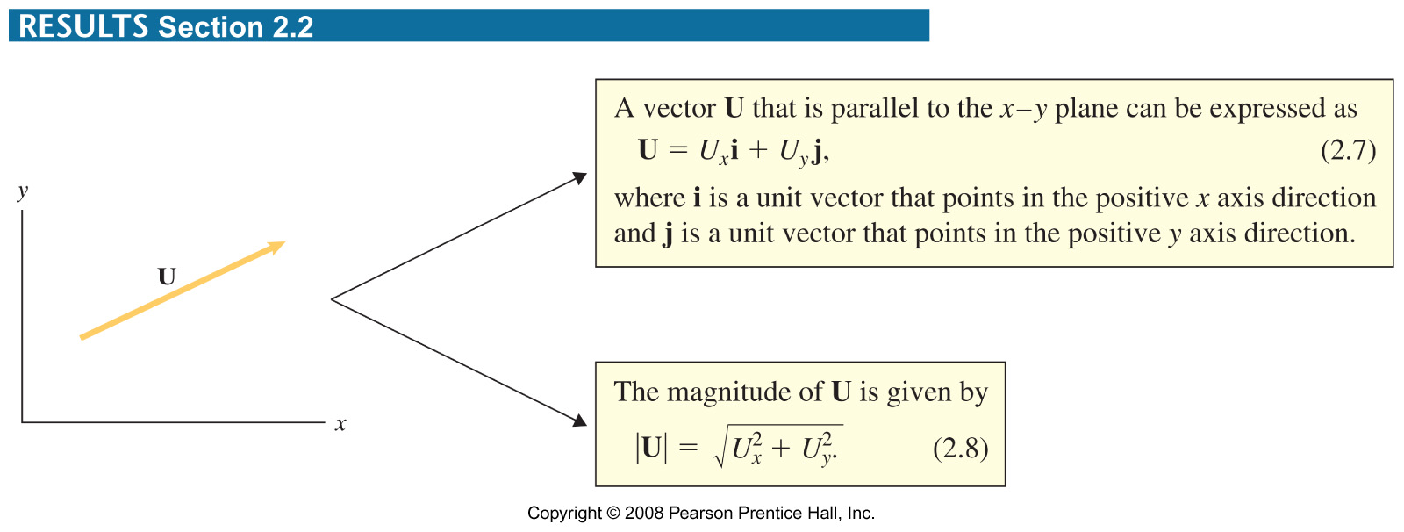

Slide 8
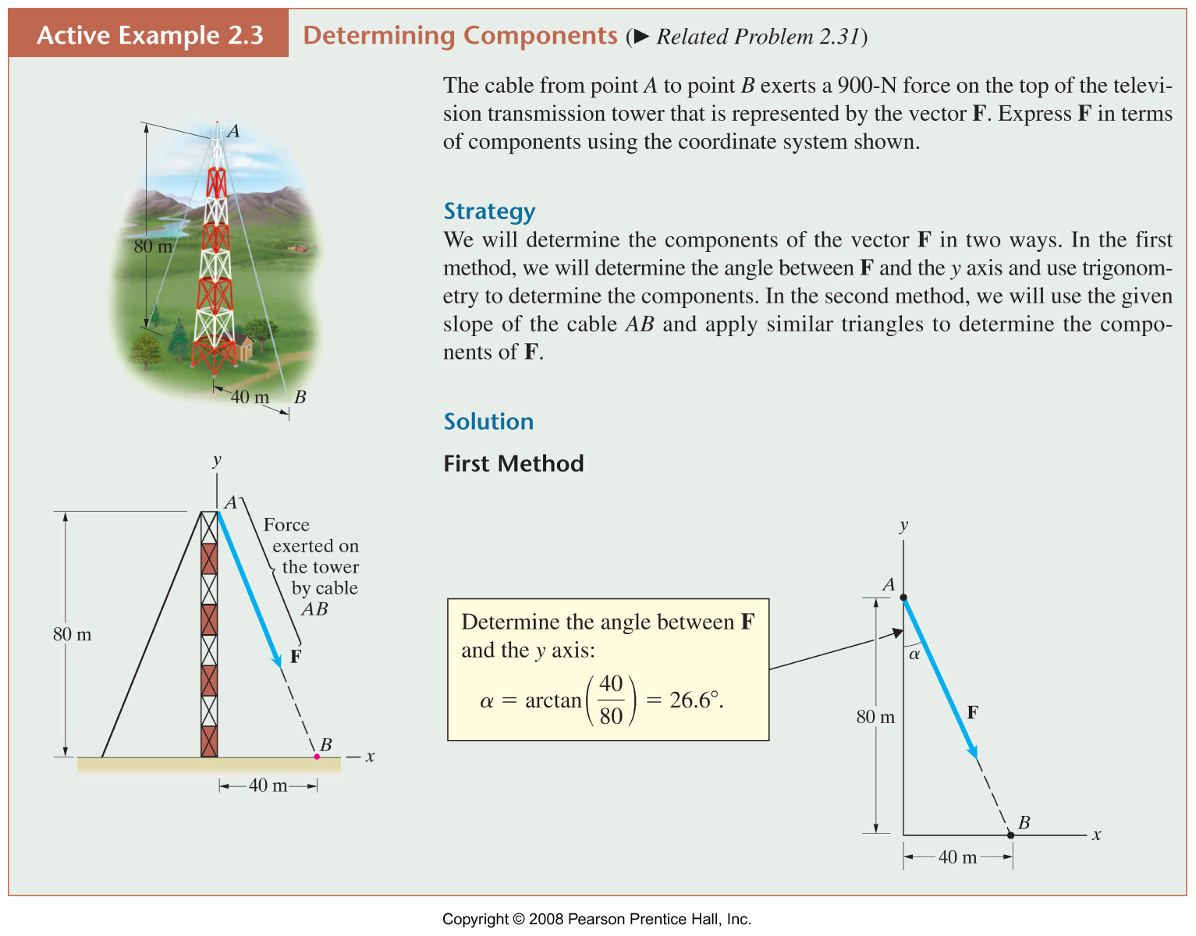
Example 2.3A

Slide 9
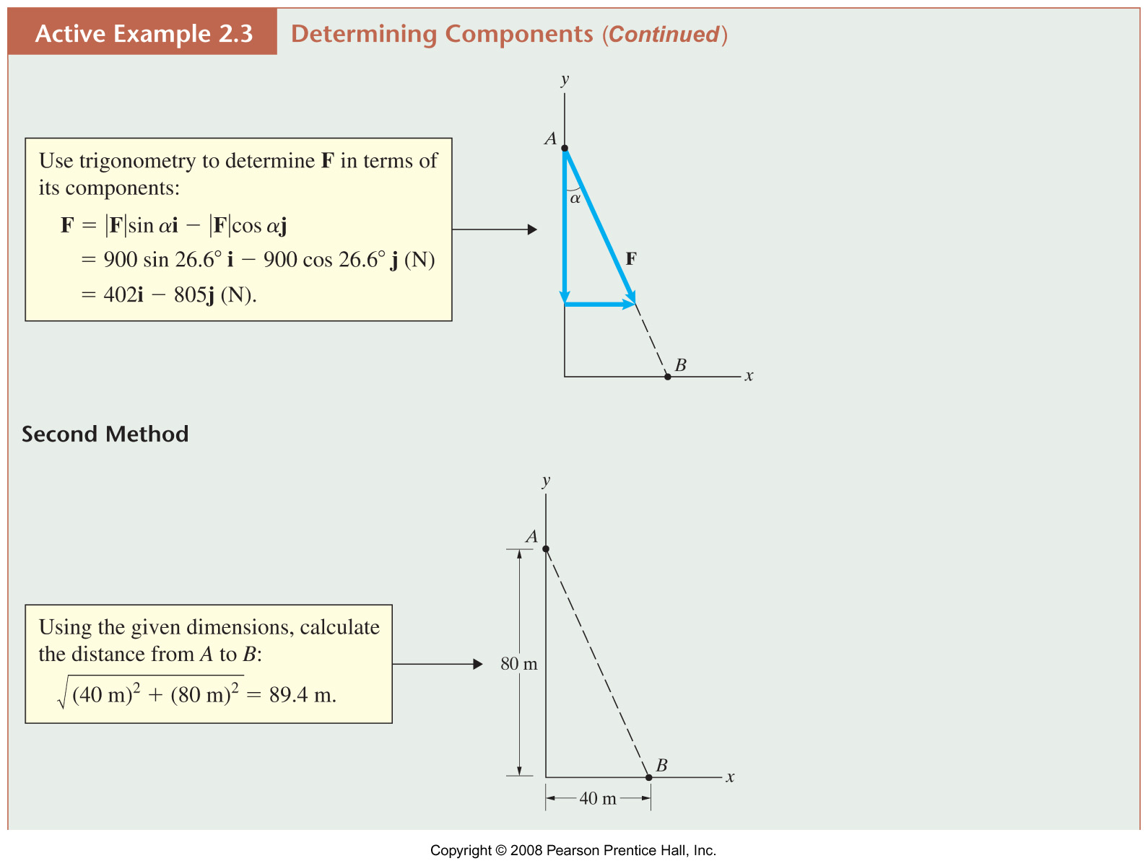
Example 2.3B

Slide 10
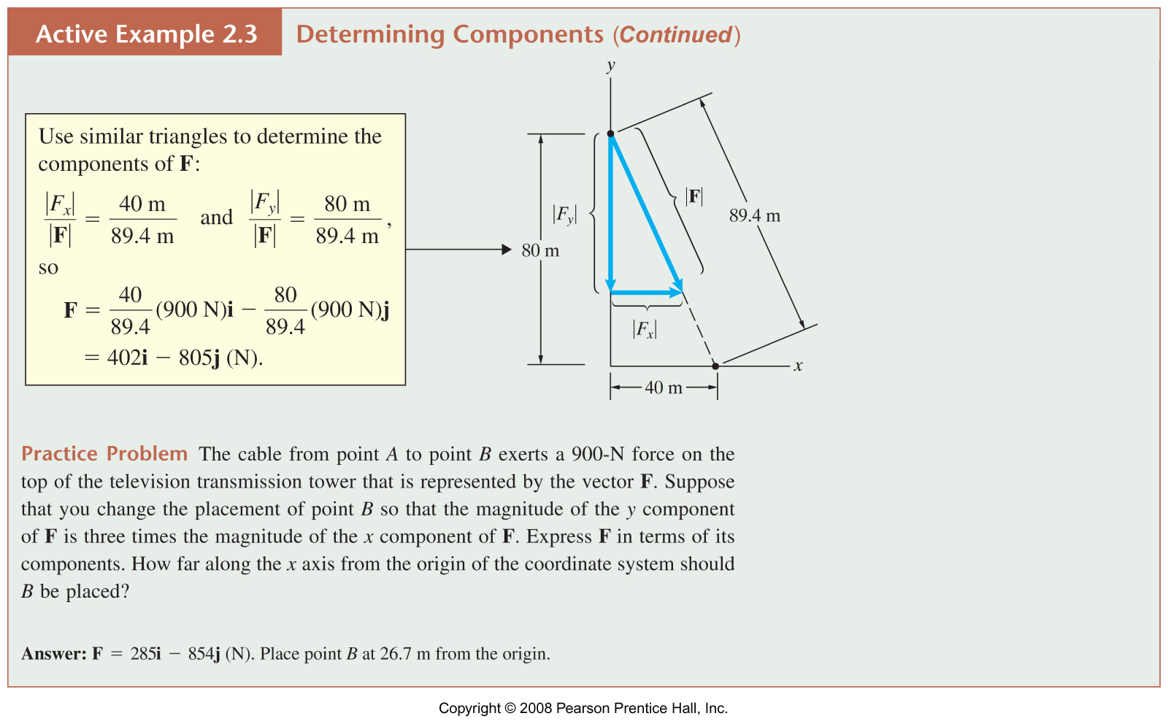
Example 2.3C

Slide 11
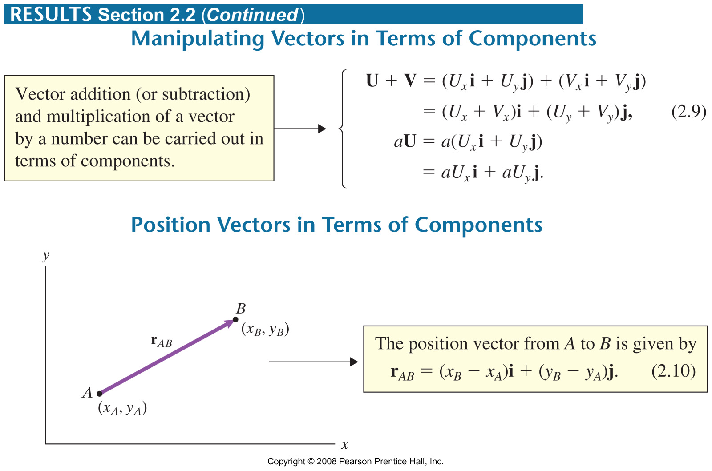

Slide 12
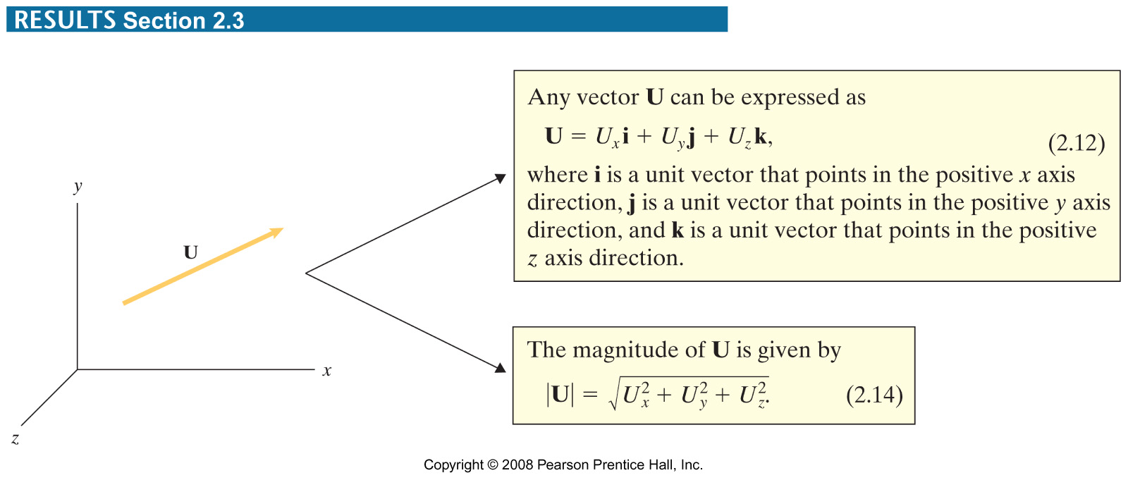

Slide 13
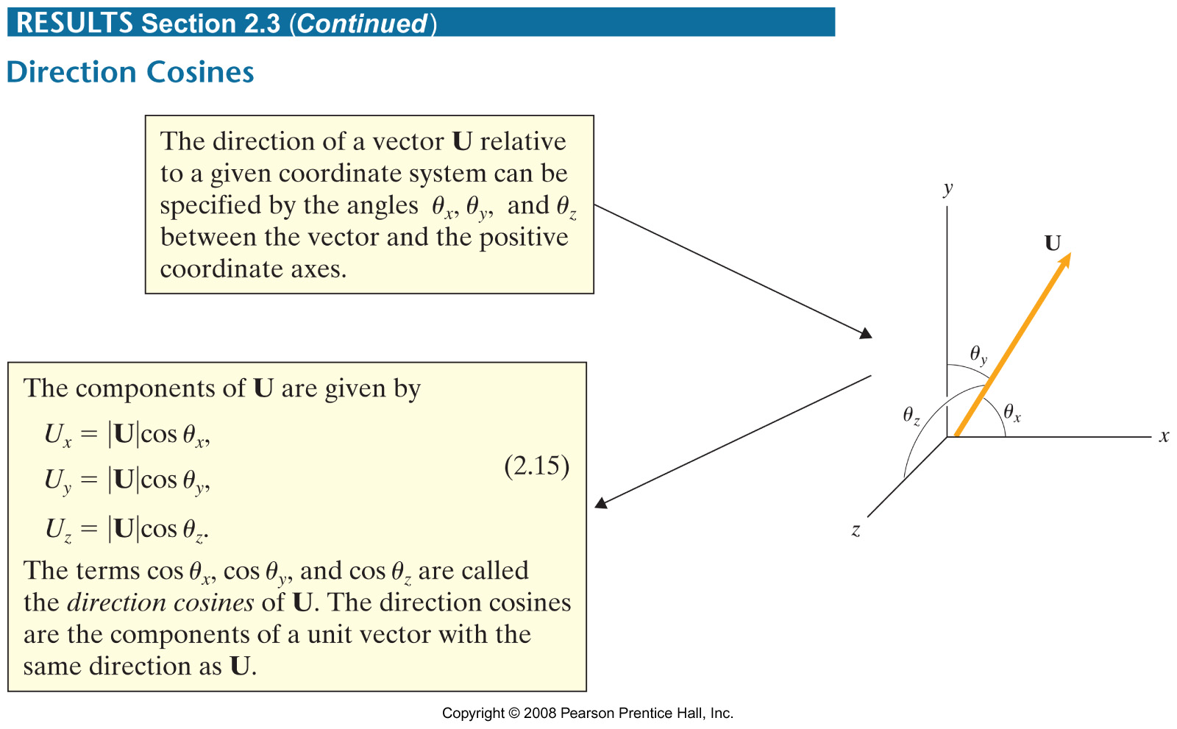

Slide 14
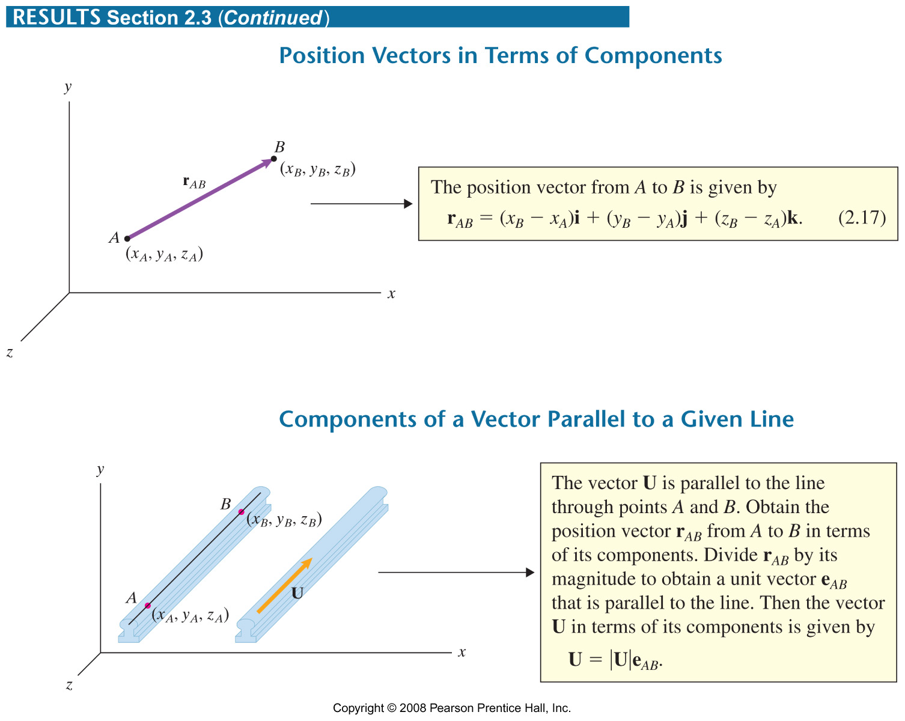

Slide 15
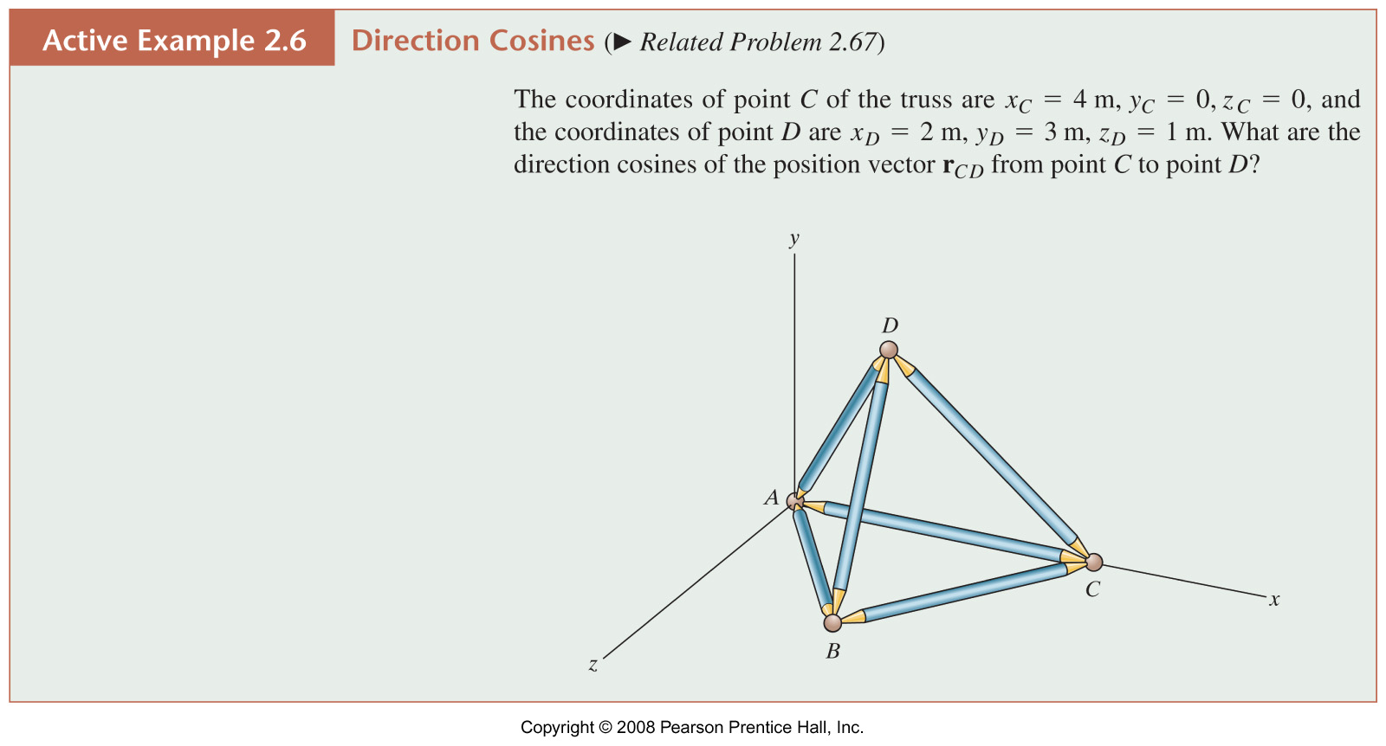

Slide 16
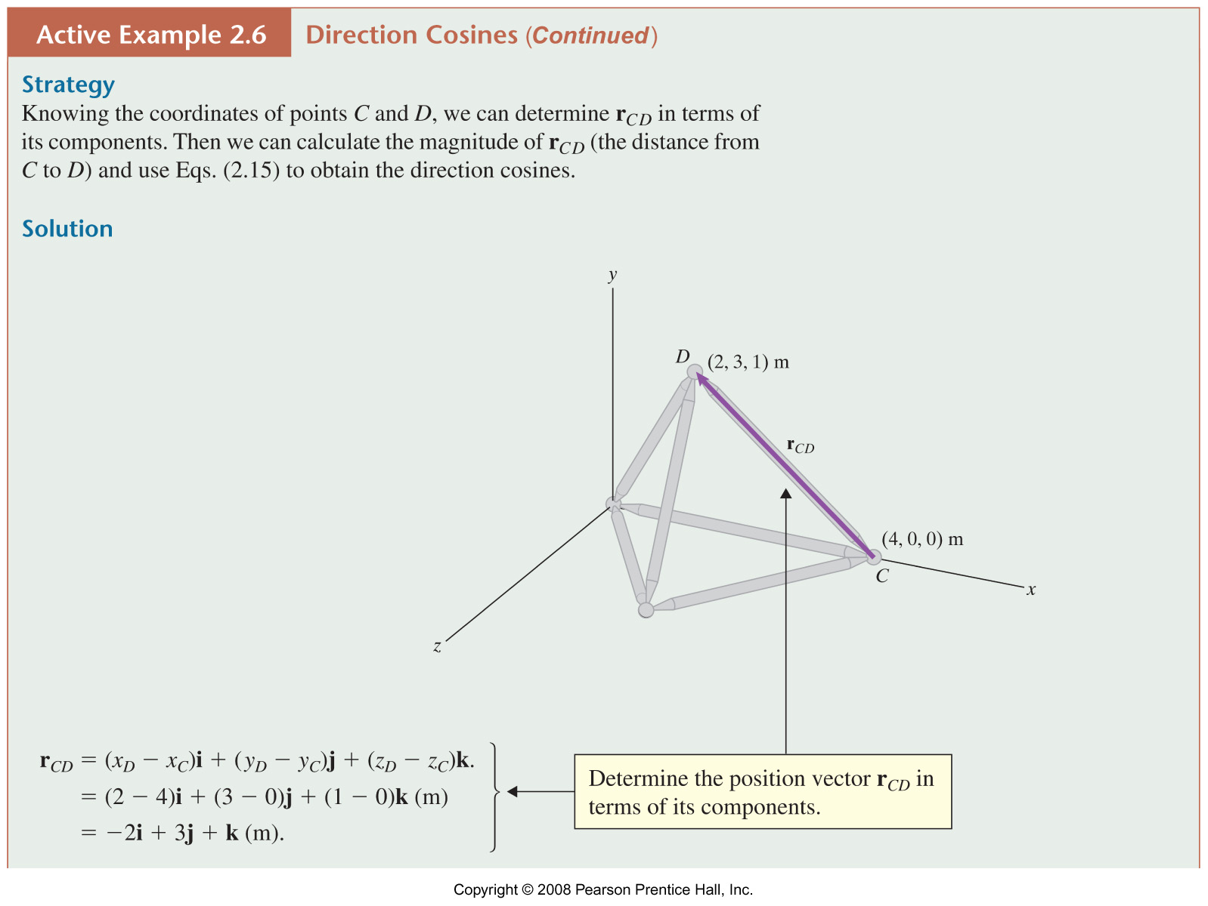
Example 2.6B

Slide 17
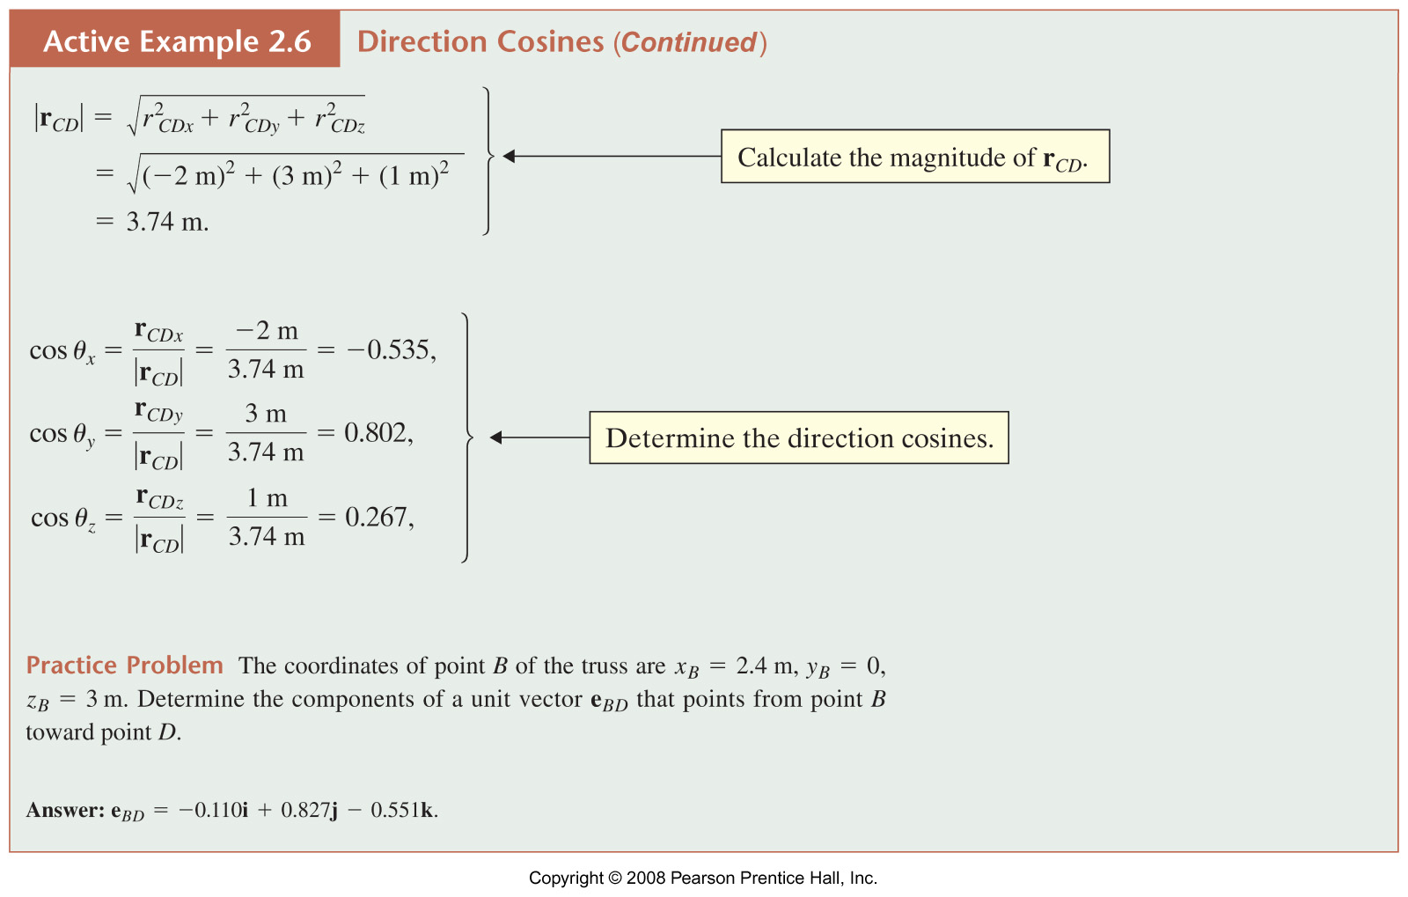
Example 2.6C

Slide 18
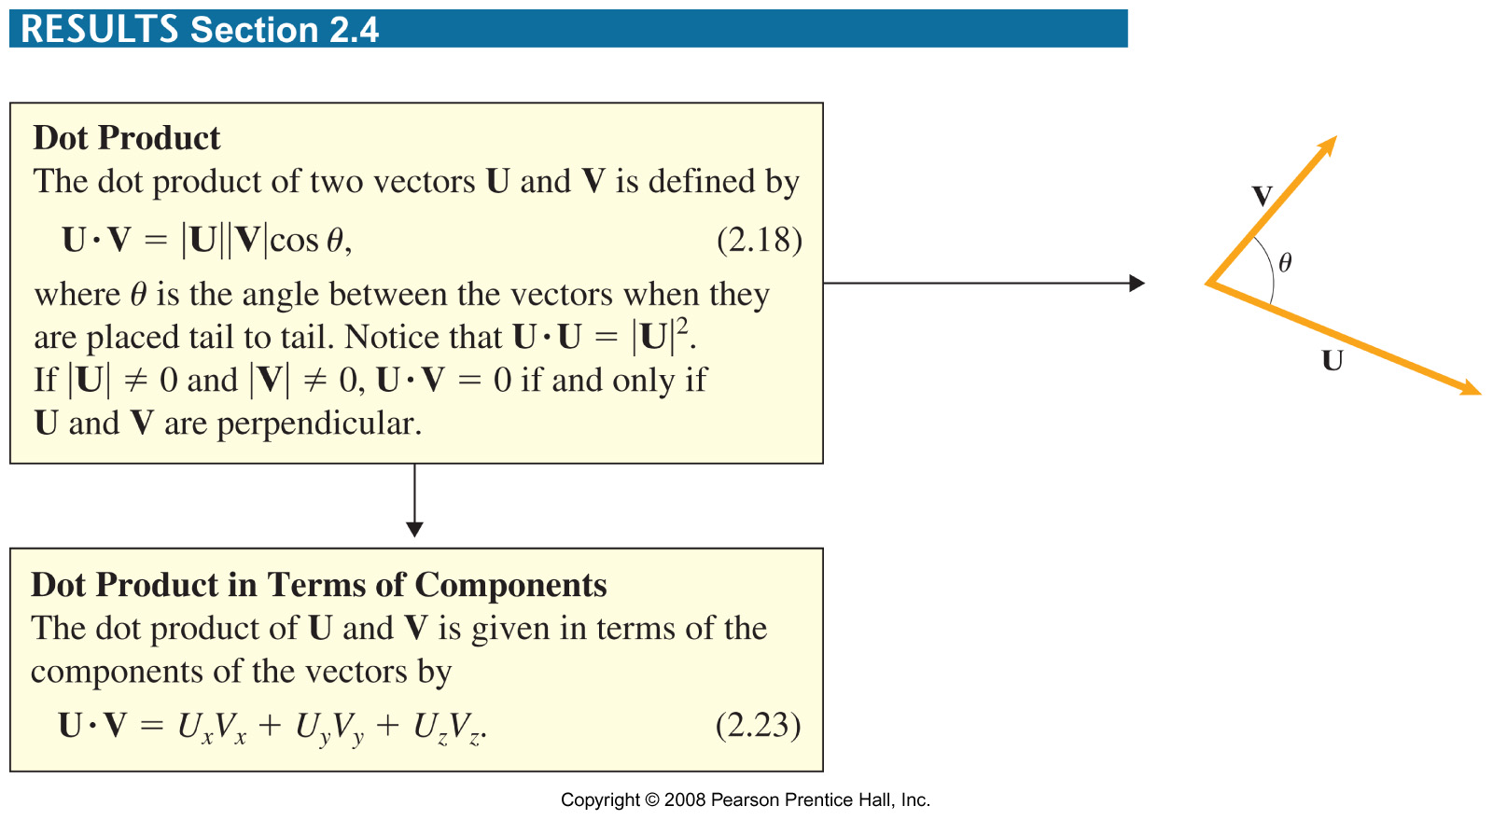

Slide 19
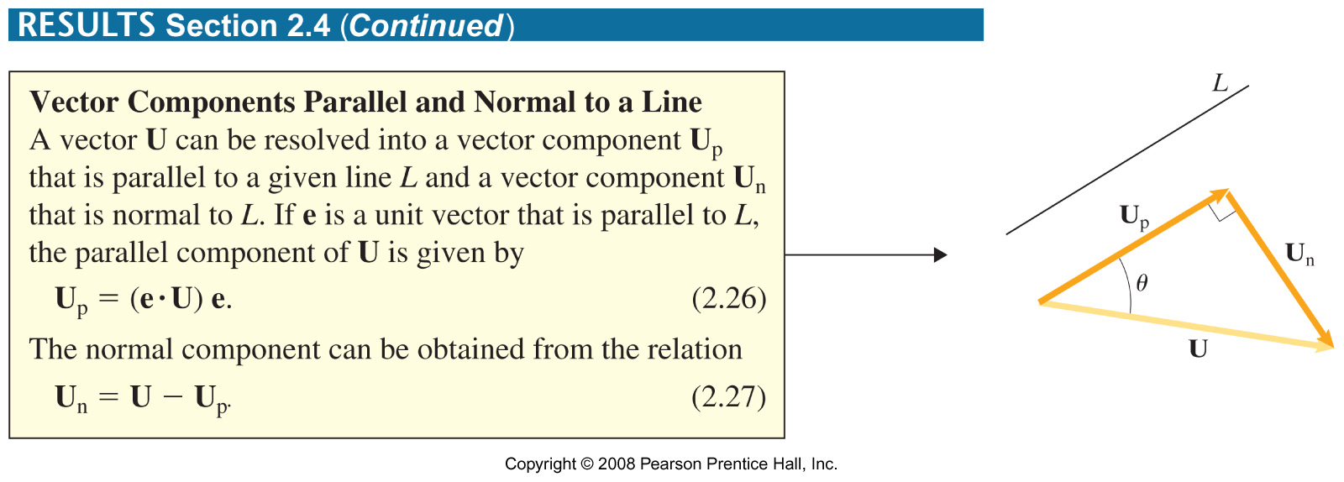

Slide 20
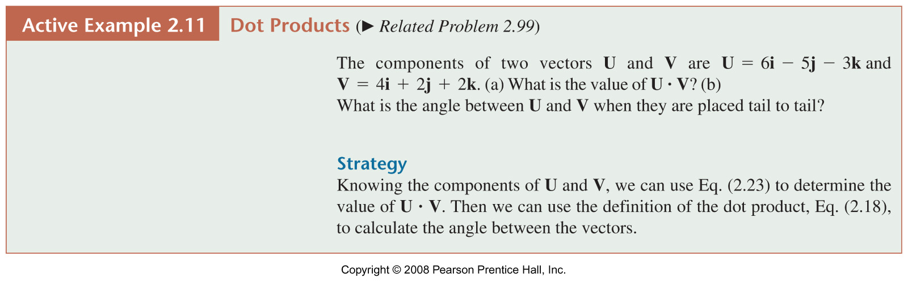

Slide 21
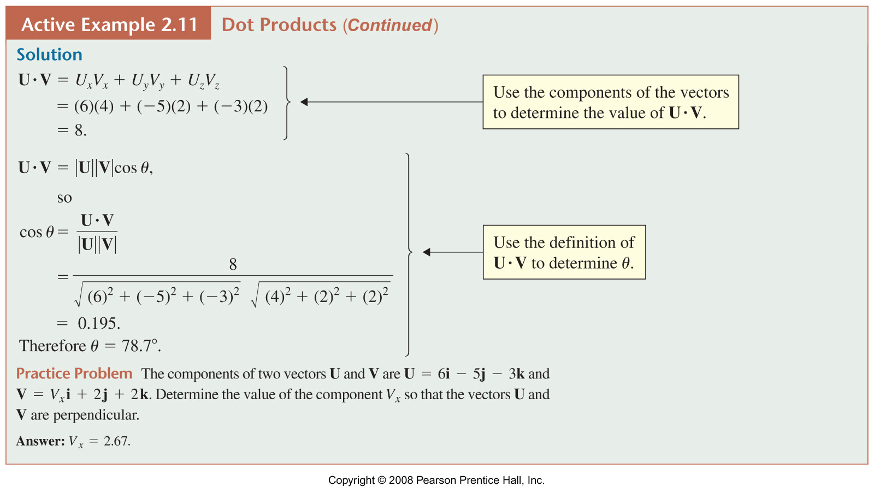

Slide 22
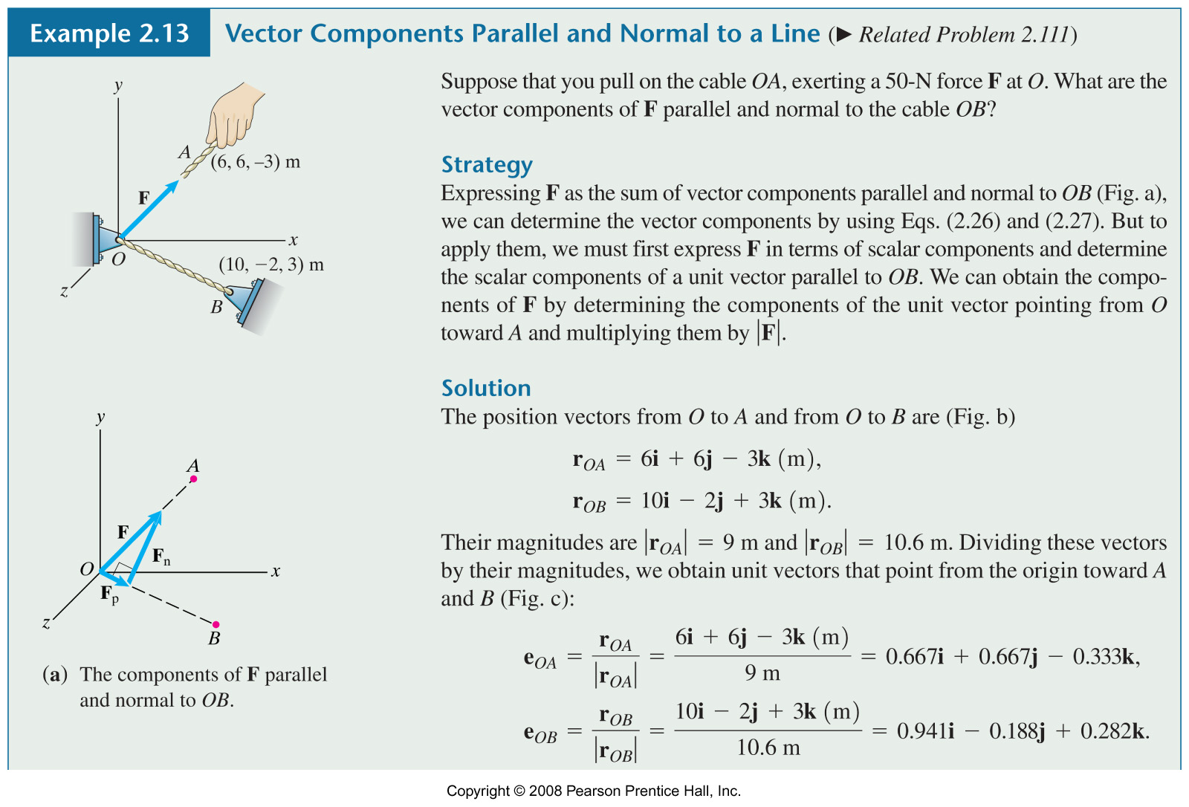
Example 2.13A

Slide 23
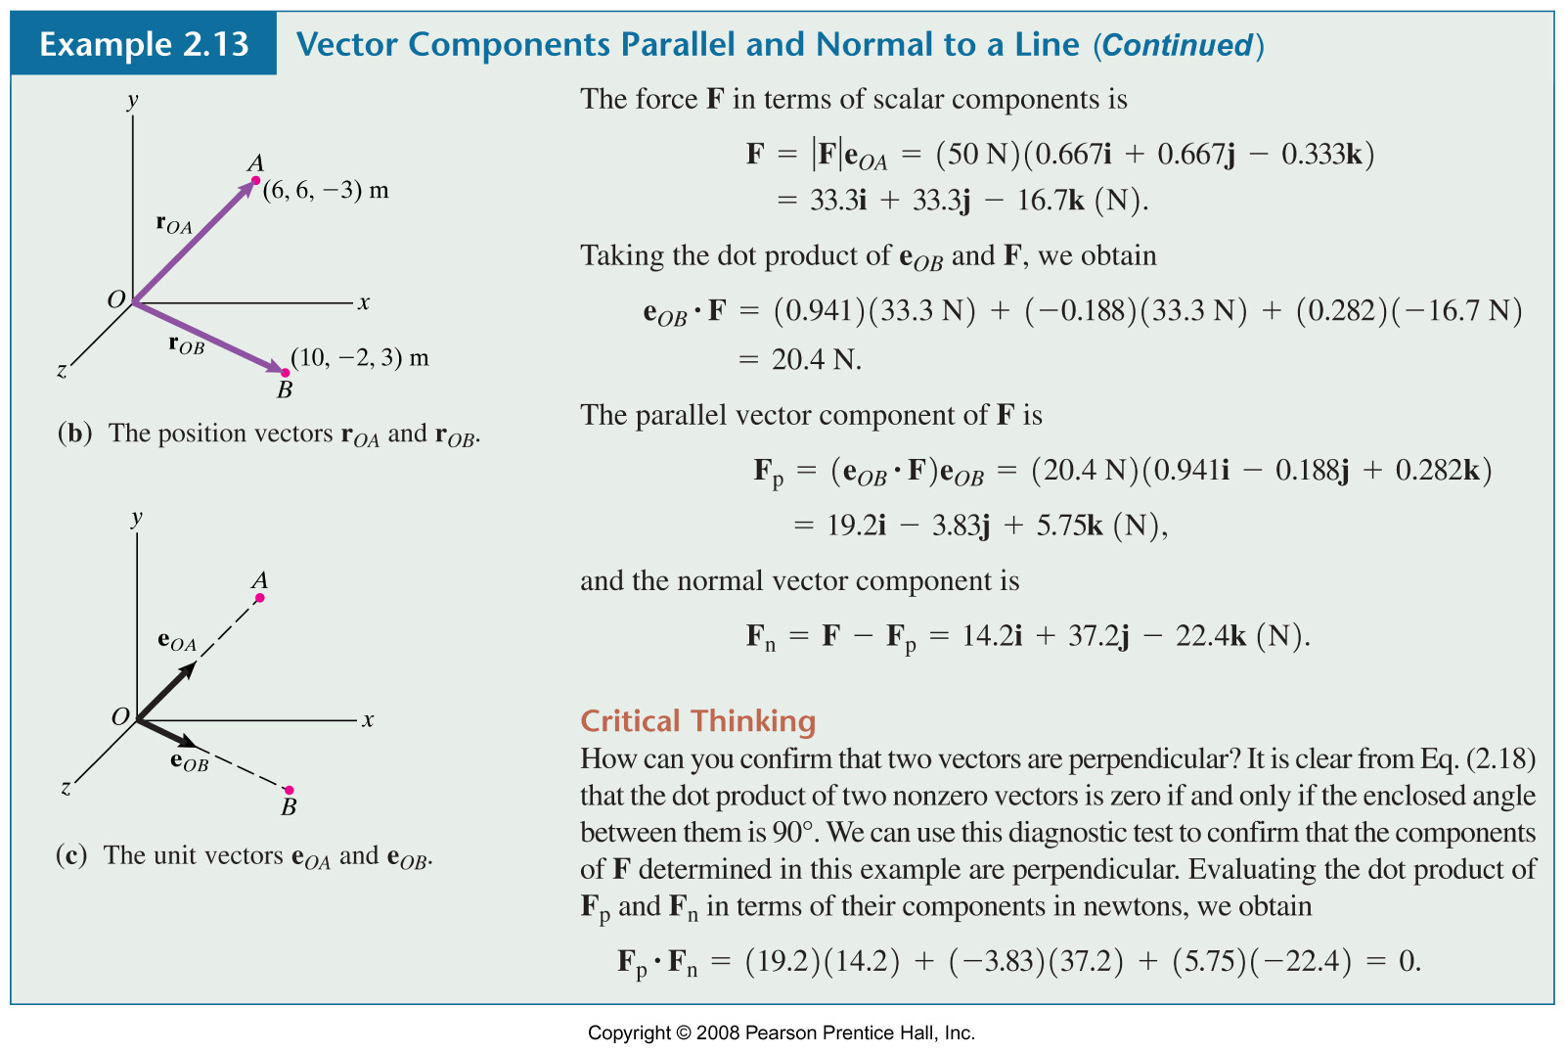
Example 2.13B

Slide 24
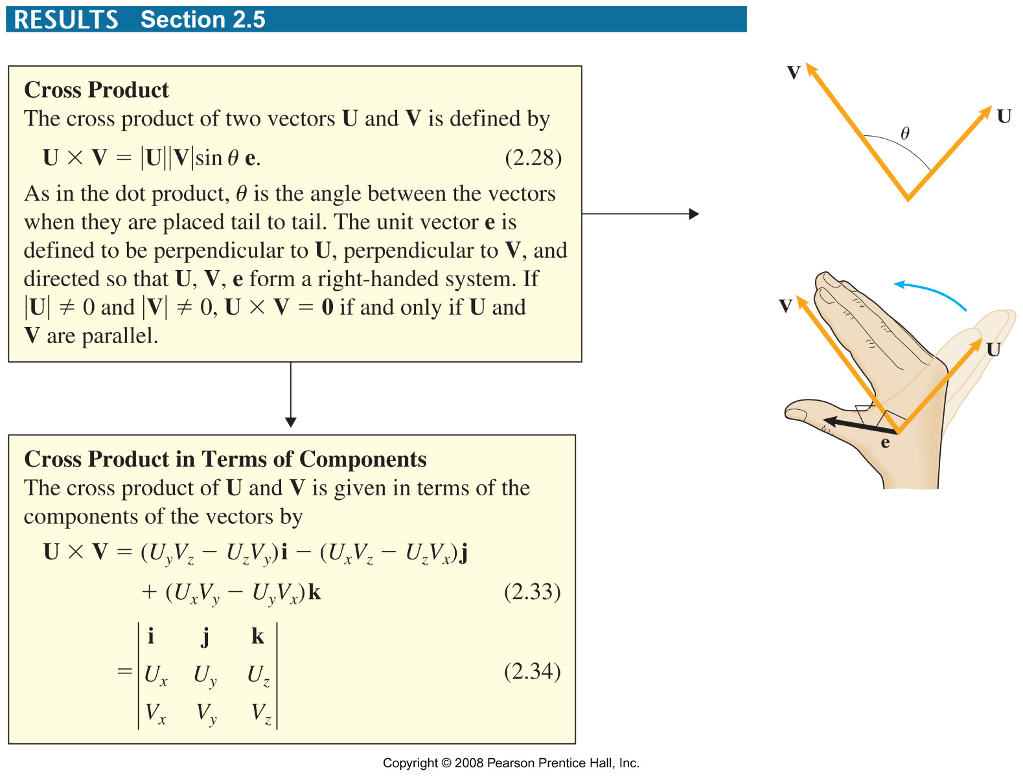

Slide 25
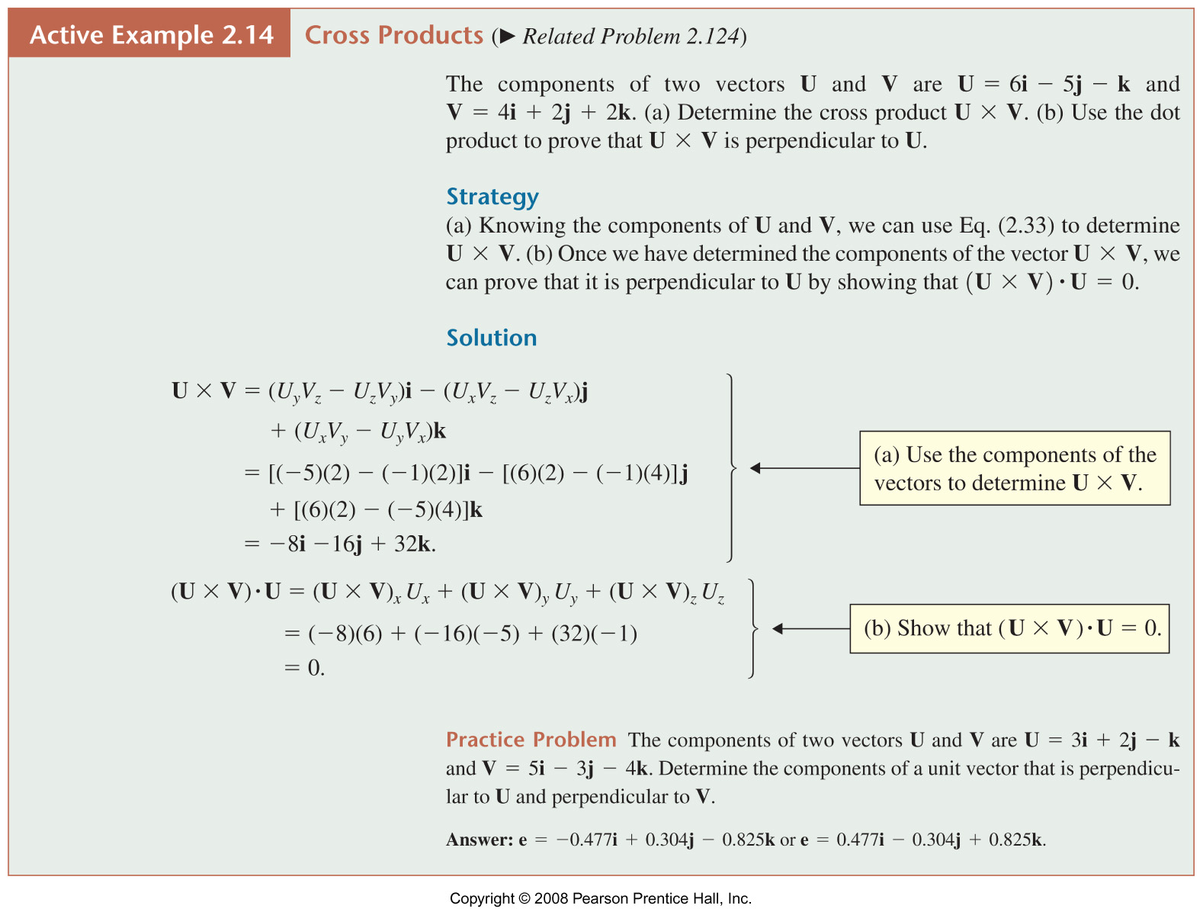
Results 2.5A

