Slide 1
ENGR 245 Mechanical Analysis
Lesson 1
Introduction

Slide 2
Learning objectives
To know the historical roots of modern Dynamics
Get an overview of what is Dynamics

Slide 3
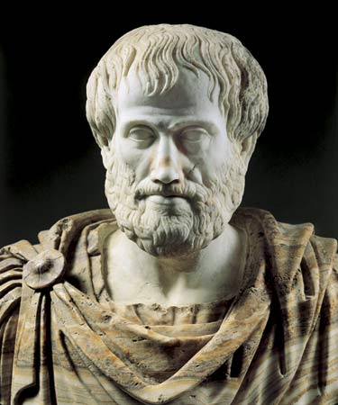
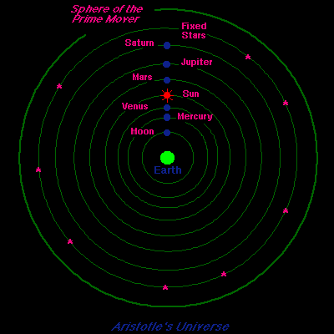
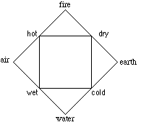
The physics of Aristotle
Natural motion = immobility
Four (five) elements
Ideal motion = circle
Aristotle
(Greek: Ἀριστοτέλης, Aristotélēs) (384 BC – 322 BC)
+ Aether (divine element)
The Universe of
Aristotle and Ptolemy

Slide 4
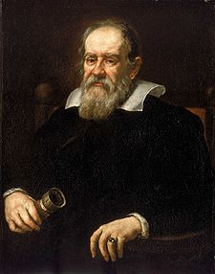
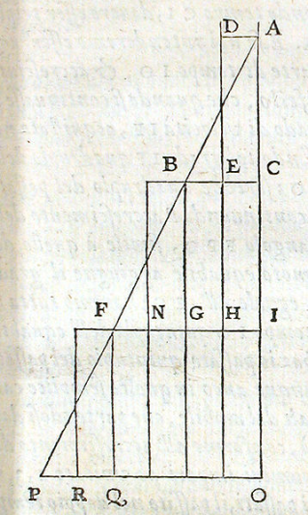
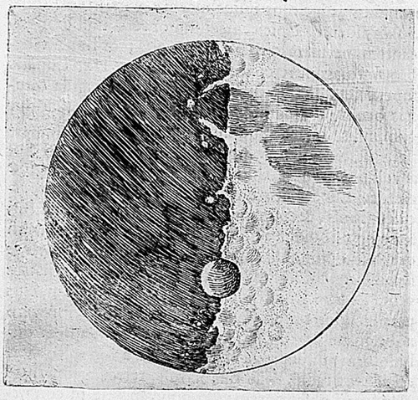
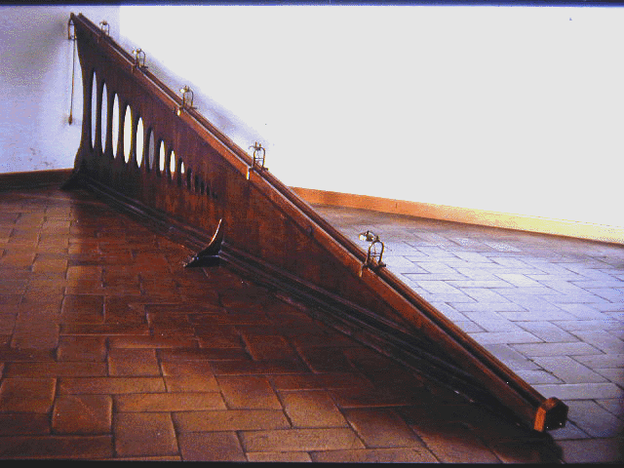
Galileo Galilei
Convinced by Heliocentric model
Natural motion = constant speed
Galileo Galilei (Italian 1564–1642)

Slide 5
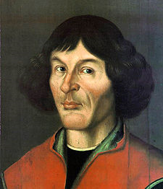
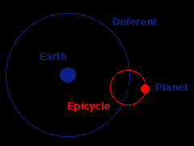
Heliocentric model
Problem: retrograde motion of planets
Elegant solution: heliocentric model
Nicolaus Copernicus
(Polish: Mikołaj Kopernik;
German: Nikolaus Kopernikus;
in his youth, Niclas Koppernigk;1473-1543)

Slide 6
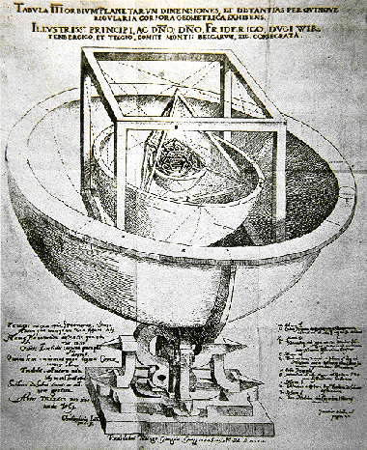
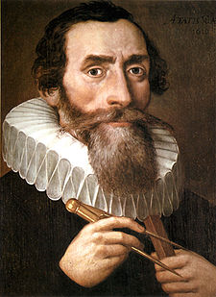
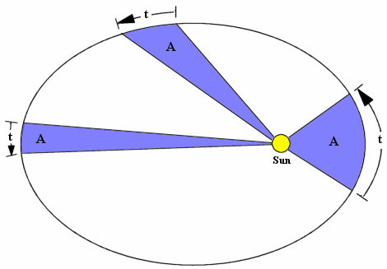
Johannes Kepler
Three laws of planetary motion
Johannes Kepler
(German 1571–1630)

Slide 7
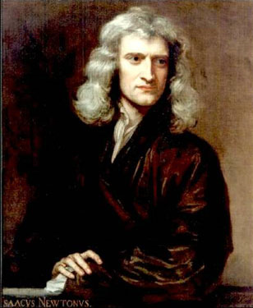
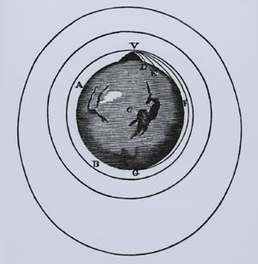
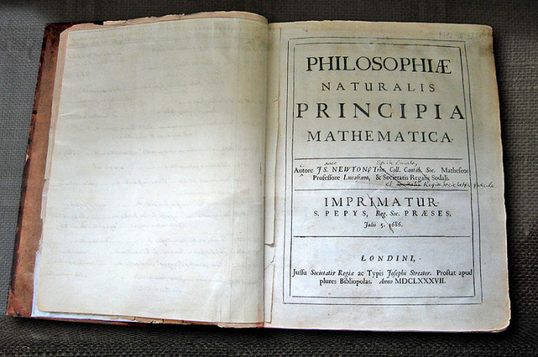
Isaac Newton
First unified description of Dynamics
Isaac Newton (British) 1643-1727

Slide 8
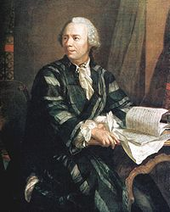
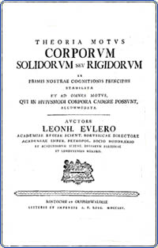
Leonard Euler
Motion of a rigid body
Mass center
Moments of inertia
Euler angles
Leonhard Euler (Swiss, 1707–1783)

Slide 9
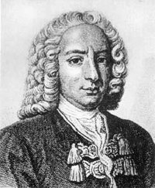
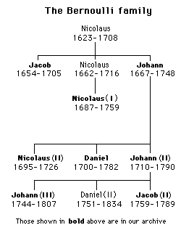
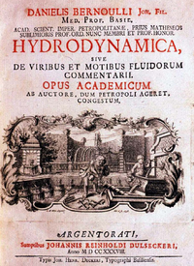
Bernoulli family
Bernoulli-Euler beam equation
Virtual Work (Jean Bernoulli)
Daniel Bernoulli (Swiss; 1700 –1782)

Slide 10
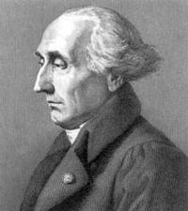
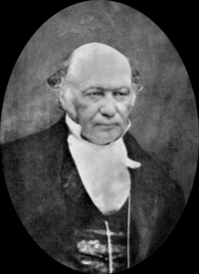




Lagrange / Hamilton
Dynamic systems under constraints
Lagrange equations
Hamilton equations
Joseph-Louis Lagrange
(Italian; 1736 –1813)
William Rowan Hamilton
(Irish; 1805–1865)

