Slide 1



Achieving Success in Changing Environments – Course Introduction, Note Taking and Exam Prep
Week 1

Slide 2
Today’s Agenda
Welcome and Tracking Sheet
Introductions and Course make up
General Administrative Stuff
Assignment Submission Requirements
The first lesson, and
A couple of fun videos to check out (if there is time)

Slide 3
This is a Hybrid Course
Two hours in class –
      Lectures and miscellaneous activities
One hour outside of class –
    Online activity – either on Blackboard or the Internet
    Reading assignments each week
Bring your laptop for in class activities and tests

Slide 4
Administrative Stuff - Who am I
Phil Beals
    A little of my background
    My teaching style
        I do not teach directly from the textbook.
    Reaching me by Email
        Preferred email – phil.beals@gmail.com
        College email – bealsp1@algonquincollege.com

Slide 5
Administrative Stuff - Communication
  Official Course stuff – i.e. Course Outline and Course Section Information, etc
Communication from my desk:
    All communications will either be sent by email to your @algonquinlive email ONLY, or posted as an announcement on Blackboard. It is your responsibility to stay connected.
    If I do not have your @algonquinlive email alias, you will miss very important information. Be sure it is on the attendance sheet.

Slide 6
Administrative Stuff - Communication
  Official Course stuff – i.e. Course Outline and Course Section Information, etc
Communications to me and submissions
    All communications to me and all submissions, whether by email or in print, must be from an email address that reflects the name you are registered under at the college.
    I will not search to try and find out who you are if you use any other name or alias or a nickname

Slide 7
Other Administrative Stuff
    Participation is key to success
        If you:
        Are here
        Learn to follow instructions
        Do the assignments
        Work well in team assignments
        Submit on time
        You will pass
    This is an EASY PASS but a MUST PASS course
    It is not easy to ace this course

Slide 8
Administrative Stuff – Hybrid Assignments
Hybrid Assignment Submissions
  There are 6 written hybrid assignments and 6 activity based assignments.
  Written hybrids are to be submitted online on Blackboard ONLY
  Written hybrid format – MUST meet requirements as outlined in the Assignment Submission Requirements document. The title is always the heading of the assignment
No late or delayed submissions are permitted without prior approval in writing.
        The written assignments will only be marked on whether you did the required work and formatted the document properly.
        Only the last submission is marked.
        Attendance in class the week hybrids are due is mandatory to earn aNY hybrid mark.

Slide 9
Administrative Stuff – Text Books
Required Text Book
Professionalism: Skills for Workplace Success, 4th Edition by Lydia E. Anderson and Sandra B. Bolt
There is required reading and exams are based on reading assignments.
Recommended:
The 7 Habits of Highly Effective People, Stephen Covey, by Steven Covey, Free Press, ISBN 978-0743269513
There is required reading and exams are based on reading assignments.

Slide 10
Administrative Stuff – Earning Marks
Activity Hybrids and Participation = 15%
Written Hybrids = 20% of Final
Four in class group activities = 20%
Two Open Book Exams = 45%
      Mid Term Exam = 20%
      Final Exam = 25%
      Exams are based on lectures; textbooks; end of class videos; and miscellaneous handouts.
      On time attendance for exams is mandatory
      All exams are Open Book (access to the text book; slide decks and your notes and limited study guide material)
I do not use Blackboard to track marks

Slide 11
Video – Don’t Sweat the Small Stuff

Slide 12
First Lesson

Slide 13
The Importance of Notetaking
Taking notes combats memory fading
Effective notes backs up and reinforces memory
Research shows a high correlation between the quality of notes and test and grade performance

Slide 14
The Importance of Notetaking
Studying from effective notes is more time efficient than rereading chapters multiple times
Well-developed notes provides effective study tools to rehearse and review
Effective note taking strategies saves study time.

Slide 15
The Note Taking Process
Note Taking:
Involves condensing or reducing large amounts of information into more manageable units.
Requires you to think carefully about information, break it down, analyze it, and select what is important to learn.
Is a multisensory process that uses visual, kinesthetic, and auditory encoding.
Individual chapters may require using more than one note taking system to create study and review tools.

Slide 16
Annotation
Annotating:
      The process of highlighting, underlining, making marginal notes, or marking specific information in printed materials.
Annotating:
      Is an active learning process
      Holds information longer in working memory
      Reduces the risk of information fading

Slide 17
Tips for Recording Notes
Headings and Subheadings: Keeps your notes organized.
Marginal Notes: Take notes on any important marginal notes in the textbook
Double Spacing: Double spacing creates room for adding additional information after the fact.
Sufficient Information: Avoid being too brief; record sufficient details to support main ideas.
Meaningful Phrases or Sentences: Check that phrases or shortened sentences are clear.

Slide 18
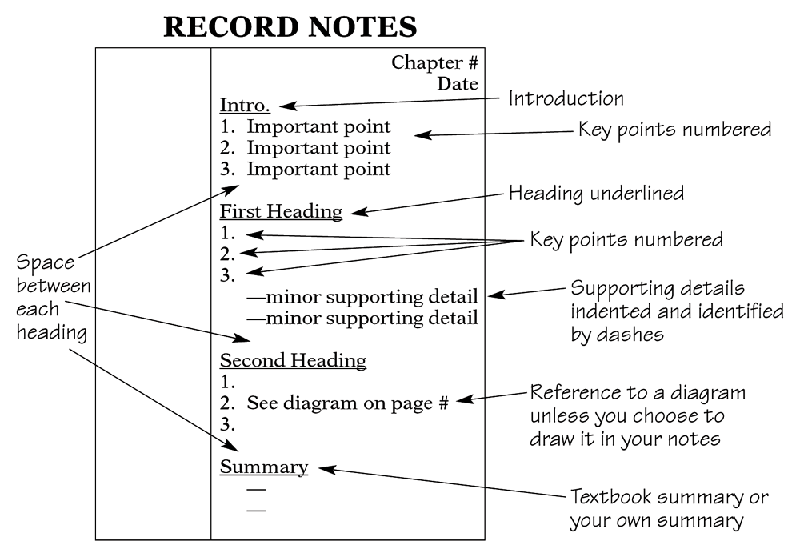
The Cornell System

Slide 19
The Two-Column System
Step 1: Write the topics, vocabulary terms, questions, or math problems in the left column.
Step 2: Write any explanations, details, or definitions in the right column.
Topic Voc. Term Study Question Formula | 1. 2. 3. Definition Answer Example

Slide 20
Preparing for Exams
Listen for favorite themes and concepts that professors keep returning to
Know the format and value of the exam before hand
Review your notes, text material, assignments, and quizzes
Review the night before but don’t cram
Get a good night’s sleep

Slide 21
The Dreaded Exam/Test-Preparation
Study Groups are a powerful way to prepare for an exam
        Social interaction breeds success
        Take advantage of others strengths & what was retained or understood by them
        Q & A’s with each other

Slide 22
4 Steps to a 5 Day Study Plan
Be specific and realistic: List the topics and materials you need to review.
Set target dates and times: Organize study blocks on four different days; reserve day 5 for final full review.
Identify the steps and a plan of action: Identify what you intend to study in each study block for each of the five days.
Plan a reward: Identify a reward for yourself after you finish your five-day study plan and complete the test.

Slide 23
Writing the Exam (Paper Based)
Read the instructions carefully and slowly
Underline key words
Write legibly. If the professor cannot read your writing, don’t expect a mark.
Pace yourself
If you begin running out of time - use point form
Ask if you are not sure

Slide 24
Writing the Exam - Computer Based
Know the rules.
Understand the testing software.
Read and choose answers carefully.
  Read each question carefully.
  Convert each option into T or F.
  Carefully select the best answer.

Slide 25
Testing Anxiety – Dealing with it
Test anxiety: excessive stress that hinders performance before and during tests.
Symptoms of test anxiety include:
Physical symptoms
Emotional symptoms
Cognitive symptoms
Behavioral symptoms

Slide 26
Testing Anxiety – Dealing with it
Test anxiety is a learned behavior.
To deal with test anxiety, begin by identifying what triggers your test anxiety.
Test anxiety may stem from:
  under-preparedness and cramming.
  past experiences.
  fear of failure.
  weak test-taking skills.

Slide 27
Testing Anxiety – Dealing with it
Use relaxation techniques.
Use positive self-talk.
Reread questions in a whispering voice.
Do not stay stuck on a question.
Use paper or your arm to block other parts of the test.
Circle or highlight key words.
Slow down the reading process; go into retrieval mode.

Slide 28
Written Hybrid 1
Spend time on Blackboard and review all material posted for this course, especially the Assignment Submission Requirements document.
Also on Blackboard, under Exercises, do the “What is Your Learning Style” quiz. DO NOT submit the results.
In 150 to 200 words, write what you might change in your learning style to more efficiently learn, or explain why you feel no changes are necessary, supporting it with how you learn now.
Don’t forget to put your registered name and the assignment title at the top of the page.
    Textbooks Reading Assignment:
    Read chapters 2 and 3 of the mandatory textbook, Professionalism: Skills for Workplace Success, 4th Edition

Slide 29
Video – Paradigms of Education
With permission from: RSAnimate (www.theRSA.org), and CognitiveMedia (www.cognitivemedia.co.uk)

Slide 30

Q & A

