Slide 1
The Ages of Greek History
3000-1100: Minoans/Mycenaeans c. 1200: Trojan War
1100- 750: Dark Age c. 800: Homer
776: Olympic Games founded 750-480: Archaic Age
480- 323: The Classical Age
323-30: The Hellenistic Age

Slide 2
Athletic Events, Part 1:
Footraces & Wrestling

Slide 3
Stephanitic/Crown Games
Notes:
Also called crown games
The only prize is a crown, no cash or anything
A wreath
4 games in particular, most famous was olympics

Slide 4
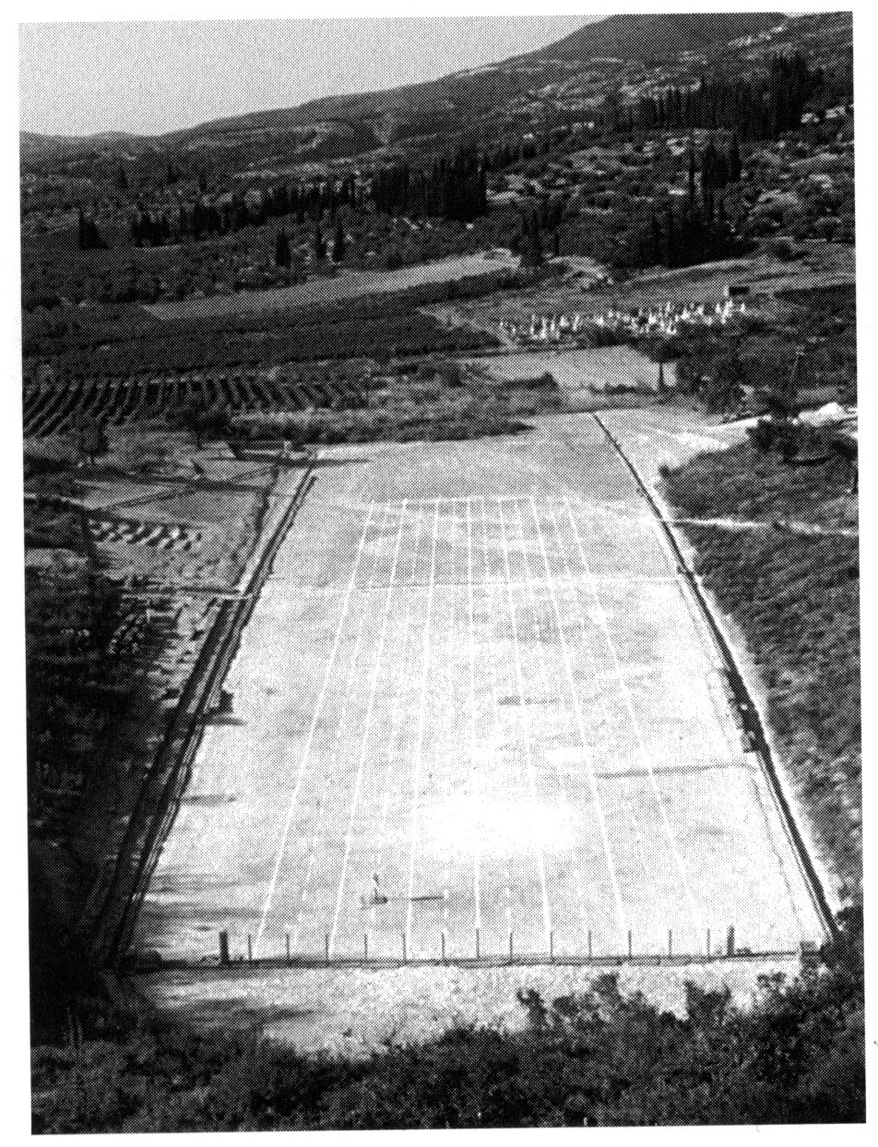
Footraces: f. 63
Stadium, 30 x 200 yards
Olympia held 20 Runners
Heats held for more than 20 runners
Notes:
Held in a stadium
Olympia was largest

Slide 5
4 Main types of footraces:
Notes:
1.

Slide 6
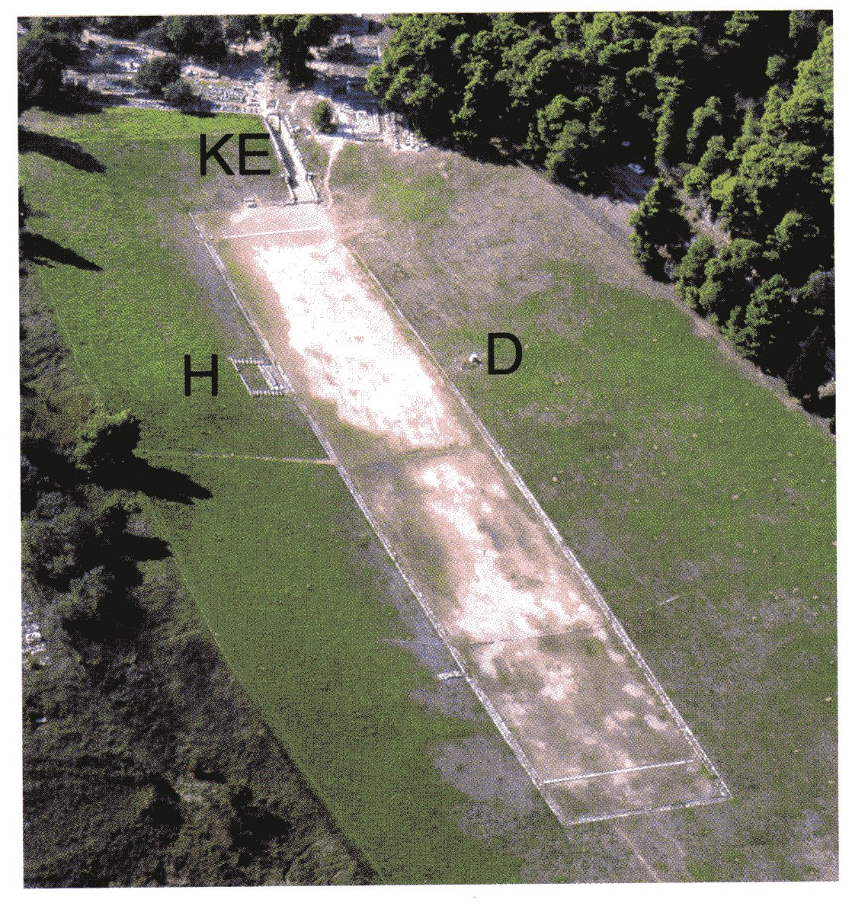
The Stadion; the Stade, f. 34
highest prestige
200 yards long
Notes:
Unit of measurement 200 yards, called the stade
Building was stadion
Winner got the olymics named after him
For first few years, this was the only competition

Slide 7
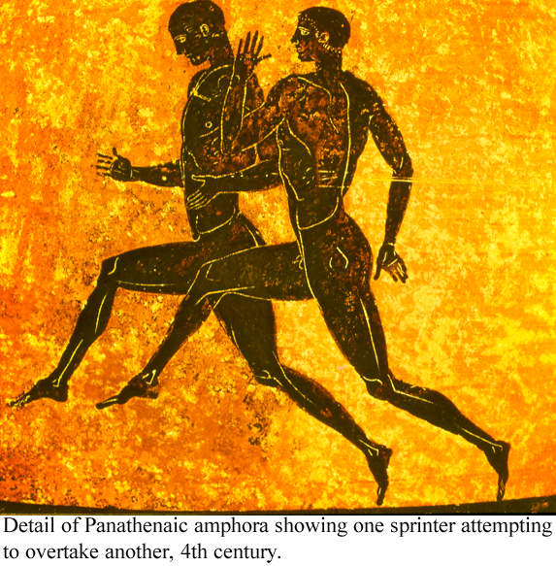
Notes:
Very sterotype (ancient art)
Artists depict things consistently the same way
You can tell what race they are running by the way their legs are positioned

Slide 8
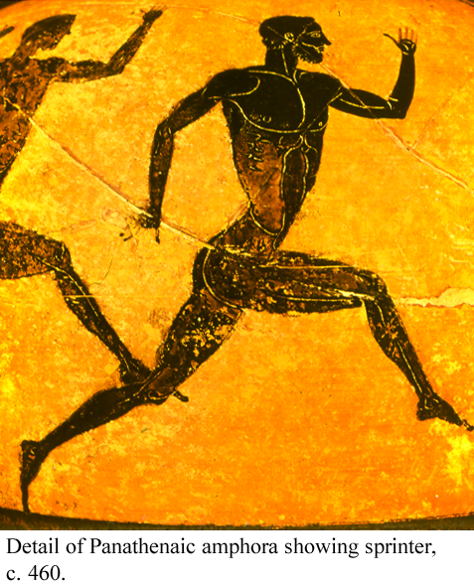

Slide 9
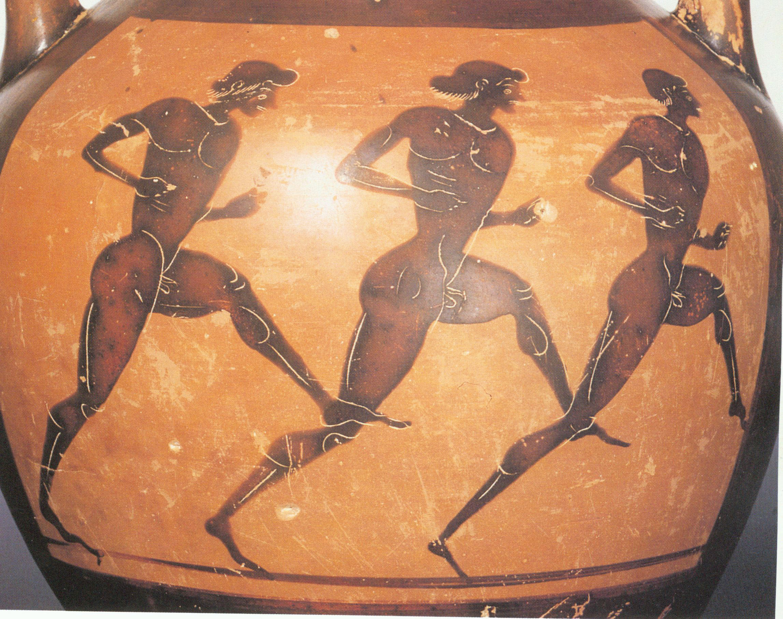

Slide 10
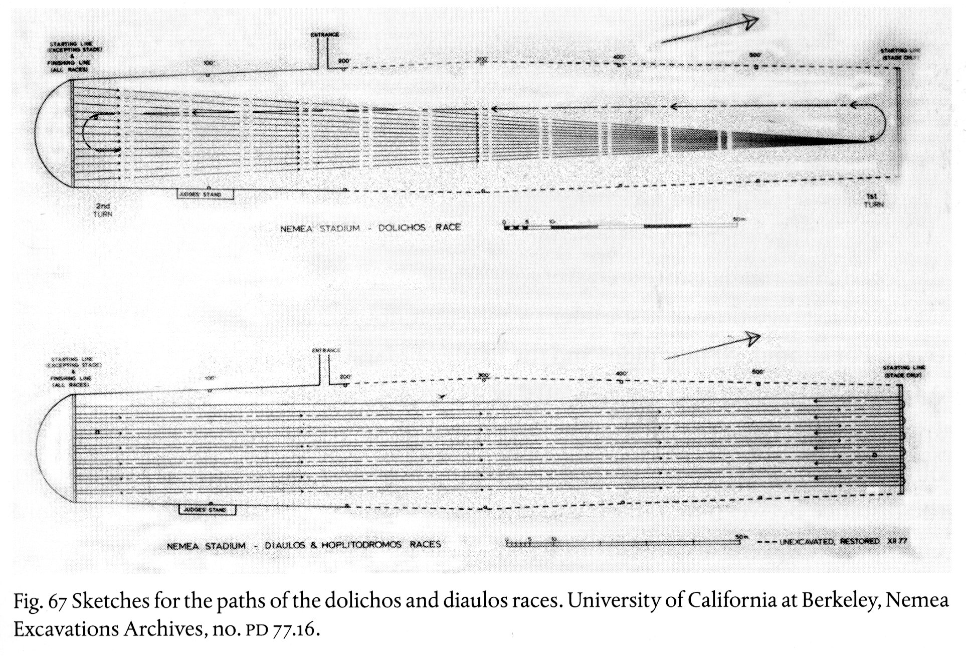
diaulos: ‘double-flute’; F. 67
400 yards
Two lengths of the stadion
Notes:
Flute is twice the length
First one to be added

Slide 11
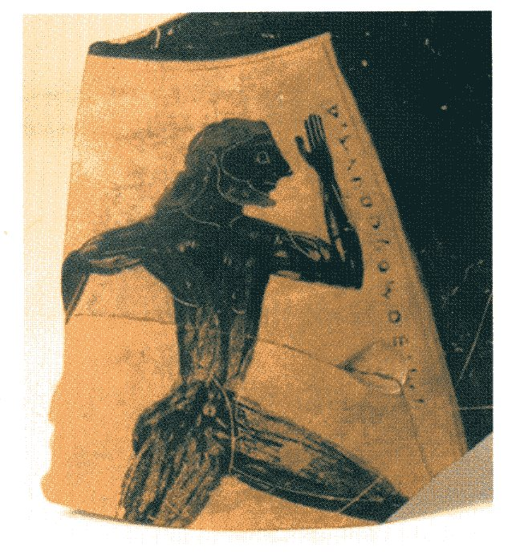
f. 31
Notes:
Something slower than stadion

Slide 12
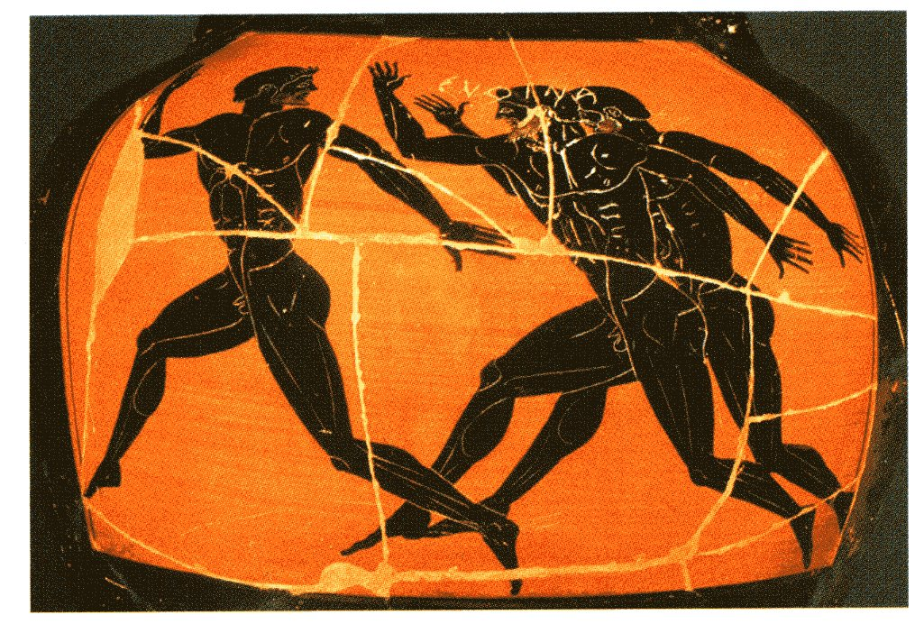
f. 30

Slide 13
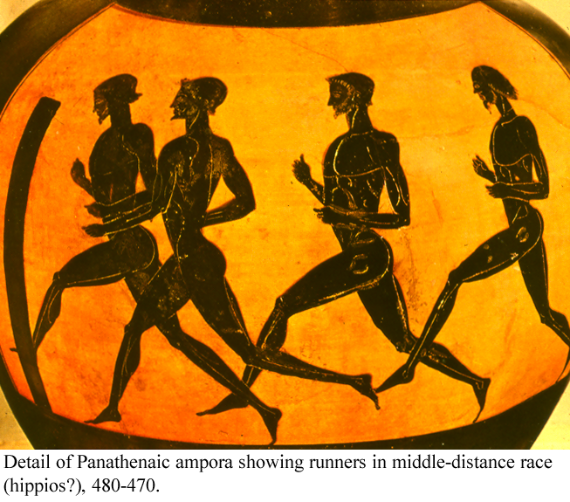
The hippios: ‘horsy-race’
800 yards, Not an Olympic event
Notes:
Other games but not here
One of the games

Slide 14
dolichos: 8000 - 9600 yds

Slide 15
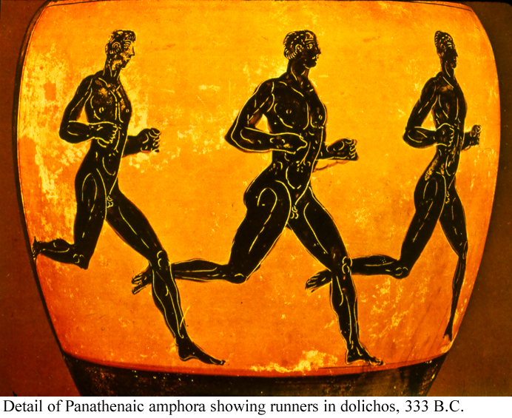

Slide 16
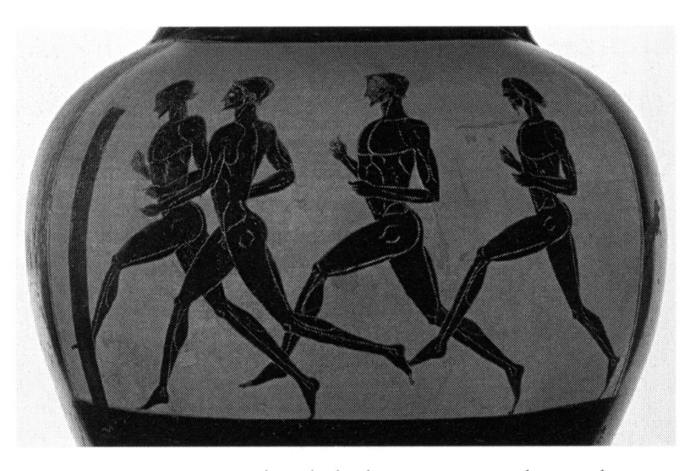
f. 65

Slide 17
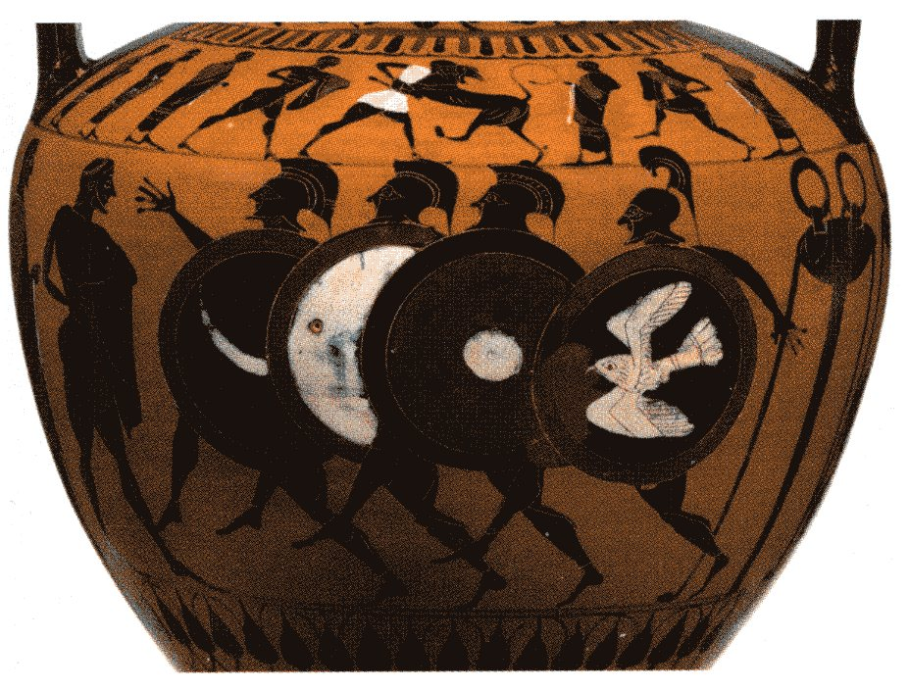
Hoplitodromos
400 yards in armor
Not very highly regarded
Notes:
Ran in armor
Sources don’t agree on what armor

Slide 18
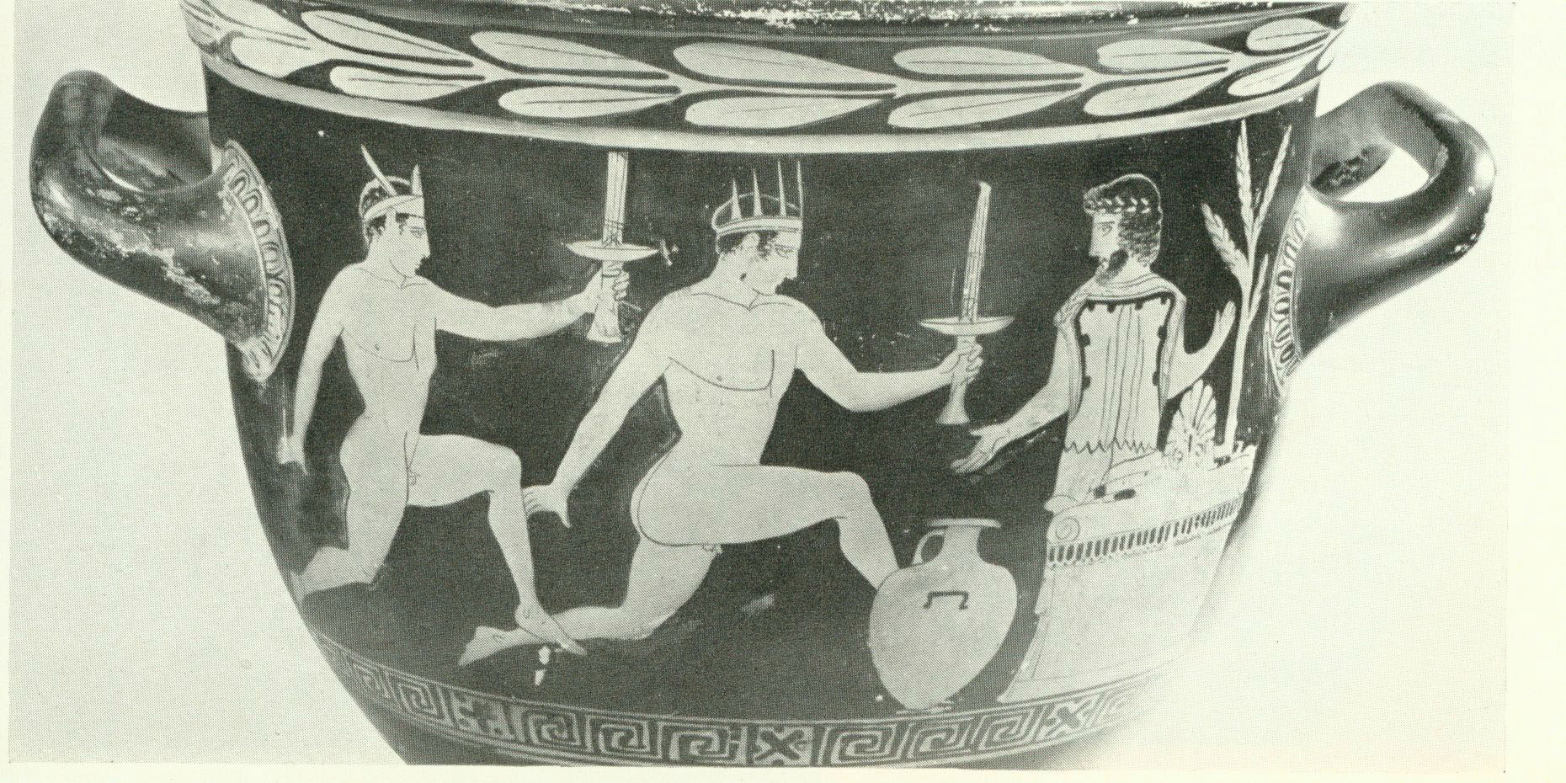
The torch race
Relay race at Athens
40 or so young men (18-20 yrs)
NO connection with Olympics

Slide 19
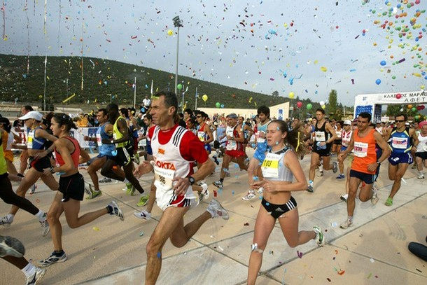
Marathon
Notes:
Not a part of the olympics
Mistake made on what marathon actually is

Slide 20
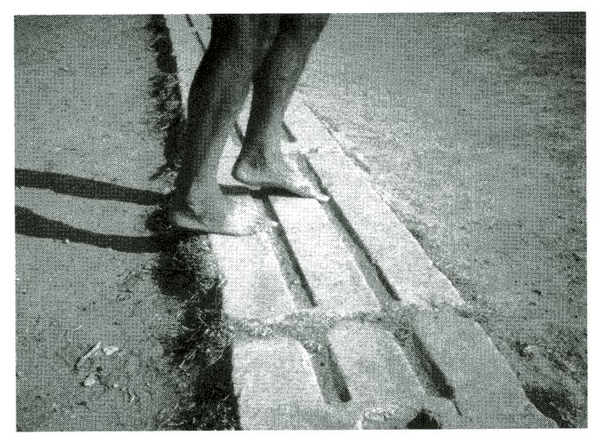
Balbis & Trumpet, f. 37
Notes:
Toe holes

Slide 21
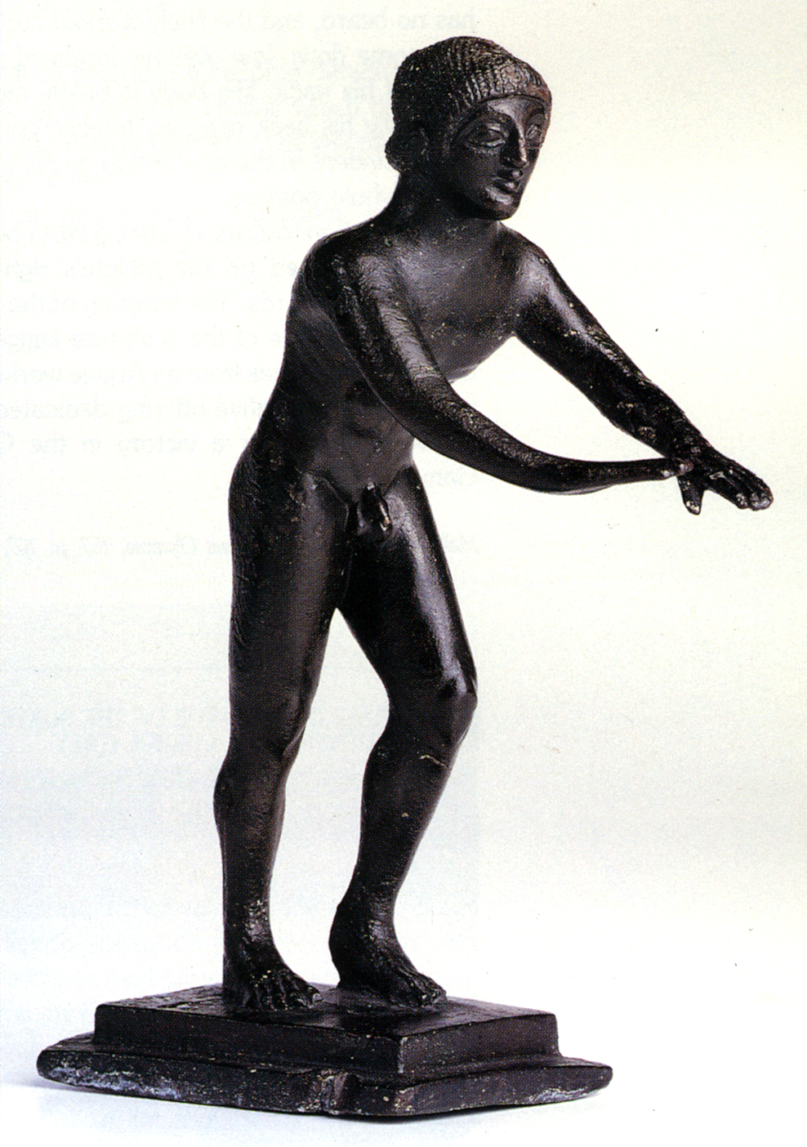
Starting Position; f.39
Notes:
Start is signalled by trumpet
If start too soon get whipped

Slide 22
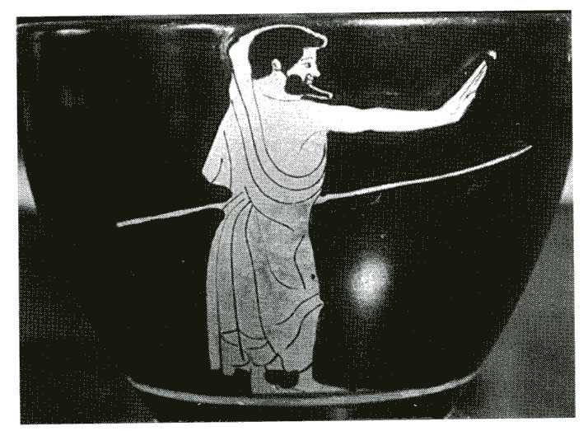
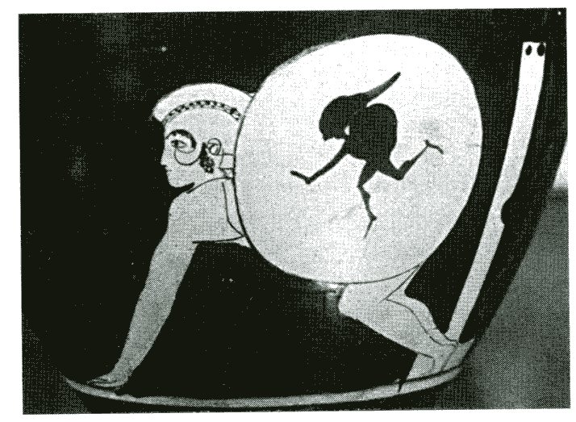
f. 43, 42
Notes:
Stick is up, person has gone forward

Slide 23
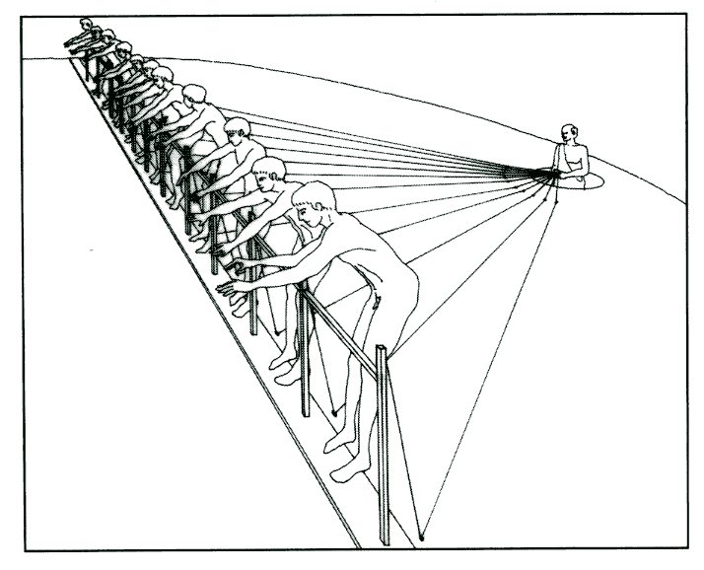
Hysplex A (5th C)
Notes:
Starting gate
Had to get rid of these

Slide 24
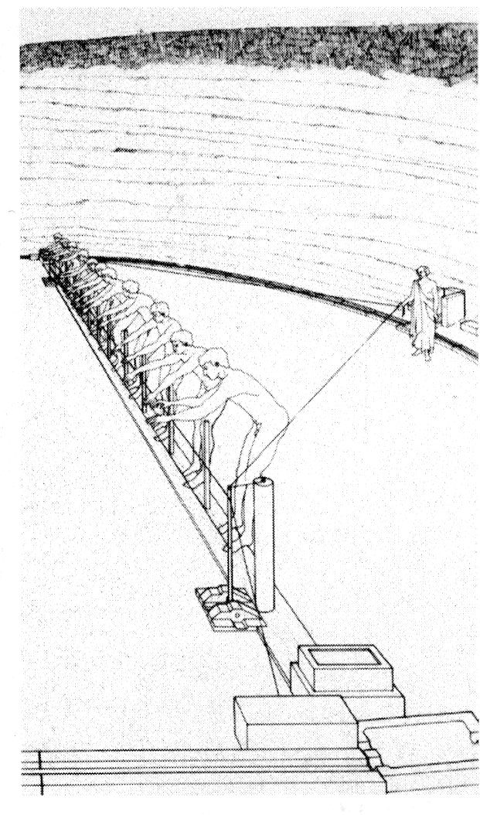
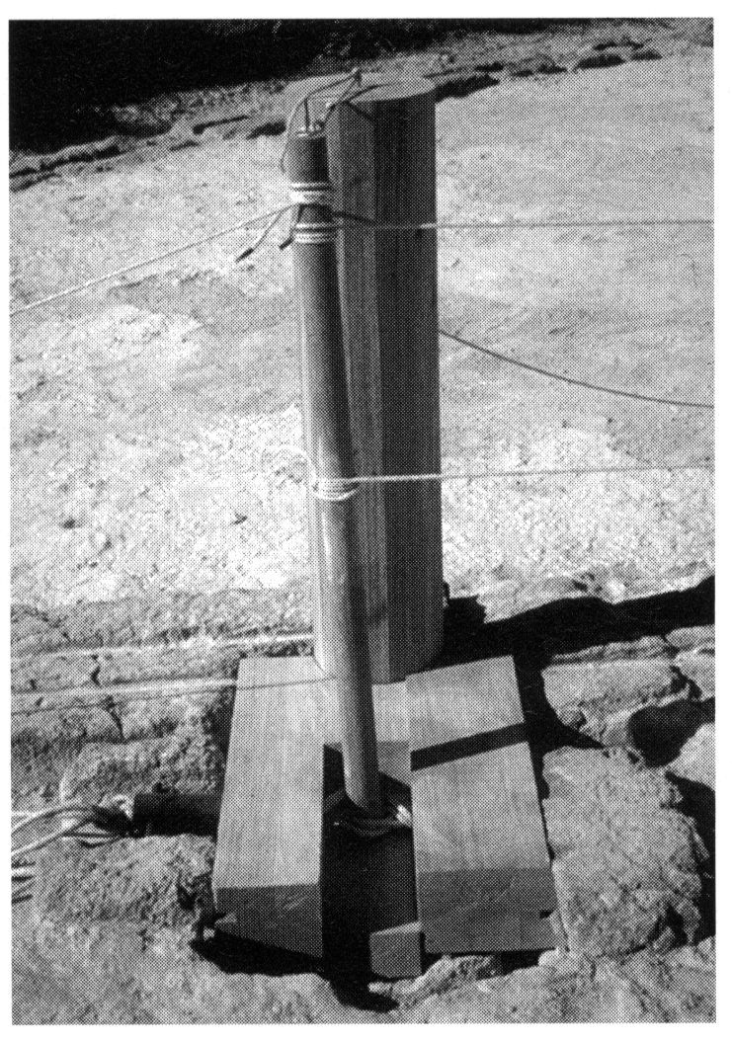
Hysplex B(4th C)
F. 55, 54
Notes:
String pulls it down
Feet untangled and everyone gets fair chance

Slide 25
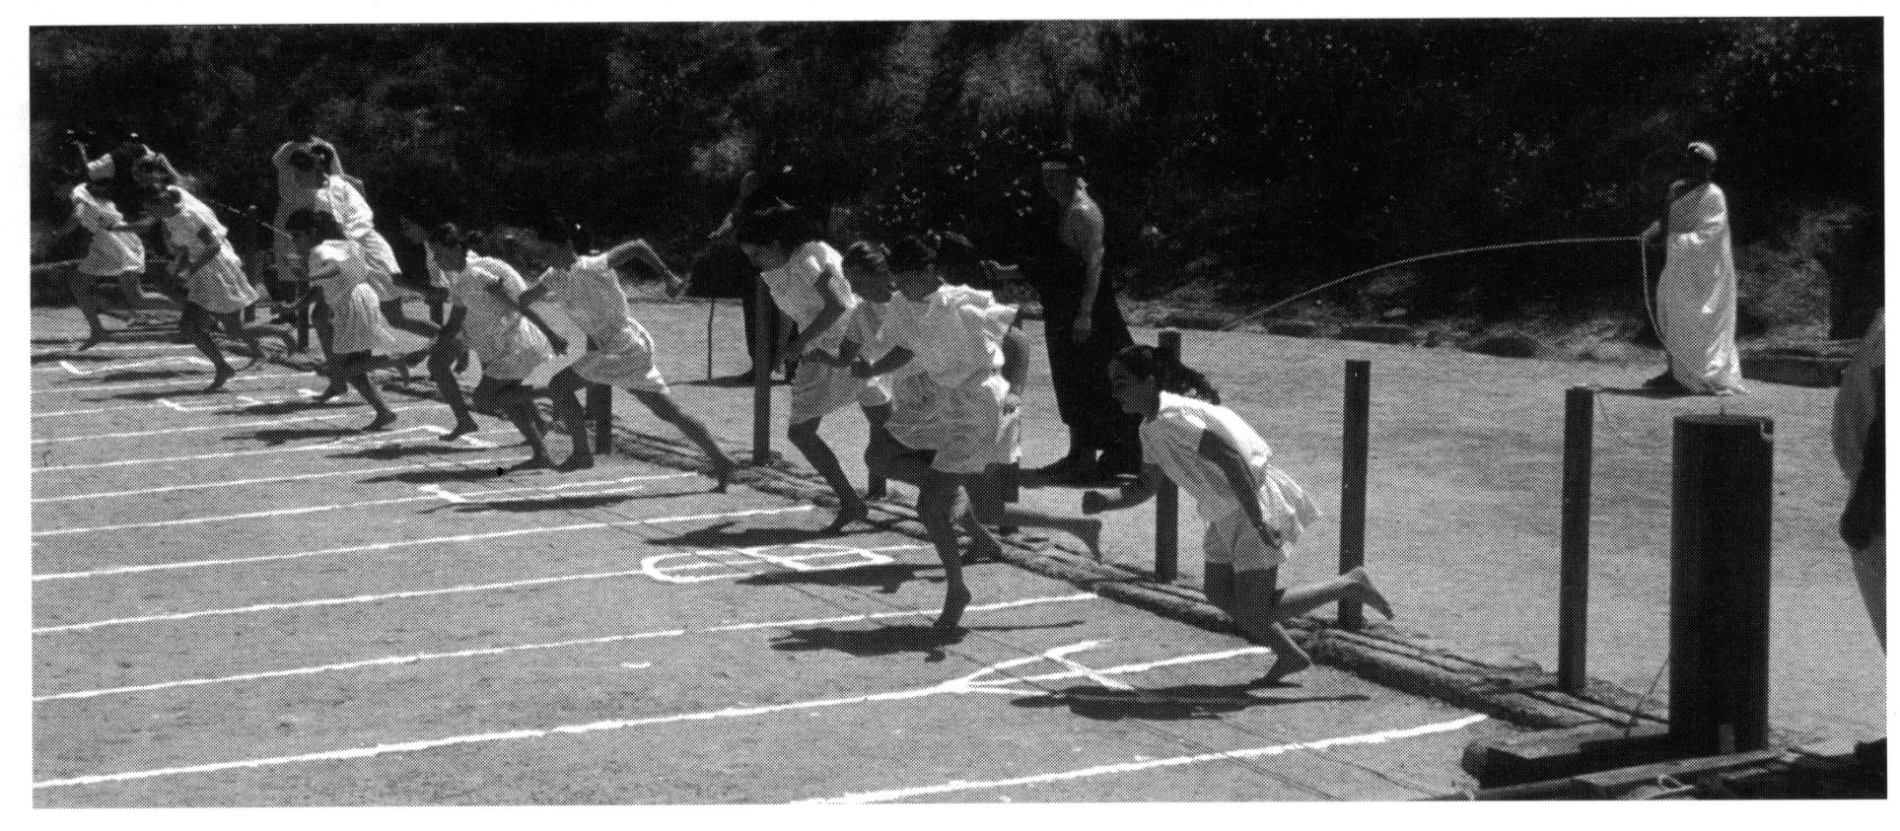

Slide 26
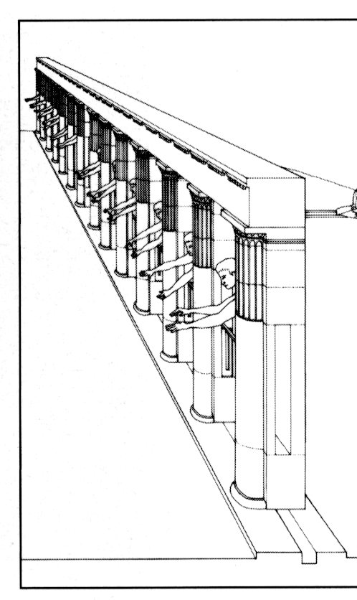
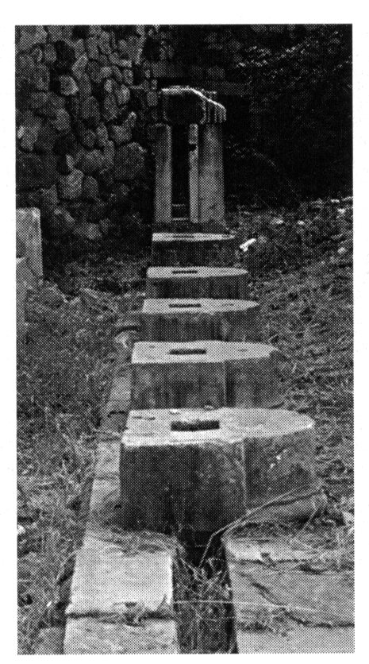
Hysplex C (3rd C), F. 62, 60
Notes:
Same mechanism
New kind of starting gate is hellenistic era
A lot more money and expense is put into these games

Slide 27
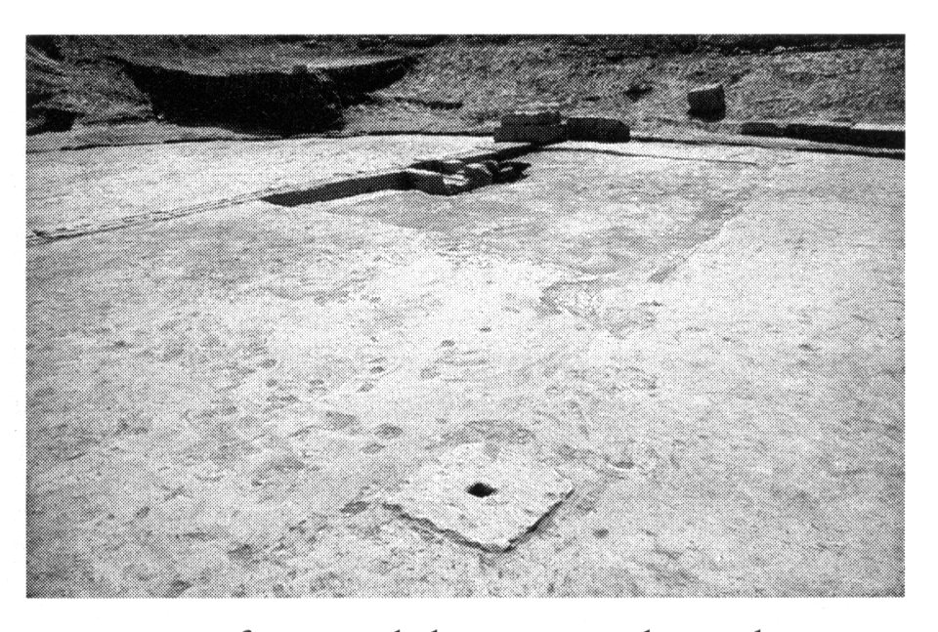
Kampter, Terma, f. 65, 66
Crashes, Cheating
No staggered starts
Notes:
Turning point
Randomly assigned who would get the randomly unfair advantage in the stadium

