Slide 1
What do you think?
Tim is 22 year old second-year university student who is 35 kg overweight and does not like exercising.
  He is a sensitive, caring young man, he has many close friends and is a volunteer at many health-related agencies that help people in need.
  He enjoys nature and the inner peace he derives from a walk on the beach or a quiet night by a campfire in the wilderness.
  He is a strong advocate for human rights, animal rights, and the preservation of the environment.
What can you say about his health and wellbeing?

Slide 2
What do you think?
Kim is a 20 year old first-year student who lives off campus.
  She tries to eat healthy foods some of the time, she thinks she is about 5 kg overweight and walks two to four kilometres per day.
  She is shy and hasn’t made many friends since coming to college. During a typical day, she goes to class, studies, watches TV and writes letters to her high school friends and family.
  She likes cycling, but she only finds time to get out for a short ride on weekends. She is tired much of the time and wonders why she is in school. After a check-up, her doctor says, “Everything looks good. Keep up whatever you’re doing, and you should be fine”
What can you say about her health and wellbeing?

Slide 3
Learning objectives for Health, illness and disease
To develop an understanding and appreciate its association with health and wellness
  Health, illness and disease
  Acute and chronic conditions
  Conventional medicine
  Health prevention
  Types of complementary and alternative medicine
  Holistic medicine
  How to improve ones health

Slide 4
Definition of health, illness and disease (1)
Historical definition
  Comparison with extremes
    No life threatening or contagious disease
  Punishment from God
    Wages of sin
  Evolving definition
    Plague, pneumonia, influenza, cholera
  Modern definition
    State of health
Modern definition
  WHO definition
    Definition by Rene Dubois

Slide 5
Definition of health, illness and disease (3):
World Health Organization definition
The World Health Organization (WHO) has developed an acceptable to all definition of health
‘Health is the state of complete physical, mental and social wellbeing and not merely the absence of disease’
However, critics of the WHO definition argue that complete health is much more than just a measure of physical, mental and social aspects of life.
Critics give recognition to contribution from environmental, intellectual (beyond mental wellbeing) and spiritual health to the quality of life as well as the number of years a person lives

Slide 6
Definition of health, illness and disease (4)
Modern definitions
Health is also closely related to factors such as income, education, access to medical care, environmental pollution, age and gender
Rene Dubois has proposed an expansion of the WHO definition of health
‘Health involves social, emotional, intellectual, spiritual and biological fitness on the part of the individual, which results from adaptation to the environment’
Today, health and wellness are often used interchangeably to mean the dynamic, ever-changing process of trying to achieve one’s individual potential in each of the several inter-relating dimensions of health

Slide 7
Disease and illness (1)
Disease is a collection of symptoms and clinical finding assembled for the convenience of the medical profession and the patient
Disease is an entity that we can isolate and eliminate
Disease helps in identifying treatment and prognosis
Disease is a state of being under the given conditions and situation
  Disease may be diagnosed
  Disease may not be diagnosed
  In either case disease may be treatable or non-treatable (terminal)

Slide 8
Disease and Ilness (2)
Disease may results from exposure to specific harmful agents
  Agents of disease
    Biological: e-coli, influenza virus, small pox virus, etc.
    Chemical: asbestos, mercury, benzene, etc.
    Physical: electromagnetic and radioactive radiations, noise
  Psychosocial factors
    Social and political
  Natural disasters
    Tsunami, earthquake, etc.
  Changing environmental conditions
    Climate change
    Environmental pollution
  Contaminated food
    Salmonella, chemicals, etc.

Slide 9
Disease and illness (3)
Illness exists independent of the disease and represents patients’ sensation and feelings, disabilities, discomforts attitudes and the effects of symptoms on activities and relationships
Patients may have a disease, but no illness and others may have an illness but no disease
  Diabetic patients experience no illness
  Dementia, Depression (people experience it but not necessarily viewed as a disease)
Disease is diagnosed, illness is experienced
Disease is treated, illness evaporates

Slide 10
Disease and illness (4)
Disease present without illness
  High blood pressure leading to increased risk of stroke is labeled a disease (hypertension) but the patient may not experience any illness
Illness present without disease
  A patient may have headache, dizziness, fatigue, tiredness and lethargy and may feel ill without any disease being present
Illness and disease present
  A patient may experience chronic fatigue, lethargy and general malaise and may not feel ill and go about their day to day activities even though these conditions may be precipitated by underlying disease condition

Slide 11


Disease and illness
Lisa is feeling low and stressed for the past couple of days, she has had a headache and no appetite and skipped classes
  she is sick (disease)
  she is faking to stay away from classes
  she is ill
  she does not like school
  she is -----------------
Bart went swimming in a public pool and since then is vomiting and has diarrhoea, the doctor has sent him for some tests and he has missed his classes for a whole week
  he is sick (disease)
  he is faking to stay away from classes
  he is ill
  he does not want to swim anymore
  he is -------------------

Slide 12
Review questions for discussion
Diabetes among aboriginals
  Increased incidence related to lifestyle, genetic and environmental factors
Immunization of infants
  Why do some parents do and others do not immunize their children?
Mammography for women
  Some women do while others prefer not to, why?
  Who should get a mammogram?
Drug addiction among young adults
  What is the cause of addiction and why are the rates increasing in recent years?

Slide 13
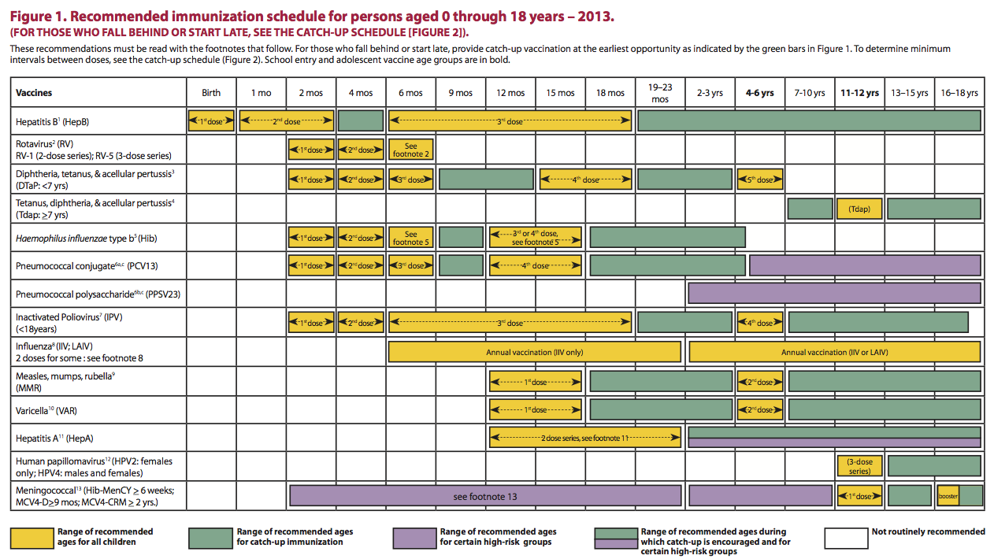
Immunization schedule at a glance

Slide 14
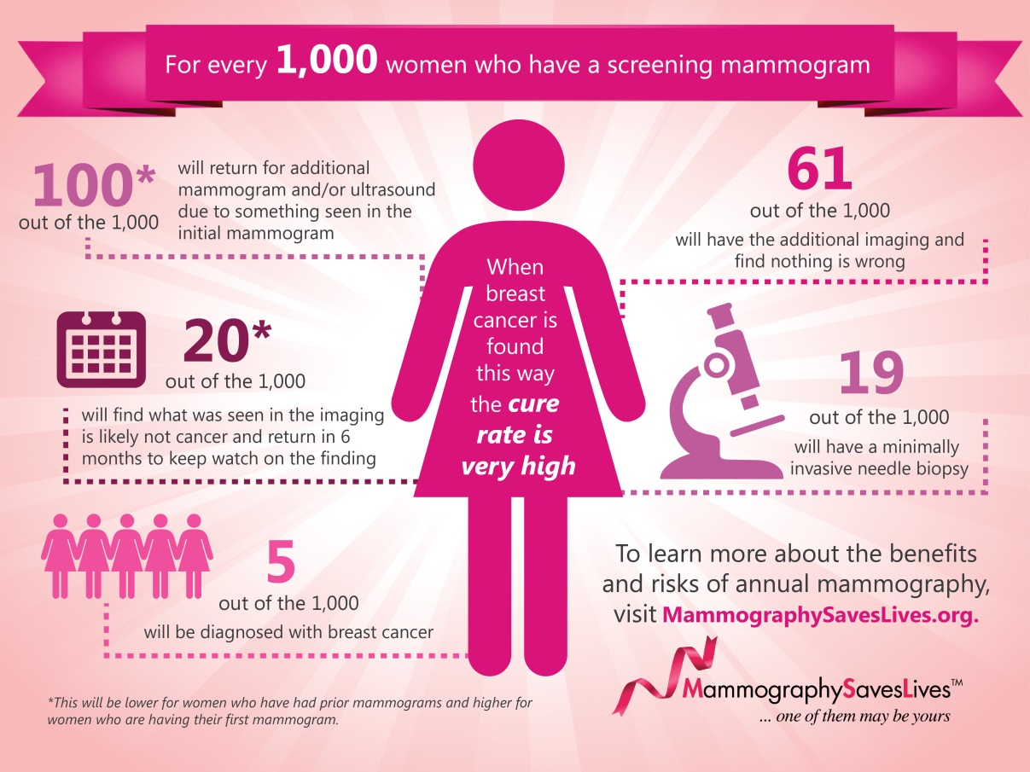
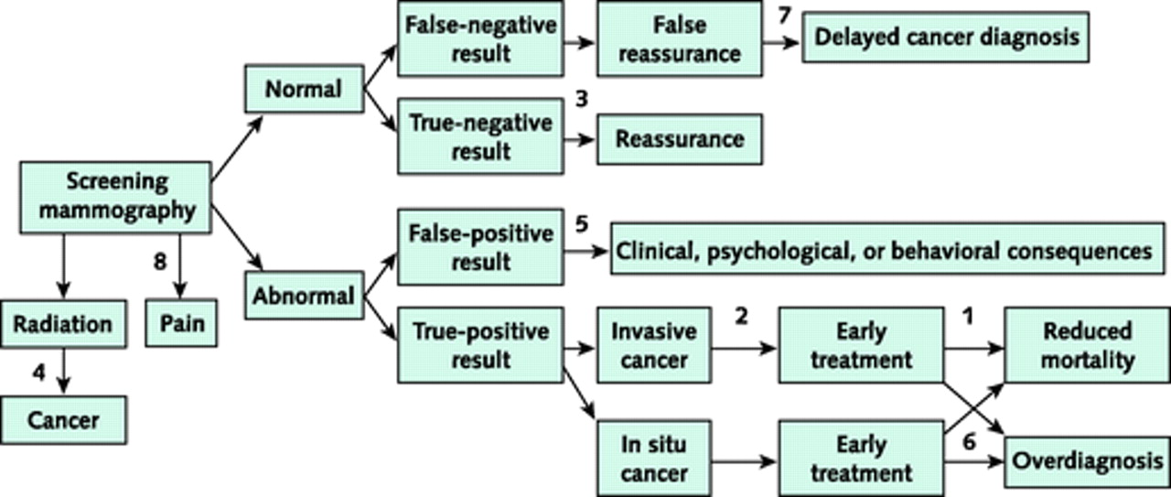

Slide 15

Homer’s health
  Homer does not like exercising?
  Homer does not have a plan for what he eats?
  Homer likes to drink a lot of beer?
  Homer does not advise the family appropriately nor is influenced by his family?
Risks
  Chronic conditions
  Chronic conditions
  Chronic conditions, liver problems
  Health education, motivator, influence for better health

Slide 16
Learning objectives for acute and chronic diseases
To define acute and chronic diseases and to differentiate between acute and chronic diseases
To develop skills to classify diseases as acute or chronic
To understand the risk factors of diseases and fundamentals of etiology

Slide 17
Types of diseases
Acute: flu, chicken pox, small pox are short term diseases, with a fixed period of illness which is usually short.
  The onset is dramatic and symptoms disappear once the course of the disease is done
Chronic: Parkinson’s disease, non-Hodgkin’s lymphoma and cancers are long term diseases, with long term disability which may last the rest of the lifetime.
  The onset of the disease in unmarked and may stretch over a period of time.
  Chronic diseases are degenerative and may be terminal

Slide 18
Chronic diseases (1)
Chronic diseases often have insidious onset, rarely has a cure and consequently lasts for years or a lifetime
  Most often a person dies of a chronic disease or dies with it
  Cardiovascular diseases, osteoarthritis
  Cancer
The incidence and prevalence of chronic diseases in recent years has been increasing very rapidly for a number of reasons
  Cardiovascular diseases
  Cancer
  Immunity and infection related diseases
Chronic diseases increase disability and loss of productivity
  Loss of health leading to increased dependency and decreased independence

Slide 19
Chronic diseases (2)
Chronic diseases are a real problem
  There is little known about their prevention
  They are multifactorial in origin and effect
  No magic drug against these, like the antibiotics of the 20th century
Chronic diseases that do not lead to early death constitute an important group of health problems
  Handicaps that affect physical, social and psychological well being
  Failure to re-establish the functional capacity to work
  Physical discomfort
  Chronic pain
  Constraints on family life

Slide 20
Acute and chronic diseases
Acute diseases have a defined start and end point and the gap between start and end is usually very brief
  Usually do not respond to therapy if neglected initially
  Disease takes its course and mortality is usually low
    SARS
    Influenza
    Tuberculosis
The incidence of some of the acute diseases has been increasing in recent years and in some cases reaching epidemic proportions
  Acute diseases are usually caused by single pathogen through direct or indirect contact with the infected person
  Some acute diseases leave lasting effects and increase disability

Slide 21
Etiology of acute and chronic diseases
The most common cause of acute diseases are bacterial, viral or chemical:
  Bacterial or viral or other pathogens (gastro-entrities, e-coli contamination of food and drinking water, influenza)
  Chemical contamination (contamination of food and dairy products with pesticides or other toxicants)
The causes of most of the chronic diseases are unknown but include
  Genetic factors (haemophilia)
  Genetic predisposition and environmental trigger (asthma and diabetes)
  Environmental and lifestyle (lung cancer)
  Occupational (asbestos)

Slide 22
Epidemiology
Is the study of health, illness and disease in a population
Provides the basis for intervention in the interest of public health and disease prevention
Epidemiological studies are aimed at:
  Examining the relationship between exposure (smoking, alcohol consumption, dietary habits) and disease incidence or disease mortality
  Exploring the relationship between biological, chemical or physical agents and disease diagnosis and prognosis
  Studying outbreak of acute diseases and etiology of chronic diseases
Epidemiology has helped to understand
  SARS outbreak, tuberculosis incidence, HIV incidence and prevalence, diabetes incidence and prevalence

Slide 23
Trends in disease related deaths in Canada, from chronic conditions: 1960-1995

Slide 24
Incidence and mortality from selected cancers in males, 1970-1998

Slide 25
Epidemiology of chronic diseases
The epidemiology of chronic diseases is not straightforward and simple
  The number of incident cases is often not confirmed
  The incidence is difficult to assess (insidious onset, method of diagnosis, severity of symptoms)
  The prevalence is also difficult to asses (variable course of disease, changes in severity, remission, relapse, recovery, recurrence)
  Chronic diseases have a low incidence and relatively high prevalence as opposed to acute diseases

Slide 26
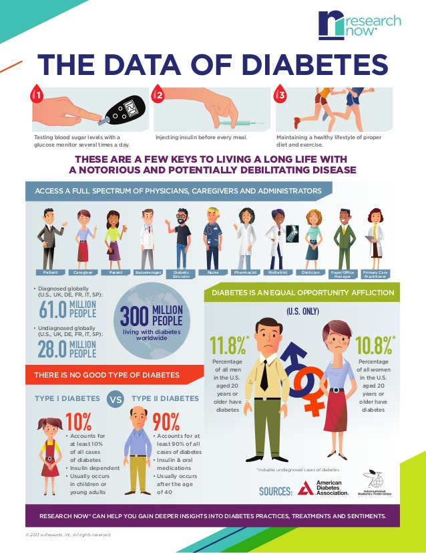


Slide 27
Natural history of chronic illness (1)
Acute onset (stroke, myocardial infarction).
  The symptoms may be severe at the beginning but may be very minimal upon recovery leading to a persistent impairment.
  The pathological process stays and could only be diminished by altered lifestyle and healthy choices.
Gradual onset with a steady, slow or more rapid deterioration (angina)
Relapse and remission.
  An individual who has had a stroke may recover very well only to suffer a further stroke.
  A cancer patient may go into remission with treatment but the disease relapses again later
Minimal initial disability (diabetes). Initially the patient shows no disability except dietary restrictions and medications. However, as disease progresses, complications develop leading to renal diseases, eye diseases, etc.

Slide 28
Natural history of chronic diseases
Optimum health
recovery
remission
Symptoms
threshold
onset
offset
relapse
recurrence

Slide 29
Natural history of chronic diseases (2)
Different manifestation of the same disease in different individuals.
  A person may suffer one or two episodes of neurological loss associated with multiple sclerosis (MS) and never have further trouble.
  Other people with MS will have a disease that gradually progresses to severe disability or to relapse or remission
Different outcomes in different individuals.
  Following stroke, there is considerable variation in the severity of the impairment and disability.
  Paralysis may involve the whole right side or a mild impairment in speech with difficulty in finding the occasional correct word

Slide 30
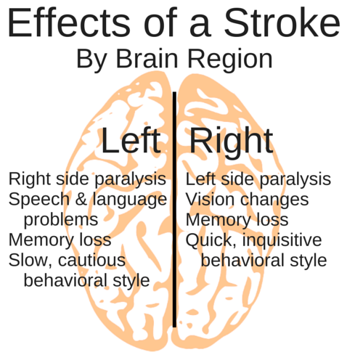

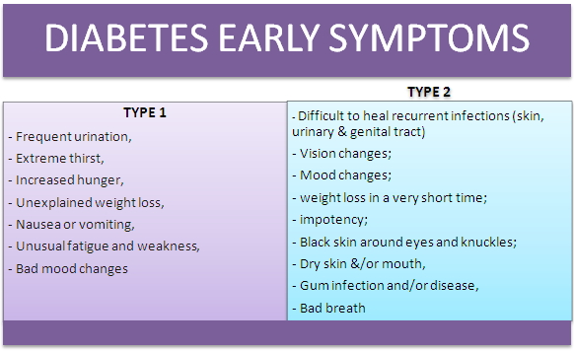

Slide 31
Impact of chronic diseases (1)
Chronic illnesses impact negatively the individual, the immediate family, their neighbors and friends and the community in which they live
The individual
  Period of denial
  The question of why me
  Self pity
  Blaming others
  Giving in totally
  Accepting the reality and moving forward

Slide 32
Impact of chronic diseases (2)
The family
  Lost productivity
  Demands on financial, emotional and temporal resources
  Curtailment of activities
  Higher prevalence of stress and other problems
  Depression and marital separation
The community
  Attitude development (support or isolation)
  Develop support mechanisms (transport, volunteerism)
  Develop new purpose and goals (community in motion)
  New dynamics (social cohesion, fund campaigns)

Slide 33
How healthy are Canadians?
Demographic statistics (2006)
Canadian population: 31,612,897
*Life expectancy at birth: 80.4 years; Females: 82.7 years; Males: 78 years
Median age: 39.5 years (+1.9 from 2001)
Aging population - drop in fertility and steady increase in life expectancy
Level of fertility (replacement fertility) for the population to replace itself from one generation to the next the fertility rate needs to be 2.1 children per woman.
  In 2006, rate was 1.59 children per woman on average.
Immigrants account for about 20% of the Canadian population (additional to the fertility rate growth)
* Life expectancy is the average number of years of life remaining at a given age.

Slide 34
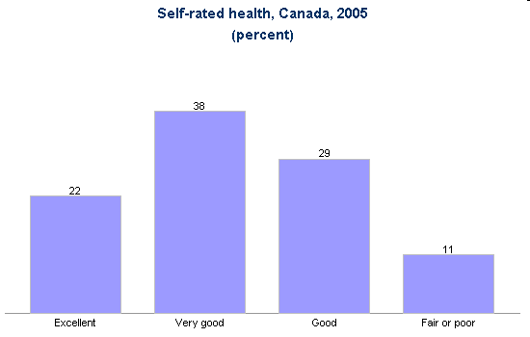
Source: Statistics Canada. Self-rated health, by age group and sex, household population aged 12 and over, Canada, provinces, territories, health regions (June 2005 boundaries) and peer groups, every 2 years (CANSIM Table 105-0422). Ottawa, Statistics Canada, 2006.
HSS1101A CA – Determinants of Health
September 10, 2009
Notes:
If we compare against the Canadian average – 60% of the population in 2005 rated their health as either very good or excellent.
This is self rated so important… how ppl see themselves

Slide 35
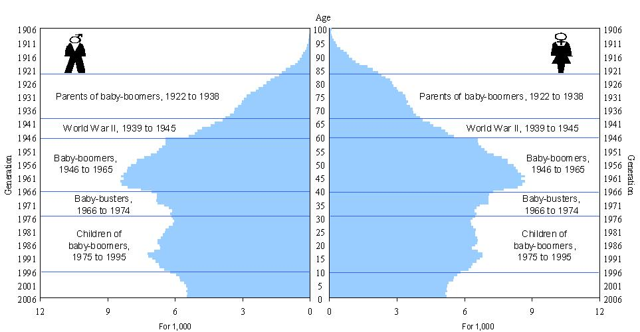
Different cohorts among the age pyramid of
the Canadian population in 2006
Gen x
Gen y
Gen z
Notes:
This figure shows the age pyramid of the Canadian population in 2006. On it is represented six large cohorts: the parents of the baby-boomers, born between 1922 and 1938, the Second world war cohort, born between 1939 and 1945, the baby-boom cohort, born between 1946 and 1964, the baby-bust cohort, born between 1966 and 1974 and the children of the baby-boom cohort, born between 1975 and 1995.
Source: Statistics Canada, Census of Population, 2006.
Pop was growing up until the end of the baby boomers gen… then pop started declining up until today

Slide 36
Discussion time in class
Discuss acute diseases of concern in Canada.
Discuss chronic diseases in Canada
It is believed that chronic diseases in Canada will rise in the coming years, why
Discuss demographic profile of Canada now and twenty years from now and fifty years from now.
Notes:
Are increasing, diseases have evolved, spread is much higher, climate is changing, contact is faster, new conditions we have never seen before cus of climate change
As the population ages, chronic diseases worsen

Slide 37
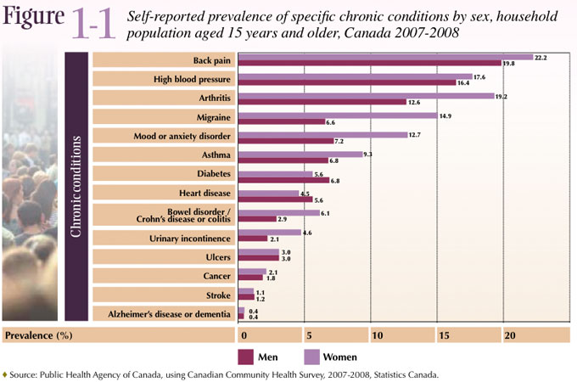
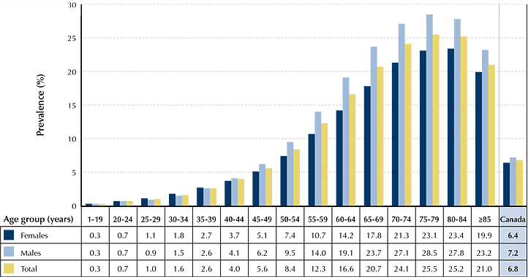
Prevalence of
Diabetes in
Canada, 2006

Slide 38
Disease and illness
http://www.youtube.com/the China Study
  Disease and illness
http://www.youtube.com/red meat
  Disease and illness, diet
http://www.youtube.com/breathing air
  Causes of disease

Slide 39
Conventional and alternative medicine
Section 1 - Learning Objectives
Define conventional medicine.
Categorize health practitioners based on the type of care delivered.
Analyze the objectives of health-care delivery systems from sick care to health promotion.
Define complementary and alver

Slide 40
Conventional Medicine
System in which health-care practitioners treat illnesses with medications and surgery
Called
  Biomedical medicine - reflects the premise that identifiable biological cause leads to physical illness
  Western medicine - suggests this type of medicine only occurs in the Western hemisphere; no longer applicable
  Allopathic medicine - treatments oppose the processes caused by the disease

Slide 41
Conventional Medicine
Strengths
Weaknesses
  High-tech diagnostic tests and treatments
  Emergency management of physical trauma
  Critical care for conditions such as heart attacks
  Prevention of illnesses through vaccinations
  Emphasis on biological disease factors over social and psychological contributors
  Insufficient attention to health promotion and disease prevention
  Inadequacies in managing chronic disease conditions

Slide 42
Health Promotion
Process of enabling people to increase control over, and to improve their health
Focuses on:
  shifting the emphasis from sick care to disease prevention and health promotion
  educating patients about lifestyles that promote health and wellness
Proposes patient-centered medical home
Asserts that treatments must have evidence of effectiveness

Slide 43
Health Promotion
Requires the participation of:
  individuals
  families
  communities
  food industry
  government

Slide 44
Providers of conventional medicine
Physicians are the top of the hierarchy and include medical doctors and osteopathic doctors:
  Primary care professionals who provide diagnoses and treatment for common acute and chronic conditions and include family physicians, internal medicine, pediatrics, geriatrics, obstetrics and gynecologists and specialists (neurology, cardiology, gastroenterology, immunology, etc.)
Nurses who provide supporting care and include registered nurses and nurse practitioners
Physician assistants
Dentists including dental surgeons and medical dentists
Optometrists and ophthalmologists
Podiatrists
Physical therapists
Clinical social workers including psychologists and psychiatrists

Slide 45
Allied Health Professionals
Public health professionals - examine population trends, identify disease outbreaks and:
  reduce health hazards
  protect health
  improve health-care access for entire populations

Slide 46
Types of care
Primary prevention involves prevention of disease from occurring through vaccination and education about healthy lifestyles and risk reduction
  Vaccination for infectious diseases, diet exercise for chronic diseases, condom use for sexually transmitted diseases, helmet use and seat belt use
Secondary prevention involves identifying diseases early so that prompt treatment be provided for specific diseases. Early detection involves the use of screening methods
  Mammograms for breast cancer, pap test for cervical cancer, PSA test for prostate cancer
Tertiary prevention targets people who have the disease so that early intervention can be provided to prevent disease progression.
  Early intervention for breast cancer, diet, exercise and drugs for diabetes, hypertension and other chronic conditions

Slide 47
Health promotion
Health promotion – WHO defines health promotion as a process of enabling people to increase control over and to improve their health status.
The goal is to enhance physical, mental and social well-being. This is achieved by securing adequate income, improving working conditions, providing adequate housing, safe neighbourhoods, providing food security, clean air and water and quality education
Different levels of government, educators, health professionals, public health agencies and others need to work together towards health promotion so that communities and populations are healthier
Healthier countries are economically and resourcefully richer

Slide 48
Learning Objectives for complementary and alternative medicine
Define complementary and alternative medicine.
Examine statistics and trends in the use of complementary and alternative medicine.
Discuss the major categories of complementary and alternative medicine and provide evidence for effectiveness and safety.

Slide 49
Complementary and Alternative Medicine (CAM)
Complementary and alternative therapies encompasses a diverse group of therapies considered outside of the realm of conventional medicine
Complementary therapies – health practices that are used alongside conventional medicine
Alternative therapies - health practices that are used instead of conventional medicine
People may use CAM with the hope of improving health, preventing illness, and relieving symptoms of acute and chronic illness. Because of the relative low cost, people lacking health insurance may turn to CAM.
CAM practitioners often provide a holistic approach to health.

Slide 50
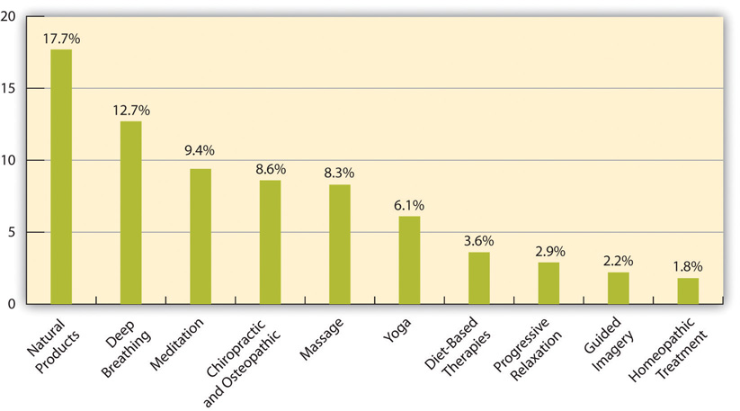
Use of CAM in the United States

Slide 51
Statistics and Trends in the
Use of CAM
4 out of 10 American adults regularly use CAM
38 percent of adults and 12 percent of children had used CAM within the previous year
Most people used these therapies as a complement rather than an alternative to conventional care
Popularity of CAM treatments seemed to plateau in about 2008

Slide 52
Categories of CAM Therapies
Mind-body medicine
Manipulative and body-based practices
Natural products
Whole medicine systems
Commonly used CAM therapies:
  Nonvitamin/nonmineral natural products
  Deep-breathing exercises
  Chiropractic or osteopathic manipulation

Slide 53
Types of Mind-Body Therapies
  The goal of all these practices is to relax mental, emotional, and physical states and to restore a sense of well-being
Meditation
  Transcendental Meditation
  Mindfulness Meditation
Breathing Exercises
  Conscious awareness and control of breath helps manage stress, anxiety, pain, and insomnia
Yoga
  Involves asanas (physical postures), pranayama (breath control), and dhyana (meditation)
T’ai Chi Ch’uan and Qigong
  Chinese moving meditations designed to improve the flow of qi (energy)

Slide 54
Mind body medicine
It provides a means to relax mental, emotional and physical state of the body and to restore a sense of well-being.
It can be achieved in many ways and include mediation, breathing exercises, yoga, t’ai chi, relaxation and others
Meditation is a common healing technique with a goal to quiet the mind and relax the entire body and achieve a state of calm and focused mental state.
  This can be achieved in many ways and so there are a number of meditation techniques.
Transcendental meditation (TM) is mantra meditation. The goal is to empty the mind and transcend ordinary thinking.
  To practice TM, the person sits in a comfortable position with eyes closed and silently repeats the mantra for about 15 minutes twice a day.

Slide 55
Mindful Meditation
Mindful mediation involves paying attention to the present moment. Dr. Jon Kabat-Zin defined mindfulness as “the awareness that emerges through paying attention on purpose, in the present moment, and non-judgmentally to the unfolding of experience moment by moment.”
The focus is on what’s going on in real time. In a detached, objective manner, you notice your emotions, thoughts (always bringing them back in a nonjudgmental way to the moment at hand), and physical sensations.
The goal isn’t a blank mind but a mind that’s focused on the present. With all senses alert, you see, smell, hear, taste, and feel. You deny nothing—your pain, your stress, your anxiety. Your goal is to simply become aware and thoroughly engaged in the reality of the present.
A regular meditation practice can also reduce high blood pressure and low back pain. Studies in college students show improved attention. Meditation helps relieve emotional distress and improve quality of life in people with chronic illnesses such as diabetes, heart failure, rheumatoid arthritis, and fibromyalgia and also stress and anxiety.

Slide 56
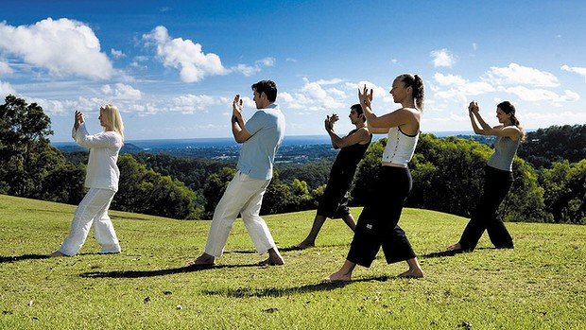
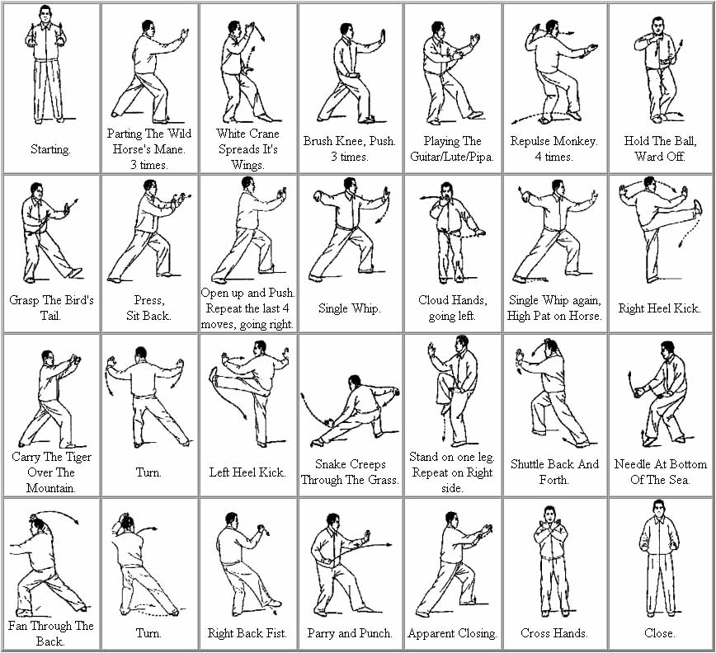
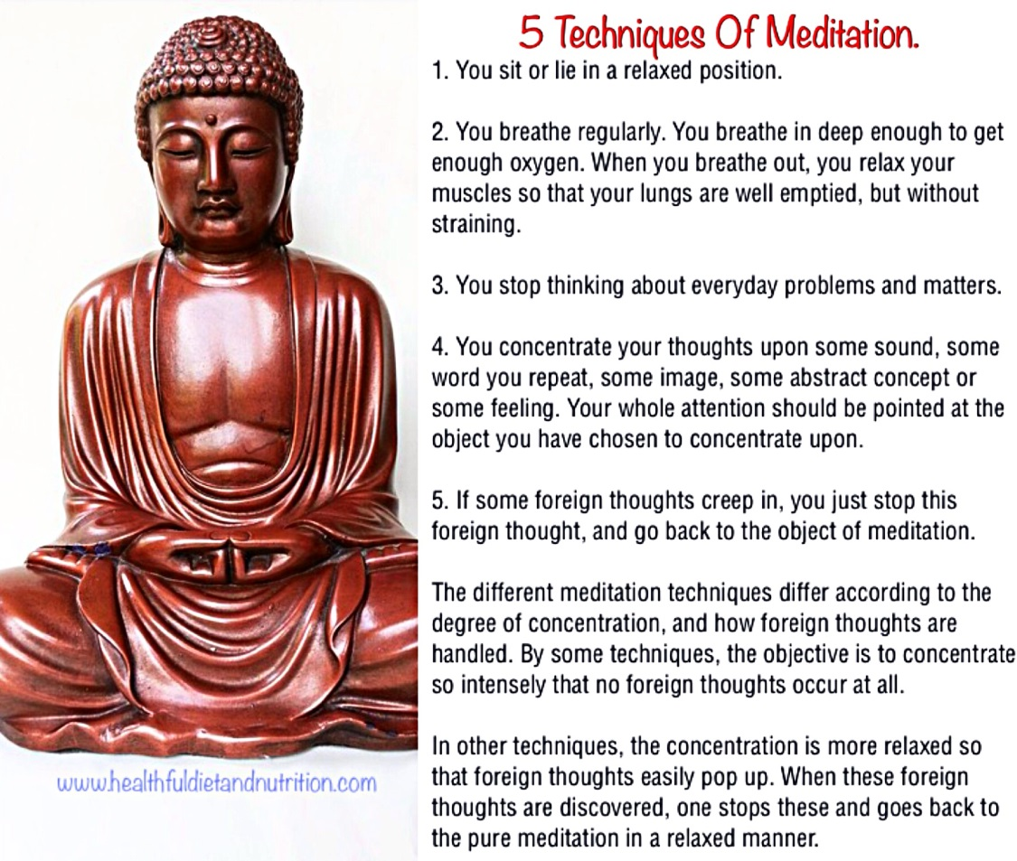

Slide 57
Breathing exercises
Breathing exercises: Conscious awareness and control of breath provide great tools for managing stress, anxiety, pain, and insomnia. If you deliberately slow and deepen your breath, you calm other bodily functions that might be otherwise overstimulated.
  More specifically, your heart rate slows, blood pressure is reduced, your thoughts become more calm and focused, and you become more aware of sensations coming from within and without.
There are a number of breathing exercises. A simple one is to sit or lie on your back in a comfortable position. Rest one hand on your chest and the other on your abdomen. Inhale deeply and fully, feeling your chest and abdomen rise. Notice how your sides become longer and your back feels fuller with inhalation. Pause briefly. Exhale completely, feeling your chest and abdomen fall.
Benefits of breathing exercises include the reduction of hot flashes associated with menopause, feelings of nervous tension and fatigue, pain perception, and test anxiety.

Slide 58
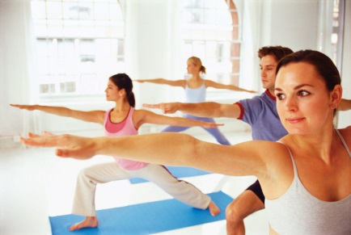
Yoga
This ancient practice originated in India some
5,000 years ago.
Hatha yoga, the form most often practiced in the Western world, emphasizes only three of those limbs: asanas (physical postures), pranayama (breath control), and dhyana (meditation).
  Often, the meditation involves awareness of breathing and concentration on physical postures. Chanting may also be included.
Studies show it enhances overall well-being, reduces feelings of stress and anxiety, improves sleep, eases low back pain, lifts mild depression, augments depression relief when added to antidepressant medications, lessens discomfort during pregnancy, reduces blood pressure, improves quality of life in the face of chronic conditions such as asthma

Slide 59
T’ai Chi Ch’uan and Qigong
T’ai chi ch’uan (tai chi) is derived from the martial arts, and the practice is nonviolent. Qigong involves slow, rhythmic movements timed with breathing.
  The exercises are designed to open the meridians (energy channels) through which qi travels. People young and old can learn the basic movements, which require low to moderate amounts of exertion.
Tai chi and qigong both tame stress. Studies in older adults indicate that tai chi and qigong may improve balance and strength, reduce falls, lower blood pressure, improve sleep, ease depression, relieve arthritis pain, and enhance immune response.
In addition, tai chi has been shown to improve exercise capacity in people with chronic obstructive lung disease. Qigong has been shown to improve sleep and reduce symptoms associated with menopause.

Slide 60
Acupuncture
Insertion of fine needles into points along meridians (energy channels) to restore balance and promote healing
Helps reduce various aches and pains
  Back pain, labor pains, arthritis pain, menstrual cramps
  Headache
  Tennis elbow
  Carpal tunnel syndrome

Slide 61
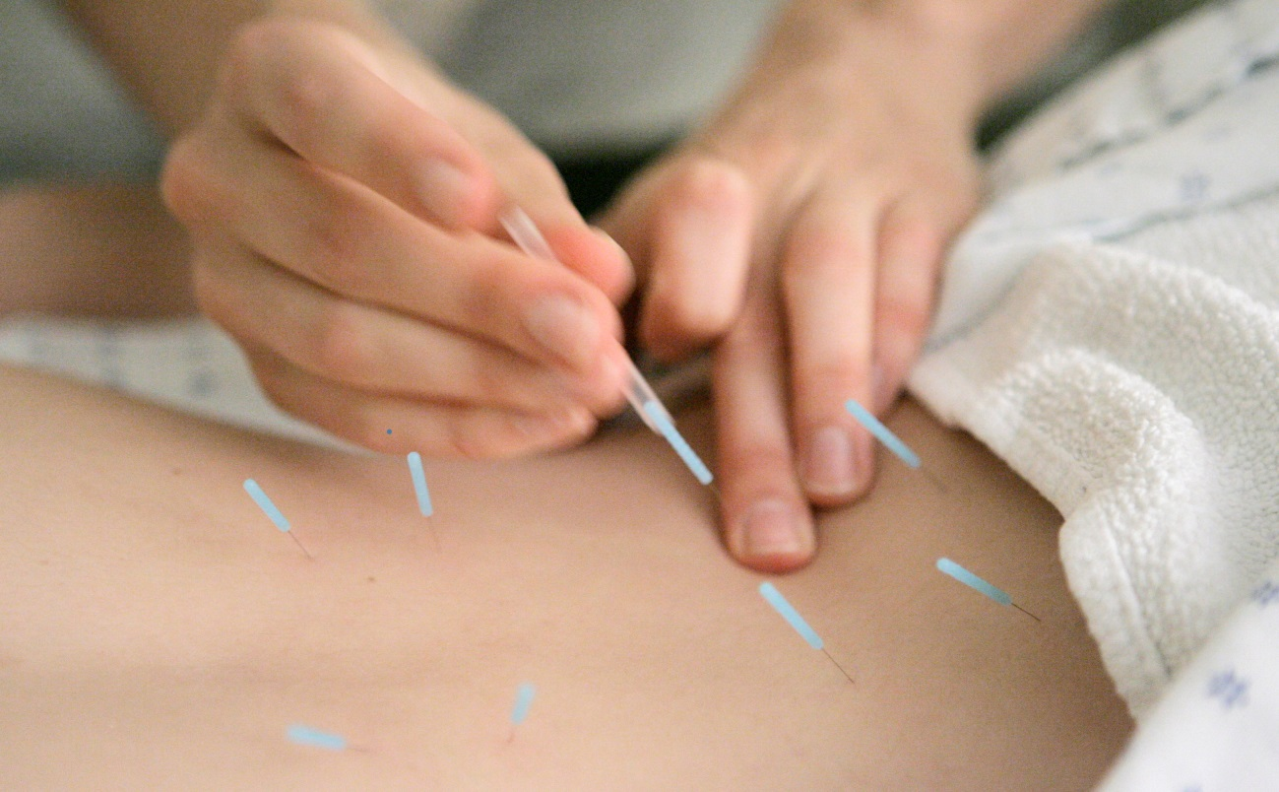
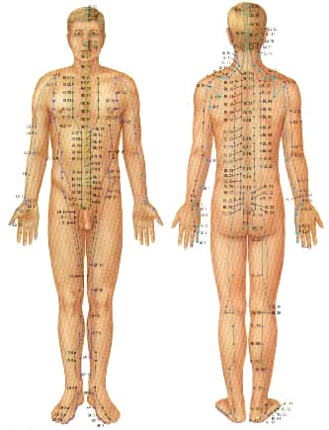
Acupuncture points

Slide 62
Relaxation Techniques
Progressive Relaxation
  Sequentially tightening and relaxing each muscle group
Guided Imagery
  Utilizes your imagination for relaxation
Self-Hypnosis
  Relies on phrases or nonverbal cues to trigger relaxation
Biofeedback
  Requires electronic devices to teach you how to gain conscious control over the relaxation response

Slide 63
Manipulative and
Body-Based Practices
Spinal Manipulation
  Applying gentle force to the spine to improve alignment and physical function and relieve pain
  Adjust joints all over the body
  Usually performed by chiropractors and osteopaths
Massage
  Relaxes tight muscles and improves the local circulation of blood
Movement-Based Therapies
  Combination of gentle manipulation, massage, and education about proper movements
  Helps avoid misalignment and unnecessary tension in performing everyday activities

Slide 64
Natural Products
Dietary supplements
  Vitamins, minerals, medical herbs, plant and fish oils, amino acids, enzymes, organ tissues, and some hormones
Regulated by FDA under Dietary Supplement Health and Education Act (DSHEA)
  Defines dietary supplements as products taken by mouth that contain a dietary ingredient
  Not as rigorous as regulation of pharmaceutical drugs

Slide 65
Herbal Medicines
Use of medicinal plants for health and healing; used worldwide
About 40 percent of drugs on the market are either natural products or derived from plants
  Advantages of nontoxic herbal medicines
    May achieve the desired effect
    The chemical complexity of plants can help buffer potential toxic effects of active chemicals
    Are generally less expensive and more easily accessible than drugs
  Disadvantages
    Slower onset and less dramatic effect than pharmaceutical drugs
    Some medicinal plants have side effects and are not safe for certain individuals, nor in high doses
    Some herbs interact unfavorably with drugs

Slide 66
Energy Medicine
Magnet Therapy
Light Therapy
Sound Energy Therapy
Therapeutic Touch and Reiki
Homeopathy
  System of medicine that treats illnesses with highly diluted substances that, in larger doses, would cause similar symptoms

Slide 67
Traditional Chinese Medicine
System of medicine originating in ancient China
Employs acupuncture, medicinal plants, massage, meditation, diet, and movement
Central tenets:
  Each person has a limited amount of qi.
  Qi circulates along 12 meridians, or energy channels, each of which links with internal organs.
  If Qi becomes depleted or blocked, ill health ensues.
  Goal is to balance the opposing forces of yin and yang.
Notes:
If there is a blockage of energy flow, sickness arises

Slide 68
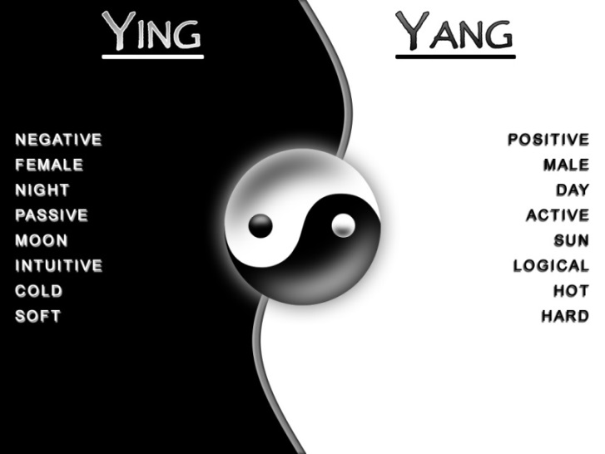
In Chinese philosophy, yin and yang describe how seemingly opposite or contrary forces may actually be complementary, interconnected, and interdependent in the natural world, and how they may give rise to each other as they interrelate to one another.
Many tangible dualities (such as light and dark, fire and water, expanding and contracting) are thought of as physical manifestations of the duality symbolized by yin and yang.
Duality is found in many belief systems, but Yin and Yang are parts of a Oneness that is also equated with the Tao.
Notes:
Opposites are complimentary

Slide 69
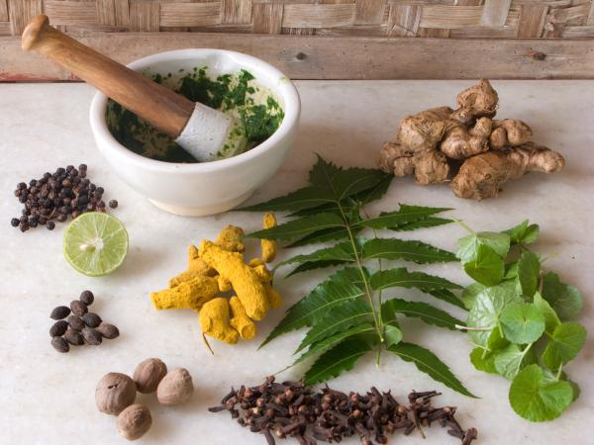
Ayurvedic Medicine
Traditional healing system that originated in India
Treatments include
  Dietary modifications, medical herbs and spices, bodywork, movement, breathing exercises, and meditation
Based on the belief that health and healing can be found through daily living practices
Notes:
Ancient use, has evolved through the years

Slide 70
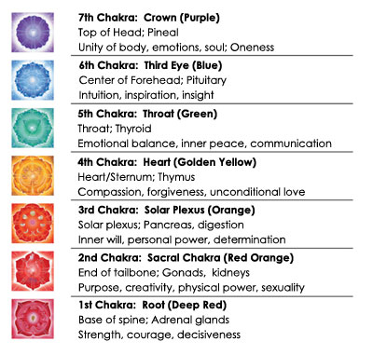
Chakras in Ayurveda
The focus is on
opening up
the Chakras
This allows
free flow of
energy and
helps the body
to function
harmoniously
Notes:
Important to understand
Flow of energy through body through chakras
They are the crossroad of energy flow
Remember the chakras what they do

Slide 71
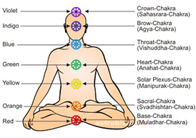
Chakras
There are 7 main energy centers in the body, known as chakras.
Each chakra is located throughout our body so that it correlates to specific body ailment and physical dysfunctions; each energy center also houses our mental and emotional strengths.
When we have a physical issue, it creates weaknesses in our emotional behavior. When we release the stale energy from the body, it can undo any tightness, stiffness, or malfunction of that area.
The clearing of the energy can also balance our emotional state of mind.
Notes:
To open up energy the chakras need to be opened, can be openend through yoga or breathing excercise

Slide 72
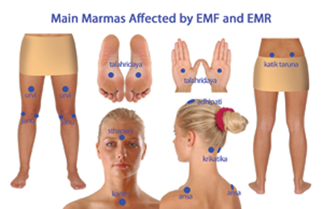
Marma
Marma therapy is an ancient Indian practice whose focus is the manipulation of subtle energy (prana) in the body for the purposes of supporting the healing process.
Marma therapy is based on the utilization of 107 points in the body which are considered to be access points to body, mind, and consciousness.
Knowledge of Marma allows the practitioner to influence the flow of prana through both the gross and subtle bodies for the purposes of restoring health and peace of mind.
Marma therapy is the original point system of healing in the body.
Notes:
The 108th one is outside the body, peripheral, hard to manage
Critical to understanding health problems, is a belief
Also used in helth and wellness, treat illness and diseases

Slide 73
Curanderismo and
Native American Healing
Curandersimo - form of Latin American folk healing
Native American healing - techniques used by the first people on this continent
Employ techniques for spiritual healing
Notes:
Not treated.. Healed .. Meaning the ilness and disease don’t return

Slide 74
Naturopathy
System of medicine that relies on natural treatments to correct imbalances and allow the body to heal.
Practitioners work with patients to address imbalances within the domains of wellness.
Goal of treatment is to address the root of the illness rather than suppress symptoms.
Practitioners employ a unique combination of modern medical science and natural medicines.
Notes:
Not one therapy, but a combiniation

Slide 75
Section 3 - Learning Objectives
Define holistic and integrative medicine.
Describe the premises and objectives of both.
Notes:
Holistic: a body as a whole not just the part that is sick, treat the whole individual, treat the whole (body, mind and spirit)

Slide 76
Holistic Medicine
Addresses the health of the whole person
  Body, mind, and spirit
Principles
  Humans have an innate ability to heal
  All dimensions of wellness must function optimally
    Physical, environmental, mental, emotional, social, spiritual, and financial
  Patients are people not diseases
  Correct the underlying cause of illness rather than symptom relief
  Patients and practitioners are partners
Notes:
Humans have innate ability to heal

Slide 77
Principles of Holistic Medicine
Homeostasis
  Internal state maintained by bodily processes
Psychoneuroimmunology (PNI)
  Study of how nervous, hormone, and immune systems interact
  Placebo - anything that isn’t expected to affect medical treatment
Placebo Effect
  Arises from administering a placebo
  Clinical trials are subject to a placebo effect
Notes:
No placebo in holistic, you either use therapy or no therapy

Slide 78
Integrative Medicine
Combines evidence-based conventional and CAM treatments
Goal: Utilize therapies that effectively improve health and well-being and minimize side effects
Increases options to prevent and manage illness
Advantageous for aging populations with complex conditions
  Prevents illness and improve disease symptoms and quality of life
  Reduces reliance on medication

Slide 79
Principles of Integrative Medicine
Patients and health practitioners work in partnership.
Practitioners consider all the domains dimensions of wellness when evaluating patients.
Practitioners promote healthy lifestyles and prevent illness.
Practitioners pick from both conventional and CAM treatments to enhance benefit and reduce risks.

Slide 80
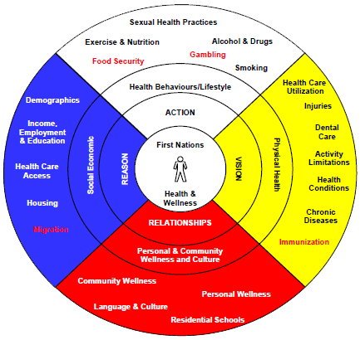
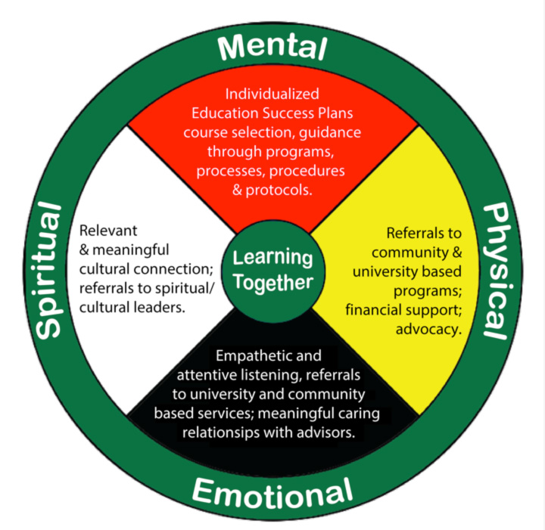
Holistic health wheel:
The four components of health
Holistic health for the
First Nations People
Notes:
Need to address ALL parts to heal a person

Slide 81
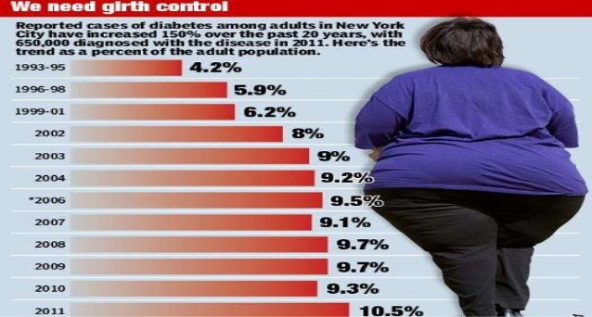
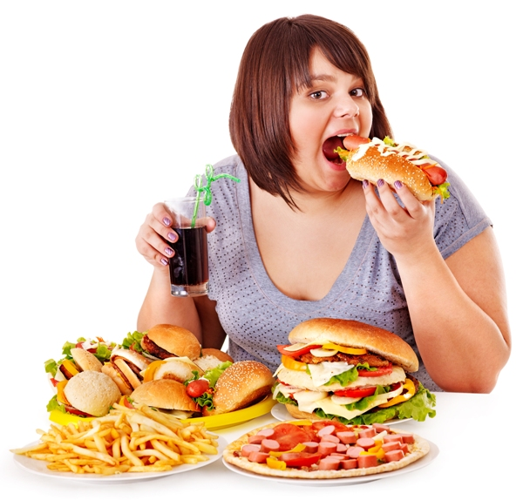
Then we wonder what is happening
Why is our body looking different
Health becomes our priority
We have a healthy appetite
We stint on physical activity
We lead a sedentary life
Health is not our priority

Slide 82
What did we learn (1)
How do we define health?
What is the difference between disease and illness?
What factors influence disease and illness?
How do we achieve optimum health?
What are the dimensions of optimum health?
Why immunize?
What are acute and chronic diseases?
Give examples of acute and chronic diseases.
Why is the etiology of chronic diseases complex?
What is epidemiology
What is the impact of chronic diseases
What is the epidemiology of chronic diseases in Canada currently and a decade later
What is preventive medicine?
Describe the different types of preventive medicine.
How do we achieve optimum health?

Slide 83
What did we learn (2)
What is conventional medicine?
What is complementary or alternative medicine?49
What CAM therapies are most commonly used in the United States? 50
Name and explain some the common complementary or alternative therapies?52
What are mind-body therapies?53
What are the benefits of mind-body therapies?54
Describe the characteristics of mindful meditation. 55
What is the goal of mindful meditation?55
What are the benefits of mindfulness?55
What are breathing exercises?57
What are the benefits of breathing exercises?57
What is hatha yoga and what are its objectives?58
What are the benefits of hatha yoga?58
How is tai-chi practised?59

Slide 84
What did we learn (3)
What are the benefits of tai-chi?59
What is acupuncture and what are its benefits?60
Name some types of relaxation techniques 62
What is the recommended Vit D intake in Canada?64
What is ayurvedic medicine?65
Name some of the energy medicines?66
What is Traditional Chinese Medicine?67
According to Chinese philosophy what is Yin and Yang?68
What is Ayurvedic medicine?69
Name the different chakras and the parts of the body they control?70
What are the colors of the different chakras?71
What is Marma?72
What is naturopathy?74
How is holistic medicine different from Western Medicine?76

Slide 85
What did we learn (4)
What are the key principles of naturopathy?77
What is integrative medicine?78
What are the principles of integrative medicine?79
What are the components of the holistic wheel?80
What are the current health problems in Canada?
How can we address the current health problems in Canada?
What is the role of CAM in Canada?

