Slide 1
Health and wellness
LEARNING OBJECTIVES
  Define health and wellness.
  Determinants of health
  Identify and characterize the relative contributions of medical care, genetics, personal behaviors, and environmental factors in determining health and longevity.
  Describe the dimensions of wellness.

Slide 2


The Healthy People Indicators
Health Indicators CIHI
What is health

Slide 3
What makes one person healthy and another ill?
Why do some people sustain long, vigorous lives while others suffer persistent illness and premature death?
Research yields some surprising answers.
  10 percent of untimely deaths are caused by shortfalls in medical care.
  Family history and genetics contribute to 30 percent of illness and death.
  Personal behaviors and environmental and social factors carry far greater weight in determining health and longevity (40%).
  These are the key indicators, but there are others.

Slide 4
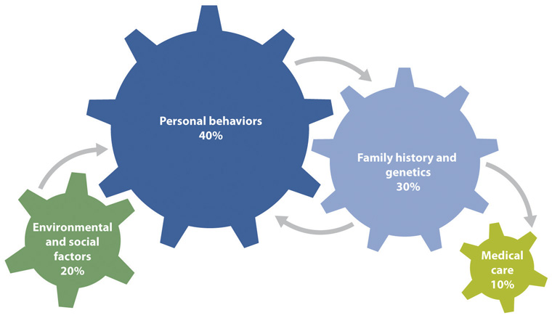

Health and Wellness/
Premature death
Four domains drive premature death:
1. Insufficient medical care is responsible for only 10 percent of these deaths.
2. Genetics and family history,
3. A person’s behaviors are the most important determinants of health and wellness;
4. Environment and social factors are also important indicators of premature death.
Furthermore, the interaction between domains need to be considered.

Slide 5
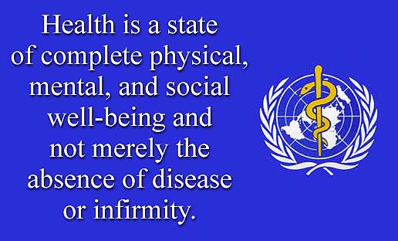
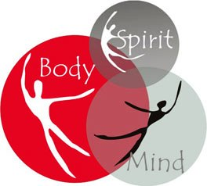
Definition of health
Class activity
Compare and contrast between Health and Wellness
How does the knowledge of health and wellness help the individual and the community?

Slide 6
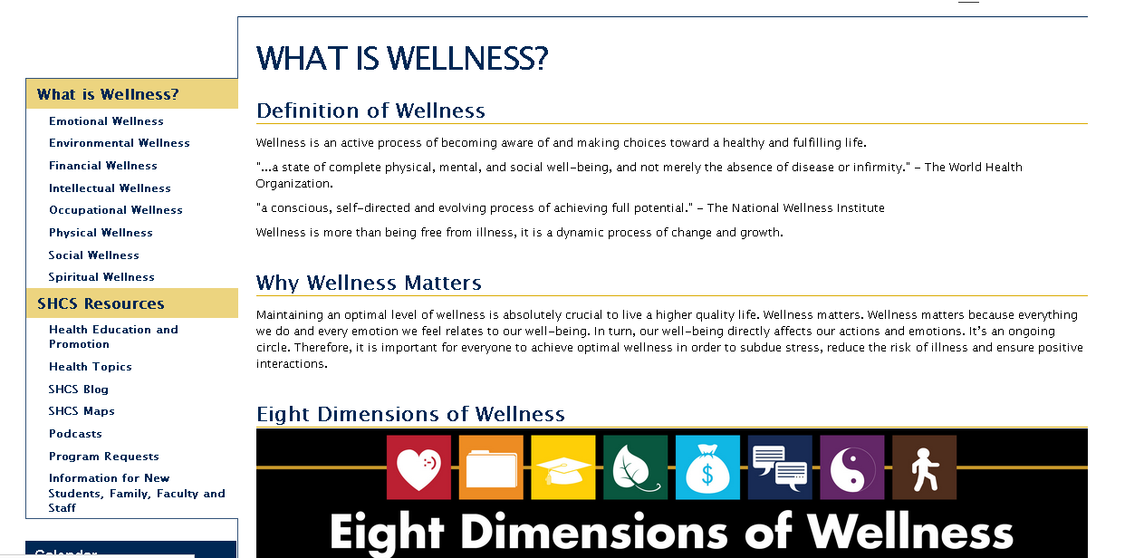
Definition of Wellness

Slide 7
Optimal health
Optimal health has become synonymous with wellness.
The WHO defines wellness as “the optimal state of health.”
The WHO further explains the two focal points of wellness:
  (1) “the realization of the fullest potential of an individual physically, psychologically, socially, spiritually and economically,” and
  (2) “the fulfillment of one’s role expectations in the family, community, place of worship, workplace, and other settings.”
  Optimum wellness is also termed “high-level wellness.”

Slide 8
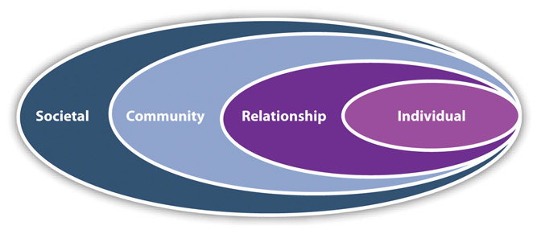
Social ecological model of health
Health can be viewed in an ecological framework, starting with an individual’s genetics and behaviors and expanding outward to social relationships, community resources, and greater societal influences.
Source: Adapted from Centers for Disease Control and Prevention. The social-ecological model: a framework for prevention. 2009. Available at: http://www.cdc.gov/violenceprevention/overview/social-ecologicalmodel.html.
Figure 1.2 "Social-Ecological Model of Health" illustrates four levels: individual, relationship, community, and societal factors.
You have the most control over your own health-related behaviors and the least over societal factors.

Slide 9
Determinants of health
Health is the ability of individuals or communities to adapt and self-manage when facing physical, mental or social challenges.
Health encompasses physical, mental, social and also quality as judged by presence or absence of disease
Determinants of health are factors that are associated with health and can impact health positively or negatively.
Determinants of health define health status and quality of health for individuals and communities.
A range of determinants of health have been defined by government and other agencies. These determinants identify, describe and predict the health of individuals and communities.
Determinants are used in assessing health, predicting health and determining the status of health.
In the present context determinants of health are synonymous with indicators of health and the definition depends on the need and use of the determinants of health.

Slide 10
Determinants of health
Individual Influences: You have the power to modify factors (beliefs and values, resiliency, coping skills, financial resources, education, health literacy, and health-related behaviors (diet, physical activity, sleep, substance use, sexual behaviors)).
  Some of the factors are outside of your control (genetics, family history, age, gender, race, and sexual orientation).
Relationships: Relationships include formal and informal social networks: family members, friends, roommates, classmates, coworkers, clubs, and support groups. Social support benefits health, particularly when friends and peers model and encourage health-promoting behaviors.
  In contrast, discord and violence undermine health; so does associating closely with people who abuse substances, engage in risky sexual behaviors, have consistently unhealthy diets, and disdain physical exercise.
Community Factors: Resources include the quality of neighborhoods, schools, religious institutions, housing, clinics and hospitals, parks and recreation centers, workplaces, air and water, and transportation. The cohesiveness of community members also figures in.
  In a pivotal examination of the health determinants published in online journal Health Affairs in 2002, J. Michael McGinnis and colleagues wrote, “Our genetic predispositions affect the health care we need, and our social circumstances affect the health care we receive.” ^{[7]}

Slide 11
Determinants of health (contd.)
Greater Societal Influences: Society and culture establish norms and attitudes about health-related issues such as diet, physical activity levels, body weight, smoking, substance abuse, sexuality, and violence. Intolerance and inequality based on gender, age, race/ethnicity, and sexual preference socially and economically marginalize those groups.
  The country’s overall economic health influences employment rates as well as the funding of social services, education, and health care. Environmental conditions directly impact health. Public health policies (public smoking bans, gun-control laws, seatbelt laws, universal vaccination, health insurance mandates) affect whole populations.
Family History and Genetics: In the past, discussions pitted genetics against environmental factors: nature versus nurture, genetic endowment as opposed to everything else—social environment and environmental influences. However, we know nature and nurture interact intricately, engaging in a lifelong dance.
  We inherit our genes from our parents. From there, ecology acts on those genes to affect our biology. Genetic traits can also color our responses to that ecology. So do the behaviors we learn from our parents, other role models, and the media. Multiple influences shape our physical, emotional, psychological, social, and financial health.

Slide 12
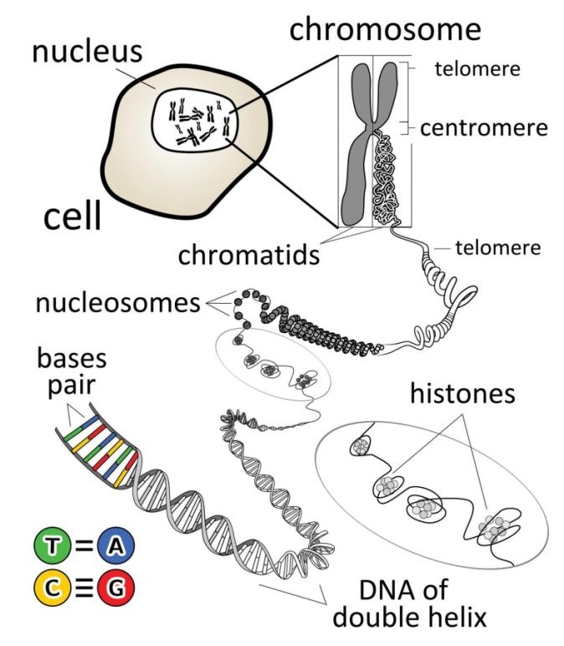
Molecular components of health
The genome is the complete set of deoxyribonucleic acid (DNA). DNA contains building blocks called nucleotides, which are arranged sequentially along chromosomes like beads on a necklace. The four nucleotide bases act like letters of the alphabet to spell out a code.
Chromosomes are threadlike structures containing DNA and protein. Humans have 23 chromosomes. pairs Most cells contain a pair of each chromosome for a total of 46. (Sperm and egg cells contain 23 chromosomes.)
Each chromosome contains many genes. A gene is the basic unit of heredity. Each gene is made of a specific sequence of nucleotide bases and codes for a particular protein. In 2003, the US Human Genome Project identified and sequenced all 20,500 human genes. The genome forms a blueprint for the structure and function of the body.
Proteins perform your body’s essential functions. They form structural components in your body (bones, ligaments, tendons, teeth, hair) and enzymes, which catalyze chemical reactions. The collection of proteins expressed by the genome is called the proteome.

Slide 13
Genetic and non-genetic basis of diseases
Only about 2 percent of deaths are purely genetic in nature and some diseases have a strong genetic component (genetic).
  A few are caused by a single mutated gene. Examples include sickle cell anemia (a mutation that distorts red blood cells), Tay Sachs disease (an enzyme deficiency that results in accumulations of fatty material in the brain), and cystic fibrosis (a defect that makes mucus sticky and difficult to clear in organs such as the lungs).
However, the marked health disparities and major diseases are not caused by genetic variations (non-genetic).
  The common chronic diseases of modern life stem from a complex interaction of genes, lifestyle habits, and environmental exposures. These so-called multifactorial diseases include common chronic conditions such as cardiovascular disease, diabetes, cancer, obesity, and Alzheimer’s disease. While these diseases may have genetic risks, they manifest from genetic vulnerability plus life experiences.
Our experiences and exposures modify gene expression, the conversion of genetic information into a protein (combined).
  Not all genes are “read” (transcribed into proteins). That’s because, within the chromosomes, DNA is coiled around special proteins. In the chromosomes, the DNA winds around histones (a particular type of protein). Genes that are tucked within this coil can’t be read. Substances can also bind to genes (and their associated proteins) to prevent or allow their expression. Some genes promote or suppress the expression of other genes.

Slide 14
Determinants of health (contd)
Environmental determinants of health
  Environmental determinants are those physical elements that affect health. The natural environment includes plants, animals, natural resources, weather, and climate change. Access to natural landscapes (“green spaces”) positively influences human health.
  The manmade environment gives us buildings (housing, workplaces, recreation centers, cultural events centers, industrial operations) and transportation. Our activities can both create aesthetically pleasing works and give rise to damaging pollutants.

Slide 15

Environmental influences on health
Environmental determinants are those physical elements that affect health. The natural environment includes plants, animals, natural resources, weather, and climate change. Access to natural landscapes (“green spaces”) positively influences human health.
The manmade environment gives us buildings (housing, workplaces, recreation centers, cultural events centers, industrial operations) and transportation. Our activities can both create aesthetically pleasing works and give rise to damaging pollutants.
Environmental influences begin before birth. Exposures to various chemicals can affect the eggs and sperm that combine to form an individual. The mother’s nutritional status, stress level, and overall health determine the environment in which a fetus develops. Early childhood experiences—some infectious diseases, abuse, neglect, family discord, and malnutrition—can have profound influences on health in adult life.

Slide 16
Environmental health (contd)
Throughout life, toxic exposures can increase the risk of cancer and other chronic diseases. Contaminants such as toxic chemicals and microorganisms in food, water, air, and soil pose health risks.
  Geographic location can determine exposure to noxious substances. Around the world, the poor are more likely than the rich to live near industrial operations and disposal sites for toxic waste. In developing countries, people often lack the luxury of clean drinking water. They may heat their homes by burning coal, which releases respiratory irritants.
The built environment shapes health; buildings for residences and workplaces need to be safe.
  Communities designed for motor vehicle transportation promote inactivity and obesity. On the other hand, communities that create safe pedestrian and bicycle routes improve health by reducing pollution and encouraging physical activity.
  People with ready access to recreation centers and safe green spaces have better physical and mental health.

Slide 17
SES and family as determinants
Socioeconomic Determinants of Health: Socioeconomic factors include your social experiences and economic realities.
  Socioeconomic status (SES) refers to one’s position in society based on education, occupation, and income. SES factors encompass social support, access to educational and job opportunities, availability of healthy foods, exposure to actual and media violence and chaos, prevailing attitudes and norms that relate to tolerance and acceptance, economic disparities, and the safety of neighborhoods.
Family: You inherit your genes from your biological parents. Your family also powerfully shapes your attitudes, values, eating habits, physical activity patterns, methods of managing stress, and social skills.
  Healthy families support and love one another, share responsibilities, eat together, enjoy leisure activities together, and don’t abuse substances. Well-nurtured children have better health and survival rates.
Notes:
Ses: income, education and job

Slide 18
Education as a determinant
Education: Educational level predicts health and longevity. Surveys show that college graduates are twice as likely as those who hadn’t graduated from high school to be in excellent health.
  Among people aged 45 to 64, the death rate for those with the highest level of education is 2.5 times lower than for people with the lowest education.
  One study found that, compared with whites with less than 12 years of education, blacks and Hispanics with 16 years of education lived an additional 7.5 and 13.6 years, respectively.
  Persistent racial discrimination and a two-tiered education system probably explain why most educated white men outlived the least educated black men by 14.2 years. The gap was 10.3 years for highly educated white women versus less educated black women.
Education promotes health for multiple reasons.
  Higher educational attainment correlates with better jobs, higher income, higher social status, health insurance coverage, less smoking, more physical activity, and less obesity.
  Education increases your health literacy, your ability to locate and understand health information, to obtain health services and to make informed health care decisions.
  Greater health literacy is linked to a reduced risk of hospitalizations, emergency room visits, and deaths.

Slide 19
Financial status and poverty
Financial Status: Poverty contributes to an estimated 6 percent of mortality (death). For every 1 percent increase in income inequality, mortality rates rise 0.4 for those at the bottom.
  Feeling poor is stressful, which is bad for your health.
  Relative to more affluent neighborhoods, poor neighborhoods tend to have higher crime, worse pollution, suboptimal schools, scarcer grocery stores, and fewer parks and other green spaces—all of which undermine health and well-being.

Slide 20
Race and ethnicity
Race and Ethnicity: Race refers to categories of people based largely upon physical appearance: the color of skin, hair, and eyes and the shape of the nose, eyes, and jaw. Ancestry influences these appearances. Ancestry also shapes ethnicity, as do culture, nationality, language, traditions, and beliefs.
  Race and ethnicity can be considered synonymous at this stage and refers to cultural, national and ethnic origins. Certain ethnic origins are susceptible to certain conditions.
Ethnicity affects health by influencing dietary patterns and attitudes toward education, substance use, physical activity, and health care.
  For example, sickle cell disease mainly affects people of African and Mediterranean descent; cystic fibrosis tends to affect people of Northern European ancestry.
Causes of death and disease prevalence vary by race.
  For instance, the number one cause of death in whites, blacks, American Indians, and Alaska Natives is heart disease. For Hispanics, Asian Americans, and Pacific Islanders, cancer is the top killer and heart disease is second.
  Hispanics are more vulnerable to diabetes, blacks to stroke, and whites to Alzheimer’s disease. Relatively more deaths from accidents, liver disease, and diabetes affect American Indians and Alaska Natives.

Slide 21
Gender and health care
Gender: Sex is biologically based. The WHO defines gender as “the socially constructed roles, behaviours, activities, and attributes that a given society considers appropriate for men and women.”
  American women outlive men by five years. In 2011, the life expectancy for men was 76.2 years versus 81.1 years for women. A complex interplay of biological and cultural differences contributes to this difference. Hormonal differences affect vulnerabilities to certain illnesses. Women are more likely to suffer from depression and osteoporosis (brittle bones).
Medical Care: Conventional medical care has a limited effect on people’s health. Insufficient medical care accounts for an estimated 10 percent of deaths. Researchers and scientists predict that, as the population continues to age (and requires more medical care), that number will rise.
Older people tend to have more diseases, many of which can be managed by medical treatment. No matter one’s age, medical treatment can be lifesaving, particularly in the face of overwhelming infection or traumatic injury. Vaccinations prevent many infections that once cut life short. Medical technology helps diagnose and promptly treat many diseases.
  On the other hand, medical care sometimes causes harm. A landmark 1999 study from the Institute of Medicine reported that as many as 98,000 people die each year from medical errors—more than deaths from car crashes, AIDS, and breast cancer.

Slide 22
Lifestyle and personal behaviors
Personal Behaviors: Modifiable lifestyle patterns contribute to an estimated 40 percent of deaths.
  Each day, you make important decisions about diet, physical activity, substance use, and sex. You decide how you’ll handle life’s curveballs, whether you stress out or view them as challenges to master. You budget how much time you make for sleep and socializing.
Four unhealthy behaviors—lack of physical activity, insufficient intake of fruits and vegetables, tobacco use, and excessive alcohol consumption—cause most of the illness and death related to chronic diseases.
  A British study tracked the impact on longevity of those four health behaviors over a span of 11 years. People with the lowest scores (smoked, didn’t exercise, drank too much, and didn’t consume at least five servings of fruit and vegetables a day) had four times the risk of dying relative to their peers who made the healthiest choices.

Slide 23
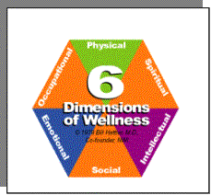
Dimensions of wellness:
  Health and wellness are more than the absence of disease.
  The most important determinant of health and longevity is personal behaviors. Genetic and family history, social factors, and environmental factors also influence health. Medical care, while critical, is the least important factor.
  Optimal wellness encompasses health in all the domains of a person’s life. The dimensions of wellness include physical, emotional, social, intellectual, spiritual, occupational, and environmental.

Slide 24
Dimensions of wellness (1)
The Dimensions of Wellness: In a move away from examining health on the physical plane alone, experts have defined wellness according to six to seven dimensions. While some sources omit environmental wellness, physical environments clearly influence people’s health and well-being.
Dimensions of wellness
1. Physical wellness takes into account a number of biological factors: level of physical fitness, presence or absence of disease or injury, and a person’s ability to take care of himself or herself.
2. Emotional wellness refers to the overall balance of a person’s emotional state (happy, sad, angry, tranquil, etc.), awareness of emotions, and ability to express emotions freely and appropriately.
  People with positive emotional health are capable of trust, intimacy, and love. They are generally happy, optimistic, and self-confident and feel they accomplish what they set out to do.
3. Social wellness springs from emotional wellness. Socially healthy people enjoy satisfying interpersonal relationships.

Slide 25
Dimensions of wellness (2)
4. Intellectual wellness refers to the ability to organize and express ideas; to think critically, rationally, and analytically; to maintain a sense of curiosity; and to solve problems using brainpower.
  Skills learned in the classroom can be used in life experiences. Creativity and zest for learning keep people vital and engaged throughout life.
5. Spiritual wellness provides a sense of meaning and purpose in life. Spiritual people possess a set of beliefs, principles, and values that guide their decisions. They rise above intolerance, petty grievances, and grudges toward compassion, forgiveness, and altruism (a selfless concern for the well-being of others).
  They may have a sense of being part of a grander scheme.

Slide 26
Dimensions of wellness (2)
6. Occupational wellness entails identifying passions and career goals, preparing to meet those goals (which is one purpose of college), and finding work that pays the bills and provides a sense of personal satisfaction. Work can be paid or unpaid, including volunteer activities and scholastic pursuits.
  Financial stability is important. Its opposite generates stress and reduces access to healthy food, safe living situations, and health care—all of which jeopardize health. It’s also important to find a healthy balance between work and play.
7. Environmental wellness refers to the safety and cleanliness of your physical environment, as well as your attitude toward the environment and your commitment to improving it. Environmental toxins can make you sick. On the other hand, beauty in your environment enhances your well-being.
  Your contributions toward protecting the planet—recycling, conserving natural resources, reducing pollution, preserving wilderness areas—have an impact and provide a sense of personal engagement.

Slide 27
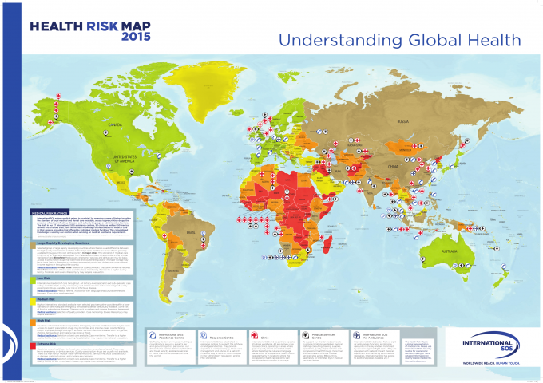
Health and wellness of individuals
Rapidly developing
Low risk
Medium risk
High risk
Very high risk

Slide 28
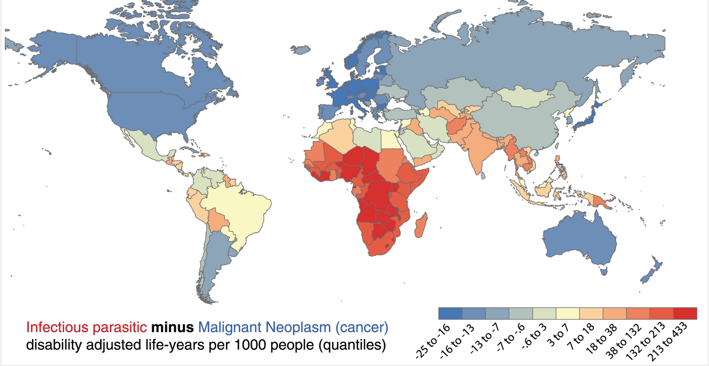
Health status across the globe

Slide 29
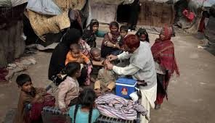
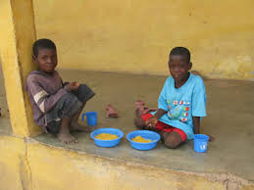
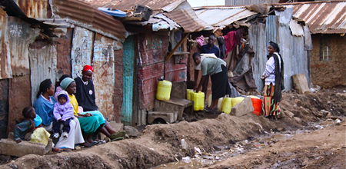
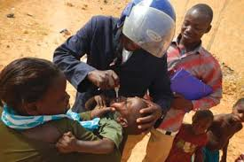

A child born today on this planet describe his/her health trajectory taking into considerations
Determinants of health

Slide 30
Global health
Global health is dependent on the demographic profile, economy, political profile, environmental conditions, health care delivery and health status of the individuals and community.
Global health relates to populations around the world. Although it transcends national concerns, the well-being of people in far-flung countries affects us all.
  Human health and wellness, education, income, productivity, environmental health, and political stability all intertwine.
International organizations such as the United Nations and the World Health Organization have focused on reducing and eliminating communicable diseases, illnesses caused by infectious agents or their toxins that people can acquire from other humans, animals, and the environment (contaminated food, air, water, soil, etc.).
  Illnesses such as infectious diarrhea, malaria, tuberculosis, and AIDS prematurely end lives.
Some of these infections are acute illnesses, meaning they last a short time. Acute illnesses can be mild or life-threatening.
  Many cases of infectious diarrhea are acute, though they can be deadly, especially in infants and small children. On the other hand, tuberculosis and AIDS are chronic illnesses, meaning they last longer than three months.

Slide 31
Global health (2)
Communicable diseases are rampant in the developing world. Their solutions lie in providing clean water and food, sanitation, vaccinations, and strategies to eradicate disease-causing agents from the environment.
  Antimicrobial drugs help treat those infections that elude prevention. These advances increase quality and quantity of life.
More recently, international experts have recognized the parallel threat of non-communicable diseases, illnesses that are not infectious or readily transmissible.
  The top non-communicable conditions are obesity, cardiovascular disease, type 2 diabetes, cancer, and chronic lung disease.
For decades, non-communicable diseases have caused significant morbidity (illness) and mortality in the developed world. As the “Western lifestyle” of tobacco; inactivity; and salty, fatty, sugary foods has spread around the globe, these chronic diseases have likewise become common in developing countries.
  These risk factors contribute to disease incidence (the number of new cases of a condition occurring within a certain time frame) and prevalence (how many people have the condition at any point in time).

Slide 32
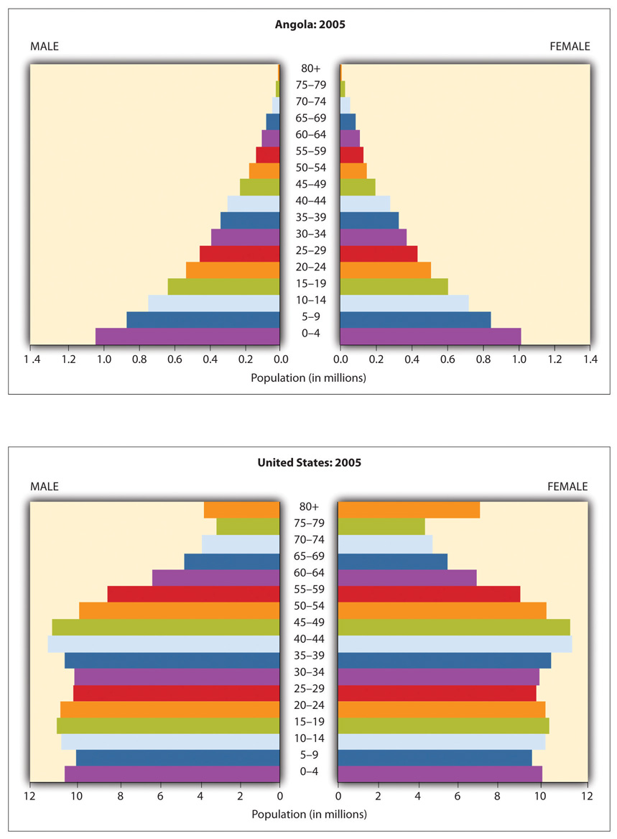
1. Compare and contrast
The two pyramids
2. Name two other
Countries with similar
Pyramids as the
USA and Angola
3. How does these
Pyramids affect
The health status of:
The individual
The community
The population of that
country
Population pyramid in the USA and Angola

Slide 33
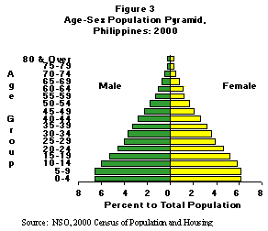
A typical population pyramid in the developing countries
Notes:
Why is the pyramid of this shape and how does it differ from that of the developed countries

Slide 34
Health of the world (1)
The Institute for Health Metrics and Evaluation periodically measures the world’s most significant health problems and evaluates their possible solutions.
Here are some of the key findings:
The world’s inhabitants are living longer, mainly because fewer infants and children succumb to infectious diseases.
In many developing countries, a number of positive changes have increased longevity: public health initiatives (clean water, proper disposal of sewage, vaccinations), improved nutrition, and family planning (which reduces the birth rate and increases the survival of those children who are born).
Africa is the one continent that hasn’t significantly improved conditions of extreme poverty: maternal and infant mortality, childhood infections, malnutrition, malaria, and AIDS.
As cars become more available in developing countries, the incidence of roadway injuries has escalated.
The incidence and prevalence of chronic, non-communicable disease has increased substantially. People live long enough to develop these conditions, and medical advances have extended the life of those who have these illnesses. That means that those years gained aren’t necessarily spent in good health.

Slide 35
Health of the world (2)
The biggest health risks for chronic illness and death are high blood pressure, tobacco use, physical inactivity, and overweight and obesity.
The top two causes of death worldwide are now heart disease and stroke (brain injury due to interrupted blood flow). Other chronic, lifestyle-related conditions that have increased include diabetes and painful conditions such as arthritis and low back pain.
The prevalence of substance abuse and mental illnesses are on the increase. Untreated mental disorders now account for 13 percent of the global burden of disease, with depression alone ranking as the third leading cause of disease burden.
People are now living long enough to develop dementia, a group of conditions marked by progressive loss of intellectual and social function. Between 1990 and 2010, Alzheimer’s disease (the most common type of dementia) tripled.

Slide 36
Why do we have more senior adults?
Four factors explain that shift toward a population top-heavy in older adults:
  Thanks to the public health measures listed, childhood death rates have fallen.
  The period of increased prosperity following World War II led to the “baby boom,” with high birth rates between 1946 and 1964.
  Birth rates have subsequently declined. That’s because contraceptives became more available and parents no longer feared their children would die of infections.
  Life expectancy increased.
Notes:
Now older Americans (those 65 and up) are the fastest growing segment of the population. The proportion of people over age 85 has also increased dramatically. At the turn of the 20th century, 4.1 percent of Americans were over the age of 65. ^{[9]} By 2004, that percentage tripled to 12.4 percent. In 2010, 13 percent of Americans were 65 and up. Baby boomers have begun to enter their senior years. By 2030, an estimated 71 million older adults will make up 20 percent of the population. ^{[10]} After 2030, this growth is expected to slow once the last baby boomers blow out the candles on their 65th birthday cakes.

Slide 37
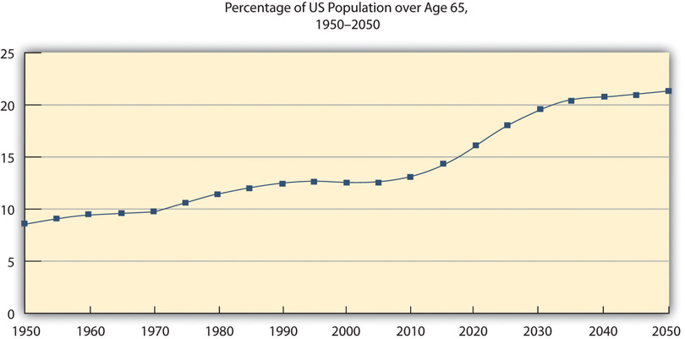
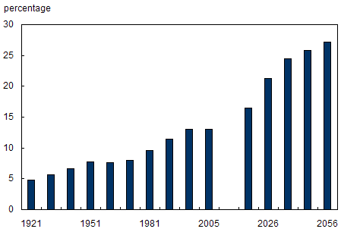
Percentage of Canadian population comprised of persons aged 65 or older,
1921 to 2005 and projections to 2056
Notes:
Unfortunately, increased longevity combined with the “Western lifestyle” has bred chronic diseases. About 80 percent of American elders live with at least one chronic condition. ^{[11]} Chronic illness accounts for 70 percent of deaths in the United States and 75 percent of health care expenditures. ^{[12]}
However, long-term medical conditions such as obesity, diabetes, and high blood pressure have become more common at all ages, even children. In 2010, at least one chronic illness plagued 147 million Americans—half the adult population. ^{[13]} Obesity, inactivity, poor nutrition (cheap, fast, widely available junk food), smoking, stress overload, sleep deprivation, social isolation, and other ills have increased the proportion of chronic diseases.
Two-thirds of American adults and one-third of children and teens are now overweight or obese. ^{[14],} ^{[15]} Since 1980, the prevalence of childhood obesity has tripled. ^{[16]} Over the past 30 years, childhood obesity has more than doubled and teen obesity has tripled. ^{[17]} Unfortunately, overweight and obesity in childhood often persists into adulthood, which raises the risk of associated chronic illnesses such as diabetes, heart disease, stroke, arthritis, and some cancers. Experts predict that, unless society halts this trend, this generation of children will be the first not to live longer than their parents. ^{[18]} In addition to the health burdens, the economic burden of lost productivity and increased health care costs will be staggering. ^{[19]}
What’s perhaps most startling is our poor ranking compared to peer nations. In early 2013, researchers from the National Research Council and Institute of Medicine published an analysis of health and longevity called U.S. Health in International Perspective: Shorter Lives, Poorer Health. ^{[20]} The subtitle says it all. Here are the findings of this study and a follow-up analysis of the data

Slide 38
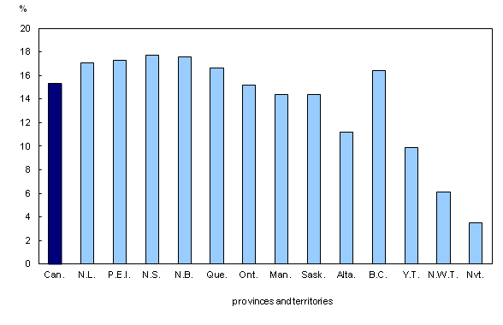
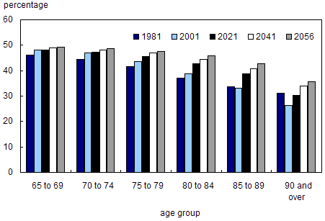
Percentage of persons within age groups who are men, Canada,
1981 and 2005, projections to 2056

Slide 39
Population distribution by age in Canada
 | Total | Male | Female
Total | 35,158,304 | 17,432,249 | 17,726,055
0 to 4 years | 1,921,412 | 984,722 | 936,690
5 to 9 years | 1,883,512 | 965,147 | 918,365
10 to 14 years | 1,869,199 | 960,742 | 908,457
15 to 19 years | 2,179,006 | 1,120,537 | 1,058,469
20 to 24 years | 2,446,698 | 1,246,369 | 1,200,329
25 to 29 years | 2,409,241 | 1,209,536 | 1,199,705
30 to 34 years | 2,435,190 | 1,214,559 | 1,220,631
35 to 39 years | 2,326,894 | 1,159,716 | 1,167,178
40 to 44 years | 2,371,685 | 1,187,356 | 1,184,329
45 to 49 years | 2,568,671 | 1,290,788 | 1,277,883
50 to 54 years | 2,754,727 | 1,382,599 | 1,372,128
55 to 59 years | 2,502,143 | 1,248,891 | 1,253,252
60 to 64 years | 2,110,304 | 1,042,961 | 1,067,343
65 to 69 years | 1,747,099 | 851,888 | 895,211
70 to 74 years | 1,256,325 | 593,901 | 662,424
75 to 79 years | 946,039 | 430,712 | 515,327
80 to 84 years | 728,181 | 308,187 | 419,994
85 to 89 years | 452,943 | 165,075 | 287,868
90 to 94 years | 200,644 | 59,521 | 141,123
95 to 99 years | 41,480 | 8,152 | 33,328
100 years and over | 6,911 | 890 | 6,021
Class activity
Determine the
percentage of
population over
60 years of age for each
of the age categories
both males and females.
Also determine the
percentage population
of the total population
over 60years of age
for each of the age
groups.
What percent of the
population is over 60 years
of age
Notes:
Plot population pyramid for Canada
Get the provincial population by age and sex and plot the population pyramids for all the provinces and describe the profile

Slide 40
Compared to 16 other affluent democracies, US life expectancy is shorter. The life expectancy at birth is now 78.7 years (76.3 for men, 81.1 for women).
  Compare that to Japan (80 for men, 86 for women).
More Americans die before age 50 and are sicker by the time they reach that age. In fact, much of the gap in life expectancy had to do with higher mortality before age 50. The United States’ ranking for key indicators of health is at the bottom.
  Recent immigrants to the United States have better health than the natives.
The United States has higher rates of low-birth-weight babies (an indicator of poor maternal health), premature babies, and infant mortality.
  The United States has higher rates of teen pregnancies and sexually transmitted infections, including HIV (human immunodeficiency virus, which can cause acquired immunodeficiency syndrome, or AIDS).
  Higher rates of unintentional injuries (especially from motor vehicle collisions) and homicides (mainly from firearms) claim the lives of many American youths.

Slide 41
Americans have a higher prevalence of anxiety, depression, impulse control, and substance abuse disorders.
Alcohol and drugs sicken and kill more Americans. In fact, drug overdoses are a big contributor to deaths under age 50.
Americans are more likely to develop obesity, heart disease, diabetes, and chronic lung disease, and general disability is higher.
Americans smoke less and do better at controlling blood pressure and cholesterol levels (two heart disease risk factors) and detecting cancer and treating cancer.
Americans who do survive to age 75 are more likely to hang on longer than do seniors in other countries.

Slide 42
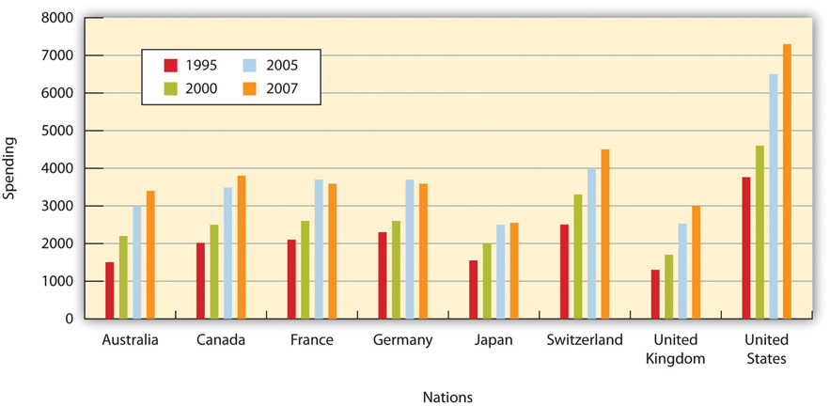
Per Capita Health Care Spending in Industrialized Countries
The United States spends more health care dollars per person than any other developed country but doesn’t earn as much from its investment.
Source: Adapted from Sugar-Baby-Love. Total health expenditure per capita, US dollars PPP. Data source: OECD Health Data 2010. Available at: http://commons.wikimedia.org/wiki/File:Total_health_expenditure_per_capita,_US_Dollars_PPP.png.

Slide 43
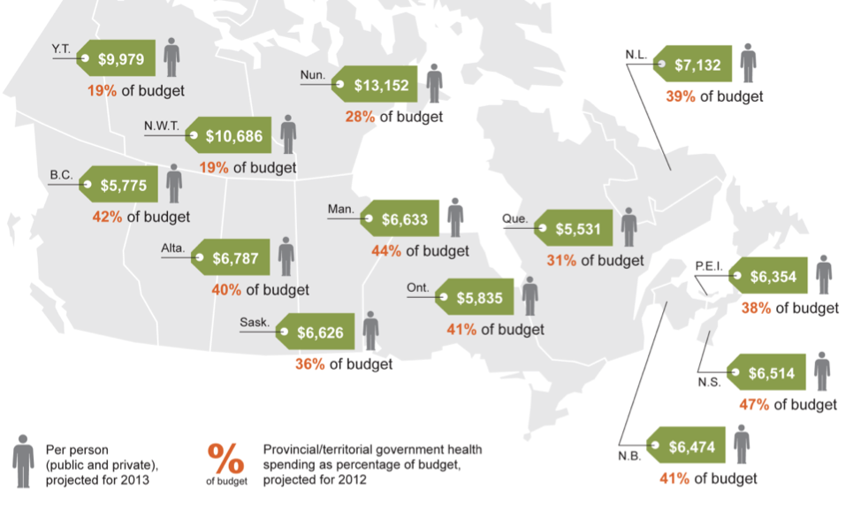
Health care spending in Canada

Slide 44
The 10 Leading Causes of Death in 2011 for Americans of All Ages
  Heart disease
  Cancer
  Chronic lower respiratory diseases (asthma, chronic bronchitis, and emphysema)
  Stroke and related diseases of the blood vessels supplying the brain
  Unintentional injuries (accidents)
  Alzheimer’s disease (the most common type of dementia)
  Diabetes mellitus
  Influenza and pneumonia
  Kidney diseases
  Suicide
Source: Hoyert DL, Xu J. Deaths: preliminary data for 2011. Natl Vital Stat Rep. 2012;61(6):4. National Center for Health Statistics. Centers for Disease Control and Prevention.
Available at: http://www.cdc.gov/nchs/data/nvsr/nvsr61/nvsr61_06.pdf. Accessed January 25, 2013.

Slide 45
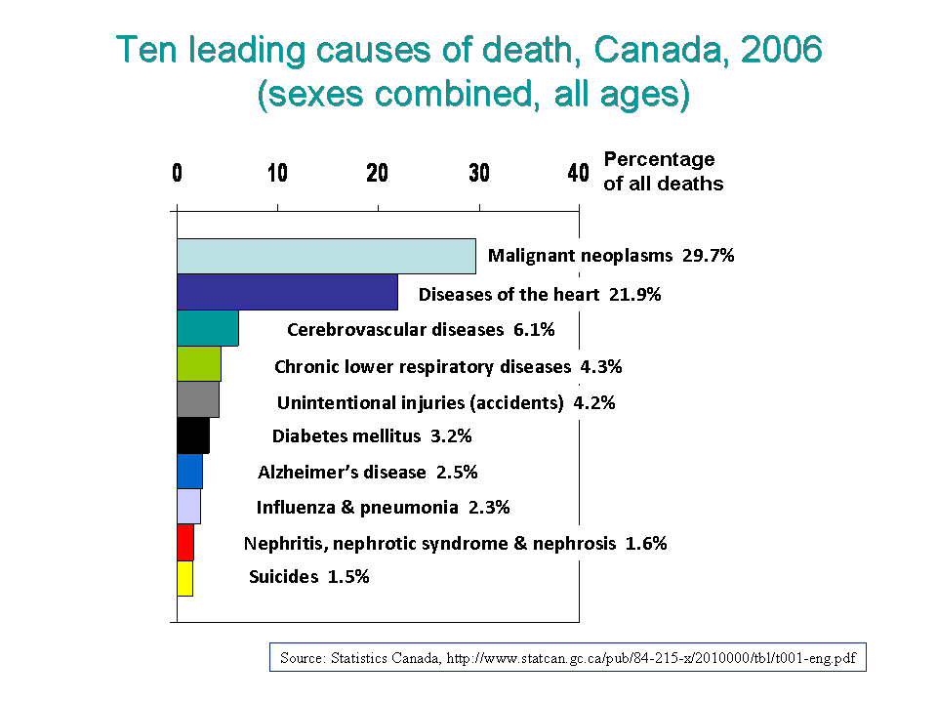

Slide 46
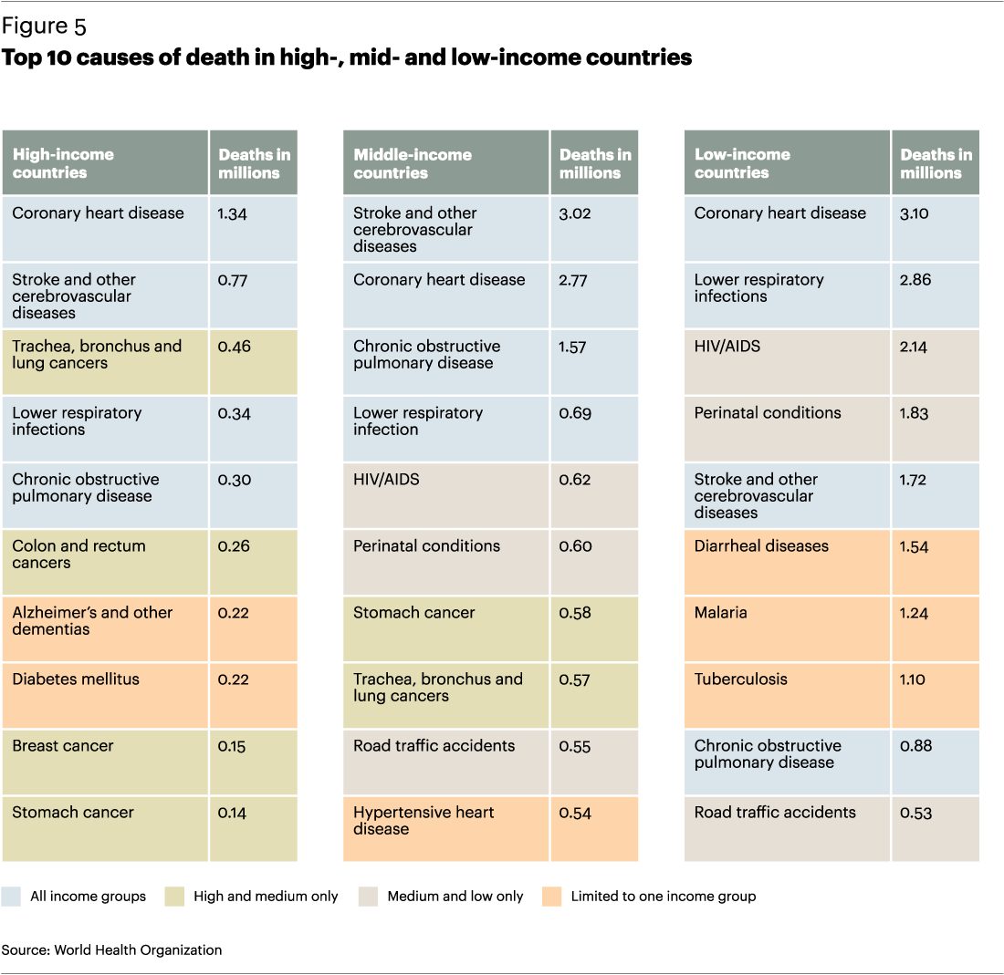

Slide 47
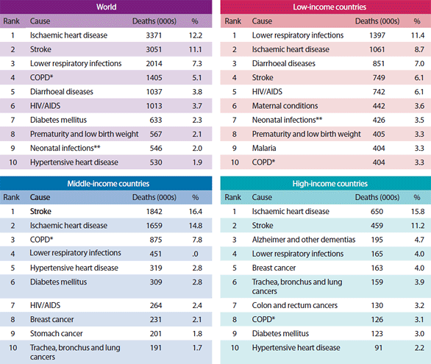

Slide 48
The 10 Leading Causes of Death in 2011 for Americans 15 to 24 Years Old
  Unintentional injuries (accidents)—of these 12,032 deaths, nearly 7,000 involved motor vehicle accidents
  Suicide
  Homicide
  Cancer
  Heart disease
  Congenital disorders (those present from birth)
  Influenza and pneumonia
  Stroke and related diseases of the blood vessels supplying the brain
  Pregnancy and childbirth
  Chronic lower respiratory diseases
Source: Hoyert DL, Xu J. Deaths: preliminary data for 2011. Natl Vital Stat Rep. 2012;61(6):30. National Center for Health Statistics. Centers for Disease Control and Prevention.
Available at: http://www.cdc.gov/nchs/data/nvsr/nvsr61/nvsr61_06.pdf. Accessed January 25, 2013.

Slide 49
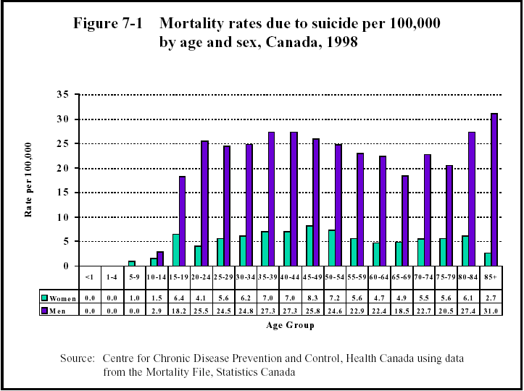
Notes:
Topic for assignment or a quiz
Describe the differences in male and female mortality in Canada.
What about similar differences in the rest of the world

Slide 50

Health People 2020 Goal

Slide 51

Healthy people: who are they and how they get healthy and why?
Wellness is not just absence of
Disease
But
Optimum health in all aspects
of the different dimensions
of wellness
Click on the picture for a video
Notes:
Three decades later, the program continues. Healthy People 2020 established ambitious yet achievable goals for a number of areas. ^{[45]} Here are some examples of those goals.
Increase health insurance coverage for 83 percent of people in 2008 to 100 percent.
Adolescent health improvements include increasing school safety, increasing the proportion of teens who receive wellness checkups, increasing high school graduation rates, reducing the proportion involved in crimes (as perpetrators or victims).
The following goals aim to lighten the burden of common chronic diseases:
reduce disability due to chronic illnesses such as arthritis and back pain;
reduce deaths caused by stroke and heart disease;
reduce the proportion of people with high blood pressure;
reduce cancer death rates, increase the proportion of Americans who receive recommended screening tests for cancer, and reduce the number of adolescents who visit tanning salons; and
reduce the number of cases of newly diagnosed diabetes and the death rate due to diabetes.
Objectives for improving health behaviors include to
increase the proportion of people at all ages who meet federal guidelines for physical activity,
reduce tobacco use in people of all ages and increase smoking-cessation success, and
decrease the number of people of all ages who use addictive substances and increase treatment for people with substance abuse problems.
Objectives for environmental health include to
increase work commutes made by bicycling and walking and taking mass transit,
reduce the risk of adverse health events caused by airborne toxins, and
reduce domestic water use.
Objectives for eliminating health disparities include to improve availability and access to nutritious food, high-quality education, decent and safe housing, health insurance, and reliable and affordable public transportation. ^{[46]}
An important addition to the 2010 goals is addressing sleep deprivation. Key goals in this area are to increase the proportion of Americans who get enough sleep and to reduce the motor vehicle crashes caused by drowsy drivers.

Slide 52
To live a long and robust life, follow the pillars of good health:
  Eat well.
  Engage in physical activity every day. To maintain flexibility, move your joints through their full range of motion.
  Make time for friends and family.
  Stay away from tobacco smoke and other toxic substances.
  Get enough sleep.
  Learn to control stress. Stress is unavoidable and, in limited amounts, good for you. Excessive stress undermines health.
  Manage your weight. Overweight and obesity raise the risk for many illnesses. While proper diet and regular exercise help, additional strategies can improve success.
  Maintain hope, optimism, and a generally positive approach to life.
  Find your passion. People who feel a sense of meaning and purpose live longer.
  Start living better now. Your lifestyle affects your well-being now and also sets the stage for your health in old age.
Notes:
That means eating vegetables or fruit at every meal, enough to cover half your plate. Other food groups to include are seafood, meat, poultry, nuts, seeds, and whole grains. View foods with added sugar (most processed foods and beverages) as occasional treats. Eat only when you’re hungry.
Try to get 30 minutes of aerobic exercise (the kind that’s intense enough to let you talk but not sing) five days a week. Do strength training twice a week.
Nurture those relationships that make you feel secure and happy. Let go of those that only hurt you. Choose friends whose attitudes, values, and habits you admire. Research increasingly shows elements of physical and mental health are “catching.” ^{[1]}
Other people’s smoke harms your health too. Smokeless forms of tobacco also damage health.
Most people need about eight hours of sleep a night. You know you’re sleeping enough if you awaken refreshed and feel alert throughout the day.

Slide 53
Optimum health (Wellness)
Optimum health
Optimum health
An individual achieves a state of health that is dependent on the lifestyle choices and environmental conditions and stages in life
Good health
Average health
Signs of illness
Symptoms of illness
Disability and death
Disability and death

Slide 54
Optimum or sustainable health
(Wellness)
Optimum health
Optimum health
It is that state in the continuum of health that an individual achieves and a state that shows
  A better overall health
  Minimum interventions to reduce or negate signs and symptoms of ill-health
  A general sense of well-being with a balanced attitude to life
  A balanced social, physical and biological wellbeing and not only absence of disease
Optimum health offers balance in the different dimensions of health
Good health
Average health
Signs of illness
Symptoms of illness
Disability and death
Disability and death

Slide 55
Dimensions of health and wellness (1)
The seven dimensions of health
  Physical health
    Body shape and size, susceptibility to disease and disorders, body functioning, recuperation and recovery
  Social health
    Interpersonal relationship
  Mental health
    Ability to think clearly and objectively, analyze critically
  Emotional health
    Ability to express emotions and control emotions when appropriate, self-esteem, self-confidence, self-efficacy, trust, love, empathy

Slide 56
Dimensions of health and wellness (2)
  Environmental health
    Appreciation of the micro and macro environment, protect, preserve and improve the environment, appreciate the relationship between environment and one’s health
  Occupational health
    Appreciation of the relationship between one’s occupation (career, work environment, job) and one’s health, satisfying balance between work and health, reduction of stress and promotion of health
  Spiritual health
    Feeling of oneness with others and with nature, a satisfying understanding of meaning and purpose of life to appreciate and experience love, joy, pain, sorrow, peace and contentment with life’s experiences, and belief in a supreme being or of force beyond our control and in that which brings purpose and meaning to life

Slide 57

Dimensions of health and wellness continuum
Optimum health
and wellness
Social health
Physical health
Mental health
Dimensions of health
Environmental health
Spiritual health
Occupational health
Emotional health
Biological and environmental health
Psychosocial health
Premature disability
and death

Slide 58
Improving your health
Benefits of health improvement
  Improved quality of life and increased lifespan
  Greater energy levels and increased capacity to enjoy life
  Stronger immune system
  Improved self-confidence, self-esteem, self-concept and self-efficacy
  Enhanced relationship with others
  Improved ability to control and manage stress and reduce dependability on the health care system
  Improved muscle tone, strength, flexibility and endurance
  Improved cardiovascular functioning
  Improved environmental sensitivity, responsibility and behaviours
  Enhanced levels of spiritual health, awareness and feeling of oneness

Slide 59
Health Belief Model
Developed in the 1950s, the Health Belief Model remains a widely used framework for explaining health behaviors. The model holds that motivation is key to making positive changes. In addition to knowledge, other motivating factors for giving up a bad habit and/or adopting a health behavior include the following:
Perceived susceptibility. You believe you’re vulnerable to diseases or other adverse consequences associated with an undesirable behavior. The following is an example: “All sexually active people are at risk for human papillomavirus. Some strains of the virus cause cancer. A vaccine helps prevent it.”
Perceived severity. You believe the consequences can be dire. Take the following example: “Alcoholism can wreck families and cause cirrhosis of the liver. My uncle was an alcoholic. He lost his job. His wife divorced him. Liver disease turned his skin and the whites of his eyes yellow. He died before he reached 60.”
Perceived benefits. You believe that positive actions will avert and improve your risks. Here’s an example: “My doctor says that even if I only lose seven pounds, my blood sugar may return to normal, and I won’t need medication for diabetes.”
Perceived cost-to-benefit ratio. You believe that the benefits of your action will outweigh any costs. For instance, a person might think, “If I quit smoking, I might gain weight. But with the money I’ll save from not buying cigarettes, I could join a gym. If I’m not smoking, it will be easier to exercise. I won’t catch as many colds.”

Slide 60
Four main factors influence the cost-to-benefit analysis:
Perceived barriers to action. These are the things individuals think will make it difficult to adopt and maintain a new behavior. For instance, you want to quit smoking but believe you’re too stressed to take that on right now. Or you would like to eat more fruits and vegetables but don’t live near a grocery store and don’t have a car.
Sense of self-efficacy. Self-efficacy means you believe you have the power to achieve your goals. You also believe that your actions make a difference to your health. Positive self-efficacy furnishes the necessary motivation, confidence, problem-solving skills, determination, and tenacity for long-term lifestyle changes. Past experiences will shade that perception, which is why it helps to remember past successes. Probably years of avoiding sweets, flossing, tooth brushing, and routine dental hygiene have prevented you from having a mouthful of rotted teeth.
Subjective assessment of starting to take action. If you perceive this adventure in a positive light, you’re more likely to persist. Stay alert to encouraging signs. Perhaps you’ve incorporated exercise into your routine in order to lose weight. Even before the scales register lost pounds, you might feel more energetic by day, have better mental focus, and fall asleep more easily at night.
Social milieu. Social influences establish norms. If many people around you disdain exercise, eat junk food, smoke, drink heavily, or express negative attitudes, those behaviors start to seem normal. Stepping outside the norm isn’t easy. It helps to hang out with people who set the bar higher, who have already achieved (or are working toward) your goal. Having even one supportive friend can make a big difference. Better yet your living and work situations support, reinforce, and reward healthy lifestyles.

Slide 61
Changing for the better
  Do it for you
  Create precise goals
  Decide when to set a bar
  Post your goals
  Take it one day at a time
  Find enjoyable substitutions
  Use your strengths and skills
  Surmount barriers
  Dodge temptations
  Create contingency plans for battling temptations
  Identify outside resources
  Pick a role model
  Inform close friends of your goals
  Team up
  Track your progress
  Pay attention to positive signs and symptoms
  Reward success
  Be flexible
  Remember you are enough – as you are right now

Slide 62


Additional resources

Slide 63
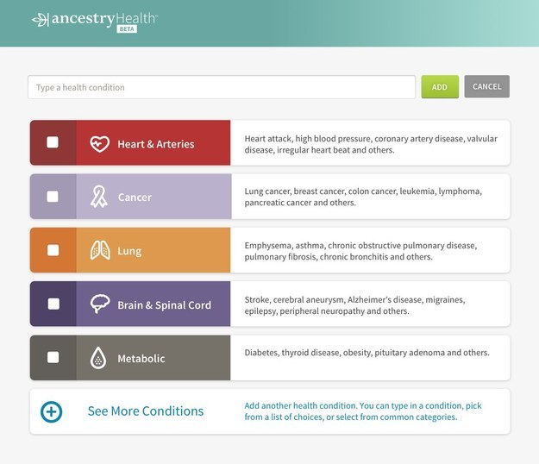

People, genetics and epigenetics

Slide 64
Population health framework
In this framework, population health is defined as health outcomes and their distribution in a population.
These outcomes are achieved by patterns of health determinants (such as medical care, public health, socioeconomic status, physical environment, individual behavior, and genetics) over the life course and affected by policies and interventions at the individual and population levels.
Health outcomes and
distribution in a population
Patterns of health determinants
over the life course
Policies and interventions
at the individual and social
levels
A Population Health Framework: The field of population health investigates each of these components and their interactions. Source: Kindig and Stoddart 2003.

Slide 65
Population health
Population refers to a group of individuals, in contrast to the individuals themselves, organized into many different units of analysis, depending on the research or policy purpose
Health has been defined in several different ways
Population health highlights the influential role of social and economic forces in combination with biological and environmental factors, that shape the health of entire populations . . .
Others interpret population health primarily as a goal—a goal of achieving measurable improvements in the health of a defined population. (Kreuter and Lezin 2001)

Slide 66
Population health and public health
Population health is “the aggregate health outcome of health adjusted life expectancy of a group of individuals, in an economic framework that balances the relative marginal return from the multiple determinants of health” (Kindig 1997).
Public health: Activities that a society undertakes to assure the conditions in which people can be healthy. These include organized community efforts to prevent, identify, and counter threats to the health of the public (Turnock 2004).

Slide 67
Community health
Community health: A perspective on public health that assumes community to be an essential determinant of health and the indispensable ingredient for effective public health practice.
Wellness: Life satisfaction or gratification in living (Cowen 1991).
Well-being: Happiness and meaning and self-realization (Ryan and Deci 2001).
Notes:
Community=smaller
Population=bigger

Slide 68
Quality of life
Quality of life: A broad construct reflecting a subjective or objective judgment concerning all aspects of an individual’s existence, including health, economic, political, cultural, environmental, aesthetic, and spiritual aspects (Gold, Stevenson, and Fryback 2002).
Health-related quality of life: The impact of the health aspects of an individual’s life on his or her quality of life or overall well-being (Gold et al. 1996).

Slide 69
Population Health Outcome Distribution Terms
Health inequality: A generic term designating differences, variations, and disparities in the health of individuals and groups (Kawachi, Subramanian, and Almeida-Filho 2002).
Disparity: Inequality or difference, as in rank, amount, or quality (Adler 2006; Webster’s 1980).
Health inequity: Those inequalities in health deemed to be unfair or to stem from some form of injustice. The dimensions of being avoidable or unnecessary have often been added to this concept (Kawachi, Subramanian, and Almeida-Filho 2002).
Variance: (1) Degree of change or difference (Webster’s 1980).

Slide 70


Slide 71
Health issues in African Republic
The WHO says a "silent epidemic" in African countries accounts for 19 of the 20 countries with the highest rates of maternal mortality worldwide and the highest death rate worldwide for babies up to a month old.
The WHO says in Africa it stands at 43 per 1,000 live births or four times the rate in Europe.
The WHO has found that some of the continent's biggest problems are getting worse and the rates of death during childbirth and among young children are increasing.
Although Africa has 11% of the global population it has 60% of the world's HIV/AIDS cases and 90% of world malaria cases, mainly in children under 5.
While diseases such as polio, measles and leprosy have almost been eradicated, the report acknowledges the growth of "lifestyle" medical conditions such as heart disease, diabetes and stroke.
Louis Gomes Sambo, WHO's regional director for Africa, says they know what the challenges are, and how to address them, but Africa's fragile health systems represent an enormous barrier.
He says African governments and their partners must make a major commitment and invest more funds, because African countries will not develop economically and socially without substantial improvements in the health of their people.
According to the report only 58 percent of the people living in sub-Saharan Africa have access to safe drinking water.

Slide 72
Recap: Determinant
Determinant:
  (1) Any factor, whether event, characteristic, or other definable entity, that brings about change in a health condition or other defined characteristic (Last 2001).
  (2) A primary risk factor (causative factor) associated with the level of the health problem, that is, the level of determinant influences the level of the health problem (Turnock 2004).
Cause: Anything producing an effect or result (Webster’s 1980).
Factor (or determinant): (1) An event, characteristic, or other definable entity that brings about a change in a health condition or other defined outcome; a causal role may be implied (Last 2001).
Risk factor: An aspect of personal behavior or lifestyle, an environmental exposure, or an inborn or inherited characteristic that, on the basis of epidemiologic evidence, is known to be associated with health related condition(s) considered important to prevent.

Slide 73
Categories of determinants
Social determinant: A proposed or established causal factor in the social environment that affects health outcomes (e.g., income, education, occupation, class, social support).
Physical environmental determinant: A proposed or established causal factor in the natural and built environment that affects health outcomes (e.g., air and water quality, lead exposure, the design of neighborhoods).
Health care determinant: A proposed or established causal factor in health care that affects health outcomes (e.g., access, quantity, and quality of health care services).
Genetic determinant: A proposed or established causal factor from the genetic composition of individuals or populations that affects health outcomes.
Behavioral determinant: A proposed or established causal factor based on individual personal choices of lifestyle or habits (either spontaneously or in response to incentives), such as diet, exercise, and substance abuse.
Biological determinant: Often, a biological mediator variable between a determinant and an outcome, such as the role of endocrine and immunologic processes in stress. In any case, all determinants must have biological mediator variables in order to affect the organism to produce the health outcomes.

Slide 74
Determinants of Health
Biological determinant
  A biological mediator is a variable between a determinant and an outcome
    E.g. Endocrine and immunologic processes in stress (psychological determinant)
  All determinants have biologic mediator variables in order to affect the organism to produce the health outcomes
  Genetic determinant is a proposed or established causal factor from the genetic composition of individuals or populations that affects health outcomes.
    E.g. genetic mutations BrcA1/2 and breast cancer
Notes:
All definitions come from “Understanding Population Health Terminology” by David Kindig, 2007…except for Political determinants which was added by myself

Slide 75
Determinants of Health
Behavioural determinants
  A proposed or established causal factor based on individual personal choices of lifestyle or habits (either spontaneously or in response to incentives), such as diet, exercise, and substance abuse.
Social determinants
  A proposed or established causal factor in the social environment that affects health outcomes (e.g. income, education, occupation, class, social support)

Slide 76
Determinants of Health
Environmental (Physical and Ecological) determinants
  A proposed or established causal factor in the natural and built environment that affects health outcomes (e.g. air and water quality, lead exposure, the design of neighborhoods).
  Natural environment refers to ecology
  Built environment refers to the physical nature of the surroundings

Slide 77
Determinants of Health
Health care determinants
  A proposed or established causal factor in health care that affects health outcomes (i.e. Access, quantity, and quality of health care services)
Political determinant (additional)
  A proposed or established causal factor in the political environment that affects health outcomes (i.e. political stability, war, civil unrest, etc.)
Notes:
Political determinant is not from Kindig, it is my own description.

Slide 78
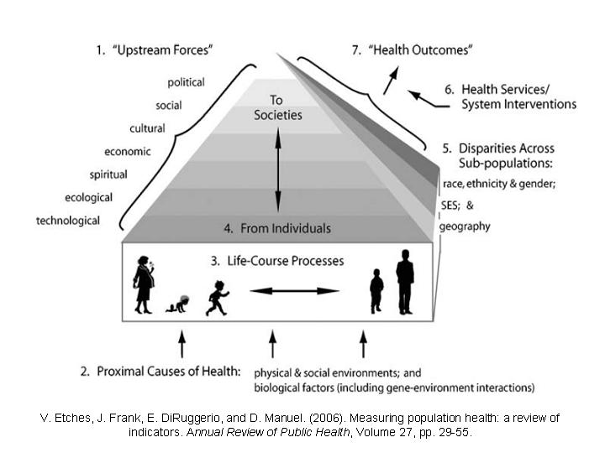
Population Health Frameworks
Distal Causes of Health
Notes:
Canadian Institutes of Health Research—Institute of Population and Public Health (CIHR-IPPH) framework
You are not required to know the framework, but to understand components of it that relate to the population health assumptions (next slide)

Slide 79
Review questions
What factor is the highest contributor to premature deaths:
  Environmental and social
  Personal behaviour
  Family history
  Medical care
  None of the above
The process of being aware of healthy choices and making choices towards a healthy lifestyle is defined as
  Wellness
  Health
  Healthiness
  Absolute health
  Total health
Wellness is synonymous with
  Healthiness
  Optimal health
  Total health
  Psychosocial health
  All of the above
The factors such as education, beliefs and values, resiliency are described as _____ determinants of health
  Individual
  Relationship
  Community
  Family history
  Societal influences
The disease that is caused by a mutation that distorts red blood cells is
  Leukemia
  Lymphoma
  Sickle cell anemia
  Melanoma
  Tay Sachs disease
Notes:
1-b; 2-a; 3-b; 4-a; 5-c

