Slide 1

Chapter 3
Cells, the living units
Human Anatomy and Physiology (10th Edition)
Marieb & Hoehn
ANP1105 2017, Semester 1, Lemaire
Lecture 1:
Membrane transport
Notes:
1
See the video:
https://www.youtube.com/watch?v=TM6hBSCcIoo
3.1 Cells are the smallest unit of life
All living organisms are composed of cells—the basic structural and functional units of life. Cells vary widely in both shape and size.
The principle of complementarity states that the biochemical activity of cells reflects the operation of their organelles.
The generalized cell is a concept that typifies all cells. The generalized human cell has three major regions—the nucleus, cytoplasm, and plasma membrane.
Extracellular materials are substances found outside the cells. They include body fluids, cellular secretions, and extracellular matrix. Extracellular matrix is particularly abundant in connective tissues.

Slide 2
Objectives
  2.1 Membrane Transport: (pp. 63-79)
    Describe the structure of the plasma membrane
    Describe and differentiate among the various types of transport across the plasma membrane
    Passive transport processes (simple diffusion, carrier-mediated diffusion, channel-mediated diffusion, osmosis)
    Active transport processes (primary and secondary active transport, endocytosis, transcytosis, exocytosis)

Slide 3
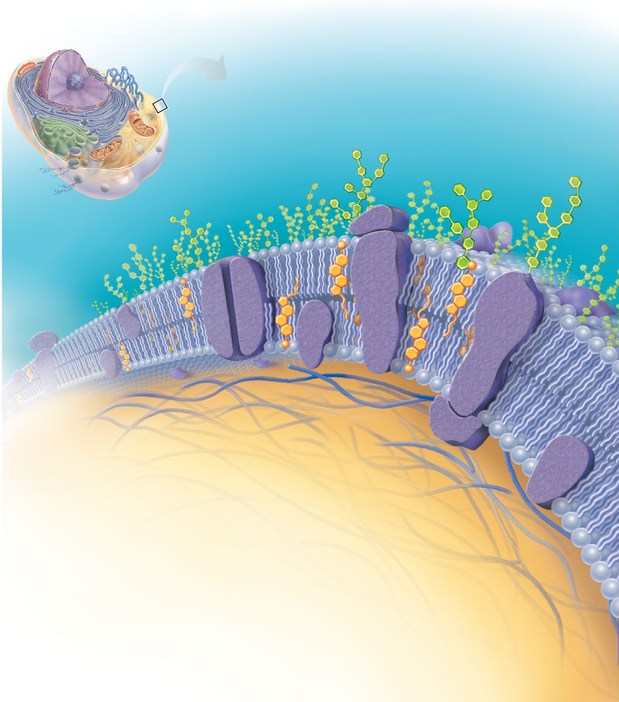
Plasma Membrane
Extracellular fluid (ECF)
(watery environment)
Polar head of
phospholipid
molecule
Cholesterol
Bimolecular layer of lipids and proteins in a constantly changing fluid mosaic
Plays a dynamic role in cellular activity
Separates intracellular fluid (ICF) from extracellular fluid (ECF)
  Interstitial fluid (IF) = ECF that surrounds cells
Glycolipid
Bimolecular
layer of lipids
Outward-
facing
layer of
phospholipids
Inward-facing
layer of
phospholipids
Nonpolar
tail of
phospholipid
molecule
Cytoplasm (ICF)
(watery environment)
Notes:
PART 1: Plasma Membrane
3.2 The fluid mosaic model depicts the plasma membrane as a double layer of phospholipids with embedded proteins
The plasma membrane encloses cell contents, mediates exchanges with the extracellular environment, and plays a role in cellular communication.
The plasma membrane is a fluid bilayer of lipids (phospholipids, cholesterol, and glycolipids) within which proteins are inserted.
The lipids have both hydrophilic and hydrophobic regions that organize their aggregation and self-repair. The lipids form the structural part of the plasma membrane.
Most proteins are integral transmembrane proteins that extend entirely through the membrane. Some, appended to the integral proteins, are peripheral proteins.
Proteins are responsible for most specialized membrane functions: Some are enzymes, some are receptors, and others mediate membrane transport functions.
Externally facing glycoproteins contribute to the glycocalyx.
Cell junctions join cells together and may aid or inhibit movement of molecules between or past cells.
111Tight junctions are impermeable junctions. Desmosomes mechanically couple cells into a functional community. Gap junctions allow joined cells to communicate.
The plasma membrane acts as a selectively permeable barrier. Substances move across the plasma membrane by passive processes, which depend on the kinetic energy of molecules, and by active processes, which depend on the use of cellular energy (ATP).

Slide 4
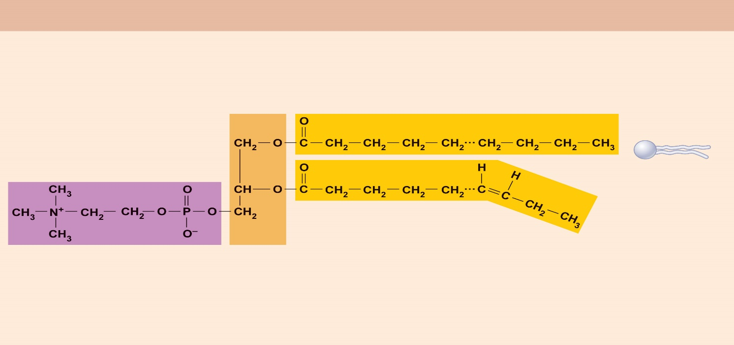
Membrane Lipids
“Typical” structure of a phospholipid molecule
Phosphorus-
containing
group (polar
“head”)
Fig 2.16b
75% phospholipids* (lipid bilayer)
  Phosphate heads: polar and hydrophilic
  Fatty acid tails: nonpolar and hydrophobic (Review Fig. 2.16b)
5% glycolipids
  Lipids with polar sugar groups on outer membrane surface
20% cholesterol
  Increases membrane stability and fluidity
Glycerol
backbone
2 fatty acid chains
(nonpolar “tail”)
Extracellular fluid (ECF)
(watery environment)
Polar head of
phospholipid
molecule
Cholesterol
Glycolipid
Outward-
facing
layer of
phospholipids
Inward-facing
layer of
phospholipids
Nonpolar
tail of
phospholipid
molecule
Cytoplasm (ICF)
(watery environment)
Notes:
*A phospholipid is a lipid containing a phosphoric acid group as mono or di-ester. This family includes, in particular, phosphatidic acids and phosphoglycerides. They are amphiphilic lipids, that is to say constituted by a polar "head" (hydrophilic) and two aliphatic "tails" (hydrophobic). Most phospholipids are phosphoglycerides, the head of which is organized around a glycerol-3-phosphate residue esterified by a polar molecule, and the two tails are the aliphatic chains of two fatty acids.
Exterior and interior are polar→ it is always changing--. Changing fluid mosaic, the fluids travel within the membrane , the protein within are dynamic and
Contain molecules of cholesterol and glycolipids
The head is Polar- attracts water
Aliphatic carbons make up middle section of the plasma membrane- acid chains (hydrophilic)
Therefore not much water can cross the membrane due to aliphatic hydrophilic middle section

Slide 5
Membrane Proteins
Extracellular fluid (ECF)
(watery environment)
Integral proteins
  Firmly inserted into the membrane (most are transmembrane)
  Functions:
    Transport proteins (channels and carriers), enzymes, or receptors
Peripheral proteins
  Loosely attached to integral proteins
  Include filaments on intracellular surface and glycoproteins on extracellular surface
  Functions:
    Enzymes, motor proteins, cell-to-cell links, provide support on intracellular surface, and form part of glycocalyx*
Cholesterol
Glycolipid
Glycoprotein
Carbohydrate
of glycocalyx
Integral
proteins
Filament of
cytoskeleton
Bimolecular
lipid layer
containing
proteins
Peripheral
proteins
Nonpolar
tail of
phospholipid
molecule
Cytoplasm (ICF)
(watery environment)
Notes:
*Glycocalyx provides protection to the outer membrane of the cell. It is composed of a layer of polysaccharides covalently bonded to the lipids and proteins of the membrane. It is very hydrophilic and therefore creates a water environment around the cell. It is clearly visible under the electron microscope after staining with ruthenium red and in optical microscopy by PAS staining. Glycocalyx accounts for 2% to 10% of the membrane material. It plays a role in the protection, in the phenomena of recognition and cell adhesion and in the infectious processes.
Glycocalyx:
Consists of sugars (carbohydrates) sticking out of cell surface
Some sugars are attached to lipids (glycolipids) and some to proteins (glycoproteins)
Every cell type has different patterns of this “sugar coating”
Functions as specific biological markers for cell- to-cell recognition
Allows immune system to recognize “self” vs. “nonself”
Peripheral proteins are attached loosely within the cell

Slide 6
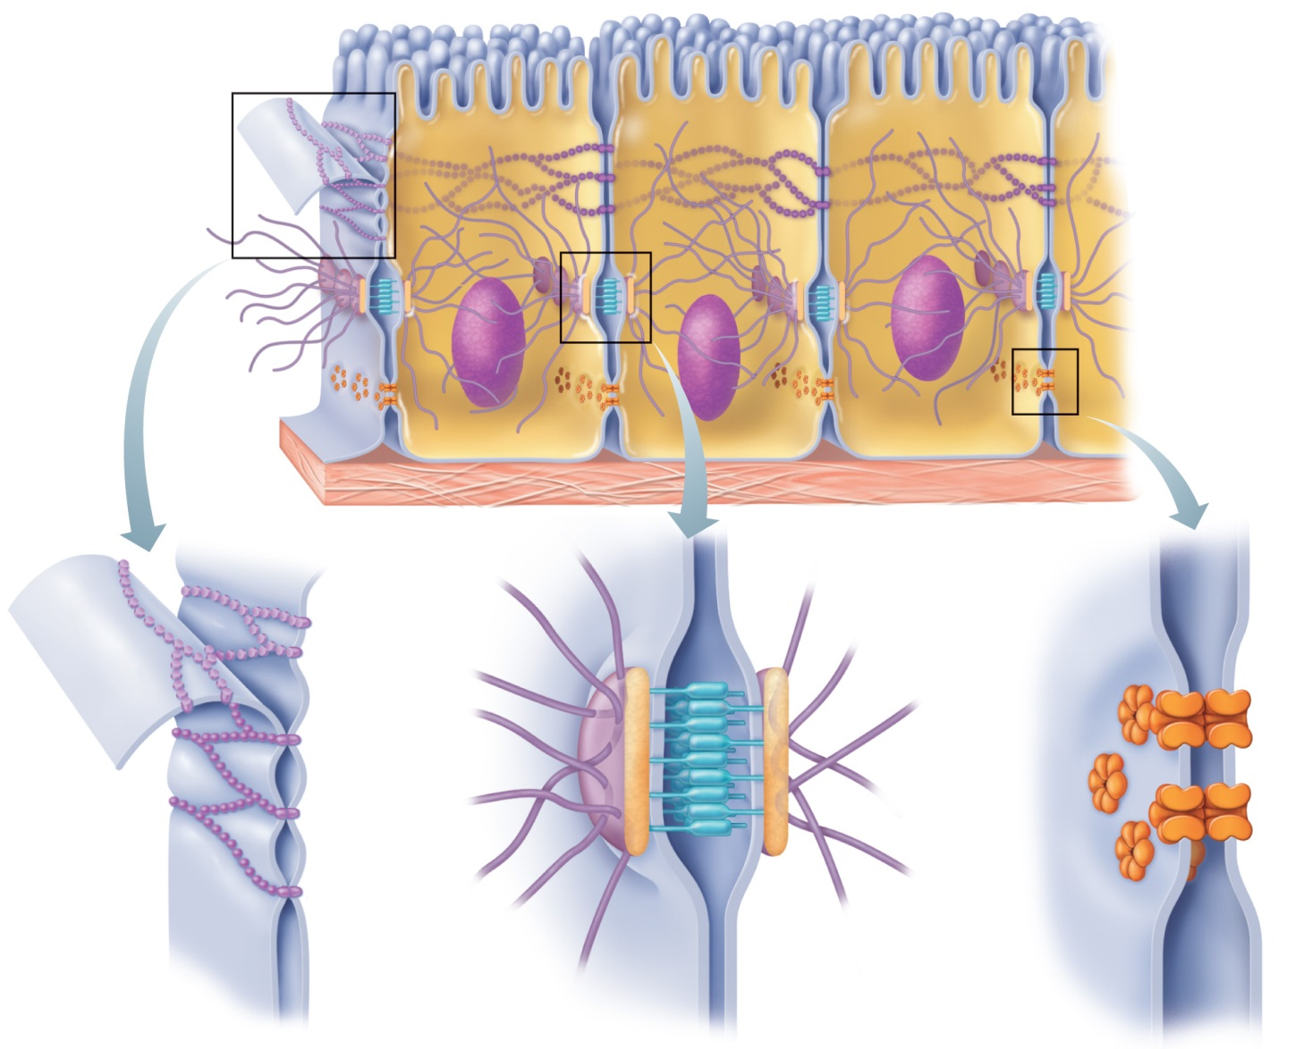
Cell junctions
Microvilli
Figure 3.5
Some cells are “free” (not bound to any other cells)
  Examples: blood cells, sperm cells
Most cells are bound together to form tissues and organs
Three ways cells can be bound to each other
  Tight junctions
  Desmosomes
  Gap junctions
Intercellular space
Basement membrane
Intercellular space
Intercellular space
Plaque
Channel
between cells
(connexon)
Interlocking
junctional proteins
Intercellular space
Intermediate
filament (keratin)
Linker glycoproteins
(cadherins)
(a) Tight junctions: Impermeable junctions prevent molecules from passing through the intercellular space.
(b) Desmosomes: Anchoring junctions bind adjacent cells together and help form an internal tension-reducing network of fibers.
(c) Gap junctions: Communicating junctions allow ions and small molecules to pass from one cell to the next for intercellular communication
Notes:
Tight junctions are one of the structures that prevent molecules from infiltrating between adjacent cells. A series of proteins (occludins etc.) present in adjacent plasma membranes interlock and thus form a tight junction.
Desmosomes are anchor junctions that prevent cells from separating. The cells are retained together by thin filaments of internal binding proteins (cadherins) attached to the plates (glycoproteins on the cytoplasmic face of each plasma membrane). These filaments advance into the intercellular space and interlock like the teeth of a zipper. This arrangement distributes the tensions and prevents the cells from tearing as they are stretched.
Gap Junctions: Open junctions (or communicating junctions) allow the passage of chemical substances from one cell to another. The cells are connected by hollow cylinders called connectors. The connection of a membrane is associated with that of a neighboring membrane to form a single channel that can open (or close) to let small molecules pass from one cell to another.
3.6 Cell adhesion molecules and membrane receptors allow the cell to interact with its environment
Cells interact directly and indirectly with other cells. Indirect interactions involve extracellular chemicals carried in body fluids or forming part of the extracellular matrix.
Molecules of the glycocalyx are intimately involved in cell-environment interactions. Most are cell adhesion molecules or membrane receptors.
Activated membrane receptors act as catalysts, regulate channels, or, like G protein–linked receptors, act through second messengers such as cyclic AMP and Ca2+. Ligand binding results in changes in protein structure or function within the targeted cell.

Slide 7
Functions of Membrane Proteins
Transport
Receptors for signal transduction
Attachment to cytoskeleton and extracellular matrix
Enzymatic activity
Intercellular joining
Cell-cell recognition

Slide 8
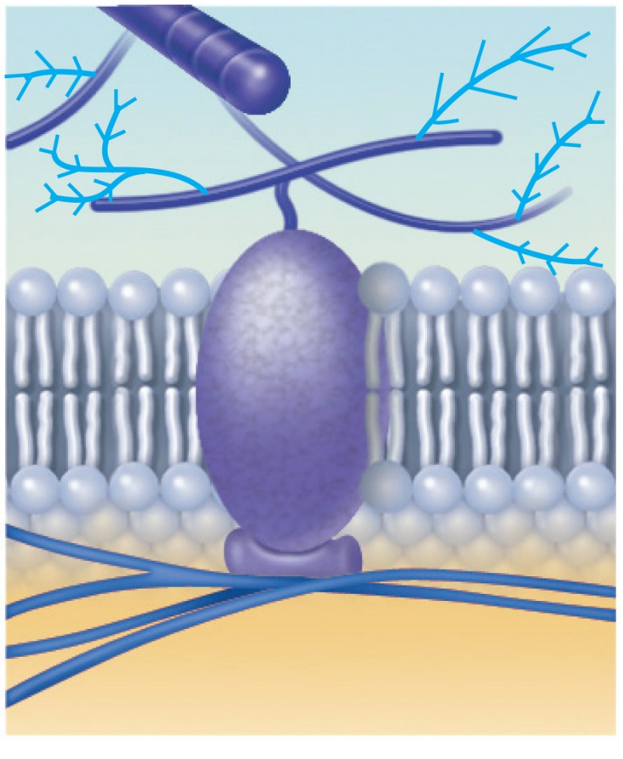
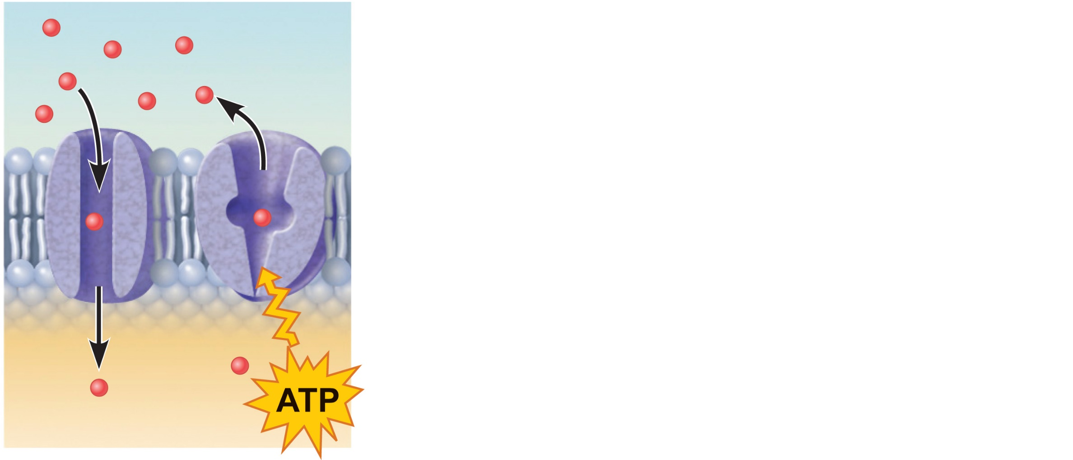
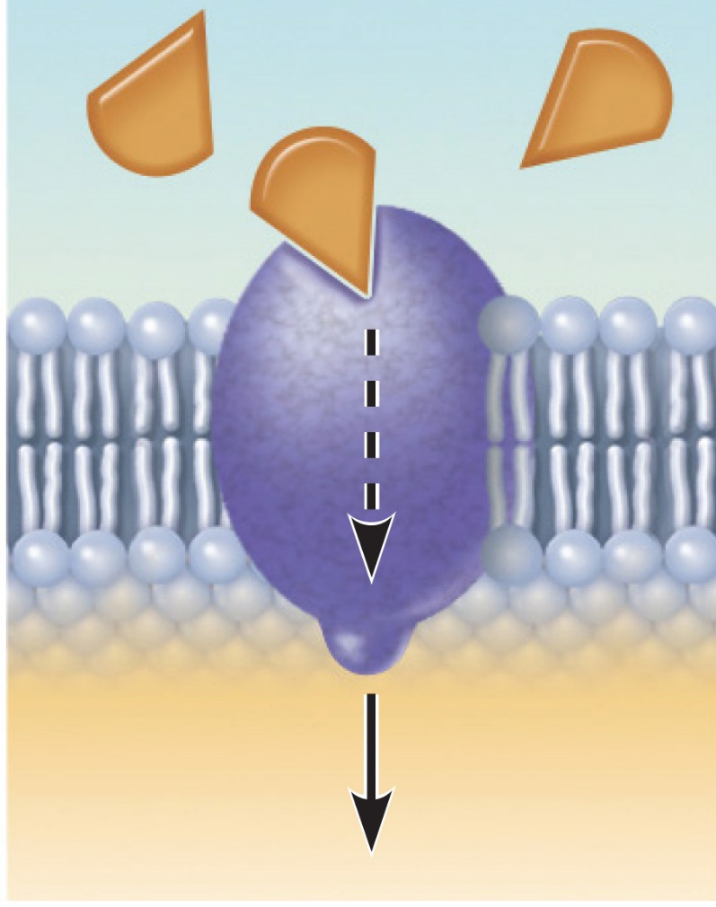
Functions of Membrane Proteins
(a) Transport
(b) Receptors for
signal transduction
(c) Attachment to the
cytoskeleton and
extracellular
matrix (ECM)
Figure 3.4
Notes:
(a) Transport:
A protein (left) that spans the membrane may provide a hydrophilic channel across the membrane that is selective for a particular solute. Some transport proteins (right) hydrolyze ATP as an energy source to actively pump substances across the
membrane.
(b) Receptor for signal transduction:
A membrane protein exposed to the outside of the cell may have a binding site with a specific shape that fits the shape of a chemical messenger, such as a hormone. The external signal may
cause a change in shape in the protein that initiates a chain of chemical reactions in the cell. GCPR receptor changes the function on the receptor
(c) Attachment to the cytoskeleton and extracellular matrix (ECM):
Elements of the cytoskeleton (cell’s internal supports) and the extracellular matrix (fibers and other substances outside the cell) may be anchored to membrane proteins, which help maintain
cell shape and fix the location of certain membrane proteins. Others play a role in cell movement or bind adjacent cells together.

Slide 9
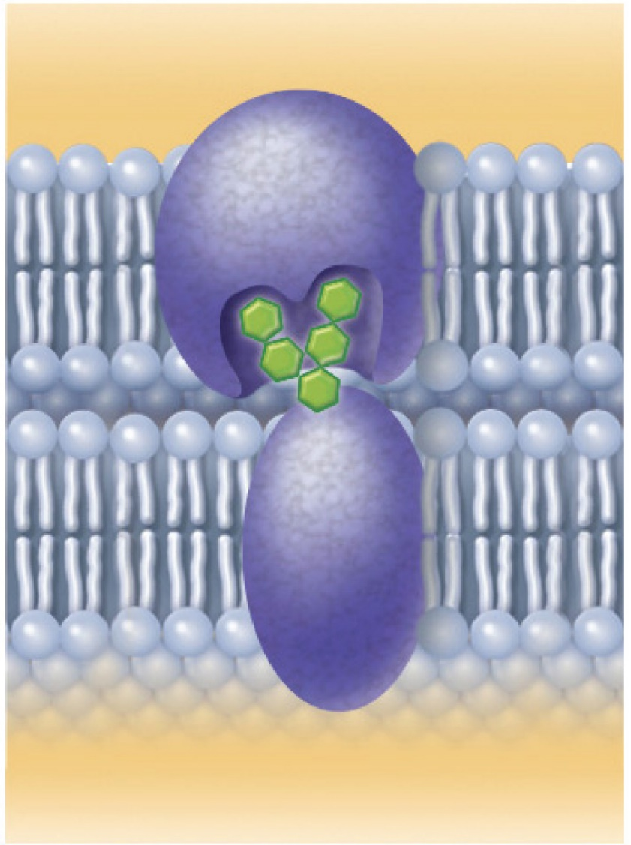
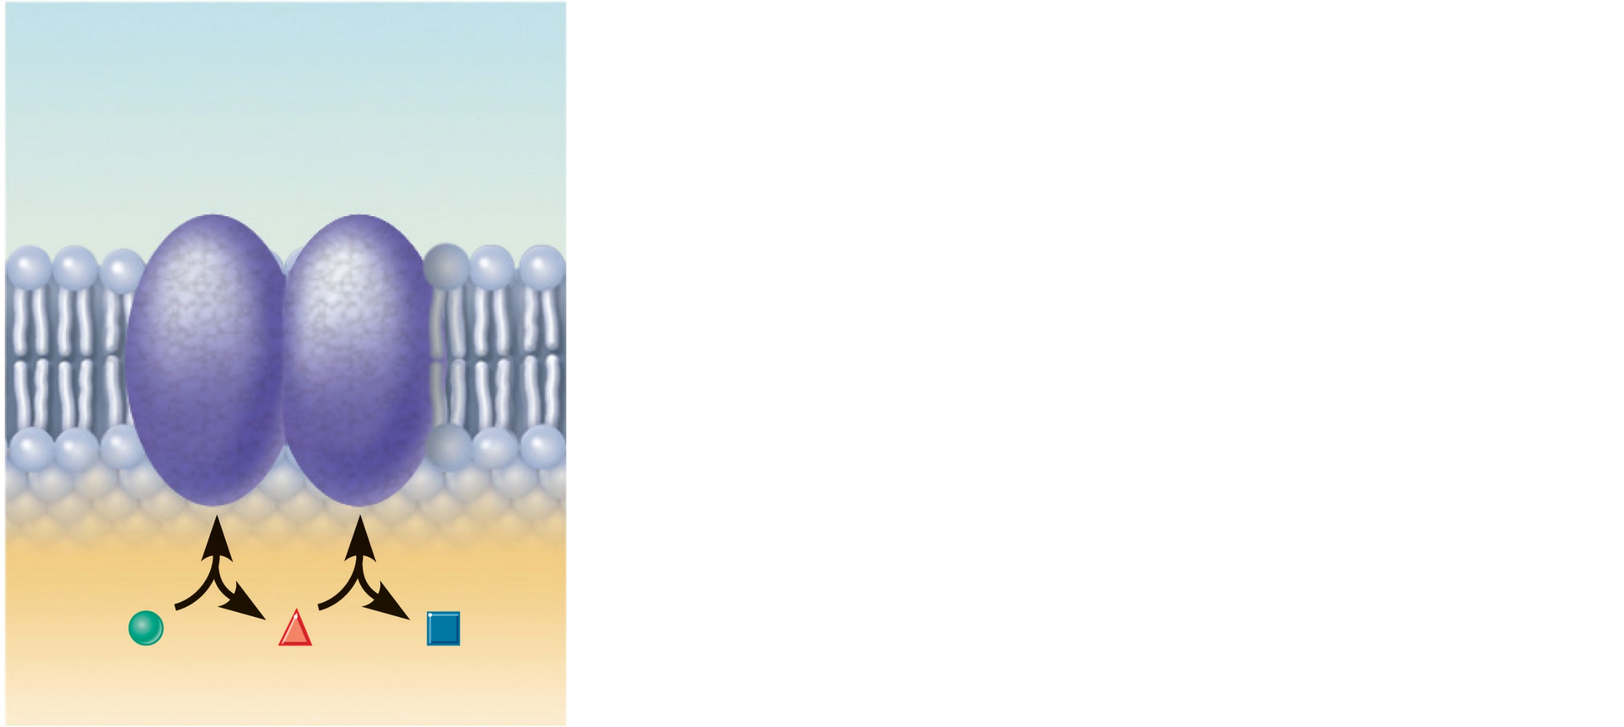
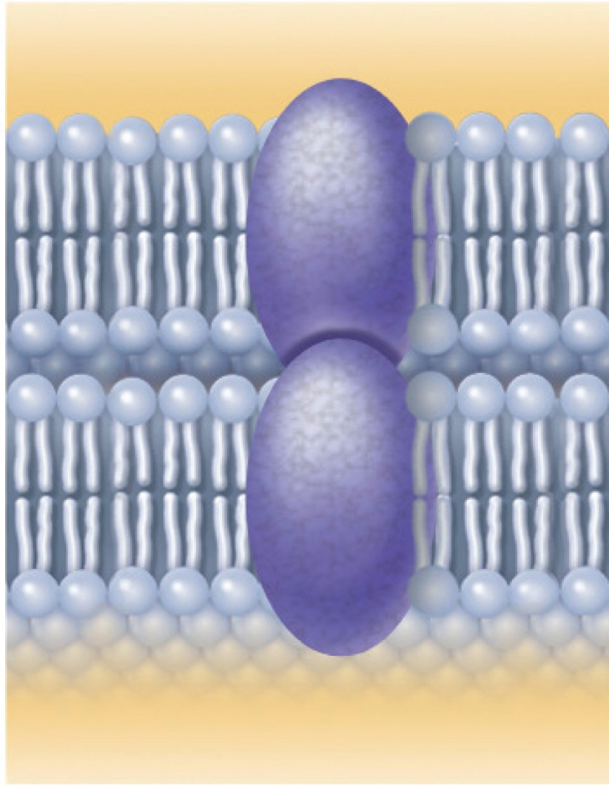
Functions of Membrane Proteins
Enzymes
(d) Enzymatic activity
(e) Intercellular
joining
(f) Cell-cell recognition
Figure 3.4d
Notes:
(d) Enzymatic activity
A protein built into the membrane may be an enzyme with its active site exposed to substances in the adjacent solution. In some cases, several enzymes in a membrane act as a team that catalyzes sequential steps of a metabolic pathway as indicated (left to right) here.
Induces the phosphor relation inside the cell and other molecules
(e) Intercellular joining
Membrane proteins of adjacent cells may be hooked together in various kinds of intercellular junctions. Some membrane proteins (CAMs) of this group provide temporary binding sites
that guide cell migration and other cell-to-cell interactions and recognizing signature of the cell
(f) Cell-cell recognition
Some glycoproteins (proteins bonded to short chains of sugars) serve as identification tags that are specifically recognized by other cells.

Slide 10
How do substances move across the plasma membrane?
Plasma membranes are selectively permeable
  Some molecules pass through easily; some do not
Membrane Transport
Types
Passive processes
  No cellular energy (ATP) required
  Substances move down their concentration gradients
Active processes
  Energy (ATP) required
  Occurs only in living cell membranes

Slide 11
1. Passive Processes
A) Diffusion
Simple diffusion (oxygen, carbon dioxide, fat-soluble vitamins) (not charged)
Carrier-mediated facilitated diffusion (glucose, some amino acids and ions)
Channel-mediated facilitated diffusion (ions, water)
Osmosis (water)
B) Filtration
Type of transport that usually occurs across capillary walls
Notes:
What determines whether or not a substance can passively permeate a membrane?
Lipid solubility of substance
Channels of appropriate size
Carrier proteins
Membrane transport:
Plasma membranes are selectively permeable
Some molecules easily pass through the membrane; others do not
3.3 Passive membrane transport is diffusion of molecules down their concentration gradient
Diffusion is the movement of molecules (driven by kinetic energy) down a concentration gradient. Fat-soluble solutes can diffuse directly through the membrane by dissolving in the lipid.
Facilitated diffusion is the passive movement of certain solutes across the membrane either by their binding with a membrane carrier protein or by their moving through a membrane channel. As with other diffusion processes, it is driven by kinetic energy, but the carriers and channels are selective.
Osmosis is the diffusion of a solvent, such as water, through a selectively permeable membrane. Water diffuses through membrane channels (aquaporins) or directly through the lipid portion of the membrane from a solution of lesser osmolarity (total concentration of all solute particles) to a solution of greater osmolarity.
The presence of solutes unable to permeate the plasma membrane leads to changes in cell tone that may cause the cell to swell or shrink. Net osmosis ceases when the solute concentration on both sides of the plasma membrane reaches equilibrium.
Solutions that cause a net loss of water from cells are hypertonic. Those causing net water gain are hypotonic. Those causing neither gain nor loss of water are isotonic.

Slide 12
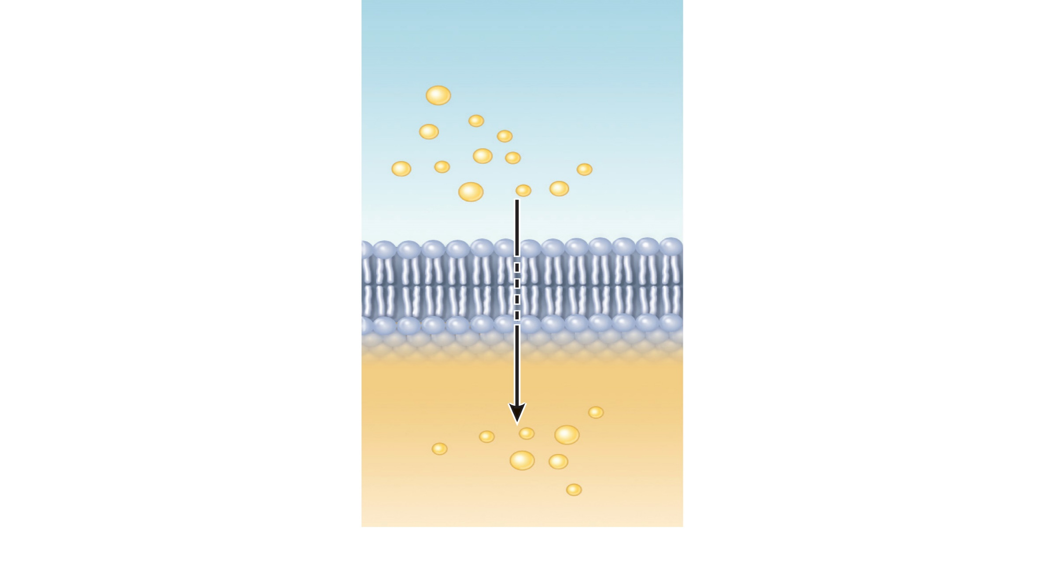
Simple diffusion through the phospholipid bilayer
Extracellular fluid
Lipid-
soluble
solutes
Down along their concentration gradient
No use of ATP
Lipid-soluble molecules (oxygen, CO₂, fat-soluble vitamins)
Cytoplasm
(a) Simple diffusion of fat-soluble molecules
directly through the phospholipid bilayer
Notes:
Nonpolar lipid-soluble (hydrophobic) substances diffuse directly through the phospholipid bilayer

Slide 13
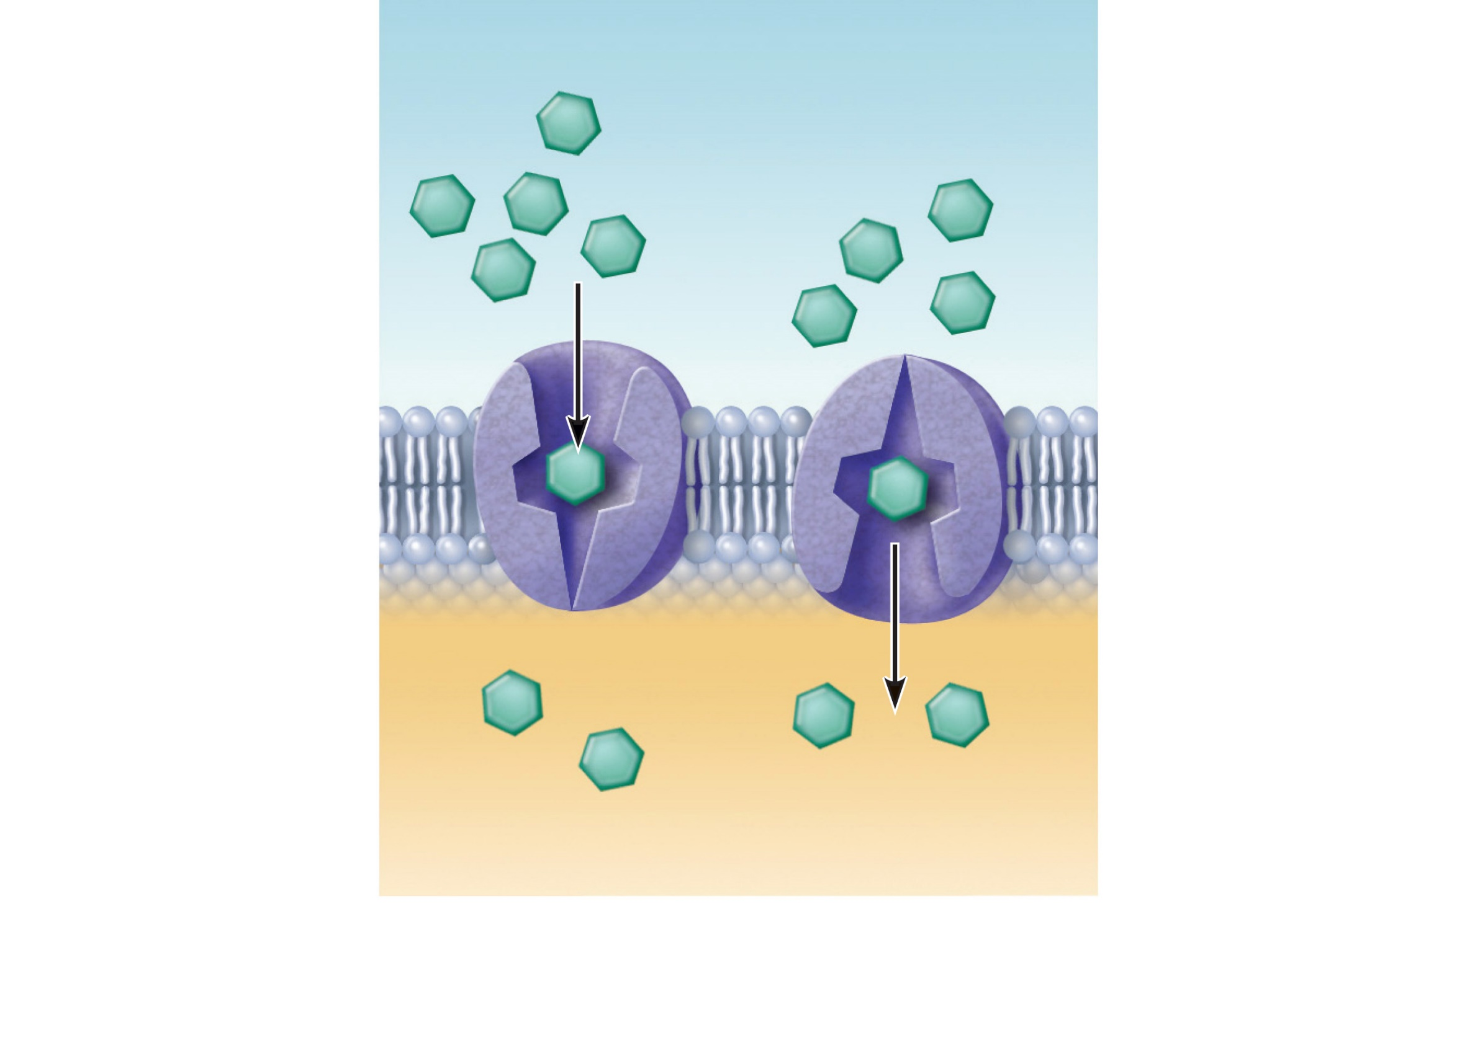
Carrier-mediated facilitated diffusion
Lipid-insoluble
solutes (such as
sugars or amino
acids)
Down the concentration gradient (ex. Glucose from blood into the cells) (as in simple diffusion)
No use of ATP
Carrier can be saturated
(b) Carrier-mediated facilitated diffusion via a protein carrier specific for one chemical; binding of substrate causes shape change in transport protein
Figure 3.7b
Notes:
Facilitated diffusion:
Certain lipophobic molecules (e.g., glucose, amino acids, and ions) use carrier proteins or channel proteins, both of which:
Exhibit specificity (selectivity)
Are saturable; rate is determined by number of carriers or channels
Can be regulated in terms of activity and quantity
Transmembrane integral proteins transport specific polar molecules (e.g., sugars and amino acids)
Binding of substrate causes shape change in carrier
Example: GLUT transporters are a large group of membrane proteins that transport glucose from epithelial cells to blood and blood to cells by passing the intestinal barrier in the direction of the gradient through passive transport.
They are insulin-dependent.

Slide 14
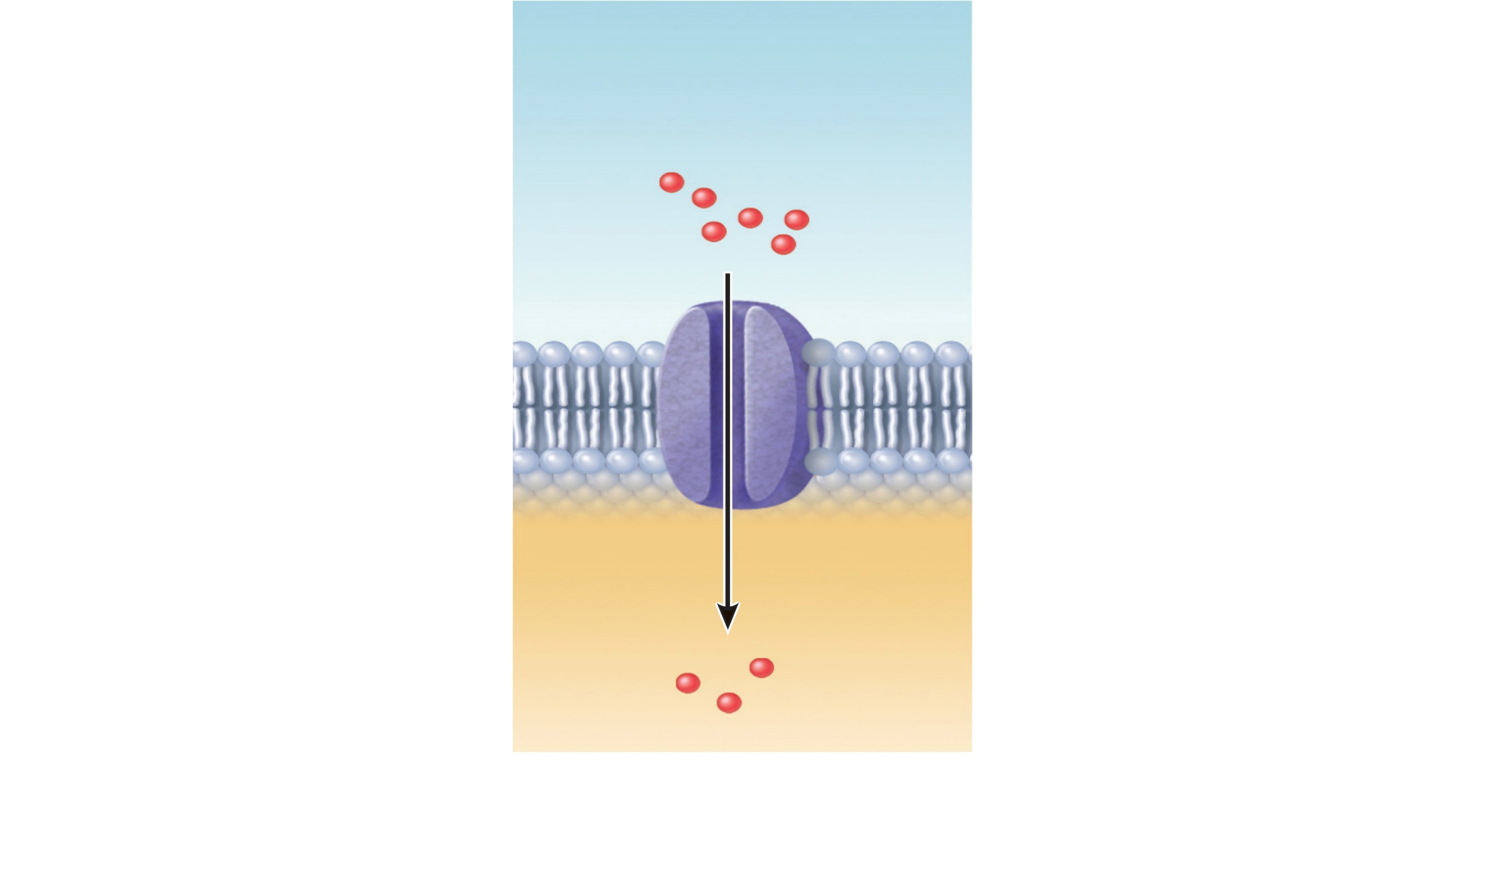
Channel-mediated facilitated Diffusion
Small lipid-
insoluble
solutes
Down along their concentration gradient through a specific channel
Lipid-soluble molecules (water, ions)
(c) Channel-mediated facilitated diffusion through a channel protein; mostly ions
selected on basis of size and charge (aquaporines for the passage of water)
Figure 3.7c
Notes:
Aqueous channels formed by transmembrane proteins selectively transport ions or water
Two types:
Leakage channels: Always open
Gated channels: Controlled by chemical or electrical signals

Slide 15
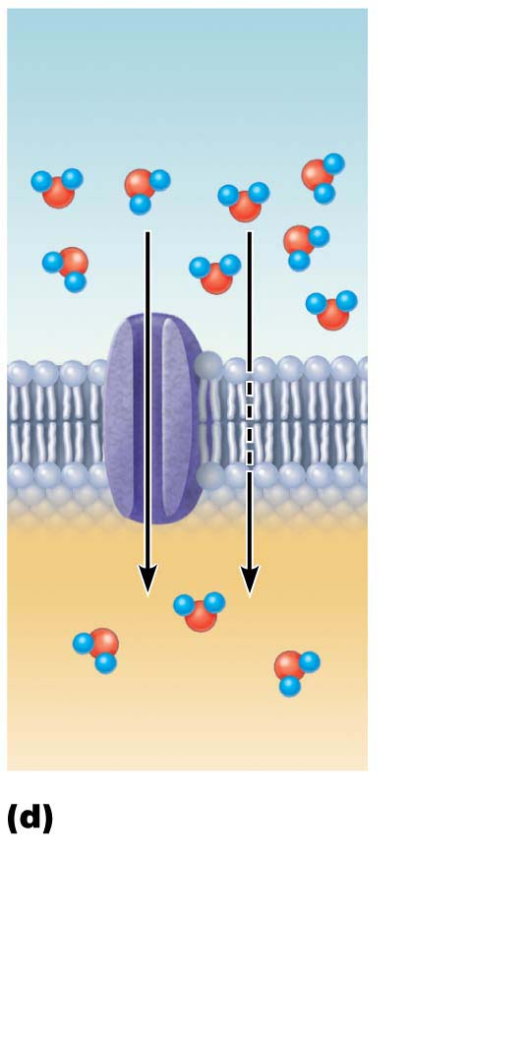
Passive Processes: Osmosis
Water
molecules
Movement of solvent (water) across a selectively permeable membrane
Water diffuses through plasma membranes:
  Through the lipid bilayer
  Through water channels called aquaporins (AQPs)
Lipid
bilayer
Aquaporin
Osmosis, diffusion of a solvent such as water through a specific
channel protein (aquaporin) or through the lipid bilayer
Notes:
Many aquaporins in the kidney, solvent go down concentration gradient and get into cell

Slide 16
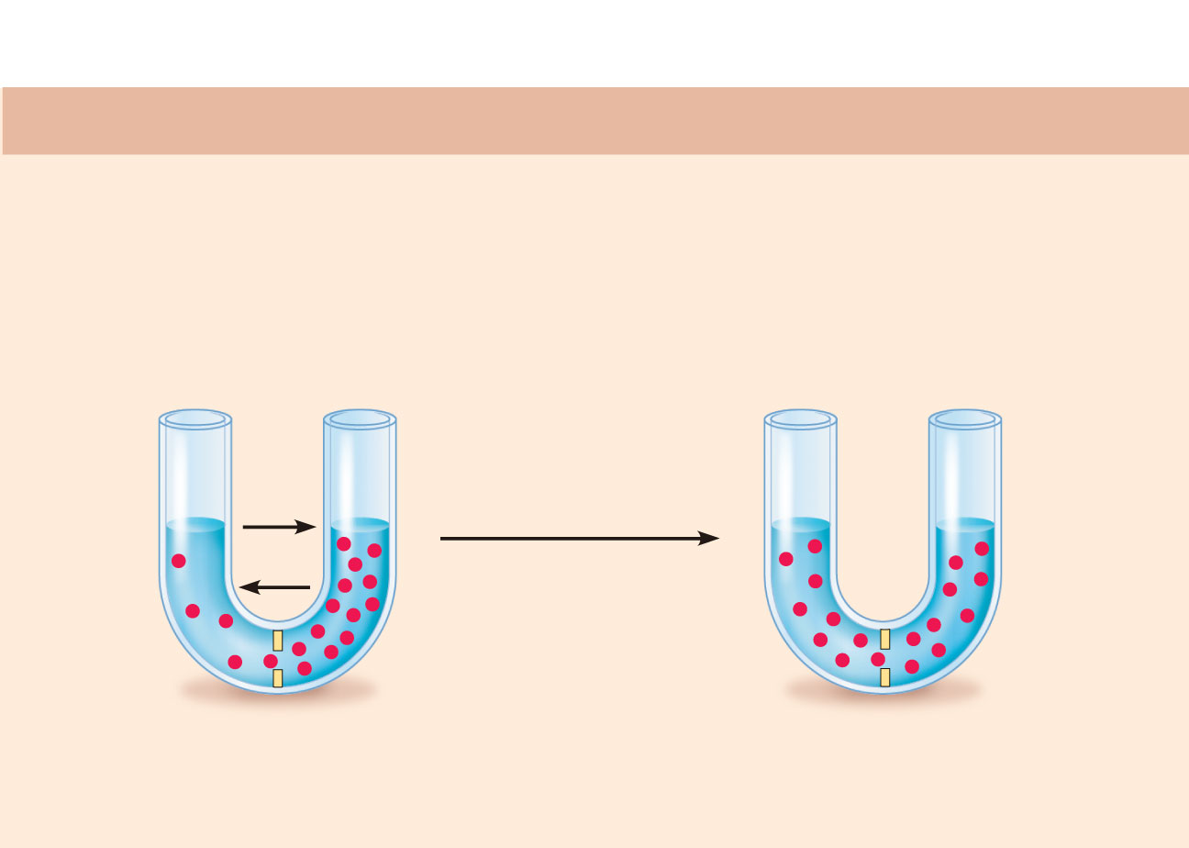
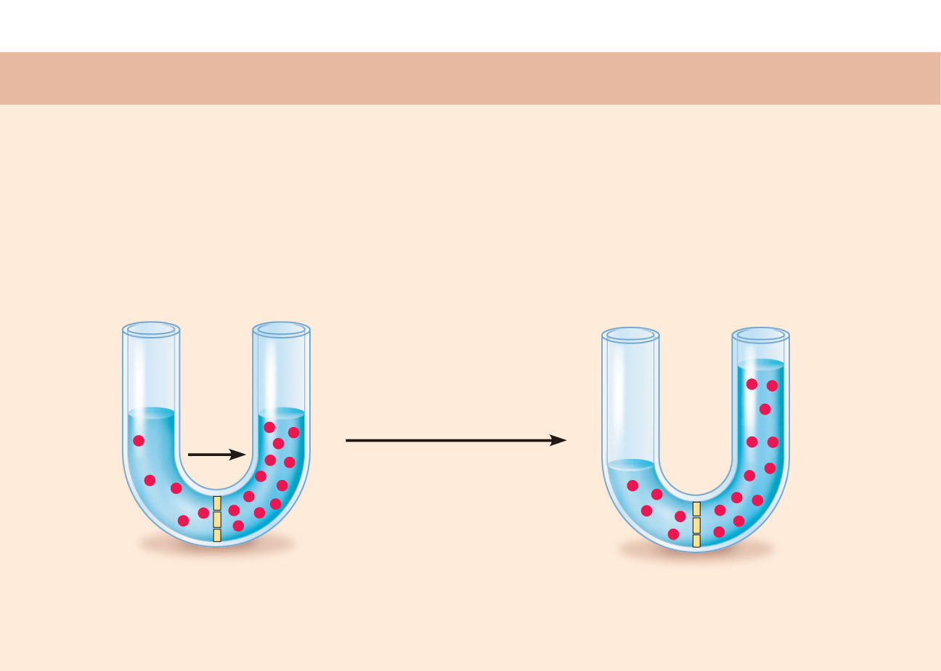
Passive Processes: Osmosis*
(a) Membrane permeable to both solutes and water
Water concentration is determined by solute concentration because solute particles displace water molecules
Osmolarity: The measure of total concentration of solute particles
When solutions of different osmolarity are separated by a membrane, osmosis occurs until equilibrium is reached
Solute molecules
(sugar)
Membrane
(b) Membrane permeable to water, impermeable to solutes
Solute molecules
(sugar)
Membrane
Notes:
*Osmosis is a phenomenon of diffusion of matter, evidenced when molecules of solvent pass through a semi-permeable membrane separating two solutions whose solute concentrations are different; The total solvent transfer is then from the less concentrated solution (hypotonic medium) to the most concentrated solution (hypertonic medium) to equilibrium (isotonic media).

Slide 17
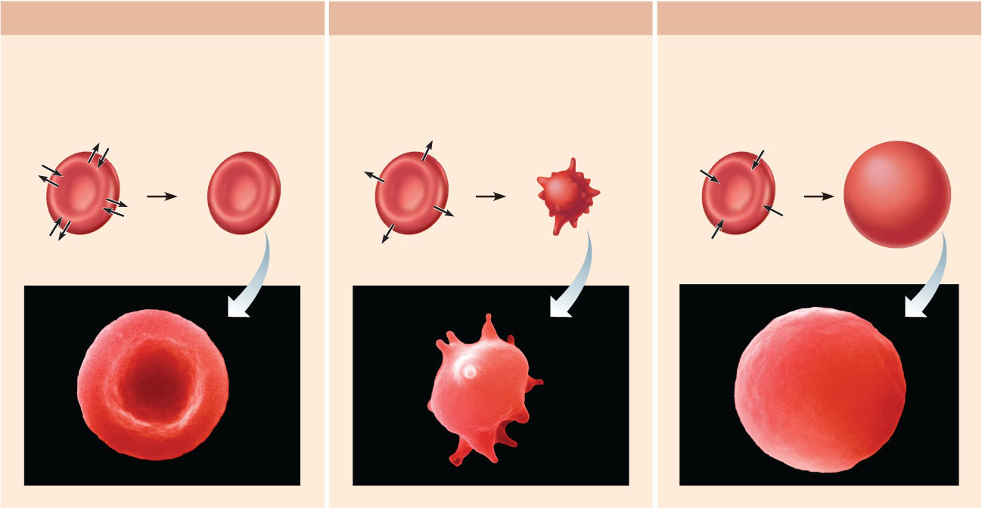
Tonicity
Isotonic
solutions
(b) Hypertonic
solutions
(c) Hypotonic
solutions
Tonicity
  Ability of a solution to change the shape or tone of cells by altering the cells’ internal water volume
    Isotonic solution has same osmolarity as inside the cell, so volume remains unchanged
    Hypertonic solution has higher osmolarity than inside cell, so water flows out of cell, resulting in cell shrinking
      Shrinking is referred to as crenation
    Hypotonic solution has lower osmolarity than inside cell, so water flows into cell, resulting in cell swelling
      Can lead to cell bursting, referred to as lysing
Cells retain their
normal
size and
shape in isotonic
solutions (same
solute/water
concentration
as inside
cells; water moves
in and out).
Cells lose water by
osmosis and
shrink in a hypertonic
solution
(contains a higher
concentration
of solutes than are
present inside
the cells).
Cells take on water
by osmosis until
they become bloated
and burst (lyse)
in a hypotonic solution
(contains a
lower concentration
of solutes than
are present in cells).
Figure 3.9
Notes:
Isotonia corresponds to an equal concentration of solutes on each side of a semipermeable membrane.
An isotonic solution relative to the intracellular medium contains an amount of dissolved solutes equal to that of the cytoplasm. In humans and most other mammals, an isotonic solution is 0.9% by weight (or 9 g / L) of sodium chloride in aqueous solution. This solution, called saline solution or saline, is generally administered intravenously.
The biological reference of the notion of isotonia is based on the behavior of red blood cells in a solution.
In a hypotonic solution, the red blood cells become turgid and finally burst (the globular resistance is measured).
In a hypertonic solution, the red blood cells dehydrate and become crenellated.
In an isotonic solution, the red blood cells remain unchanged.

Slide 18
2. Active Processes of membrane transport
Two types of active processes:
  Active transport
  Vesicular transport
Both use ATP to move solutes across a living plasma membrane (the driving force of the transport necessitates cell energy)
Requires carrier proteins (solute pumps)
Moves solutes against a concentration gradient
Types of active transport:
  Primary active transport
  Secondary active transport
Notes:
3.4 Active membrane transport directly or indirectly uses ATP
Active transport (solute pumping) depends on a carrier protein and energy. Substances transported move against concentration or electrical gradients. In primary active transport, such as that provided by the Na+-K+ pump, ATP directly provides the energy.
In secondary active transport, the energy of an ion gradient (produced by a primary active transport process) is used to transport a substance passively. Many active transport systems are coupled, and cotransported substances move in either the same (symport) or opposite (antiport) directions across the membrane.
Vesicular transport also requires that energy be provided. Endocytosis brings substances into the cell, typically in protein-coated vesicles. If the substances are relatively large particles, the process is called phagocytosis. If the substances are dissolved molecules, the process is pinocytosis. Receptor-mediated endocytosis is selective: Engulfed molecules attach to receptors on the membrane before endocytosis occurs. Exocytosis, which uses SNAREs to anchor the vesicles to the plasma membrane, ejects substances (hormones, wastes, secretions) from the cell.
Most endocytosis (and transcytosis) is mediated by clathrin-coated vesicles. Other types of protein coating are found in caveolae and vesicles involved in vesicular trafficking.

Slide 19
Primary Active Transport
Energy from hydrolysis of ATP causes shape change in transport protein so that bound solutes (ions) are “pumped” across the membrane
Sodium-potassium pump (Na⁺-K⁺ ATPase)<-- enzyme in all cell types
  Located in all plasma membranes
  Involved in primary and secondary active transport of nutrients and ions
  Maintains electrochemical gradients essential for functions of muscle and nerve tissues
Notes:
Requires a pump

Slide 20
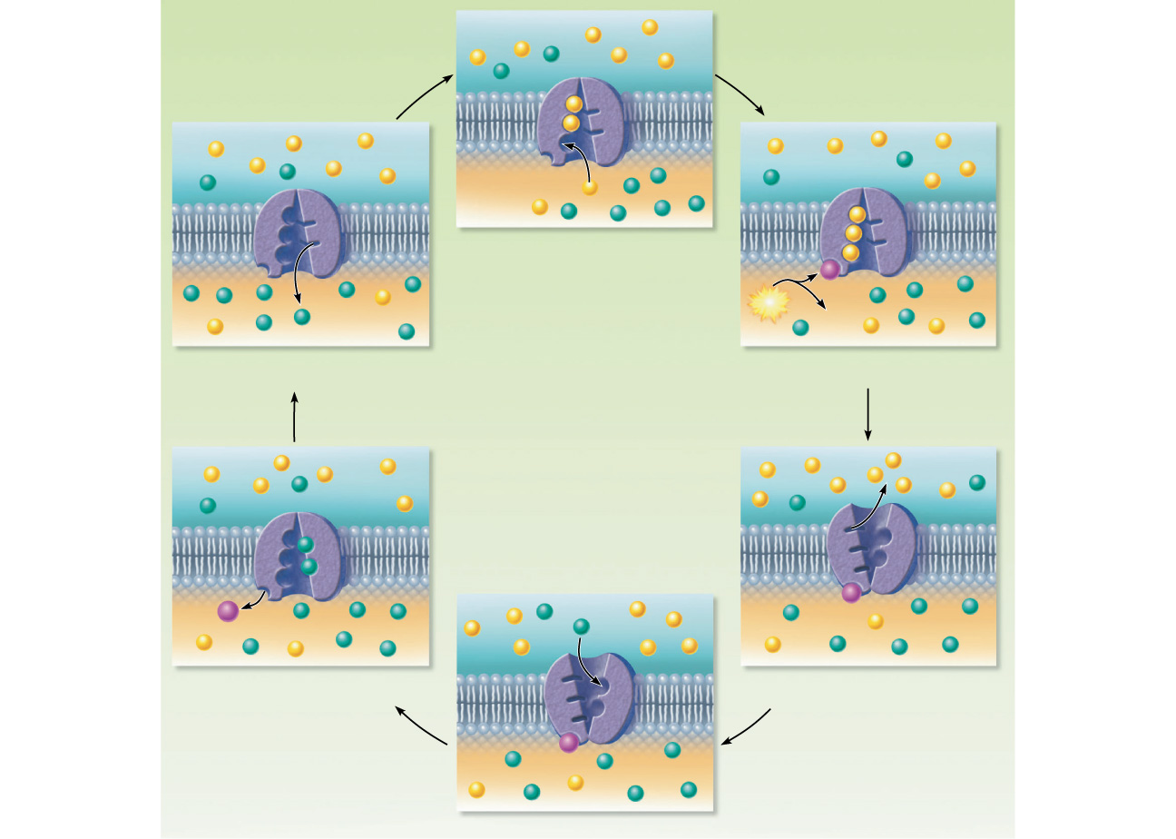
Primary Active Transport: Role of Na⁺-K⁺ ATPase*
6. Pump protein
binds ATP; releases
K⁺ to the inside,
and Na⁺ sites are
ready to bind Na⁺
again. The cycle
repeats
Three cytoplasmic
Na⁺ bind to pump
protein
Extracellular fluid
Na⁺
Na⁺-K⁺ pump
ATP-binding site
K⁺
Na⁺ bound
Cytoplasm
1
Cytoplasmic Na⁺ binds to pump protein.
2. Binding of Na+
promotes phosphor-
rylation of the
protein by ATP.
P
K⁺ released
ATP
ADP
6
2
5. K⁺ binding triggers
release of the phos-
phate.The dephos-
phorylated pump
resumes its original
conformation.
K⁺ is released from the pump protein
and Na⁺ sites are ready to bind Na⁺ again.
The cycle repeats.
Binding of Na+ promotes
phosphorylation of the protein by ATP.
Na⁺ released
K⁺ bound
3. Phosphorylation
causes the pump to
change shape,
expelling Na⁺ to
the outside.
Two extracellular K⁺ bind to pump.
P
P_{i}
Two extracellular K⁺ bind to pump.
K⁺
5
3
K⁺ binding triggers release of the
phosphate. Pump protein returns to its
original conformation.
Phosphorylation causes the protein to
change shape, expelling Na⁺ to the outside.
4. Two extracellular
K⁺ bind to pump
P
4
Figure 3.10
Extracellular K⁺ binds to pump protein.
Notes:
*The sodium-potassium or Na + -K + ATPase pump is a transmembrane protein whose enzymatic activity uses energy derived from the degradation of ATP to ADP and inorganic phosphate to transport potassium and sodium ions against their concentration gradient. It plays a role in maintaining the resting membrane potential of nerve, muscle and cardiac cells. The pump allows exchange of sodium (Na +) ions from the intracellular medium with K + potassium ions from the extracellular medium in an accurate ratio (3 Na⁺ / 2 K⁺). This pump is responsible for restoring the initial equilibrium after an action potential.
3.5 Selective diffusion establishes the membrane potential (seen and explained later in the third lecture)
All cells in the resting stage exhibit a voltage across their membrane, called the resting membrane potential. Because of the membrane potential, both concentration and electrical gradients determine the ease of an ion’s diffusion.
The resting membrane potential is generated by concentration gradients of ions and the differential permeability of the plasma membrane to ions, particularly potassium ions. Sodium is in high extracellular concentration and low intracellular concentration, and the membrane is poorly permeable to it. Potassium is in high concentration in the cell and low concentration in the extracellular fluid. The membrane is more permeable to potassium than to sodium. Protein anions in the cell are too large to cross the membrane, and Cl−, the main anion in extracellular fluid, is repelled by the negative charge on the inner membrane face.
Essentially, a negative membrane potential is established when the movement of K+ out of the cell equals K+ movement into the cell. Na+ movements across the membrane contribute minimally to establishing the membrane potential. The greater outward diffusion of potassium (than inward diffusion of sodium) leads to a charge separation at the membrane (inside negative). This charge separation is maintained by the operation of the sodium-potassium pump.

Slide 21
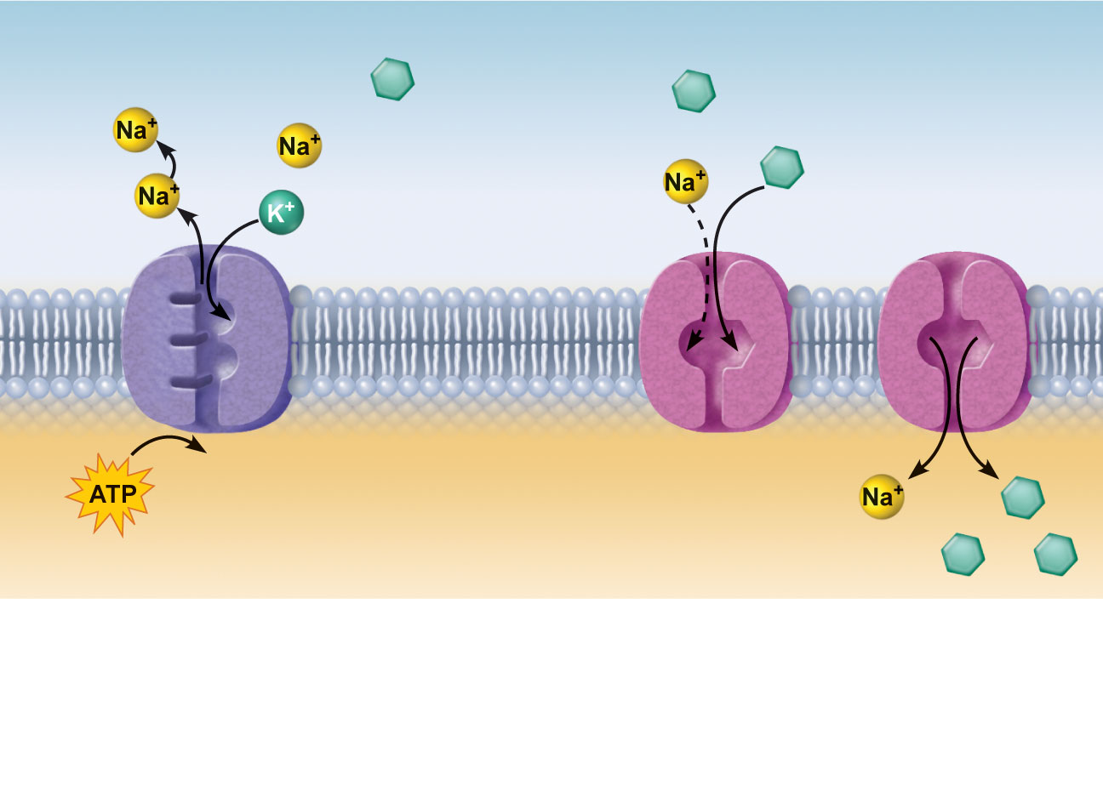
Secondary Active Transport*
Extracellular fluid (ECF)
Glucose
Depends on an ion gradient created by primary active transport
Energy stored in ionic gradients is used indirectly to drive transport of other solutes
Cotransport—always transports more than one substance at a time
  Symport system: Two substances transported in same direction
  Antiport system: Two substances transported in opposite directions
Na⁺-glucose
symport
transporter
loading
glucose from
ECF
Na⁺-glucose
symport transporter
releasing glucose
into the cytoplasm
Na⁺-K⁺
pump
Cytoplasm
1
2
The ATP-driven Na⁺-K⁺ pump
stores energy by creating a
steep concentration gradient for
Na⁺ entry into the cell.
As Na⁺ diffuses back across the
membrane through a membrane
cotransporter protein, it drives glucose
against its concentration gradient
into the cell. (ECF = extracellular fluid)
Figure 3.11
Notes:
*Secondary active transport, unlike primary active transport, does not use the energy directly supplied to it as in the case of hydrolysis of ATP. Instead, the electrochemical potential difference is used.
The two main forms are the symport and antiport.

Slide 22
Vesicular Transport
Vesicular transport
Transport of large particles, macromolecules, and fluids across plasma membranes
Requires cellular energy (e.g., ATP)
Functions:
  Exocytosis—transport out of cell
  Endocytosis—transport into cell
  Transcytosis—transport into, across, and then out of cell
  Substance (vesicular) trafficking—transport from one area or organelle in cell to another

Slide 23
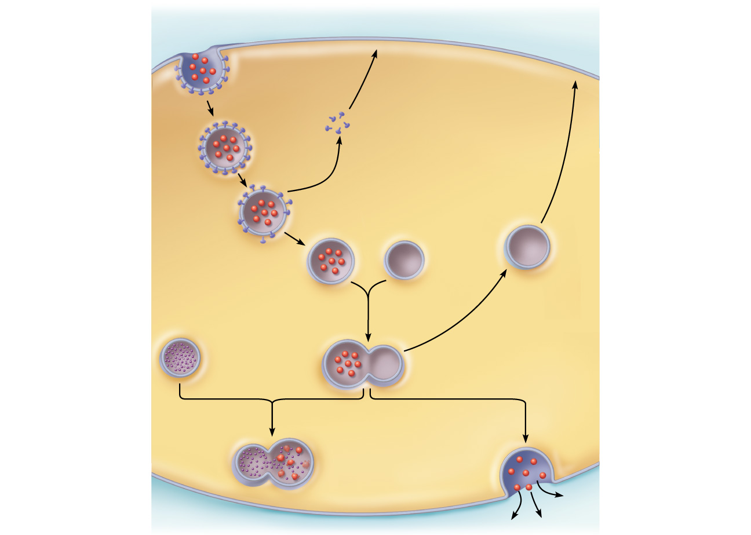
Coated pit ingests
substance.
1
Extracellular fluid
Plasma
membrane
Endocytosis and transcytosis:
Involve formation of protein-coated vesicles
Often receptor mediated, therefore very selective
Protein coat
(typically
clathrin)
Cytoplasm
2
Protein-
coated
vesicle
detaches.
3
Coat proteins detach
and are recycled to
plasma membrane.
Transport
vesicle
Endosome
Uncoated
endocytic vesicle
4
Uncoated vesicle fuses
with a sorting vesicle
called an endosome.
5
Transport
vesicle containing
membrane components
moves to the plasma
membrane for recycling.
Lysosome
6
Fused vesicle may (a) fuse
with lysosome for digestion
of its contents, or (b) deliver
its contents to the plasma
membrane on the
opposite side of the cell
(transcytosis).
(a)
(b)
Figure 3.12
Notes:
Digestion of bacteria

Slide 24
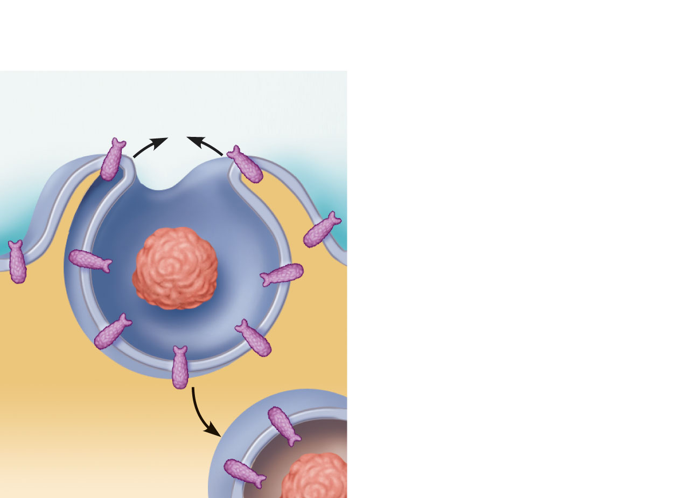
Endocytosis
Endocytosis: phagocytosis
(a)
Phagocytosis
The cell engulfs a large
particle by forming pro-
jecting pseudopods (“false
feet”) around it and en-
closing it within a membrane
sac called a phagosome.
The phagosome is
combined with a lysosome.
Undigested contents remain
in the vesicle (now called a
residual body) or are ejected
by exocytosis. Vesicle may
or may not be protein-
coated but has receptors
capable of binding to
microorganisms or solid
particles.
Phagocytosis—
Pseudopods engulf solids and bring them into cell’s interior
  Macrophages and some white blood cells
Phagosome
Figure 3.13a
Notes:
Phagocytosis, in biology, is the cellular process by which certain cells grouped under the general denomination of phagocytes can ingest solid foreign particles of micrometric scale. It is usually considered that phagocytosis is a particular form of endocytosis. It is distinguished from other processes of cellular internalisation (endocytosis, pinocytosis) by at least two general criteria:
Phagocytosis is induced by physical contact with the target particle;
The target particle of the phagocytosis has a size greater than 0.5 μm.
Although phagocytosis has been observed experimentally in several cell types, it is generally strongly associated with certain leukocyte categories, such as macrophages, dendritic cells or neutrophils. The consequences of phagocytic activity are numerous and important. These include elimination of pathogens, presentation of antigens to lymphocytes, elimination of proinflammatory cell debris

Slide 25
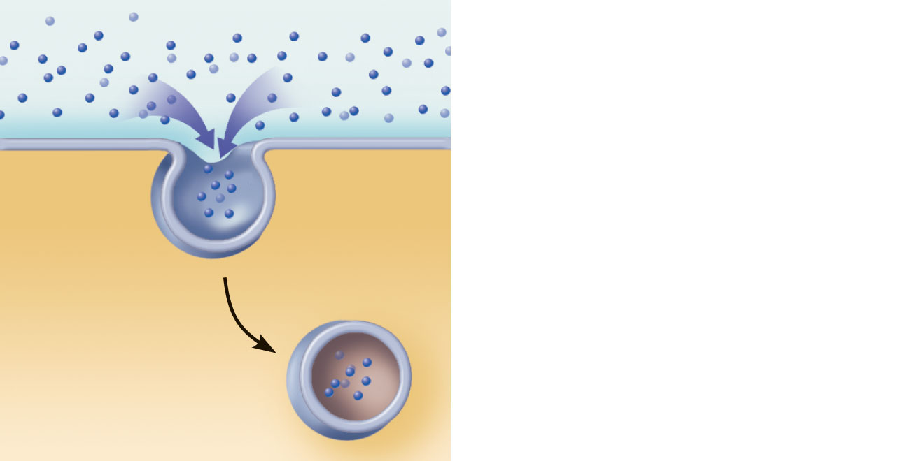
Endocytosis: pinocytosis
(b)
Pinocytosis
The cell “gulps” drops of
extracellular fluid containing
solutes into tiny vesicles. No
receptors are used, so the
process is nonspecific. Most
vesicles are protein-coated.
Fluid-phase endocytosis (pinocytosis)—
plasma membrane infolds, bringing extracellular fluid and solutes into interior of the cell
  Nutrient absorption in the small intestine
Vesicle
Figure 3.13b
Notes:
Pinocytosis is a type of non-specific endocytosis: in pinocytosis, the cell absorbs droplets of extracellular fluid, and redirects them in the form of tiny vesicles, to the lysosomes for assimilation. This is a particularly frequent process in filtering organisms (sponges, molds or ciliated aquatic microorganisms). It also plays a role in the absorption of certain toxins.
Since all solutes dissolved in the droplets are encompassed without discrimination, pinocytosis is not a specific form of transport.

Slide 26
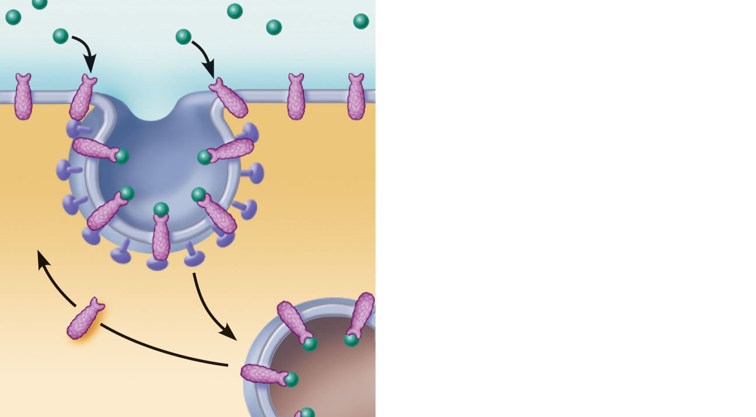
(c)
Receptor-mediated
endocytosis
Extracellular substances
bind to specific receptor
proteins in regions of coated
pits, enabling the cell to
ingest and concentrate
specific substances
(ligands) in protein-coated
vesicles. Ligands may
simply be released inside
the cell, or combined with a
lysosome to digest contents.
Receptors are recycled to
the plasma membrane in
vesicles.
Receptor-mediated endocytosis—
clathrin-coated pits provide main route for endocytosis and transcytosis
  Uptake of enzymes, low-density lipoproteins, iron, and insulin
Vesicle
Receptor recycled
to plasma membrane
Figure 3.13c
Notes:
Receptor-mediated endocytosis, also known as clathrin mantle pinocytosis, is a selective endocytosis due to the existence of membrane receptors which allow recognition and thus binding to specific molecules (eg LDL for the transport of cholesterols).
These formed vesicles (containing the LDL) are then transported into the cytosol by the cytoskeleton and its protein motors (ex: dyneins on microtubules). These (intracellular) vesicles can then undergo different evolutions depending on the utility for the cell (cholesterol is used in particular in cells that synthesize steroid hormones such as testosterone)

Slide 27
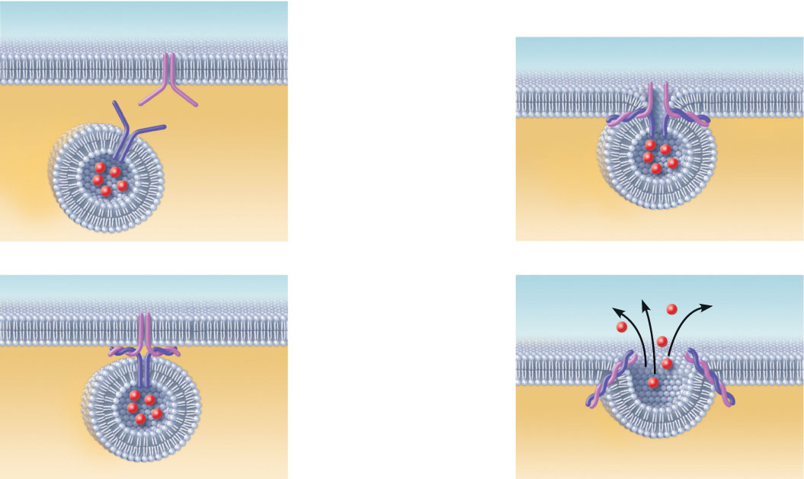
Exocytosis
Plasma membrane
SNARE (t-SNARE)
The process
of exocytosis
Extracellular
fluid
Examples of exocytosis:
  Hormone secretion
  Neurotransmitter release
  Mucus secretion
  Ejection of wastes
Fusion pore formed
1
Secretory
vesicle
Vesicle
SNARE
(v-SNARE)
The membrane-
bound vesicle
migrates to the
plasma membrane.
3
The vesicle
and plasma
membrane fuse
and a pore
opens up.
Molecule to
be secreted
Cytoplasm
2
There, proteins
at the vesicle
surface (v-SNAREs)
bind with t-SNAREs
(plasma membrane
proteins).
4
Vesicle
contents are
released to the
cell exterior.
Fused
v- and
t-SNAREs
Figure 3.14a
Notes:
Exocytosis is the mechanism by which the cell releases large biomolecules through its membrane. Exocytosis occurs when transport or secretion vesicles fuse with the plasma membrane and their contents exit into the extracellular medium. Example: Expulsion of neuromediators from synaptic vesicles to the extracellular medium.
The purpose of exocytosis may be:
Waste disposal.
Mucus secretion (protection of GI mucus membranes)
The functions of signaling and regulation (nerve and endocrine functions).
The production of macromolecules which will have a role outside the cell (membrane receptors, wall construction material, extracellular matrix molecules, etc.)

Slide 28
Comparison of passive and active membrane processes
Passive process | Energy source | Examples
Simple diffusion | Kinetic energy | Movement of O₂ through phospholipid bilayer
Facilitated diffusion | Kinetic energy | Movement of glucose into cells
Osmosis | Kinetic energy | Movement of H₂O through phospholipid bilayer or AQPs
Active process | Energy source | Examples
Primary active transport | ATP | Pumping of ions across membranes
Secondary active transport | Ion gradient | Movement of polar or charged solutes across membranes
Exocytosis | ATP | Secretion of hormones and neurotransmitters
Phagocytosis | ATP | White blood cell phagocytosis
Pinocytosis | ATP | Absorption by intestinal cells
Receptor-mediated endocytosis | ATP | Hormone and cholesterol uptake

