Slide 1
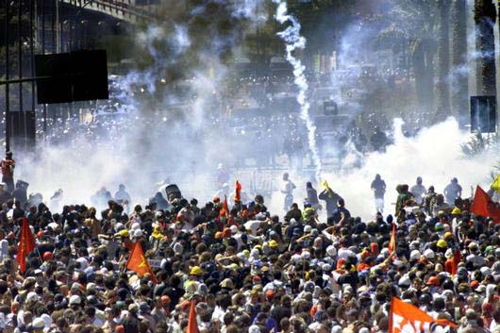
SCS1150D Introduction to Studying the Social Sciences
Introduction

Slide 2

Textbook
Suzanne Staggenborg 2014. Social Movements. Toronto: Oxford University Press. Available at the University Bookstore

Slide 3
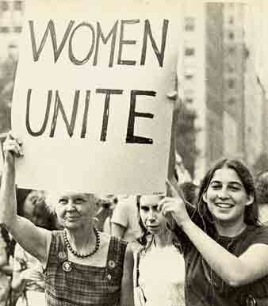
Class Structure
Tuesday, 8:30 -9:50
Friday, 10:00 - 11:20

Slide 4
# | Date | Lecture Title | Readings
1 | Sept. 11 | Introduction: Social Movements, Assignments. | Ch. 1
2 | Sept. 15 | Sociology & Anthropology | AnthroNotes PDF
3 | Sept. 18 | Mentoring Session | TBA
4 | Sept. 22 | Social Movements: Terms, Theories, Protest | Ch. 2.
5 | Sept. 25 | Library tutorial: VNR 2008 | C.R.
6 | Sept. 27 | 1960s Part 1 | Ch.3
7 | Sept. 29 | Campus Tour. TBT 101, 11:30AM | Ch. 4
8 | Oct. 2 | 19660s Part 2. Outline & annotated ref. list Due | CRM PDF
9 | Oct. 6 | Marx & Marxism in the Social Sciences | Marxism PDF
10 | Oct. 9 | Aboriginal politics & Protest in Canada | Ch.5. O.J.E.N.
11 | Oct. 13 | Gender & the fight for Sexual Equality | Ch. 6 & Ch. 7
12 | Oct. 16 | Career services | TBA
13 | Oct. 20 | The Arab Spring | Dupont & Passy PDF
14 | Oct. 23 | Virtual Protest. Summary Due. | Schwarz PDF
 | Oct. 27 | Reading week: No Classes. | Reading review
 | Oct. 30 | Reading week: No Classes. | Reading review
15 | Nov. 3 | Violence & Social Movements | Durham Pilot PDF
16 | Nov. 6 | Protest and the Environment | Ch. 8
17 | Nov. 10 | Exams & Essays: Studying and Writing | Essay File. Ch. 9
18 | Nov. 13 | Presentations | Christensen & Christensen PDF
19 | Nov. 17 | Presentations | Stephan & Chenoweth PDF
20 | Nov. 20 | Presentations | Morris PDF
21 | Nov. 24 | Presentations. Essay due. | Ibrahim PDF
22 | Nov. 27 | Presentations | Bullard PDF
23 | Dec. 1 | Presentations | Durham PDF
24 | Dec. 4 | Presentations | Crossley PDF
25 | Dec. 8 | Conclusion | Ch. 10

Slide 5
Liam Kilmurray
M.A. - Anthropology
M.Philosophy - Anthropological Theory – Cambridge U.K.
PhD - Prehistory and Archaeology – Sheffield U.K.
8 years in fieldwork (Archaeology)
13 years University teaching

Slide 6
CONTACT INFORMATION
Office Location: FSS, Room 8053
Office Hours: Tuesday 10-11
Office phone #: 562-5800, ext. 4731
Email: lkilmurr@uottawa.ca

Slide 7
Evaluation
Evaluation format | Weight | Date Due
Outline and annotated reference list | 10% | October 2, 2014
Summary | 15 % | October 23, 2014
Term paper | 25% | November 24, 2014
15-minute Oral presentation | 15% | Nov 13th - Dec 4th
Final exam | 30 % | Formal Exam. Dec. 10-22
Participation | 5% | Course duration

Slide 8
Assignments
Due Date October 2nd
Course value 15%
Length of this assignment is 3 pages
Oct 2nd is our ninth class, by this point you must have completed your preliminary research for your essay topic and have constructed most of your bibliography
A. Outline and annotated reference list: For this assignment you will use the sample provided in class to develop an outline of your final paper. The outline will include an annotated reference list of no less than 6 appropriate and scholarly references. Additional details to be provided in class.

Slide 9

Assignments
The outline and annotated reference list should incorporate the books and articles that you have initially perused.
This does not mean you have to stick to all of these works for your final paper
But you do have to submit an analysis of 6 appropriate sources.

Slide 10
Assignments
B. Text Summary: In this assignment you will be asked to summarize one of the course readings. This text has been selected by the professor and will be posted on virtual campus. Additional details will be provided in class.
Summary of a course reading
Due October 23rd
Course value 15%
Length of this assignment is 2 pages

Slide 11
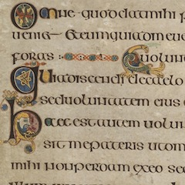
Text Summary
David S Meyer: how social movements matter
In two pages you will explain the academic essence of the chosen text
Describing the subject matter, theoretical approach, analytical argument, methodology etc. of the article

Slide 12
Assignments
Due November 24th
Course value 25%
Length of assignment 5-6 pages
C. Term paper: Building on your outline, the term paper assignment is a research-based paper of approximately 5-6 pages in which you are expected to make an argument based on the information you have collected. Your topic must be approved by the professor by September 27th. You will be provided with additional details in class.

Slide 13

The Presentations
The Presentation will be based on your research paper.
You will have a total of 15 minutes.

Slide 14
Assignments
Date: TBA, Dec 10-22
Course weight 30%
The Structure of the final exam will be short answer
Multiple choice and True or False, some Blanks
We will address this in the final part of the course
E. Final Exam: A final exam consisting of multiple-choice and short answer questions will be scheduled during the official exam period. The questions will be based on all class materials, lectures and readings. The date of the exam will be announced later in the semester.

Slide 15
Final exam
Many of the questions on this exam will be taken from the readings assigned from Nov 13th to Dec 8th
15 | Nov. 13 | Presentations | Christensen & Christensen PDF
16 | Nov. 17 | Presentations | Stephan & Chenoweth PDF
17 | Nov. 20 | Presentations | Morris PDF
18 | Nov. 24 | Presentations. Essay due. | Ibrahim PDF
19 | Nov. 27 | Presentations | Bullard PDF
20 | Dec. 1 | Presentations | Durham PDF
21 | Dec. 4 | Presentations | Crossley PDF
22 | Dec. 8 | Conclusion | Ch. 10

Slide 16
Social Movement: one Definition
A recurrent pattern of polymorphous and value-charged protest activities.
A distinction is thus made between social movements and occasional protests, organised political groups, and regimes.

Slide 17
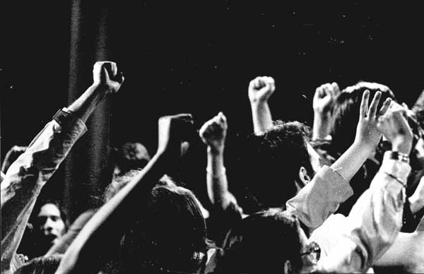
Key Questions
Why do movements originate when they do?
How do they attract and maintain support?
How do they present issues & formulate strategies?
How do they structure their organizations?

Slide 18
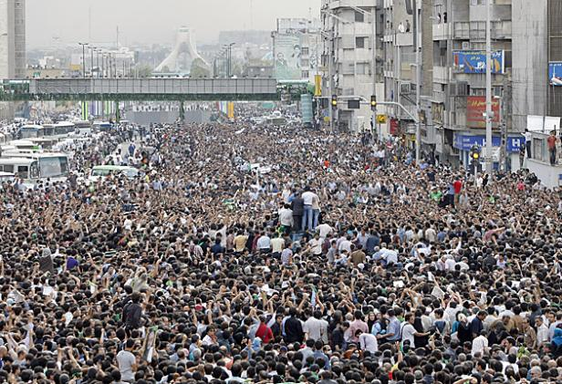
Key Questions
How do social movements impact on culture?
Why do social movements generate opposition?
Why do social movements persist or decline?
How/why do they succeed or fail?

Slide 19
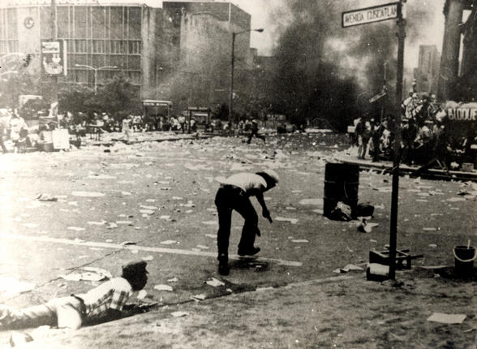
Contentious Politics
How do social structures, institutions, and the character of contentious politics interact?
We “must look systematically at the interplay among regimes, institutions, political opportunity structure, and repertoires…” (Tarrow & Tilley 2007:50).

