Slide 1
Reminder
Midterm 1:
  Next Tuesday, February 9th at 10:00am
  Content from lectures AND textbook:
    Chapter 1
    Chapter 2
    Chapter 3 (pp.67-87)
    Chapter 4
    Chapter 5 (pp.129-139)
  Multiple-choice questions, fill-in-the-blank questions and short-answer questions

Slide 2
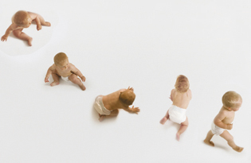
Motor Skills & Growth
PSY 2105G
Younger, Adler, & Vasta, 2012

Slide 3

States of alertness
Infant alertness changes day and night through 6 different states:
  Deep sleep
  Light sleep
  Drowsiness
  Alert inactivity
  Alert activity
  Crying
Quiet sleep versus Active sleep
Notes:
Deep/quiet sleep
Light/ active
Next states are awareness states
Alert inactivity taking the most in from environment
Alert activity – most movement, baby can be overstimulated
Crying – asking for help, direct communication
Quiet sleep and active sleep (move eyes back and forth, REM sleep)

Slide 4
States of Alertness
EEG demonstrates that sleep states change throughout our lifespan:
  Duration of sleep per night decreases with age
  The amount of time spent in active sleep decreases with age
    REM sleep
Notes:
Newborn sleeps 16 hours a day, 6 months – 13 hours a day, young adults sleep 8 hours
REM – internalizing all the stimulation from the day

Slide 5
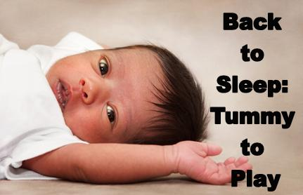
Sudden infant death Syndrome (SIDS)
SIDS: sudden and unexpected death of an infant under one year of age
Most vulnerable period: 2-4 months
Causes are still not completely understood
Risk factors:
  Position in which the baby is sleeping
  Soft bedding
  Overheating
  Cigarette smoke
  Co-sleeping
Notes:
Most vulnerable period is between 2 and 4 months (lower level of serotonin in brain – linked to regulating heart and breathing)
Highest for mothers aged under 20, uncommon in Asian families
60% are in baby boys, being born prematurely, low birth weight, low afgar score, infants that suffer from respiratory problems, pre-drug use from mother
Soft bedding – no pillows, blankets or stuffed animals in crib
Preventing – breast feeding, giving a pacifier,

Slide 6
Newborn Reflexes
Reflex: patterns in response to specific stimuli
Survival instincts
Primitive instincts
Presence or absence of reflexes gives information on the infant’s nervous system
Automatic and stereotyped behaviour
Notes:
Survival – blinking, swallowing, breathing
Primitive – no longer important survival reflex (rooting reflex, stepping reflux
Should always be born with these but should disappear, if doesn’t could have something to do with poor immune system

Slide 7

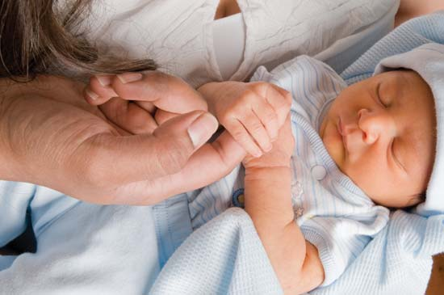
Newborn Reflexes
Rooting Reflex:
  First to appear
  Stimulation of the cheek elicits head turn toward stimulus
  Disappears 3-4 months
Palmar Reflex:
  Pressure by a stimulus on the palm of the infants elicits a grasping of the stimulus
  Disappears 3-4 months
Notes:
Absent in depressed babies (lack of interest in environment)
Palmer reflex – grasping when push their palm, increases in 1st month, absent or weak in depressed babies

Slide 8
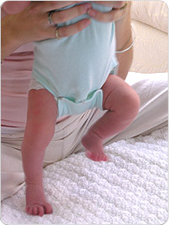
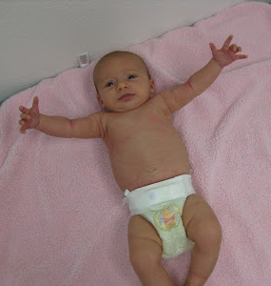

Newborn reflexes
Stepping Reflex:
  When bare feet are placed on a flat surface, infant makes stepping motion as if walking
  Disappears 2-3 months
Moro Reflex:
  Loss of head support or loud noise elicits a motor sequence of embracing
  Disappears around 5 months
Babinski Reflex:
  Gentle stoke of the side of the infant’s foot from heel to toes elicits a flexed big toe and infant fans out other toes
  Disappears near the end of the first year
Notes:
Stepping motion- muscles too weak to support legs, comes back in water (less gravity) and when on a treadmill

Slide 9
Congenitally Organized behaviours
What are they?
  Not associated to specific identifiable stimuli; do not require specific external stimulation
  Useful for the infant in controlling and exploring the environment; more adaptable than reflexes
Three well-organized behaviours:
  Looking
  Sucking
  Crying
Notes:
Looking – don’t have to have light to look, even when not externally stimulated
Sucking – children can suck spontaneously (too soothe themselves or explore), don’t need food to suck
Crying – doesn’t have to be illicited by a stimulous, may just cry for parents attention

Slide 10
Congenitally Organized behaviours
Looking:
  Infants will examine their environment even when they are not externally stimulated
Sucking:
  Infants suck spontaneously (not just to get nourishment)
  Acts as an exploration tool
  Buffer against pain and overstimulation
Crying:
  Hunger
  Emotions: Anger or Pain
  Influences early social relationships

Slide 11
Motor development
Motor development can be divided in two groups:
    1) - Postural development: increasing ability of the baby to control parts of his/her body
    - Locomotion: movement of a person through space
  2) Prehension: ability to use fingers and hands to grasp and manipulate stimuli

Slide 12
Motor Development
The sequence of motor development progresses through:
  The proximodistal principle: body parts near the center of the infant develop before the distant parts
  The cephalocaudal principle: body parts near the head develop first

Slide 13
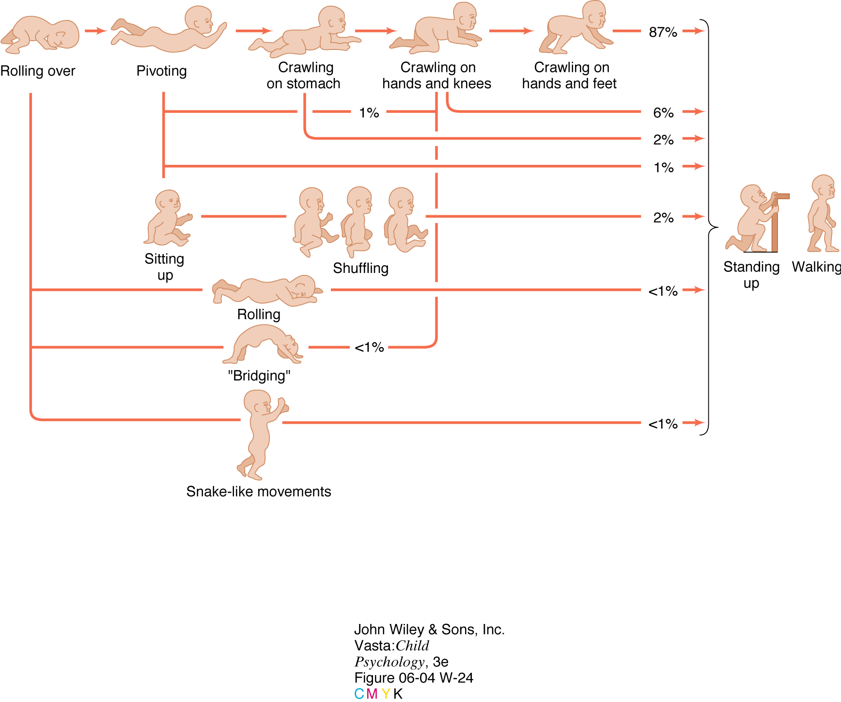
Development of locomotion
Younger, Adler, & Vasta, 2012

Slide 14
Milestones in Motor Development
Age in months | Locomotion and Postural Development | Prehension and Manipulative Skills
0 | - Turns head to side when on stomach - Poor head control when lifted - Alternating movement of legs when on stomach | - Reflex grasp
3 | - Head erect and steady when held vertically - When on stomach, elevates head and shoulders by arms/hands/shoulders - Sits with support - Anticipate adjustment of lifting | - Grasps rattle - Reaches for objects with two hands
6 | - Sits alone momentarily - Pulls self to siting position with adult’s hand as puller - Rolls from back to stomach | - Grasps cube with simultaneous flexion of fingers - Reaches with one hand and rotates wrist - Transfers cube between hands
Younger, Adler, & Vasta, 2012

Slide 15
Milestones in Motor Development
Age in months | Locomotion and Postural Development | Prehension and Manipulative Skills
9 | - Sits alone - Pulls self to sitting position in crib - Makes forward progress in prone position toward toy - Walks holding on furniture | - Pincer grasp: opposes thumb and finger in seizing cube - Picks up pellet with forefinger and thumb
12 | - Stands alone - Lowers self to sitting from a standing position - Walks with help - Creeping perfected - Into everything | - Holds crayon adaptively to make a mark
18 | - Walks well (since about 15 months) and falls rarely - Climbs stairs or chair | - Throws ball into box - Scribbles vigorously - Builds towers (3+ blocks)
24 | - Walks up and down stairs - Walks backward - Runs | - Places squares in form board - Imitates folding of paper - Builds towers (6+ blocks) - Puts blocks in a row to form a train
Younger, Adler, & Vasta, 2012

Slide 16
Nature versus Nurture
Nature:
  Motor skills are genetically preprogrammed
Nurture:
  Environmental influences impact motor development
Dynamic Systems Approach:
  Esther Thelen
  Motor skill development depends on the nature of the task (infant motivation and task difficulty) and on the infant’s pre-existing physical abilities
Notes:
Esther thelen – experiment with the stepping reflexes and the treadmill
Not just nature or nurture another example would be motivation
Emotional refueling – further away child crawls the more they need reassuring things are okay, then go back to exploring
She put weights on babies legs that still had the stepping reflex and they stopped?
Saying not just nature or nurture, mix of both, element that unites nature and nurture is the infants goal or motivation. Learns of kicking or moving in a certain way they can move in a certain direction
Emotional refueling – leaving to explore and then going back to the parent
Cruising – experimenting with balance, using something to hold themselves up when trying to walk
Using beams with gaps to see if the baby will keep going, if gap is too big reverts back to crawling. Hands are essential to hold themselves up and to guide them to judge what they can and can’t do safely
Walking – manipulating a ramps steepness to see a babies control, revert to sitting and going down the hill when too steap

Slide 17
Physical Growth
Physical growth is rapid during the fetal period then it slows down until the growth spurt of early adolescence
Growth trends show various patterns across genders
Disease and malnutrition can effect growth:
  Catch-up growth
How do they access rate of maturation of a child’s physical development?
  Skeletal maturity
Notes:
Adolescence growth rate goes up again (girls 10, boys 12)
Catch up growth – after malnutrition, growing quicker than usual to catch up to the rest of their peers

Slide 18
Physical growth
Specific body areas have their own developmental trajectory: head, height, internal organs
Fat versus muscles
Puberty:
  Chemical and physical changes occur that enable sexual reproduction
  Starts between the ages of 10 and 14
  Pubertal timing depends on genetic and environmental factors as well as family dynamics
Notes:
Head and brain grow fast, height during adolescence
Fat and muscle – changes with age and differs between genders, infant grows fat until 9months (females have more fat than boys; muscle), time when girls have more muscle than boys
Puberty – males changes penial, testicular, girls; breast and growth of pubic hair, menarchy - increase in self esteem or if don’t have info may be a risk factor usually when younger
Stressful homes can cause puberty to occur quicker

Slide 19
Factors affecting Growth and maturation
1) Heredity:
  Genetics influence height, weight, timing of teething and pace of pubertal development
2) Nutrition:
  Malnourishment
  Eating disorders: anorexia, bulimia, obesity and binge-eating
3) Abuse and psychological trauma:
  Failure-to-thrive syndrome
Notes:
Identical twin studies show high occurrence in genetic influence
Eating disorders can effect growth and maturation, can cause loss of menstrual cycle, can effect heart, poor self-esteem (obesity), orthorexia – obsessed with eating right to an extreme thinking they’re really bad even if not, assessing everything they see and other people’s diets
Children who fail gain weight, impaired growth rates, take children out of home and they do the catch up growth.

