Slide 1
1. Developmental Plasticity
HSS4102B – DEVELOPMENT OF HEALTH PROBLEMS THROUGH THE LIFESPAN
Gustavo Gottret
Interdisciplinary School of Health Sciences
Faculty of Health Sciences – University of Ottawa

Slide 2
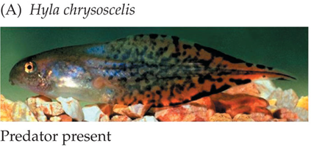
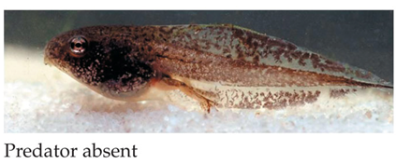
THE ENVIRONNEMENT AS A NORMAL AGENT IN PRODUCING PHENOTYPES

Slide 3
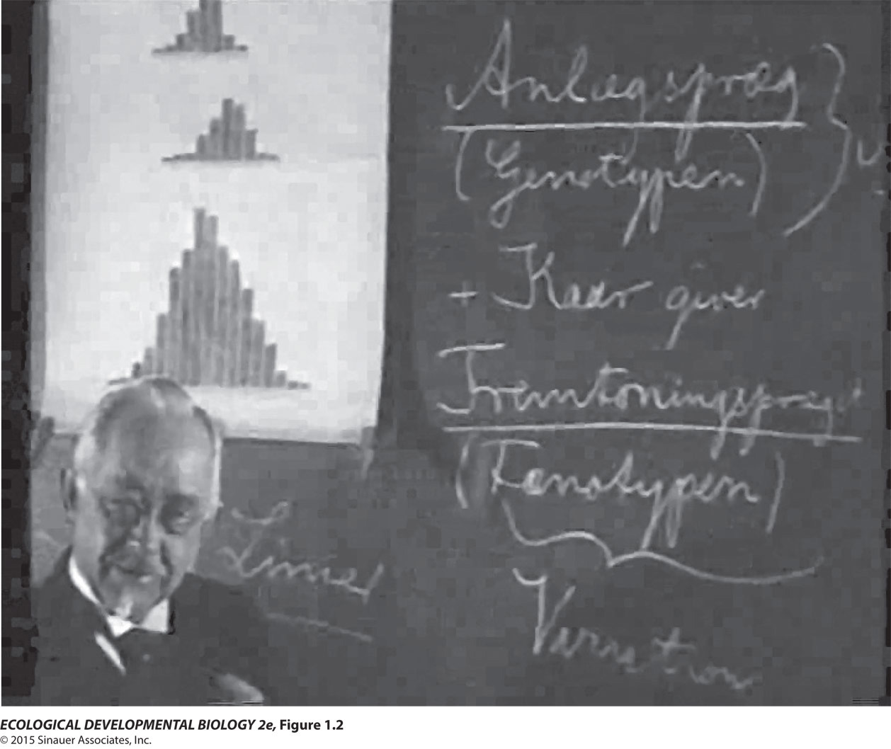
Plasticity Is a Normal Part of Development
A CENTURY OF STUDIES
Wilhelm Johannsen

Slide 4
Epistemology:
Looking for the “truth”
  The knowing subject
  The object of our knowledge
  Socrates, Plato, Aristotle
  Plate believed in a realm of ideas
  Aristotle believed in the observed realism, one must be able to observe reality

Slide 5
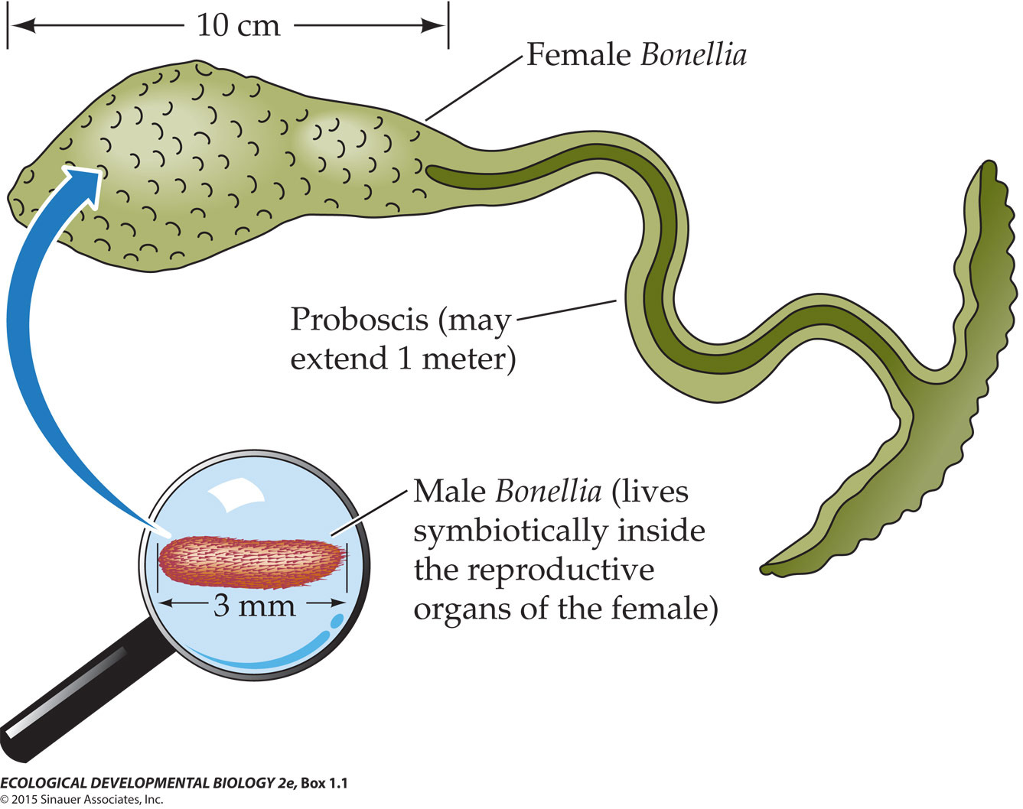
Plasticity Is a Normal Part of Development
A CONTEXTUALLY INTEGRATED VIEW OF LIFE
Box 1.1 Bonellia viridis:
When the Environment Determines Sex

Slide 6
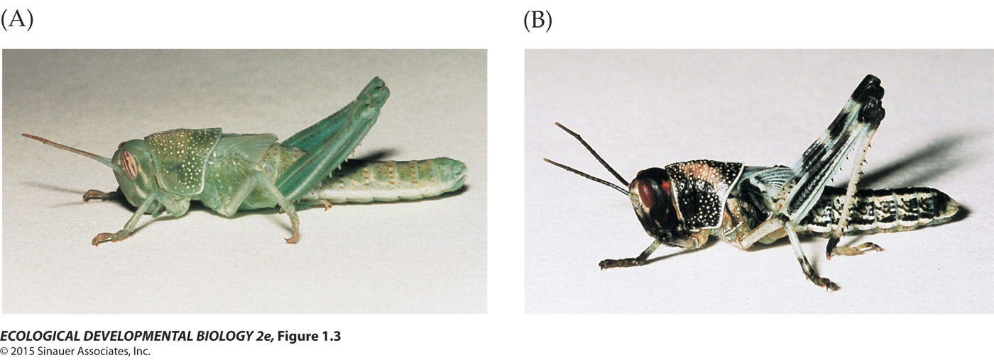
“Eco-Devo”: Embryology Meets Developmental Plasticity
REACTION NORMS AND POLYPHENISM

Slide 7
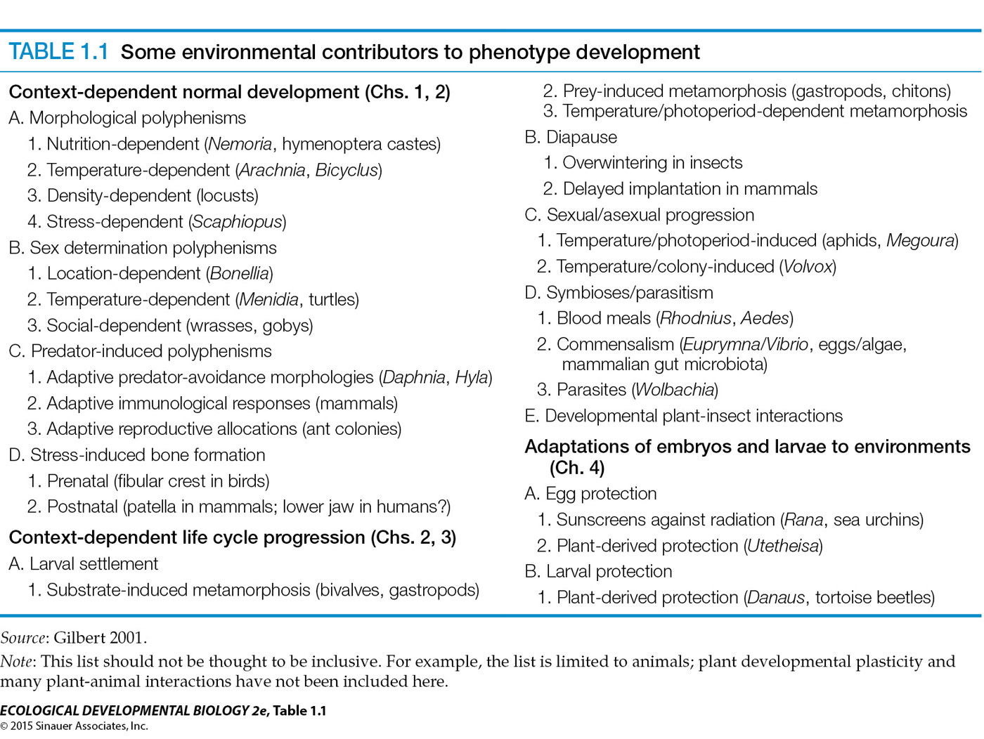
“Eco-Devo”: Embryology Meets Developmental Plasticity
EPIGENETICS
  Epigenetic Inheritance
AGENTS OF DEVELOPMENTAL PLASTICITY

Slide 9
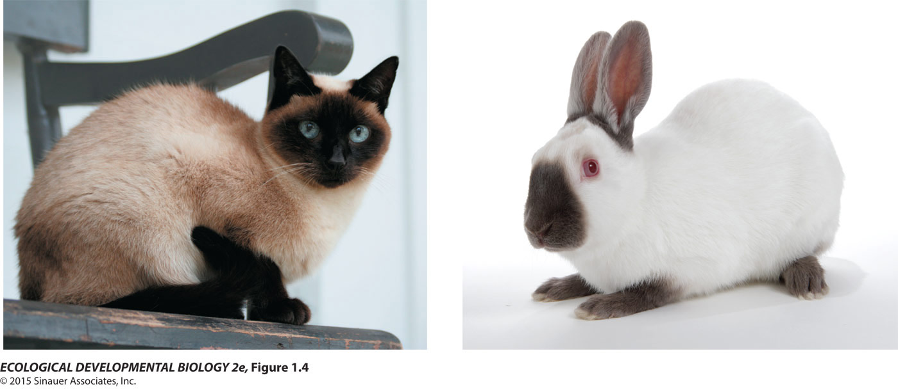
Temperature-Dependent Phenotypes
ENZYME ACTIVITY AS A FUNCTION OF TEMPERATURE
Notes:
Figure 1.4 The dark pigment melanin is synthesized only in the colder areas of the vertebrate skin in Siamese cats and Himalayan rabbits

Slide 10
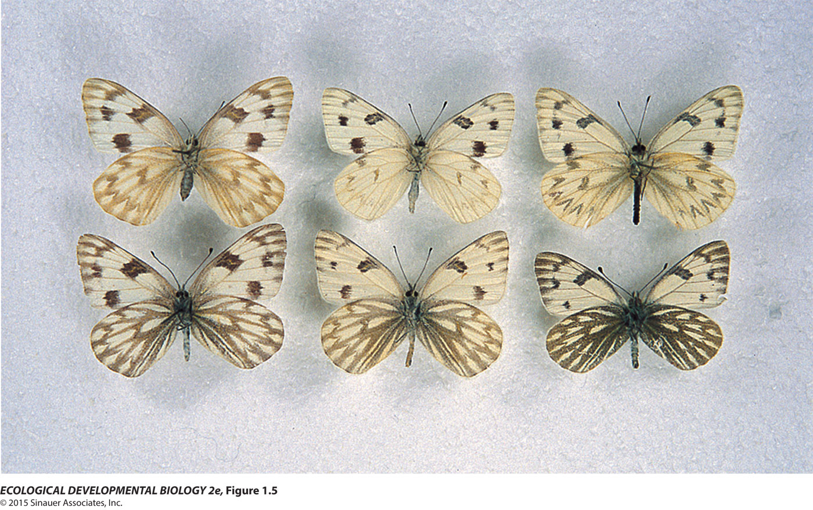
Temperature-Dependent Phenotypes
SEASONAL POLYPHENISM

Slide 11
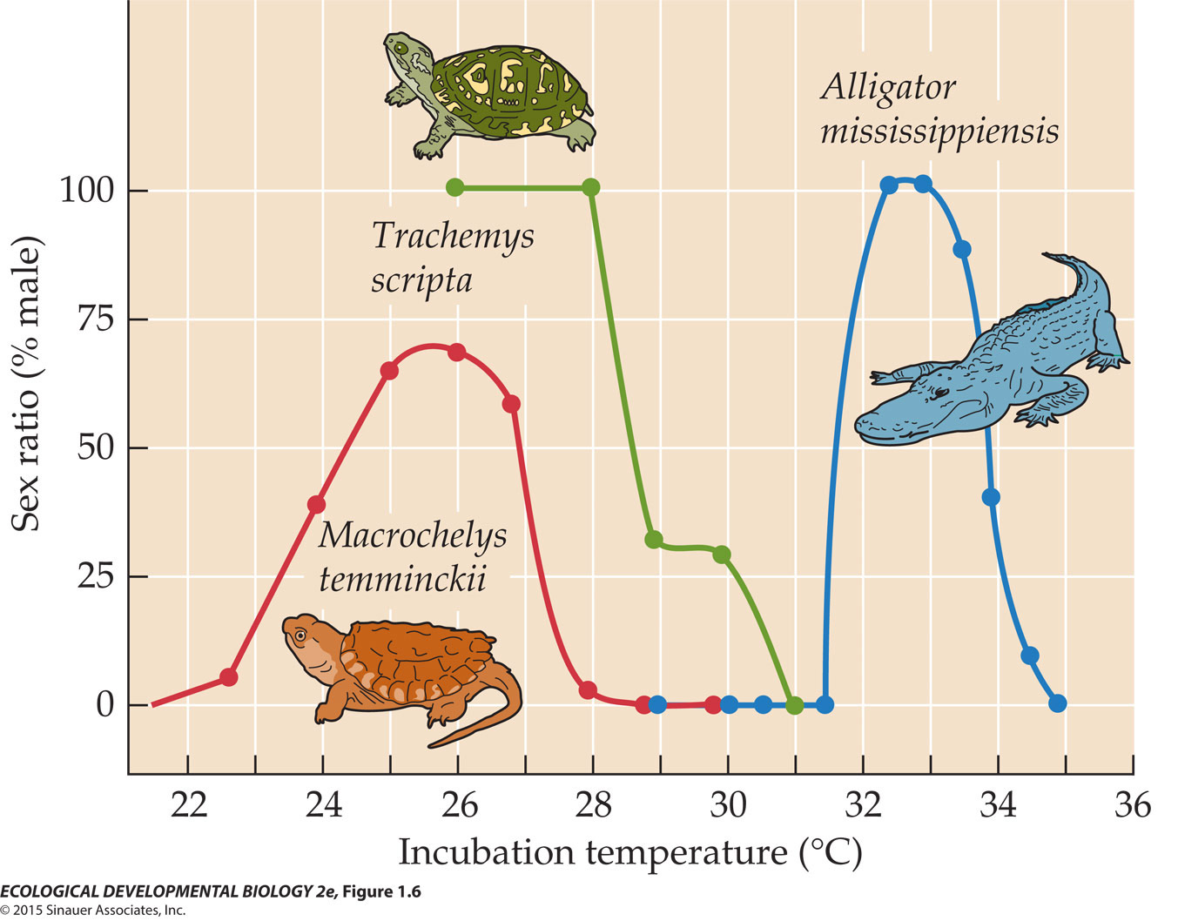
Temperature-Dependent Phenotypes
TEMPERATURE AND SEX

Slide 12
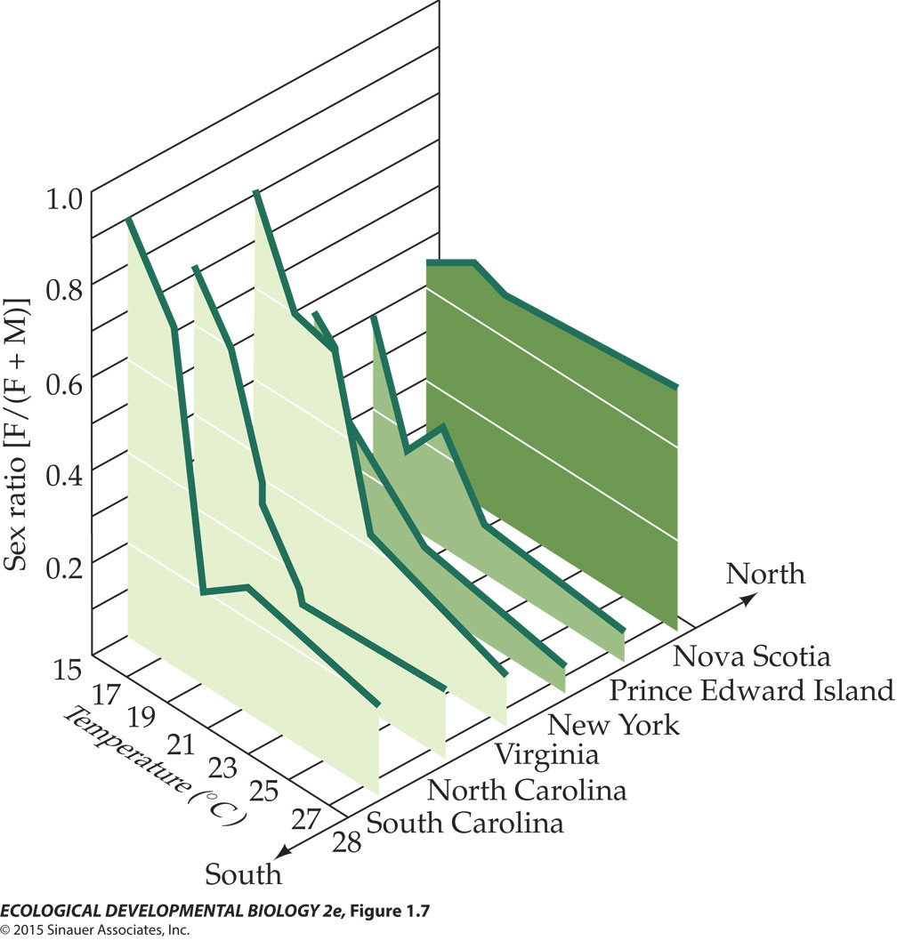
Temperature-Dependent Phenotypes
TEMPERATURE AND SEX (2)

Slide 13
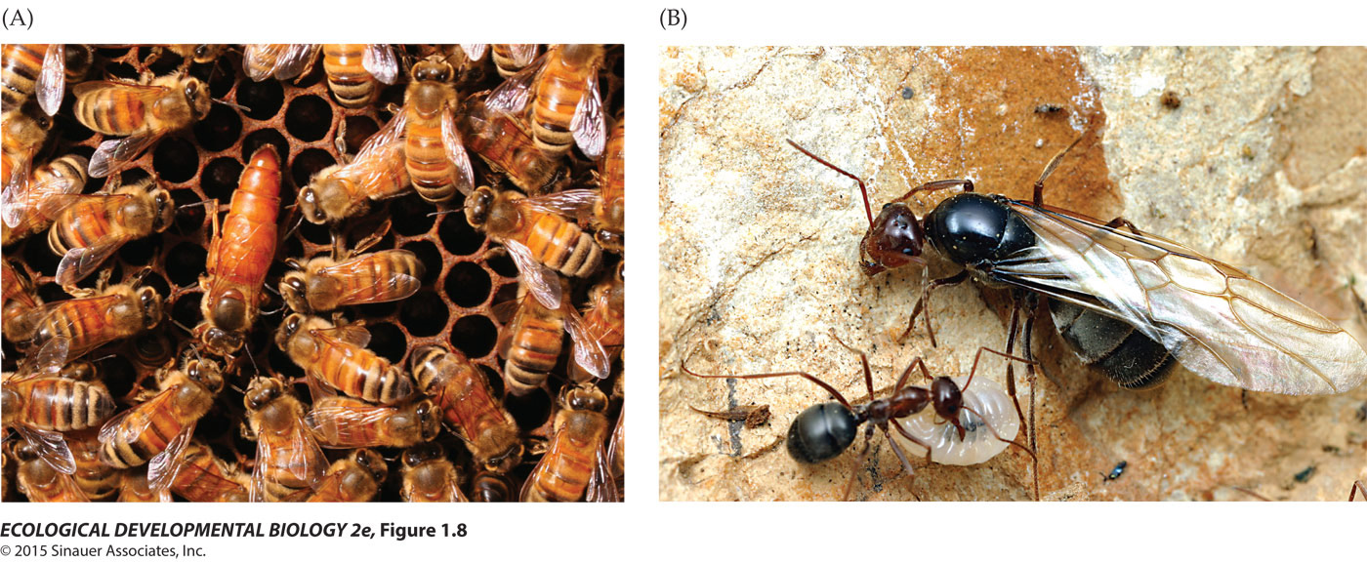
Nutritional Polyphenism:
What you eat becomes you!
ROYAL JELLY AND EGG-LAYING QUEENS

Slide 14
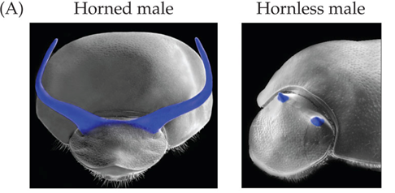
Nutritional Polyphenism:
What you eat becomes you!
HORN LENGTH IN MALE DUNG BEETLE (1)

Slide 15
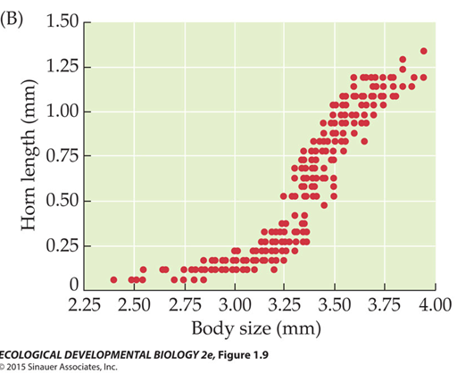
Nutritional Polyphenism:
What you eat becomes you!
HORN LENGTH IN MALE DUNG BEETLE (2)

Slide 16
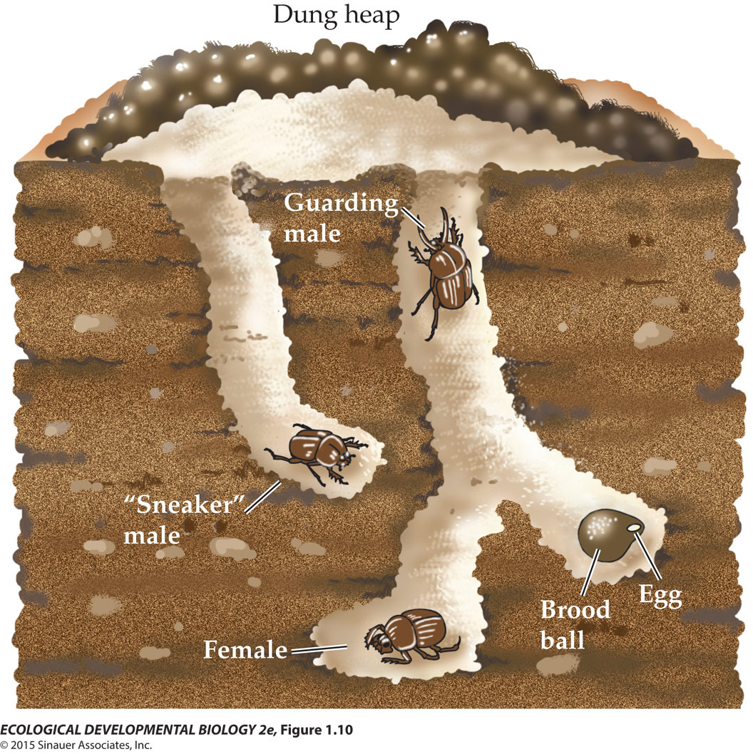
Nutritional Polyphenism:
What you eat becomes you!
HORN LENGTH IN MALE DUNG BEETLE (3)

Slide 17
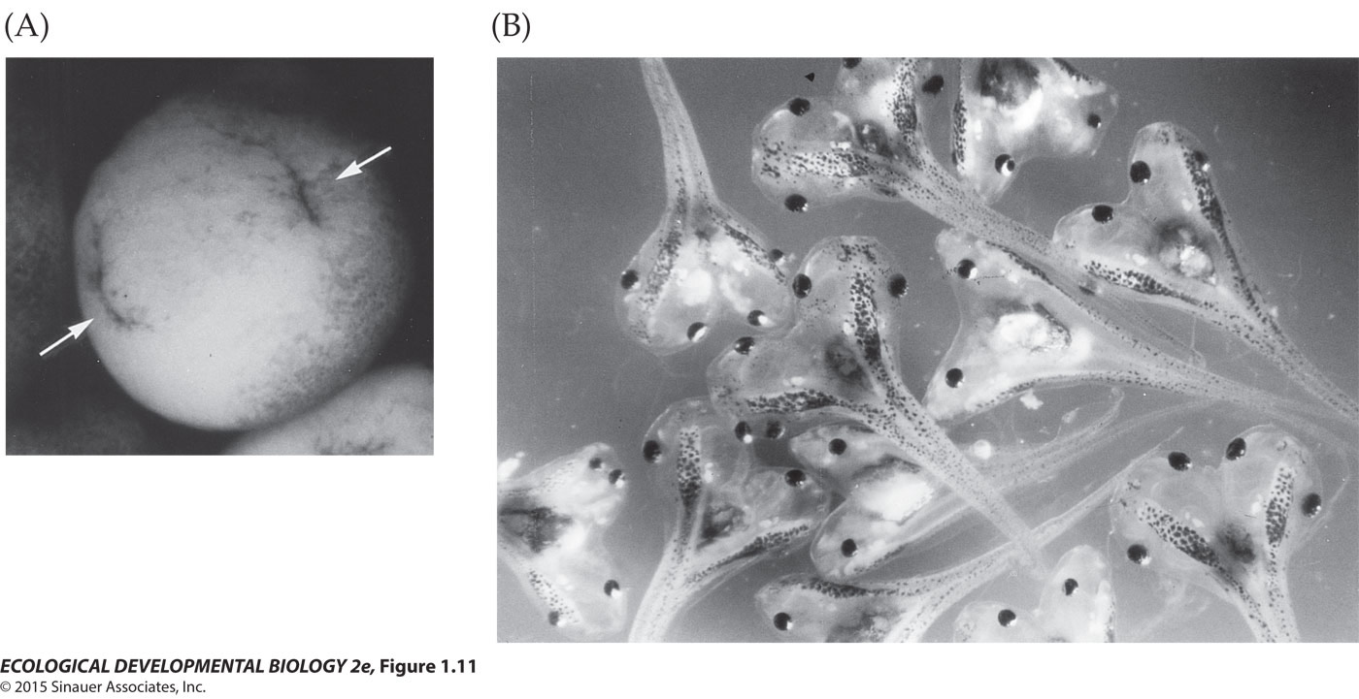
Gravity and Pressure

Slide 18
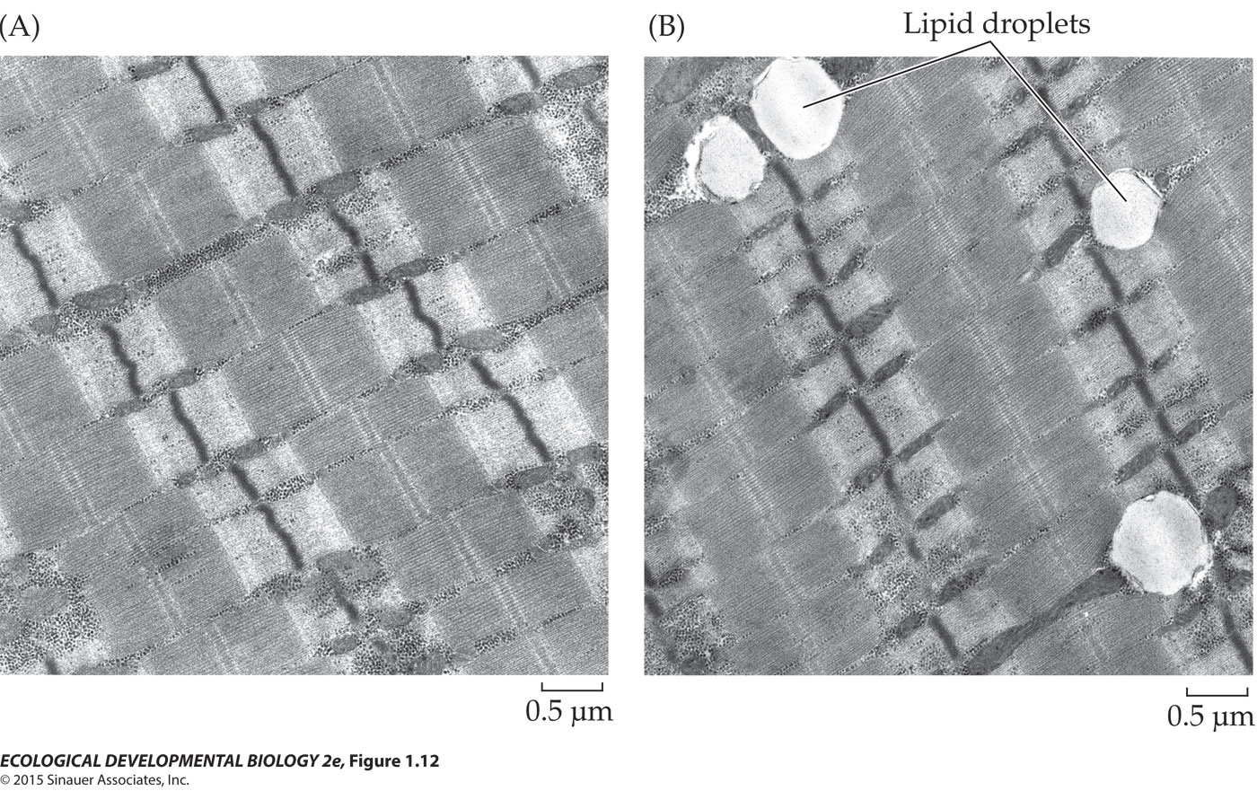
Gravity and Pressure

Slide 19
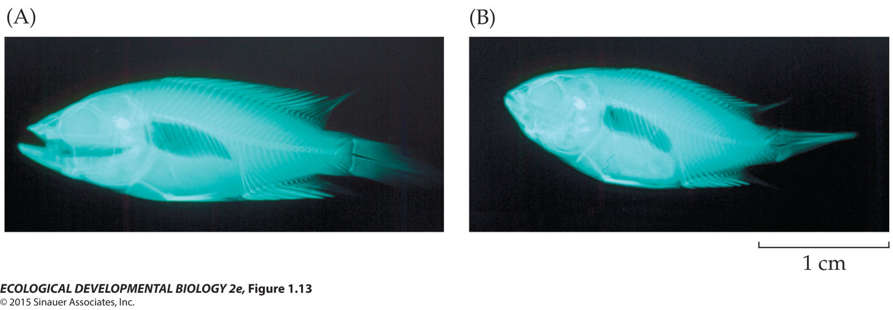
Gravity and Pressure

Slide 20
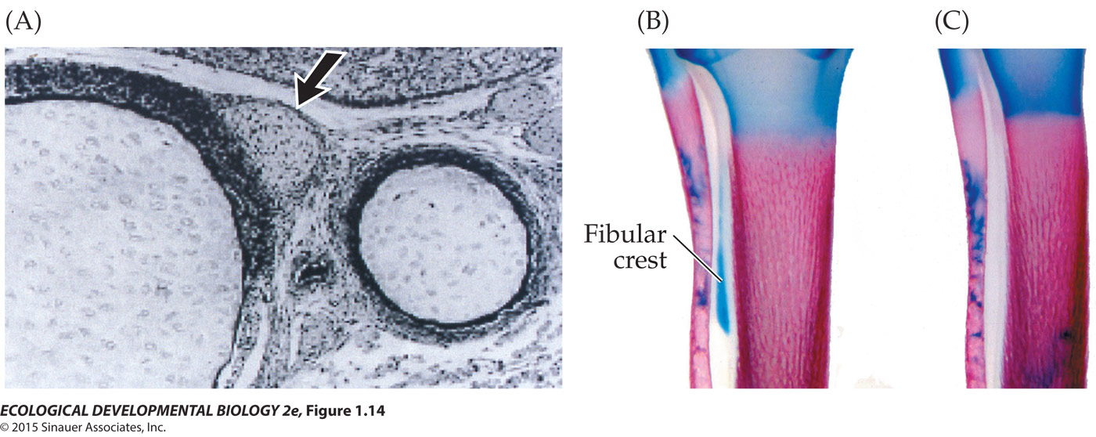
Gravity and Pressure

Slide 21
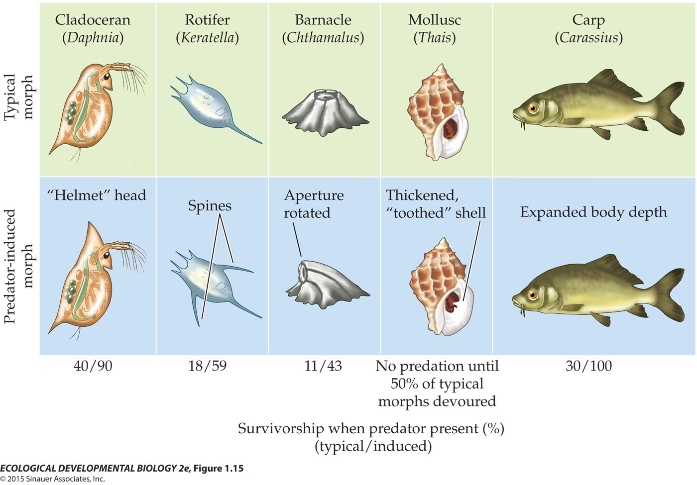
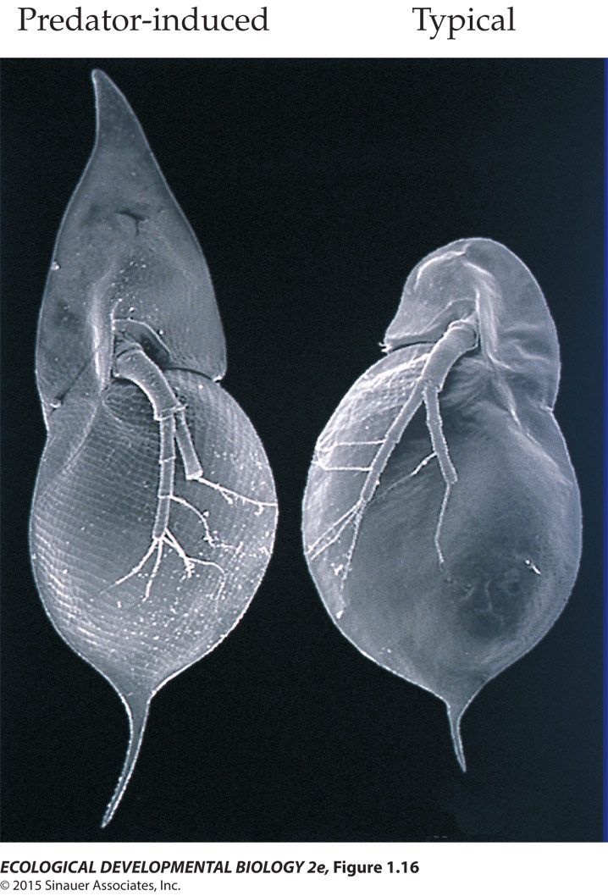
Predator Induced Polyphenisms
IN INVERTEBRATES

Slide 22
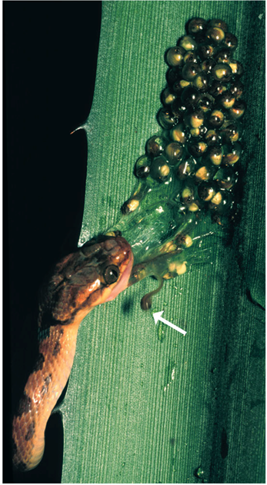
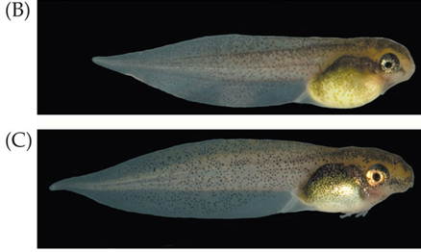
Predator Induced Polyphenisms
IN VERTEBRATES

Slide 23
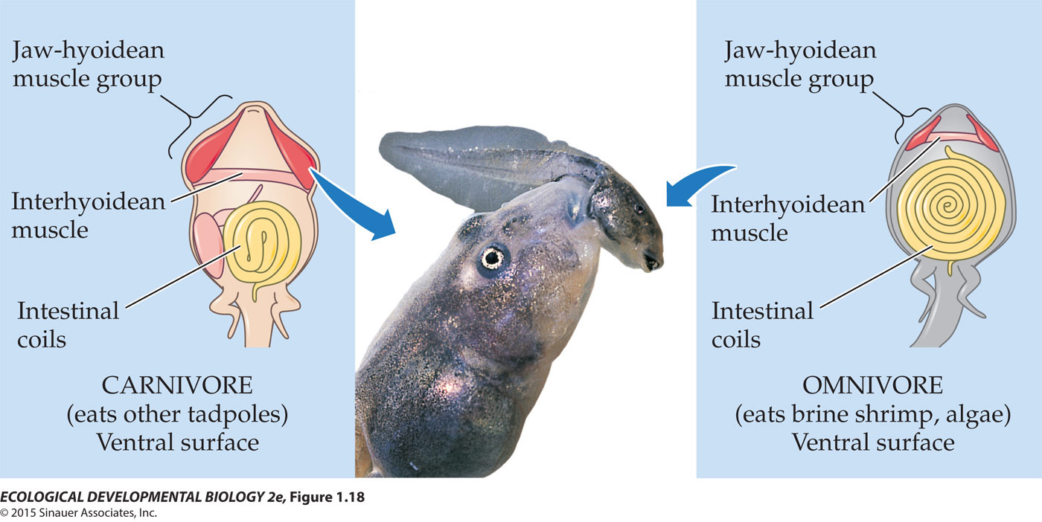
The Presence of Conspecifics:
It is who you know
A SWARM OF LOCUSTS: Polyphenism through touch
SEXUAL POLYPHENISM INDUCED BY THE COMMUNITY ENVIRONNEMENT
CANNIBALISM: An extreme phenotype for extreme times

Slide 25
Convergence on Favourable Phenotypes

Slide 26
Looking Ahead

