Slide 1
Comm 401 004 F2017
Business & Corporate Strategy
Commerce
Facilitator: Gary J. Bissonette
Course Overview
Please pick up the following items as you come in:
Copy of Course Syllabus
Copy of CBS “Getting Started” guidance document
Capsim CBS Team Member Guide (orange booklet)
Name Card

Slide 2
Comm 401 – Overview
Capstone course with strategic management emphasis
Focus is on managerial decision-making relating to strategy formulation and implementation
Qualitative and quantitative assessment skills are revisited
Application is emphasized over theory
Additional Point
Workload is heavier than average course, but… it is your “Capstone” course

Slide 3
Comm 401 – Six Guiding Metrics
To think about the different perspectives around which strategic decision-making can evolve.
To appreciate the importance of competitive advantages, and how their development and/or absence can impact an organization’s performance.
To recognize the forces that drive industry profitability and understand how industry and business model structure influences a firm’s competitive behavior and overall industry attractiveness.
To understand the impact of the different business functions on a firm’s potential as a result of strategy implementation and/or execution.
To communicate professionally; to present analysis, recommendations, and strategic recommendations clearly, both in writing and through oral presentations.
To collaborate effectively in a team environment.

Slide 4
Course Structure
Case Exercises & Briefings
Capstone Business Simulation
Topical Discussion & Idea Presentation

Slide 5
Performance Evaluation Scheme
100 Points
Individual | Value |  | Team-Based | Value
Class Preparation Assignments (10) | 21 |  | Capstone Team - Presentation | 10
Class Participation – Attendance Quality of Contribution Active Participation Meeting Simulation Requirements | 9 |  | Capstone Reports Intended Strategy Report Emerging Strategy Report | 10
Competitive Analysis Assignment | 10 |  | Capstone Company Performance | 10
Final Exam (Comprehensive) | 30
Total | 70 |  | Total | 30
Peer Evaluation

Slide 6
Note on Class Participation
Expectation is that you will come to class and participate.
I have an 80% attendance rule – that should cover off recruiting, etc. Less than 80% attendance impacts your class participation grade.
If you cannot make a class due to recruiting, etc., I expect an email indicating this. I view it as just like missing a meeting.
You must be in attendance to receive credit for in-class exercises.
Failure to submit a Capstone Business Simulation decision on time will penalize each member of the team 1.50 class participation points.

Slide 7
Class Preparation Assignment Grading: 3-2-1
TAs will grade course content CPAs based on the following criteria:
3 – Complete answer (the student shows thorough understanding of the topic; all key aspects of the subject are well explained);
2 – Incomplete answer (the student understands the subject, but some important aspects of the topic are not adequately explained);
1 – Insufficient answer (student shows poor understanding of the subject; the answer is confusing; key aspects of the subject matter are not discussed);
0 – Non-submitted assignment (or the answer does not meet required response criteria).
Please note:
CPA #3 is a quiz relating to the Capstone Business Simulation. It is graded online through D2L.
Barring exceptional circumstances, there are no make-up options relating to Class Preparation Assignments.

Slide 8
Course Layering
Strategy Execution
Strategy Integration, disruptions, Leadership and Governance
Capsim Business Simulation
Strategy Formulation, Execution and Reporting
Strategy Fundamentals
Strategic Planning, Business Model Framing, Competitive Dynamics

Slide 9
Required Materials
Course Package
  Copyright Protected…Readings - $20.00 CAD
  Pick up from Materials Management Office – LL132
Capstone Registration –
  Required for simulation participation…licensing agreement requires each student register separately for the simulation.
  Purchased online at capsim.com. $53.99 USD
Are your quantitative skills rusty? If so...
Warren Buffett and the Interpretation of Financial Statements, written by Mary Buffett and David Clark, published by Scriber – on reserve at the Stauffer Library

Slide 10


Capstone Business Simulation
What do you remember about the Foundation Business Simulation?
$100 million company
Start with 5 products…expand to 8 products
5 market segments to choose from
5 advanced modules – marketing, HR, TQM, Labour Negotiations, Ethics Plug-in
Requires stronger financial, analytical , forecasting, and project management skills, not to mention strong planning skills
Greater volatility and uncertainty within the industry…resulting in heightened market dynamics

Slide 11
Simulation Roadmap
Team-Based Decisions
Getting Started Exercises
Situational Analysis
Strategy Selection
Practice Rounds
Assess Competencies
Individual Exercises
Company Report #1
Strategy Selection
Competition Rounds 1 to 4
Assess Competencies
Company Report #2
Strategy Adjustment
Competition Rounds 5 to 8
Final Analysis & Presentation

Slide 12
CBS Ramp Up
Date | Time | Type | Action Required
September 18, 2017 | 11:00 pm | Individual | Capsim Registration - Completion
September 26, 2017 | 11:00 pm | Individual | Getting Started, Rehearsal Tutorial, and Situational Analysis Exercises – Completion
October 2, 2017 to October 17, 2017 | 11:00 pm | Team | Practice Rounds Decisions- four in total – Oct. 5th, Oct. 10th, Oct. 14th, and Oct. 17th, 2017, (all decisions due at 11:00 pm on these dates)
October 18, 2017 | 9:00 am |  | Simulation reset to competition rounds
October 18, 2017 to November 21, 2017 | 11:00 pm | Team | Competition Round #1 – decisions due Oct. 21, 2017. 8 competition rounds in total.
Board Presentations |  | Team | Week of November 25, 2016

Slide 13

The Story: Background on Your Company
Deregulation and emerging customer preferences have driven the need to restructure the industry.
Andrews
Baldwin
Chester
Digby
Erie
Ferris
Started as a single corporation named Sensors, Inc.
Sold sensors as main product
Industry is being deregulated to facilitate and enhance competition for the benefit of customers
Your job: Operate one of the companies and make it successful.

Slide 14

The Start
When Sensor Inc. breaks up, each of the new companies starts off with the following scenario:
$100 Million in Sales
5 Product Lines
Closed Marketplace
5 Market Segments

Slide 15






Sensors: An Overview of Your Company’s Product
Customers (OEMs) need sensors for their products to function.
Used for diverse applications
Five clear market segments
Low End
Traditional
High End
Performance
Size
Customer demands vary between the five segments.

Slide 16

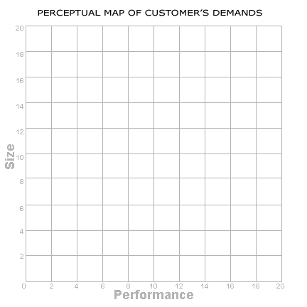

The Marketplace
5 Products currently located in the segment overlap
Over 8 years customers will demand much faster and smaller sensors
Market Segments will continue to diverge
Low
Tech
Performance
Traditional
Size
High
Tech

Slide 17
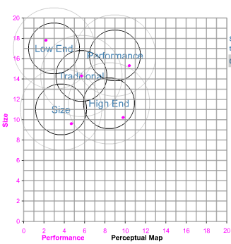
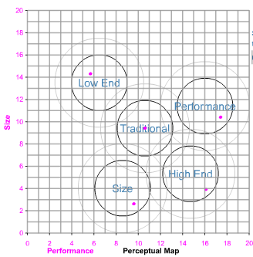
The Marketplace: A Look Into The Segments
Perceptual map used to track changing consumer demands in size and performance
Each year, consumers will expect faster (higher performance) and smaller products (lower size)
This causes the segment circles to drift to the lower right constantly
Market segments continue to diverge over time
*Note the drift towards the lower right(expectations of faster and smaller products). Also note the divergence of the segments.
Round 1 Consumer Segment Expectations
Round 8 Consumer Segment Expectations

Slide 18
Traditional Consumer Characteristics
Price
Price sensitive, but willing to spend more than Low End consumers
Positioning
“Average” Performance and Size
Age
Ideal Age: 2 years
Reliability
Ideal MTBF: 14000-19000
What the customers say
I want these sensors to be moderately cheap.
I want them to have been around for a while…no beta testing!
They have to be moderately reliable…but not enough to drive up the price!
I want good sensors… not cutting edge, but reliable.

Slide 19
High End Consumer Characteristics
Price
Not price sensitive, willing to pay highest prices.
Positioning
High Performance and Small Size
Age
Ideal Age: 0 years
Reliability
Ideal MTBF: 20000-25000
What the customers say
Price is not an issue. I want the best sensors in the market!
I want the newest sensors you have!
Only the most cutting edge products will satisfy me!
We need the total package. High performance and miniaturized for our products.

Slide 20
Decision Areas
Coordinate strategy and tactics across the following areas of the company:
R&D
Marketing
Production
Finance
Additional Modules
Active in all Rounds
HR
TQM
Advanced Marketing
Active in Rounds 3 & 6
Labour Negotiations
Round 5
- Ethics Module

Slide 21
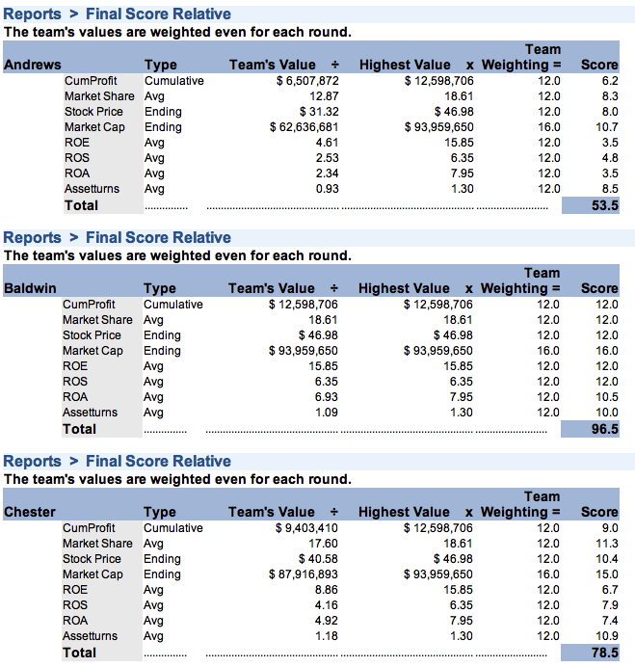
Success Measures
Locked in as of Competition Round #2
Success Measures
  In the real world, companies have different goals. Using the same success measures, YOU get to choose the parameters on which your company is measured.
  Some of the Criteria that are used:
    Cumulative Profits
    Average Market Share
    Average ROS (Return on Sales)
    Average Asset Turnover
    Average ROA (Return on Assets)
    Average ROE (Return on Equity)
    Ending Stock Price
    Ending Market Cap
  You or the professor choose the percentage weighting for each selection.
You Choose Success Measures
Maximum is 25% per measure
Must have at least four measures

Slide 22
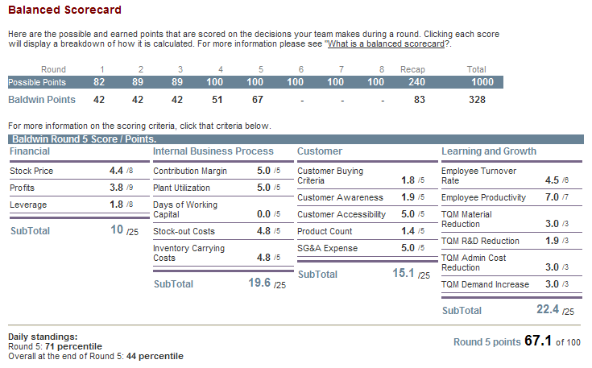
Balanced Scorecard
Balanced Scorecard
  Improving company financial picture in preparation for final debrief
  Point System
  Gauges company performance based on four perspectives
    The Customer
    Internal Business Process
    Innovation and Learning
    Financials
  In the simulation, a Proforma Balanced Scorecard is available to project results for the upcoming year.

Slide 23
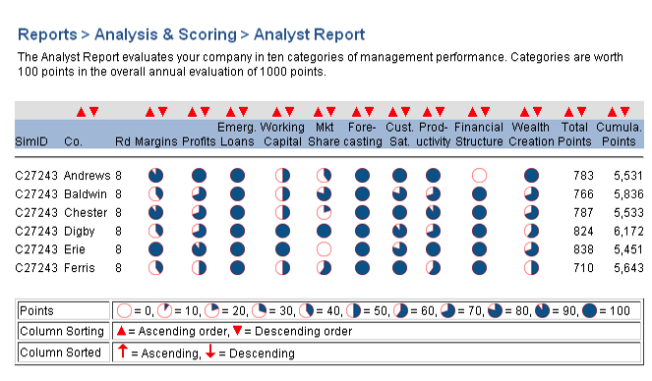
Analyst Report
Analyst Report
  Evaluates your company in ten categories:
    Margins
    Profits
    Emergency Loans
    Working Capital
    Market Share
    Forecasting
    Customer Satisfaction
    Productivity
    Financial Structure
    Wealth Creation

Slide 24
Capstone Business Simulation – Nuts and Bolts
Individual Ramp-up
Register – Sept. 18th
Individual Exercises– Sept. 26th
4 Practice Round Decisions – Oct. 5th, 10th, 14th, and 17th
8 Competition Round Decisions
Oct. 15th to Nov. 21st
Team-Based Board Presentation/Discussion – Week Nov. 27th
See Capstone “Getting Started” document for details
Advanced Modules – Advanced Marketing, HR, TQM – rounds #1 through #8
Labour Negotiations – rounds #3 and #6

Slide 25
Team Creation – Case Challenge & Capstone
(see full commentary on team selection “best practices” within the course syllabus)
Students are required to form their teams by 4:00 pm on September 18, 2017. The composition of team members is to be submitted to the course website “Dropbox” before this date and time. Team maximum is 5 students. Team members must be from your registered section of Comm 401.
Once teams are finalized, students will be assigned to a specific Capstone Simulation industry and team (i.e. C82515 Andrews).
The instructor reserves the right to modify team requests and to reconfigure team composition.
Please create a welcoming atmosphere to our “International Student” cohort.

Slide 26
What I Expect From You
Class sessions are treated as a professional work environment.
Pre-session work will be completed…even if quickly scanned.
Active participation in the Capstone Business and in-class exercises
Ramp up requirements associated with the Capstone Business Simulation are met.
Active participation and contribution outside of class with respect to your team.
Attendance and participation at class.
An email indicating your non-attendance in class, when required.

Slide 27
Comment Relating to Session Slides
  Comm 401 is meant to inspire critical thinking and the formulation of personal views and perspectives.
  In this regard, I do not post slide decks prior to course sessions.
  Slide decks are posted after a particular topic/session has been discussed and are meant to be a reflection of one interpretation of a position relating to discussion points covered.

