Slide 1



Achieving Success in Changing Environments – Course Introduction, Note Taking and Exam Prep
Week 1

Slide 2
Today’s Agenda
Welcome and Tracking Sheet
Introductions and Course make up
General Administrative Stuff
Assignment Submission Requirements
The first lesson, and
A fun video to check out (if there is time)

Slide 3
This is a Hybrid Course
Two hours in class –
      Lectures and miscellaneous activities
One hour outside of class –
    Online activity – either on Blackboard or the Internet
    Reading assignments each week
Bring your laptop for in class activities and tests

Slide 4
Administrative Stuff - Who am I
    Angie Peterson
    petersa2@algonquincollege.com
    613-727-4723 ext. 6329
    Email me for an appointment!

Slide 5
Other Administrative Stuff
    Participation is key to success
        If you:
        Are here
        Learn to follow instructions
        Do the assignments
        Work well in team assignments
        Submit on time
        You will pass
    This is an EASY PASS but a MUST PASS course
    It is not easy to ace this course

Slide 6
Administrative Stuff – Hybrid Assignments
Hybrid Assignment Submissions
  Submit online on Blackboard ONLY
  Format – Per the Assignment Submission Requirements document
  The title is always the heading on the assignment
No late or delayed submissions are permitted without prior approval in writing.
        Only the last submission prior to the deadline will be marked
        Assignment Submission Requirements document takes precedence in all cases

Slide 7
Administrative Stuff – Text Books
Required Text Book
Professionalism: Skills for Workplace Success, 4th Edition by Lydia E. Anderson and Sandra B. Bolt
Recommended:
The 7 Habits of Highly Effective People, Stephen Covey, by Steven Covey, Free Press, ISBN 978-0743269513

Slide 8
Administrative Stuff – Earning Marks
Participation = 15%
Hybrids = 20% of Final
Four in class group activities = 20%
Two Exams = 45%
      Mid Term Exam = 20%
      Final Exam = 25%
      Exams are based on lectures; textbooks; end of class videos; and miscellaneous handouts.
      On time attendance for exams is mandatory
      All exams are Open Book (access to the text book; slide decks and your notes)

Slide 9
First Lesson

Slide 10
The Importance of Notetaking
Taking notes combats memory fading
Effective notes backs up and reinforces memory
Research shows a high correlation between the quality of notes and test and grade performance

Slide 11
The Importance of Notetaking
Studying from effective notes is more time efficient than rereading chapters multiple times
Well-developed notes provides effective study tools to rehearse and review
Effective note taking strategies saves study time.

Slide 12
The Note Taking Process
Note Taking:
Involves condensing or reducing large amounts of information into more manageable units.
Requires you to think carefully about information, break it down, analyze it, and select what is important to learn.
Is a multisensory process that uses visual, kinesthetic, and auditory encoding.
Individual chapters may require using more than one note taking system to create study and review tools.

Slide 13
Annotation
Annotating:
      The process of highlighting, underlining, making marginal notes, or marking specific information in printed materials.
Annotating:
      Is an active learning process
      Holds information longer in working memory
      Reduces the risk of information fading

Slide 14
Tips for Recording Notes
Introductions: Create and underline a heading for the information; then list and number key points.
Headings and Subheadings: Copy and underline headings and subheadings in your notes. Number key points under each heading or subheading.
New Headings: Add new headings if you want to reorganize or insert more helpful headings.
Marginal Notes: Take notes on any important marginal notes in the textbook

Slide 15
Tips for Recording Notes
Double Spacing: Double space before beginning a new heading; this chunks or groups information into meaningful units.
Sufficient Information: Avoid being too brief; record sufficient details to support main ideas.
Meaningful Phrases or Sentences: Check that phrases or shortened sentences are clear.
Annotations: Use your annotations to guide you in deciding what information to include. (brk)

Slide 16
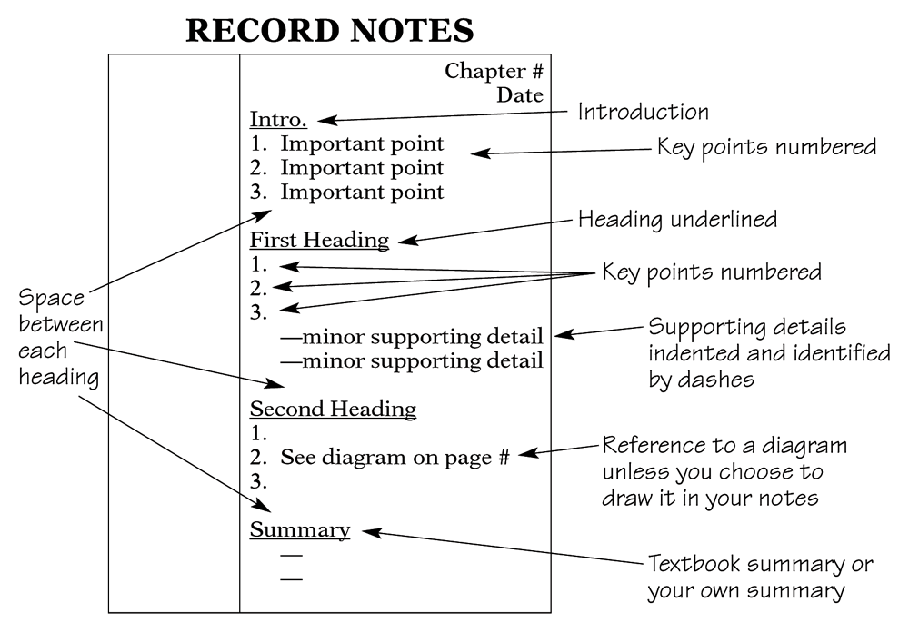
The Cornell System

Slide 17
The Two-Column System
Step 1: Write the topics, vocabulary terms, questions, or math problems in the left column.
Step 2: Write any explanations, details, or definitions in the right column.
Topic Voc. Term Study Question Formula | 1. 2. 3. Definition Answer Example

Slide 18
The Three-Column System
Write the topics in the left column.
Identify labels or categories of information in the middle and the last column.
Work with all three columns: cover a column, recite, and check accuracy.
Topic Topic Problem Problem | Source Def. Rework Steps | Source 2 Example Solution Example

Slide 19
The Dreaded Exam/Test-Preparation
Study Groups are a powerful way to prepare for an exam
Why are study groups powerful?
        Social interaction breeds success
        Take advantage of others strengths & what was retained or understood by them
        Put yourself into the role of professor – when you are explaining something to someone else, more of the brain is engaged
        Q & A’s with each other

Slide 20
Preparing for Exams
Listen for favorite themes and concepts that professors keep returning to
Know the format and value of the exam before hand
Review your notes, text material, assignments, and quizzes
Review the night before but don’t cram
Get a good night’s sleep

Slide 21
Preparing for Exams (cont’d)
Make sure you have eaten to keep your blood sugar up (AVOID ENERGY DRINKS)
Give yourself plenty of travel time
Stay calm outside the exam and stay away from people that are peeking
If something comes up that stops you from attending, stay calm and prepare your case and have proof

Slide 22
Writing the Exam
Read the instructions carefully and slowly
Underline key words
Write legibly. If the professor cannot read your writing, don’t expect a mark.
Pace yourself - check your pace at 1/4 of the time
If you begin running out of time - use point form
Ask if you are not sure

Slide 23
4 Steps to a 5 Day Study Plan
Be specific and realistic: List the topics and materials you need to review.
Set target dates and times: Organize study blocks on four different days; reserve day 5 for reviewing summary notes.

Slide 24
4 Steps to a 5 Day Study Plan
Identify the steps and a plan of action: Identify what you intend to study in each study block for each of the five days.
Plan a reward: Identify an intrinsic or an extrinsic reward for yourself after you finish your five-day study plan and complete the test.

Slide 25
Computer Based Tests
Know the rules.
Allow ample time.
  Go to the lab when you are not rushed.
  Go when you feel mentally sharp.
  Choose a computer away from the flow of traffic.
Understand the testing software commands.
Read and choose answers carefully.
  Read each question carefully.
  Convert each option into T or F.
  Carefully select the best answer.

Slide 26
Testing Anxiety – Dealing with it
Test anxiety: excessive stress that hinders performance before and during tests.
Symptoms of test anxiety include:
Physical symptoms
Emotional symptoms
Cognitive symptoms
Behavioral symptoms

Slide 27
Testing Anxiety – Dealing with it
Test anxiety is a learned behavior.
To deal with test anxiety, begin by identifying what triggers your test anxiety.
Test anxiety may stem from:
  under-preparedness and cramming.
  past experiences.
  fear of failure.
  weak test-taking skills.

Slide 28
Testing Anxiety – Dealing with it
Use relaxation techniques.
Use positive self-talk.
Reread questions in a whispering voice.
Do not stay stuck on a question.
Use paper or your arm to block other parts of the test.
Circle or highlight key words.
Slow down the reading process; go into retrieval mode.

Slide 29
Video – Paradigms of Education
With permission from: RSAnimate (www.theRSA.org), and CognitiveMedia (www.cognitivemedia.co.uk)

Slide 30

Q & A

